Slide 1


Project Quality
Management
Prepared by Dr. Ehab Mahmoud

Slide 2



Project Quality
Management
Lecture 4
PMG354
Statistical Quality Control – part 1
Prepared by
Dr. Ehab Mahmoud
www.midocean.ae

Slide 3

Lecture
Objectives
04
At the end of this lecture, we expect to acquire a knowledge about fundamentals for statistical quality control to use in project stages and assure the conformity od outcomes
www.midocean.ae

Slide 4

Lecture
Contents
04
Introduction
Quality Engineering
A Brief History of Quality Control and Improvement
Statistical Methods for Quality Control and Improvement
Statistical process control
Process Improvement Using the Control Chart
Procedure for Construction of X and R Control Chart
Example
www.midocean.ae

Slide 5
Introduction
Quality means fitness for use
  Quality of design
  Quality of conformance
Quality is inversely proportional to variability.
Quality Improvement
  Quality improvement is the reduction of variability in processes and products.
Alternatively, quality improvement is also seen as “waste reduction”.
www.midocean.ae

Slide 6
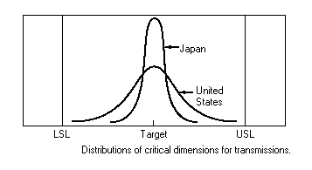
Introduction
Example
www.midocean.ae

Slide 7
Types of quality chracteristics
Physical - length, weight, voltage, viscosity
Sensory - taste, appearance, color
Time Orientation - reliability, durability, serviceability
www.midocean.ae

Slide 8
Quality Engineering
Is the set of operational, managerial, and engineering activities that a company uses to ensure that the quality characteristics of a product are at the nominal or required levels.
www.midocean.ae

Slide 9
Quality Engineering Terminology
Two types of data
  Attributes Data - discrete data, often in the form of counts.
  Variables Data - continuous measurements such as length, weight.
www.midocean.ae

Slide 10
Quality Engineering Terminology
Specifications
Quality characteristics being measured are often compared to standards or specifications.
Nominal or target value
Upper Specification Limit (USL)
Lower Specification Limit (LSL)
www.midocean.ae

Slide 11
A Brief History of Quality Control and Improvement
Walter Shewhart (1924) introduced statistical control chart concepts.
The American Society for Quality Control formed in 1946 (now known as the American Society for Quality (ASQ).
1950s and 1960s saw an increase in reliability engineering, experimental design, and statistical quality control
www.midocean.ae

Slide 12
A Brief History of Quality Control and Improvement
Competition from foreign industries (Japan) increases during the 1970s and 1980s.
Statistical methods for quality improvement use increases in the United States during the 1980s
Total Quality Management (TQM) emerges during 1970s and into the 1980s as an important management tool to implement statistical methods.
www.midocean.ae

Slide 13
A Brief History of Quality Control and Improvement
Malcolm Baldridge National Quality Award is established in 1988.
ISO 9000 certification activities increase in U.S. industry in the 1990s.
Applying Six-Sigma initiative begins in the late 1980’s thru 1992 till now.
www.midocean.ae

Slide 14
Statistical Methods for Quality Control and Improvement
Statistical Quality
Control
Process
Control
Acceptance
Sampling
Design of
Experiments
www.midocean.ae

Slide 15
Statistical Process Control (SPC)
Control charts are used for process monitoring and variability reduction.
SPC is an on-line quality control tool.
www.midocean.ae

Slide 16
Acceptance Sampling
Acceptance sampling is the inspection and classification of a sample of the product selected at random from a larger batch or lot and the ultimate decision about disposition of the lot.
Two types:
  1. Outgoing inspection - follows production
  2. Incoming inspection - before use in production
www.midocean.ae

Slide 17
Design of Experiments
Experimental design is an approach to systematically varying the controllable input factors in the process and determine the effect these factors have on the output responses.
Experimental designs are off-line quality tools.
Crucial for variability reduction.
www.midocean.ae

Slide 18
Other Aspects of Quality Control and Improvement
Total Quality Management (TQM)
TQM is a managerial framework to accomplish quality improvement.
Other names and related approaches:
  Company-Wide Quality Control (CWQC)
  Total Quality Assurance (TQA)
  Six-Sigma-Black Belt Program
www.midocean.ae

Slide 19
Statistical process control
If a product is to meet customer requirements, it should be produced by a process that is stable or repeatable.
Statistical process control is a collection of tools that when used together can result in process stability and variability reduction.
www.midocean.ae

Slide 20
Statistical process control
A process that is operating with only chance causes of variation present is said to be in statistical control.
A process that is operating in the presence of assignable causes is said to be out of control.
The eventual goal of SPC is reduction or elimination of variability in the process by identification of assignable causes.
www.midocean.ae

Slide 21
Statistical process control
The terminology chance and assignable causes was developed by Dr. Walter A. Shewhart.
Today, some writers or practitioners use the terminology common cause instead of chance cause and special cause instead of assignable cause.
www.midocean.ae

Slide 22
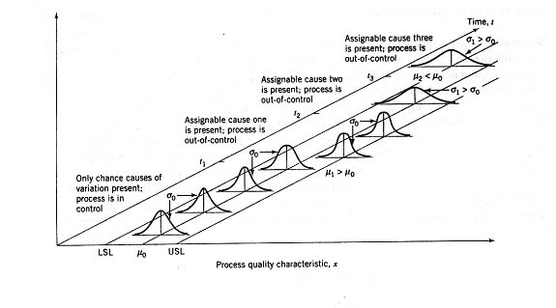
Principle of the Control Chart
A typical control chart is a graphical display of a quality characteristic that has been measured or computed from sample versus the sample number or time.
www.midocean.ae

Slide 23
Elements of A Control Chart
The chart contains a center line that represents the average value of the quality characteristic.
Also it has control limits set at values such that if the process is in control, nearly all points will lie between the upper control limit (UCL) and the lower control limit (LCL).
www.midocean.ae

Slide 24
Control Situations
Out-of-Control
If at least one point plots beyond the control limits, the process is out of control.
If the points behave in a systematic or nonrandom manner, then the process could be out of control.
Action is necessary.
In-Control
As long as the points plot within the control limits, the process is assumed to be in control.
No action is necessary.
www.midocean.ae

Slide 25
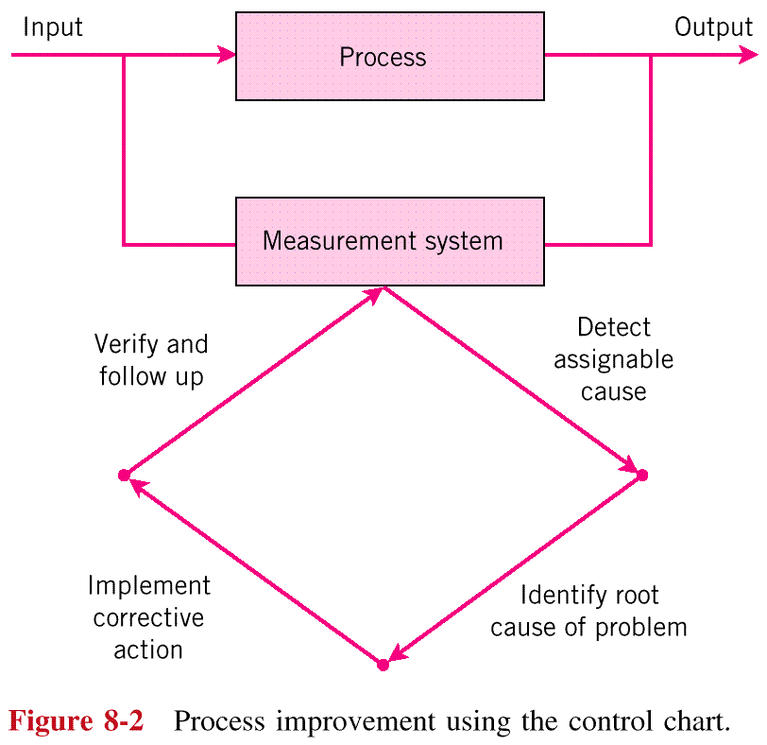
Process Improvement Using the Control Chart
www.midocean.ae

Slide 26
Benefits of control charts
Control charts are a proven technique for improving productivity.
Control charts are effective in defect prevention.
Control charts prevent unnecessary process adjustment.
Control charts provide diagnostic information.
Control charts provide information about process capability.
www.midocean.ae

Slide 27
Design of a Control Chart
The important factors in the design of a control chart is selection of the following three parameters:
  The width of the control limits (L)
  The sample size (n)
  The frequency of sampling (h)
www.midocean.ae

Slide 28
Design of a Control Chart
where L = distance of the control limit from the center line, expressed in standard deviation units.
= mean of the sample statistic, w.
= standard deviation of the statistic, w.
www.midocean.ae

Slide 29
Three-Sigma Limits
The use of 3-sigma limits generally gives good results in practice.
If the distribution of the quality characteristic is reasonably well approximated by the normal distribution, then the use of 3-sigma limits is applicable.
These limits are often referred to as action limits.
www.midocean.ae

Slide 30
Three-Sigma Limits
www.midocean.ae

Slide 31
Warning Limits on Control Chart
Warning limits (if used) are typically set at 2 standard deviations from the mean.
If one or more points fall between the warning limits and the control limits, or close to the warning limits the process may not be operating properly.
Good thing: warning limits often increase the sensitivity of the control chart.
Bad thing: warning limits could result in an increased risk of false alarms.
www.midocean.ae

Slide 32
Sample Size and Sampling Frequency
In designing a control chart, both the sample size to be selected and the frequency of sampling must be specified.
Larger samples make it easier to detect small shifts in the process.
Current practice tends to favor smaller, more frequent samples.
www.midocean.ae

Slide 33
Sample Size and Sampling Frequency
Assume the quality characteristic of interest is normally distributed with mean μ, and standard deviation, σ.
If x₁, x₂, …, x_{n} is a sample of size n, then the average of this sample is
is normally distributed with mean, μ, and standard deviation,
www.midocean.ae

Slide 34
Sample Size and Sampling Frequency
n - size of the sample (sometimes called a subgroup) chosen at a point in time
m - number of samples selected (sample frequency)
= average of the observations in the i sample (where i = 1, 2, ..., m)
= grand average or “average of the averages” (this value is used as the center line of the control chart)
www.midocean.ae

Slide 35
Sample Size and Sampling Frequency
Assume the quality characteristic of interest is normally distributed with mean μ, and standard deviation, σ.
If x₁, x₂, …, x_{n} is a sample of size n, then the average of this sample is
is normally distributed with mean, μ, and standard deviation,
www.midocean.ae

Slide 36
Control Limits for the X Chart
Process center may be monitored by plotting values of the sample average on a control chart. The center line and control limits are as follows:
The constant A₂ is tabulated for various sample sizes.
www.midocean.ae

Slide 37
Control Limits for the R Chart
Process variability may be monitored by plotting values of the sample average on a control chart. The center line and control limits are as follows:
The constant D₄ and D₃ is tabulated for various sample sizes.
www.midocean.ae

Slide 38
Procedure for Construction of X and R Control Chart
Select the quality characteristic.
Choose the rational subgroup.
Collect the data
Determine the trial control limits.
Establish the revised control limits
Achieve the objective
www.midocean.ae

Slide 39
Procedure for Construction of X and R Control Chart
x chart monitors the between samples variability.
R chart monitors the within sample variability.
www.midocean.ae

Slide 40
Example
Piston rings for an automotive engine are produced by a forging process. We wish to establish statistical control of the inside diameter of the rings manufactured by this process using x and R charts. Twenty five samples, each of size 5, have been taken when we think the process is in control.
  The inside diameter measurement data from these sample are shown in the next table.
www.midocean.ae

Slide 41
Example
Sample Number | Observations |  |  |  |  | x_{i} | R_{i}
1 | 74.030 | 74.002 | 74.019 | 73.992 | 74.008 | 74.010 | 0.038
2 | 73.995 | 73.992 | 74.001 | 74.011 | 74.004 | 74.001 | 0.019
3 | 73.988 | 74.024 | 74.021 | 74.005 | 74.002 | 74.008 | 0.036
4 | 74.002 | 73.996 | 73.993 | 74.015 | 74.009 | 74.003 | 0.022
5 | 73.992 | 74.007 | 74.015 | 73.989 | 74.014 | 74.003 | 0.026
6 | 74.009 | 73.994 | 73.997 | 73.985 | 73.993 | 73.996 | 0.024
7 | 73.995 | 74.006 | 73.994 | 74.000 | 74.005 | 74.000 | 0.012
8 | 73.985 | 74.003 | 73.993 | 74.015 | 73.988 | 73.997 | 0.030
9 | 74.008 | 73.995 | 74.009 | 74.005 | 74.004 | 74.004 | 0.014
… | … | … | … | … | … | … | …
24 | 74.015 | 74.008 | 73.993 | 74.000 | 74.010 | 74.005 | 0.022
25 | 73.982 | 73.984 | 73.995 | 74.017 | 74.013 | 73.998 | 0.035
Sum |  |  |  |  |  | 1850.028 | 0.581
 |  |  |  |  |  | x = 74.001 | R = 0.023
www.midocean.ae

Slide 42
Example
Using the data from the previous table, we find that the center line for the R chart is
For samples of n = 5, and using the table we have
  D₃ = 0
  D₄ = 2.115
www.midocean.ae

Slide 43
Example
The trial control limits for the R chart are
www.midocean.ae

Slide 44
Example
When the 25 sample ranges are plotted on the chart, there is no indication of an out-of-control condition.
Since the R chart indicates that process variability is in control, we may construct the x chart.
www.midocean.ae

Slide 45
Example
The center line is
To find the control limits, for sample of size n = 5 and using the table
  A₂ = 0.577
www.midocean.ae

Slide 46
Example
Therefore, the trial control limits for the x chart are
www.midocean.ae

Slide 47
Example
When preliminary sample averages plotted on the chart, no indication of an out-of-control condition is observed.
www.midocean.ae

Slide 48
Example
Since both the x and R exhibit control, we would conclude that the process is in control at the stated level.
Adopt the trial control limits for use in on-line statistical process control.
www.midocean.ae

Slide 49
Example
In practice, it is common to use computer software packages in control chart construction.
Minitab software will produce both chart at once.
www.midocean.ae

Slide 50



Thank You

