Slide 1



Source, Message, and
Channel Factors
Prepared by Dr. Perihan Salah
MKT728
Lecture 4

Slide 2



Chapter
04
Learning Objectives
To study the major variables in the communication system and how they influence consumers’ processing of promotional messages
To examine the considerations involved in selecting a source or communicator of a promotional message
To examine different types of message structures and appeals that can be used to develop a promotional message
To consider how the channel or medium used to deliver a promotional message influences the communication process

Slide 3
Chapter
04
Persuasion Matrix
Helps marketers see how each controllable element interacts with the consumer’s response process

Slide 4
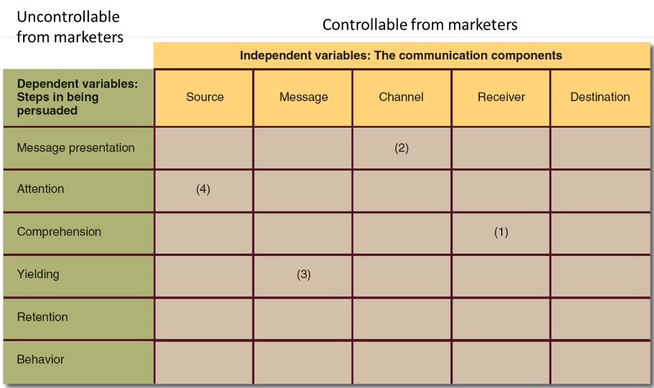
Chapter
04
The Persuasion Matrix

Slide 5


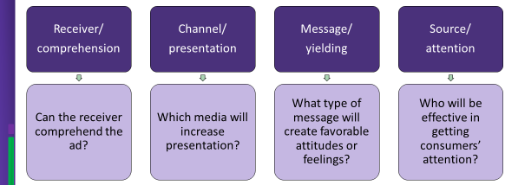
Chapter
Decisions Evaluated with the Persuasion Matrix
04

Slide 6
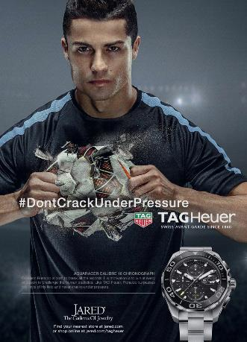

Chapter
04
CR The more you criticize him the more he performs better next time.
He is well known to handle pressure. (Attention & Yielding)

Slide 7
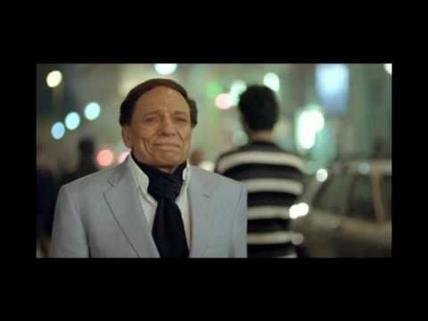
Source
Attention

Slide 8

Attention for Product

Slide 9

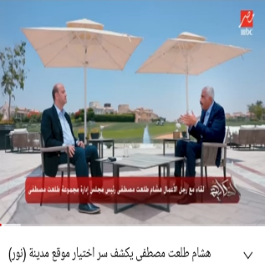
Source
Person involved in communicating a marketing message.
Direct source - Delivers a message and/or endorses a product or service (CEO or video for plant is best to deliver msg)
Indirect source - Draws attention to and enhances the appearance of an ad (celebrity)

Slide 10
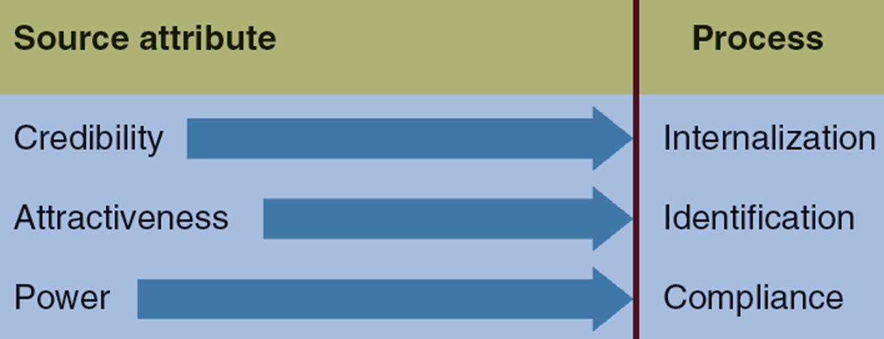
Source Attributes and Receiver Processing Modes

Slide 11
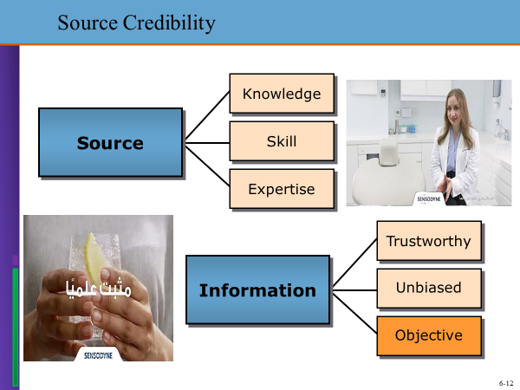
Source Attributes and Receiver Processing Modes

Slide 12

Source Credibility
Extent to which the recipient:
  Sees the source as having relevant knowledge, skill, or experience
  Trusts the source to give unbiased, objective information
Internalization: Adopting the opinion of a credible communicator and the belief that information from this source is accurate
(happens in subconscious due to pressure of IMC)

Slide 13
Source Credibility
Enhanced by:
  Applying expertise and trustworthiness
  Using corporate leaders as spokespeople (say proofed revenues, profits & sales)
Limitations
  High- and low-credibility sources are equally effective when arguing for a position opposing their own best interest (taking money) (pepsi can get researches that isn’t harmful)
  Sleeper effect: Persuasiveness of a message increases with the passage of time and pressure

Slide 14


Source Attractiveness
Attractiveness: Characteristic that encompasses similarity, familiarity, and likability. (Based on target cust. & market) it makes noise to my voice. So unconsciously identification occurs. I only listen to the source not my voice.
Identification: Receiver is motivated to seek some type of relationship with the source
  Adopts similar beliefs, attitudes, preferences, or behavior
  **Attractiveness noise could be –ve or +ve

Slide 15



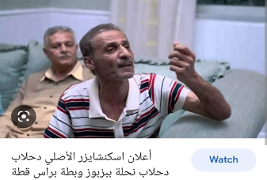
Source Attractiveness
Enhanced by:
  Applying similarity
  Using celebrities as spokespeople
  Understanding the meaning of celebrity endorsers
Limitations of celebrities as spokespeople
  Overshadow the product الدحلاب
  Overexposure
  Target audiences’ receptivity
  Risk to the advertiser

Slide 16


Slide 17

Source Attractiveness: Identification

Slide 18
Chapter
Source Attractiveness
04
Similarity
Familiarity
Likeability
Resemblance between the source and recipient of the message
Knowledge of the source through repeated or prolonged exposure
Affection for the source resulting from physical appearance, behavior, or other personal traits

Slide 19
Choosing a Celebrity Endorser
Match w/audience
Trust
Match w/product
Risk
Factors
Image
Familiarity
Cost/ROI
Likability

Slide 20
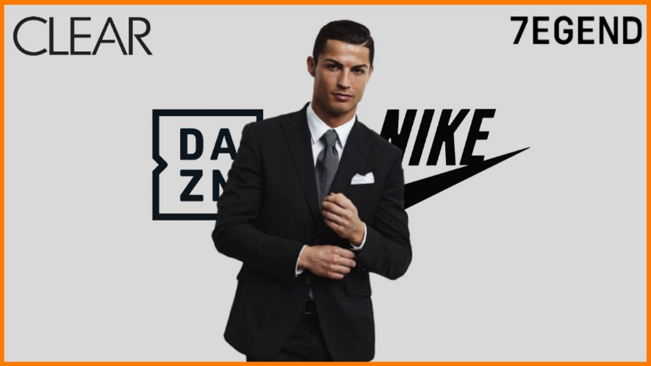
Lifetime contract x Nike
market research proofed that his lifestyle, mindset, health and attitude matches to be Nike figure and he will not harm my brand
Match w/audience
Match w/product
Factors
Image
Cost/ROI

Slide 21

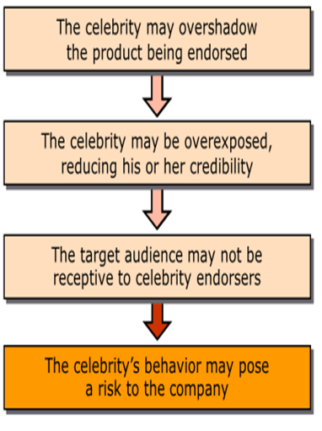
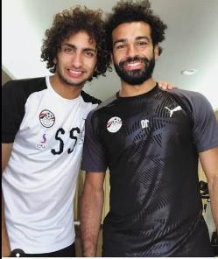

Risks of Using Celebrities

Slide 22
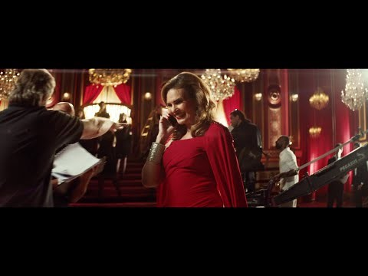
Comprehending & Recalling

Slide 23

Chapter
Source Power
04
Source is capable of administering rewards and punishments to the receiver
Depends on a source’s perceived control & concern
Compliance: Receiver accepts a source’s persuasive influence and acquiesces to his or her position
  To obtain a favorable reaction or to avoid punishment
  Mo Salah has set of beliefs to influence audience

Slide 24

Chapter
Source Power: Compliance
04

Slide 25
Source Power
Perceived control
Source Power
Perceived concern
Perceived scrutiny

Slide 26
Message Factors
Message structure
  Order of presentation
  Conclusion drawing
  Message sidedness
  Refutation
  Verbal versus visual messages
Message appeals
  Comparative advertising
  Fear appeals
  Humor appeals
  Sex appeal

Slide 27
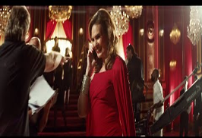
Message Structure
Order of presentation - Strongest arguments should be presented early or late in the message but never in the middle
  Primacy effect: Information presented first is most effective (msg at first moment)
  Recency effect: Last arguments presented are most persuasive (msg at last moment)
قوتك في عيلتك

Slide 28
Message Structure
  Depends on:
  Target audience’s receptivity to the message
    Length of the message
    Medium used to communicate the message
Conclusion drawing - Messages with explicit conclusions are more easily understood and effective in influencing attitudes
  Depends on:
    Target audience
    Type of issue or topic
    Nature of the situation
Msg should be quick on radio. “on the go, on the run”
Peer pressure effect & athletes

Slide 29
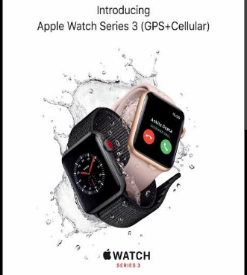
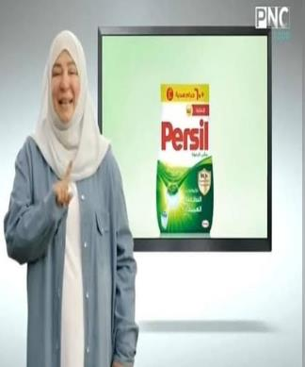
Sophisticated ad for high end vs easy ad
Conclusion at the end
Conclusion at the beginning

Slide 30
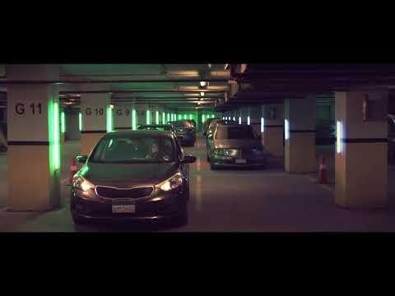
Sophisticated ad for high end vs easy ad

Slide 31
Message Structure
One-sided message: Mentions only positive attributes or benefits, effective if target audience:
  Already holds a favorable opinion about the topic
  Is less educated
Two-sided message: Presents both good and bad points, effective when the target audience:
  Holds an opposing opinion
  Is highly educated

Slide 32

Chapter
04
2 sided msg

Slide 33

Message Structure
Refutational appeal: Communicator presents both sides of an issue and then refutes the opposing viewpoint
Verbal versus visual messages - When verbal information is:
  Low in imagery value, use of pictures increase immediate and delayed recall
  High in imagery value, addition of pictures do not increase recall

Slide 34
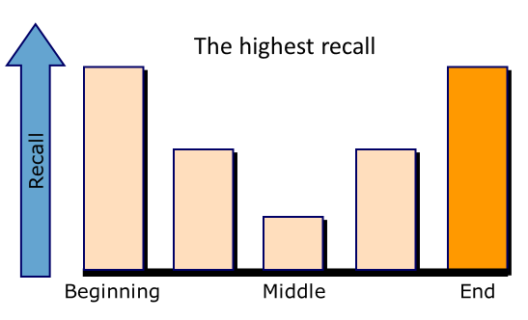
Chapter
04
Recall and Presentation Order

Slide 35
Chapter
04
Message Appeal Options
Comparative
Ads
Fear
Appeals
Humor
Appeals
May be especially useful for new brands
Often used for brands with small market share
Frequently use in political advertising
May stress physical danger or threats to health
May identify social threats: disapproval or rejection
May backfire if the level of threat is too high
They can attract and hold attention
They are often the best remembered
They put the consumer in a positive mood

Slide 36

Chapter
04
Message Appeal Options

Slide 37

Message Appeals
Comparative advertising: Directly or indirectly naming competitors in an ad and comparing one or more attributes
Fear appeals: Evoke an emotional response to a threat and arouse individuals to take steps to remove the threat
  Effective when the recipient is:
    Self-confident and prefers to
    cope with dangers
    A nonuser of the product

Slide 38


Slide 39
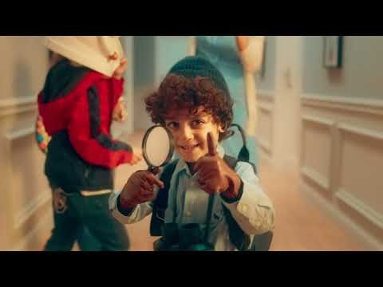

Slide 41
Sex & fear appeal

Slide 42


Slide 43

Message Appeals
  Protection motivation model - States that ads using fear appeals should give the target audience information on the:
    Severity of the threat
    Probability of its occurrence
    Effectiveness of a coping response
    Ease with which the response can be implemented

Slide 44
Message Appeals
Humor appeals - Humorous ads:
  Attract and hold consumers’ attention
  Put consumers in a positive mood
  Increase consumers' liking of the ad and their feeling toward the product. (increase bullying)
  Distract the consumer from counter arguing against the message
  May wear out faster than serious appeals
    Wearout: Tendency of a commercial to lose effectiveness when seen or heard repeatedly

Slide 45

Humor Appeal

Slide 46
Humor Appeals Advantages and Disadvantages
Advantages
Disadvantages
  Aid with awareness and attention
  Aid name and simple copy registration
  Aid retention
  Aid persuasion to switch brands
  Create a positive mood that enhances persuasion
  Harm recall and comprehension
  Harm complex copy registration (creative)
  Do not aid persuasion in general
  Do not aid source credibility
  Not very effective in bringing about sales

Slide 47

Humor Appeals Advantages and Disadvantages
Humorous
harm brand

Slide 48
Channel Factors
Personal versus nonpersonal channels - Information received from personal channels is more persuasive than that received from the mass media. (depends)
Effects of alternative mass media
  Differences in information processing
    Self-paced - Readers process the ad at their own rate and study it as long as they desire
    Externally paced - Transmission rate is controlled by the medium

Slide 49
Self versus External Paced Media
Self-Paced
Media
Externally Paced
Media
Newspapers
Magazines
Direct Mail
Internet
Radio
Television
vs.

Slide 50
Channel Factors
Effects of context and environment
  Qualitative media effect: Influence the medium has on a message
  Image of the media vehicle affect reactions to the message
Clutter: Amount of advertising in a medium
  All the nonprogram material that appears in the broadcast environment

Slide 51
Chapter
04
To Sum Up…
Studied the major variables in the communication system and how they influence consumers’ processing of promotional messages
Examined the considerations involved in selecting a source or communicator of a promotional message
Examined different types of message structures and appeals that can be used to develop a promotional message
Considered how the channel or medium used to deliver a promotional message influences the communication process

Slide 52


Thank You
Dr. Perihan Salah

