Slide 1




Secure Operating Systems (CYB610)
Master of Science in Cybersecurity
Dr. Ibrahim Gomaa
Faculty of Informatics
Midocean University
Lecture-Intro

Slide 2



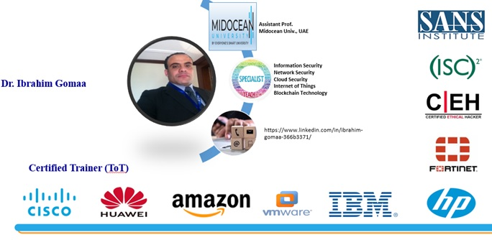
Secure Operating Systems (CYB610)

Slide 3

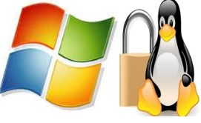
The course that will be taught
Secure Operating Systems
Secure Operating Systems, Dr. Ibrahim Gomaa

Slide 4
A brief about OS
Operating System is a software, that manages all hardware resources associated with the computer.
Generally, Operating System is comprised of number of pieces such as
the Boot loader,
the Kernel,
Daemons,
Desktop environment and
Applications.
Typically, OS is deployed in any system when multi-tasking required to be performed, which is achieved by resource management functionality of the OS.
Along with that, the user also requires interface with the system to interact and invoke various applications. In modern day OS, these interfaces (popularly known as GUI) are expected to provide best-in-class User Experience (UX) to the users, by making it easy to use the system.
Secure Operating Systems, Dr. Ibrahim Gomaa
Notes:
Daemons: a background process that handles requests for services such as print spooling and file transfers, and is dormant when not required.
عملية في الخلفية تعالج طلبات الخدمات مثل التخزين المؤقت للطباعة ونقل الملفات، وتكون خاملة عندما لا تكون هناك حاجة إليها.

Slide 5
Introduction
In Previous Courses you learned:
The concepts of computer security, cryptography, digital money, secure protocols, detection, and other security techniques.
The essential techniques in protecting information systems, IT infrastructure, analyzing and monitoring potential threats and attacks, devising security architecture, and implementing security solutions.
Various network technologies and cyber-attacks and their issues.
The origin of Malware, and its security.
Secure Operating Systems, Dr. Ibrahim Gomaa

Slide 6
Introduction
In Previous Courses you learned:
How to Identify & Evaluate vulnerabilities in information systems and apply security measures to real-time scenarios.
Security Protocols for avoiding the basic level threat.
The use of standards to enhance information security in the development process and infrastructure protection.
Recognize the appropriate steps for information security risk, response, and recovery.
Demonstrate the ability to assess and implement access controls.
Secure Operating Systems, Dr. Ibrahim Gomaa

Slide 7
Primary Goal of This Course
In this course,
The goal is to gain an understanding of how hardware and software constructs protect modern operating systems.
Secure Operating Systems, Dr. Ibrahim Gomaa

Slide 8
Units of Course Contents
Module | Course Unit
1 | Module 1: Introduction, and an overview about OS Security Threats and basic components of OS Security.
2 | Module 2: User privileges, Permissions and Files systems and encryption.
3 | Module 3: Securing services.
4 | Module 4: Firewalls, Remote Access, Secure Network-attached storage (NAS).
5 | Module 5: Network application security.
6 | Module 6: Managing security alerts and updates.
7 | Module 7: Detecting and responding to security breaches.
Secure Operating Systems, Dr. Ibrahim Gomaa

Slide 9

Teaching Methodology
منهجية التدريس
Recorded Lectures
المحاضرات المسجلة
Live Sessions
جلسات وحلقات النقاش
References
المراجع المعتمدة للمقرر الدراسي
Virtual Labs
المعامل الأفتراضية
Secure Operating Systems, Dr. Ibrahim Gomaa

Slide 10

Study System
Secure Operating Systems, Dr. Ibrahim Gomaa

Slide 11

Course Information - Evaluation
  Assessment Method:
Short Exam
  80% marks
    Count of short Exam 10 (Weekly)
    8 Marks for each of short Exam.
  20% marks
  Final Examination
Secure Operating Systems, Dr. Ibrahim Gomaa

Slide 12
Learning Outcomes
After completion of this course, the students should be able to:
Explain what operating system and network security means.
Explain how viruses, worms, and Trojan horses spread.
Explain encryption and authentication methods and how they are used.
Create account naming and security strategies.
implement directory, folder, and file security.
Configure the firewall capabilities in operating systems.
Explain physical security methods for workstations, servers, and network devices.
Configure security for wireless interfaces in workstation operating systems.
Explain how e-mail can be secured through certificates and encryption.
Explain how to use disaster recovery techniques to secure operating systems, prevent data loss, and reduce downtime.
Secure Operating Systems, Dr. Ibrahim Gomaa

Slide 13
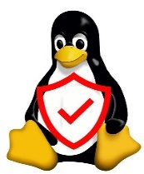
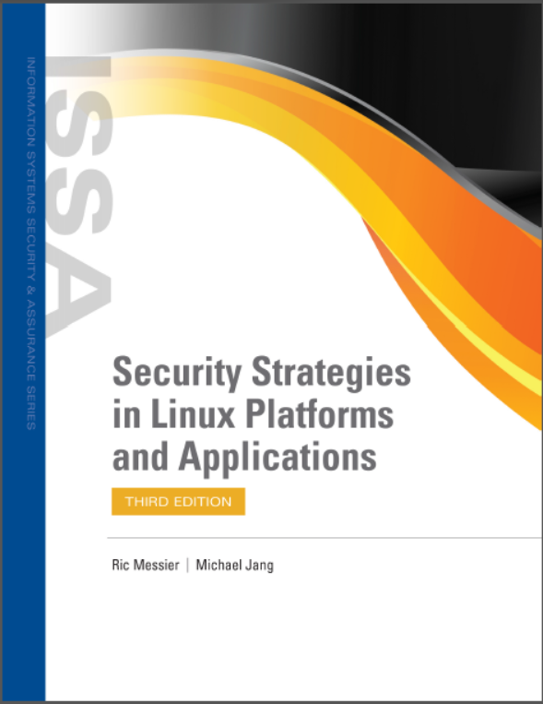
Learning Resources:
Credit Hours:
3 credit hours.
  References:
1- Jang M. and Messier R., “Security Strategies in Linux Platforms and Applications”, 2024, Jones and Bartlett Learning, ISBN 9781284255850.
2- Trent Jaeger, Operating System Security. Synthesis Lectures on Information Security, Privacy, and Trust, Springer International Publishing 2022, ISBN 978-3-031-01205-1.
.
Secure Operating Systems, Dr. Ibrahim Gomaa

Slide 14


Thank You

