Slide 1



Lecture No. 10
BY
Dr. Manal El-Sayed
MGM223

Slide 2






Slide 3




















Test your knowledge for the previous lecture
Finding the ideal opportunity
Define your personal strategy.
Know the Employer’s perspective
How to conduct your internet research.
How to build your network
Planning your résumé

Slide 4












Learning Objectives
Submitting your résumé
Understanding the interview process
Preparing for a job interview
Interviewing for success
Following up after an interview

Slide 5


Submitting Your Résumé

Slide 6


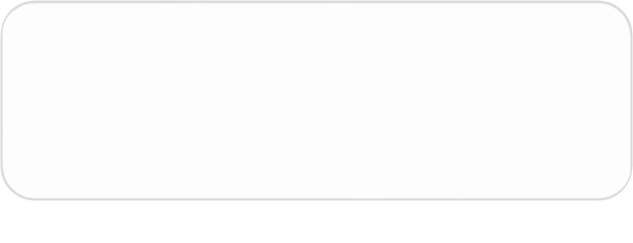


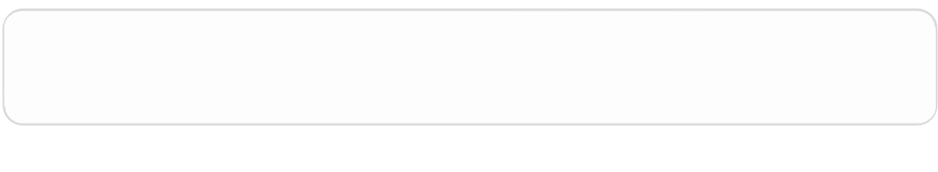

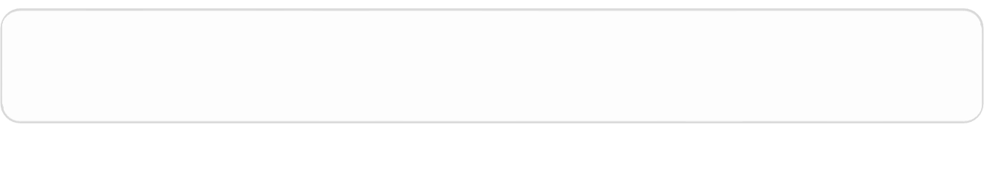

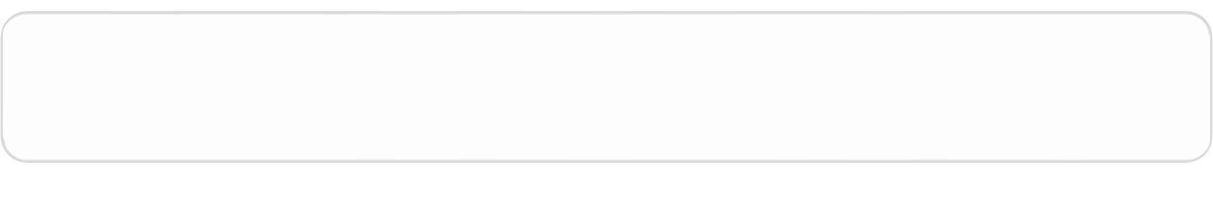

Application Letters
Solicited
Unsolicited
What You Are Sending
Why You Are Sending It
Benefits of Reading It

Slide 7

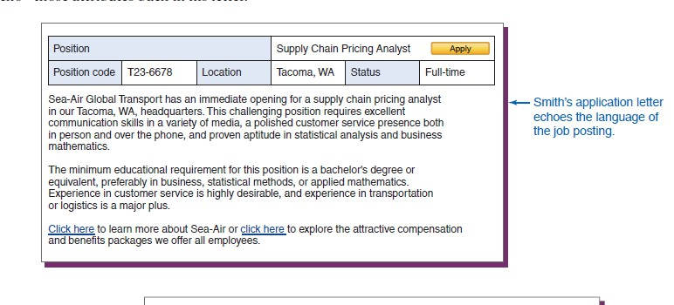
Application Letters

Slide 8

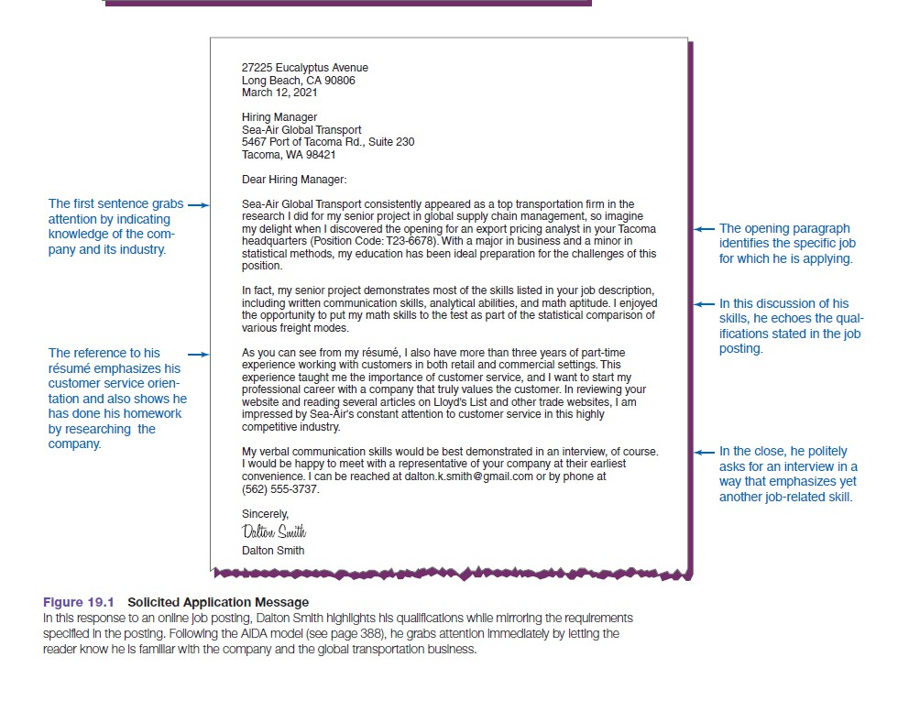
Application Letters

Slide 9


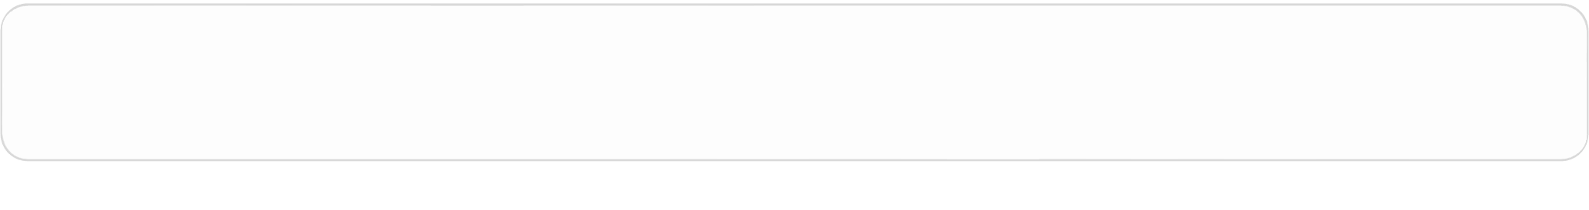


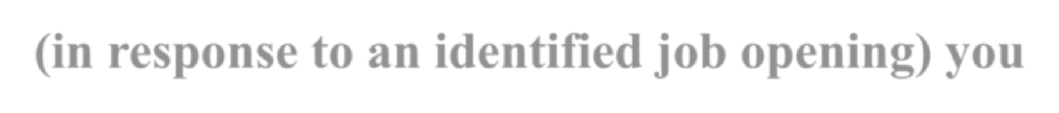







Application
Letters
Solicited application letter
(in response to an identified job opening) you’ll know what qualifications the organization is seeking. You’ll also have more competition because hundreds of other job seekers will have seen the listing and may be sending applications too

Slide 10

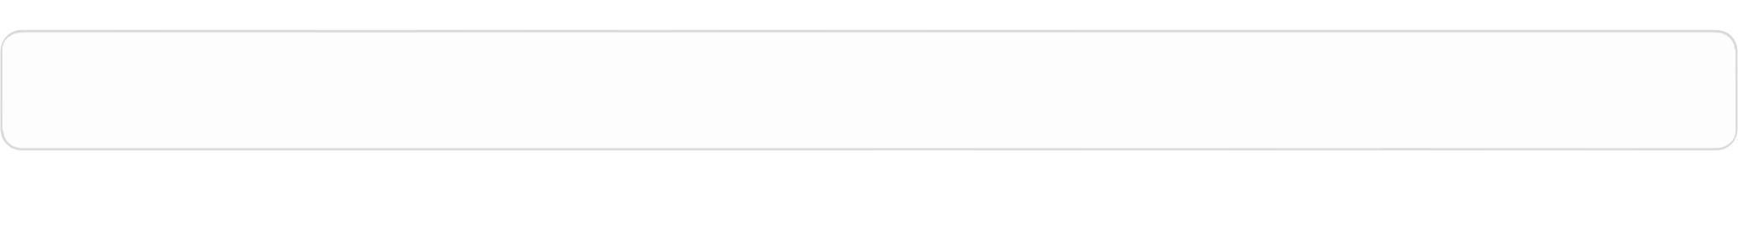



Application Letters
unsolicited application letter
(a prospecting letter to an organization that has not announced an opening), you will have to do some research to identify the requirements the position is likely to have. In addition, search for information about the company, its customers, the profession, or the manager to whom you are writing. Using such information in your letter will help you establish common ground with your reader and show that you are tuned into what is going on in the industry.

Slide 11

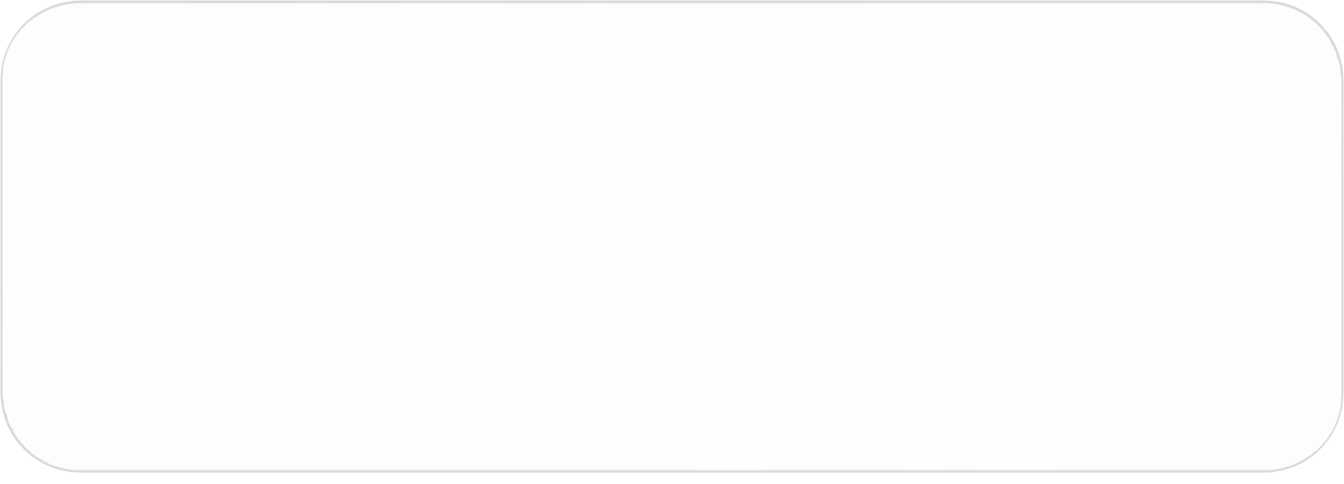











Application Letter Tips
Clearly identify the opportunity
Show you understand the company
Don’t volunteer salary history
Keep it short—about three paragraphs
Show personality but stay businesslike
Project confidence, not arrogance

Slide 12








Using the AIDA Plan
Attention
Interest
Desire
Action

Slide 13










Résumé Follow-Up
Communication
Professionalism
Employer Instructions
Closing Date

Slide 14















Follow-Up Questions
Has a decision been made?
Can you tell me what will happen next?
What is the company’s time frame?
Could I follow-up in another week?
Can I provide additional information?

Slide 15



Understanding the Interview Process

Slide 16







Interview Sequence
Screening
Selection
Final Stage

Slide 17









Structured
Open-Ended
Panel
Types of Interview s
Group
Behavioral
Situational
Working
Stress

Slide 18








Interview Media
Telephone
Email and IM
Video Technology
Online Options

Slide 19












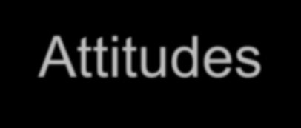






What Employers Seek
Suitability Organization Fit
Education
Background
Experience
Attitudes
Job-Related Traits
Personal Style

Slide 20

Preemployment Tests
Knowledge and Skills
Substance Abuse
Background
Integrity
Personality Cognition

Slide 21



Preparing for a Job Interview

Slide 22












Employer’s Questions
The hardest decision you ever made
Your greatest weaknesses
Goals over the next five years
What you didn’t like about prior jobs
Relate something about yourself

Slide 23






Build Your Confidence
Weaknesses
Strengths
فوخلا وأ سجوتلا
Apprehension

Slide 24






Professional Image
Clothing
Grooming
Behavior

Slide 25

Interviewing for Success

Slide 26










The Warm-Up Stage
First Impression
Body Language
Social Skills

Slide 27






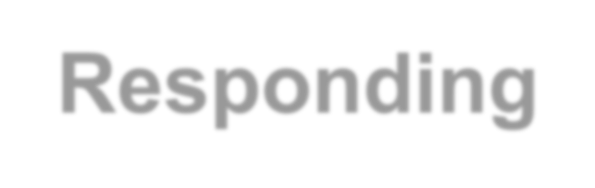




Questions-and-Answers
Asking and Responding
Careful Listening
Personal Questions

Slide 28




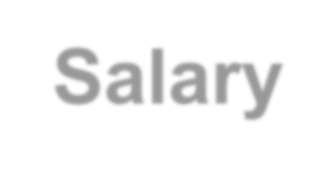
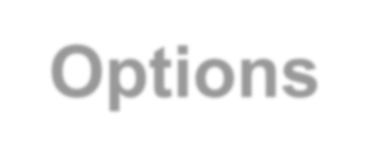


Close the Interview
Courtesy and Interest Salary Options Interview Notes

Slide 29



Following Up After an Interview

Slide 30




Follow-Up Messages
Thank-You Message
Message of Inquiry
Request Time Extension

Slide 31
Follow-Up Messages
Letter of Acceptance
Letter Declining Job Offer
Letter of Resignation

Slide 32


