Slide 1



Introduction to Economics
Lecture 7
MGM112
Production, and Cost
Prepared by
Lec. Dina ElWakkad
www.midocean.ae

Slide 2

Chapter
Production, and Cost
07
Explain how economists measure a firm’s cost of production and profit.
Explain the firm’s Production
Explain the relationship between a firm’s output and labor employed in the short run.
Explain the firm’s costs in the short run.
www.midocean.ae

Slide 3
Chapter
Production, and Cost
07
1) Calculating Profit
www.midocean.ae

Slide 4

Chapter
1) Calculating Profit
07
www.midocean.ae

Slide 5

Chapter
1) Calculating Profit
07
www.midocean.ae

Slide 6
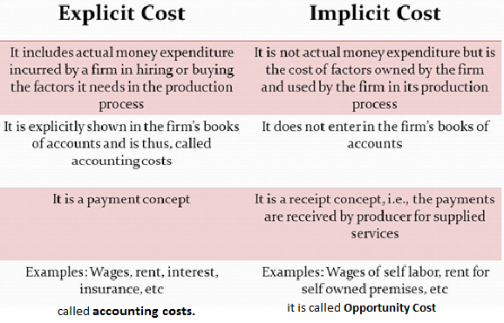
Chapter
1) Calculating Profit
07
The cost of treating diseases that result from pollution would be considered an Economic implicit cost of production.
www.midocean.ae

Slide 7
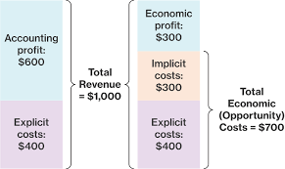
Chapter
1) Calculating Profit
07
www.midocean.ae

Slide 8
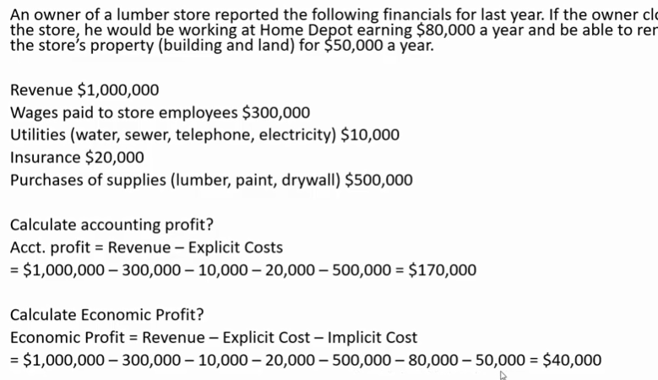
Chapter
1) Calculating Profit
07
www.midocean.ae

Slide 9
Chapter
Production, and Cost
07
2) Production
www.midocean.ae

Slide 10
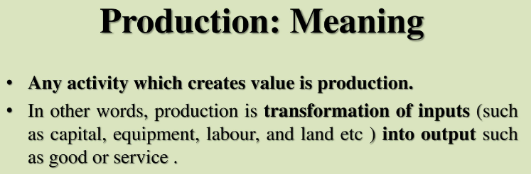
Chapter
Production
07
www.midocean.ae

Slide 11
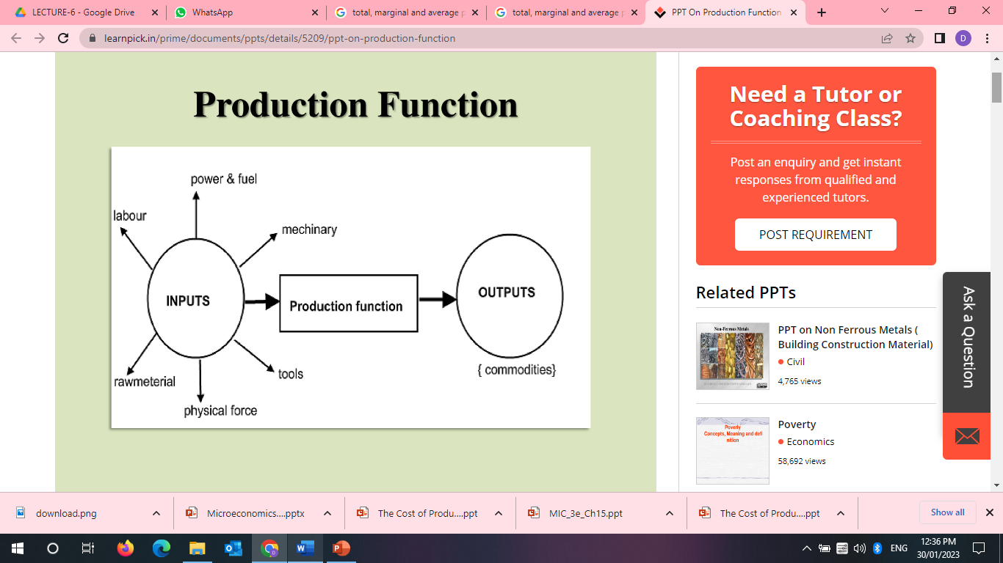
Chapter
Production
07
www.midocean.ae

Slide 12
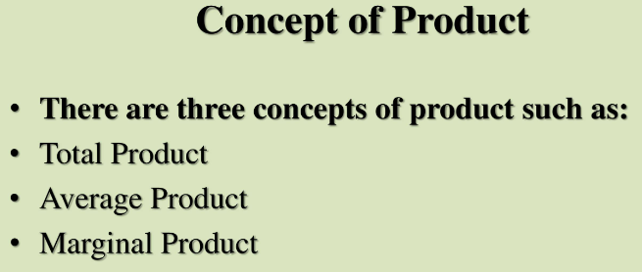
Chapter
Production
07
www.midocean.ae

Slide 13
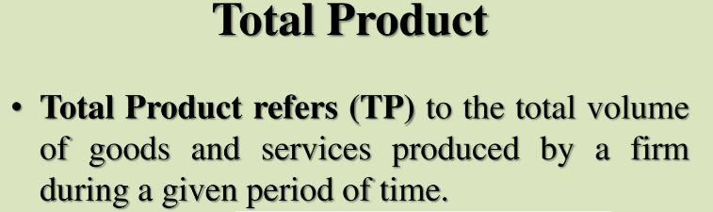
Chapter
Production
07
(1)
www.midocean.ae

Slide 14
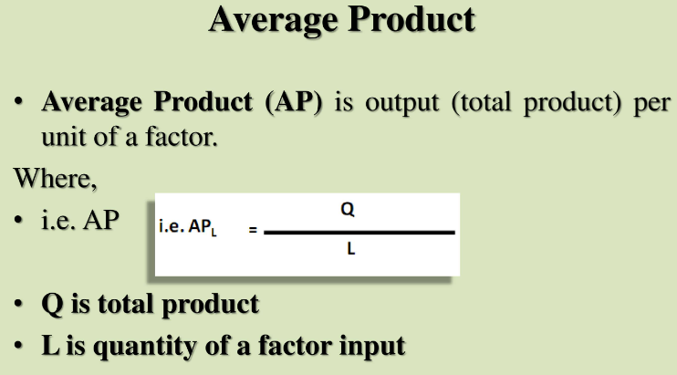
Chapter
Production
07
(2)
www.midocean.ae

Slide 15
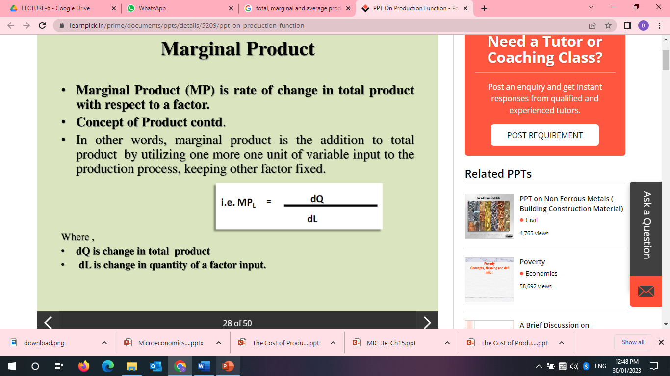
Chapter
Production
07
(3)
www.midocean.ae

Slide 16
Chapter
Production
07
A) The relationship between a firm’s output and labor employed
In Short run: :It is a time frame in which to increase output with a fixed capital, a firm must increase the quantity of labor it uses
The short run is a time period in which some resources are fixed, and other variables
www.midocean.ae

Slide 17
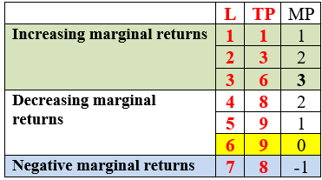
Chapter
Production
07
www.midocean.ae

Slide 18
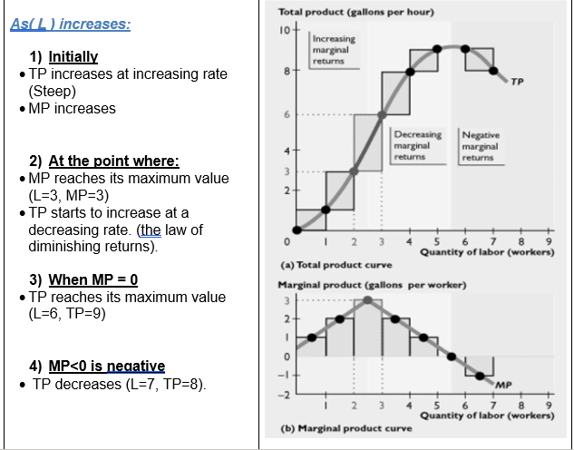
Chapter
07
www.midocean.ae

Slide 19
Chapter
Production
07
B) The relationship between total, marginal and average productivity
TP, AP, MP
www.midocean.ae

Slide 20
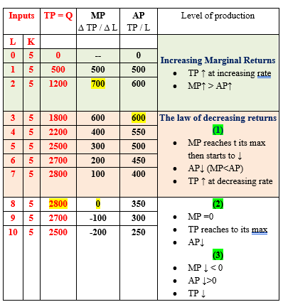
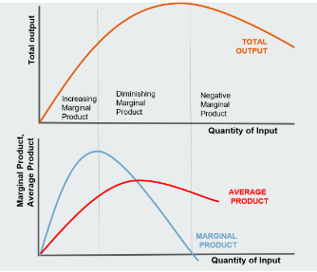
www.midocean.ae

Slide 21
Chapter
Production, and Cost
07
3) Cost
www.midocean.ae

Slide 22
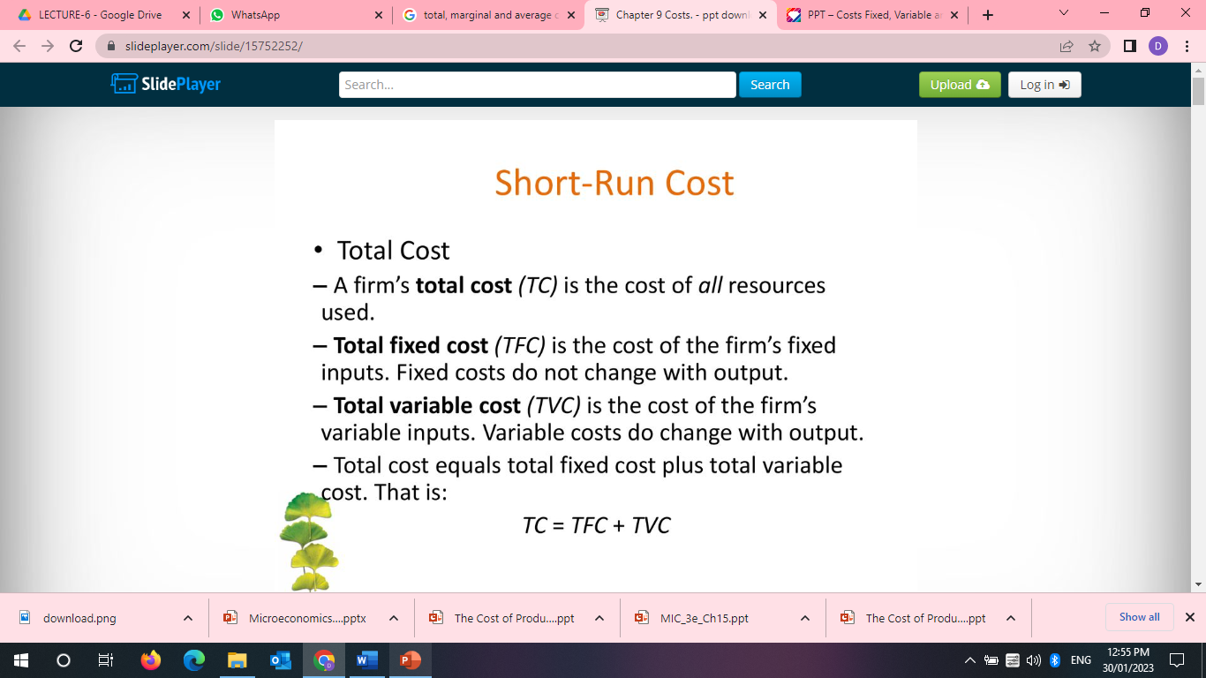
Chapter
Cost
07
www.midocean.ae

Slide 23
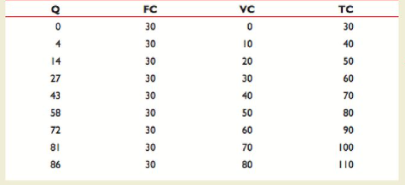
Chapter
Cost
07
www.midocean.ae

Slide 24
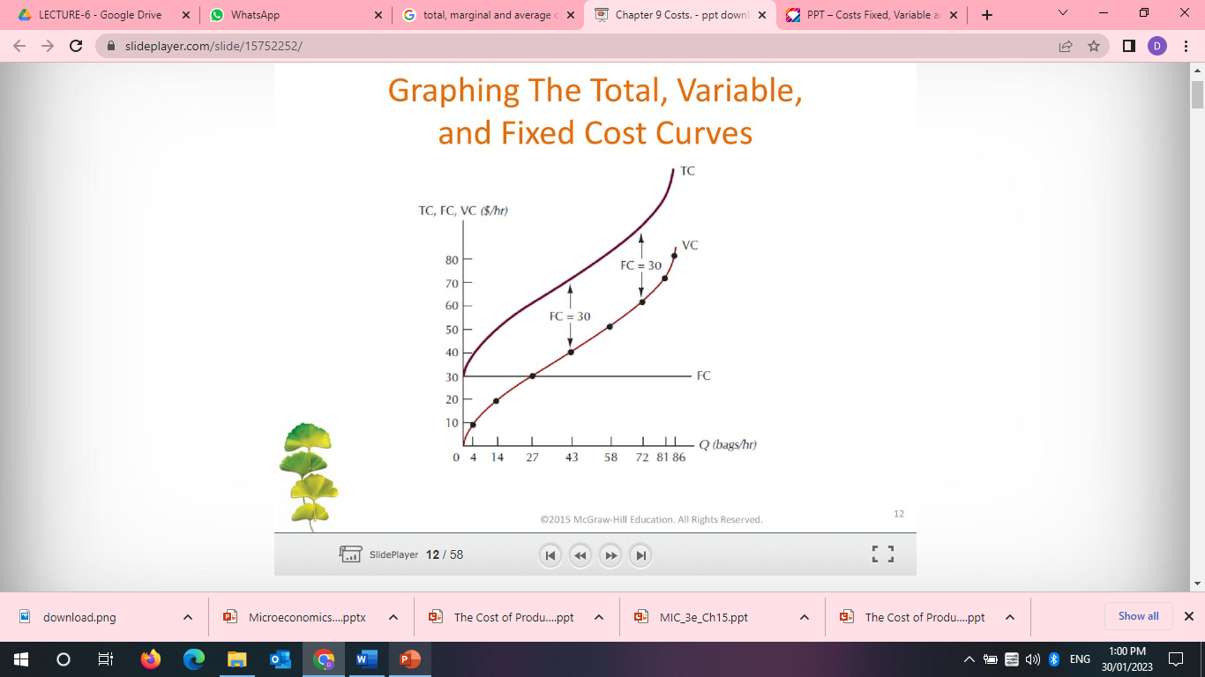
Chapter
Cost
07
(TC) increases as output increases.
TVC increases as output increases
(TFC) is constant—it graphs as a horizontal line
The vertical distance between the TC curve and the TVC curve is TFC as illustrated by the two arrows. TFC = TC – TVC
www.midocean.ae

Slide 25
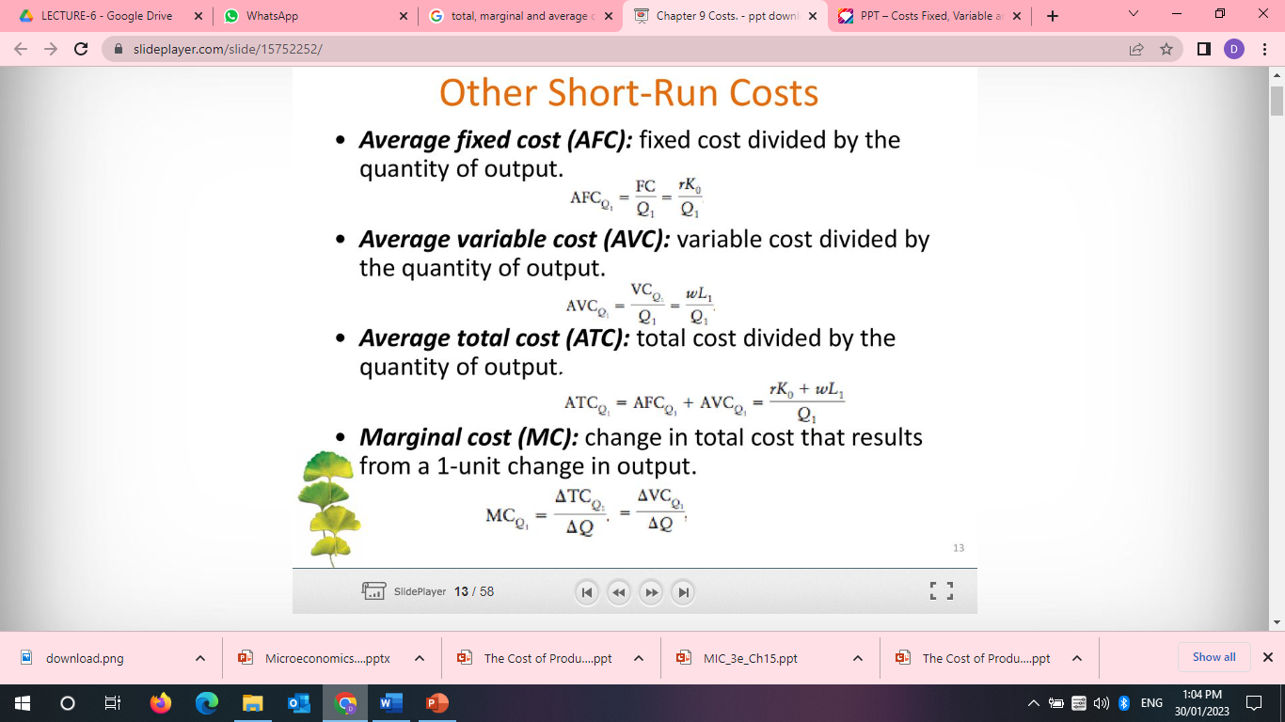
Chapter
Cost
07
www.midocean.ae

Slide 26
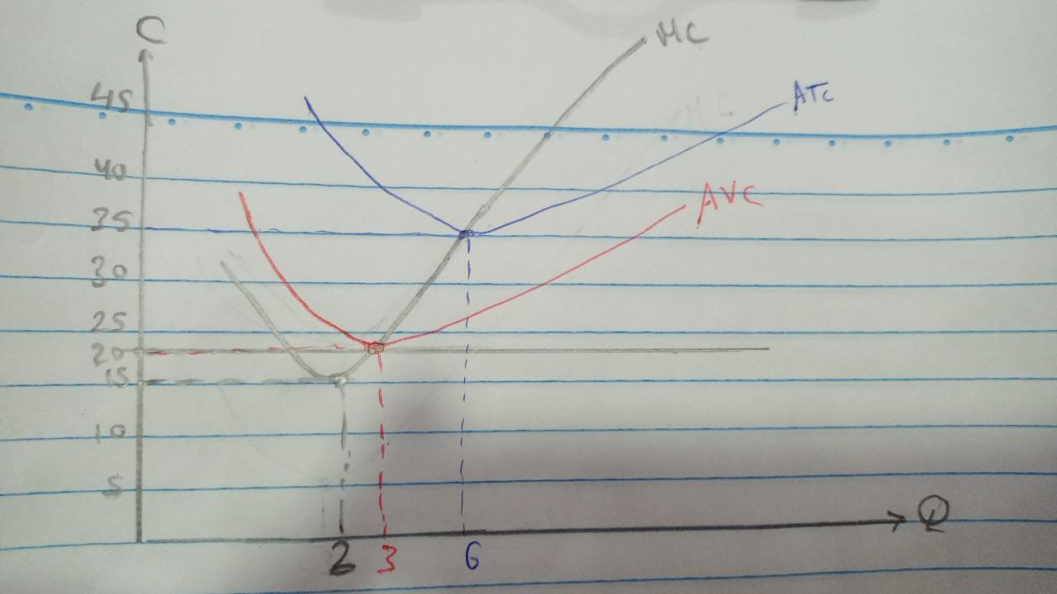
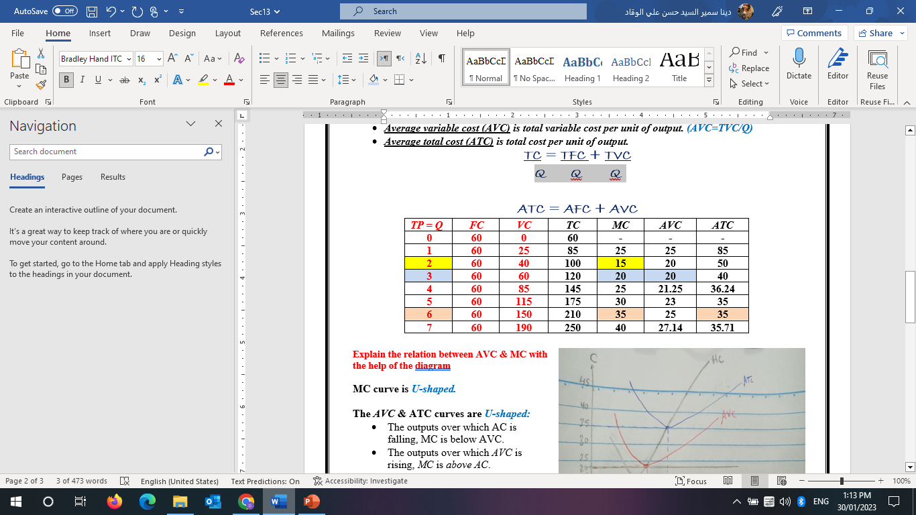
Chapter
Cost
07
Graphically
www.midocean.ae

Slide 27
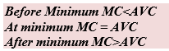
Cost
Chapter
07
The relation between AVC & MC with the help of the diagram
MC curve is U-shaped.
The AVC & ATC curves are U-shaped:
  The outputs over which AC is falling, MC is below AVC.
  The outputs over which AVC is rising, MC is above AC.
  The output at which AVC is at the minimum, MC equals AC.
  a minimum are listed in order : MC, AVC, ATC
www.midocean.ae

Slide 28
Chapter
Cost
07
ATC = TC/Q
ATC= AVC+AFC
AVC = VC/Q
AVC= ATC-AFC
AFC = FC/Q
AFC= ATC-AVC
TC = VC+ FC
TC = ATC*Q
VC= TC-FC
VC= AVC*Q
FC=TC-VC
FC=AFC*Q
MC = ∆TC / ∆Q
AP = TP / L
MP = ∆TP / ∆L
www.midocean.ae

Slide 29
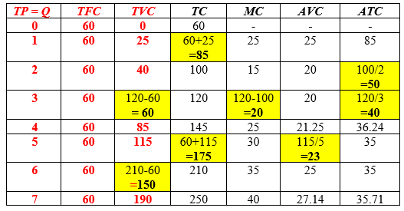

Think
www.midocean.ae

Slide 30
Think
A cost that can be easily adjusted is known as -----
total cost.
variable cost.
fixed cost.
average fixed cost.
The short run is a time frame in which
A) the firm is not able to hire more workers.
B) the amount of output produced is fixed.
C) there is a shortage of most factors of production.
D) at least one factor of production is fixed.
www.midocean.ae

Slide 31
Think
The marginal cost (MC) curve intersects the
A) ATC, AVC, and AFC curves at their minimum points.
B) ATC and AFC curves at their minimum points.
C) AVC and AFC curves at their minimum points.
D) ATC and AVC curves at their minimum points.
If ATC is falling, then MC must be.
A) rising
B) falling.
C) equal to ATC.
D) above ATC.
www.midocean.ae

Slide 32
Think
At that amount of output were diminishing marginal returns first sets in,
A) average product begins to decrease.
B) total product begins to decrease.
C) marginal cost begins to decrease.
D) marginal product begins to decrease.
www.midocean.ae

Slide 33
Think
Which one of the following statements is correct?
A) When marginal product is increasing, average product is decreasing.
B) When average product is less than zero, marginal product is positive.
C) When marginal product is increasing and greater than average product, average product is increasing.
D) When marginal product is zero, total product is at its minimum.
www.midocean.ae

Slide 34
Think
Diminishing marginal returns occur when the marginal product of an additional worker is
less than zero.
less than the marginal product of the previous worker.
equal to the marginal product of the previous worker.
greater than the marginal product of the previous worker.
When the average product is greater than the marginal product, then the average product is
equal to zero.
falling.
not changing.
rising.
www.midocean.ae

Slide 35
Think
Implicit costs are:
A) equal to total fixed costs.
B) comprised entirely of variable costs.
C) "payments" for self-employed resources.
D) always greater in the short run than in the long run.
Which would be an implicit cost for a firm? The cost:
A) of worker wages and salaries for the firm.
B) paid for leasing a building for the firm.
C) paid for production supplies for the firm.
D) of wages foregone by the owner of the firm
www.midocean.ae

Slide 36
Think
Suppose that a firm revenue is $5,000,000. The explicit costs of production are $2,500,000 and the implicit costs of production are $200,000. The firm has an accounting profit of:
A) $2,500,000 and an economic profit of $2,300,000 .
B) $6,000,000 and an economic profit of $2,000,000.
C) $7,000,000 and an economic profit of $4,000,000.
D) $8,000,000 and an economic profit of $5,000,000.
www.midocean.ae

Slide 37
Think
The Answer:
TR= $5,000,000
The explicit costs= $2,500,000
implicit costs= $200,000
Eco. Profit = TR- (explicit + implicit) = $5,000,000- ($2,500,000 + $200,000) = $2,300,000
Acc. Profit = TR- explicit cost= $5,000,000- $2,500,000 = $2,500,000
www.midocean.ae

Slide 38
Think
When marginal product reaches its maximum, what can be said of total product?
A) total product must be at its maximum
B) total product starts to decline even if marginal product is positive
C) total product is increasing if marginal product is still positive
D) total product levels off
www.midocean.ae

Slide 39
Chapter
Summary outlines
07
The difference between Accounting, and Economic profit
Production: Meaning, concepts of product
The relationship between a firm’s output and labor employed.
The relationship between total, marginal and average productivity (TP, AP, MP)
Short run costs
www.midocean.ae

Slide 40


Thank You

