Slide 1



Physical Layer
Lecture 2
CCNA – Introduction to Networks V7.0 (ITN)
Prepared by
Dr. Abdelrhman Ahmed

Slide 2
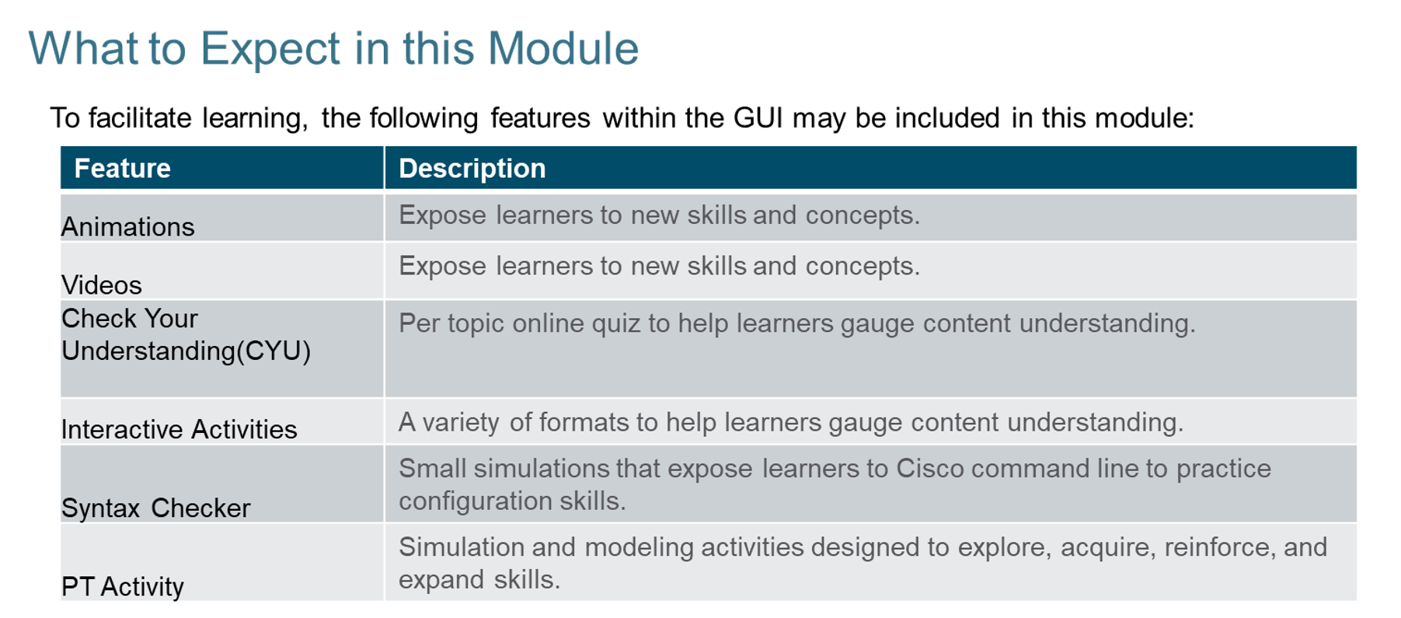
Chapter
What to Expect in this Module
02

Slide 3
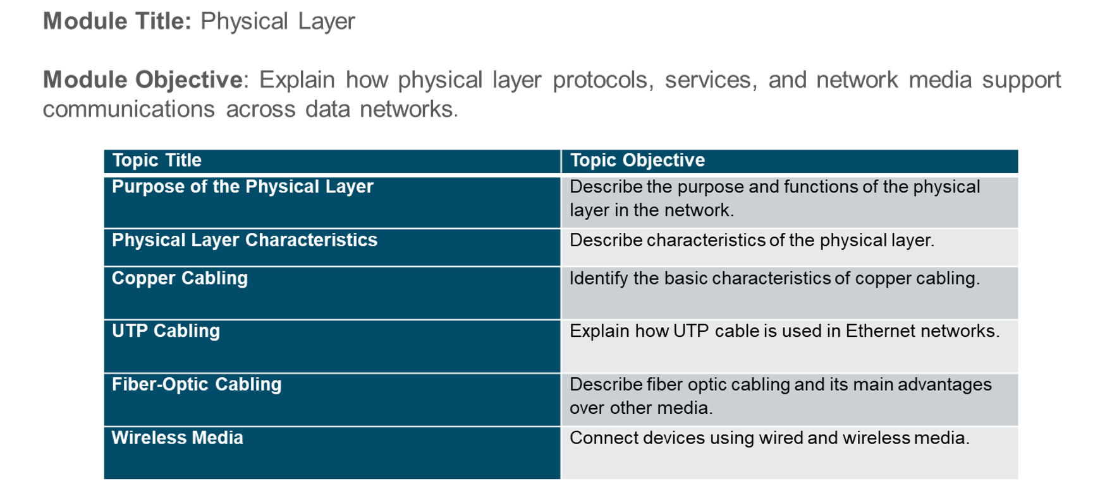
Chapter
Module Objectives
02

Slide 4
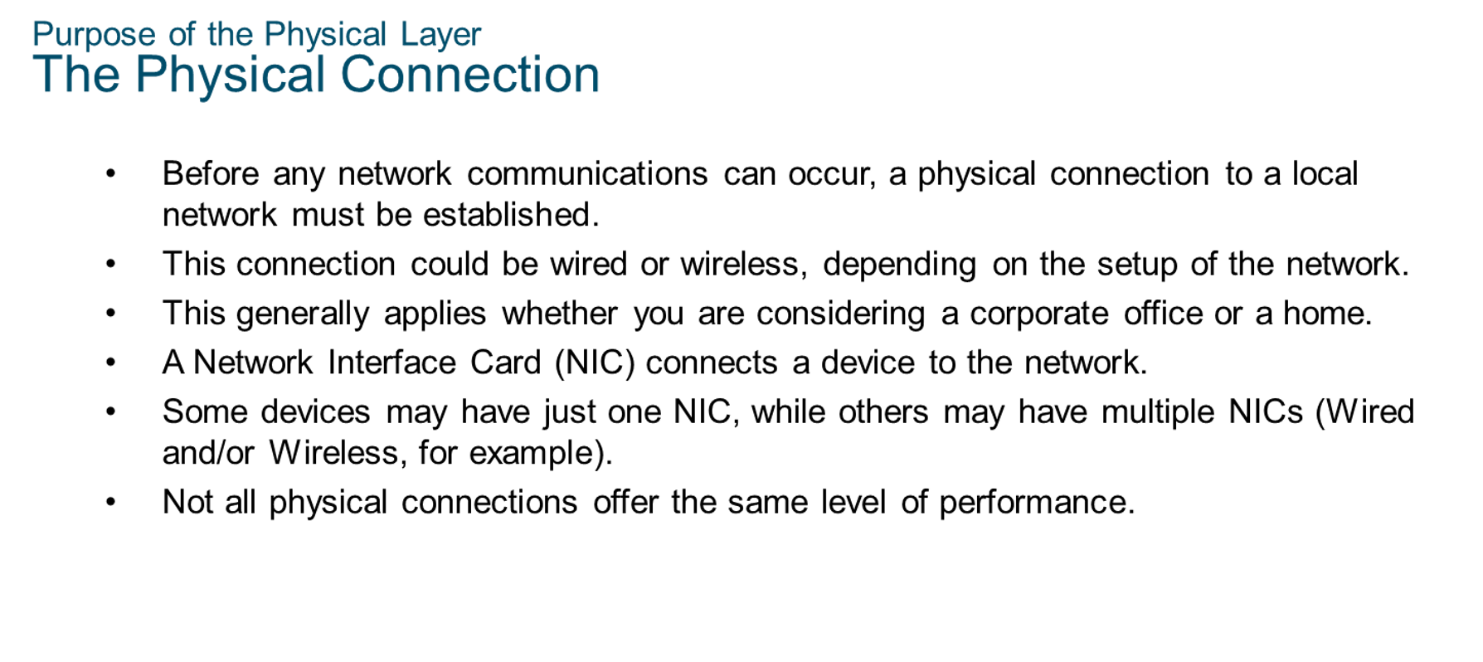
Chapter
Purpose of the Physical Layer
02

Slide 5
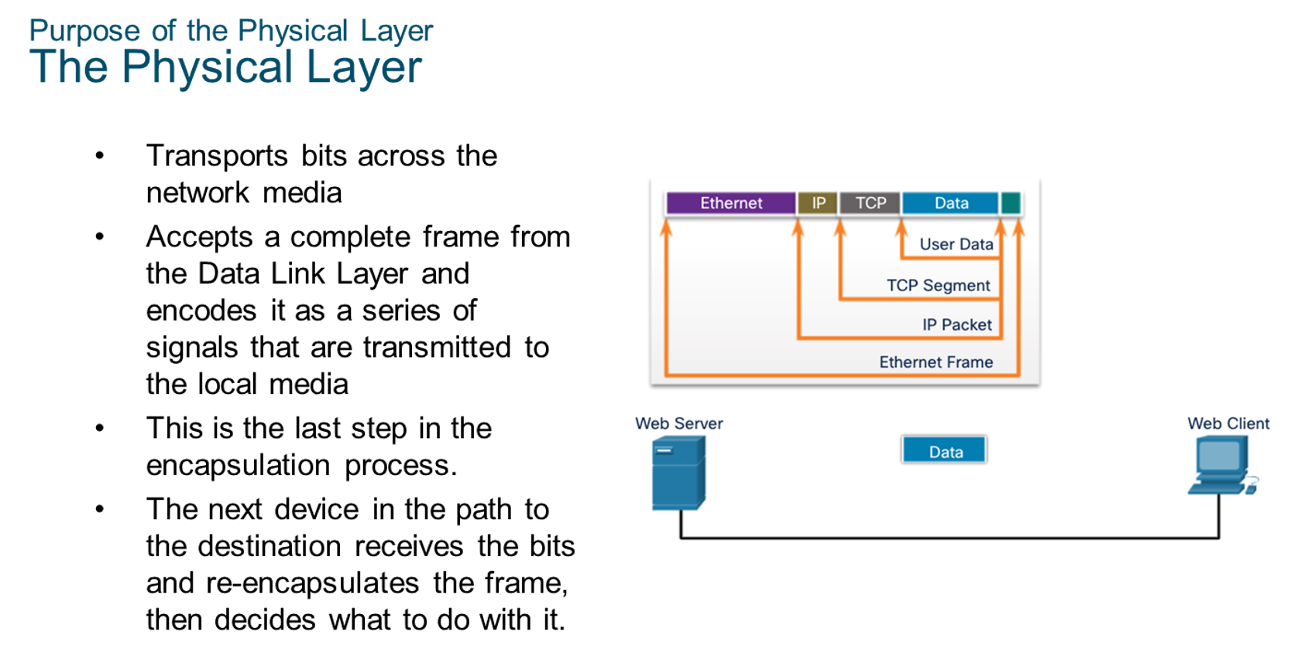
Chapter
Purpose of the Physical Layer
02

Slide 6
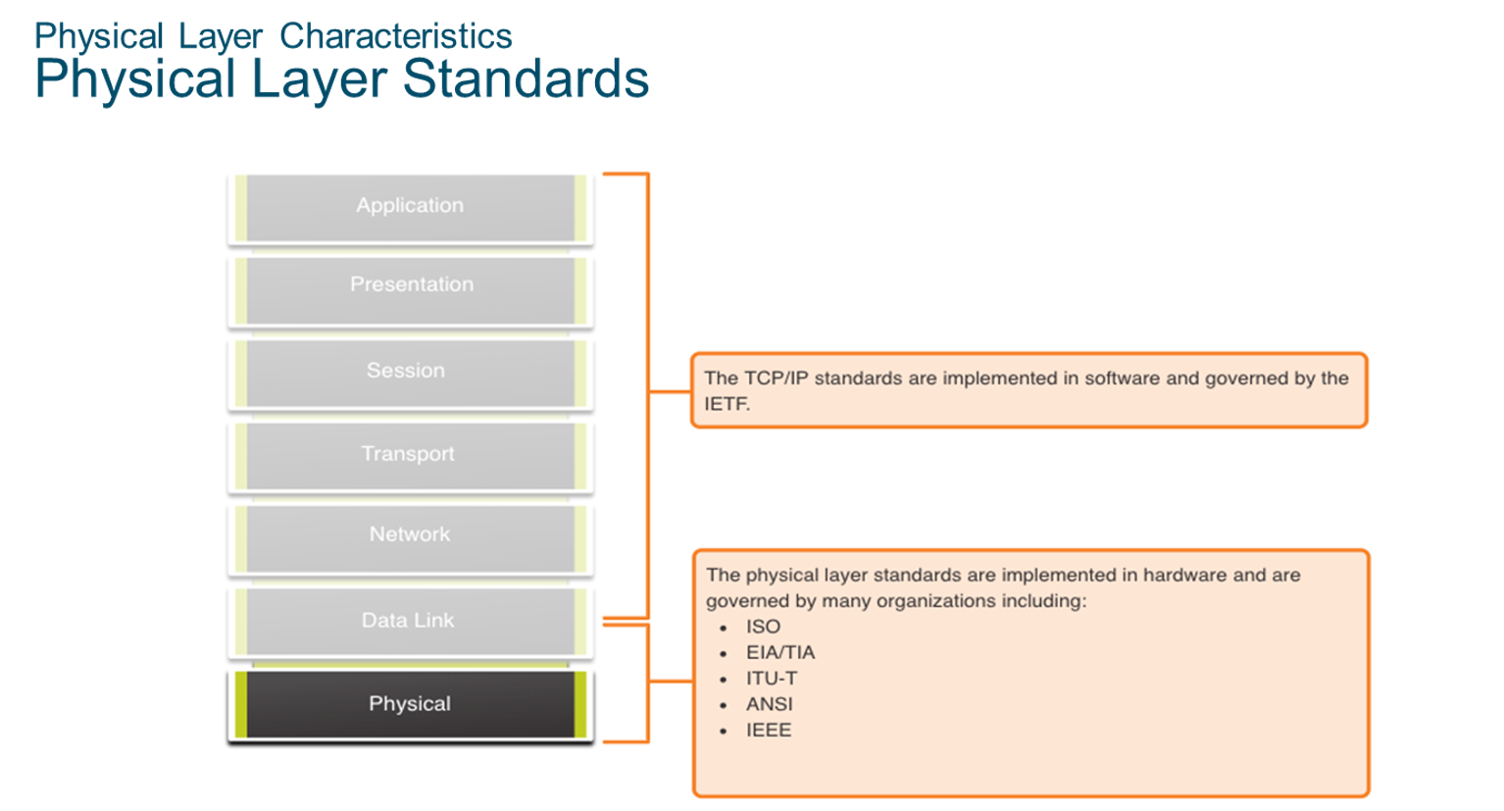
Chapter
Physical Layer Characteristics
02

Slide 7
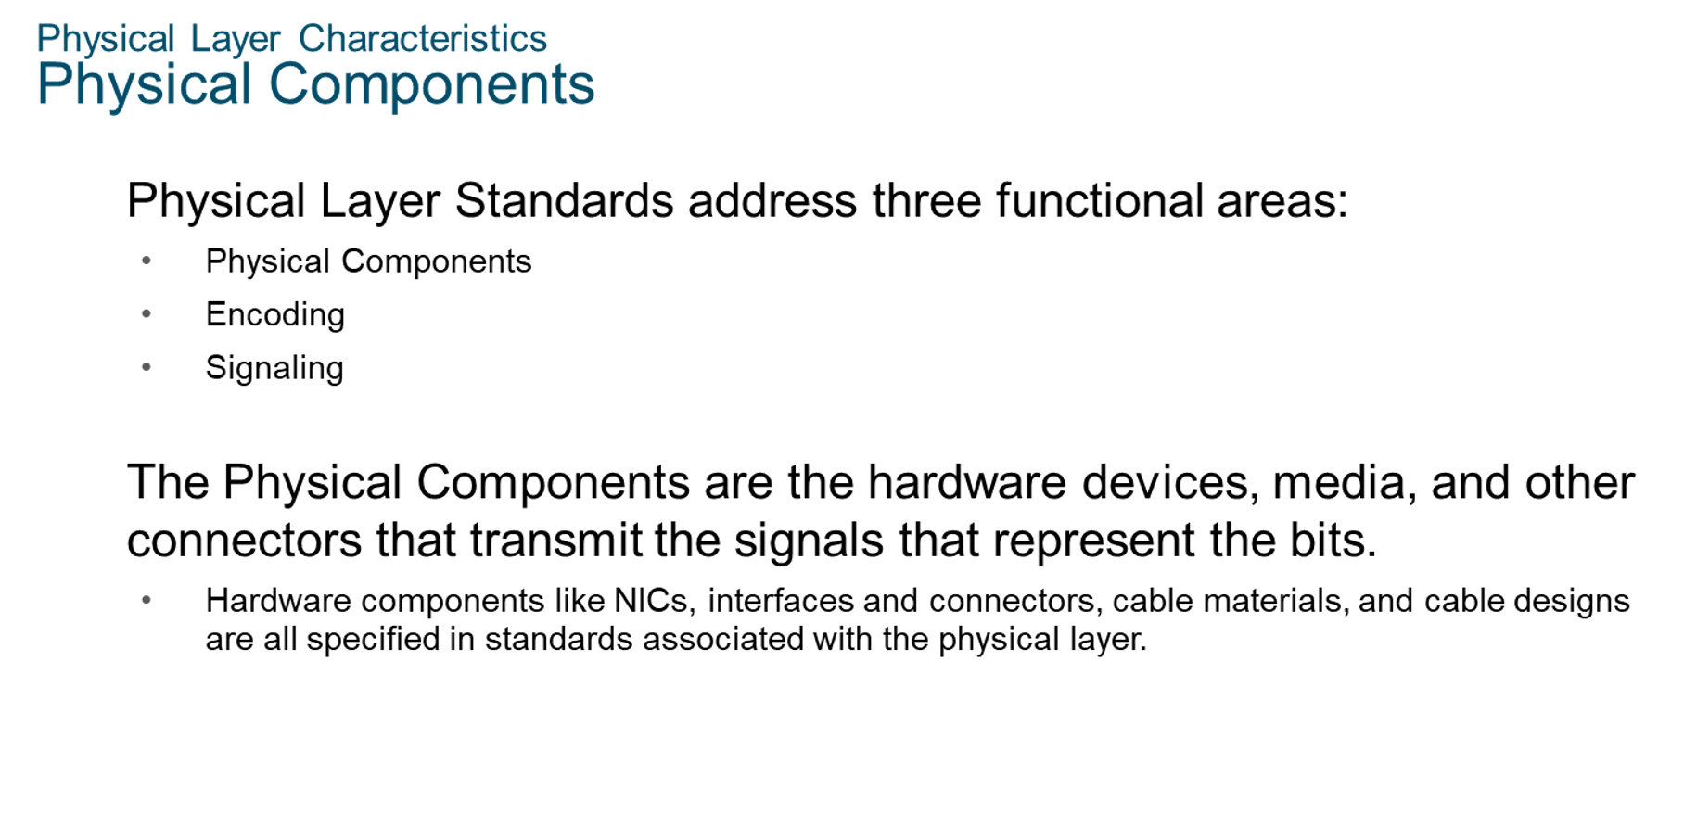
Chapter
Physical Layer Characteristics
02

Slide 8
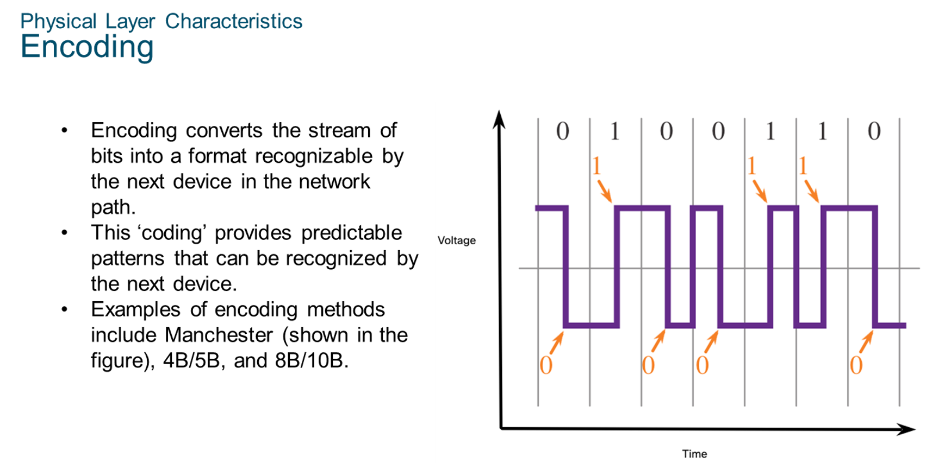
Chapter
Physical Layer Characteristics
02

Slide 9
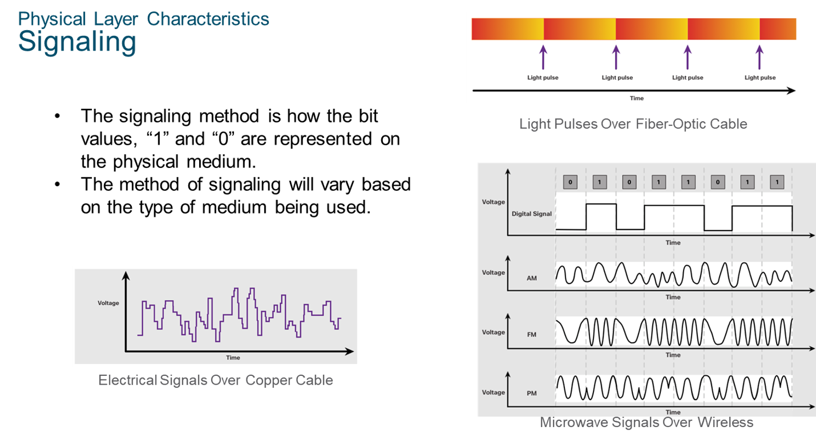
Chapter
Physical Layer Characteristics
02

Slide 10
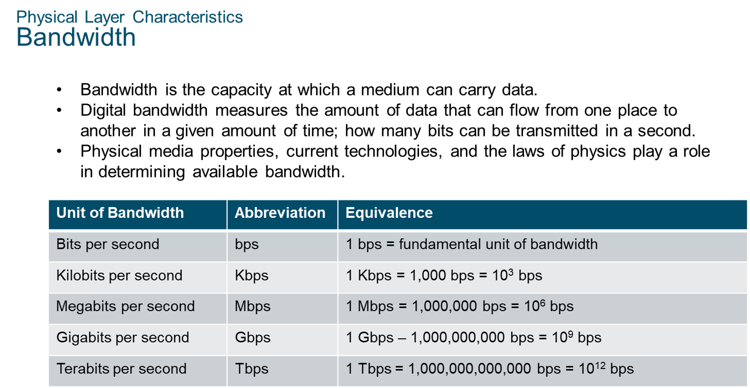
Chapter
Physical Layer Characteristics
02

Slide 11
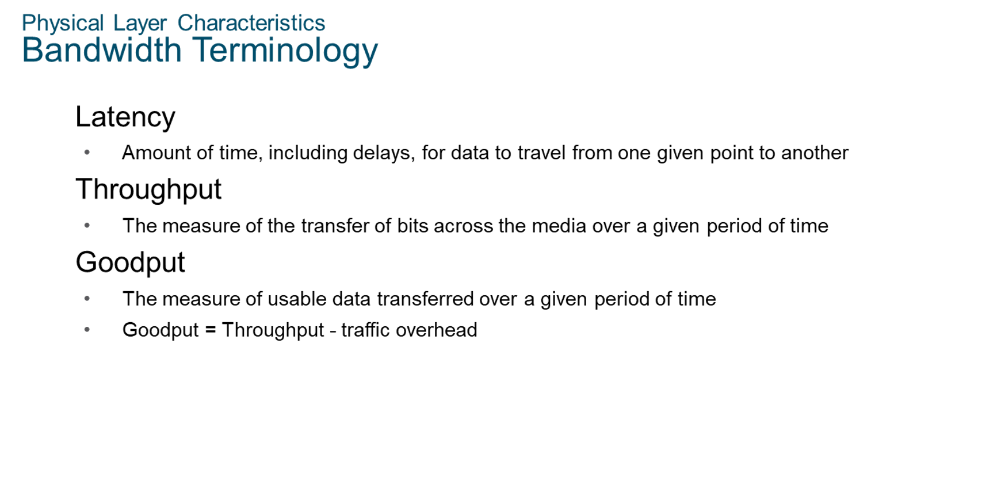
Chapter
Physical Layer Characteristics
02

Slide 12
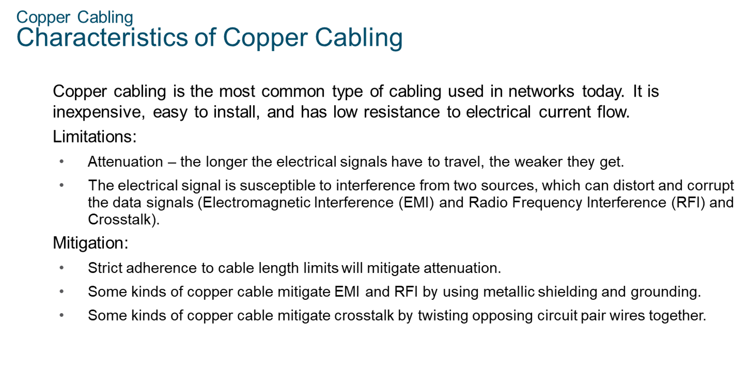
Chapter
Copper Cabling
02

Slide 13
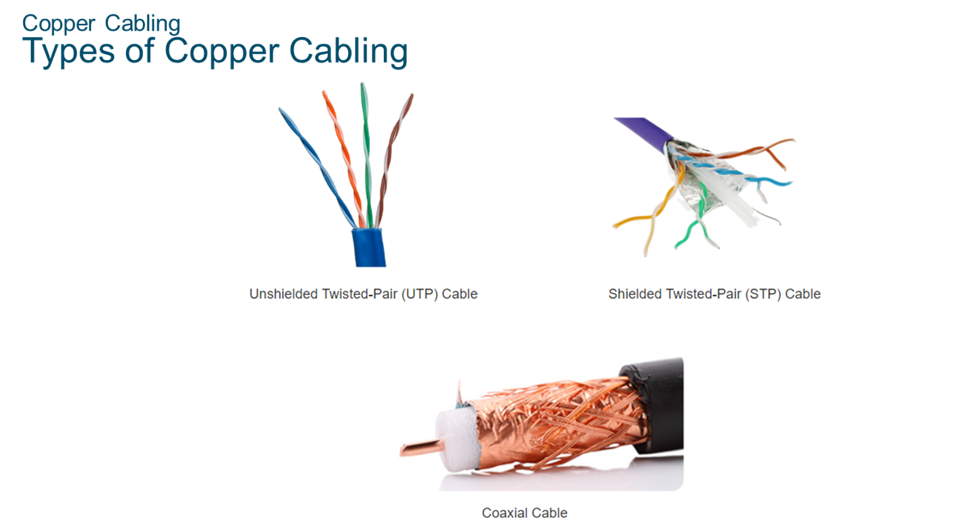
Chapter
02
Copper Cabling

Slide 14
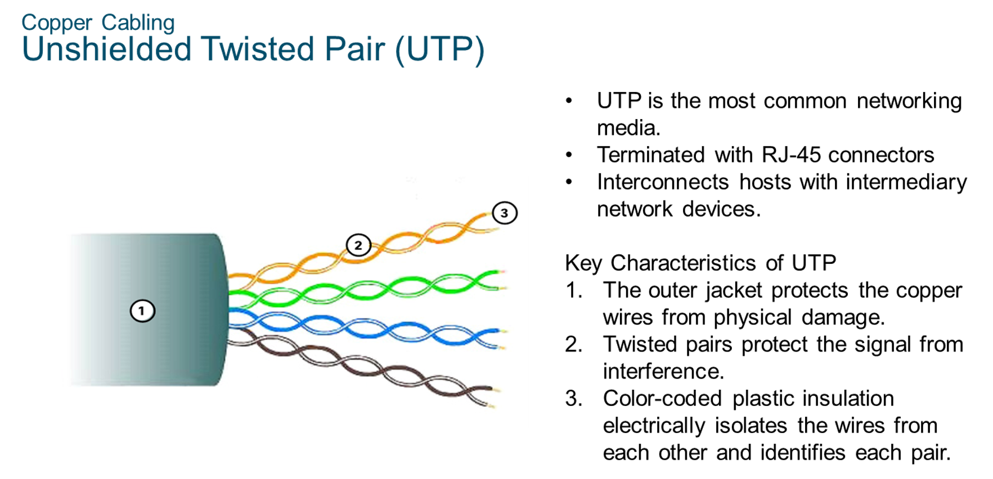
Chapter
Copper Cabling
02

Slide 15
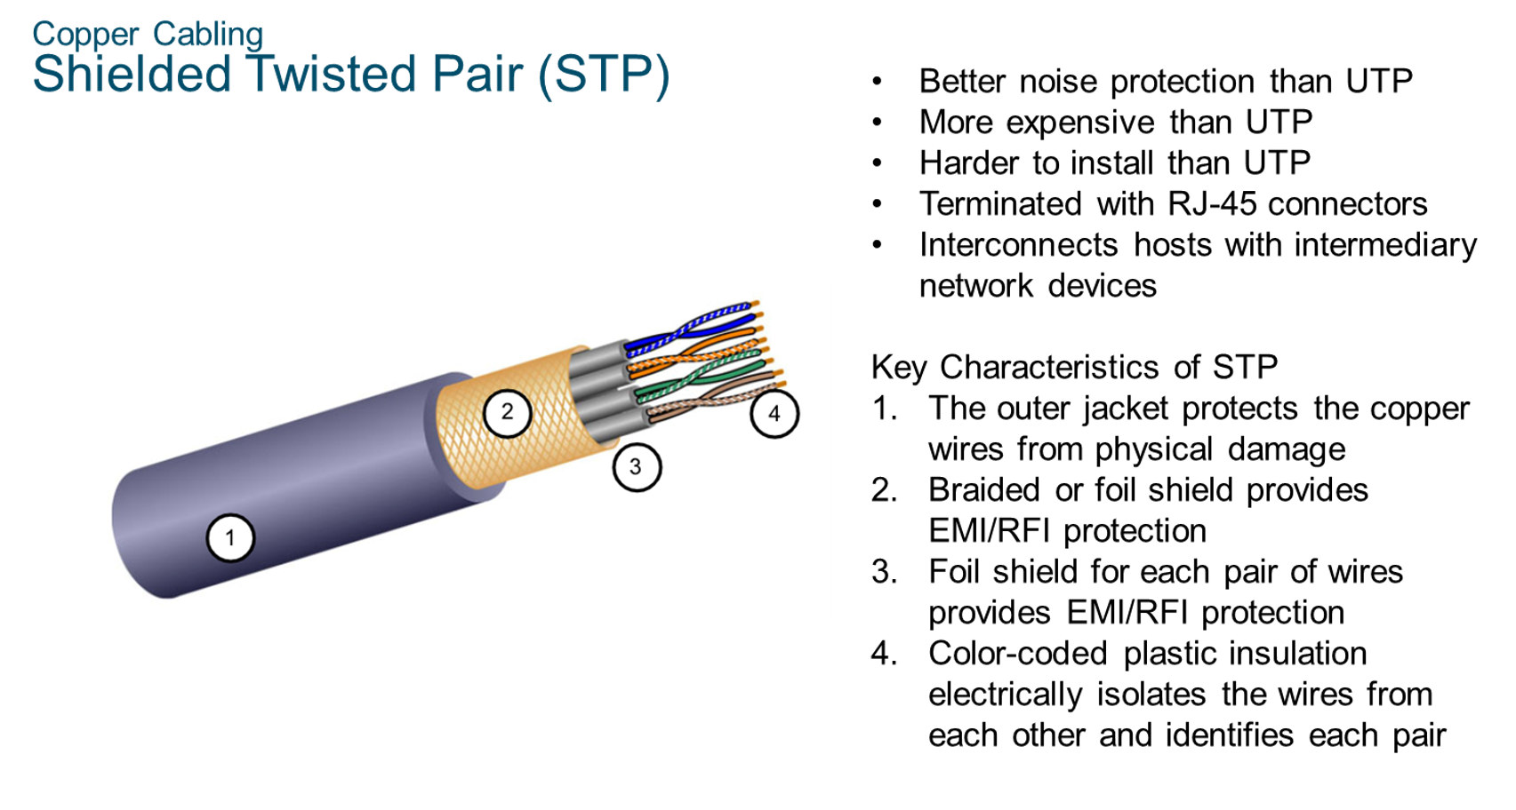
Chapter
Copper Cabling
02

Slide 16
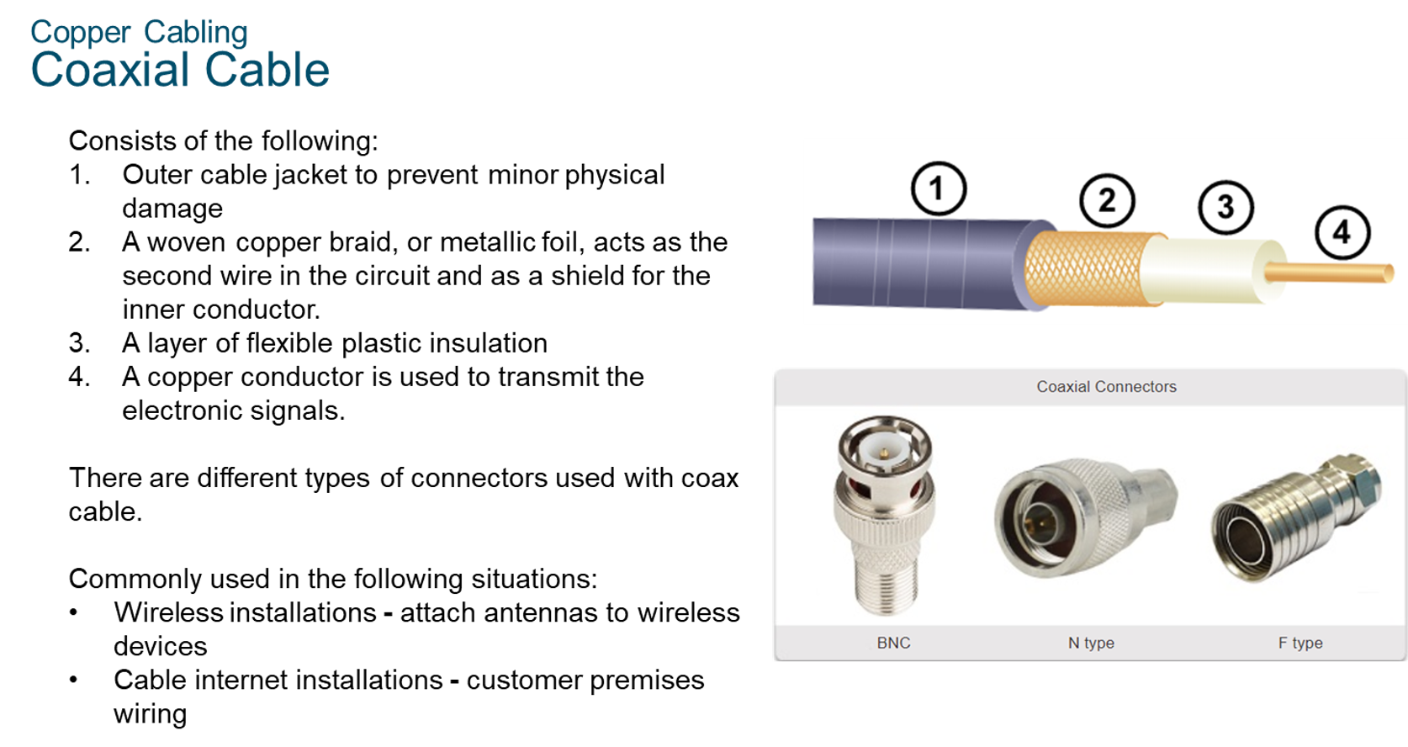
Chapter
Copper Cabling
02

Slide 17
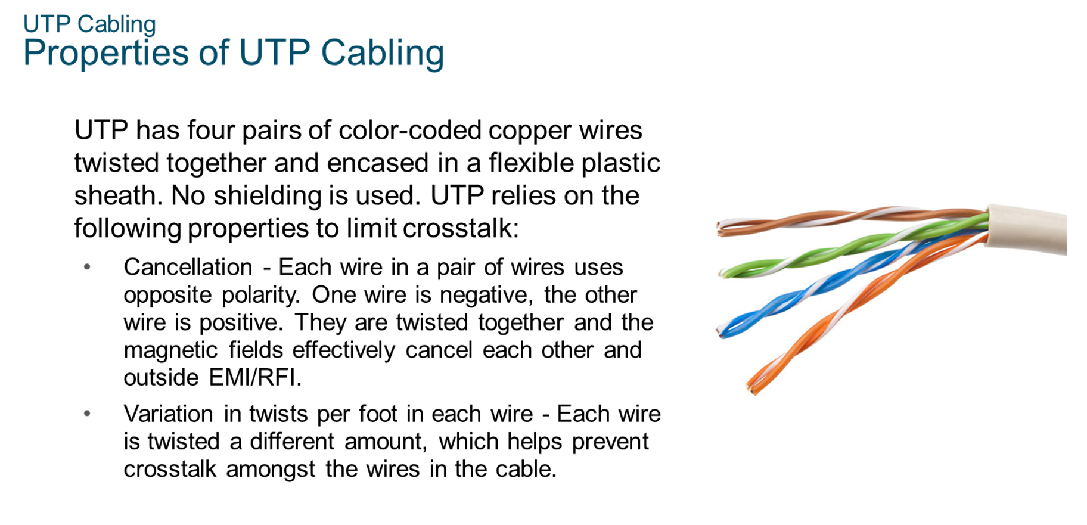
Chapter
UTP Cabling
02

Slide 18
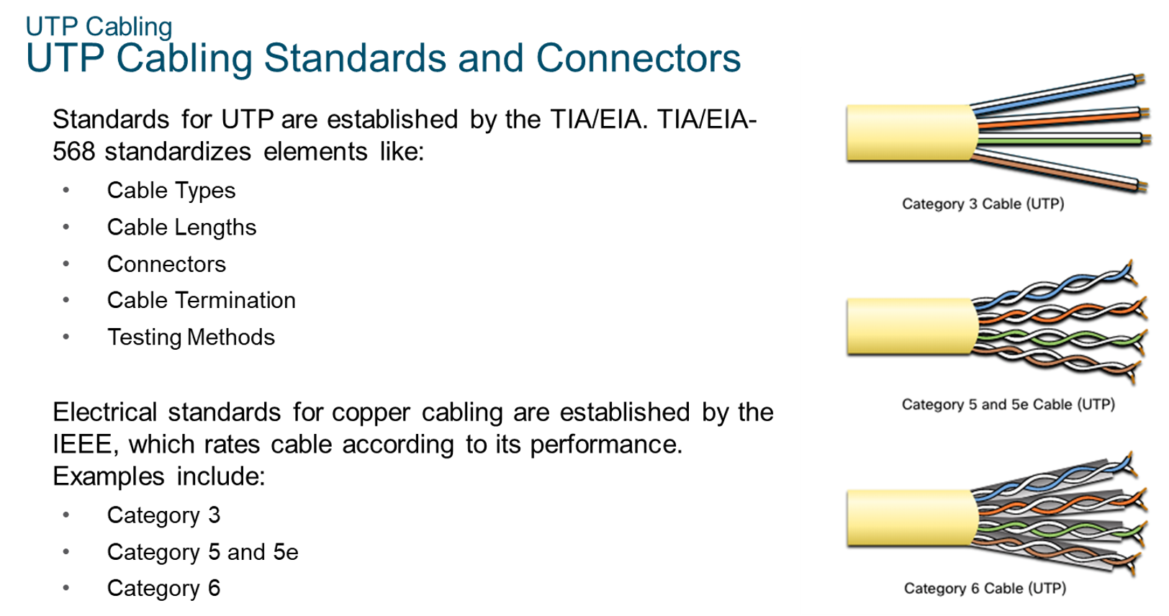
Chapter
UTP Cabling
02

Slide 19
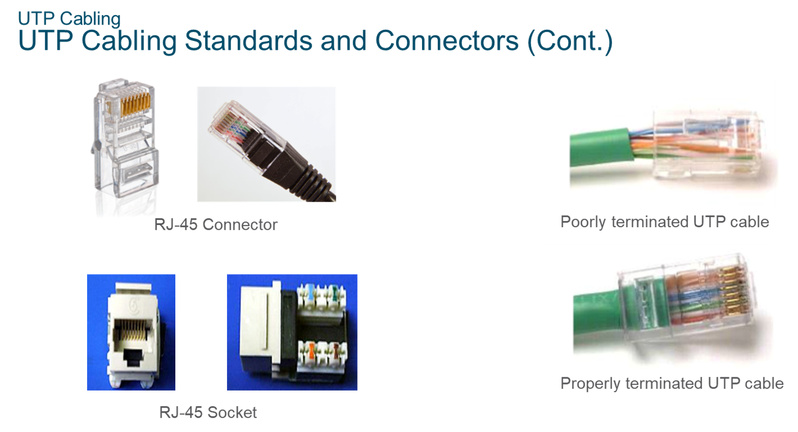
Chapter
UTP Cabling
02

Slide 20
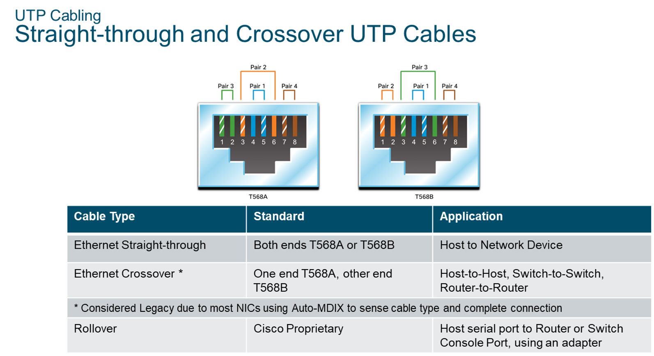
Chapter
UTP Cabling
02

Slide 21
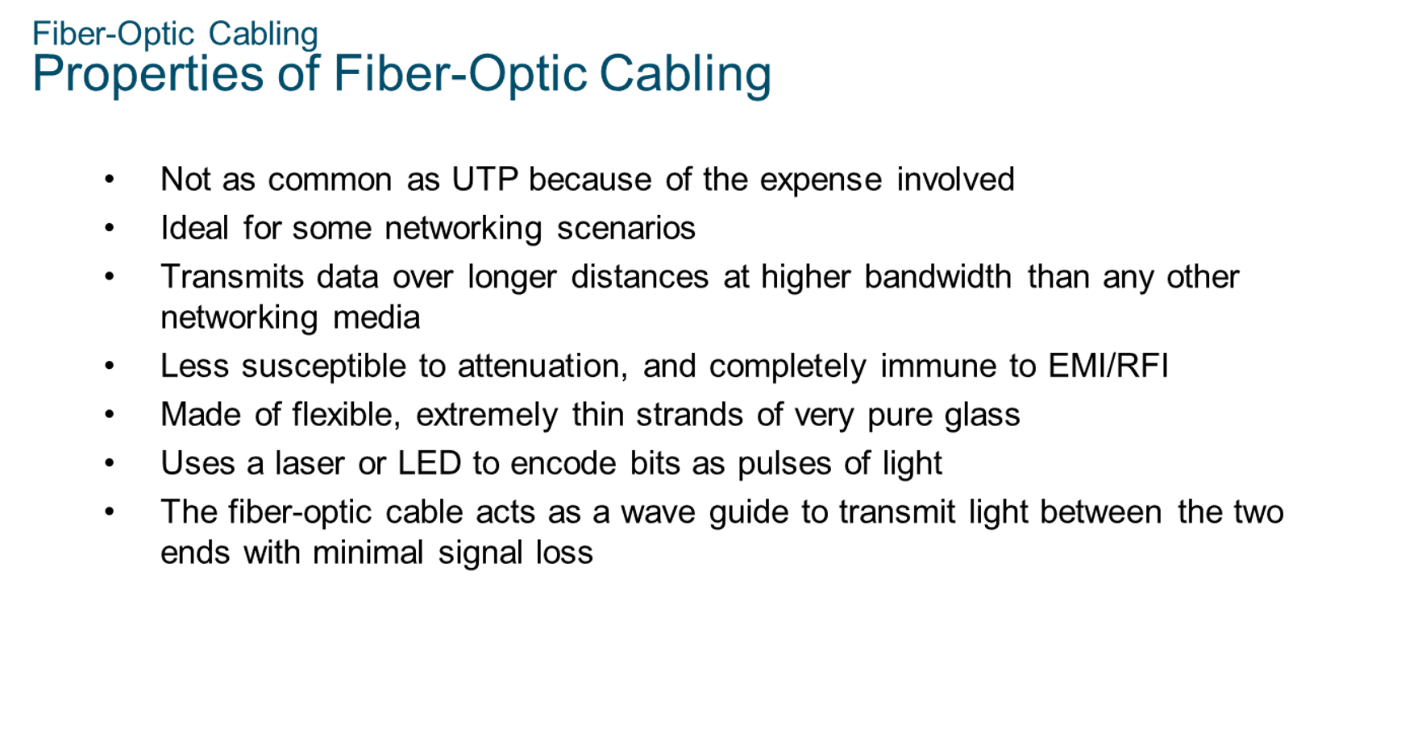
Chapter
Fiber-Optic Cabling
02

Slide 22
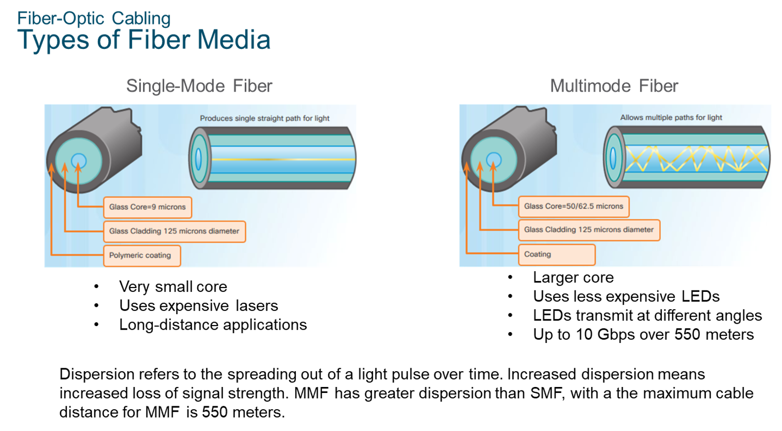
Chapter
Fiber Optic Cabling
02

Slide 23
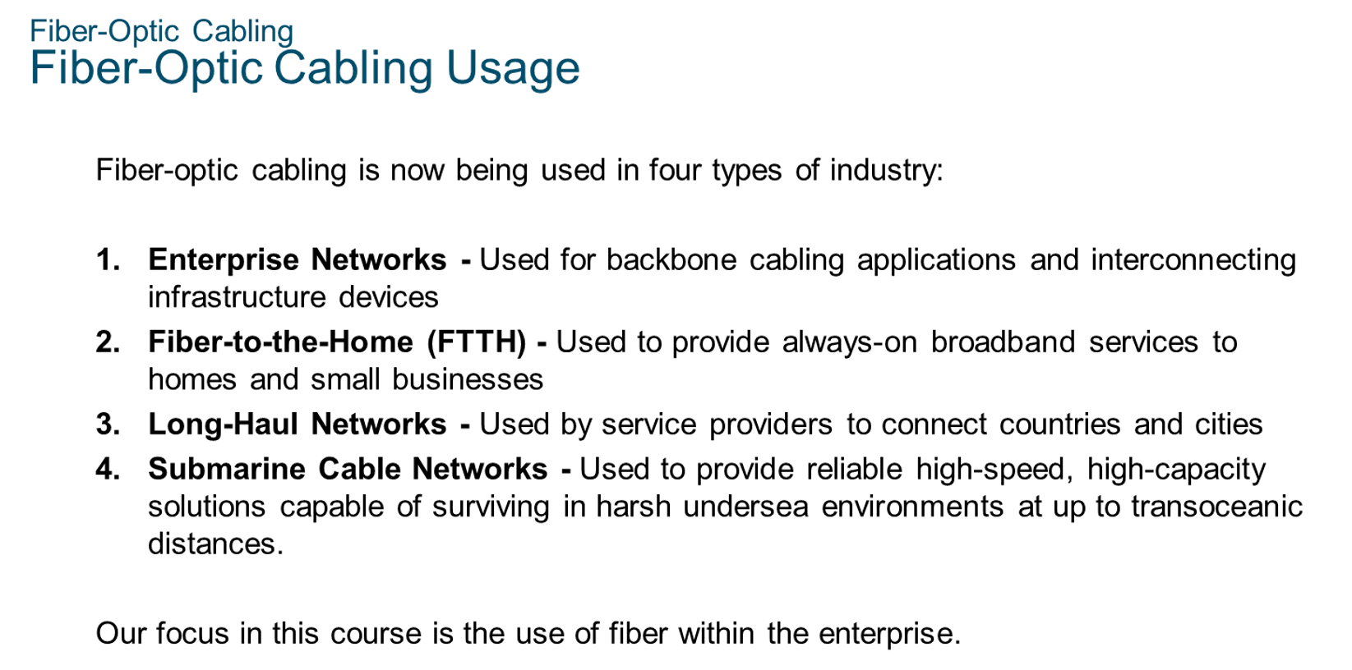
Chapter
Fiber Optic Cabling
02

Slide 24
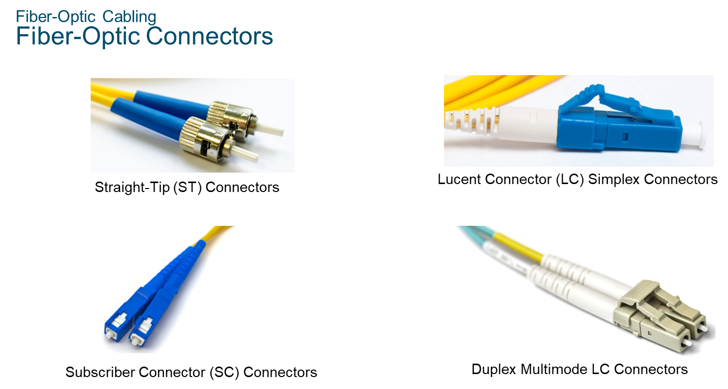
Chapter
Fiber Optic Cabling
02

Slide 25
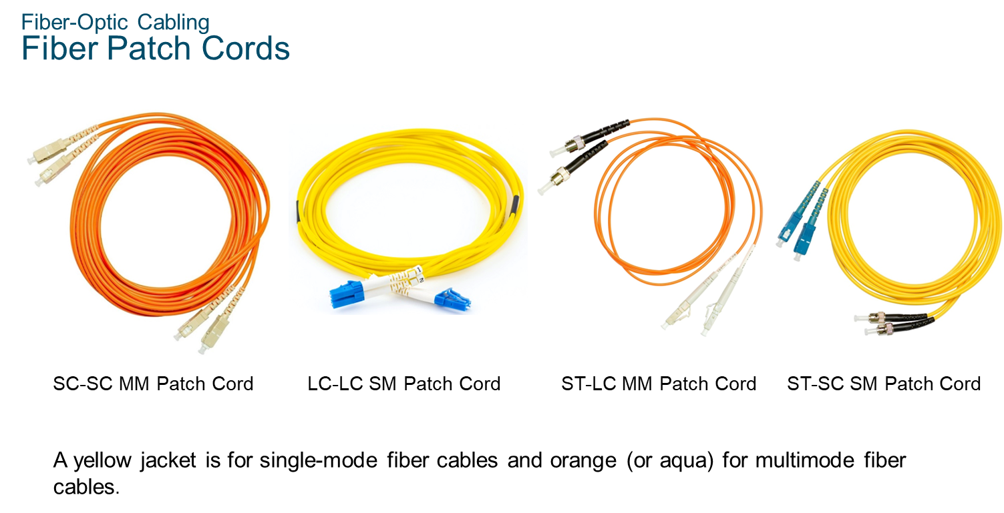
Chapter
Fiber Optic Cabling
02

Slide 26
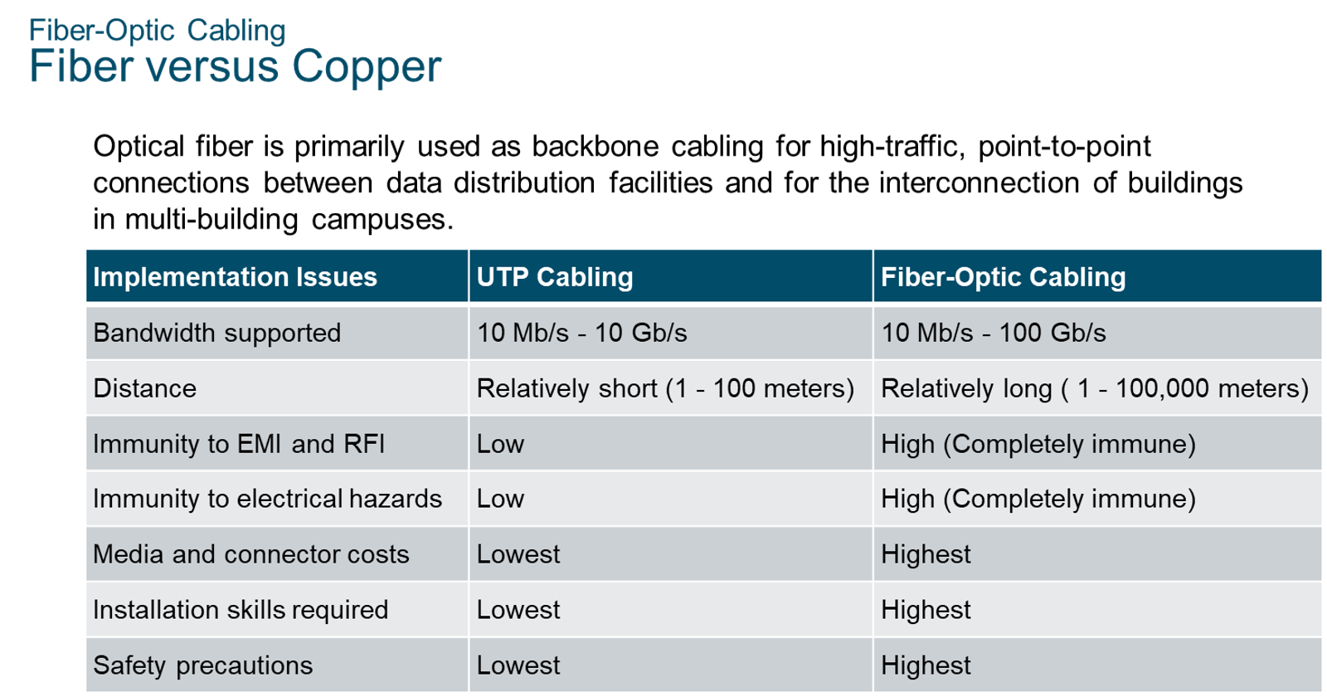
Chapter
Fiber Optic Cabling
02

Slide 27
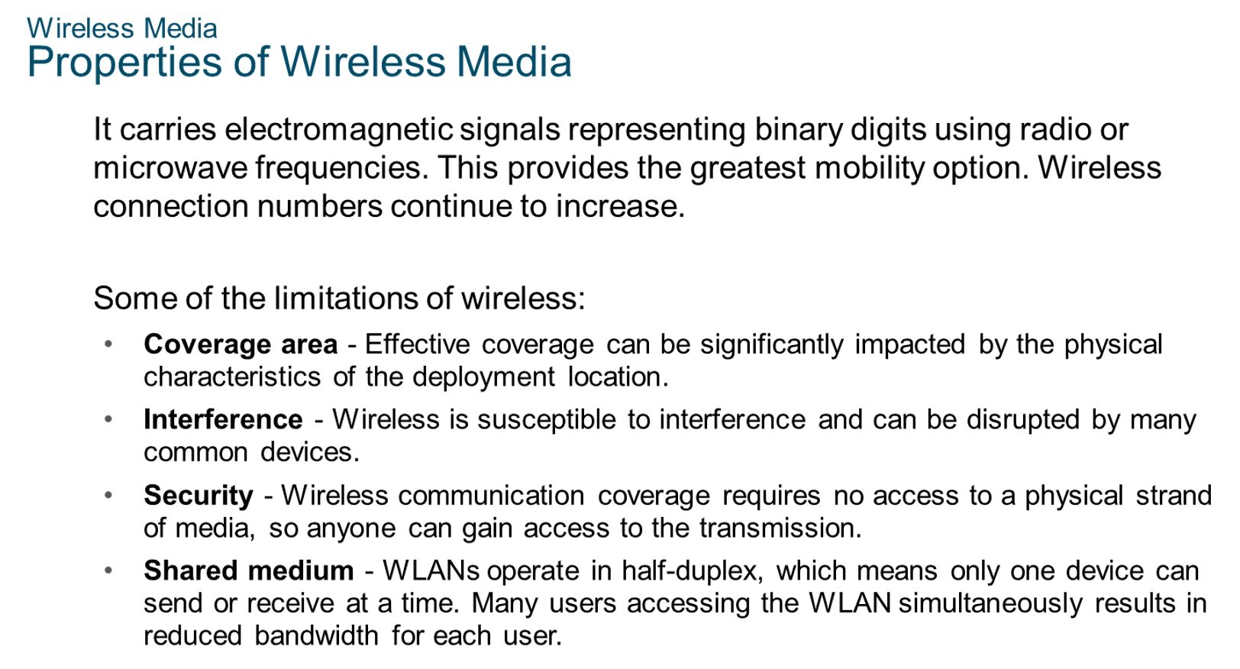
Chapter
Wireless Media
02

Slide 28
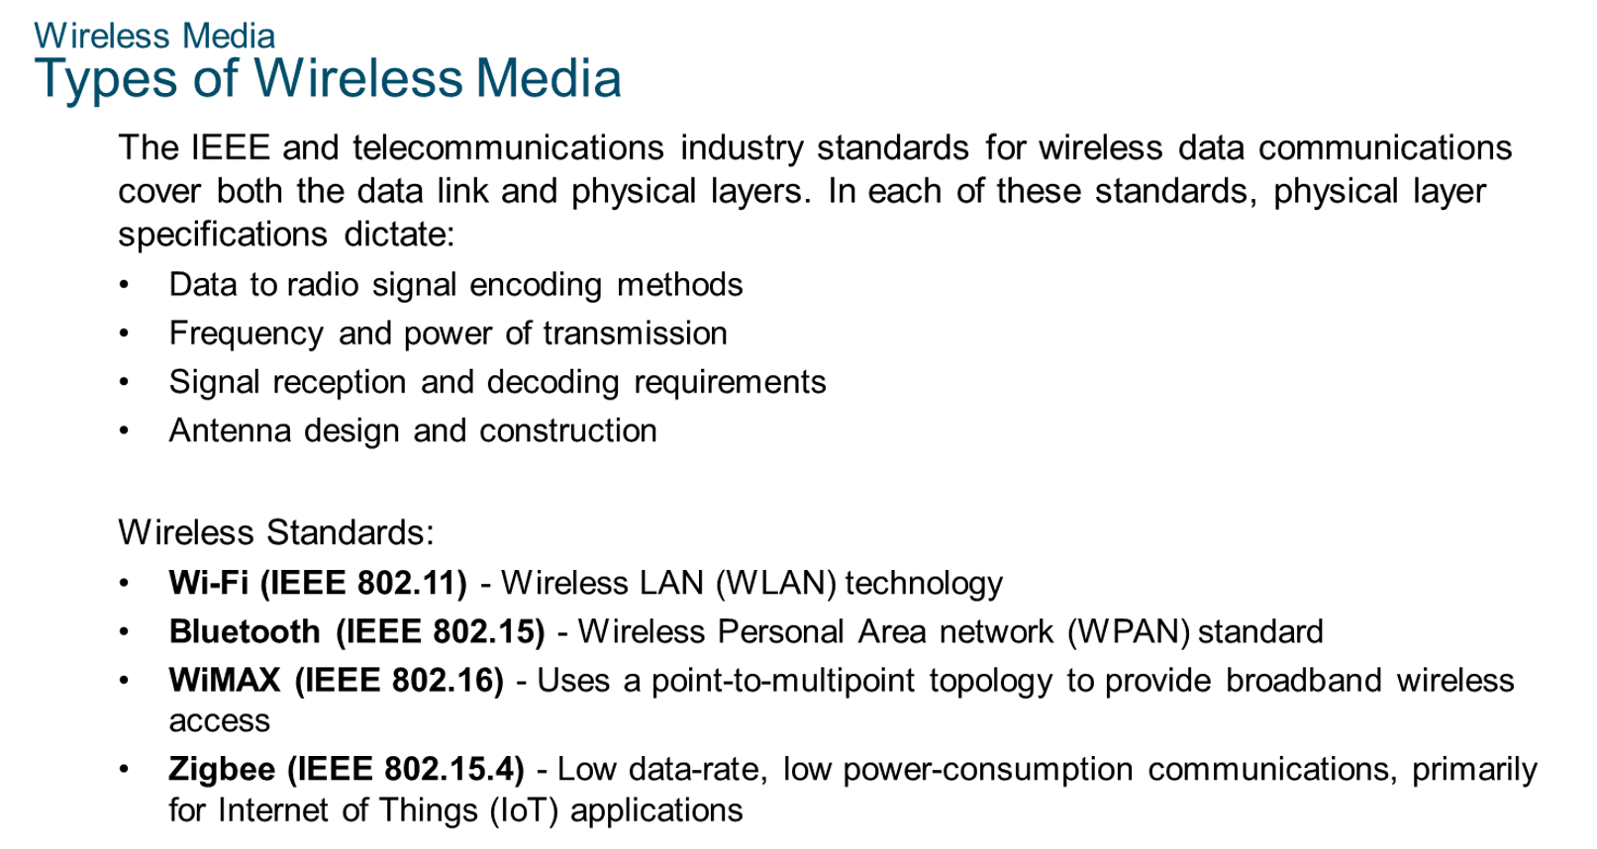
Chapter
Wireless Media
02

Slide 29



Thank You

