Slide 1
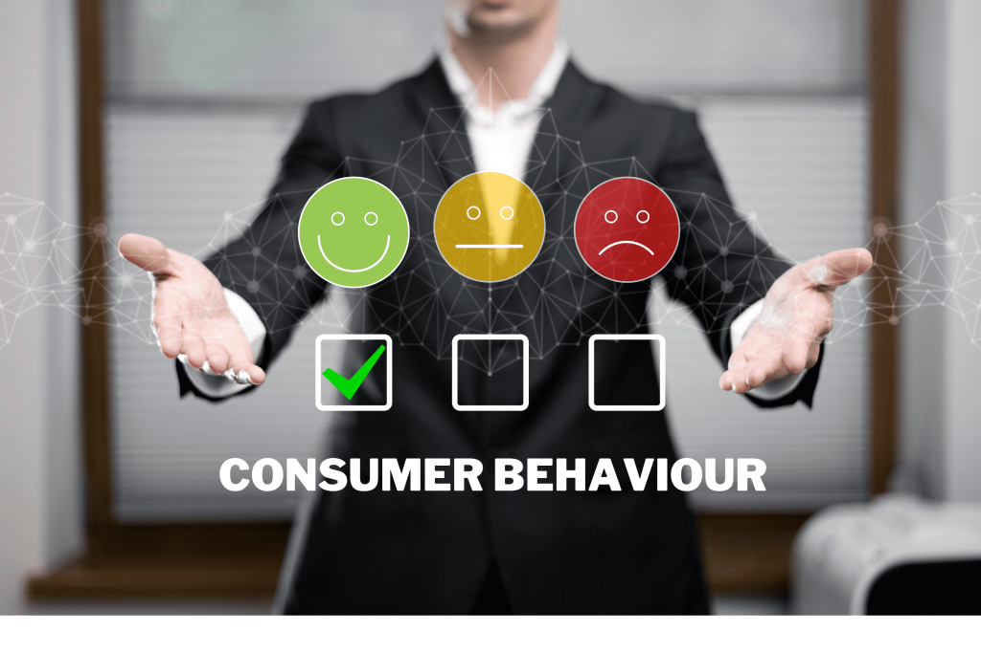

Consumer Behavior
Prepared by Thana Ahmed
MGM204
PRINCIPLE OF MARKETING
Lecture 04

Slide 2
Introduction: The marketing Process
Consumer Behavior & Consumer market
Model of Consumer Behavior
Characteristics affecting consumer behavior
4.1. Culture
4.2. Social Factors
4.3. Personal Factors
4.4. Psychological Factor
The Buying Decision Process
5.1. Need Recognition
5.2. Information Search
5.3. Evaluation of alternatives
5.4. Purchase Decision
5.5. Post-purchase behavior
CONTENT

Slide 3
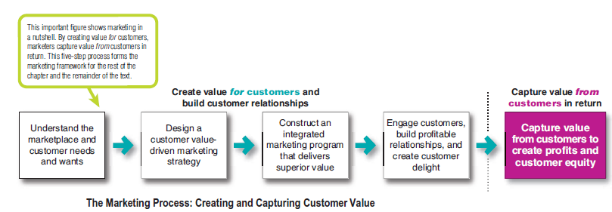
1. Reminder: The marketing Process

Slide 4

2. Consumer Behavior & Consumer Market
Consumer buyer behavior
refers to the buying behavior of final consumers—individuals and households who buy goods and services for personal consumption.
Consumer market
refers to all of the personal consumption of final consumers.

Slide 5
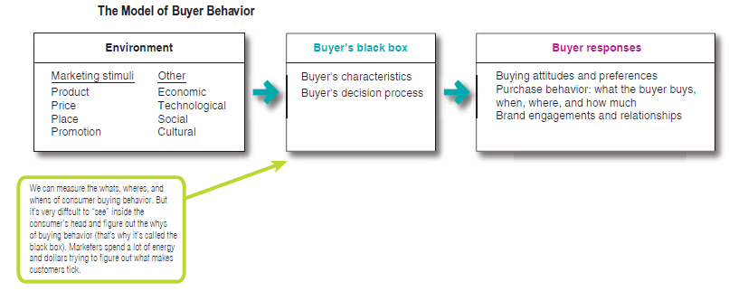
3. Model of Consumer Behavior

Slide 6
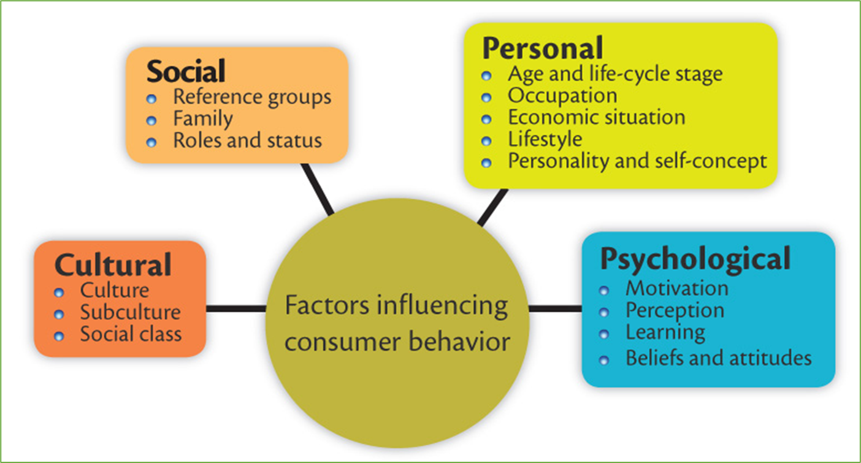
4. Characteristics affecting consumer behavior
Marketers cannot control such factors, but they must take them into account

Slide 7
4. Characteristics affecting consumer behavior
4.1. Culture:
4.1.1. Culture
  The set of basic values, perceptions, wants, and behavior learned by a member of society from family and other important institutions.
  It is the most basic cause of person’s wants and behavior.
  Marketers are always monitoring the market for cultural shifts in order to seize new opportunities by developing new products.

Slide 8
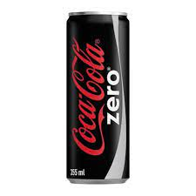
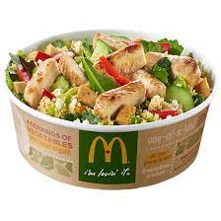


Example: Shift towards healthy lifestyle (healthy eating + fitness)

Slide 9

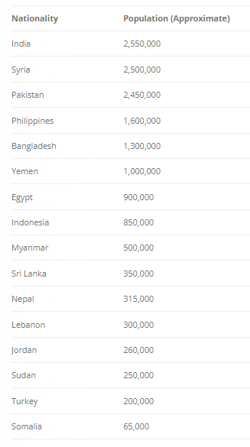
Characteristics affecting consumer behavior
Expatriate population in the KSA according to nation
4.1.2. Subculture:
  Subculture is a group of people with shared value systems based on common life experiences and situations.
  Subcultures include nationalities, religions, racial groups, and geographic regions.
  Many subcultures make up important market segments, and marketers often design products and marketing programs tailored to their needs

Slide 10
Characteristics affecting consumer behavior
4.1.3. Social Class:
  Permanent and ordered divisions in a society whose members share similar values, interest, and behaviors.
  We can divide society as following: upper upper class, lower upper class, upper middle class, middle class, working class, upper lower class, lower lower class.
  Social class is not determined by a single factor such as income but is measured as a combination of occupation, income, education, wealth, and other variables.
  In some social system members of different classes are reared for certain roles and cannot change their social position like in India
  Marketers are interested in social class because people within a given social class tend to exhibit similar buying behavior

Slide 11
4. Characteristics affecting consumer behavior

Slide 12
Characteristics affecting consumer behavior
4.2. Social Factors:
  Consumer’s behavior also is influenced by social factors such as consumer small groups, social networks, family, and social roles and status.
Social Factors
Social Networks
Social Roles & Status
Small Groups
Family

Slide 13

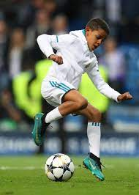
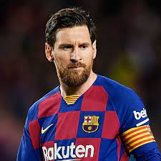
Social Factors
4.2.1. Groups and Social Networks:
  Groups are two or more people who interact to accomplish individual or mutual goals.
  Many small groups influence the person's behavior
  Membership groups= groups that have a direct influence and to which a person belongs.
  Reference groups = serve as direct (face to face interactions) or indirect points of comparison or reference informing a person's attitude or behavior. Example: aspirational group = group to which the individual wishes to belong

Slide 14
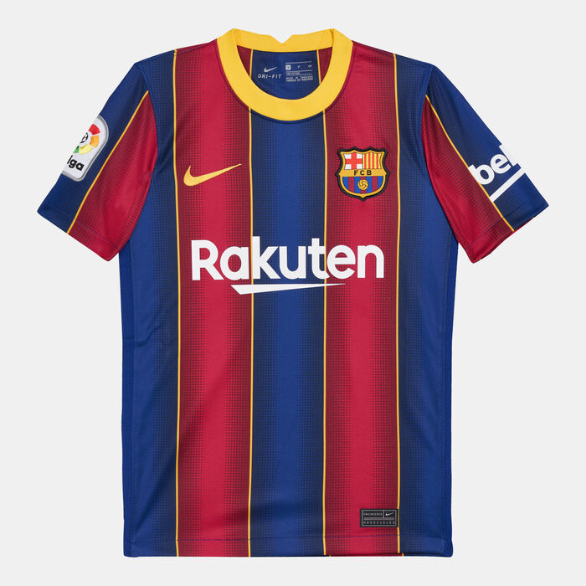
Social Factors
4.2.1. Groups and Social Networks:
  Marketers try to identify the reference groups of their target markets
  Reference groups influence the person's attitude and self-concept and create pressures to conform that may affect the person product and brand choices.
  The importance of group influence occurs across products and brands. It tends to be strongest when the product is visible to others who the buyer respects

Slide 15
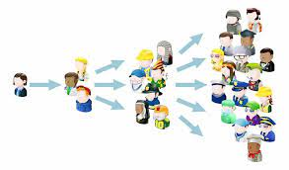
Social Factors
Word-of-Mouth Influence: The impact of the personal words and recommendations of trusted friends, family, associates, and other consumers buying behavior.
  Influence can have a powerful impact on consumer buying behavior. The person words and recommendations of trusted friends, family, associates and other consumers tend to be more credible than those coming from commercial sources such as advertisements or salesperson
  One recent study showed that 92% of consumer trust recommendations from friends and family above any form of advertising.
  Another study found that 80% of consumer’s purchases are made following a friend, a family member or other influencers recommendations.
  Most word-of-mouth influence happens naturally. However, rather than leaving it to chance, marketers can help to create a positive conversation about their brands

Slide 16

Example of WOM
After just 48 hours the video had 10 million views on YouTube
It is one of the most watched automotive add ever on YouTube with more than 18 million views
The day after its release the film was the most shared video in the world

Slide 17

Example of a marketing campaign that creates the buzz

Slide 18
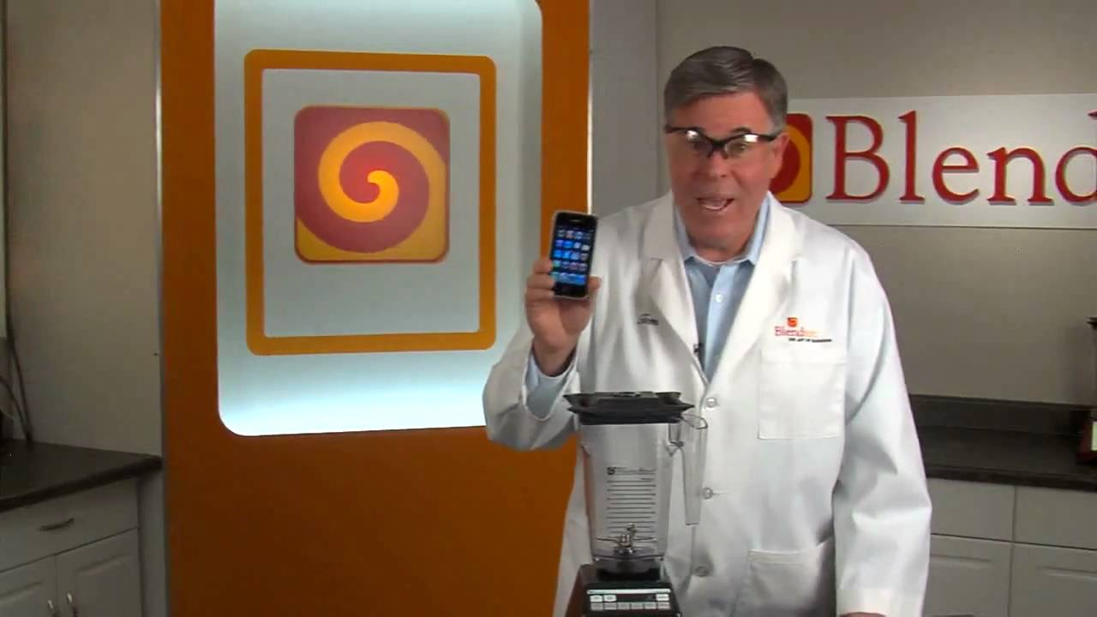
WILL IT BLEND?

Slide 19
Social Factors
Opinion Leaders: A person within a reference group who because of special skills, knowledge, personality, or other characteristics exert social influence on others.
Marketers try to identify opinion leaders for their products and direct marketing efforts toward them.
Online Social Networks: Online communities (blogs, social network websites. and other online communities) where people socialize or exchange information and opinions. Marketers Try to use these new social networks to promote their products and build closer customer relationships. They use it to interact with customers and become a part of their conversations and lives.

Slide 20

Social Factors
4.2.2. Family:
Family members can strongly influence buyer behavior. The family is the most important consumer behavior organization in society, and it has been researched extensively. Marketers are interested in the role and influences of the husband, wife, and children on the purchase of different products and services.
Husband- wife involvement varies widely by product category and stage in the buying process. Buying groups roles change with evolving consumer lifestyle. Marketers in industries that have traditionally sold their products to only women or men only are now carefully targeting the opposite sex. Other companies are showing their products in “Modern Family" context.

Slide 21
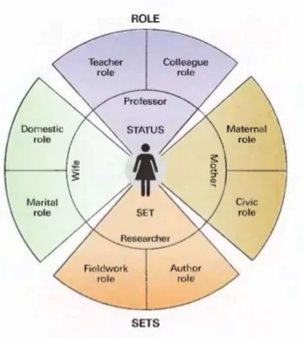
Social Factors
4.2.3. Roles and Status:
A role consists of the activities people are expected to perform according to the people around them. Each role carries a status reflecting the general esteem given to it by society. A person may belong to many groups at the same time.

Slide 22
4. Characteristics affecting consumer behavior

Slide 23
4.3. Personal Factors:
Occupation
Age and Life Stage
Economic Situation
Lifestyle
Personality & Self-concept

Slide 24
4.4. Psychological Factors
Motivation
Psychological
Factors
Beliefs and
Attitudes
Perception
Learning

Slide 25
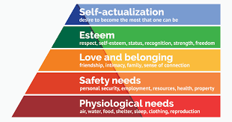
4.4. Psychological Factors
4.4.1. Motivation:
Motive is a need that is sufficiently pressing to direct a person to seek satisfaction.

Slide 26







What type of needs are used in each one of the following ads?

Slide 27
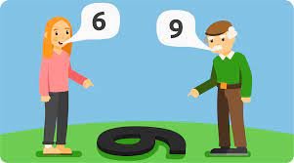
4.4. Psychological Factors
4.4.2. Perception:
The process by which people select, organize, and interpret information to form a meaningful picture of the world.
How the person acts is influenced by his or her own perception of the situation
All of us learn by the flow of information through our five senses sight hearing smell touch and taste. However, each of us receives, organizes, and interprets the sensory information in an individual way.

Slide 28

4.4. Psychological Factors
4.4.3. Learning:
Learning is changing in an individual’s behavior arising from experience.
A consumer’s drive for self-esteem ,for example, can drive him to buy an expensive brand of cars after being exposed to an advertisement. If the Experience is rewarding, he probably will use the car more and more; and his or her response will be reinforced. The next time he or she shops for a car the probability is greater than he or she will buy some the same brand.

Slide 29

4.4. Psychological Factors
4.4.4. Beliefs and Attitudes:
A belief is a descriptive thought that a person holds about something. Beliefs may be based on real knowledge, or opinion, or faith, or may or may not carry an emotional charge.
Marketers are interested in the beliefs that people formulate about specific products and services because these beliefs makeup product and brand images that affect buying behavior.

Slide 30
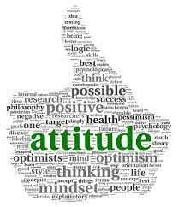
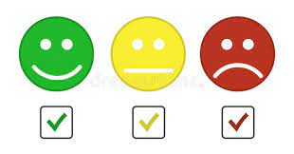
4.4. Psychological Factors
4.4.4. Beliefs and Attitudes:
Attitudes: A person’s relatively consistently favorable or unfavorable evaluations, feelings, and tendencies toward an object or idea.
People may have a positive, a negative or a neutral attitude.
Attitudes are very difficult to change.

Slide 31
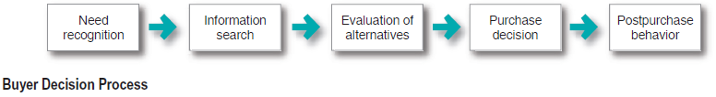
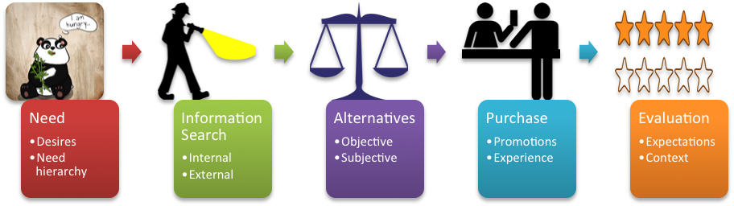
5. THE BUYER DECISION PROCESS

Slide 32
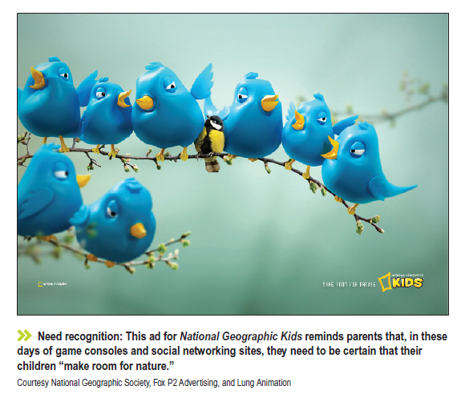
5. THE BUYER DECISION PROCESS
5.1. Need Recognition:
The buyer recognizes a problem or need.
The need can be triggered by internal stimuli or external stimuli
At this stage, the marketer should research consumers to find out what kinds of need or problems arise, what brought them about, and how they lead the consumer to this particular product.

Slide 33

5. THE BUYER DECISION PROCESS
5.2. Information search:
An interested consumer may or may not search For more information
if the consumers desire is strong and satisfying product is near at hand, he or she is likely to buy it
if not, the consumer may store the need in memory or undertake an information search related to the need

Slide 34
5. THE BUYER DECISION PROCESS
5.2. Information search:
Consumer can obtain information from several sources:
  Personal sources (Family, friends, neighbors, acquaintances…)
  Commercial sources (advertising, salesperson, dealer, websites , packaging ..)
  Public sources (mass media, consumer rating, social media, online searchers, peer reviews…)
  Experiential sources (examining and using the product).
Companies must design their marketing mix to make prospects aware and knowledgeable about their brands.
It should carefully identify consumer sources of information and the importance of each source.

Slide 35
5. THE BUYER DECISION PROCESS
5.3. Evaluation of alternatives:
In the previous steps consumers use information to arrive at a set of final brand choices.
Next marketers need to know about alternative evaluation that is how consumers process information to choose among alternative brands.
Consumers do not use a single and simple evaluation process in all buying situation instead several evaluation processes are at work.

Slide 36
5. THE BUYER DECISION PROCESS
5.3 Evaluation of alternatives:
  How consumers go about evaluating purchases alternatives depends on the individual consumer and the specific buying situation (consumer personality, time, purchase power etc…)
  Sometimes consumers buy impulsively and rely on intuition, and sometimes they do a lot of thinking to evaluate alternatives.
  Sometimes consumers make buying decisions on their ownm and sometimes they turn to friends, family, salesperson etc…
  Marketers should study buyers to find out how they actually evaluate brand alternatives.

Slide 37
5. THE BUYER DECISION PROCESS
5.4. Purchase Decision:
  In the evaluation stage the customer ranks brands and forms purchase intentions.
  Generally, the consumers purchase decision would be to buy the most preferred brand, but two factors can come between the purchasing tension and the decision: attitudes of others and expected situational factors.
  Thus, preferences and even purchase intention to not always result in an actual purchase choice.

Slide 38
5. THE BUYER DECISION PROCESS
5.5. Post-purchase Behavior:
  The marketer’s job does not end when the product is bought. After purchasing the product, the consumer will either be satisfied or dissatisfied and will engage in post purchase behavior (review, complaint, tell others (word-of-mouth)…)
  The relationship between consumer’s expectations and the product’s perceived performance determine whether he/she is satisfied or not.
  The larger the negative gap between expectations and performance, the greater the consumer’s dissatisfaction.
  Some major purchases results in cognitive dissonance, which is a buyer discomfort caused by post-purchase conflict.
  Customer satisfaction is a key to building profitable relationships with consumers.
  Many marketers go beyond merely meeting the expectation of customers they aim to delight customers.

Slide 39
THE BUYER DECISION PROCESS (Mc Kinsey)

Slide 40

Applying The Buyer Decision Process
Scenario: A college student, Leila, who has a computer that is starting to run slowly. She is getting ready to start the semester and needs a computer that will efficiently help her with her assignments.
Need recognition
Recognizing unfulfilled needs Attract Customers
Arouse latent desires

Slide 41

Leila may start seeking information to help resolve her immediate problem, which is speeding up her computer. Depending on what she finds, she may also begin searching for options for purchasing a new computer. She may ask a repairing technician, or an online community, a friend or a family member.
Information Search
Get products in front of customers eyes
Explain and convince of products benefits

Slide 42

Evaluation of alternatives
Leila may decide that buying a new computer is the better option and might be making a comparison list of multiple computers. The list may include prices, features, and reviews…
Make information available to customers (buyer’s guide, brochures…)

Slide 43

Now that Leila has decided to buy, she is likely eager to make the purchase and get her computer. She may, therefore, be more likely to buy the computer if she gets free and expedited shipping.
Will she buy it for sure? May be….
Purchase Decision
Make it easy to buy
Give information to corroborate buying decision (In-store (website) advertisements, salespersons pitches…)

Slide 44


When Leila makes it to this phase of her buying decision process, she is using the computer and discovering what she likes and doesn’t like. Reading resources that show her how to better utilize the computer could make her like it more.
Post-Purchase Evaluation
Reduce Cognitive dissonance
Build Customer relationship
Cross-selling if possible

Slide 45


