Slide 1

PMG 622
Agile Project Management
LECTURE 08: ANNEX A3
OVERVIEW OF AGILE AND LEAN FRAMEWORKS [2/2] & TAILORING
Everyone’s Smart
University
دكتور مهندس استشاري ادارة المشروعات
Eng. Dr. Akram Mustafa Suliman Ali,
PhD. AU, BEng. & MSc. AAST, CEng CMarEng MIMarEST, PE, PMP®,
ASQ CSSBB, ISO Lead Auditor, NDT Level II,

Slide 2
Quality by design
Topic raised as a question by one of the colleagues.
In very close relation to our Forum on Value.
Founded in Juran’s work
You can add any input related to Quality by Design or other work of Juran and any of the main Quality Gurus.
Forum Topic: QUALITY BY DESIGN

Slide 3
DYNAMIC SYSTEMS DEVELOPMENT METHOD

Slide 4
DSDM
Dynamic Systems Development Method (DSDM) is an agile project delivery framework initially designed to add more rigor to existing iterative methods popular in the 1990s.
It was developed as a noncommercial collaboration among industry leaders.
DSDM is known best for its emphasis on constraint-driven delivery.
The framework will set cost, quality, and time at the outset, and then use formalized prioritization of scope to meet those constraints.
Notes:
RIGOR : دقة

Slide 5
Constraint-driven agility

Slide 6
Dsdm principles
Focus on the business need.
Deliver on time.
Collaborate.
Never compromise quality.
Build incrementally from firm foundations.
Develop iteratively.
Communicate continuously and clearly.
Demonstrate control (use appropriate techniques).

Slide 7
AGILE UNIFIED PROCESS

Slide 8
agileUP
The Agile Unified Process (AgileUP) is an offshoot of the Unified Process (UP) for software projects.
It features more accelerated cycles and less heavyweight processes than its Unified Process predecessor.
The intent is to perform more iterative cycles across seven key disciplines, and incorporate the associated feedback before formal delivery.
Notes:
Replaced with DAD (Disciplined Agile Delivery)

Slide 9
The Key Elements of the Agile Unified Process

Slide 10
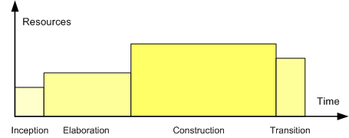
the relative sizes of the four phases of the Unified Process.

Slide 11
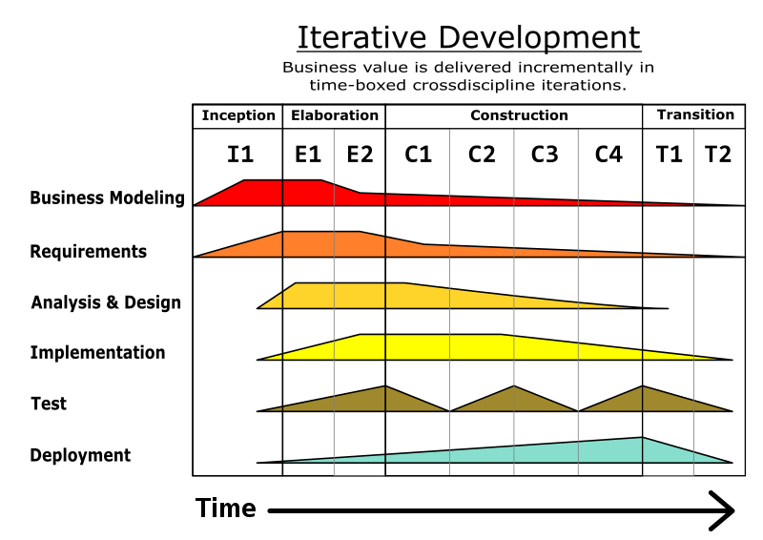

Slide 12
SCALING FRAMEWORKS

Slide 13
SCRUM OF SCRUMS

Slide 14
SoS
Scrum of Scrums (SoS), also known as “meta Scrum,” is a technique used when two or more Scrum teams consisting of three to nine members each need to coordinate their work instead of one large Scrum team.
A representative from each team attends a meeting with the other team representative(s), potentially daily but typically two to three times a week. The daily meeting is conducted similar to the daily standup in Scrum where the representative reports completed work, next set of work, any current impediments, and potential upcoming impediments that might block the other team(s).
The goal is to ensure the teams are coordinating work and removing impediments to optimize the efficiency of all the teams.

Slide 16
SCALED AGILE FRAMEWORK

Slide 17
SAFe®
Focuses on providing a knowledge base of patterns for scaling development work across all levels of the enterprise.
focuses on detailing practices, roles, and activities at the portfolio, program, and team levels with an emphasis on organizing the enterprise around value streams that focus on providing continuous value to the customer.

Slide 18
SAFe® principles
Take an economic view.
Apply systems thinking.
Assume variability; preserve options.
Build incrementally with fast, integrated learning cycles.
Base milestones on objective evaluation of working systems.
Visualize and limit work in progress, reduce batch sizes, and manage queue lengths.
Apply cadence; synchronize with cross-domain planning.
Unlock the intrinsic motivation of knowledge workers.
Decentralize decision making.

Slide 19
LARGE SCALE SCRUM (LeSS)

Slide 20
LeSS
Large Scale Scrum (LeSS) is a framework for organizing several development teams toward a common goal extending the Scrum method.
The core organizing principle is to retain as much as possible of the elements of the conventional single-team Scrum model.
This helps minimize any extensions to the model that might create unnecessary confusion or complexity.
In order to extend Scrum without losing its essence, LeSS promotes the use of certain discerning principles, such as systems thinking, whole product focus, transparency, and others.

Slide 21
Comparison of LeSS and Scrum

Slide 22
ENTERPRISE SCRUM

Slide 23
ENTERPRISE SCRUM
Enterprise Scrum is a framework designed to apply the Scrum method on a more holistic organizational level rather than a single product development effort.
Specifically, the framework advises organization leaders to:
  Extend the use of Scrum across all aspects of the organization;
  Generalize the Scrum techniques to apply easily at those various aspects; and
  Scale the Scrum method with supplemental techniques as necessary.
The intent is to use agile approaches beyond project execution by enabling disruptive innovation.

Slide 24
DISCIPLINED AGILE (DA)

Slide 25
DA
Disciplined Agile (DA) is a process decision framework that integrates several agile best practices into a comprehensive model.
DA was designed to offer a balance between those popular methods deemed to be either too narrow in focus (e.g., Scrum) or too prescriptive in detail (e.g., AgileUP).

Slide 26
DA principles
People-first. Enumerating roles and organization elements at various levels.
Learning-oriented. Encouraging collaborative improvement.
Full delivery life cycle. Promoting several fit-for-purpose life cycles.
Goal-driven. Tailoring processes to achieve specific outcomes.
Enterprise awareness. Offering guidance on cross-departmental governance.
Scalable. Covering multiple dimensions of program complexity.

Slide 27
APPENDIX X2
ATTRIBUTES THAT INFLUENCE TAILORING

Slide 28
FIRST SOME CAUTIONS!!!!!!!!!!!!
Tailoring is an advanced topic that should be undertaken by experienced practitioners who have been successful using agile approaches as originally described in multiple environments before they consider tailoring them.
In other words, gain experience and be successful with one approach before attempting to tailor the approach.

Slide 29
Shu-Ha-Ri
Model of skills acquisition describes progression from obeying the rules (Shu 守, means to obey and protect), through consciously moving away from the rules (Ha 破, means to change or digress), and finally through steady practice and improvement finding an individual path (Ri 離, means to separate or leave).
We need to start and practice at the Shu level before we are ready to move to the Ha level to tailor the process or the Ri level to invent a new custom process.

Slide 30
TAILORING RECOMMENDATIONS

Slide 31
BEWARE OF TAKING THINGS AWAY
Many of the agile practices act as self-supporting pairs.
For instance, colocation and frequent business conversations allow for lightweight requirements since gaps in understanding can be filled quickly.
Likewise, XP's ruthless testing allows for courageous refactoring as one practice supports the other.
Removing something without understanding or addressing its counterbalanced practice will likely create more problems than it solves.

Slide 32
USE THE TAILORING GUIDELINES TABLE

Slide 33
Very large project teams [1/2]
Restructure large projects as multiple smaller projects.
Try a technology trial project first and then an implementation project.
Consider more frequent releases of fewer features each, which allows for the creation of smaller project teams.
Consider reducing the team down to its critical core members.
Often too many people hinder a process, not help it.

Slide 34
Very large project teams [2/2]
Reducing a team size can reduce churn as well as costs.
Break large teams into multiple smaller teams and use program management to synchronize and coordinate.
Use agile and lean program management to organize the larger effort.
Consider a scaled agile or lean framework such as DA, SAFe®, or LeSS.
Each offers some useful ideas, and each carries implementation risks and process weight/cost.

Slide 35
Dispersed teams [1/2]
Many projects have (some) dispersed team members.
Tools like instant messaging, video conferencing, and electronic team boards help bridge many of the communication gaps.
When teams are likely to remain stable, set up face-to-face meetings as soon as possible to make future remote conversations more effective.
People who have met face-to-face are more likely to enter unfiltered debate because of higher trust.

Slide 36
Dispersed teams [2/2]
When conducting meetings with remote participants where there is a loss of facial and body-language cues, consider round-robin check-ins to ensure participation and check consensus for decisions.
Also, consider the use of iteration-based agile approaches.
When team members are many time zones apart, consider using whole-project interactions less frequently, while encouraging more personal meetings (two or three people at a time) more frequently.

Slide 37
Some safety critical products may require additional documentation and conformance checks beyond what agile processes suggest out-of- the-box [1/2]
Agile approaches can still be used in these environments, but they need to have the appropriate additional layers of conformance review, documentation, and certification that is required by the domain.
In that case, documentation could be part of what the team delivers along with finished features.
Features may not be done until the documentation is completed.

Slide 38
Some safety critical products may require additional documentation and conformance checks beyond what agile processes suggest out-of- the-box [2/2]
Consider using a hybrid approach (multiple agile approaches) to get the benefits of improved collaboration and communication brought by agile with the added rigor required by the product environment.
Aircraft flight system developers and drug companies use agile approaches coupled with their own additional processes to leverage the benefits and retain appropriate controls.

Slide 39
Stable requirements and execution process
Is agile really needed? If uncertainty in requirements is low, low rates of change, or minimal execution risk, the full suite of agile approaches may not be needed.
While any project benefits from increased collaboration and transparency; some of the iterative build and review cycles might be overkill.
If build/feedback cycles do not routinely uncover or refine requirements, consider extending their durations to minimize the cost impact of review time.
If the project has high rates of change during design and development, but rolling it out to customers is a defined and repeatable process, hybrid approaches that use the appropriate life cycle model for each project phase may make more sense.

Slide 40
Teams are in functional silos inside functional organizations
Agile is built on the idea of cross-functional teams.
Consider asking people to create cross-functional teams themselves, without management involvement and see what happens.
If the compensation system is organized to recognize and reward functional areas, consider changing that first.
People might not act in the interest of the product or the team until it affects their compensation in some way.

Slide 41
Transparency can cause fear
Agile creates a culture of transparency: people show and share their work throughout development.
This sharing of interim deliverables and being open and honest about successes, failures, and current state is transparency.
Transparency requires courage.
Lead by example and demonstrate transparency in decision making processes by using a status board or whiteboard.

Slide 42
Many of the team members have little technical domain knowledge [1/2]
Agile approaches encourage and make use of self-directing teams to make local decisions about work items, such as task sequencing and which approach to use when solving a problem.
When the majority of team members are inexperienced, consensus-based approaches may lead to problems and rework.
So, for these teams, additional help “assigning” and “directing” may be necessary until the team gains the necessary skills.

Slide 43
Many of the team members have little technical domain knowledge [2/2]
In other words, do not just declare that agile will be used and let an inexperienced team try to figure everything out because they are empowered and self-directing.
Consider building centers of competencies to help provide guidance and build domain knowledge.

Slide 44
Lack of executive buy-in
When executive buy-in is missing, teams will encounter a clash between the agile mindset and approaches and the more predictive mindset and approaches.
Find common ground, areas for improvement based on the organization's needs, and then use experiments and retrospectives to progress.
Consider education/training for executives.
Consider explaining agile in terms of lean thinking: short cycles, small batch sizes, frequent reviews, and retrospectives with small improvements.

Slide 45
Agile terms and language do not fit the organizational culture
Modify the terms so people will understand and agree to the activities, if not the agile language.
Be specific about what each term means.
For example, If the organization finds the word “game” unprofessional, don't use terms such as “planning game.”
Instead, consider using the term “planning workshop.”
Notes:
Dog Sizes

