Slide 1


System Administration (2)
IT401
Prepared by
Dr. Ahmed El-Douh
Lecture 5

Slide 2



System Administration 2
Lecture 5
IT401
File Permission Control and Process Management
Prepared by
Dr. Ahmed El-Douh

Slide 3
Objectives
Upon completion of this lecture, you will be able to:
  List file system permissions on files and directories, and interpret the effect of those permissions on access by users and groups.
  Change the permissions and ownership of files with command-line tools.
  Control the default permissions of user-created files, explain the effect of special permissions, and use special and default permissions to set the group owner of files that are created in a directory.

Slide 4
Chapter
Outlines
05
Control Access to Files with Linux system permissions
Monitoring and Managing Linux Processes

Slide 5


Control Access to Files with Linux system permissions

Slide 6
Linux file system permissions
• Access to files is controlled by file permissions.
• The system is designed to be simple, flexible, and easy to apply.
• Permissions are applied across three distinct categories of users:
  1. The owning User (The creator/owner).
  2. The owning Group (A single primary group).
  3. Other Users (Everyone else on the system).
Permissions Hierarchy Rule: Specific permissions override general ones. The User permission overrides the Group permission, which overrides the Other permission.

Slide 7
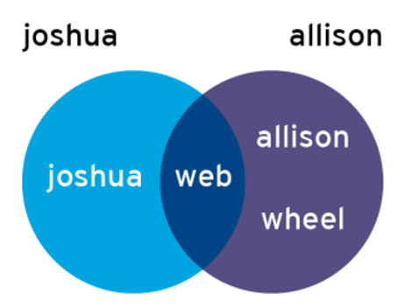
GROUP PERMISSIONS: Enabling Collaboration
Scenario: Users joshua and allison need to collaborate on files.
Shared Group: The common group between them is web (The intersection point).
Implementation: Files are associated with the group web.
Goal: By setting appropriate Group Permissions, both users gain the necessary access to the files.

Slide 8
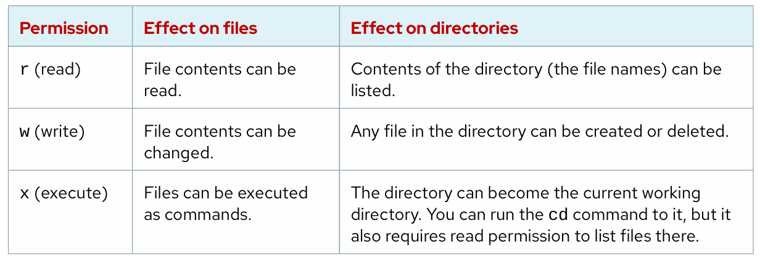
Effects of Permissions on Files and Directories

Slide 9
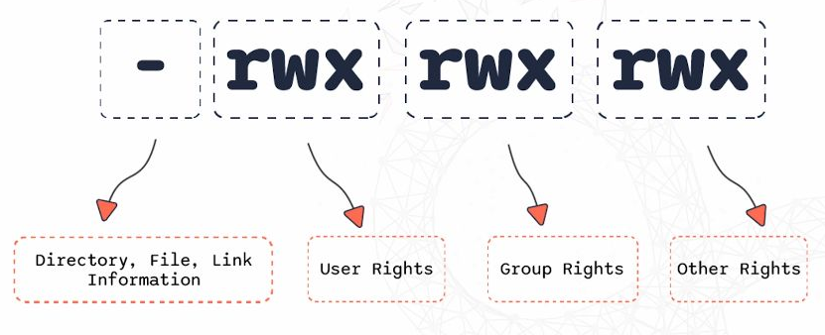

View File and Directory Permissions and Ownership
Default File Permission Assignment
File Owner and Group:
Owner (User): The user who created the file
rw-: Owner (student) permissions - read and write, no execute
Group: The user's primary group (from /etc/passwd)
rw-: Group (student) permissions - read and write, no execute
Others: Everyone else on the system
r--: Others permissions - read only

Slide 10
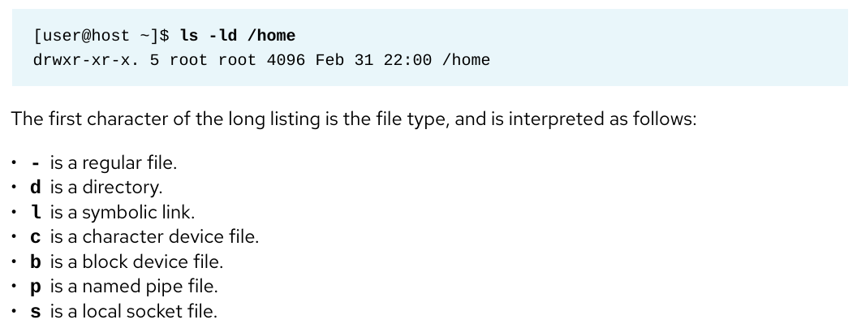
View File and Directory Permissions and Ownership
To prevent the descent into the directory and see the expanded listing of the directory itself, add the -d option to ls:

Slide 11
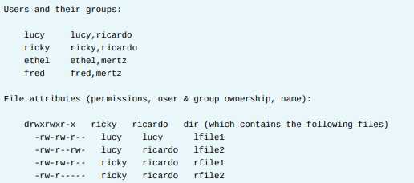
View File and Directory Permissions and Ownership
EXAMPLES: LINUX USER, GROUP, OTHER CONCEPTS

Slide 12
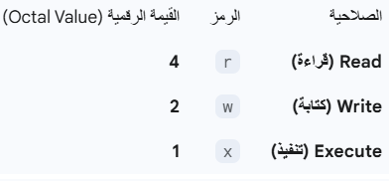
File Permission Control
The main purpose of the Purpose : Secure files/directories by modifying access rights for users, groups, and others
Permission Basics:
Three Entities:
  u → Owner
  g → Group
  o → Others
  a → all (user + group + others)
Three Permissions:
  r = Read (4)
  w = Write (2) [rwx]
  x = Execute (1)

Slide 13
Change File and Directory Permissions
What is chmod?
chmod stands for Change Mode — it’s the command used in Linux to set file and directory permissions.
Symbolic Mode
  + Adds the given permission(s) without changing existing ones.
  - Removes the given permission(s) but leaves others unchanged.
  = Replaces all permissions for the category with exactly what you specify.
chmod u+x file.txt # Add execute for user
chmod g-w file.txt # Remove write for group
chmod o=r file.txt # Set read only for others
chmod a+rw file.txt # Add read/write for everyone

Slide 14
Change File and Directory Permissions
chmod
Numeric Mode
Uses numbers:
r = 4, w = 2, x = 1 , - = 0 Sum them to get permission values.
chmod 754 lab.txt
7 → user: 4+2+1 = rwx
5 → group: 4+0+1 = r-x
4 → others: 4+0+0 = r--

Slide 15
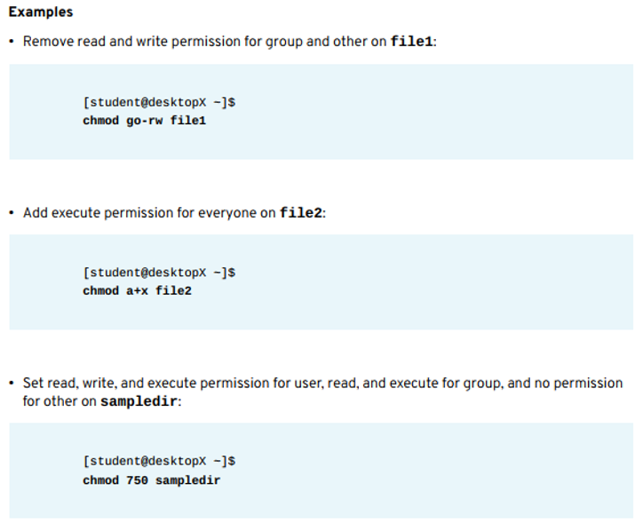
File Permission Control
chmod

Slide 16



FILE/DIRECTORY OWNERSHIP MANAGEMENT (chown)
Change the file's User or Group owner to manage access for collaboration.
Files are initially owned by the creator user and their primary group.
Key Command: Use chown (change owner).
Practical Examples:
  Change User Owner: chown student foofile
  Change Recursively: chown -R student foodir (Applies to all sub-contents).
  Change Group Only: chown :admins foodir (Use a colon : before the group name).

Slide 17

FILE/DIRECTORY OWNERSHIP MANAGEMENT (chown)
Change User & Group Together:
  Use the syntax owner:group.
  Example: chown visitor:guests foodir
Privileges for Ownership Change:
  File Owner: Only the root user can change the file's primary owner.
  Group Owner: Can be changed by root OR the file's current owner.
Group Granting Rules:
  Root can set group ownership to any group on the system.
  Non-root users can only set group ownership to groups they are currently a member of.

Slide 18
Manage Default Permissions and File: Access Special Permissions
setuid / setgid on Executable Files:
  Command runs with the permissions of the file's owner/group, not the user executing it (e.g., the passwd command).
  Indicated by s (or S) in the user/group execute position.
sticky bit on Directories:
  Restricts file deletion: Only the file's owner (or root) can delete files inside the directory (e.g., /tmp).
  Indicated by t (or T) in the other execute position.
setgid on Directories:
  New files created inside the directory inherit the directory's group ownership, which is crucial for group collaboration.
  Indicated by s (or S) in the group execute position.

Slide 19
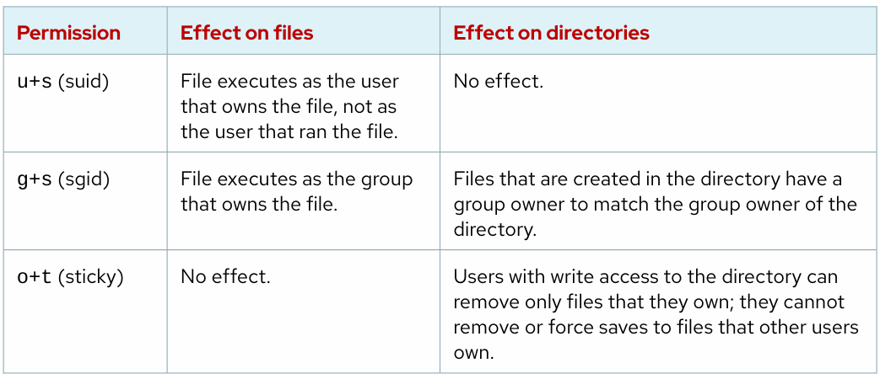
Effects of Special Permissions on Files and Directories

Slide 20
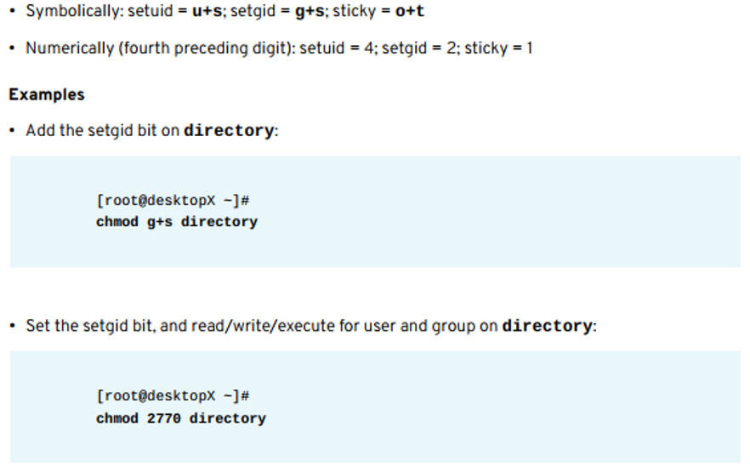
Effects of Special Permissions on Files and Directories

Slide 21
Control Access to Files
File ownership permissions have three categories. A file is owned by a user, a single group, and
other users.
The most specific permission applies. User permissions override group permissions
and group permissions override other permissions.
• The ls command -l option expands the file listing to include both the file permissions and
ownership.
• The chmod command changes file permissions from the command line.
• The chmod command can use one of two methods to represent permissions: symbolic or octal.
• The chown command changes file ownership. The chown command -R option recursively
changes the ownership of a directory tree.
• The umask command without arguments displays the current umask value of the shell. Every
process on the system has a umask. The default umask values for Bash are defined in the
/etc/profile and /etc/bashrc files.
• The suid, sgid, and sticky special permissions provide additional access-related features to
files.

Slide 22
Monitoring and Managing Linux Processes

Slide 23
WHAT IS A PROCESS?
Definition: A process is a running instance of an executable program.
Key Components (A Process Includes):
  An address space (allocated memory).
  Security properties (ownership and privileges).
  Execution threads of program code.
  The process state (Running, Sleeping, Stopped, etc.).
Process Environment: Includes variables, a scheduling context, and allocated system resources (like file descriptors and network ports).
Process Creation (The Hierarchy):
  A parent process uses fork to create a child process structure.
  Each process is assigned a unique PID and has a PPID (Parent's PID).
  All processes descend from systemd (PID:1) (the first system process).

Slide 24
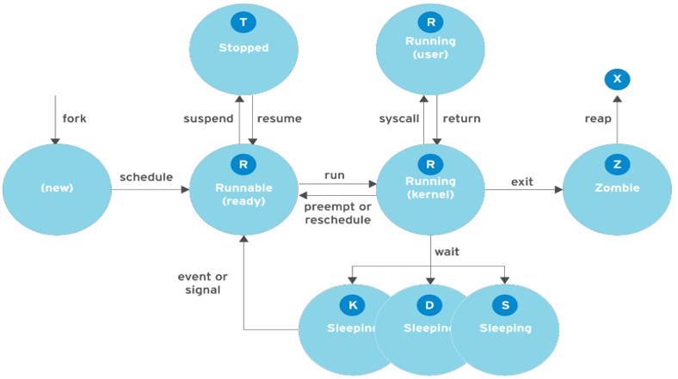
PROCESS STATES
In a multitasking OS, a process is assigned a state that reflects its immediate resource needs (CPU time, I/O, etc.).
Key States and Transitions:
(new): Initial state after fork.
Runnable (ready): Process is ready to run and waiting for the CPU scheduler.
Running (user/kernel): The process is currently executing instructions on the CPU.
Sleeping (S, D, K): The process is temporarily inactive, waiting for a resource or an event.
Stopped (T): The process is temporarily suspended (suspend) but can be resumed.
Zombie (Z): The process has finished execution (exit) but its entry remains in the process table until the parent process cleans it up (reap).

Slide 25
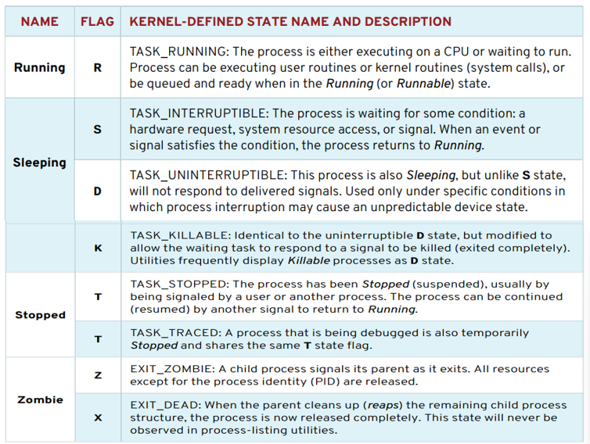
Linux Process States

Slide 26
LISTING PROCESSES
LISTING PROCESSES: The ps Command
The ps command is the primary tool for listing current processes on the system.
ps provides detailed information, including:
  UID (User Identification) to determine privileges.
  PID (Process Identification) for unique tracking.
  CPU and real time already expended.
  Memory allocation.
  The controlling terminal (location of STDOUT).
  The current process state.

Slide 27
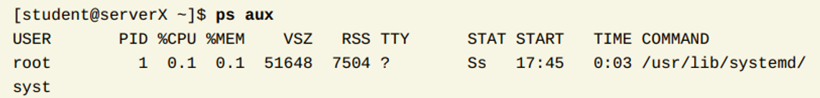
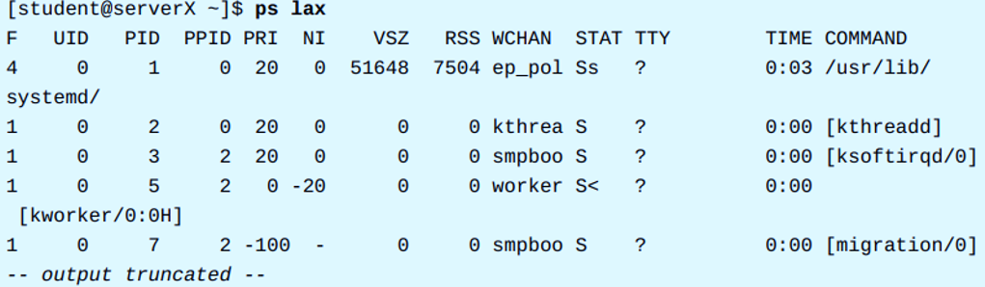
LISTING PROCESSES
LISTING PROCESSES: ps Options
ps aux (Common Display):
  Displays all processes on the system.
  Includes processes without a controlling terminal.
ps lax (Long, Detailed Display):
  Provides more technical detail.
  May display faster because it avoids looking up the username.
UNIX Equivalent: The options -ef provide similar functionality for displaying all processes.

Slide 28
Controlling Jobs

Slide 29
Control Access to Files: JOBS AND SESSIONS
Job Control: A feature of the shell that enables a single shell instance to manage and run multiple commands.
A job is created for every command or pipeline entered at the shell prompt.
Process Group: All processes associated with a single job/pipeline are members of the same process group.

Slide 30

Control Access to Files: RUNNING JOBS IN THE BACKGROUND
• Start any command or pipeline in the background by adding an ampersand (&) at the end of the command line.
• Shell Output: The bash shell immediately provides two identifiers:
  The job number (unique to the current session).
  The PID (Process ID) of the new child process.
• Result: The shell prompt immediately returns, allowing the user to execute new commands while the job runs non-interactively in the background.

Slide 31
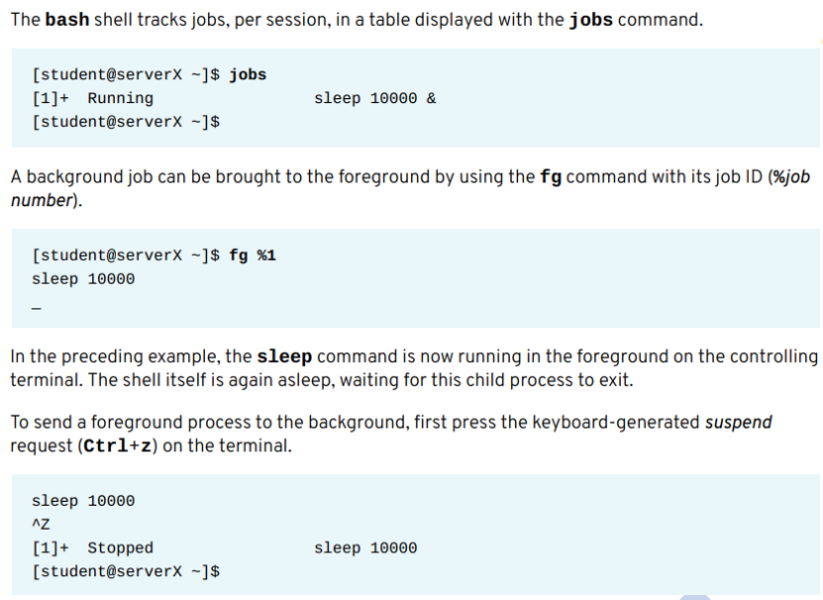

Control Access to Files: RUNNING JOBS IN THE BACKGROUND

Slide 32
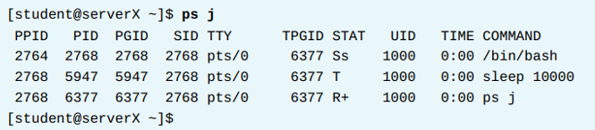
Control Access to Files: RUNNING JOBS IN THE BACKGROUND
The ps j command is used to display detailed information about running jobs and processes.
Key Identifiers:
  PGID: The Process Group ID, which is the PID of the process group leader (the first process in the job's pipeline).
  SID: The Session ID, which is the PID of the session leader (the controlling interactive shell).
Process State (STAT): The STAT field indicates the process state. For the suspended example, the state is T (for Suspended/Stopped).

Slide 33
KILLING PROCESSES
Signal Definition: A signal is a software interrupt delivered to an executing process.
Signal Purpose: Signals report events or notifications to the program.
Sources of Signals:
  An error within the program.
  An external event (e.g., I/O request, timer expiration).
  An explicit request (e.g., a signal-sending command or keyboard sequence).
System administrators use fundamental signals (like HUP / SIGHUP) for routine process management.

Slide 34
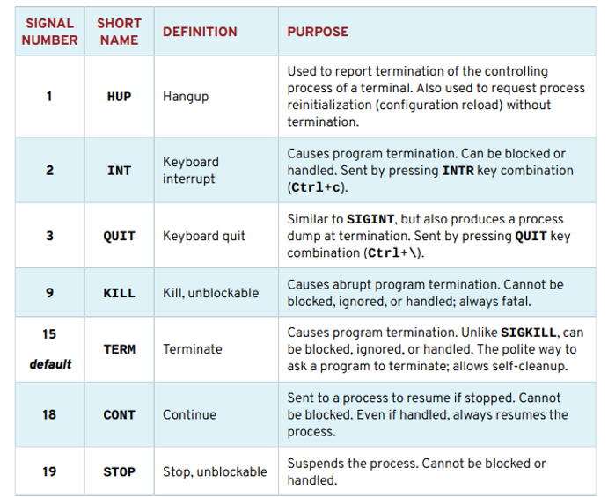

Slide 35
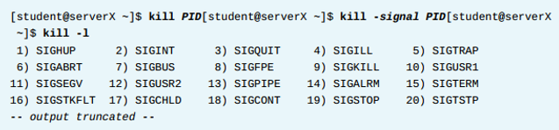
SENDING SIGNALS
Foreground Control (Keyboard): Use key combinations for immediate action on the foreground process:
  Ctrl+z to suspend.
  Ctrl+c to kill (terminate).
  Ctrl+\ to core dump.
Background Control (Command): Signalling background processes requires a signal-sending command.
The kill Command: Sends a specified signal (by name or number) to a process using its PID. It is used for all signals, not just killing.
Permissions: You can kill your own processes, but root privilege is required to kill processes owned by other users.

Slide 36
Controlling Processes
Controlling Processes
kill -9 1234 # Force kill by PID
pkill -f "pattern" # Kill by process name/pattern
kill -STOP 1234 # Pause process
kill -CONT 1234 # Resume process

Slide 37
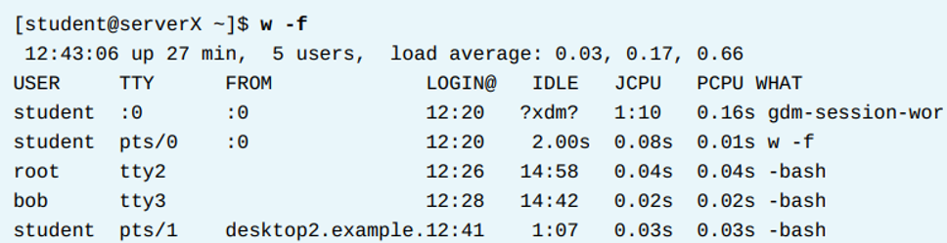
LOGGING USERS OUT ADMINISTRATIVELY
Command: The w command shows users currently logged into the system and their cumulative activities.
Location Identification: Use the TTY and FROM columns to determine the user's location.
Terminal Types (TTY):
  pts/N (pseudo-terminal) for graphical environment windows.
  ttyn for system console or direct device.
Remote Users: Remote connections show the connecting system name in the FROM column when the -f option is used.

Slide 38
Monitor Process Activity
LOAD AVERAGE
The load average metric is calculated by the Linux kernel as an exponential moving average of the load number.
Load Number: This is a cumulative CPU count of active system resource requests (running threads and threads waiting for I/O).
  The load number calculation runs every five seconds by default, accumulating and averaging active requests for all CPUs.
Exponential Moving Average (EMA): A mathematical formula used to smooth out data highs and lows, increase the significance of current activity, and decrease the quality of aging data.
Displayed Values: The load average collectively refers to the three displayed values, which represent the system activity data averaged for the last 1, 5, and 15 minutes.

Slide 39
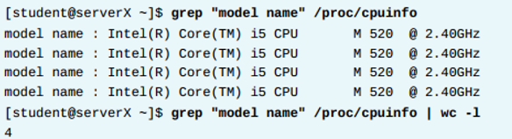
Understanding the Linux load average calculation
Load Representation: The load average represents the perceived system load, based on expected service wait times for CPU, disk, and network I/O.
Active Tasks: Linux counts not only processes but also threads individually as separate tasks.
  Threads counted include those running (R) and those waiting for I/O resources (D), which corresponds to the Uninterruptable Sleeping state.
Load Number Calculation: The load number is a global calculation summed for all CPUs, ensuring an accurate cumulative count even if tasks reschedule to different CPUs after sleep.
CPU Counting: Linux counts each physical CPU core and hyperthread as a separate individual CPU with independent request queues.
  The number of logical CPUs can be viewed via /proc/cpuinfo.

Slide 40
Interpret Load Average Values
Values Meaning: The three displayed values represent the weighted values over the last 1, 5, and 15 minutes.
Monitoring Tools: Commands like top, uptime, w, and the gnome-system-monitor display the load average values.
Per-CPU Calculation: To determine if the system is experiencing significant waiting, the displayed load average should be divided by the number of logical CPUs in the system.
Interpretation Threshold:
  A value below 1 indicates satisfactory resource utilization and minimal wait times.
  A value above 1 indicates resource saturation and some amount of service waiting times.

Slide 41
REAL-TIME PROCESS MONITORING
The top program provides a dynamic view of the system's processes.
Output: It displays a summary header followed by a process or thread list, similar to the information provided by ps.
Dynamic Nature: Unlike the static output of ps, top continuously refreshes at a configurable interval.
Features: top allows for column reordering, sorting, and highlighting, and user configurations can be saved.
Default Columns: Recognizable columns include the Process ID (PID) and the User name (USER), which is the process owner.

Slide 42
Linux Processes: Process Control
A process is a running instance of an executable program. Processes are assigned a state, which
can be running, sleeping, stopped, or zombie. The ps command lists processes.
Each terminal has its own session and can have a foreground process and independent
background processes. The jobs command displays processes within a terminal session.
A signal is a software interrupt that reports events to an executing program. The kill, pkill,
and killall commands use signals to control processes.
Load average is an estimate of how busy the system is. To display load average values, you can
use the top, uptime, or w command.

Slide 43



Thank You

