Slide 1
Real-Time Arabic Sign Language Recognition Using a Hybrid Deep Learning Model

Slide 2
Authors: Talal H. Noor , Ayman Noor , Ahmed F. Alharbi, Ahmed Faisal, Rakan Alrashidi, Ahmed S. Alsaedi, Ghada Alharbi, Tawfeeq Alsanoosy and Abdullah Alsaeed
Taibah University
Published on Sensors

Slide 3
Overview:
Goal: develop a reliable, real-time system to help bridg the gap between deaf and hearing people.
Use of deep learning— Hybrid model: CNN and LSTM architectures

Slide 4
Dataset & Preprocessing
captured using built-in webcams with a resolution of 480p
10 words - 400 images each.
10 words - 50 videos.
Data taken from
  Handspeak website: https://www.handspeak.com/com/
  Saudi Sign Language: https://sshi.sa/
Training 80% Testing 20%

Slide 5
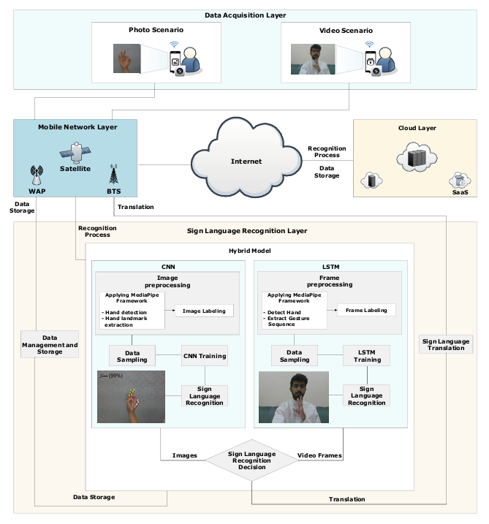

Slide 6
Google MediaPipe framework to identify the hand’s 21 3D landmarks
CNN Model
  LeNet-5
  2 x convolutional layers, 2 x max-pooling layers, 3 x fully connected layers
LSTM
  stack structure - involves arranging multiple LSTM layers in sequence, the output of each serves as the input for the next.
  3 x LSTM Layers, 3 x fully connected layers
Methodologies

Slide 7
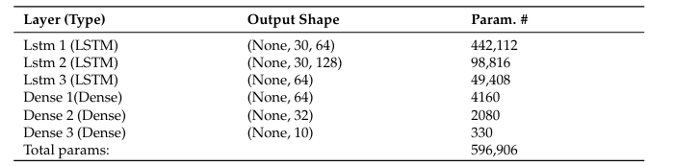
CNN
  Learning rate of 0.001 to ensure stable convergence
  50 epochs to allow for thorough training and convergence.
  Adam optimizer & cross-entropy loss function
  Dropout rate of 0.5 To prevent overfitting.
LSTM
Training

Slide 8
CNN
  Accuracy of 94.40%
  recall and F1 scores of 94.40% and 94.90%, respectively
LSTM
  Accuracy of 82.70%
  recall and F1 scores of 82.50% and 82.70%, respectively
Model Evaluation & Results

Slide 9
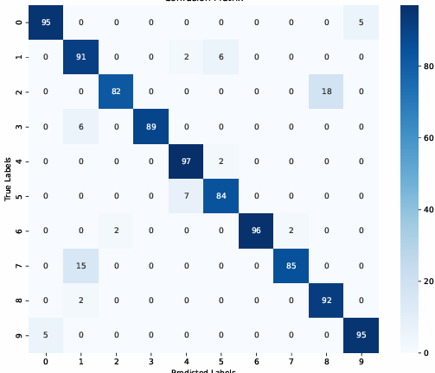
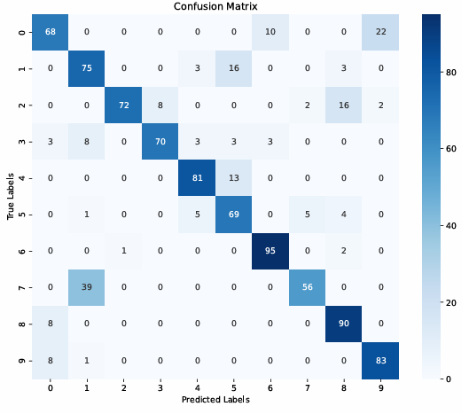
CNN
LSTM

Slide 10
Limitations
Dataset. 10 static & 10 dynamic
Controlled Data

