Slide 1



Social Media and Crises
Prepared by: Dr. Doaa Rady
DGM 730
Lecture 1
Social Media and Ethics

Slide 2
Lec. 1
Introduction
Lecture outline
Social Media and Ethics
    Social Media Policy and adherence
    Understanding copyright and creative commons
    Disclosure and Transparency
    Social Media risks and rewards
    Conclusion
    Recommended References

Slide 3
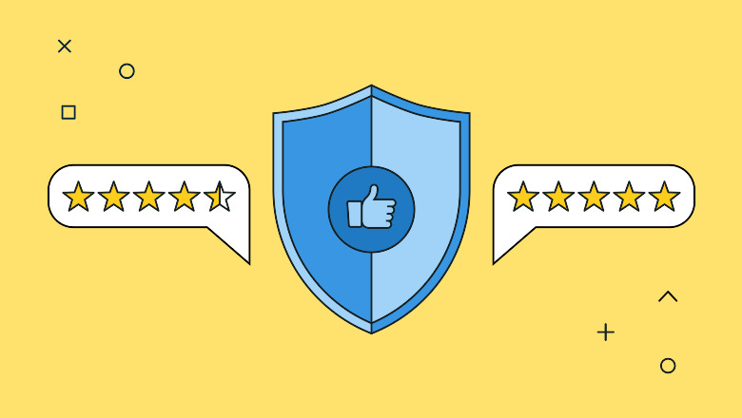
Lec. 1
Social Media Policy
and adherence

Slide 4
Lec. 1
What is a company social media policy?
Social media has become a large part of our everyday lives. Consumers expect brands to have an active online presence and the ability to answer any questions they have fast.
But a poorly timed or worded social post could harm your brand reputation.
Although people may forgive your brand, the internet never forgets, so it’s better to be safe than sorry! Implementing a social media policy will help protect your company and give employees the space to advocate for themselves while staying true to the brand and its values.

Slide 5
Lec. 1
What is a company social media policy?
A social media policy is part of a company’s business code of conduct that tells employees how they should represent themselves and the brand on social media. It includes guidelines to protect the brand’s security, privacy and legal interests.
Social media platforms provide avenues for brand promotion, but they also present opportunities to misrepresent your brand, which is why a good social media policy is so necessary.
To do so, this means keep it simple, clear, accessible, and continued to be updated. The goal is to emphasize some basic conduct so, there are no major issues in the future.

Slide 6
Lec. 1
Why do you need a social media policy for employees
Create brand advocates
Social media policies allow you to unlock all the benefits of employee advocacy, without putting your brand credibility at risk.
When your employees post about the organization online, it can increase brand awareness, establish thought leadership and drive qualified leads. Along with helping social selling, employee posts can support social recruiting efforts, attracting top talent to your company.
Your social media policy is a critical advocacy tool, giving your employees the guidance they need to represent your brand accurately within social networks.

Slide 7
Lec. 1
Why do you need a social media policy for employees
Promote DEI (Diversity, Equity, & Inclusion)
Brand diversity in social media is more important than ever. Company alignment with personal values is 74% more important to consumers than it was in 2021, so brands need to show and tell audiences what the company values.
Amplifying diverse voices via social media is an actionable step brands can take to prioritize representation and attract top talent from marginalized communities. An inclusive social media policy will empower and encourage voices from all backgrounds to advocate for the brand.

Slide 8
Lec. 1
Why do you need a social media policy for employees
Maintain a consistent brand identity
A social media policy ensures that whenever someone interacts with your company online, either through a brand channel or an employee, they get the same consistent experience. This develops a more reliable, trustworthy identity for your company, turning customers into loyal fans and ambassadors.

Slide 9
Lec. 1
Why do you need a social media policy for employees
Minimize legal action against your brand
Social media presents complicated considerations such as privacy law and copyright law. A well made social media policy will protect the company from potential lawsuits.
Consult with your legal counsel and outline a list of do’s and don’ts for the company to follow. These rules of thumb will help ensure the organization and contractors are compliant with laws, reducing the risk of legal action against the company.

Slide 10
Lec. 1
Why do you need a social media policy for employees
Protect your brand from privacy and security risks
There are many privacy and security risks involved with using social media.
The larger your team is, the larger those risks become. A good social media policy combined with security protocols will protect your accounts against hacking, phishing and fraud accounts.
And since social media is a common resource for scammers and criminals, it’s imperative your social media policy includes guidelines that protect both your employees and company. Whether it’s defending against phishing scams or ransomware attacks, make sure that everyone in your organization is vigilant about online protection.

Slide 11
Lec. 1
Why do you need a social media policy for employees
Prevent a public relations crisis
Many organizations make the mistake of waiting until they’ve faced a public relations disaster to put a policy in place. Be proactive and implement a strategy in advance to minimize crisis.
Your social media crisis plan should align with your social media policy. For example, the policy can designate which teams are responsible for handling a PR crisis.

Slide 12
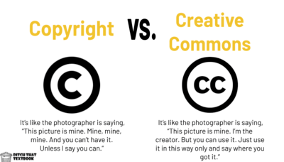
Lec. 1
Understanding copyright and creative commons

Slide 13


Lec. 1
Understanding copyright and creative commons
Copyright law gives creators certain kinds of control over their creative work. If people want to use copyrighted work, they often have to ask for permission from the creator.
Creative Commons works within copyright law. It allows creators to grant permission to everyone in the world to use their work in certain ways.
Copyright Symbol
Creative Commons Symbol

Slide 14
Lec. 1
Understanding copyright and creative commons
Creative commons and copyright both refer to legal explanations and sanctions regarding authorship. Both authorizations refer to creators’ conditions regarding their original outputs such as books, websites, software, movies, and songs. However, creative commons is only applicable to those protected by copyright while copyright covers original work.
What is Creative Commons?
Creative Commons (CC) aims to increase the number of legally available creative works. CC licenses give creators the freedom to decide which rights are being reserved and waived. It is currently being incorporated in popular online platforms such as YouTube and Flickr. CC licenses are based upon copyright specifics and only utilize one page of highly comprehensible explanation of rights.

Slide 15
Lec. 1
Understanding copyright and creative commons
What is Copyright?
Copyright grants authors the exclusive rights regarding the use and reproduction of their original work. With the Licensing of the Press Act 1662, the English Parliament addressed the unauthorized printing of books and pamphlets. This legal concept was then adapted by various countries.
Copyright is one of the group of laws under intellectual property which immediately applies to any novel work which facilitates authors’ selling activities. However, when an employee gets paid for creating a certain material, the employer often gets the copyright. An infringement of copyright occurs when an owner’s product is reproduced without permission. Copyright registration is not needed in most countries; however, many authors still opt to register for marketing purposes.

Slide 16
Lec. 1
Understanding copyright and creative commons
Difference between Creative Commons and Copyright
Implementation of Creative Commons vs. Copyright
Creative Commons is only applied to already copyrighted materials as it is a license which specifies the author’s conditions regarding the baseline permissions of reproduction, distribution, display, and performance. On the contrary, copyright instantly applies when a work is originally created; this is why it is described as “magical”.
Profit
Creative Commons, a non-profit organization, lets other people copy and use a creator’s work for noncommercial purposes only. However, Copyright allows commercial goals, hence profit, to be achieved. The author may also lend or assign the copyright with the pertinent signed contracts.

Slide 17
Lec. 1
Understanding copyright and creative commons
Difference between Creative Commons and Copyright
Nature
Creative Commons is an organization and a license which can take the forms of differing attributions while copyright is a law which allows owners to license their work.
Expiration
The licenses of Creative Commons expire when the elemental copyright also expires. As for Copyright, the US constitution mandates that it expires 50 years after the author’s death. However, this may vary in other countries, for example, the UK regulation dictates the expiration to be 70 years after the author’s death.

Slide 18
Lec. 1
Understanding copyright and creative commons
Difference between Creative Commons and Copyright
Pro-User
Creative Commons shows more advantages to the user as it allows free reproduction and utilization under certain circumstances. On the other hand, Copyright features more advantages to the owner regarding protection and commercial use.

Slide 19
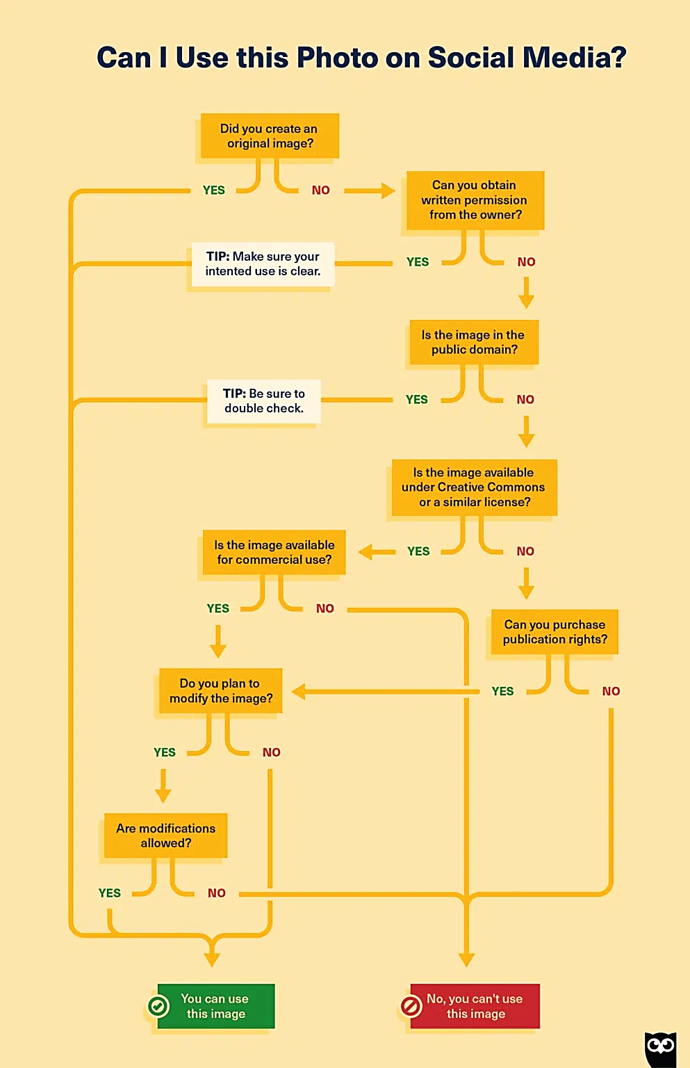
Lecture
Example
Lec. 1
Copyright laws for social media are, well, pretty much exactly the same as copyright laws everywhere else. If you want to use an image that isn’t yours, you must obtain permission. That might be through a license or through the creator directly.

Slide 20
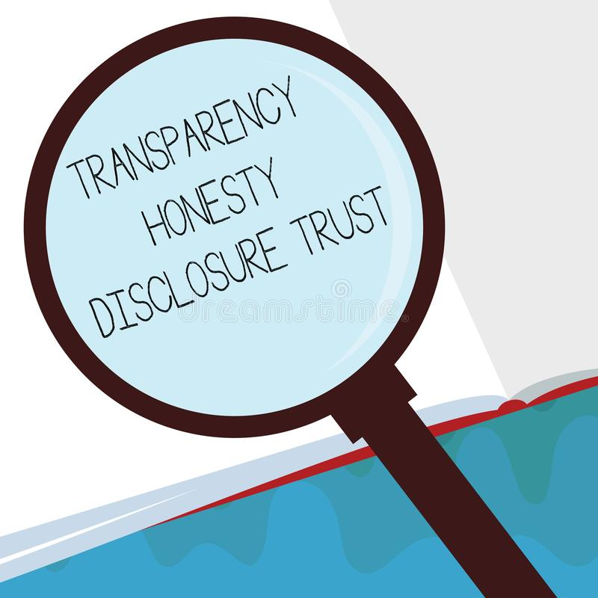
Lec. 1
Disclosure and Transparency

Slide 21
Lec. 1
Disclosure and Transparency
Transparency is not a single policy tool. It has different dimensions. Roughly, they are providing disclosures to users, public reporting, and access to data for researchers.
Disclosure to users includes revealing information about the content moderation standards a social media company has in place, its enforcement processes, and explanations of takedowns and other content moderation actions, descriptions of complaint procedures, among other things. Each of these outputs provide users with opportunities to complain about problematic content and to receive due process when social media companies take action against them.

Slide 22
Lec. 1
Disclosure and Transparency
Why transparency is essential?
Seeing all that is involved in implementing transparency measures brings us back to one question: Why do this at all? What good does transparency do? In general, the answer is that it provides public accountability.
Without transparency, due process for social media users is impossible. If users do not know what the rules are, how can they stay within the guardrails? If they have no mechanism to complain about problematic content or about mistaken moderation decisions, how can the content moderation process satisfy the demands of procedural fairness for users?

Slide 23
Lec. 1
Disclosure and Transparency
Why transparency is essential?
Disclosure and due process are so intimately linked that user transparency measures often include due process requirements. For instance, often legislation does not merely require platforms to disclose whatever complaint process they happen to have, it also requires platforms to have a complaint process.
Policy makers should explore various transparency measures for digital social media platforms. A balanced and clear legal structure for disclosure can help to restore public trust in these platforms and provide assurances that they are operating in the public interest.

Slide 24
Lecture
Lec. 1
Disclosure and Transparency
Why transparency is essential?
Mandated public reports on moderation practices are likely to improve content moderation, just as accounting reporting requirements encourage good corporate financial conduct. When companies know that they will have to issue these detailed assessments, they are more likely to take steps to mitigate problems to reduce the reputational risks that would come with a poor report card.
Researcher access to internal company data allows independent outside assessments of company conduct and can indicate areas for improvement that the companies themselves might have missed or tried to cover up in their public reports.

Slide 25
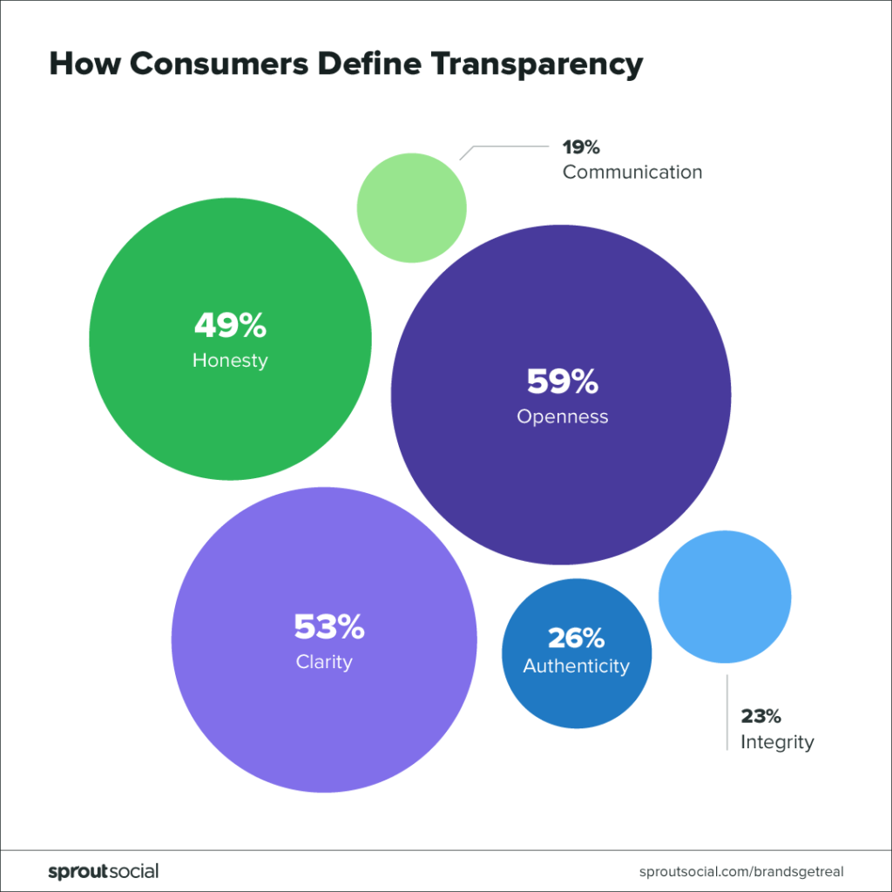
Lec. 1
Disclosure and Transparency
The largest number of people say transparency is when businesses are open (59%), clear (53%) and honest (49%).
These guiding principles give a sense of what consumers are looking for. A study proves no channel is better suited than social media as communication channel to make good on the interest in more transparency.

Slide 26
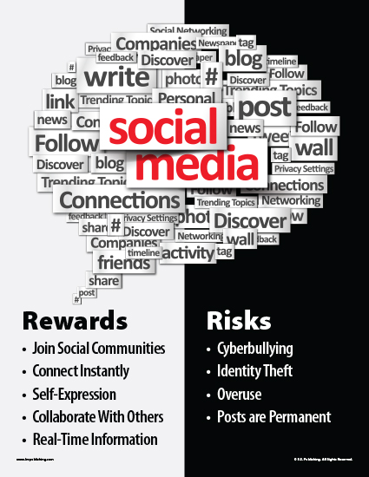
Lec. 1
Social Media risks and rewards

Slide 27
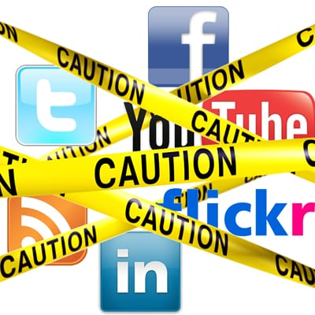
Lec. 1
Social Media risks and rewards
Social media is a powerful tool that gives organizations the ability to expand their brand value; it can also tarnish a brand overnight.
Given the visibility, risk, and real-time monitoring and response required to effectively manage social media channels, companies must establish extensive protocols for use by their organization in order to engage with external channels.

Slide 28
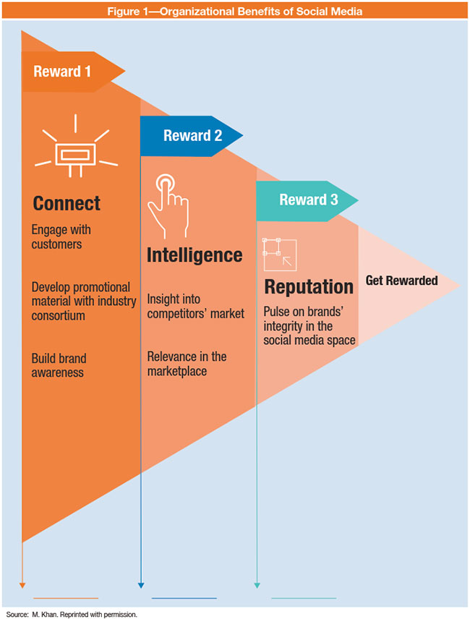
Lec. 1
Social Media risks and rewards
Some of the most advanced social media topics and benefits include:
Connecting with customers—The ability to engage with customers is the most critical aspect of social media. Developing a brand and promoting it through various channels of social media can create further brand value and awareness.
Marketing intelligence—Social media marketing gives the organization the ability to monitor the brand and listen to what the public is saying in the social media space.

Slide 29
Lec. 1
Social Media risks and rewards
The insight is the reward the organization reaps by playing a larger role in social media, which can be invaluable. The organization can enhance its marketing, business development efforts and other valuable venues to further its ability to be competitive.
Pulse on brand reputation—Keeping the pulse of the organization’s social media reputation and metrics is critical to staying ahead of the brand’s recognition and signs of reputational risk.

Slide 30
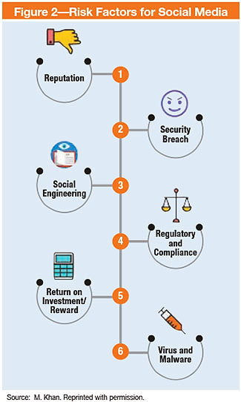
Lec. 1
Social Media risks and rewards
Reputational risk—Damage to an organization’s reputation stemming from a social media mishap can bring the organization to its knees, whether it is the chief executive officer (CEO) stating something controversial on his/her Twitter account or an organization-bashing employee video that goes viral. According to a leading publisher, “A reputational crisis can wipe tens of millions of pounds from a company’s value, and this risk has increased because the rise of online and social media means crises are now less predictable and can happen faster.”

Slide 31
Lec. 1
Social Media risks and rewards
Data security breach—According to research from Forrester:
From reconnaissance to brand hijacking and threat coordination, cyber criminals have been using social media to boost the effectiveness of their attacks for years. It’s clear that social media risk isn’t solely about brand and reputation damage but is a sinister cybersecurity threat that can lead to major data breaches, numerous compliance issues, and large amounts of lost revenue due to fraud and counterfeit sales, along with a slew of other risks.

Slide 32
Lec. 1
Social Media risks and rewards
Social engineering—Employees in almost all organizations are savvy, and many have a social media presence on major sites such as Facebook, LinkedIn, Quora and Twitter. Each platform has the potential to provide a hacker several key data points about employees, which can enable use of the data to hack the employee account at the enterprise layer by spoofing and launching a social engineering attack on the company. Due to the multitude of options of going through social media accounts with exposed data, attackers can gather these data to further their advances in terms of hacking into accounts.

Slide 33
Lec. 1
Social Media risks and rewards
Compliance or regulatory violations—The growing number of privacy changes and regulations globally is impacting how customer data are utilized in the social media space. There are four key areas with which to be concerned:
Privacy
Content ownership
Intellectual property (IP) infringement
Unauthorized activities

Slide 34
Lec. 1
Social Media risks and rewards
Compliance to changing the regulatory climate—These regulatory changes require the organization to adapt its strategy if it wishes to comply on a global basis. This approach, while necessary for an organization that uses social media regularly, may result in the organization’s increased visibility with authorities.
Some industries may shy away from this situation in light of audits that occur due to being in the social media space so frequently.

Slide 35
Lec. 1
Social Media risks and rewards
Return on investment—The benefit the organization gains from being present in the social media space is hard to calculate and very subjective. The risk over reward, therefore, cannot be calculated without proper assurance, which leaves the decision to enter the social media space questionable for some industries.

Slide 36
Lec. 1
Social Media risks and rewards
Phishing—One of the popular techniques used by criminals is to get unknowing individuals to disclose personal information while posing as a fictitious representative of a legitimate professional or company. This, primarily, is the key driver for collecting personal data for financial gain to individuals or organizations. Due to the lack of awareness about the phishing techniques used by hackers, employees fall victim to email, phone call and website phishing schemes, resulting in exposure to enterprise-level risk.

Slide 37
Lec. 1
Social Media risks and rewards
Viruses and malware—Hackers’ ability to penetrate the organization’s network via unsafe social media websites and accounts opens a new threat vector. On one hand, employees who access social media websites can act as brand ambassadors; on the other hand, their activity may leave an open door for viruses and malware to enter into the network. According to security experts, “A majority of current attacks simply use the social platforms as a delivery mechanism, and have been modeled after the older Koobface malware.”

Slide 38
Conclusion
Lec. 1
Lecture Topic
Social Media and Ethics
    Social Media Policy and adherence
    Understanding copyright and creative commons
    Disclosure and Transparency
    Social Media risks and rewards

Slide 39
Lecture
Lec. 1
Recommended References
Insignia-communications. (n.d.). (PDF) braving the Social Media Crisis - learn how to survive a social media crisis by Insignia Communications. dokumen.tips. https://dokumen.tips/business/braving-the-social-media-crisis-learn-how-to-survive-a-social-media-crisis-by-insignia-communications.html?page=1
Kenan, J. (2023, March 31). Social Media Policy: A guide for your organization. Sprout Social. https://sproutsocial.com/insights/social-media-policy/
Mzyece, N. (2020). An Assessment on the Effects of Social Media on Crisis Management in Telecommunication Companies in Zambia (Doctoral dissertation, Cavendish University). http://155.0.3.194:8080/jspui/bitstream/123456789/626/1/An%20Assessment%20on%20the%20Effects%20of%20Social%20Media%20on%20Crisis%20Management%20in%20Telecommunication%20Companies%20in%20Zambia.pdf
Capozzi, L. (2013). Crisis management in the age of Social Media. Business Expert Press. https://core.ac.uk/download/pdf/326763005.pdf
Copyright and creative commons are friends. Creative Commons. (2017, February 28). https://creativecommons.org/get-cc-savvy/copyright-creativecommons-are-friends/
gene BrownJean Brown is a Registered Psychologist. (n.d.). Gene Brown. Difference Between Similar Terms and Objects. http://www.differencebetween.net/business/difference-between-creative-commons-and-copyright/
Newberry, C. (2022, July 19). Can I use this photo on social media? understanding image copyright. Social Media Marketing & Management Dashboard. https://blog.hootsuite.com/understanding-image-copyright/#What_is_image_copyright
Social Media Rewards and Risk. ISACA. (n.d.). https://www.isaca.org/resources/isaca-journal/issues/2017/volume-4/social-media-rewards-and-risk
MacCarthy, M. (2022, November 4). Transparency is essential for effective social media regulation. Brookings. https://www.brookings.edu/blog/techtank/2022/11/01/transparency-is-essential-for-effective-social-media-regulation/
#brandsgetreal: Social Media & The Evolution of Transparency. Sprout Social. (2023, February 6). https://sproutsocial.com/insights/data/social-media-transparency/

Slide 40



Thank You

