Slide 1

Revision
Prepared by Dr. Shereen Kedwany
Final Lecture
DGM 711
Introduction to Digital Media

Slide 2
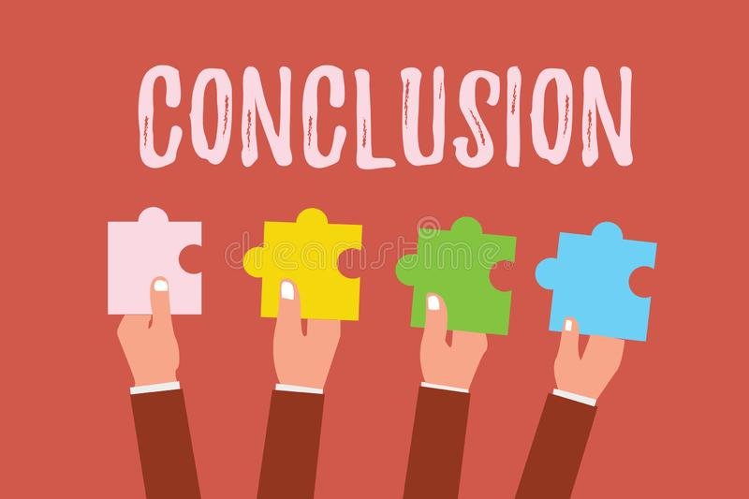

Chapter
01
Media and Digital Technologies
Mediatization is the increasing presence of media in all aspects of life .
Computer networks have become “the key infrastructure for all aspects of life in the digital environment.
“Digital Media” are “the means that they carry information represented by a numeric code and then transform it into human language”.
Digital media is sometime called multimedia.
Digital media can carry information very efficiently than old media.
The introduction of new media has not caused the disappearance of the old media.
A practice, content, or format can be re‐mediated by a new technology .

Slide 3

Chapter
02
Digital Media Infrastructures
Digital media have common characteristics that distinguish them from Analog old media (Convergent, Hypertextual, Distributed, Pervasive, Algorithmic, Asymmetric, Ephemeral & Permanent) .
The architecture of the digital networks is not neutral, but rather has the power to shape the behaviors of their users.
The internet is an open system , based upon a global governance system.
Digital media and network technologies are composed of different “layers,” (physical, logical, content & Legal).
There are three generations of the web (Web 1.0 - Web 2.0 - Web 3.0 ).

Slide 4

Chapter
03
The Information Society
The concept of information society refers to a form of society characterized by the importance of the production and management of information and knowledge.
The ability to produce, manipulate, and distribute information becomes one of the main factors related to wealth and power.
The birth of the information society was described as a third industrial revolution .
The economic system of the information society is characterized by being informational, global, and networked.
In an information society, intellectual property rights are divided in three main types: (copyright, trademarks , patents).
A globalized economy is characterized by multinational companies, which own digital media, and foster the emergence of a global consumer culture .

Slide 5
Chapter
04
Digital Media and Society
Technological determinism approach understands technology as an independent force that can determine the development of a society.
The social construction of technology approach suggests that the development, structure, and significance of a technology depends on the strength, needs, and values of the social groups that promote and design it.
Technologies are not neutral but rather have a “politics.”
Similar approaches also recognize the active role of users of technologies repurpose, modify, and resist technology.
Scholars have also noted the existence of “superusers” with specific technical skills and professional positions.
Electronic media were destined to transform humanity into a “global village”.

Slide 6

Chapter
05
Digital Media and Social Relations
Digital media foster new forms of interaction and enrich the social life of individuals.
Therefore, social relationships seem to always be mediated.
Yet the social relations these technologies mediate are not neutral, but rather depend on uneven power dynamics, as well as on cultural and identity factors.
Social media are “coding relationships between people, things and ideas into algorithms.”
This means that it analyzes past interactions in order to predict future behavior .
These companies have developed business models that allow them to extract profits from the information they manage.
The information collected by social media platforms can be sold to third parties.

Slide 7
Chapter
06
Digital Media and Identity
Digital media, and social media platforms in particular, are important instruments through which individuals implement active strategies of identity building.
social media are one of the “stages” from which individuals represent their own identity. individuals perform the continuous work of identity construction
The so‐called “digital afterlife can create a kind of “immortality” in which the digital identity of the deceased survives his death .
The use of digital media as social spaces is not neutral, but rather influenced by social factors such as age, gender, ethnicity, or class, Like “digital natives” and “digital immigrants”.
Algorithms reinforce inequalities.
The “algorithmic identity based on algorithmic evaluations of our online behavior.
Forms of sociality mediated by digital technologies have been faced with many critiques.

Slide 8
Chapter
07
Collaborative Digital Media
Digital technologies facilitate the active participation of individuals in media production.
Digital collaborations rely on the culture of participation.
Digital platforms offer possibilities for users to become content producers or contribute to assessing and improving the content provided by a service.
Wikipedia, social media and mashup services are examples of digital collaboration.
Legal systems have adapted copyright laws to facilitate the spread of self‐publishing platforms such as YouTube.
Digital media users contribute only marginally to decision‐making processes.
The work of users is aggregated for profit purposes by private companies, removing power and decisions from the users.

Slide 9
Chapter
08
The Digital Public Sphere
The public sphere, a fundamental component of modern democracies, where individuals are free to discuss politics without being subject to an external authority, and can thus form a public opinion.
Media publics can successfully become politically active thanks to the emergence of an information‐rich digital environment and its related communication tools..
Digital technologies also favored the emergence of new kinds of players in the contemporary public sphere , such as WikiLeaks and “Panama papers .
The networked public sphere is not inherently democratic in nature.
The algorithms that underpin digital platforms shape political and social interactions.
These are new forms of “algorithmic gatekeeping,”

Slide 10

Chapter
09
The Digital Media & Politics
Power relations are now also systematically organized around digital media and the networked public sphere
There has been an increase in the number of citizens who access information and participate in political debates through digital media.
Digital divide is the difference in access to network technologies that occurs between rich countries and poor countries, which depends on the type of society Policies related to access to and transparency of information .
Several Western governments operate surveillance systems that allow them to record all phone and online interactions.
Web corporations capture users' data to improve their services or provide personalized advertising.
Individuals can choose specific strategies to resist surveillance, such as encryption or refusal of participation in the commercial web services

Slide 11
Chapter
10
The Digital Media Economy
The information economy is a dynamic economic sector, dominated by new players.
Microsoft’s Bill Gates, Amazon’s Jeff Bezos, and Facebook’s Mark Zuckerberg are among the wealthiest individuals in the world.
They influence the development of global capitalism through their investments.
The global market supports the economies of areas that produce hardware components, such as East Asia , and others that manage innovation and marketing processes, such as the United States .
Some web companies simply sell content distributed through digital networks.
Most services for user‐generated content are free to the user and rely on advertising .
Startup economy is based on new emerging companies often pass through an incubator.
Prosumer, which combines the words “producer” and “consumer,” has been used to define individuals who have an active role in processes of both creation and consumption of goods .

Slide 12
Thank you for listening
DGM 711
Introduction to Digital Media

