Slide 1




Mathematics 3 – MAT132
Dr. Israa Lewaa
Lecture 7 – Advanced Topics in Calculus

Slide 2



Lecture Objective
Lecture
05
Chapter Objectives
To develop and apply the formula for integration by parts.
To show how to integrate a proper rational function.
To illustrate the use of the table of integrals.
To develop the concept of the average value of a function.
To define and evaluate the improper integral.
To discuss functions of several variables and to compute function values.
To compute partial derivatives.
To find partial derivatives of a function defined implicitly.
To compute higher-order derivatives.
Lecture 7 Dr. Israa Lewaa Mathematics 3

Slide 3
Lecture Outline
Lecture
09
Lecture Outline
1- Integration by Parts
2- Integration with Initial Conditions
3- Definite Integral
Lecture 7 Dr. Israa Lewaa Mathematics 3

Slide 4
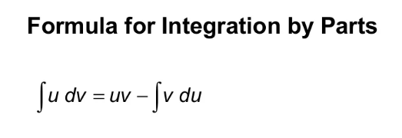
1- Integration by Parts
Lecture
08
1- Integration by parts
Lecture 7 Dr. Israa Lewaa Mathematics 3

Slide 5
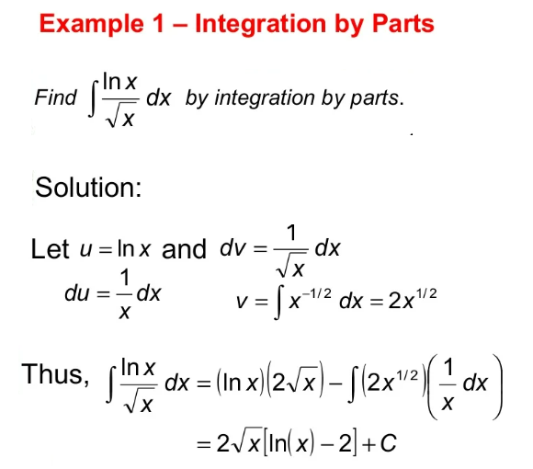
Extra Practice - Example 1
Lecture
08
Example

Slide 6
Extra Practice - Example 2
Lecture
08
Example

Slide 7
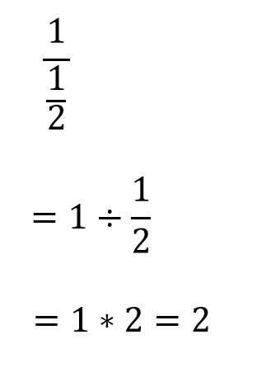
** Revision – Fundamentals
Lecture
08
** Revision – Fundamentals
Lecture 7 Dr. Israa Lewaa Mathematics 3

Slide 8
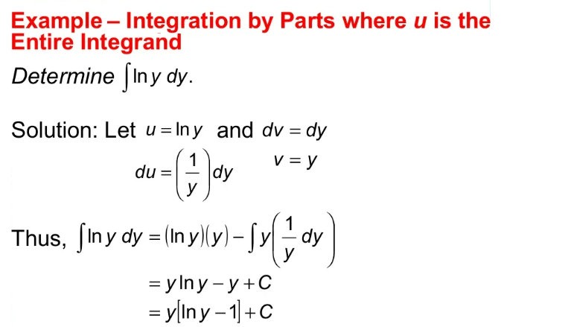
Extra Practice - Example 3
Lecture
08
Example

Slide 9

2- Integration with Initial Conditions
Lecture
08
Integration with initial Conditions
Integration with initial Conditions
Lecture 7 Dr. Israa Lewaa Mathematics 3

Slide 10
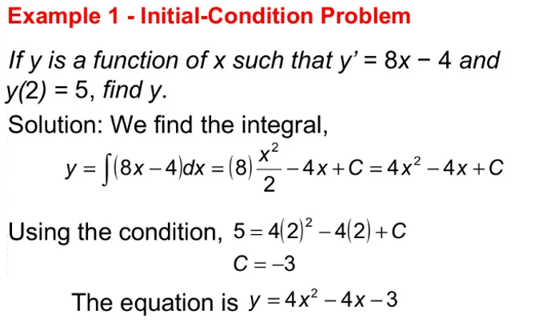
Extra Practice - Example 4
Lecture
08
Example
Lecture 7 Dr. Israa Lewaa Mathematics 3

Slide 11
Extra Practice - Example 5
Lecture
08
Example
Lecture 7 Dr. Israa Lewaa Mathematics 3

Slide 12
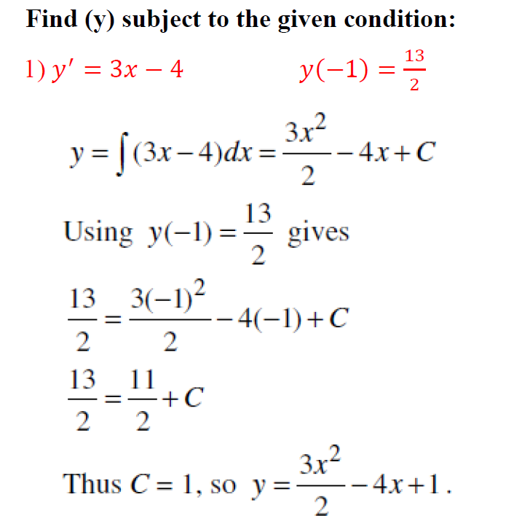
Extra Practice – Example 6
Lecture
07
** EXTRA PRACTISE
Lecture 7 Dr. Israa Lewaa Mathematics 3

Slide 13
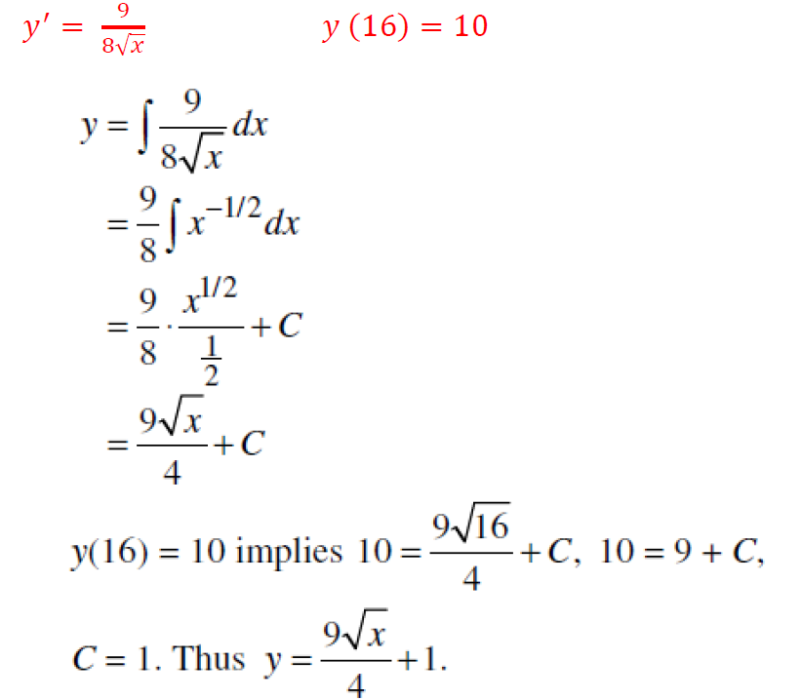
Extra Practice – Example 7
Lecture
07
** EXTRA PRACTISE

Slide 14
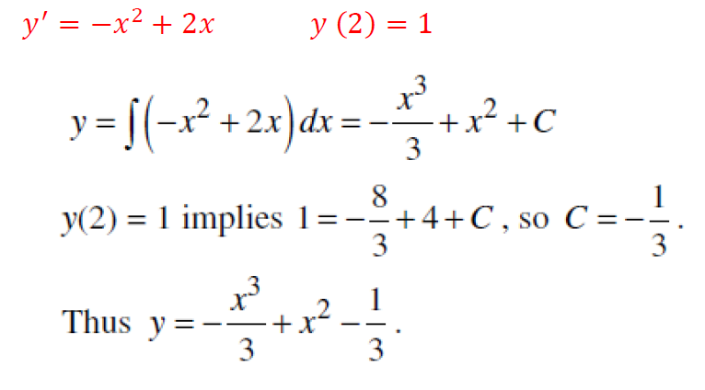
Extra Practice – Example 8
Lecture
07
** EXTRA PRACTISE
Lecture 7 Dr. Israa Lewaa Mathematics 3

Slide 15
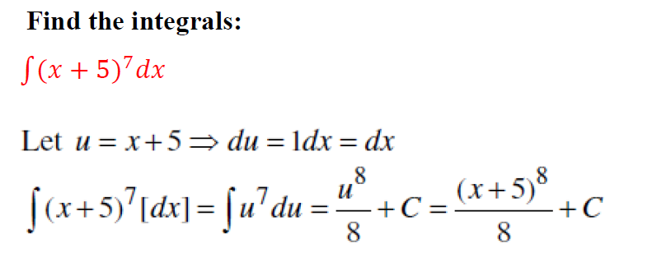
Extra Practice – Example 9
Lecture
08
Examples for different Methods of Integration
Lecture 7 Dr. Israa Lewaa Mathematics 3

Slide 16
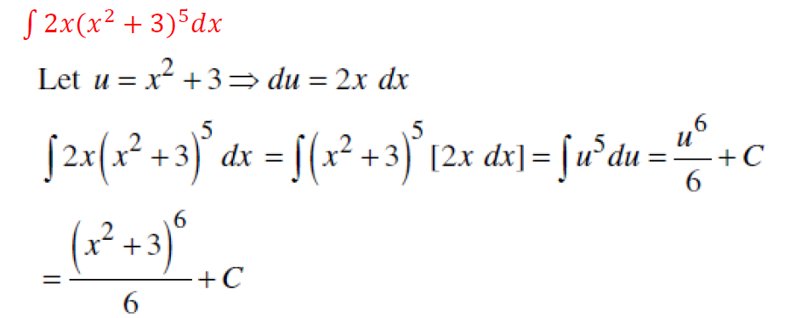
Extra Practice – Example 10
Lecture
08
Example
Lecture 7 Dr. Israa Lewaa Mathematics 3

Slide 17
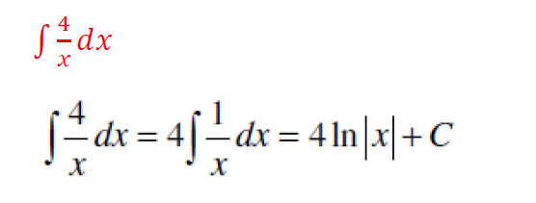
Extra Practice – Example 11
Lecture
08
Example
Lecture 7 Dr. Israa Lewaa Mathematics 3

Slide 18
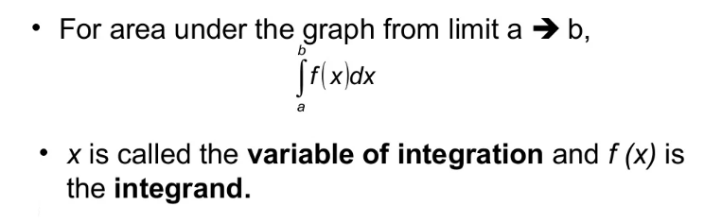
3- The Definite Integral
Lecture
08
The Definite Integral
Lecture 7 Dr. Israa Lewaa Mathematics 3

Slide 19

Extra Practice – Example 12
Lecture
08
Example 1 - Definite Integration

Slide 20
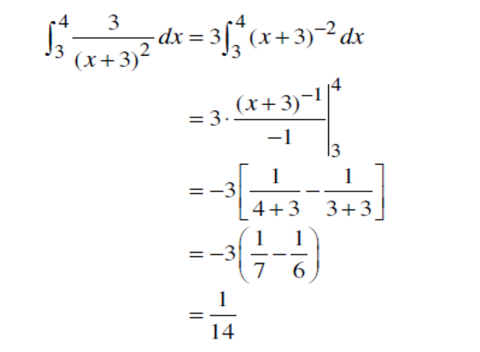
Extra Practice – Example 12 Solution
Lecture
08
Example 1 Solution
Lecture 7 Dr. Israa Lewaa Mathematics 3

Slide 21
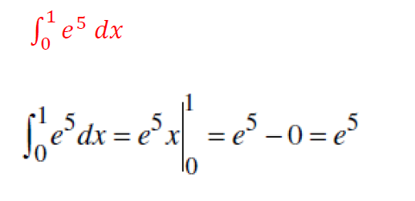
Extra Practice – Example 13
Lecture
08
Example

Slide 22
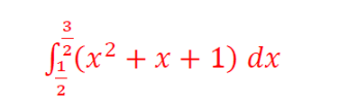
Extra Practice – Example 14
Lecture
08
Example

Slide 23

Extra Practice – Example 15
Lecture
08
** EXTRA PRACTISE
Lecture 7 Dr. Israa Lewaa Mathematics 3

Slide 24
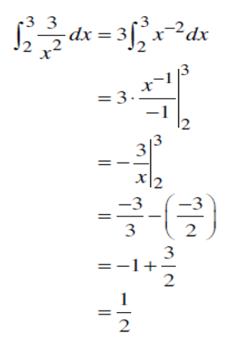
Extra Practice – Example 15 solution
Lecture
08
** EXTRA PRACTISE
Lecture 7 Dr. Israa Lewaa Mathematics 3

Slide 25

Extra Practice – Example 16
Lecture
08
** EXTRA PRACTISE

Slide 26
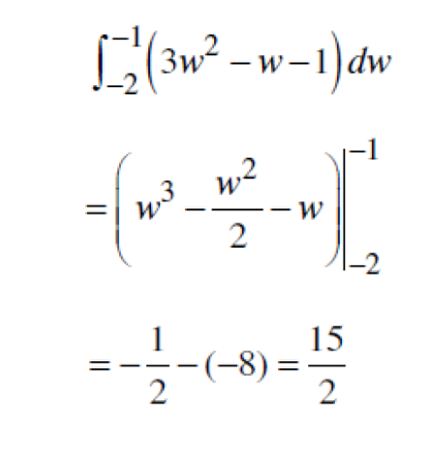
Extra Practice – Example 16 solution
Lecture
08
** EXTRA PRACTISE
Lecture 7 Dr. Israa Lewaa Mathematics 3

Slide 27
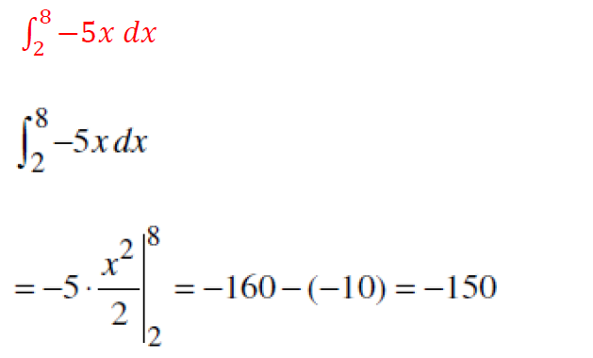
Extra Practice – Example 17
Lecture
08
** EXTRA PRACTISE
Lecture 7 Dr. Israa Lewaa Mathematics 3

Slide 28
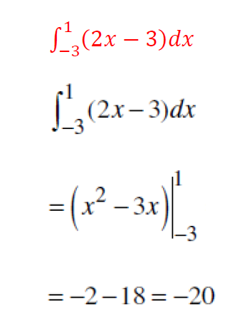
Extra Practice – Example 18
Lecture
08
** EXTRA PRACTISE

Slide 29
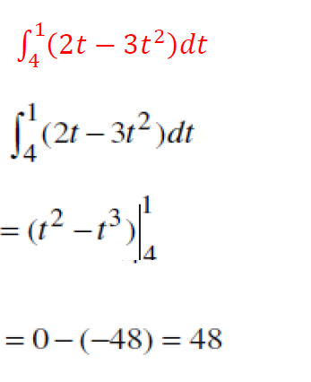
Extra Practice – Example 19
Lecture
08
** EXTRA PRACTISE
Lecture 7 Dr. Israa Lewaa Mathematics 3

Slide 30
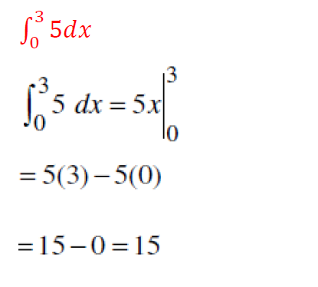
Extra Practice – Example 20
Lecture
08
** EXTRA PRACTISE

Slide 31
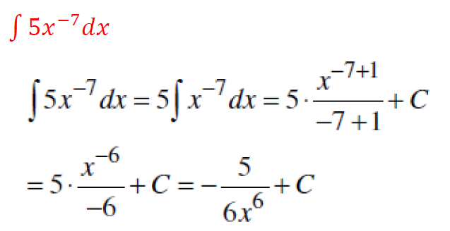
Extra Practice – Example 21
Lecture
07
** EXTRA PRACTISE
Lecture 7 Dr. Israa Lewaa Mathematics 3

Slide 32
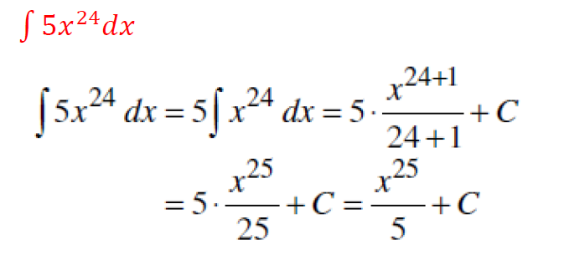
Extra Practice – Example 22
Lecture
07
** EXTRA PRACTISE
Lecture 7 Dr. Israa Lewaa Mathematics 3

Slide 33
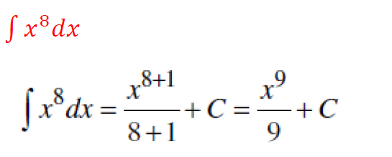
Extra Practice – Example 23
Lecture
07
** EXTRA PRACTISE
Lecture 7 Dr. Israa Lewaa Mathematics 3

Slide 34
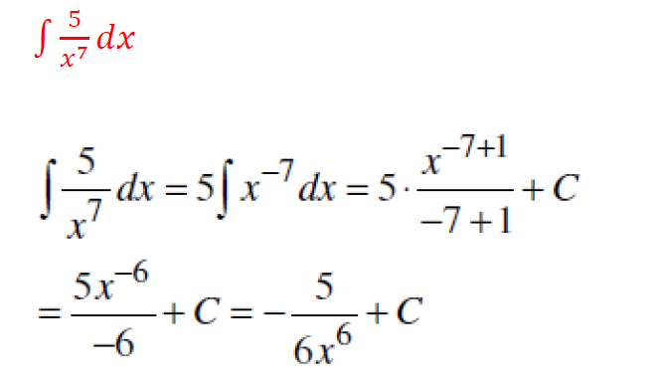
Extra Practice – Example 24
Lecture
07
** EXTRA PRACTISE
Lecture 7 Dr. Israa Lewaa Mathematics 3

Slide 35
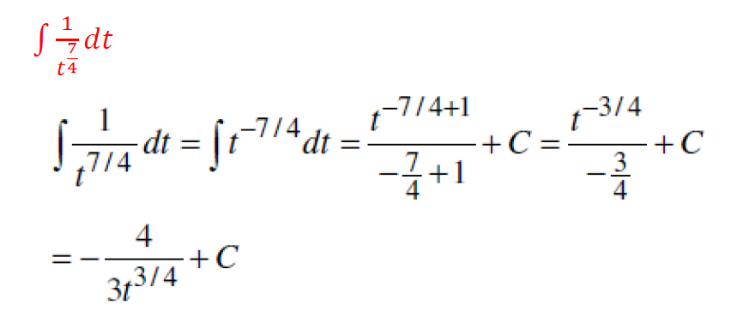
Extra Practice – Example 25
Lecture
07
** EXTRA PRACTISE
Lecture 7 Dr. Israa Lewaa Mathematics 3

Slide 36
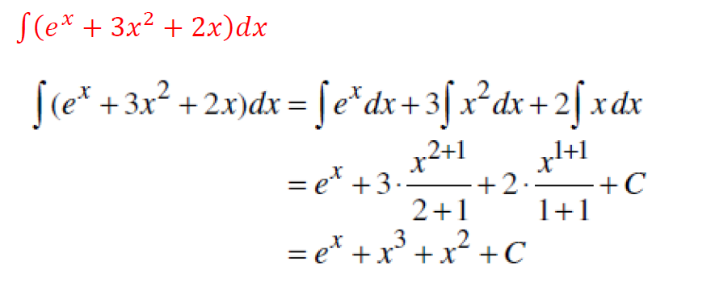
Extra Practice – Example 26
Lecture
07
** EXTRA PRACTISE
Lecture 7 Dr. Israa Lewaa Mathematics 3

Slide 37
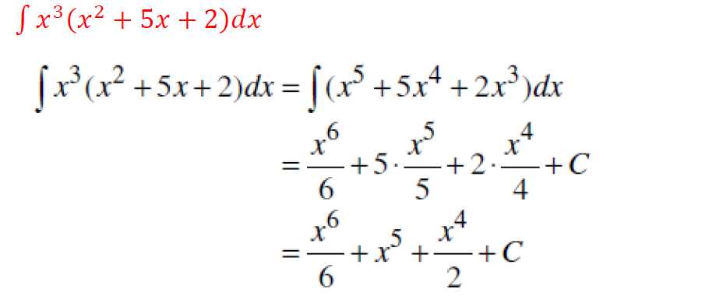
Extra Practice – Example 27
Lecture
07
** EXTRA PRACTISE
Lecture 7 Dr. Israa Lewaa Mathematics 3

Slide 38
Lecture Summary
Lecture
09
Lecture Summary
1- Integration By Parts
2- Integration with Initial Conditions
Lecture 7 Dr. Israa Lewaa Mathematics 3

