Slide 1



Project Feasibility Study
PMG201
Prepared by Mrs. Deena Ibrahim
Lecture 7
Budgeting the Project

Slide 2

Methods of Budgeting.
Cost Estimating.
Improving the Process of Cost Estimation.
Budget Uncertainty and Risk Management.

Slide 3
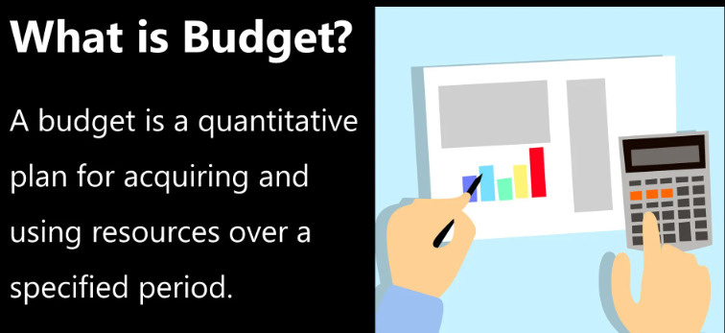
Budgeting the Project
Having finished the planning for the technical aspects of the project, there is one more important element of planning to finish that then results in the final go - ahead from top management to initiate the project.
A budget must be developed in order to obtain the resources needed to accomplish the project ’ s objectives. A budget is simply a plan for allocating organizational resources to the project activities.
But the budget also serves another purpose: It ties the project to the organization ’ s aims and objectives through organizational policy.

Slide 4
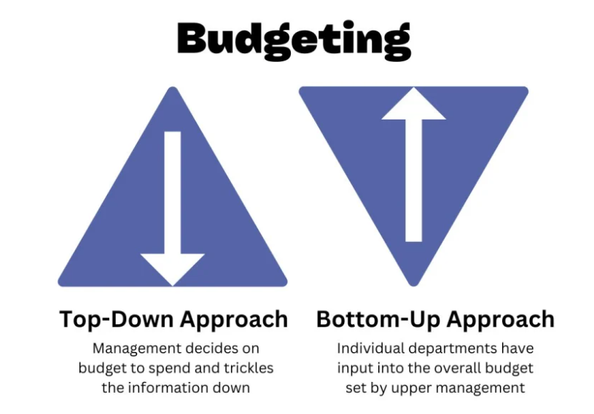
1- Methods of Budgeting
Top-Down Budgeting.
Bottom-Up Budgeting.

Slide 5
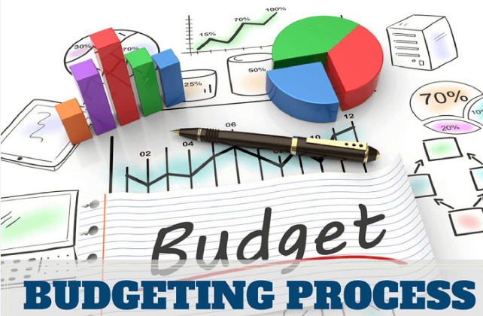
Methods of Budgeting
Organizational tradition also impacts project budgeting. Every firm has its own rules about how overhead and other indirect costs are charged against projects.
Next, we look at two different approaches for gathering the data for budgeting a project: top - down and bottom - up.

Slide 6
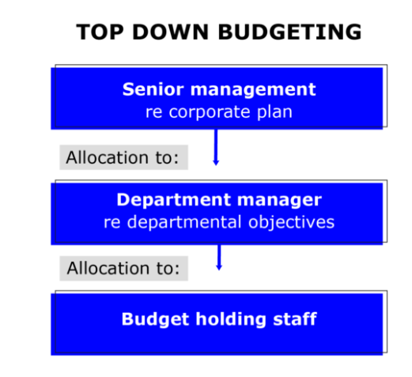
Top-Down Budgeting
The top - down approach to budgeting is based on the collective judgments and experiences of top and middle managers concerning similar past projects. These managers estimate the overall project cost by estimating the costs of the major tasks, which estimates are then given to the next lower level of managers to split up among the tasks under their control, and so on, until all the work is budgeted.

Slide 7

Top-Down Budgeting
The advantage of this approach is that overall budget costs can be estimated with fair accuracy.
Another advantage is that errors in funding small tasks need not be individually identified because the overall budget allows for such exceptions.
The experience and judgment of top management are suppose to include all such elements in the overall estimate.

Slide 8
Top-Down Budgeting
Based on managerial judgment, and historical data.
History can include actual costs from similar projects, adjusted for differences and for inflation.
Start at the top, and allocate down through the WBS.

Slide 9
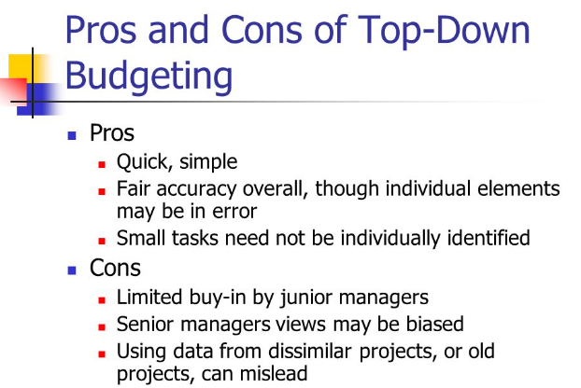
Pros and Cons of Top-Down Budgeting

Slide 10
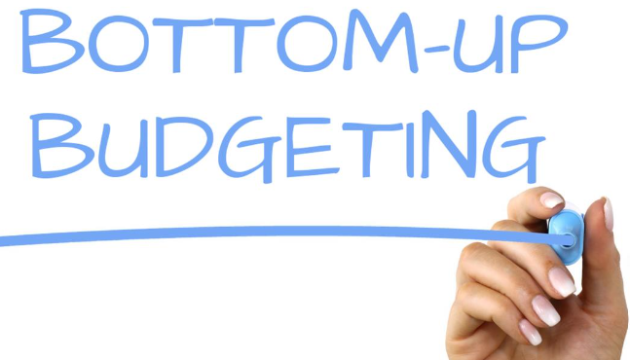
Bottom-Up Budgeting
In bottom - up budgeting, the WBS identifies the elemental tasks, whose resource requirements are estimated by those responsible for executing them.
This can result in much more accurate estimates.. The resources, such as labor and materials, are then converted to costs and aggregated to different levels of the project, eventually resulting in an overall direct cost for the project.
The PM then adds, according to organizational policy, indirect costs such as general and administrative, a reserve for contingencies, and a profit figure to arrive at a final project budget.

Slide 11
Bottom-Up Budgeting
Bottom - up budgets are usually more accurate in the detailed tasks, but costly tasks.
Such an approach, however, is common in organizations with a participative management philosophy and leads to better morale, greater acceptance of the resulting budget, and heightened commitment by the project team.
It is also a good managerial training technique for aspiring project and general managers.

Slide 12

Bottom-Up Budgeting
Unfortunately, true bottom - up budgeting is rare. Upper level managers hesitate to let the workers develop the budget, fearing the natural tendency to overstate costs, and fearing complaints if the budget must later be reduced to meet organizational resource limitations.
Moreover, the budget is upper management ’ s primary tool for control of the project, and they hesitate to let others set the control limits.
Again, we will see that the budget is not a sufficient tool for controlling a project. Top - down budgeting allows the budget to be controlled by people who play little role in designing and doing the work required by the project. It should be obvious that this will cause problems — and it does.

Slide 13
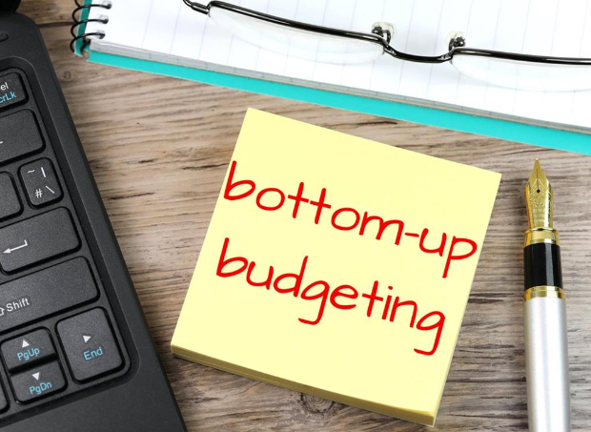
Bottom-Up Budgeting
Starts at the bottom of the WBS, with the people who do the work
Then costs are aggregated upward
Overhead, project reserves, and profit have to be added in

Slide 14
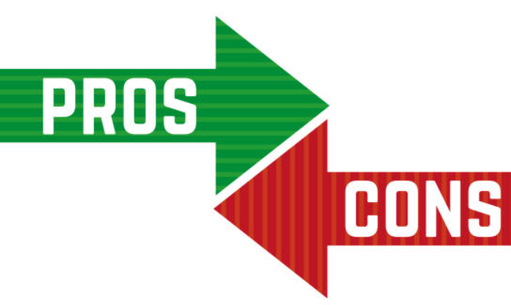
Bottom-Up Budgeting
Project budgeting is a difficult task due to the lack of experience with unique project undertakings.
The two major ways of generating a project budget are top - down and bottom - up.
The former (top – down) is usually accurate overall but possibly includes significant error for low - level tasks. The latter (bottom – up) is usually accurate for low - level tasks but costly tasks.
Most organizations use top - down budgeting in spite of the fact that bottom -up results in better acceptance and commitment to the budget.

Slide 15
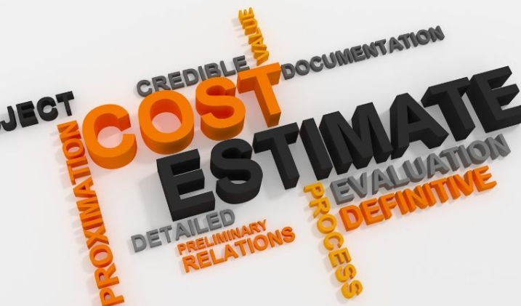
2. Cost Estimating
Work Element Costing
The Impact of Budget Cuts.
Activity vs. Program Budgeting.

Slide 16
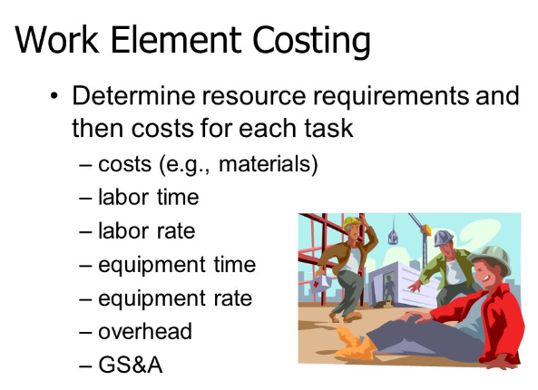
Work Element Costing
The task of building a budget is relatively straightforward but boring. Each work element is evaluated for its resource requirements, and its costs are then determined.
In some organizations, the PM adds the overhead charges to the budget. In others, the labor time and materials are just sent to the accounting department and they run the numbers, add the appropriate overhead, and total the costs.

Slide 17

The Budget cuts
The Budget cuts can be challenging, but they're a practical management strategy. It may be necessary for a company to make budget cuts during un favorable economic conditions that may affect the company's return on investments. When the management makes these decisions, it becomes your responsibility to convey this news and handle the reduction with your team.

Slide 18
This could be happen through the following steps:
Take care of yourself first (and take care of your team).
Give clear and concise facts.
Stay calm and polite.
Manage expectations.
Address areas with low investment returns.
Focus resources on revenue generators.
Work with employees.
Reduce unnecessary expenses.

Slide 19
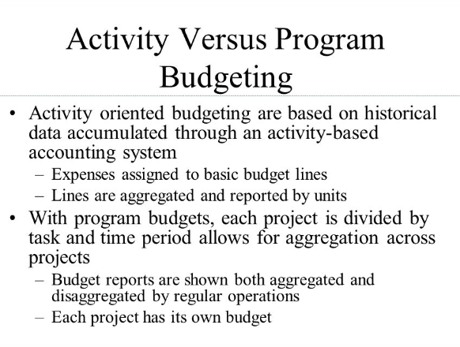
Activity vs. Program Budgeting
Activity oriented budgeting are based on historical data accumulated through an activity-based accounting system.
Expenses assigned to basic budget lines,
Lines are aggregated and reported by units.
With program budgets, each project is divided by task and time period allows for aggregation across projects.
Budget reports are shown both aggregated and disaggregated by regular operations.
Each project has its own budget.

Slide 20
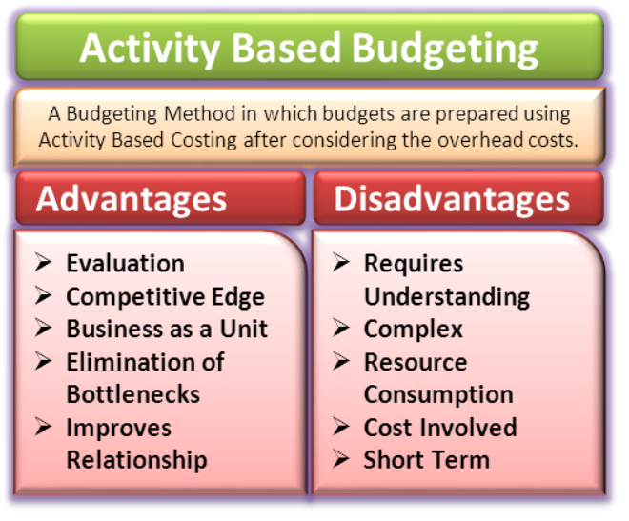
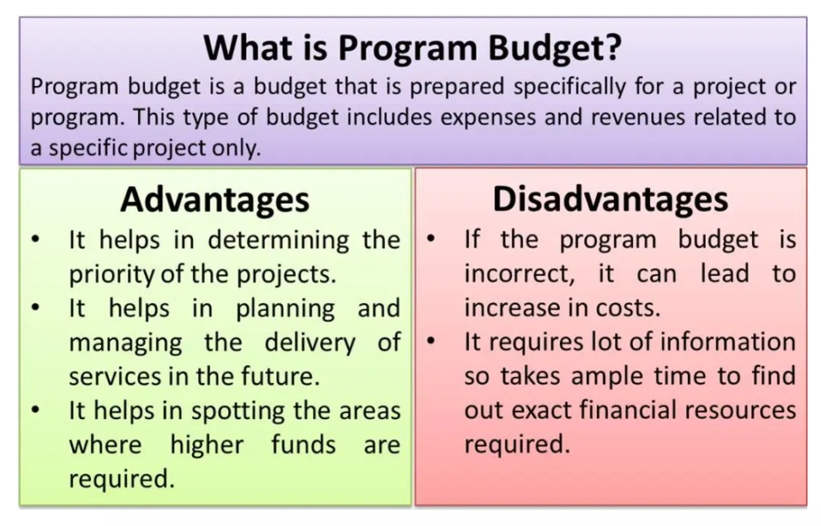
Activity vs. Program Budgeting

Slide 21

3- Improving the Process of Cost Estimation
There are two fundamentally different ways to manage the risks associated with the chance events that occur on every project:
The most common is to make an allowance for contingencies - usually 5 or 10 percent.
Another is when the forecaster selects “most likely, optimistic, and pessimistic” estimates.

Slide 22

Funding Non profitable Projects
There are several reasons that firms would choose to fund a project that is not profitable :
To develop knowledge of a technology.
To get the organization’s “foot in the door”.
To be in a good position for a follow-on contract.
To improve a competitive position.
To broaden a product line or a line of business.

Slide 23
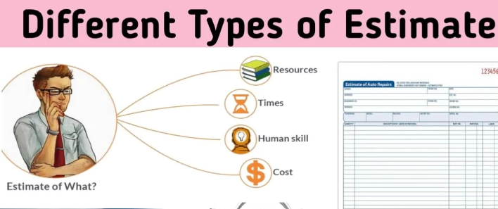
Types of Estimation Error
There are two generic types of estimation error:
Random error - where overestimates and underestimates are likely to be equal.
Bias - a systematic error where the chance of overestimating and underestimating are not likely to be equal.

Slide 24

4. Budget Uncertainty and Risk Management
Budget Uncertainty
Risk Management

Slide 25

Budget Uncertainty
In spite of the care and effort expended to create an accurate and fair budget, it is still only an estimate made under conditions of uncertainty. Because projects are unique, risk pervades all elements of the project, and particularly the project ’ s goals of performance, schedule, and budget. We will discuss these issues of uncertainty and risk here, and offer some suggestions for dealing with them.

Slide 26
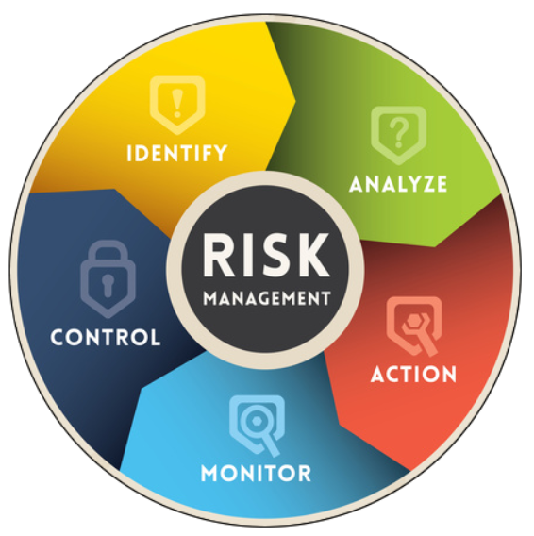
Risk Management.
The field of risk management has grown considerably over the last decade. In general, risk management includes three areas:
(1) risk identification
(2) risk analysis
(3) response to risk.
The process of accomplishing these three tasks is broken down into six sub processes:

Slide 27
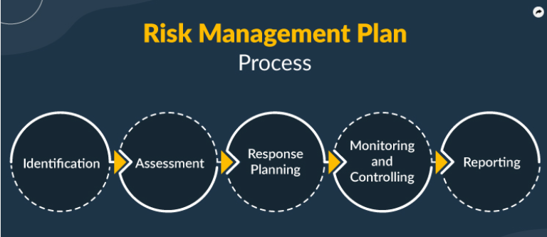
Risk Management
1. Risk Management Planning developing a plan for risk management activities.
2. Risk Identification finding those risks that might affect the project.
3. Qualitative Risk Analysis evaluating the seriousness of the risk and the likelihood
it will affect the project.

Slide 28
Risk Management
4. Quantitative Risk Analysis Developing measures for the probability of the risk
and its impact on the project.
5. Risk Response Planning finding ways of reducing negative impacts on the project as well as enhancing positive impacts.
6. Risk Monitoring and Control Maintaining records of and evaluating the sub processes,

Slide 29
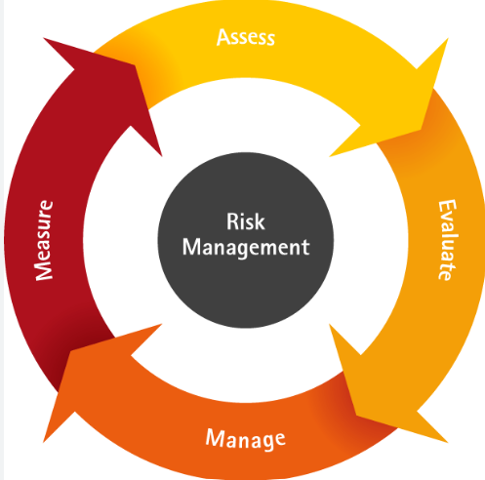
In spite of the effort taken to make realistic budget estimates, it can still be useful to prepare for changes in the budget as the project unfolds. Such changes derive from multiple sources, including technology, economics, improved project understanding, and mandates. It is best to try to include these contingencies in the contract in case they come to pass.

Slide 30
Risk management consists of risk planning identification, qualitative and quantitative analysis, response, and monitoring. We deal with risk through such means as decision tables, simulation, and response, which entail identifying which risks will be prepared for and which will be ignored and simply accepted.

Slide 31


Slide 32


