Slide 1

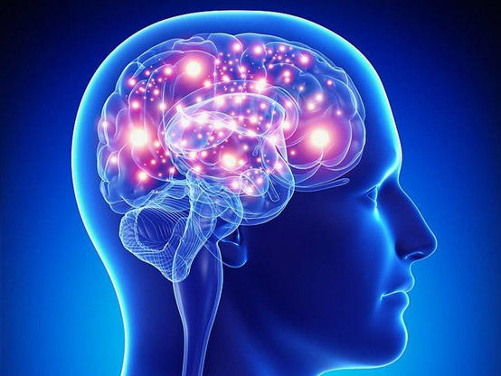
AI System for Detecting Brain Tumor
Prepared By
Name: Alaa Mohammed Hassan ID No. 252000381
Supervisor Name: Dr. Ashraf Elsayed
Collage of Informatics, Midocean University, Comoros

Slide 2
Content
1- Introduction
2- Problem
3- Objective
4- Dataset
5- Methodology & Proposed Approach
6- Data Preprocessing
5- Experimental Results
6- Performance Analysis of the MobileNetV2
7- Performance Analysis Inception V3
8- Performance Analysis of the EfficientNetB0 Model
9- Conclusion
10- Future Work

Slide 3
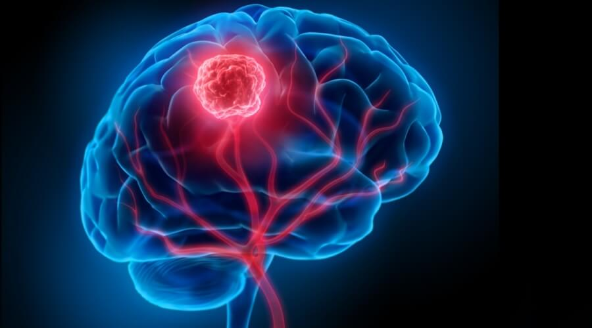
1
Introduction
The brain is the main control center for all bodily functions. It is responsible for issuing commands and regulating vital functions that ensure the continuation of life. Any damage to the brain can directly affect a person's physical and cognitive abilities. Brain tumors are defined as abnormal growths in brain cells that form masses which may be benign or malignant. Early detection is a crucial step in improving treatment outcomes and reducing complications.
In light of the rapid technological advancements we are witnessing and the integration of artificial intelligence into many aspects of our daily lives and across various fields, it has become possible to harness it in the medical field. Detecting brain tumors is one of the most difficult challenges due to their diversity and the difficulty in differentiating between them using traditional methods.

Slide 4
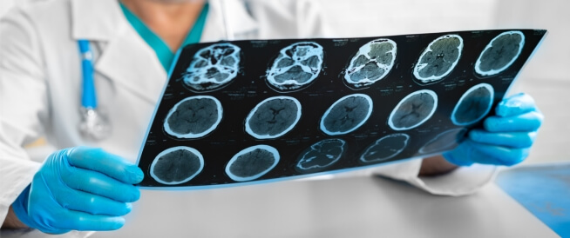
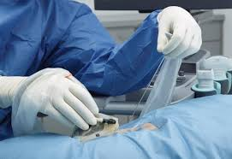
2
Problem
Traditional Diagnosis
This relies entirely on human evaluation of MRI scans and is a time-consuming and laborious process
Human Error
The possibility of error in various types of malignant tumors (benign/malignant) due to stress or tissue similarity
Delay in Treatment
Any delay in diagnosis leads to deterioration of vital functions (such as glandular and sensory functions) and reduced chances of survival
Biopsy Risks
A surgical biopsy is a painful, invasive procedure and may not always be necessary in the final stages of the disease

Slide 5
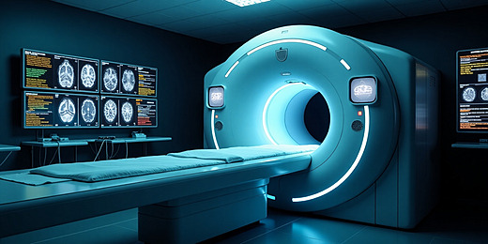
3
Objective
I chose this project because it combines artificial intelligence and medicine, helping doctors make highly accurate diagnoses using algorithms that classify different images (MRI scans) and detect various tumors with exceptional precision. This allows doctors to analyze thousands of images in minutes, significantly reducing human error during diagnosis, contributing to faster decision-making and the selection of the most appropriate treatment, thus increasing the patient's chances of recovery, God willing. This is our goal.

Slide 6
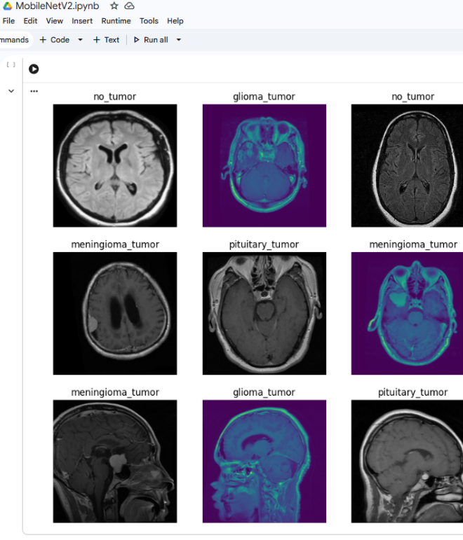
4
Dataset
First dataset
A dataset titled "Brain Tumor Classification (MRI)" was downloaded from Kaggle. It consists of 2,656 JPG images, divided into two categories: training (80%) and testing (20%). Each category is further divided into four subcategories: pituitary tumor, glioma, no tumor, and meningioma.
Second dataset
Another dataset, "Brain Tumor Dataset," was downloaded from Kaggle. It contains 10,560 images, also divided into four subcategories, in both JPG and PNG formats.

Slide 7
5
Methodology & Proposed Approach
Data collection
Data Preprocessing
Built Pre-trained CNNs models
Training model
Evaluation Mode
Prediction images

Slide 8
Data Preprocessing
6
Environment Setup:
Google Colab .
Import libraries(TensorFlow, Keras, Sklearn, Matplotlib).
Data Extraction:
Load and read the MRI images from the four categories
Preprocessing:
Normalization: Standardize pixel values (0-1) to accelerate learning
& img_size = (224, 224)
Augmentation:
Generate additional images (rotation, displacement) to increase the model's generalization ability.
Result
Achieve 4580 images
per category to ensure the model is unbiased.

Slide 9
Experimental Results
7
Approaches | Models | Accuracy | Precision | Recall | F1-score
Pre-trained CNN | MobileNetV2 | 80.4% | 81% | 79% | 79%
 | EfficientNetB0 | 68% | 14% | 21% | 15%
 | Inception v3 | 68% | 69% | 70% | 68%

Slide 10
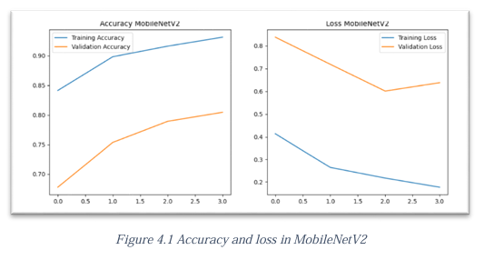
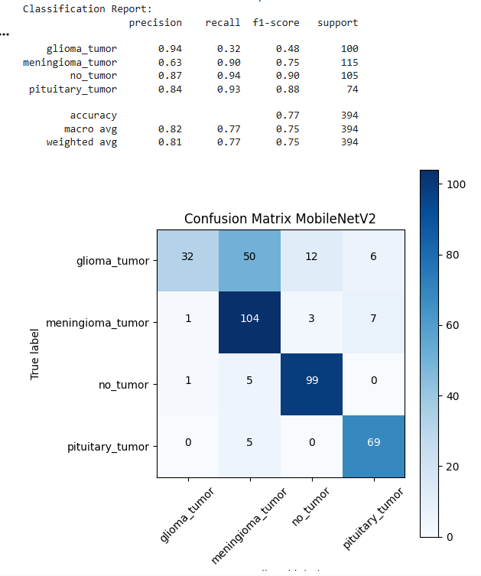
Performance Analysis of the MobileNetV2 Model
8
The model was trained for 4 epochs . Training time: 64 min 52 sec
Accuracy:
A gradual increase in training and validation accuracy.
Convergence of the two curves indicates no overfitting.
Loss:
A clear decrease in training and validation loss across epochs.
Model stability and improved performance over time.
Conclusion:
The model learns efficiently.
Balanced performance between training and validation.
Confusion Matrix
The model performed exceptionally well for pituitary tumor, followed by no tumor, and then meningioma. However, glioma tumor showed the highest error rate.

Slide 11
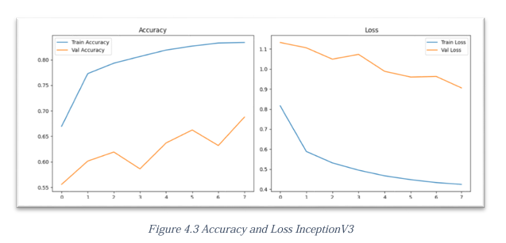
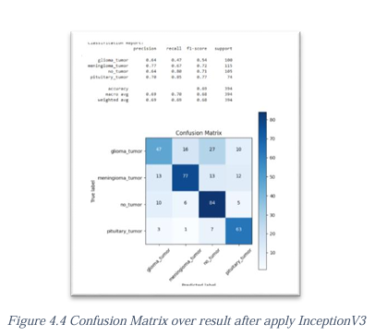
Inception V3 Model Performance Analysis
9
The model was trained for 8 epochs. The training time was 663 minutes and 3 seconds.
Accuracy:
Improved accuracy.
Loss:
Significantly reduced training and validation loss across epochs.
Model stability and improved performance over time.
Conclusion:
The model learns efficiently and does not suffer from over-customization.
Balanced performance between training and validation.
Confusion Matrix
Diagonal values ​​represent correct classifications, while non-diagonal values ​​represent incorrect classifications. The sum of each row represents the actual number of brain tumor types. The sum of each column represents the predicted number of brain tumor types.

Slide 12
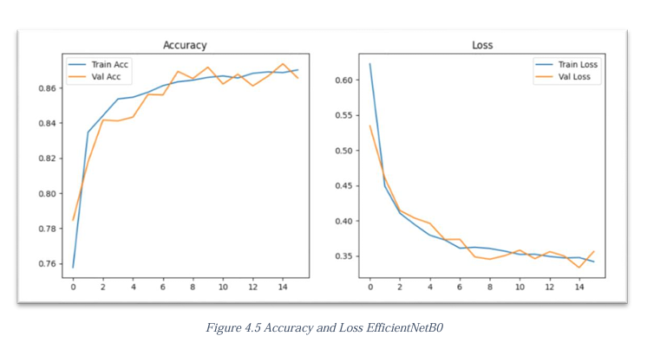
Performance Analysis of the EfficientNetB0 Model
10
The model was trained for 16 epochs.
Training time: 472 min 19 sec.
Accuracy:
Training accuracy increased, and verification accuracy improved.
Loss:
Training and verification losses decreased smoothly.
Similar pattern.
Conclusion:
The model showed no signs of over-customization.
This demonstrates the efficiency of the EfficientNetB0 model architecture in feature extraction while maintaining a balance between learning processes.
The EfficientNetB0 model exhibited balanced and stable performance during the training process, outperforming all other models.

Slide 13
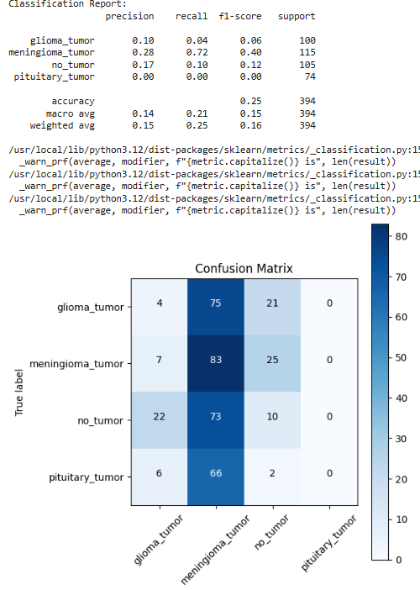
The EfficientNetB0 Confusion Matrix
10
Completely failed to recognize and predict pituitary tumors. In the "no tumor" category, it could not distinguish between healthy and affected images. The model was clearly biased towards classifying most images as meningiomas.
This indicates that the model suffers from several problems and challenges:
Including bias towards a single category.
Poor generalization.
Inability to differentiate between types.
Not learning enough features from the images to classify them correctly.
This model leads to misdiagnosis, making it unsuitable for clinical application without further improvement.

Slide 14
Conclusion
11
The results of this study highlight the importance of early detection of brain tumors and its role in improving treatment outcomes and reducing mortality. The models used showed varying performance, with MobileNetV2 achieving the best accuracy and generalization, while EfficientNetB0 and InceptionV3 scored lower. Data augmentation techniques also contributed to improving the performance of all models and overcoming the data imbalance. These results confirm the effectiveness of using artificial intelligence to support medical diagnosis, especially given the increasing need for accurate and rapid tools for detecting brain tumors.

Slide 15
Future Work
12
Loss Function Enhancement:
Transitioning from a cross-functional loss function to a focal loss function to address model breakdown for dominant classes.
Advanced Balancing:
Applying advanced SMOTE techniques and utilizing intelligent synthetic features selected from the original iteration.
Super parameter Adjustment:
Conducting experiments on learning rate and batch size to ensure stability (confusion matrix).
Multimodal Data:
Integrating MRI data with medical reports (metadata) to perform individualized diagnostic analysis and conduct clinical trials with appropriate specificity.
Increasing data volume to fully leverage the advantages of its structure and optimize tumor profiling.
These studies can greatly benefit low-income healthcare facilities and remote areas, reducing the workload on healthcare practitioners and improving the speed and accuracy of results.

Slide 16
Thank you
13

