Slide 1



Strategic Management
Prepared by Dr. Amira Elfekky
Lecture 9
MGM414

Slide 2



Strategic Leadership
Lecture 9
MGM414
Prepared by
Dr. Amira Elfekky
www.midocean.ae

Slide 3

Content
Part One / Analysis
Chapter 1 What Is Strategy?
Chapter 2 Strategic Leadership: Managing the Strategy Process
Chapter 3 External Analysis: Industry Structure, Competitive Forces, and Strategic Groups
Chapter 4 Internal Analysis: Resources, Capabilities, and Core Competencies
Chapter 5 Competitive Advantage, Firm Performance, and Business Models

Slide 4
Content
Part Two/ Formulation
Chapter 6 Business Strategy: Differentiation, Cost Leadership, and Blue Oceans
Chapter 7 Business Strategy: Innovation, Entrepreneurship, and Platforms
Chapter 8 Corporate Strategy: Strategic Alliances, Mergers, and Acquisitions
Chapter 9 Global Strategy: Competing Around the World
Part Three/ Implementation
Chapter 10 Organizational Design: Structure, Culture, and Control

Slide 5



Strategic Management
Strategic management involves developing and implementing plans to help an organization achieve its goals and objectives. This process can include formulating strategy, planning organizational structure and resource allocation, leading change initiatives, and controlling processes and resources.
www.midocean.ae

Slide 6
Agenda Global Strategy: Competing Around the World
IKEA’s case study
What Is Globalization?
Stages of Globalization
Going Global: Why?
Advantages of Going Global
Disadvantages of Going Global
Going Global: Where and How?
Where in the World to Compete? The CAGE
Distance Framework
National Competitive Advantage: World Leadership in Specific Industries
International Strategy
Multidomestic Strategy
Global-Standardization Strategy
Transnational Strategy
www.midocean.ae

Slide 7
Agenda Global Strategy: Competing Around the World
IKEA’s case study
What Is Globalization?
Stages of Globalization
Going Global: Why?
Advantages of Going Global
Disadvantages of Going Global
Going Global: Where and How?
Where in the World to Compete? The CAGE
Distance Framework
National Competitive Advantage: World Leadership in Specific Industries
International Strategy
Multidomestic Strategy
Global-Standardization Strategy
Transnational Strategy
www.midocean.ae

Slide 8

IKEA’s Secret Strategy
Let’s see if Tesla stuck to its strategy. In 2008, Tesla introduced its first car: the Roadster, a $110,000 sports coupe with faster acceleration than a Porsche or a Ferrari. Tesla’s first vehicle served as a prototype to demonstrate that electric vehicles can be more than mere golf carts. Tesla thus successfully completed Step 1 of the master plan.
How IKEA Used Globalization Strategically
THE WORLD’S MOST profitable global retailer is not Walmart or the UK-based Tesco, but IKEA—a privately owned home-furnishings company hailing from Sweden.
In 2017, IKEA owned more than 400 stores in various formats worldwide in 28 countries, employed over 160,000 people, and earned revenues of more than 35 billion euros. IKEA started as a small retail outlet in 1943 by then-17-year-old Ingvar Kamprad. Though IKEA has become a global phenomenon, it was initially slow to internationalize. It took 20 years before the company expanded beyond Sweden to its neighbour Norway.
www.midocean.ae

Slide 9
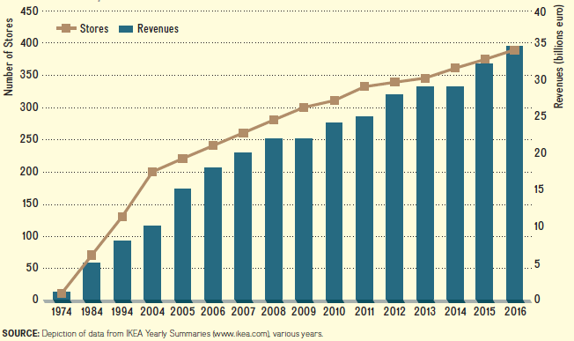
IKEA’s Secret Strategy
Let’s see if Tesla stuck to its strategy. In 2008, Tesla introduced its first car: the Roadster, a $110,000 sports coupe with faster acceleration than a Porsche or a Ferrari. Tesla’s first vehicle served as a prototype to demonstrate that electric vehicles can be more than mere golf carts. Tesla thus successfully completed Step 1 of the master plan.
How IKEA Used Globalization Strategically
www.midocean.ae

Slide 10
IKEA’s Secret Strategy
Let’s see if Tesla stuck to its strategy. In 2008, Tesla introduced its first car: the Roadster, a $110,000 sports coupe with faster acceleration than a Porsche or a Ferrari. Tesla’s first vehicle served as a prototype to demonstrate that electric vehicles can be more than mere golf carts. Tesla thus successfully completed Step 1 of the master plan.
How IKEA Used Globalization Strategically
IKEA is present across all major markets today, having entered India and Serbia in 2017. In recent years IKEA’s strategy has evolved.
IKEA’s revenues by geographic region are mainly from Europe (69 percent), with the rest from North America (18 percent), Asia and Australia (9 percent), and Russia (4 percent); see Exhibit 10.2. Although IKEA’s largest market is in Germany (14 percent of total sales), it is seeing strong growth in China, Canada, Poland, and Australia.
www.midocean.ae

Slide 11
IKEA’s Secret Strategy
Let’s see if Tesla stuck to its strategy. In 2008, Tesla introduced its first car: the Roadster, a $110,000 sports coupe with faster acceleration than a Porsche or a Ferrari. Tesla’s first vehicle served as a prototype to demonstrate that electric vehicles can be more than mere golf carts. Tesla thus successfully completed Step 1 of the master plan.
How IKEA Used Globalization Strategically
IKEA also successfully reinvented itself with changing consumer demands: newer formats such as smaller stores in city centers, click-and-collect locations (small stores for retrieval of online purchases), and more customized furniture solutions to meet the needs of an increasingly urban population. In addition, IKEA is investing heavily in its online presence, enabling consumers to do all their purchasing online, and then schedule delivery, and even installation of furniture. Busy urban professionals are less inclined to spend the well-known frustrating and long hours putting IKEA furniture together (“easy assembly”) with the included low-quality tool and minimal instructions.
www.midocean.ae

Slide 12
Agenda Global Strategy: Competing Around the World
IKEA’s case study
What Is Globalization?
Stages of Globalization
Going Global: Why?
Advantages of Going Global
Disadvantages of Going Global
Going Global: Where and How?
Where in the World to Compete? The CAGE
Distance Framework
National Competitive Advantage: World Leadership in Specific Industries
International Strategy
Multidomestic Strategy
Global-Standardization Strategy
Transnational Strategy
www.midocean.ae

Slide 13

Globalization
Globalization is a process of closer integration and exchange between different countries and peoples worldwide, made possible by falling trade and investment barriers, advances in telecommunications, and reductions in transportation costs.
www.midocean.ae

Slide 14
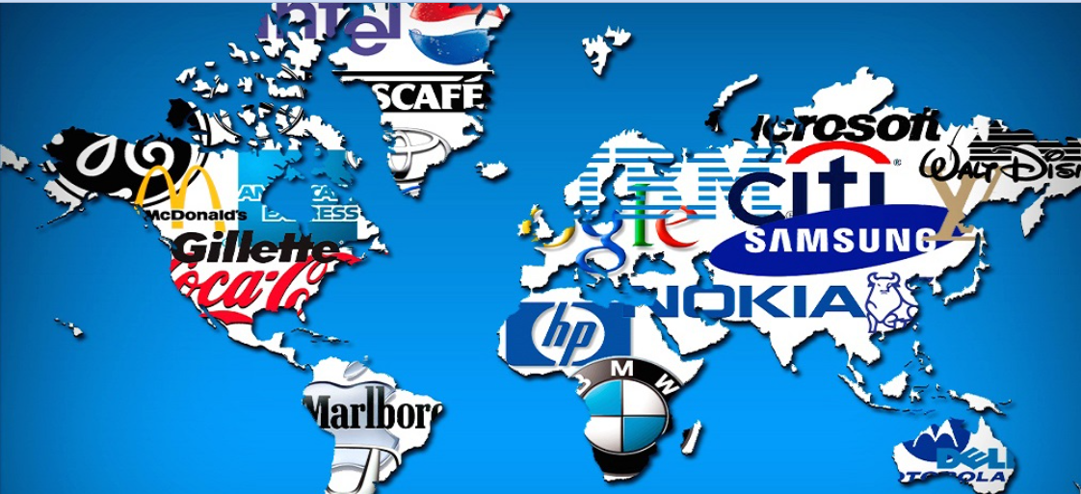
Multinational Enterprise
A company that deploys resources and capabilities in the procurement, production, and distribution of goods and services in at least two countries.
www.midocean.ae

Slide 15

Global Strategy
Global strategy Part of a firm’s corporate strategy to gain and sustain a competitive advantage when competing against other foreign and domestic companies around the world.
www.midocean.ae

Slide 16
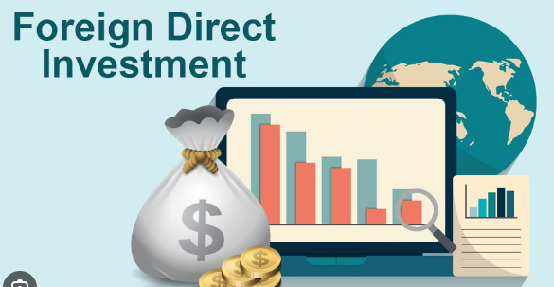
Foreign Direct Investment (FDI)
A firm’s investments in value chain activities abroad.
www.midocean.ae

Slide 17
Agenda Global Strategy: Competing Around the World
IKEA’s case study
What Is Globalization?
Stages of Globalization
Going Global: Why?
Advantages of Going Global
Disadvantages of Going Global
Going Global: Where and How?
Where in the World to Compete? The CAGE
Distance Framework
National Competitive Advantage: World Leadership in Specific Industries
International Strategy
Multidomestic Strategy
Global-Standardization Strategy
Transnational Strategy
www.midocean.ae

Slide 18

Stages of Globalization
Since the beginning of the 20th century, globalization has proceeded through three notable stages. Each stage presents a different global strategy pursued by MNEs headquartered in the United States.
Globalization 1.0: 1900–1941
Globalization 2.0: 1945–2000
Globalization 3.0: 21st century
www.midocean.ae

Slide 19
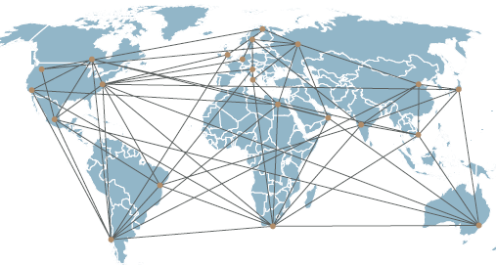
Chapter
Stages of Globalization
9
1- Globalization 1.0: 1900–1941
Globalization 1.0 took place from about 1900 through the early years of World War II. In that period, basically all the important business functions were located in the home country. Strategy formulation and implementation, as well as knowledge flows, followed a one-way path—from domestic headquarters to international outposts. This time period saw the blossoming of the idea of MNEs. It ended with the U.S. entry into World War II.
www.midocean.ae

Slide 20
Chapter
Stages of Globalization
9
2- Globalization 2.0: 1945–2000
With the end of World War II came a new focus on growing business—not only to meet the needs that went unfulfilled during the war years but also to reconstruct the damage from the war. From 1945 to the end of the 20th century, in the Globalization 2.0 stage, MNEs began to create smaller, self contained copies of themselves, with all business functions intact, in a few key countries; notably, Western European countries, Japan, and Australia.
www.midocean.ae

Slide 21
Chapter
Stages of Globalization
9
3- Globalization 3.0: 21st Century
we are in the Globalization 3.0 stage. One watershed event was China’s entry into the World Trade Organization in the same year. The World Trade Organization (WTO) is a global organization overseeing and administering the rules of trade between nations. The goal of the WTO is to help companies conduct their business across borders based on multinational treaties that are negotiated and signed by its 164 member nations.
www.midocean.ae

Slide 22
Agenda Global Strategy: Competing Around the World
IKEA’s case study
What Is Globalization?
Stages of Globalization
Going Global: Why?
Advantages of Going Global
Disadvantages of Going Global
Going Global: Where and How?
Where in the World to Compete? The CAGE
Distance Framework
National Competitive Advantage: World Leadership in Specific Industries
International Strategy
Multidomestic Strategy
Global-Standardization Strategy
Transnational Strategy
www.midocean.ae

Slide 23
Going Global: Why?
The decision to pursue international expansion results from the firm’s assessment that doing so enhances its competitive advantage and that the benefits of globalization exceed the costs. Expanding beyond the home market, therefore, should reinforce a company’s basis of competitive advantage—whether differentiation, low-cost, or value innovation. Here we consider both the advantages and disadvantages of expanding beyond the home market
www.midocean.ae

Slide 24
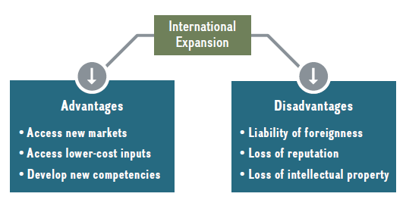
Going Global: Why?
www.midocean.ae

Slide 25
Agenda Global Strategy: Competing Around the World
IKEA’s case study
What Is Globalization?
Stages of Globalization
Going Global: Why?
Advantages of Going Global
Disadvantages of Going Global
Going Global: Where and How?
Where in the World to Compete? The CAGE
Distance Framework
National Competitive Advantage: World Leadership in Specific Industries
International Strategy
Multidomestic Strategy
Global-Standardization Strategy
Transnational Strategy
www.midocean.ae

Slide 26
Advantages of going global
Why do firms expand internationally? The main reasons firms expand abroad are to
■ Gain access to a larger market.
■ Gain access to low-cost input factors.
■ Develop new competencies.
www.midocean.ae

Slide 27
Chapter
Advantages of going global
9
1- Gain access to a larger market
Becoming an MNE provides significant opportunities for companies, given economies of scale and scope that can be reaped by participating in a much larger market. Companies that base their competitive advantage on economies of scale and economies of scope have an incentive to gain access to larger markets because this can reinforce the basis of their competitive advantage.
www.midocean.ae

Slide 28
Chapter
Advantages of going global
9
2 - Gain access to low-cost input factors
MNEs that base their competitive advantage on a low-cost leadership strategy are particularly attracted to go overseas to gain access to low-cost input factors. Access to low-cost raw materials such as lumber, iron ore, oil, and coal was a key driver behind Globalization 1.0 and 2.0. India carved out a competitive advantage in business process outsourcing (BPO), not only because of low-cost labour but also because of an abundance of well-educated, English-speaking young people.
www.midocean.ae

Slide 29
Chapter
Advantages of going global
9
3 - Develop new competencies
Some MNEs pursue a global strategy in order to develop new competencies. This motivation is particularly attractive for firms that base their competitive advantage on a differentiation strategy. These companies are making foreign direct investments to be part of communities of learning, which are often contained in specific geographic regions. AstraZeneca, a Swiss-based pharmaceutical company, relocated its research facility to Cambridge, Massachusetts, to be part of the Boston biotech cluster, in hopes of developing new R&D competencies in biotechnology.
www.midocean.ae

Slide 30
Agenda Global Strategy: Competing Around the World
IKEA’s case study
What Is Globalization?
Stages of Globalization
Going Global: Why?
Advantages of Going Global
Disadvantages of Going Global
Going Global: Where and How?
Where in the World to Compete? The CAGE
Distance Framework
National Competitive Advantage: World Leadership in Specific Industries
International Strategy
Multidomestic Strategy
Global-Standardization Strategy
Transnational Strategy
www.midocean.ae

Slide 31
Disadvantages of going global
Companies expanding internationally must carefully weigh the benefits and costs of doing so. If the cost of going global as captured by the following disadvantages exceeds the expected benefits in terms of value added (C > V), that is, if the economic value creation is negative, then firms are better off by not expanding internationally. Disadvantages of going global include;
■ Liability of foreignness.
■ Loss of reputation.
■ Loss of intellectual property.
www.midocean.ae

Slide 32
Chapter
Advantages of going global
9
1 - Liability of foreignness
In international expansion, firms face risks. In particular, MNEs doing business abroad also must overcome the liability of foreignness. This liability consists of the additional costs of doing business in an unfamiliar cultural and economic environment, and of coordinating across geographic distances. For instance, Walmart’s problems in several international markets are in large part because of the liability of foreignness.
www.midocean.ae

Slide 33
Chapter
Advantages of going global
9
2 - Loss of reputation
One of the most valuable resources that a firm may possess is its reputation. A firm’s reputation can have several dimensions, including a reputation for innovation, customer service, or brand reputation. Apple’s brand, for example, stands for innovation and superior customer experience. Apple’s reputation is also one of its most important resources. Apple’s brand is valued at $230 billion, making it (with Google’s) one of the two most valuable brands in the world
www.midocean.ae

Slide 34
Chapter
Advantages of going global
9
3 - Loss of intellectual property
Finally, the issue of protecting intellectual property in foreign markets. The software, movie, and music industries have long lamented large-scale copyright infringements in many foreign markets. In addition, when required to partner with a foreign host firm, companies may find their intellectual property being siphoned off and reverse-engineered.
www.midocean.ae

Slide 35
Agenda Global Strategy: Competing Around the World
IKEA’s case study
What Is Globalization?
Stages of Globalization
Going Global: Why?
Advantages of Going Global
Disadvantages of Going Global
Going Global: Where and How?
Where in the World to Compete? The CAGE
Distance Framework
National Competitive Advantage: World Leadership in Specific Industries
International Strategy
Multidomestic Strategy
Global-Standardization Strategy
Transnational Strategy
www.midocean.ae

Slide 36
Where in the world to compete?
The question of where to compete geographically is, following vertical integration and diversification, the third dimension of determining a firm’s corporate strategy. The primary driver behind firms expanding beyond their domestic market is to strengthen their competitive position by gaining access to larger markets and low-cost input factors and developing new competencies. To aid MNEs in deciding where in the world to compete, Pankaj Ghemawat introduced the CAGE distance framework. CAGE is an acronym for different kinds of distance:
■ Cultural.
■ Administrative and political.
■ Geographic.
■ Economic.
www.midocean.ae

Slide 37
Chapter
Advantages of going global
9
1 - Cultural
Between two countries increases with.
• Different languages, religions, social norms, and dispositions
• Lack of connective ethnic or social networks
• Lack of trust and mutual respect
www.midocean.ae

Slide 38
Chapter
Advantages of going global
9
1 - Cultural
Most affects industries or products
• With high linguistic content (TV)
• Related to national and/or religious identity (foods)
• Carrying countrys pecific quality associations (wines)
www.midocean.ae

Slide 39
Chapter
Advantages of going global
9
2 - Administrative and Political
Between two countries increases with.
• Absence of trading bloc
• Absence of shared currency, monetary or political association
• Absence of colonial ties العلاقات الاستعمارية
• Political hostilities
• Weak legal and financial institutions
www.midocean.ae

Slide 40
Chapter
Advantages of going global
9
2 - Administrative and Political
Most affects industries or products
• That a foreign government views as staples (electricity), as building national reputations (aerospace), or as vital to national security (telecommunications)
www.midocean.ae

Slide 41
Chapter
Advantages of going global
9
3 - Geographic
Between two countries increases with.
• Lack of common border, waterway access, adequate transportation, or communication links
• Physical remoteness
• Different climates and time zones
www.midocean.ae

Slide 42
Chapter
Advantages of going global
9
3 - Geographic
Most affect industries or products
• With low value- weight ratio (cement)
• That is fragile or perishable (glass, meats)
• In which communications are vital (financial services)
www.midocean.ae

Slide 43
Chapter
Advantages of going global
9
4 - Economic
Between two countries increases with.
• Different consumer incomes
• Different costs and quality of natural, financial, and human resources
• Different information or knowledge
www.midocean.ae

Slide 44
Chapter
Advantages of going global
9
4 - Economic
Most affect industries or products
• For which demand varies by income (cars)
• In which labor and other cost differences matter (textiles)
www.midocean.ae

Slide 45
Agenda Global Strategy: Competing Around the World
IKEA’s case study
What Is Globalization?
Stages of Globalization
Going Global: Why?
Advantages of Going Global
Disadvantages of Going Global
Going Global: Where and How?
Where in the World to Compete? The CAGE
Distance Framework
National Competitive Advantage: World Leadership in Specific Industries
International Strategy
Multidomestic Strategy
Global-Standardization Strategy
Transnational Strategy
www.midocean.ae

Slide 46
National Competitive Advantage: World
Leadership in Specific Industries
MNEs face two opposing forces when competing around the globe: cost reductions versus local responsiveness. Indeed, cost reductions achieved through a global standardisation strategy often reinforce a cost-leadership strategy at the business level.
The four strategic positions, which we will discuss in the following sections are;
■ International strategy
■ Multidomestic strategy
■ Global-standardization strategy
■ Transnational strategy
www.midocean.ae

Slide 47

Chapter
Advantages of going global
9
1 - International strategy
Characteristics
Often the first step in internationalizing. Used by MNEs with relatively large domestic markets or strong exporters (e.g., MNEs from the United States, Germany, Japan, South Korea).
Well-suited for high-end products with high value-to-weight ratios such as machine tools and luxury goods that can be shipped across the globe. Products and services tend to have strong brands. Main business-level strategy tends to be differentiation because exporting, licensing, and franchising add additional costs.
www.midocean.ae

Slide 48

Chapter
Advantages of going global
9
1 - International strategy
Benefits
To benefit from core competencies.
Economies of scale.
Low-cost implementation through:
• Exporting or licensing (for products)
• Franchising (for services)
• Licensing (for trademarks)
www.midocean.ae

Slide 49
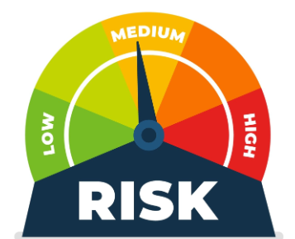
Chapter
Advantages of going global
9
1 - International strategy
Risks
No or limited local responsiveness.
Highly affected by exchange rate fluctuations.
Intellectual property embedded in a product or service can be confiscated.
www.midocean.ae

Slide 50
Chapter
Advantages of going global
9
2 – Multi domestic strategy
Characteristics
Used by MNEs to compete in host countries with large and/or lucrative but idiosyncratic domestic markets (e.g.,
Germany, Japan, Saudi Arabia).
Often used in consumer products and food industries.
Main business-level strategy is differentiation.
MNE wants to be perceived as local company.
www.midocean.ae

Slide 51
Chapter
Advantages of going global
9
2 - Multidomestic strategy
Benefits
Highest-possible local responsiveness.
Increased differentiation.
Reduced exchange-rate exposure.
www.midocean.ae

Slide 52
Chapter
Advantages of going global
9
2 - Multidomestic strategy
Risks
Duplication of key business functions in multiple countries leads to a high cost of implementation.
Little or no economies of scale.
Little or no learning across different regions.
Higher risk of IP expropriation.
www.midocean.ae

Slide 53
Chapter
Advantages of going global
9
3 - Global-standardization strategy
Characteristics
Used by MNEs that are offering standardized products and services (e.g., computer hardware or business process outsourcing).
The main business-level strategy is cost leadership.
www.midocean.ae

Slide 54
Chapter
Advantages of going global
9
3 - Global-standardization strategy
Benefits
Location economies: global division of labour based on wherever best-of-class capabilities reside at the lowest cost.
Economies of scale and standardization.
www.midocean.ae

Slide 55
Chapter
Advantages of going global
9
3 - Global-standardization strategy
Risks
No local responsiveness. Little or no product differentiation.
Some exchange-rate exposure. “Race to the bottom” as wages increase.
Some risk of IP expropriation.
www.midocean.ae

Slide 56
Chapter
Advantages of going global
9
4 - Transnational strategy
Characteristics
Used by MNEs that pursue a blue ocean strategy at the business level by simultaneously focusing on product differentiation and low cost.
Mantra: Think globally, act locally.
www.midocean.ae

Slide 57
Chapter
Advantages of going global
9
4 - Transnational strategy
Benefits
Attempts to combine benefits of localization and standardization strategies simultaneously by creating a global matrix structure.
Economies of scale, location, experience, and learning.
www.midocean.ae

Slide 58
Chapter
Advantages of going global
9
4 - Transnational strategy
Risks
Global matrix structure is costly and difficult to implement, leading to a high failure rate.
Some exchange-rate exposure.
Higher risk of IP expropriation.
www.midocean.ae

Slide 59

www.midocean.ae

Slide 60

Thank You

