Slide 1

PMG 622
Agile Project Management final exam summary slides
18-Apr-2022
Everyone’s Smart
University
دكتور مهندس استشاري ادارة المشروعات
Eng. Dr. Akram Mustafa Suliman Ali,
PhD. AU, BEng. & MSc. AAST, CEng CMarEng MIMarEST, PE, PMP®,
ASQ CSSBB, ISO Lead Auditor, NDT Level II,

Slide 2
All contents of all lectures are included in the exam
يتم تضمين جميع محتويات جميع المحاضرات في الاختبار
The intention of the summary slides is to highlight main concepts of each chapter for the purpose of increasing students’ comprehension.
الغرض من شرائح الملخص هو إبراز المفاهيم الرئيسية لكل فصل بغرض زيادة فهم الطلاب.

Slide 3
PMG 622
Agile Project Management
LECTURE 05: IMPLEMENTING AGILE: DELIVERING IN AN AGILE ENVIRONMENT [Part 2 of 2]
Everyone’s Smart
University
دكتور مهندس استشاري ادارة المشروعات
Eng. Dr. Akram Mustafa Suliman Ali,
PhD. AU, BEng. & MSc. AAST, CEng CMarEng MIMarEST, PE, PMP®,
ASQ CSSBB, ISO Lead Auditor, NDT Level II,

Slide 4
MEASUREMENTS IN AGILE PROJECTS

Slide 5
AGILE TEAMS MEASURE RESULTS
Agile favors empirical and value-based measurements instead of predictive measurements.
Agile measures what the team delivers, not what the team predicts it will deliver.
Agile is based on working products of demonstrable value to customers and not managing to a baseline
Notes:
there is evidence that the smaller the chunk of work, the more likely people are to deliver it.
As an example, if the team averages 50 story points per iteration, and the
team estimates there are about another 500 points remaining, the team
estimates it has about 10 iterations remaining. As the product owner refines
the stories remaining and as the team refines its estimates, the project estimate
could go up or down, but the team can provide an estimate.

Slide 6
Agile duration prediction
Once the team establishes a reliable velocity (average stories or story points per iteration) or the average cycle time, the team can predict how much longer the project will take
Teams might discover it can take four to eight iterations to achieve a stable velocity. The teams need the feedback from each iteration to learn about how they work and how to improve.

Slide 7
Flow-based agile teams measurements:
Lead time (the total time it takes to deliver an item, measured from the time it is added to the board to the moment it is completed)
Cycle time (the time required to process an item)
Response time (the time that an item waits until work starts)
Teams measure cycle time to see bottlenecks and delays, not necessarily inside the team.

Slide 8
tip
When teams depend on external people or groups, measure cycle time to see how long it takes for the team to complete the work.
Measure lead time to see the external dependencies after the team completes its work.
Teams can also measure the reaction time, the time from ready to the first column, to see how long it takes them—on average—to respond to new requests.

Slide 9
The downside of relative estimation
There is no way to compare teams or add velocity across teams

Slide 10
PMG 622
Agile Project Management
LECTURE 06: ORGANIZATIONAL CONSIDERATIONS FOR PROJECT AGILITy
Everyone’s Smart
University
دكتور مهندس استشاري ادارة المشروعات
Eng. Dr. Akram Mustafa Suliman Ali,
PhD. AU, BEng. & MSc. AAST, CEng CMarEng MIMarEST, PE, PMP®,
ASQ CSSBB, ISO Lead Auditor, NDT Level II,

Slide 11
introduction
Cultures, structures, and policies can influence both the direction and the outcome of any project.
Project leaders are expected to navigate organizational dynamics skillfully
Leaders can explore options for change, to increase project success
Project agility is more effective and sustained as the organization adjusts to support it

Slide 12
ORGANIZATIONAL CHANGE MANAGEMENT

Slide 13
iNTRODUCTION
Organizational change management covers the skills and techniques for influencing changes that support agility

Slide 14
DRIVERS FOR CHANGE MANAGEMENT
All projects are about change. However, there are two key factors that further motivate the use of change management practices in an agile context:
  Changes associated with accelerated delivery.
    Agile approaches emphasize delivering project outputs early and often.
    However, the receiving organization may not be fully prepared to incorporate those outputs at an increased pace.
    Customer acceptance of and alignment with project outputs becomes even more prevalent in an agile environment.
  Changes associated with agile approaches.
    Higher degrees of collaboration may require more frequent handoffs between teams, departments, or vendors.
    Decomposing work into iterative prototypes involves rework that could be viewed negatively.
    Leaders should consider change management techniques to address the hurdles of transitioning to the use of agile approaches.
Notes:
1- Successfully discovering and delivering a project's features is not enough. If the organization resists the project's output, then the targeted return on investment is delayed.
2- Organizations just beginning to use agile approaches also experience high degrees of change.

Slide 15
READINESS FOR CHANGE

Slide 16
organizational change-friendly characteristics
Executive management's willingness to change;
Organization's willingness to shift the way it views, reviews, and assesses employees;
Centralization or decentralization of project, program, and portfolio management functions;
Focus on short-term budgeting and metrics versus long-term goals;
Talent management maturity and capabilities.

Slide 17
Organizational roadblock to change
Work is decomposed into departmental silos, creating dependencies that prevent accelerated delivery instead of building cross-functional teams with guidance from centers of competencies.
Procurement strategies are based on short-term pricing strategies, rather than long-term competencies.
Leaders are rewarded for local efficiencies rather than end-to-end flow of project delivery or optimizing the whole (in regard to the organization).
Employees are specialized contributors with limited tools or incentives to diversify their skills instead of building T-shaped specialists.
Decentralized portfolios pull employees simultaneously onto too many projects at once instead of keeping them focused on one project at a time.

Slide 18
approaches to accelerate a cultural compatibility:
Visible and active executive sponsorship,
Change management practices, including communication and coaching,
Progressively pacing the adoption of agile practices on a project-by project basis
Incremental introduction of agile practices to the team; and
Leading by example by using agile techniques and practices where possible.

Slide 19
ORGANIZATIONAL CULTURE

Slide 20
organization's DNA
An organization's culture is its DNA—its core identity.
Culture will always influence the use of agile approaches.
Organizational culture runs along a continuum, from highly predictive plans to lean startup where everything is an experiment.
Although agile approaches fit well with the lean startup culture, a highly predictive organization can encourage empirical measurements, small experiments, and learning so they can move toward agility.

Slide 21
“Culture eats strategy for breakfast”—Peter Drucker
This statement stresses the importance of people's commitment and passion for a cause.
No matter what strategy or plan you implement with your team, its success is going to be governed by the people implementing the plan.
If the people who are driving the strategy aren't passionate about the change, or worse, are apathetic about their job and their organization, then you stand little chance of implementing the change.
Notes:
Peter Ferdinand Drucker
(November 19, 1909 – November 11, 2005)
An Austrian management consultant, educator, and author, whose writings contributed to the philosophical and practical foundations of the modern business corporation.
He invented the concept known as management by objectives and self-control
He has been described as "the founder of modern management".

Slide 22

CREATING AN ENVIRONMENT OF SAFETY
The most important cultural norm in an organization willing to try any new method or technique is enabling a safe work environment.
Only in a safe, honest, and transparent environment can team members and leaders truly reflect on success and failed projects in order to apply lessons learned.

Slide 23
ASSESSING ORGANIZATIONAL CULTURE
Notes:
In this example, a project leader initiates a conversation about organizational priorities with stakeholders, team members, and senior management.
Those priorities are then recorded as positions on a sliding scale between two extremes.
The results are then used to find agile techniques that best fit with those priorities.

Slide 24
Tip: Culture versus Structure
Some people insist new organizational structures be installed before any cultural shift can begin.
Others maintain the opposite—those new organizational structures are only superficial adjustments until the collective culture moves in a meaningful direction.
In reality, one cannot progress without the other.
Project leaders wanting to achieve agility should consider the current and future states of both of these aspects in their organization.
Notes:
Process Re-engineering
Re-structuring
Evolution
Revolution

Slide 25
PMG 622
Agile Project Management
LECTURE 07: ANNEX A3
OVERVIEW OF AGILE AND LEAN FRAMEWORKS [1/2]
Everyone’s Smart
University
دكتور مهندس استشاري ادارة المشروعات
Eng. Dr. Akram Mustafa Suliman Ali,
PhD. AU, BEng. & MSc. AAST, CEng CMarEng MIMarEST, PE, PMP®,
ASQ CSSBB, ISO Lead Auditor, NDT Level II,

Slide 26
Introduction TO AGILE AND LEAN FRAMEWORKS
These approaches can be used as is or combined to adapt to what works best for a given environment or situation.
It is NOT necessary to use any of these; an agile approach can be developed from scratch as long as it adheres to the mindset, values, and principles of the Agile Manifesto.
If the agile principles are followed to deliver value at a sustainable pace, and the developed approach promotes collaboration with the customer, a specific approach is not required.

Slide 27
SELECTION CRITERIA FOR THE AGILE PRACTICE GUIDE
Designed for holistic use
  Intended to guide a broad set of project activities
Formalized for common use
  Intended for common use in a variety of contexts
Popular in modern use
  Adopted by a significant number of industries

Slide 28
scrum

Slide 29
SCRUM
Scrum is a single-team process framework used to manage product development.
The framework consists of Scrum roles, events, artifacts, and rules, and uses an iterative approach to deliver working product.
Scrum is run on timeboxes of 1 month or less with consistent durations called sprints where a potentially releasable increment of product is produced.

Slide 30
The Scrum team (roles)
The product owner is responsible for maximizing the value of the product.
The development team is a cross-functional, self-organizing team consisting of team members who have everything they need within the team to deliver working product without depending on others outside of the team.
The scrum master is responsible for ensuring the Scrum process is upheld and works to ensure the Scrum team adheres to the practices and rules as well as coaches the team on removing impediments.

Slide 31
Scrum events and artifacts

Slide 32
EXTREME PROGRAMMING

Slide 33
XP
eXtreme Programming (XP) is a software development method based on frequent cycles.
The name is based on the philosophy of distilling a given best practice to its purest, simplest form, and applying that practice continuously throughout the project.
XP is most known for popularizing a holistic set of practices intended to improve the results of software projects.
The method was first formalized as a set of twelve primary practices, but then gradually evolved to adopt several other corollary practices.

Slide 34
Notes:
Information Radiators

Slide 35
core values
communication,
simplicity,
feedback,
courage,
respect

Slide 36
key principles
Humanity
Economics
mutual benefit
self-similarity
Improvement
Diversity
Reflection
Flow
Opportunity
redundancy
Failure
Quality
baby steps
accepted responsibility
Notes:
Redundancy
Remove redundant code
Testing is a redundancy we want to keep

Slide 37
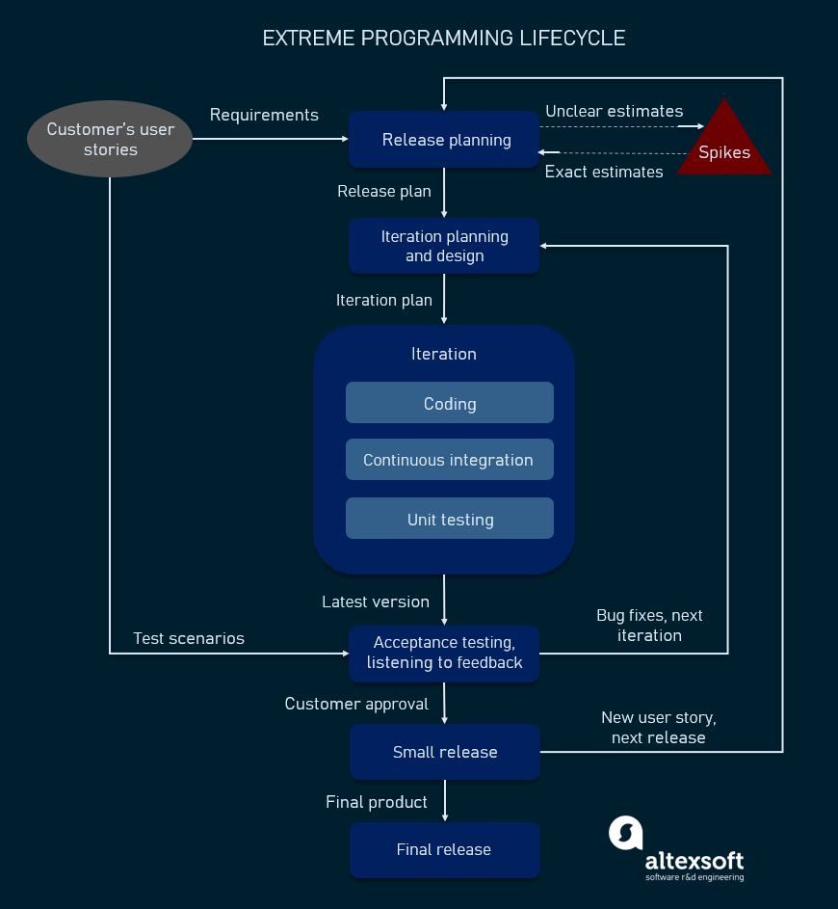

Slide 38
KANBAN METHOD

Slide 39
KANBAN METHOD [1/2]
Kanban in lean manufacturing is a system for scheduling inventory control and replenishment.
This process of “just-in-time” inventory replenishment was originally seen in grocery stores when shelves were restocked based on the gaps in the shelves and not supplier inventory.
Inspired by these just-in-time inventory systems, Taiichi Ohno developed Kanban and it was applied at the main Toyota manufacturing facility in 1953.
The Kanban Method is a holistic framework for incremental, evolutionary process and systems change for organizations.

Slide 40
KANBAN METHOD [2/2]
The method uses a “pull system” to move the work through the process. When the team completes an item, the team can pull an item into that step.
In the Kanban Method, it is more important to complete work than it is to start new work.
There is no value derived from work that is not completed so the team works together to implement and adhere to the work in progress (WIP) limits and get each piece of work through the system to “done.”

Slide 41
KANBan
The word kanban is literally translated as “visual sign” or “card.”
Physical kanban boards with cards enable and promote the visualization and flow of the work through the system for everyone to see.
This information radiator (large display) is made up of columns that represent the states the work needs to flow through in order to get to done.
The simplest of boards could have three columns (i.e., to do, doing, and done), but it is adaptable to whatever states are deemed needed by the team utilizing it.

Slide 42
Applicability and utilization
The Kanban Method is utilized and applicable in many settings and allows for a continuous flow of work and value to the customer.
The Kanban Method is less prescriptive than some agile approaches and thus less disruptive to begin implementing as it is the original “start where you are” method.
Organizations can begin applying Kanban Methods with relative ease and progress toward fully implementing the method if that is what they deem necessary or appropriate.

Slide 43
emphasis
Unlike most agile approaches, the Kanban Method does not prescribe the use of timeboxed iterations.
Iterations can be used within the Kanban Method, but the principle of pulling single items through the process continuously and limiting work in progress to optimize flow should always remain intact.

Slide 44
Conditions for best use [1/2]
Flexibility. Teams are typically not bound by timeboxes and will work on the highest priority item in the backlog of work.
Focus on continuous delivery. Teams are focused on flowing work through the system to completion and not beginning new work until work in progress is completed.
Increased productivity and quality. Productivity and quality are increased by limiting work in progress.
Increased efficiency. Checking each task for value adding or nonvalue-added activities and removing the non-value adding activities.

Slide 45
Conditions for best use [2/2]
Team member focus. Limited work in progress allows the team to focus on the current work.
Variability in the workload. When there is unpredictability in the way that work arrives, and it becomes impossible for teams to make predictable commitments; even for short periods of time.
Reduction of waste. Transparency makes waste visible so it can be removed.

Slide 46
Defining Principles and Properties of the Kanban Method

Slide 47
Kanban board
Kanban boards are a low-tech, hightouch technology that may seem overly simplistic at first, but those using them soon realize their power.
Utilizing policies for entry and exit to columns, as well as constraints such as limiting work in process, kanban boards provide clear insight to workflow, bottlenecks, blockers, and overall status.
Additionally the board acts as an information radiator to anyone who sees it, providing up-to-date information on the status of the work of the team.

Slide 48
PMG 622
Agile Project Management
LECTURE 08: ANNEX A3
OVERVIEW OF AGILE AND LEAN FRAMEWORKS [2/2] & TAILORING
Everyone’s Smart
University
دكتور مهندس استشاري ادارة المشروعات
Eng. Dr. Akram Mustafa Suliman Ali,
PhD. AU, BEng. & MSc. AAST, CEng CMarEng MIMarEST, PE, PMP®,
ASQ CSSBB, ISO Lead Auditor, NDT Level II,

Slide 49
DYNAMIC SYSTEMS DEVELOPMENT METHOD

Slide 50
DSDM
Dynamic Systems Development Method (DSDM) is an agile project delivery framework initially designed to add more rigor to existing iterative methods popular in the 1990s.
It was developed as a noncommercial collaboration among industry leaders.
DSDM is known best for its emphasis on constraint-driven delivery.
The framework will set cost, quality, and time at the outset, and then use formalized prioritization of scope to meet those constraints.
Notes:
RIGOR : دقة

Slide 51
Constraint-driven agility

Slide 52
Dsdm principles
Focus on the business need.
Deliver on time.
Collaborate.
Never compromise quality.
Build incrementally from firm foundations.
Develop iteratively.
Communicate continuously and clearly.
Demonstrate control (use appropriate techniques).

Slide 53
SCALING FRAMEWORKS

Slide 54
SCRUM OF SCRUMS

Slide 55
SoS
Scrum of Scrums (SoS), also known as “meta Scrum,” is a technique used when two or more Scrum teams consisting of three to nine members each need to coordinate their work instead of one large Scrum team.
A representative from each team attends a meeting with the other team representative(s), potentially daily but typically two to three times a week. The daily meeting is conducted similar to the daily standup in Scrum where the representative reports completed work, next set of work, any current impediments, and potential upcoming impediments that might block the other team(s).
The goal is to ensure the teams are coordinating work and removing impediments to optimize the efficiency of all the teams.

Slide 57
DISCIPLINED AGILE (DA)

Slide 58
DA
Disciplined Agile (DA) is a process decision framework that integrates several agile best practices into a comprehensive model.
DA was designed to offer a balance between those popular methods deemed to be either too narrow in focus (e.g., Scrum) or too prescriptive in detail (e.g., AgileUP).

Slide 59
DA principles
People-first. Enumerating roles and organization elements at various levels.
Learning-oriented. Encouraging collaborative improvement.
Full delivery life cycle. Promoting several fit-for-purpose life cycles.
Goal-driven. Tailoring processes to achieve specific outcomes.
Enterprise awareness. Offering guidance on cross-departmental governance.
Scalable. Covering multiple dimensions of program complexity.

Slide 60
PMG 622
Agile Project Management
LECTURE 10: ACP
Everyone’s Smart
University
دكتور مهندس استشاري ادارة المشروعات
Eng. Dr. Akram Mustafa Suliman Ali,
PhD. AU, BEng. & MSc. AAST, CEng CMarEng MIMarEST, PE, PMP®,
ASQ CSSBB, ISO Lead Auditor, NDT Level II,

Slide 61
How Does PMI Think About Agile? [1/3]
The Agile Coach focuses on clarifying project objectives, coordinating with organizational stakeholders, and assisting the self-managing team
You [the Coach] are supporting an Agile project team
  Multi-release schedule
  Numerous Stakeholders
  Software project for large organization
Planning is important, but less important than adapting to change!

Slide 62
How Does PMI Think About Agile? [2/3]
You support the Agile team throughout the project, key Stakeholders are engaged effectively, roles and responsibilities are defined
Self-organizing teams own implementation of project processes
Agile Coaches influence stakeholders, enable change, help to resolve problems, and help teams focus on, and communicate outcomes
We are always looking for small, incremental improvements

Slide 63
How Does PMI Think About Agile? [3/3]
Agile Coaches spend their time:
  Helping the team self-organize and self-manage
  Helping the team resolve problems and impediments
  Help engage stakeholders
  Coach team members and members of the organization on Agile principles
The Agile approach stipulates:
  Plan at the high level up-front, and execute releases and iterations, help the team manage work, communicate with stakeholders
  Planning actions are done by Product Owner working with the team; decisions are made by the team
  Changes to the plan are sought after, and embraced

Slide 64
VALUE-DRIVEN DELIVERY

Slide 65
Introduction
Delivering Value is a cornerstone of Agile methods.
Projects are undertaken to provide businesses with additional value.
Value Driven Delivery is the aim to maximize value throughout the life of the project
  - “Will it make the boat go faster?”
Negative risk reduces or removes value = “Anti-Value”

Slide 66
Assessing Value
There are several mathematical ways to assess value
  Return on investment (ROI)
  Net present value (NPV)
  Internal rate of return (IRR)

Slide 67
Customer-Valued Prioritization
Determining what holds the greatest value for our customers.
MUST involve the customer
Prioritized work packages are arranged in a Product Backlog (SCRUM) or Feature List (FDD).
This is an ongoing process (and relationship!)

Slide 68
LinkedIn account
https://www.linkedin.com/in/doctorakramali/

