Slide 1


Entrepreneurial
New Ventures
Prepared by Dr. Sarah Chahine
ENT 634
Strategies for Firm Growth
Lecture 10

Slide 2


Entrepreneurial
New Ventures
Lecture 10
ENT 634
Strategies for Firm Growth
Prepared by
Dr. Sarah Chahine
www.midocean.ae

Slide 3

Chapter
Introduction
14
Growth strategies can be internal, international and external.
www.midocean.ae

Slide 4

Chapter
Internal Growth Strategies
14
Internal growth strategies involve efforts taken within the firm itself, such as new product development, other product-related strategies, and international expansion, for the purpose of increasing sales revenue and profitability.
The distinctive attribute of internally generated growth is that a business relies on its own competencies, expertise, business practices, and employees. Internally generated growth is often called organic growth because it does not rely on outside intervention.
www.midocean.ae

Slide 5
Chapter
Internal Growth Strategies
14
There are limits to internal growth. As a company enters the middle and later stages of its life cycle, sustaining growth strictly through internal means becomes more challenging.
This can happen when a company has the same product or service that it tries to sell to the same list of potential buyers. Companies in this predicament need to either expand their client list, add new products or services to complement their existing ones, or find new avenues to growth.
www.midocean.ae

Slide 6
Chapter
Internal Growth Strategies
14
New Product Development
New product development involves designing, producing, and selling new products (or services) as a means of increasing firm revenues and profitability. In many fast-paced industries, new product development is a competitive necessity.
It is is a high-risk strategy. The key is developing innovative new products that aren’t simply “me-too” products that are entering already crowded markets.
In many cases, the products are patented, meaning that no one else can make them, at least until the patents expire. Successful new products can also provide sufficient cash flow to fund a company’s operations and provide resources to support developing additional new products.
www.midocean.ae

Slide 7
Chapter
Internal Growth Strategies
14
New Product Development
The keys to effective new product and service development:
  Find a need and fill it: Most successful new products fill a need that is presently unfilled. “Saturated” markets should be avoided.
  Develop products that add value: in addition to finding a need and satisfying it, the most successful products are those that “add value” for customers in some meaningful way.
  Get quality and pricing right: every product represents a balance between quality and pricing. If the quality of a product and its price are not compatible, the product may fail and have little chance for recovery.
www.midocean.ae

Slide 8
Chapter
Internal Growth Strategies
14
New Product Development
The keys to effective new product and service development:
  Focus on a specific target market: Every new product and service should have a specific target market in mind. This degree of specificity gives the innovating entrepreneurial venture the opportunity to conduct a focused promotional campaign and select the appropriate distributors.
  Conduct ongoing feasibility analysis: once a product or service is launched, the feasibility analysis and marketing research should not end. The initial market response should be tested in customer interviews, focus groups, and surveys, and incremental adjustments should be made when appropriate.
www.midocean.ae

Slide 9
Chapter
Additional Internal Product-Growth Strategies
14
Improving an Existing Product or Service:
A business can often increase its revenue by improving an existing product or service—enhancing quality, making it larger or smaller, making it more convenient to use, improving its durability, or making it more up-to-date. Improving an item means increasing its value and price potential from the customer’s perspective.
A mistake many businesses make is not remaining vigilant enough regarding opportunities to improve existing products and services. It is typically much less expensive for a firm to modify an existing product or service and extend its life than to develop a new product or service from scratch.
www.midocean.ae

Slide 10
Chapter
Additional Internal Product-Growth Strategies
14
Increasing the Market Penetration of an Existing Product or Service:
A market penetration strategy involves actions taken to increase the sales of a product or service through greater marketing efforts or through increased production capacity and efficiency.
An increase in a product’s market share is typically accomplished by increasing advertising expenditures, offering sales promotions, lowering the price, increasing the size of the sales force, or increasing a company’s social media efforts.
www.midocean.ae

Slide 11
Chapter
Additional Internal Product-Growth Strategies
14
Increasing the Market Penetration of an Existing Product or Service:
Increased market penetration can also occur through increased capacity or efficiency, which permits a firm to have a greater volume of product or service to sell.
  In a manufacturing context, an increase in product capacity can occur by expanding plant and equipment or by outsourcing a portion of the production process to another company.
Outsourcing is work that is done for a company by people other than the company’s full-time employees.
www.midocean.ae

Slide 12
Chapter
Additional Internal Product-Growth Strategies
14
Extending Product Lines:
A product line extension strategy involves making additional versions of a product so that it will appeal to different clientele or making related products to sell to the same clientele.
Geographic Expansion:
Many entrepreneurial businesses grow by simply expanding from their original location to additional geographic sites. This type of expansion is most common in retail settings.
www.midocean.ae

Slide 13
Chapter
International Expansion
14
From the time they are started, these firms, which are sometimes called “global start-ups” or “born globals,” view the world as their marketplace rather than confining themselves to a single country.
Although there is vast potential associated with selling overseas, it is a fairly complex form of firm growth.
www.midocean.ae

Slide 14
Chapter
External Growth Strategies
14
An emphasis on external growth strategies typically results in a more fast-paced, collaborative approach toward growth than the slower-paced internal strategies, such as new product development.
External growth strategies level the playing field between smaller firms and larger companies.
www.midocean.ae

Slide 15
Chapter
External Growth Strategies
14
Mergers and Acquisitions:
Many entrepreneurial firms grow through mergers and acquisitions. A merger is the pooling of interests to combine two or more firms into one. An acquisition is the outright purchase of one firm by another. In an acquisition, the surviving firm is called the acquirer, and the firm that is acquired is called the target. This section focuses on acquisitions rather than mergers because entrepreneurial firms are more commonly involved with acquisitions than mergers.
www.midocean.ae

Slide 16
Chapter
External Growth Strategies
14
Mergers and Acquisitions:
Acquiring another business can fulfill several of a company’s needs, such as expanding its product line, gaining access to distribution channels, gaining access to technology that will enhance its current offerings, or gaining access to talented employees. In most cases, a firm acquires a competitor or a company that has a product line or a core competence that it needs.
Although it can be advantageous, the decision to grow the entrepreneurial firm through acquisitions should be approached with caution. Many firms have found that the process of assimilating another company into their current operation is not easy and can stretch finances to the brink.
www.midocean.ae

Slide 17
Chapter
External Growth Strategies
14
Finding an Appropriate Acquisition Candidate:
If a firm decides to grow through acquisition, it is very important for it to exercise extreme care in finding acquisition candidates. Many acquisitions fail not because the companies involved lack resolve, but because they were a poor match to begin with. There are typically two steps involved in finding an appropriate target firm. The first step is to survey the marketplace and make a “short list” of promising candidates. The second is to carefully screen each candidate to determine its suitability for acquisition. The key areas to focus on in accomplishing these two steps are as follows:
www.midocean.ae

Slide 18
Chapter
External Growth Strategies
14
Finding an Appropriate Acquisition Candidate:
The target firm’s openness to the idea of being acquired.
The strength of the target firm’s management team, its industry, and its physical proximity to the acquiring firm’s headquarters.
The perceived compatibility of the target company’s top management team and corporate culture with the acquiring firm’s top management team and corporate culture.
The target firm’s past and projected financial performance.
The extent to which the acquiring firm understands the business and industry of the target firm.
www.midocean.ae

Slide 19
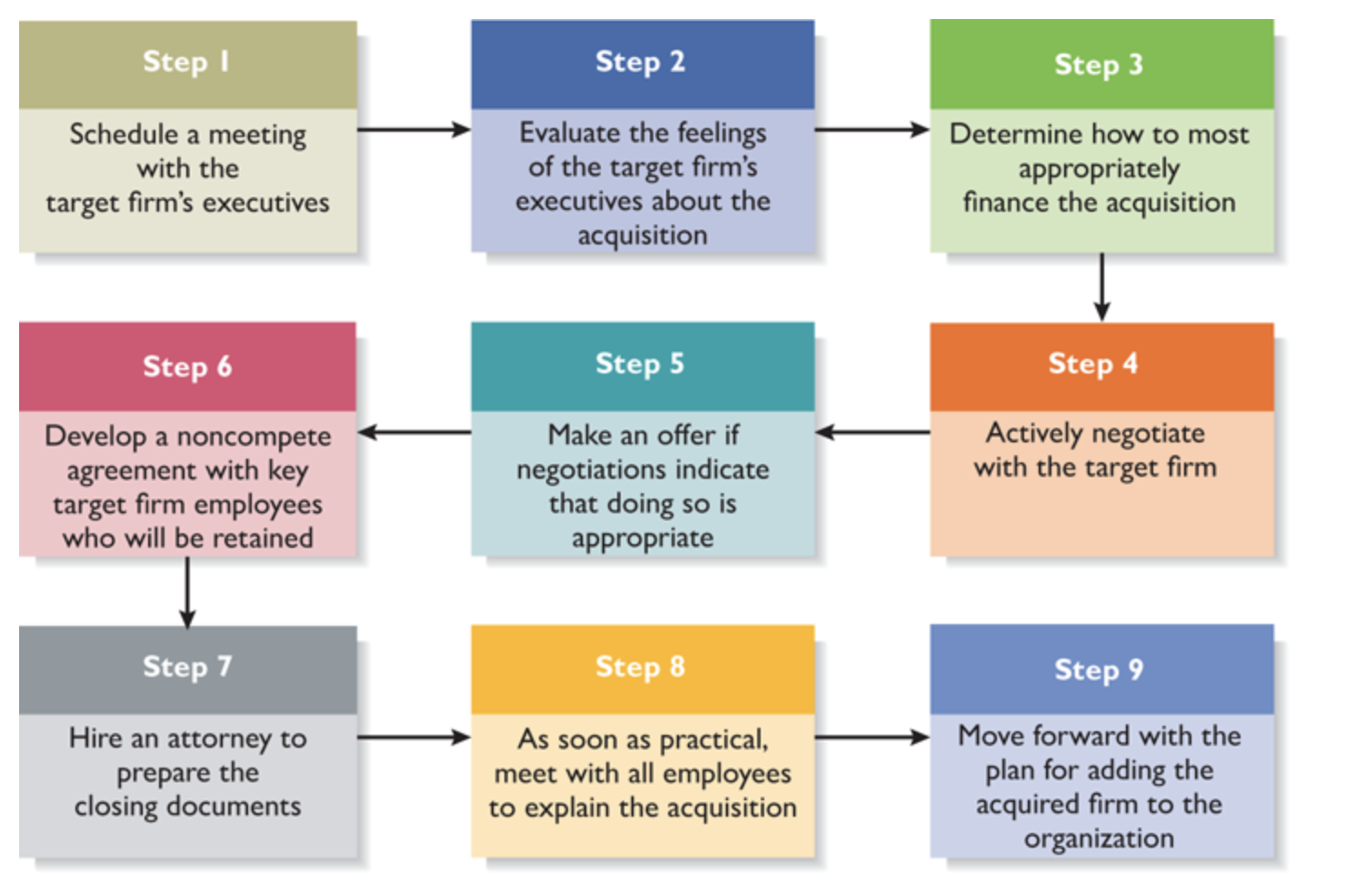
Chapter
External Growth Strategies
14
Steps Involved in an Acquisition:
www.midocean.ae

Slide 20
Chapter
External Growth Strategies
14
Licensing:
Licensing is the granting of permission by one company to another company to use a specific form of its intellectual property under clearly defined conditions. Virtually any intellectual property a company owns that is protected by a patent, trademark, or copyright can be licensed to a third party. Licensing also works well for firms that create novel products but do not have the resources to build manufacturing capabilities or distribution networks, which other firms may already have in place.
www.midocean.ae

Slide 21
Chapter
External Growth Strategies
14
Licensing:
The terms of a license are spelled out through a licensing agreement, which is a formal contract between a licensor and a licensee. The licensor is the company that owns the intellectual property; the licensee is the company purchasing the right to use it. A license can be exclusive, nonexclusive, for a specific purpose, and for a specific geographic area.
In almost all cases, the licensee pays the licensor an initial payment plus an ongoing royalty for the right to use the intellectual property. There is no set formula for determining the amount of the initial payment or the royalties—these are issues that are part of the process of negotiating a licensing agreement.
www.midocean.ae

Slide 22
Chapter
External Growth Strategies
14
Licensing:
There are two principal types of licensing: technology licensing and merchandise and character licensing.
Technology licensing is the licensing of proprietary technology that the licensor typically controls by virtue of a utility patent.
Merchandise and character licensing is the licensing of a recognized trademark or brand that the licensor typically controls through a registered trademark or copyright.
www.midocean.ae

Slide 23
Chapter
External Growth Strategies
14
Strategic Alliances and Joint Ventures:
A strategic alliance is a partnership between two or more firms that is developed to achieve a specific goal. Various studies show that participation in alliances can boost a firm’s rate of patenting, product innovation, and foreign sales. Alliances tend to be informal and do not involve the creation of a new entity (such as in a joint venture). Although engaging in alliances can be tremendously helpful for an entrepreneurial firm, setting up an alliance and making it work can be tricky.
www.midocean.ae

Slide 24
Chapter
External Growth Strategies
14
Strategic Alliances and Joint Ventures:
Technological alliances and marketing alliances are two of the most common forms of alliances.
Technological alliances feature cooperation in research and development, engineering, and manufacturing. Research-and-development alliances often bring together entrepreneurial firms with specific technical skills and larger, more mature firms with experience in development and marketing. By pooling their complementary assets, these firms can typically produce a product and bring it to market faster and cheaper than either firm could alone.
www.midocean.ae

Slide 25
Chapter
External Growth Strategies
14
Strategic Alliances and Joint Ventures:
Marketing alliances typically match a company that has a distribution system with a company that has a product to sell in order to increase sales of a product or service. For example, an American food company may initiate an alliance with Nestlé (a Swiss food company) to gain access to Nestlé’s distribution channels in Europe.
www.midocean.ae

Slide 26
Chapter
External Growth Strategies
14
Strategic Alliances and Joint Ventures:
Both technological and marketing alliances allow firms to focus on their specific area of expertise and partner with others to fill their expertise gaps. This approach is particularly attractive to entrepreneurial firms, which often lack the financial resources or time to develop all the competencies they need to bring final products to market quickly.
www.midocean.ae

Slide 27
Chapter
External Growth Strategies
14
Strategic Alliances and Joint Ventures:
A joint venture is an entity created when two or more firms pool a portion of their resources to create a separate, jointly owned organization.
Gaining access to a foreign market is a common reason for a firm to form a joint venture. In these cases, the joint venture typically consists of the firm trying to reach a foreign market and one or more local partners. Joint ventures created for reasons other than foreign market entry are typically described as either scale or link joint ventures.
www.midocean.ae

Slide 28
Chapter
External Growth Strategies
14
Strategic Alliances and Joint Ventures:
In a scale joint venture, the partners collaborate at a single point in the value chain to gain economies of scale in production or distribution. This type of joint venture can be a good vehicle for developing new products or services.
In a link joint venture, the position of the parties is not symmetrical, and the objectives of the partners may diverge. For example, many of the joint ventures between American and European food companies provide the American partner with access to European markets and distribution channels and the European partner with the opportunity to add to its product line.
www.midocean.ae

Slide 29


Thank You

