Slide 1


College of Humanities
Master of Financial
Technology-
FinTech
Business Analysis
FNT613
7th Lecture
Prepared By:
Dr. Abeir Moussa

Slide 2



Defining the Solution&
Making a Business and Financial Case
7th lecture
FNT613
Prepared By:
Dr. Abeir Moussa
www.midocean.ae

Slide 3


Defining the Solution&
Making a Business and Financial Case
Week8
Chapters- 8&9
www.midocean.ae

Slide 4

Learning objectives
Understand the problem or challenge that needs to be addressed.
learn how to gather relevant information and data through research.
Ability to generate creative and innovative ideas for potential solutions.
Develop the skills to evaluate and assess potential solutions.
Effectively communicate the solution to stakeholders,
Ability to document and present the defined solution in a structured and organized manner.
www.midocean.ae

Slide 5
Learning objectives Cont.
Understanding Business and Financial Case
Ability to identifying Objectives and Benefits
Ability to Conducting Cost-Benefit Analysis
Ability to assess Risks and Mitigation Strategies
Developing skills of analyzing Financial Viability
Ability to develop a Business Case
Develop skills to Communicate the Business Case:
www.midocean.ae

Slide 6
Chapter outline
Defining the Solutions
Making a Business and Financial Case
www.midocean.ae

Slide 7
1. Defining the Solution
One of the key activities conducted by business analysts is the analysis of the gap between where the business is currently and where it needs to be in terms of its processes and systems.
While addressing the problematic areas identified during the analysis process, the selected option will also need to align with the defined business architecture for the organization.
This part of knowledge looks at two aspects regarding the development of options for business change:
1. Analyzing the gap between the current and desired business systems.
2. Ensuring the alignment of any proposed actions with the business architecture.
www.midocean.ae

Slide 8

GAP Analysis
Organization
People
Formulating Options
Defining Business Requirements
Introduction to Business Architecture
Defining of Business Architecture
Structure of a Business Architecture
Business Architecture Techniques
Defining the Solution
www.midocean.ae

Slide 9
1. Defining the Solution
GAP Analysis
          Identifying areas of concern
          Framework for gap analysis
          Processes
          Information and technology
                IT support
                Accessibility
                Alignment with the enterprise architecture
www.midocean.ae

Slide 10
1. Defining the Solution
Gap Analysis
Gap analysis requires the business analyst to explore the differences between a current state and a desired future state.
A Business Activity Model (BAM) provides a conceptual overview of a desired future business system, showing ‘what’ activities would be needed to fulfil a stakeholder perspective, or where this is a consensus BAM, the agreed perspective.
At a more specific level, gap analysis may be used to examine any of the following areas:
the ‘as is’ and ‘to be’ business process models;
the competencies held by an individual and those required for a particular role;
the IT system requirements and the features offered by an off-the-shelf soft-ware package.
www.midocean.ae

Slide 11
1. Defining the Solution
GAP Analysis
Identifying areas of concern
  The activities on the BAM should be inspected and categorized in order to identify those requiring further attention. Three categories may be used for the activities:
  operating satisfactorily – no immediate action;
  some issues to be addressed – action required;
  not in place – urgent consideration.
Categorizing the activities in this way allows us to priorities the work in line with the original objectives and scope for the business analysis work. Once we have an idea of the areas requiring most attention, we can conduct the gap analysis at a more detailed level, focusing on ‘how’ the work is conducted.
www.midocean.ae

Slide 12
1. Defining the Solution
GAP Analysis
  Framework for gap analysis
it is often the case that the initial investigation focuses on modelling the processes or defining the requirements but this can lead to the change proposals being limited or failing to address the real problems.
When taking a holistic approach, the analysts ensure that they consider aspects such as the organization's structure, culture and management style in addition to examining the business processes and IT systems.
The POPIT™ model, shown in Figure 8.1, provides a framework and aide memoire that helps ensure that the analysis considers all of the required elements.
www.midocean.ae

Slide 13
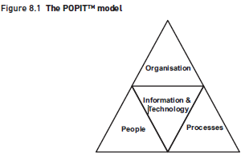
1. Defining the Solution
www.midocean.ae

Slide 14
1. Defining the Solution
GAP Analysis
  Processes
The usual starting point for gap analysis is to consider the ‘as is’ and ‘to be’ processes.
if a process improvement requires that two roles are to be merged, then there is likely to be a corresponding impact on the structure, job role descriptions, skill requirements and IT systems.
The definition of the revised processes will need to be clear and unambiguous which is why using a standard modelling technique, can be extremely helpful.
It is also important that a more detailed definition is developed, representing the procedures to be applied when individual tasks are undertaken; this is necessary to support the definition of the IT requirements, clarify any new process documentation requirements, support the development of revised job role descriptions and form the basis for training in the new processes.
www.midocean.ae

Slide 15
1. Defining the Solution
GAP Analysis
  Information and technology
During gap analysis, the information required should be analyzed using techniques such as document analysis and modelled using entity relationship models or class diagrams.
These help to identify the information needed to perform the business processes, identify where additional information is required and clarify the information requirements.
The technology element of the POPIT model is often the core enabler of the business change. Typically, it will be important to think about the following areas:
www.midocean.ae

Slide 16
1. Defining the Solution
GAP Analysis
  Information and technology
    IT support
    Accessibility
    Alignment with the enterprise architecture
www.midocean.ae

Slide 17
1. Defining the Solution
GAP Analysis
  Information and technology
    IT support
If the ‘to be’ business processes require additional IT support, the analysts will need to consider the requirements that should be delivered by the technology.
    Accessibility
  When introducing a change to the IT systems used to perform processes, it is important to ensure that the systems are as accessible as possible to effectively used.
www.midocean.ae

Slide 18
1. Defining the Solution
GAP Analysis
  Information and technology
    Alignment with the enterprise architecture
    IT systems should be well-integrated with each other and with the overall infrastructure that exists for the delivery of the IT services. This to avoid problems such as limited automatic data transfer, which may result in the re-keying of data, inconsistent data formats and definitions, and different systems holding differing values for the same data.
www.midocean.ae

Slide 19
1. Defining the Solution
Organization
This is often the area that is overlooked during gap analysis and option development.
One of the reasons why a holistic view is so important during the investigation of the current system, is that it causes us to consider organizational aspects such as structure and culture.
McKinsey’s 7-S model (Figure 8.2), introduced in Chapter 3, can be useful here, providing a framework for thinking about the different elements that contribute to the organizational view.
www.midocean.ae

Slide 20
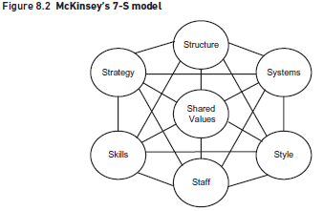
1. Defining the Solution
www.midocean.ae

Slide 21
1. Defining the Solution
People
The analysis should consider the impact upon the people who will perform the work and identify any gaps to be addressed. The following areas are particularly important:
  Skills
  Recruitment
  Staff development
  Motivation and reward
www.midocean.ae

Slide 22
1. Defining the Solution
People
  Skills
It is necessary to think about what skills the new job roles require, how much support will be needed during the transition and what training should be delivered to ensure the smooth implementation of the new business processes.
  Recruitment
If there is a skills gap, there may be a need for further recruitment of staff. The definition of the required skills will help to provide a basis for any additional recruitment.
  Staff development
One of the gaps may concern the approach adopted to career development. It is important to think about questions such as ‘Is there an appraisal scheme in place?’ and if so, ‘Does it appraise the right things and lead to effective skill development?’
  Motivation and reward
It can also be useful to consider the levels of staff motivation and, more tangibly, the reward systems in place.
www.midocean.ae

Slide 23
1. Defining the Solution
Formulating Options
Once we have an understanding of the gaps to be addressed, we can begin to formulate the options for change. As in all business changes, we need to ensure that any proposals are feasible from the financial, business and technological perspectives.
It is of no use putting forward proposals that change one or two elements of the POPIT model while not considering the others; the best IT systems in the world will not operate effectively if the people do not know how to use them or cannot access them.
Similarly, it is not possible to change a team structure without considering the impact on individuals and ensuring that they are clear about the new way of working.
www.midocean.ae

Slide 24
1. Defining the Solution
Defining Business Requirements
The outcome from the gap analysis is a list of business requirements that need to be delivered. These requirements are likely to be at the ‘what’ level rather than dictating the precise ways in which they will be met. However, at this point, there are likely to be some requirements that will need to form part of the IT solution.
www.midocean.ae

Slide 25
1. Defining the Solution
Introduction to Business Architecture
Any proposed business change must align with the business architecture.
It is common for even small changes to affect multiple processes, IT systems and databases requiring vast expense, often without the change adding any real value and causing disruption to areas of the business that were working well.
In many cases, this is because business analysts usually work in one designated area and do not always have the opportunity to see how the change they propose fits within the broader picture or indeed whether work being undertaken elsewhere may impact upon their work.
A business architecture begins to evolve when two or more business areas (including those from outside the scope of the specific business itself) are thought of as an integrated set of capabilities that delivers value.
Once a high level plan or blueprint of the organization exists, it is possible to evaluate various scenarios for change in terms of their impact and effectiveness, and ensure that any changes to be undertaken can be aligned with this overall business architecture.
www.midocean.ae

Slide 26
1. Defining the Solution
Defining of Business Architecture
The Business Architecture Guild (2014) defines business architecture as:
A blueprint of the enterprise that provides a common understanding of the organization that can be used to align strategic objectives and tactical demands.
This definition encapsulates the important role that the business architecture plays as an interface between strategy and the implementation of change. Hence, employed effectively, a robust business architecture results in the following:
the strategy drives changes to the business architecture;
the business architecture informs and refines the strategy;
the business architecture translates the strategy for execution;
the strategy execution enables and generates improvement to the overall business architecture.
www.midocean.ae

Slide 27
1. Defining the Solution
Structure of a Business Architecture
There are many models and documents that could be included as artefacts within a business architecture; in effect they would provide many different views of the business. For example, the artefacts of a business architecture might document any of the following:
capabilities;
values;
information;
products;
suppliers and partners;
motivations;
business units;
policies.
www.midocean.ae

Slide 28
1. Defining the Solution
Structure of a Business Architecture
Evolving best practice has shown that the key elements of a business architecture represent the following areas:
business motivations;
business capabilities;
value streams (which can be mapped to more detailed business processes);
organizational business units;
information concepts.
From this list, the business capabilities and the value streams that enable them are widely regarded as the essence of an effective business architecture and it is with these that the construction of a business architecture should always begin.
www.midocean.ae

Slide 29
1. Defining the Solution
Business Architecture Techniques
The two key techniques from that form the essence of an effective Business Architecture are:
  Business capability modeling
  Value stream analysis
www.midocean.ae

Slide 30
1. Defining the Solution
Business Architecture Techniques
  Business capability modeling
Capability models represent, at a high level, what the organization need to be able to do in order to deliver value to customers. While these initial capabilities can be decomposed to a number of levels, they should never reflect how delivery is actually achieved in practice.
A capability is a particular ability to achieve an outcome, i.e. they reflect what a business is able to do that creates value for a customer. A full business capability model usually investigates and models the whole organization across a number of business strata (layers). The main strata found on a typical business capability model would be:
strategic or direction setting;
core or customer facing;
supporting.
Table 8.1 provides some examples of business capabilities at the Foundation level.
www.midocean.ae

Slide 31
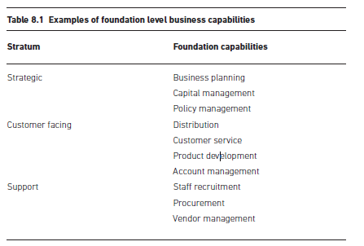
1. Defining the Solution
www.midocean.ae

Slide 32
1. Defining the Solution
Business Architecture Techniques
  Value stream analysis
There are many techniques that can be used to investigate and represent the delivery of value.
A value stream is an end-to-end collection of high-level linear stages that create an outcome of value to a specific customer group. Value streams are used to identify, map and analyze the value exchanged between an organization and various stakeholders (internal and external). They focus on the delivery of value and may not reflect the way the work is done in practice.
The value stream shows the main sequential stages which add value to the customer.
Figure 8.3 shows an example of a value stream dealing with mortgage applications on behalf of a mortgage lender.
www.midocean.ae

Slide 33
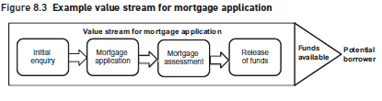
1. Defining the Solution
www.midocean.ae

Slide 34
1. Defining the Solution
Business Architecture Techniques
  Value stream analysis
When producing a value stream, it is worth noting some key guiding principles. Value streams should:
be stakeholder focused;
take an holistic view;
be customer centric;
facilitate further decomposition;
help identify which business capabilities help achieve stakeholder value.
www.midocean.ae

Slide 35
2. Making a Business and Financial Case
A business case is a key document in a business analysis project and is the place where the analysts present their findings and propose a course of action for senior management to consider. To some extent, a business case is a ‘sales’ document, aimed at getting people to take a decision. Therefore, some of the key rules of successful selling apply: stress benefits, not features; sell the benefits before discussing the cost; get the ‘buyers’ to understand the size of the problem – or opportunity – before presenting the amount of time, effort and money that will be needed to implement a solution.
www.midocean.ae

Slide 36
The Business Case in the Project Life cycle
Defining Options
Assessing Project Feasibility
Structure of a Business Case
Investment Appraisal
Presentation of a Business Case
RAID and CARDI Logs
2. Making a Business and Financial Case
www.midocean.ae

Slide 37
2. Making a Business and Financial Case
The Business Case in the Project Life cycle
A question often asked about the business case is ‘when should it be produced?’ This issue is addressed in Figure 9.1. As the illustration shows, a business case is a living document and should be revised as the project proceeds and as more is discovered about the proposed solution and the costs and benefits of introducing it.
In addition, organizations and the environments in which they operate are not static and so the business case must be kept under review to ensure that changing circumstances have not invalidated it.
The initial business case often results from a feasibility study, where the broad requirements and options have been considered and where ‘ballpark’ estimates of costs and benefits are developed.
The business case should next be reviewed before the solution is deployed, precisely because the costs of deployment are now more reliable.
www.midocean.ae

Slide 38
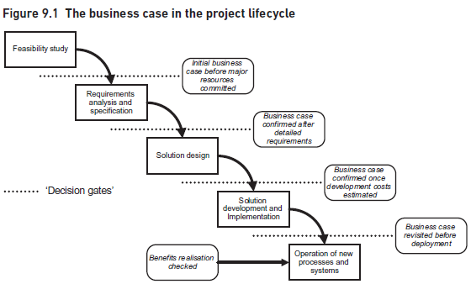
2. Making a Business and Financial Case
www.midocean.ae

Slide 39
2. Making a Business and Financial Case
The Business Case in the Project Life cycle
Figure 9.1 refers to each of these review points as ‘decision gates’. The concept shown, now widely used in project management, is that projects should pass certain tests – not least those relating to their business viability – before they can be allowed to proceed to the next stage.
www.midocean.ae

Slide 40
2. Making a Business and Financial Case
2. Identifying Options
The first step in putting together a business case is to identify and explore the various options that exist for solving the business issue. There are actually two kinds of options:
Business options that explore what the proposed solution is intended to achieve in business terms – for example, ‘speed up invoice handling by 50 per cent’ or ‘reduce the number of people we need to staff our supermarket’.
Technical options that consider how the solution is to be implemented, often through the use of information technology.
At one time, it was considered that these two elements should be considered separately and deal with business first, the aim being to avoid the technical ‘tail’ wagging the business ‘dog’.
Nowadays, however, most changes to business practice involve the use of IT in some form and it is often the availability of technology that makes the business solutions possible.
For this reason, it is a bit difficult to keep business and technical options separate but it remains true that business needs should drive the options process, rather than the use of technology for its own sake.
www.midocean.ae

Slide 41
2. Making a Business and Financial Case
2. Identifying Options
The basic process for developing options is shown in Figure 9.2. Identifying options is probably best achieved through some form of workshop, where brainstorming and other creative problem-solving approaches can be employed. Modelling techniques such as Business Activity Modelling or Business Process Modelling are also useful to help generate options. The aim is to get all of the possible ideas out on the table before going on to consider which ones are most promising. Even if some of the ideas seem a bit far-fetched, they may provide part of the actual solution or stimulate other people to come up with similar, but more workable, suggestions. Another way of identifying options is to study what other organizations – possibly your competitors – have done to address the same issues.
www.midocean.ae

Slide 42

2. Making a Business and Financial Case
Once all the possibilities have been flushed out, they can be subjected to evaluation to see which ones are worth examining further. Some ideas can usually be rejected quite quickly as being too expensive, or taking too long to implement, or being counter-cultural.
www.midocean.ae

Slide 43
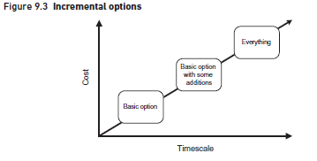
2. Making a Business and Financial Case
www.midocean.ae

Slide 44
2. Making a Business and Financial Case
2. Identifying Options
In Figure 9.3, the bottom option just deals with the most pressing issues, as quickly as possible and at minimal cost. The next option adds some additional features to the solution but costs more and takes longer. The last option a comprehensive solution but obviously takes the longest and costs the most.
One option that should always be considered – and which should usually find its way into the actual business case – is that of doing nothing.
www.midocean.ae

Slide 45
2. Making a Business and Financial Case
3. Assessing Project Feasibility
There are many issues to think about in assessing feasibility but all fall under the three broad headings illustrated in Figure 9.4.
www.midocean.ae

Slide 46
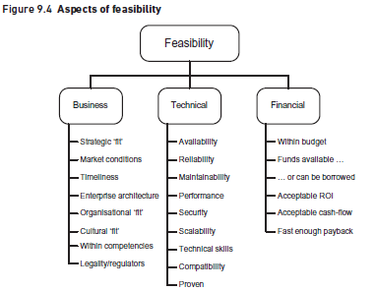
2. Making a Business and Financial Case
www.midocean.ae

Slide 47
2. Making a Business and Financial Case
3. Assessing Project Feasibility
Business feasibility: issues include whether the proposal matches the business objectives and strategy of the organization
Technical feasibility: one is normally – though not necessarily – considering IT. The proposed solution must meet the organization's demands in terms of system performance, availability, reliability, maintainability and security
Financial feasibility: is about whether the organization can afford the proposed solution. There may already be a budget imposed. The organization needs either to have the required funds available or to be in a position to borrow them.
www.midocean.ae

Slide 48
2. Making a Business and Financial Case
3. Assessing Project Feasibility
Another tool that can be used in assessing feasibility is a PESTLE analysis. PESTLE examines the environment outside an organization, or perhaps within an organization but outside the area being studied. It can be used to assess feasibility like this:
  Political: Is the proposed solution politically acceptable?
  Economic: Can the organization afford the solution?
  Socio-cultural: Does the solution fit with the organization's culture?
  Technological: Can the solution be achieved, technically?
  Legal: Is it legal, will the regulator allow it?
  Environmental: Does it raise any ‘green’ environmental issues?
www.midocean.ae

Slide 49
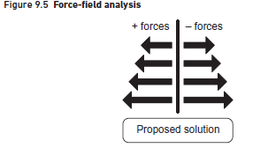
2. Making a Business and Financial Case
A final tool that can be employed to assess the feasibility of an option is a ‘force-field analysis’, illustrated in Figure 9.5.
www.midocean.ae

Slide 50
2. Making a Business and Financial Case
With a force-field analysis, we consider those forces inside and outside the organization that will support adoption of the proposal and those that will oppose it; and we need to be sure that the positive forces outweigh the negative. The forces may include the PESTLE factors mentioned above, the elements identified in Figure 9.4 and also the key stakeholders in the organization (see Chapter 6). If we conclude that the negative forces are just too strong, then the proposal is not feasible and must be abandoned or re-cast in a way that gets more positive forces behind it.
In considering the feasibility of options, we also need to think about their impacts and risks.
www.midocean.ae

Slide 51
2. Making a Business and Financial Case
4. Structure of a Business Case
the structure and content of most business cases are similar and tend to include these elements:
introduction;
management summary;
description of the current situation;
options considered;
analysis of costs and benefits;
impact assessment;
risk assessment;
recommendations;
appendices, with supporting information.
www.midocean.ae

Slide 52
2. Making a Business and Financial Case
4. Structure of a Business Case
Introduction
This sets the scene and explains why the business case is being presented. Where relevant, it should also describe the methods used to examine the business issue and acknowledge those who have contributed to the study.
Management summary
this is the most important part of the document as it is possibly the only part that the senior decision-makers will study properly. It should be written after the rest of the document has been completed and should distill the whole of the business case into a few paragraphs. In an ideal situation, three paragraphs should suffice:
          What the study was about and what was found out about the issues under consideration.
          A survey of the options considered, with their principal advantages and dis-advantages.
          A clear statement of the recommendation being made and the decision required.
www.midocean.ae

Slide 53
2. Making a Business and Financial Case
4. Structure of a Business Case
Description of the current situation
This section of the document discusses the current situation and explains where the problems and opportunities lie. As long as these issues are covered to a sufficient level of detail.
Options considered
In this section , the options to be considered are described with a brief explanation of why this option is recommended and why the others not recommended.
www.midocean.ae

Slide 54
2. Making a Business and Financial Case
4. Structure of a Business Case
Analysis of costs and benefits
Cost–benefit analysis is one of the most interesting – and also the most difficult – aspects of business case development.
Although cost–benefit analysis is interesting, it does pose a number of challenges:
  working out in the first place where costs will be incurred and where benefits can be expected;
  being realistic about whether the benefits will be realized in practice;
  placing a value on intangible elements like ‘improved customer satisfaction’ or ‘better staff morale’.
Costs and benefits fit into one of four categories, as illustrated in Figure 9.6.
www.midocean.ae

Slide 55
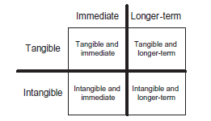
2. Making a Business and Financial Case
Figure 9.6 Categories of costs and benefits
www.midocean.ae

Slide 56
2. Making a Business and Financial Case
Analysis of costs and benefits:
Tangible costs
Development staff costs: In many projects, particularly those that involve developing new processes or IT systems, these will be a major cost element.
User staff costs: These are often forgotten but can be significant. User staff will have to be available for the initial investigation and analysis.
Equipment: Where IT is involved, there will often be a need to purchase new hardware.
Infrastructure: This includes elements like cabling and networks.
Packaged software: Estimates of the cost of this can be obtained from package vendors, probably based on the proposed number of users or licenses.
www.midocean.ae

Slide 57
2. Making a Business and Financial Case
Analysis of costs and benefits:
Tangible costs
Packaged software: Estimates of the cost of this can be obtained from package vendors, probably based on the proposed number of users or licenses.
Relocation: This can be quite difficult to cost.
Staff training and retraining: To work this out, we need to know how many people need to be trained and what they need to learn.
Ongoing costs: Once any new systems are in place, they will require maintenance and support,
www.midocean.ae

Slide 58
2. Making a Business and Financial Case
Analysis of costs and benefits:
Intangible costs
Disruption and loss of productivity: However good a new process or system is in the long run, there is bound to be some disruption as it is introduced.
Recruitment: This ought to be tangible but organizations often have little idea of the total cost to recruit someone although elements of this cost, such as agency fees, will be tangible
www.midocean.ae

Slide 59
2. Making a Business and Financial Case
4. Structure of a Business Case
Analysis of costs and benefits:
Tangible benefits
Staff savings: This is the most obvious saving, though many organizations are now so lean that it is hard to see where further reductions will come from.
Reduced effort and improved speed of working: If staff posts are not completely removed, it may be possible to carry out some tasks in a shorter timescale thus freeing up time for other work.
Faster responses to customers: It would be necessary to make a pre-change measurement of the time taken to respond to customers’ needs in order to quantify any possible benefits.
Reduced accommodation costs: These may have already been factored into the cost of employing staff. The facilities or finance department should have some idea about the cost of accommodation.
Reduced inventory: New systems – especially ‘just in time’ systems – usually result in the need to hold less stock.
Other costs reductions: These include things like reduced overtime working,
www.midocean.ae

Slide 60
2. Making a Business and Financial Case
Analysis of costs and benefits:
Intangible benefits
Increased job satisfaction;
Improved customer satisfaction
Better management information
Greater organizational flexibility:
More problem-solving time:
Improved presentation or better market image:
Better communications:
Avoided costs
It is one particular form of benefit, which is worth thinking about, is what we might call ‘avoided costs’. There are often situations where an organization has to do something and has already budgeted for it; that budget can be offset against a more radical solution that would offer additional business benefits.
www.midocean.ae

Slide 61
2. Making a Business and Financial Case
Analysis of costs and benefits:
Presenting the financial costs and benefits
Once the various tangible costs and benefits have been assessed, they need to be presented so that management can see whether and when the project pays for itself.
Impact assessment
In addition to the costs and benefits already mentioned, for each of the options we need to explore in the business case any impacts that there might be on the organization. Some of these impacts may have costs attached to them but some may not and are simply the things that may happen as a result of adopting the proposed course of action. Examples include:
www.midocean.ae

Slide 62
2. Making a Business and Financial Case
Examples include:
Organization structure: It may be necessary to reorganize departments or functions to exploit the new circumstances properly.
Interdepartmental relations: Similarly, the relationships between departments may change and there may be a need to introduce service level agreements or in other ways redefine these relationships.
Working practices: New processes and systems invariably lead to changes in working practices
Management style: Sometimes, the style that managers adopt has to change
Recruitment policy: The organization may have to recruit different types of people and look for different skills.ge.
Appraisal and promotion criteria: It may be necessary to change people’s targets and incentives in order to encourage them to display different behaviors, for example to be more customer-focused.
Supplier relations: These may have to be redefined
www.midocean.ae

Slide 63
2. Making a Business and Financial Case
4. Analysis of costs and benefits:
Risk assessment
No change comes without risk and it is unrealistic to think otherwise. A business case is immeasurably strengthened if it can be shown that the potential risks have been identified and that suitable countermeasures are available.
The principal risks should be identified. For each risk, the following should be recorded:
Description: The cause of the risk should be described and also its impact,
Impact assessment: This should attempt to assess the scale of the damage that would be suffered if the risk occurred
Probability: How likely is it that this risk will materialize?
Countermeasures: This is the really important part, the question being what can we do to either reduce the likelihood of the risk occurring or lessen its impact if it does.
Ownership: For each risk, we need to decide who would be best placed to take the necessary countermeasures.
www.midocean.ae

Slide 64
2. Making a Business and Financial Case
4. Analysis of costs and benefits:
Recommendations
Finally, we need to summaries the business case and make clear the decisions that the senior managers are being asked to take. If the business case is for carrying out a project of some sort, then an outline of the main tasks and timescales envisaged is useful to the decision-makers. This is best expressed graphically, as a Gantt/bar chart as illustrated in Figure 9.7.
Appendices and supporting information
Where detailed information needs to be included in the business case, this is best put into appendices. This separates out the main points, that are put in the main body of the case, from the supporting detail.
www.midocean.ae

Slide 65
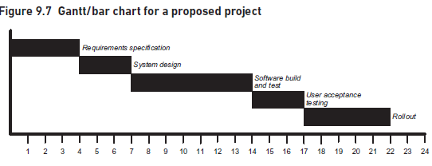
2. Making a Business and Financial Case
www.midocean.ae

Slide 66
2. Making a Business and Financial Case
5. Investment Appraisal
In this part of the business case, the financial aspects – in other words the tangible costs and benefits – are contrasted so see if, and when, the project will pay for itself. The ways of doing this are,
Payback period- Table 9.1
Net present Value (NPV)- (table 9.2)
www.midocean.ae

Slide 67
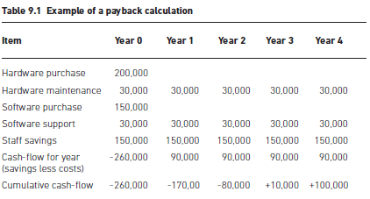
2. Making a Business and Financial Case
www.midocean.ae

Slide 68
2. Making a Business and Financial Case
5. Investment Appraisal
Net present Value (NPV)
A method that takes account of the time value of money is known as discounted cash flow (DCF) which leads to a ‘net present value’ (NPV) for the project. This means that all of the cash-flows in years after Year 0 are adjusted to today’s value of money. (table 9.2)
www.midocean.ae

Slide 69
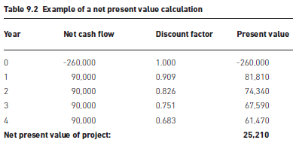
2. Making a Business and Financial Case
www.midocean.ae

Slide 70
2. Making a Business and Financial Case
6. Presentation of a Business Case
There are two basic ways in which a business case can be presented:
as a written document, and
as a face-to-face presentation.
In both cases, the way the business case is presented can often have a major impact on whether it is accepted or not and there are some simple rules that apply to both approaches:
  Think about the audience:
  Keep it short:
  Consider the structure:
  Think about appearances:
www.midocean.ae

Slide 71
2. Making a Business and Financial Case
7. RAID and CARDI Logs
Business case documents the risks of a proposed project and it also may set out any constraints, assumptions or dependencies on which it has been based. Since all of these will have ongoing effects throughout the project, this is a good point at which to set up logs that will assist us in managing these factors. A RAID log documents risks, assumptions, issues and dependencies; a CARDI log includes these elements plus constraints.
A CARDI log therefore contains sections that document:
Constraints: The main constraints on any project are; time, cost, resources, and product/quality, the need to comply with certain legislation, to use certain standards or to make sure an IT solution runs on a specific platform.
Assumptions: The business case, and thus the project, may rest on certain assumptions, for example that government funding may be available for part of the project.
www.midocean.ae

Slide 72
2. Making a Business and Financial Case
7. RAID and CARDI Logs
A CARDI log therefore contains sections that document:
Risks: The risks documented in the business case form the start of the overall risk log for the project and will be added to as more is known about it.
Dependencies: Because modern organizations are so complex, an individual project often has dependencies on other projects, or may be depended upon by other projects.
Issues: An issue is something that has occurred on a project which could have an effect on it (for good or ill) and which therefore needs to be managed.
www.midocean.ae

Slide 73
CONCLUSION
This part of knowledge consider the defining of solution and the making of a business and financial case.
The gap analysis is concerned with identifying the differences between the current business situation and the desired future business system. The gap analysis need to take a holistic view, considering elements such as the business processes and people in addition to the processes and IT systems.
The overall goal of a business architecture is to enable an organization to focus on the products and services it delivers to its customers and the value these customers receive. Hence, any business architecture needs to reflect a high level of abstraction, considering what the business needs to do to deliver value to its customers rather than how, who or where this value is delivered.
www.midocean.ae

Slide 74
CONCLUSION
A coherent and well-researched business case should be an important guiding document for any change project. There are several approaches to investment appraisal, which assesses the financial costs and benefits of a proposed change project. At a designated point after the project has been completed, the business case should form the basis for a review to determine whether the expected benefits have been realized in practice and to identify any actions required to support the delivery of those benefits.
www.midocean.ae

Slide 75
REFERENCES
Required Reference:
Debra Paul and James Cadle, et al, (2020). “Business Analysis”. BCS, 4th Edition. ISBN:978-1-78017-5102
Recommended Reading
James Cadle, Debra Paul, Jonathan Hunsley, Adrian Reed, David Beckham, Paul Turner (2021). “Business Analysis Techniques” 3rd Edition, BCS. ISBN: 978-1-78017-5690
www.midocean.ae

Slide 76


The End of Lecture
Thank You

