Slide 1

Mathematics
Prepared by Dr.Israa Lewaa
Lecture 2
MAT 122
Scalar and Vector

Slide 2

Lecture
02
Lecture Outline
What is the scalar?
Examples for scalar
What is the vectors?
Examples for vectors
Dot product and cross product concept
How to calculate the dot product ?

Slide 3
Lecture
02
Scalar and Vector
What
is Scalar?

Slide 4


Lecture
02
Example of scalar
Length of a car is 4.5 m

Slide 5


Lecture
02
Example of scalar
Mass of gold bar is 1 kg

Slide 6
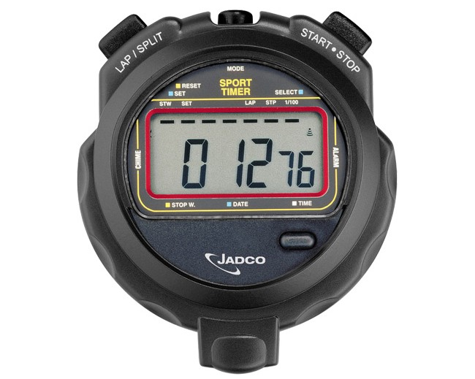

Lecture
02
Example of scalar
Time is 12.76 s

Slide 7
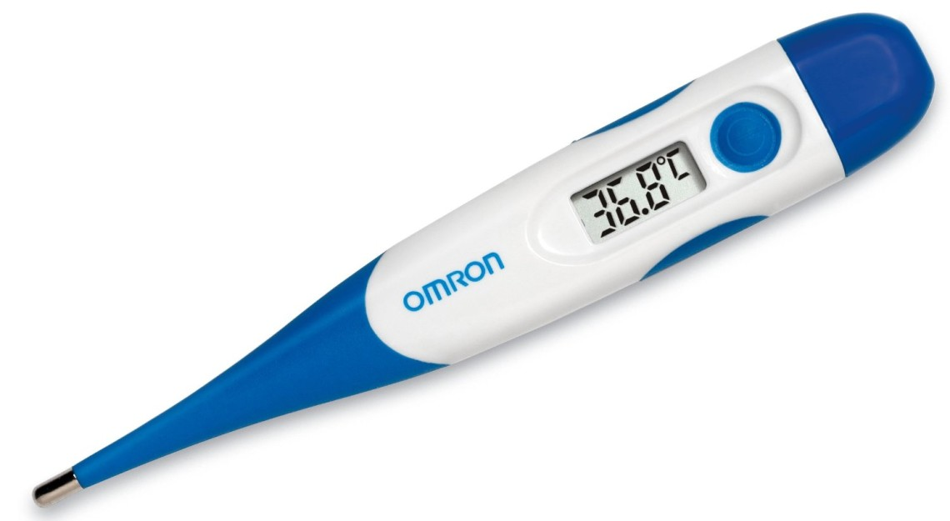


Lecture
02
Example of scalar
Temperature is 36.8 $°$C

Slide 8
Lecture
02
Scalar Defination
A scalar is a physical quantity that has only a magnitude.
Examples:
Mass
Length
Time
Temperature

Slide 9
Lecture
02
What is vector ?
What
is Vector?

Slide 10

Lecture
02
Vector Example
North
Carolina
California
Position of California from North Carolina is 3600 km
in west
physical quantity
magnitude
direction

Slide 11


Lecture
02
Vector Example
USA
China
Displacement from USA to China is 11600 km
in east
physical quantity
magnitude
direction

Slide 12
Lecture
02
Vector Definition
A vector is a physical quantity that has
both a magnitude and a direction.
Examples:
Position
Displacement
Velocity
Acceleration
Momentum
Force

Slide 13
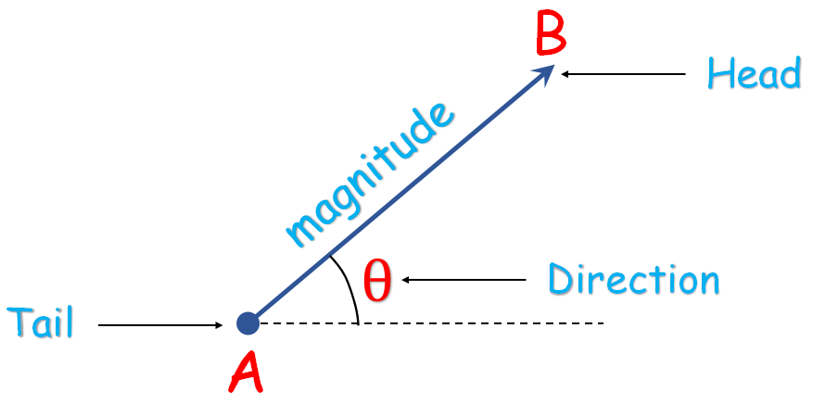
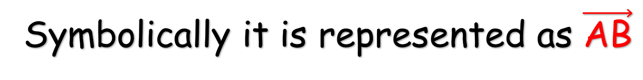
Lecture
02
Representation of a vector
Symbolically it is represented as $\vec{\text{AB}}$

Slide 14
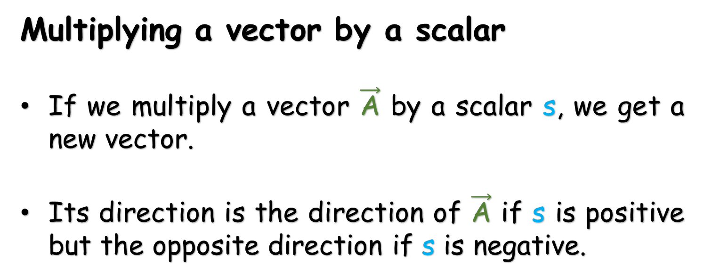
Lecture
02
Vector Characteristics
Multiplying a vector by a scalar
If we multiply a vector $\vec{\text{A}}$ by a scalar s, we get a new vector.
Its direction is the direction of $\vec{\text{A}}$ if s is positive but the opposite direction if s is negative.

Slide 15
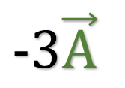

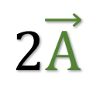

Lecture
02
Vector Characteristics
If s is positive:
$$\vec{\text{A}}$$
$$2\vec{\text{A}}$$
If s is negative:
$$\vec{\text{A}}$$
$$−3\vec{\text{A}}$$

Slide 16
Lecture
02
Multiply vector by vector
There are two ways to multiply a vector by a vector:
The first way produces a scalar quantity and called as scalar product (dot product).
The second way produces a vector quantity and called as vector product (cross product).

Slide 17
Lecture
02
Some important Points
Notes
Theorem
Facts

Slide 18
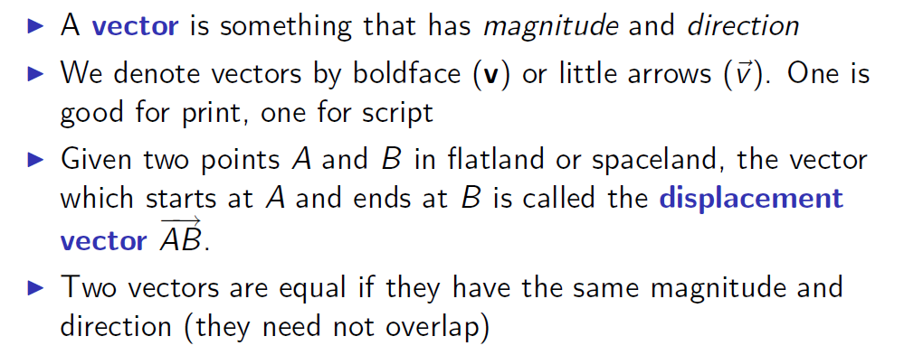
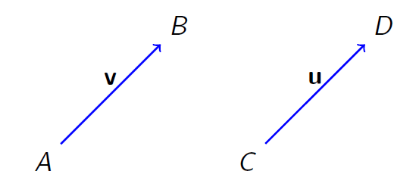
Lecture
02
Notes

Slide 19
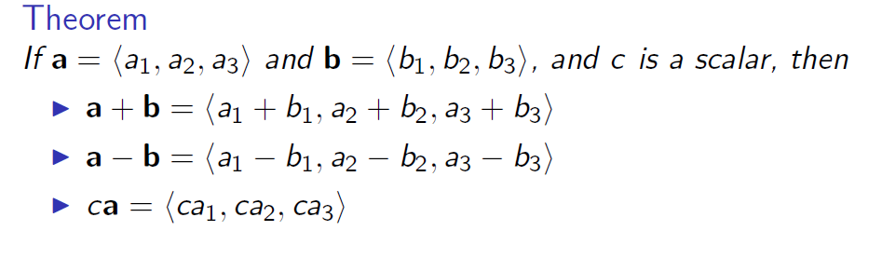
Lecture
02
Theorem

Slide 20
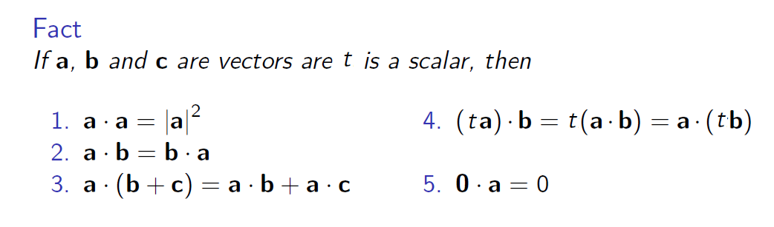
Lecture
02
Fact

Slide 21
Lecture
02
Extra Practice
Extra Practice

Slide 22
Lecture
02
Example 1
Example 1
Calculate the dot product of
a=(1,2,3) and b=(4,−5,6)

Slide 23
Lecture
02
Solution of Example 1
Solution:
Using the component formula for the dot product of three-dimensional vectors,
a⋅b=a1b1+a2b2+a3b3,
we calculate the dot product to be
a⋅b=1(4)+2(−5)+3(6)=4−10+18=12.

Slide 24
Lecture
02
Example 2
Calculate the dot product of
a=(−4,−9) and b=(−1,2).

Slide 25
Lecture
02
Solution of Example 2
Solution:
Using the component formula for the dot product of two-dimensional vectors,
a⋅b=a1b1+a2b2
we calculate the dot product to be
a⋅b =−4(−1)−9(2)=4−18=−14.

Slide 26

Lecture
02
Example 3

Slide 27
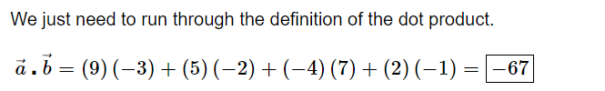
Lecture
02
Solution of Example 3

Slide 28

Lecture
02
Example 4

Slide 29
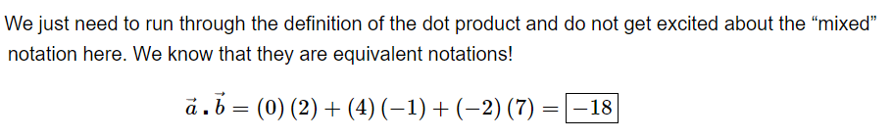
Lecture
02
Solution of Example 4

Slide 30
Lecture
02
Example 5
Calculate the dot product of
a=(4,2,1) and b=(−1,5,7).

Slide 31
Lecture
02
Solution of Example 5
Solution:
Using the component formula for the dot product of two-dimensional vectors,
a⋅b=a1b1+a2b2+ a3b3
we calculate the dot product to be
a⋅b =4(−1)+2(5)+1(7)=-4+10+7= 13.

Slide 32
Lecture
02
Example 6
Calculate the dot product of
a=(5,2,1) and b=(8,2,2).

Slide 33
Lecture
02
Solution of Example 6
Solution:
Using the component formula for the dot product of two-dimensional vectors,
a⋅b=a1b1+a2b2+ a3b3
we calculate the dot product to be
a⋅b =5(8)+2(2)+1(2)= 40+4+2= 46.

Slide 34
Lecture
02
Example 7
Calculate the dot product of
a=(6,9,0) and b=(8,3,1).

Slide 35
Lecture
02
Solution of Example 7
Solution:
Using the component formula for the dot product of two-dimensional vectors,
a⋅b=a1b1+a2b2+ a3b3
we calculate the dot product to be
a⋅b =6(8)+9(3)+0(1)= 48+27+0= 75

Slide 36
Lecture
02
Example 8
Calculate the dot product of
a=(1,−2,5,-4) and b=(1,3,-4,5).

Slide 37
Lecture
02
Solution of Example 8
Solution:
Using the component formula for the dot product of two-dimensional vectors,
a⋅b=a1b1+a2b2+ a3b3 + a4b4
we calculate the dot product to be
a⋅b =1(1) -2 (3)+5(-4)-4(5)= 1 -6 -20-20= -45

Slide 38
Lecture
02
Lecture Summary
What is the scalar?
Examples for scalar
What is the vectors?
Examples for vectors
Dot product and cross product concept
How to calculate the dot product ?

