Slide 1


Reinforcement Learning
(AI644)
Prepared by Dr. Ashraf Elsayed
Orientation Show عرض توجيهي

Slide 2



Reinforcement Learning
Orientation Show
Prepared by
Dr. Ashraf Elsayed
www.midocean.ae

Slide 3
About me
Associate Professor of Computer Science, Faculty of Science, Alexandria University, Egypt.
My research Interests include Artificial Intelligence, Machine Learning, Deep Learning, Data Science, Big data Analytics, Medical Image Mining.
Qualifications:
received B.Sc. degree from the Alexandria University, Alexandria, Egypt, in 1995, the M.Sc. degree from the Alexandria University, Alexandria, Egypt, in 2004, both in Computer science. And the Ph.D. degree from the University of Liverpool, UK, in 2012, in Computer science.
www.midocean.ae

Slide 4
How to reach me
Email: ashrafelsayed@midocean.edu.km
(please include “Reinforcement Learning” in subject line)
Office Hours:
Discussion time:حلقة نقاش تفاعلية Wednesday 9:00PM every week
www.midocean.ae

Slide 5
Reinforcement Learning
www.midocean.ae

Slide 6
What is Reinforcement Learning?
RL is a type of machine learning paradigm where an agent learns to make decisions by interacting with an environment. The agent takes actions in the environment, and based on these actions, it receives feedback in the form of rewards or penalties. The goal of the agent is to learn a policy, which is a mapping from states to actions, that maximizes the cumulative reward over time.
www.midocean.ae

Slide 7
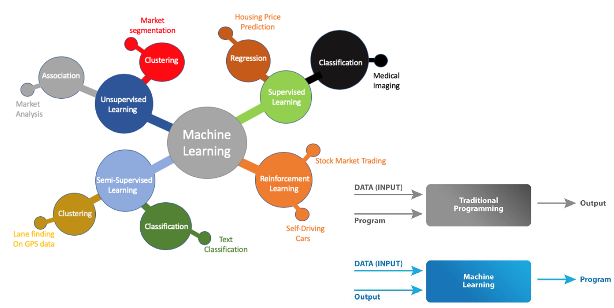
Machine Learning
www.midocean.ae

Slide 8
Machine Learning Areas
Supervised Learning: Data and corresponding labels are given
Unsupervised Learning: Only data is given, no labels provided
Semi-supervised Learning: Some (if not all) labels are present
Reinforcement Learning: An agent interacting with the world makes observations, takes actions, and is rewarded or punished; it should learn to choose actions in such a way as to obtain a lot of reward
www.midocean.ae

Slide 9
Supervised Learning
Learning a discrete function: Classification
  Boolean classification:
    Each example is classified as true(positive) or false(negative).
Learning a continuous function: Regression
www.midocean.ae

Slide 10
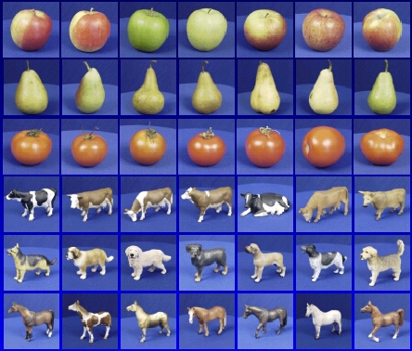

Steps
Training
Training Labels
Training Images
Image Features
Training
Learned model
Testing
Image Features
Learned model
Prediction
Test Image
www.midocean.ae

Slide 11


















Unsupervised Learning
Given x₁, x₂, ..., x_{n} (without labels)
Output hidden structure behind the x’s
– E.g., clustering
www.midocean.ae

Slide 12










Unsupervised Learning
Social network analysis
Market segmentation
Image credit: NASA/JPL-Caltech/E. Churchwell (Univ. of Wisconsin, Madison)
Astronomical data analysis
www.midocean.ae

Slide 13
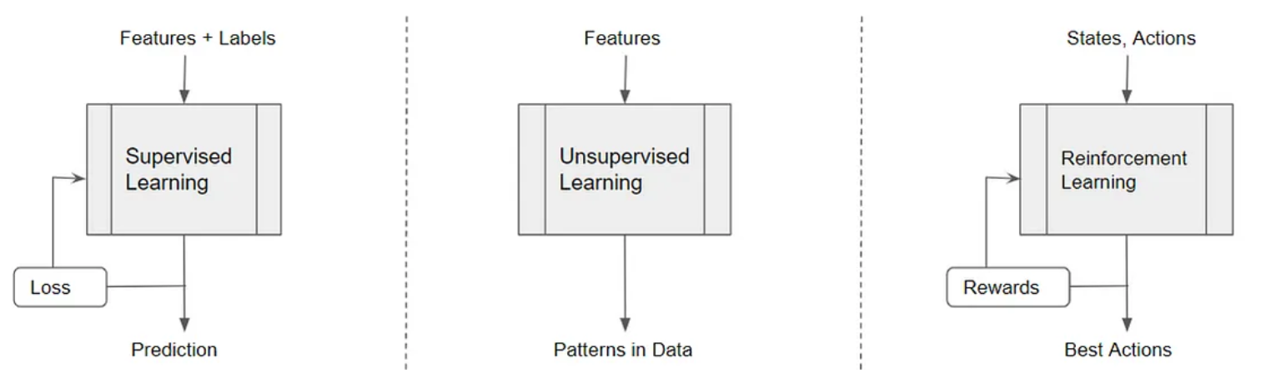
Reinforcement Learning
www.midocean.ae

Slide 14
What is Reinforcement Learning?
Learning from interaction with an environment to achieve some long-term goal that is related to the state of the environment
The goal is defined by reward signal, which must be maximized
Agent must be able to partially/fully sense the environment state and take actions to influence the environment state
The state is typically described with a feature-vector
www.midocean.ae

Slide 15
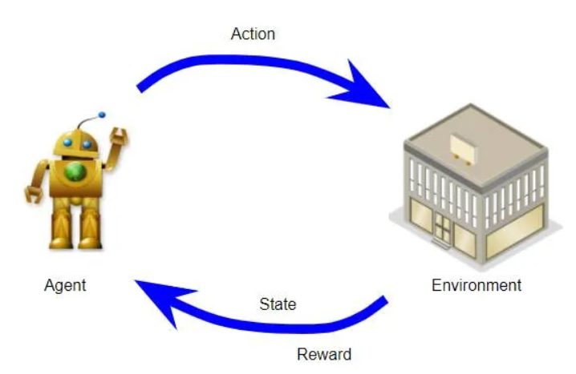
Agent, Environment, States, Actions and Rewards
www.midocean.ae

Slide 16
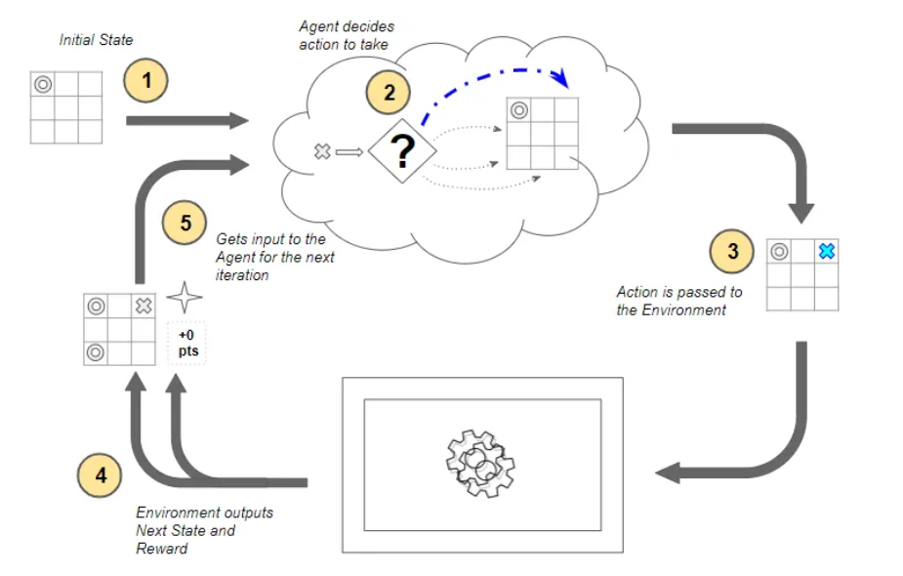
Example (Tic-Tac-Toe)
www.midocean.ae

Slide 17
Applications
Operating a drone or autonomous vehicle
Manipulating a robot to navigate the environment and perform various tasks
Managing an investment portfolio and taking trading decisions
Playing games such as Go, Chess, video games
www.midocean.ae

Slide 18
Primary Goal of This Course
This course has been designed to give students an extensive overview of Reinforcement Learning issues, tools and techniques that are critical in solving problems in RL domain.
This course aims to: Provide students with concepts of:
a solid understanding of key concepts, algorithms, and techniques used in Reinforcement Learning.
Understanding the formal framework of Markov Decision Processes, which is a mathematical model used to describe decision-making problems in Reinforcement Learning.
Understanding policies as strategies that map states to actions. Students learn how to formulate and evaluate different policies in the context of RL.
Grasping the trade-off between exploration (trying new actions to discover their effects) and exploitation (choosing actions that are known to yield high rewards). This is a crucial aspect of RL.
Applying RL concepts to real-world problems and case studies, such as game playing, robotics, and autonomous systems.
www.midocean.ae

Slide 19

www.midocean.ae

Slide 20
Units of Course Contents
Lecture # | Course unit | Week #
1 | Introduction to Reinforcement Learning | 1st
2 | Exploration and Exploitation | 2nd
3 | Markov Decision Processes | 3rd
4 | Value Functions & Bellman Equations | 4th
5 | Dynamic Programming | 5th
6 | Sample-based Learning Methods | 6th
7 | Temporal Difference Learning Methods for Prediction | 7th
8 | Temporal Difference Learning Methods for Control | 8th
9 | Expected SARSA & Planning | 9th
10 | Dyna-Q architecture, Dyna-Q algorithm | 10th
www.midocean.ae

Slide 21
Teaching Methodology
Recorded Lectures (10 Lectures)
Live Session Wednesday 9:00PM (optional)
References
www.midocean.ae

Slide 22

Study System
www.midocean.ae

Slide 23
Course Information - Evaluation
Assessment Method:
Short Exam (MCQ)
  80% marks
    10 Weekly exams
    8 marks for each short exam
  20% marks
    Final exam
www.midocean.ae

Slide 24
Course Learning Outcomes (CLOs)
By the end of the course, the students should be able to:
Recognize the advanced paradigms of Reinforcement learning.
Demonstrate use of appropriate theory, science, mathematics and computational technology to analyze and solve real-life problems
Formalize a task as a reinforcement learning problem.
Apply suitable algorithms to tackle different reinforcement learning problems.
Solve problems relevant to applications of Reinforcement Learning in computer science using ideas and techniques some of which are at the forefront of the discipline
www.midocean.ae

Slide 25
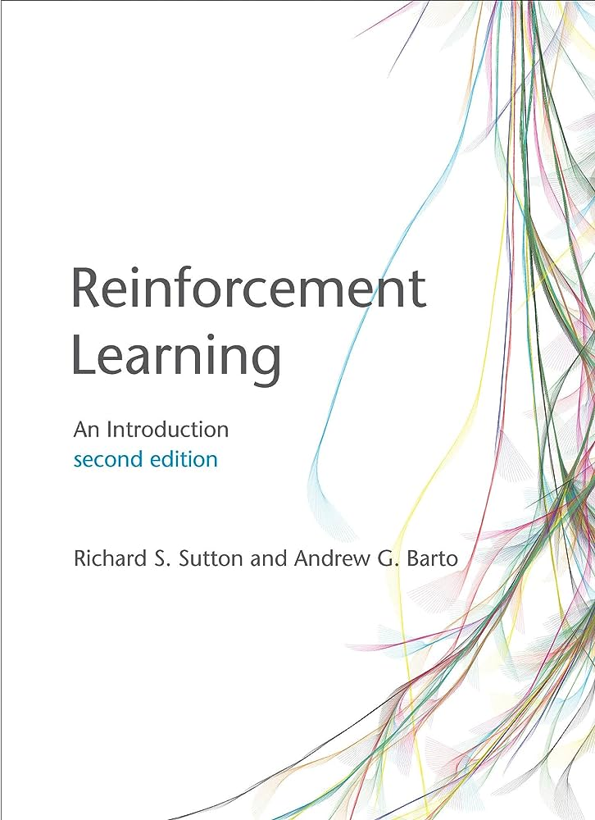
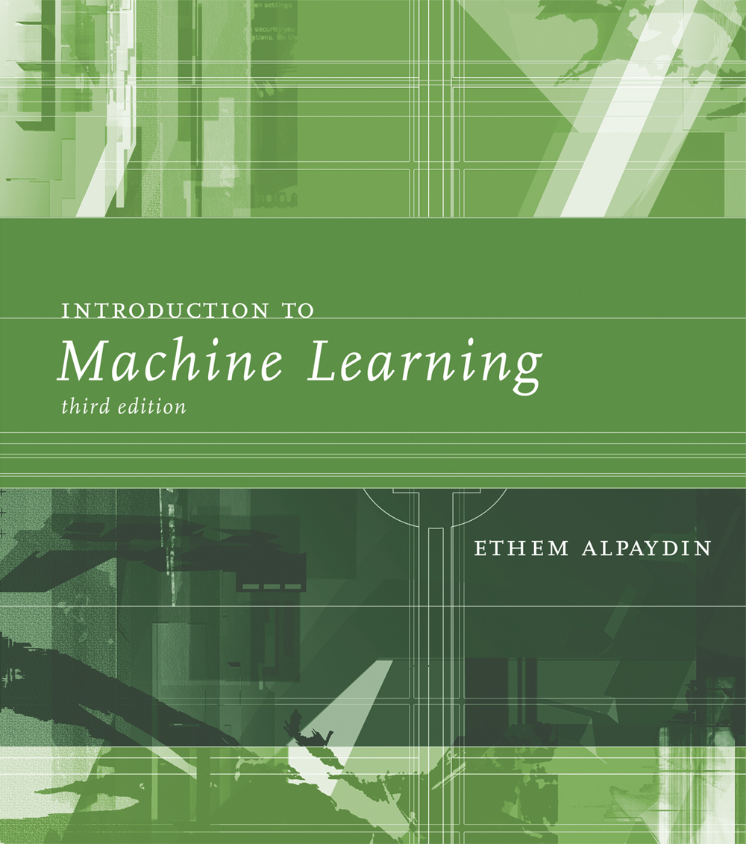
Recommended Textbooks
www.midocean.ae

Slide 26


Thank You

