Slide 1

Advanced Project Management APM
Prepared by Dr. Ahmad Al Ghamdi
Lecturer by Waseem Al Tabbaa
PMG 506
Advanced Project Management (APM)

Slide 2
Advanced Project Management
Prepared by Dr. Ahmad Al Ghamdi
Lecturer by Waseem Al Tabbaa
Lecture 4
PMG 506
Negotiation and the Management of Conflict

Slide 3


Lecture 4
The Project Manager

Slide 4
Lecture 4
Negotiation and the Management of Conflict
Why should there be so much conflict on projects?
Conflict arises when people working on the same project have somewhat different ideas about how to achieve project objectives.
But why should such a disagreement occur? Is there not “one best way?”
There may be one best way, but exactly which way is the “one best” is a matter surrounded by uncertainty.
Most conflicts have their roots in uncertainty, and negotiation is a way of managing the resultant risk.
Therefore, this chapter is also about risk management, about dealing with conflicts that often arise from uncertainty.

Slide 5
Lecture 4
Negotiation and the Management of Conflict
Conflict has sometimes been defined as “the process which begins when one party perceives that the other has frustrated, or is about to frustrate, some concern of his” (Thomas, 1976, p. 891).
Our concern is focused on goal conflicts that occur when an individual or group pursues goals different from those of other individuals or groups (Raiffa, 1982, Chapter 12).
A party to the conflict will be satisfied when the level of frustration has been lowered to the point where no action, present or future, against the other party is contemplated. When all parties to the conflict are satisfied to this point, the conflict is said to be resolved.

Slide 6
Lecture 4
Negotiation and the Management of Conflict
4.1 THE NATURE OF NEGOTIATION
The favored technique for resolving conflict is negotiation. Wall (1985, preface) defines negotiation as “the process through which two or more parties seek an acceptable rate of exchange for items they own or control.”
The concept of a Pareto-optimal solution i.e. “to find a solution such that no party can be made better off without making another party worse off by the same amount or more” is important. Approaching intraproject conflicts with a desire to win a victory over other parties is inappropriate. The PM must remember that she will be negotiating with project stakeholders many times in the future. If she conducts a win-lose negotiation and the other party loses, from then on she will face a determined adversary who seeks to defeat her. This is not helpful. The proper outcome of this type of negotiation should be to optimize the outcome in terms of overall organizational goals. Although it is not always obvious how to do this, negotiation is clearly the correct approach.

Slide 7
Lecture 4
Negotiation and the Management of Conflict
4.1 THE NATURE OF NEGOTIATION
During the negotiation process, an ethical situation often arises that is worth mentioning. Consider the situation where a fi rm requests an outside contractor to develop a software package to achieve some function. When the fi rm asks for a specific objective to be accomplished, it frequently does not know if that is a major job or a trivial task because it lacks technical competence in that area. Thus, the contractor has the opportunity to misrepresent the task to its customer, either inflating the cost for a trivial task or minimizing the impact of a significant task in order to acquire the contract and then boosting the cost later.
The ethics of the situation require that each party in the negotiation be honest with the other, even in situations where it is clear there will not be further work between the two.

Slide 8
Lecture 4
Negotiation and the Management of Conflict
4.2 PARTNERING, CHARTERING, AND SCOPE CHANGE
Projects provide ample opportunity for the project manager (PM) to utilize her or his skills at negotiation. There are three situations commonly arising during projects that call for the highest level of negotiating skill the PM can muster:
the use of subcontractors,
the use of input from two or more functional units to design and develop the project’s mission, and
the management of changes ordered in the project’s deliverables and/or priorities after the project is underway.
Partnering (outsourcing)
Generally, relations between the organization carrying out a project and a subcontractor working on the project are best characterized as adversarial. The parent organization’s objective is to get the deliverable at the lowest possible cost, as soon as possible. The subcontractor’s objective is to produce the deliverable at the highest possible profit with the least effort.

Slide 9
Lecture 4
Negotiation and the Management of Conflict
4.2 PARTNERING, CHARTERING, AND SCOPE CHANGE
Partnering
These conflicting interests tend to lead both parties to work in an atmosphere of mutual suspicion and antagonism.
Indeed, it is almost axiomatic that the two parties will have significantly different ideas about the exact nature of the deliverable itself. The concept of “partnering” has been developed to replace this atmosphere with one of cooperation and mutual helpfulness, but the basically adversarial relationship makes cooperation difficult in the best of cases.
Cowen et al. (1992, p. 5, italics in original) define partnering as follows:
Project partnering is a method of transforming contractual relationships into a cohesive, cooperative project team with a single set of goals and established procedures for resolving disputes in a timely and effective manner.

Slide 10
Lecture 4
Negotiation and the Management of Conflict
4.2 PARTNERING, CHARTERING, AND SCOPE CHANGE
Partnering
They present a multistep process for building partnered projects.
First, the parent firm must make a commitment to partnering, select subcontractors who will also make such a commitment, engage in joint team-building exercises, and develop a “charter” for the project.
Second, both parties must implement the partnering process with a four-part agreement on: (1) “joint evaluation” of the project’s progress; (2) a method for resolving any problems or disagreements; (3) acceptance of a goal for continuous improvement (also known as TQM) for the joint project; and (4) continuous support for the process of partnering from senior management of both parties.
Finally, the parties commit to a joint review of “project execution” when the project is completed.

Slide 11
Lecture 4
Negotiation and the Management of Conflict
4.2 PARTNERING, CHARTERING, AND SCOPE CHANGE
Partnering
The concept of partnering goes far beyond two-party agreements between buyer and seller or interdepartmental cooperation on a project. The use of multiparty consortia to pursue technological research objectives is common.(Bluetooth)
There can be no doubt that those who have not had much experience with partnering underrate its difficulty. Partnering requires strong support from senior management of all participants, and it requires continuous support of project objectives and partnering agreements. Above all, and most difficult of all, it requires open and honest communication between the partners. With all of its problems, partnering yields benefits great enough to be worth the efforts required to make it work correctly

Slide 12
Lecture 4
Negotiation and the Management of Conflict
4.2 PARTNERING, CHARTERING, AND SCOPE CHANGE
Chartering
The agreements between groups partnering on large endeavors are often referred to as charters.
A project charter is simply a written agreement between the PM, senior management, and the functional managers who are committing resources and/or people to a specific project (program, etc.). Bear in mind, the charter may take many different forms.
Typically, it details the expected deliverables, often including schedules, budgets, and resource commitments. It attests to the fact that senior management of all relevant organizations, functional managers, and the PM are “on the same page,” agreeing about what is to be done, when, and at what cost. Note that if there is such an agreement, there is also an implication that none of the parties will change the agreement unilaterally, or, at least, without prior consultation with the other parties. Most projects do not have charters, which is one reason for observing that most projects are not completed on specification, on time, and on budget.

Slide 13
Lecture 4
Negotiation and the Management of Conflict
4.2 PARTNERING, CHARTERING, AND SCOPE CHANGE
Scope Change
No matter how carefully a project is planned, it is almost certain to be changed before completion. No matter how carefully defined at the start, the scope of most projects is subject to considerable uncertainty. There are three basic causes for change in projects. Some changes result because planners erred in their initial assessment about how to achieve a given end or erred in their choice of the proper goal for the project. Technological uncertainty is the fundamental causal factor for either error. The foundation for a building must be changed because a preliminary geological study did not reveal a weakness in the structure of the ground on which the building will stand.
Other changes result because the client/user or project team learns more about the nature of the project deliverable or about the setting in which it is to be used. An increase in user or team knowledge or sophistication is the primary factor leading to change. A computer program must be extended or rewritten because the user thinks of new uses for the software.

Slide 14
Lecture 4
Negotiation and the Management of Conflict
4.2 PARTNERING, CHARTERING, AND SCOPE CHANGE
Scope Change
A third source of change is the mandate. This is a change in the environment in which the project is being conducted. As such, it cannot be controlled by the PM. A new law is passed. A government regulatory unit articulates a new policy. A trade association sets a new standard. The parent organization of the user applies a new criterion for its purchases. In other words, the rules of conduct for the project are altered.
To some extent, risk management techniques can be applied to scope change. Technological uncertainty can be mitigated by careful analysis of the technologies involved, including the use of technological forecasting. Risk of scope change caused by increased user knowledge can only be managed by improving the up-front communication with the client and then establishing a formal process to handle change. Finally, mandates are, for the most part, unpredictable. These can be “managed” only by having some flexibility built into the budget and schedule of the project

Slide 15
Lecture 4
Negotiation and the Management of Conflict
4.2 PARTNERING, CHARTERING, AND SCOPE CHANGE
Scope Change
As Greek philosopher Heraclitus said, “Nothing endures but change.” It is thus with projects, but whatever the nature of the change, specifications of the deliverables must be altered, and the schedule and budget recalculated.
Negotiation will be required to develop new agreements between the parties-at-interest to the project. These negotiations are difficult because most of the stakeholders will have a strong interest in maintaining the status quo.
If the proposed change benefits the client and increases the cost of the project, the producer will try to sequester some of the user’s potential benefit in the form of added charges to offset the added cost. The client will, of course, resist. All parties must, once again, seek a Pareto- optimal solution, always a difficult task.

Slide 16
Lecture 4
Negotiation and the Management of Conflict
4.3 CONFLICT AND THE PROJECT LIFE CYCLE
In this section, following a brief discussion of the project life cycle, we will categorize the types of conflicts that frequently occur in the project environment, and then amplify the nature of these conflicts. Finally, we will link the project life cycle with the fundamental conflict categories and discover that certain patterns of conflict are associated with the different periods in the life of a project.
With this knowledge, the PM can do a faster and more accurate job of diagnosing the nature of the conflicts he or she is facing, thereby reducing the likelihood of escalating the conflict by dealing with it ineffectually.
More on the Project Life Cycle
Thamhain et al. (1975a) used a four-stage model with project formation, buildup, main program, and phase-out to identify the stages of the project life cycle.
During the first stage, senior management tentatively, sometimes unofficially, approves preliminary planning for a project. Often, this management recognition is preceded by some strictly unofficial “bootleg” work to test the feasibility of an idea.

Slide 17
Lecture 4
Negotiation and the Management of Conflict
4.3 CONFLICT AND THE PROJECT LIFE CYCLE
More on the Project Life Cycle
Initial planning is undertaken, basic objectives are often adopted, and the project may be “scoped out.”
The second stage is typified by detailed planning, budgeting, scheduling, and the aggregation of resources.
In the third stage, the lion’s share of the actual work on the project is accomplished. During the final stage of the life cycle, work is completed and products are turned over to the client or user. This stage also includes disposition of the project’s assets and personnel. It may even include preparation for the initial stage of another related project to follow
Categories of Conflict
All stages of the project life cycle appear to be typified by conflict. These conflicts center on such matters as schedules, priorities, staff and labor requirements, technical factors, administrative procedures, cost estimates, and, of course, personality conflicts.

Slide 18
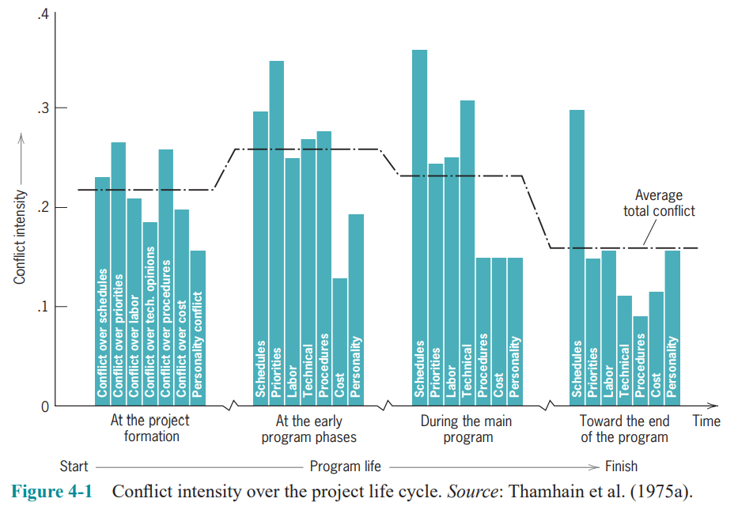
Lecture 4
Negotiation and the Management of Conflict
4.3 CONFLICT AND THE PROJECT LIFE CYCLE
Categories of Conflict
Thamhain et al. collected data on the frequency and magnitude of conflicts of each type during each stage of the project life cycle. Multiplying conflict frequency by a measure of conflict magnitude and adjusting for the proportion of PMs who reported each specific type of conflict, they derived an estimate of the “intensity” of the conflicts

Slide 19
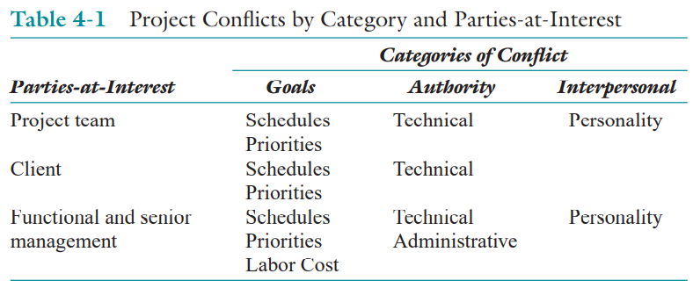
Lecture 4
Negotiation and the Management of Conflict
4.3 CONFLICT AND THE PROJECT LIFE CYCLE
Categories of Conflict
On examination of the data, it appears that the conflicts fall into three fundamentally different categories:
Groups working on the project may have different goals and expectations.
There is considerable uncertainty about who has the authority to make decisions.
There are interpersonal conflicts between people who are parties-at-interest in the project.

Slide 20
Lecture 4
Negotiation and the Management of Conflict
4.3 CONFLICT AND THE PROJECT LIFE CYCLE
Project Formation
In the initial stage of the project life cycle, most of the conflict centers around the inherent confusion of setting up a project in the environment of matrix management. Almost nothing about the project or its governance has been decided. Even the project’s technical objectives, not clearly defined or established, are apt to be understood only in the most general sense. Moving from this state of semi-chaos to the relatively ordered world of the buildup stage is difficult.
To make this transition, four fundamental issues must be handled, although not necessarily in the order presented here.
First, the technical objectives of the project must be specified to a degree that will allow the detailed planning of the buildup stage to be accomplished.
Second, commitment of resources to the project must be forthcoming from senior management and from functional managers.

Slide 21
Lecture 4
Negotiation and the Management of Conflict
4.3 CONFLICT AND THE PROJECT LIFE CYCLE
Project Formation
Third, the priority of the project, relative to the priorities of the parent organization’s other projects, must be set and communicated.
Fourth, the organizational structure of the project must be established to an extent sufficient for the WBS and a linear responsibility chart, or its equivalent, to be prepared during the next stage of the life cycle.
Project Buildup
This is the period during which the project moves from a general concept to a highly detailed set of plans. If the project’s organizational format is a strong matrix, the PM seeks a commitment of people from the functional departments. If the project is organized as a weak matrix, the PM seeks a commitment of work from the functional departments. In either case, the PM seeks commitment from functional managers who are under pressure to deliver support to other projects, in addition to the routine, everyday demands made on their departments.

Slide 22
Lecture 4
Negotiation and the Management of Conflict
4.3 CONFLICT AND THE PROJECT LIFE CYCLE
Project Buildup
As the project’s plans become detailed, conflicts over technical issues build again, conflicts between the PM and the functional areas tend to predominate. Usually, the functional departments can claim more technical expertise than the PM, who is a “generalist.” On occasion, however, the PM is also a specialist. In such situations, discussions between the functional manager and the project manager about the best technical approach often result in conflict. The total level of conflict is at its highest in this transition.
Main Program
Schedules are still a major source of conflict in this phase of the project life cycle, though the proximate cause of schedule-related conflict is usually different than in the earlier stages. Project plans have been developed and approved by everyone involved and the actual work is under way. Let us assume that some activity runs into difficulty and is late in being completed.

Slide 23
Lecture 4
Negotiation and the Management of Conflict
4.3 CONFLICT AND THE PROJECT LIFE CYCLE
Main Program
Every task that is dependent on this late activity will also be delayed. Some of these subsequent activities will, if sufficiently late and if the late work is not made up, delay the entire project.
The PM must try to get the schedule back on track. But catching up is considerably more difficult than falling behind. Catching up requires extra resources that the functional groups who are doing the “catching up” will demand, but which the PM may not have.
Project Phase-out
As in the main program stage, schedule is the major source of conflict during project phaseout. If schedule slippage has occurred in the main program stage (and it probably has), the consequences will surely be felt in this final stage. During phase-out, projects with firm deadlines develop an environment best described as hectic. The PM, project team, and functional groups often band together to do what is necessary to complete the project on time and to specification.

Slide 24
Lecture 4
Negotiation and the Management of Conflict
4.3 CONFLICT AND THE PROJECT LIFE CYCLE
Project Phase-out
Cost overruns, if not outrageously high, are tolerated—though they may not be forgiven and they will certainly be remembered.
Technical problems are comparatively rare during phase-out because most have been solved or bypassed earlier. Similarly, working interfaces have been developed and put in place. If the project involves implementing a technology in an outside client’s system, technical conflicts will probably arise, but they are usually less intense.
Thamhain et al. (1975b, p. 41) note that personality conflicts are the second-ranked source of conflict during phase-out. They ascribe these conflicts to interpersonal stress caused by the pressure to complete the project, and to individuals’ natural anxiety about leaving the project either to be assigned to another, or be returned to a functional unit. In addition, we have observed conflict, sometimes quite bitter, focused on the distribution of the project’s capital equipment and supplies when the project is completed. Conflict also arises between projects phasing out and those just starting, particularly if the latter need resources or personnel with scarce talents being used by the former.

Slide 25
Lecture 4
Negotiation and the Management of Conflict
4.3 CONFLICT AND THE PROJECT LIFE CYCLE
Project Phase-out
Conflict is an inherent characteristic of projects, and the project manager is constantly beset by conflict. The ability to reduce and resolve conflict in ways that support achievement of the project’s goals is a prime requisite for success as a PM. The primary tool to accomplish conflict resolution and reduction is negotiation, and the method of handling conflict established in the project formation stage will set the pattern for the entire project. Therefore, the style of negotiation adopted by the PM is critical.

Slide 26
Lecture 4
Negotiation and the Management of Conflict
4.4 SOME REQUIREMENTS AND PRINCIPLES OF NEGOTIATION
The key to understanding the nature of negotiation as it applies to project management is the realization that few of the conflicts arising in projects have to do with whether or not a task will be undertaken or a deliverable produced. Instead, they have to do with the precise design of the deliverable and/or how the design will be achieved, by whom, when, and at what cost. The implication is clear: The work of the project will be done. If conflicts between any of the parties to the project escalate to the point where negotiations break down and work comes to a halt, everyone loses. One requirement for the conflict reduction/resolution methods used by the PM is that they must allow the conflict to be settled without irreparable harm to the project’s objectives.
A second requirement for the conflict resolution/reduction methods used by the PM is that they allow (and foster) honesty between the negotiators.
It is a requirement of all conflicting parties to seek solutions to the conflict that not only satisfy their own individual needs, but also satisfy the needs of other parties to the conflict, as well as the needs of the parent organization.

Slide 27
Lecture 4
Negotiation and the Management of Conflict
4.4 SOME REQUIREMENTS AND PRINCIPLES OF NEGOTIATION
Fisher et al. (1983, p. 11) have developed “principled negotiation,” that is, win-win. The method is straightforward; it is defined by four points.
1. Separate the people from the problem.
The conflicting parties are often highly emotional. They perceive things differently and feel strongly about the differences. Emotions and objective fact get confused to the point where it is not clear which is which. Conflicting parties tend to attack one another rather than the problem. To minimize the likelihood that the conflict will become strictly interpersonal, the substantive problem should be carefully defined. Then everyone can work on it rather than each other.
2. Focus on interests, not positions.
Positional bargaining occurs when the PM says to a functional manager: “I need this subassembly by November 15.” The functional manager responds: “My group can’t possibly start on it this year. We might be able to deliver it by February 1.” These are the opening lines in a dialogue that sounds suspiciously. A simple “Let’s talk about the schedule for this subassembly” would be sufficient to open the discussion.

Slide 28
Lecture 4
Negotiation and the Management of Conflict
4.4 SOME REQUIREMENTS AND PRINCIPLES OF NEGOTIATION
Otherwise each party develops a high level of ego involvement in his or her position and the negotiation never focuses on the real interests and concerns of the conflicting parties—the central issues of the conflict.
The exchange deteriorates into a series of positional compromises that do not satisfy either party and leave both feeling that they have lost something important.
In positional negotiation, the “positions” are statements of immediate wants and assume that the environment is static.
3. Before trying to reach agreement, invent options for mutual gain.
The parties-in-conflict usually enter negotiations knowing the outcome they would like. As a result, they are blind to other outcomes and are not particularly creative. Nonetheless, as soon as the substantive problems are spelled out, some effort should be devoted to finding a wide variety of possible solutions—or elements thereof—that advance the mutual interests of the conflicting parties. Success at finding options that produce mutual gain positively reinforces win-win negotiations.

Slide 29
Lecture 4
Negotiation and the Management of Conflict
4.4 SOME REQUIREMENTS AND PRINCIPLES OF NEGOTIATION
4. Insist on using objective criteria.
If a functional manager wants to use an expensive process to test a part, it is acceptable for the PM to ask if such a process is required to ensure that the parts meet specified quality standards.
Almost every writer on negotiation emphasizes the importance of understanding the interests of the person with whom you are negotiating. As we noted above, the positions taken by negotiators are not truly understandable without first understanding the interests and concerns that prompt those positions.
If the negotiation remains a debate on positions, you will never find out the real cause of the issue. The key to finding a negotiator’s interests and concerns is to ask “Why?” when he or she states a position.

Slide 30
Lecture 4
Negotiation and the Management of Conflict
SUMMARY
This chapter addressed the need for negotiation as a tool to resolve project conflicts. We discussed the nature of negotiation and its purpose in the organization. We also described various categories of conflict and related them to the project life cycle. We followed this by identifying a number of requirements and principles of negotiation. Finally, we presented a short vignette illustrating an actual negotiation situation.
Specific points made in the chapter were these:
• Negotiation within the firm should be directed at obtaining the best outcome for the organization, not winning.
• There are three traditional categories of conflict: goal-oriented, authority-based, and interpersonal.
• There are also three traditional sources of conflict. They are the project team itself, the client, and functional and senior management. We added the problem/discipline orientation of people working on the project.

Slide 31
Lecture 4
Negotiation and the Management of Conflict
SUMMARY
• Critical issues to handle in the project formation stages are delimiting technical objectives, getting management commitment, setting the project’s relative priority, and selecting the project organizational structure.
• The total level of conflict is highest during the project buildup stage.
• Scheduling and technical conflicts are most frequent and serious in the project buildup and main program stages, and scheduling conflicts in particular during the phase-out stage.
• Project negotiation requirements are that conflicts must be settled without permanent damage, the methodology must foster honesty, and the solution must satisfy both individuals’ and the organization’s needs.
• One promising approach to meeting the requirements of project negotiation is called “principled negotiation.”
In the next chapter we move to the first task of the PM, organizing the project. We deal there not only with various organizational forms, such as functional, project, and matrix, but also with the organization of the project office. This task includes setting up the project team and managing the human element of the project.

Slide 32
Lecture 4
Negotiation and the Management of Conflict
GLOSSARY
Interfaces The boundaries between departments or functions.
Lateral Relations Communications across lines of equivalent authority.
Pareto-Optimal Solution A solution such that no party can be made better off without making another party worse off by the same amount or more.
Positional Negotiation Stating immediate wants on the assumption that the environment is static.
Principled Negotiation A process of negotiation that aims to achieve a win-win result. Parties-at-interest Those who have a vested interest in the outcome of the negotiations. Win-win When both parties are better off in the outcome.

Slide 33
Lecture 1
Projects in Contemporary Organizations
Thank you

