Slide 1




HCIA-AI Huawei
Eng.Eman Elgallad
Lecture 03 – Machine Learning Overview

Slide 2
Lecture
03
Machine Learning Algorithms
Types of Machine Learning
Machine Learning Process
Important Machine Learning Concepts
Common Machine Learning Algorithms

Slide 3
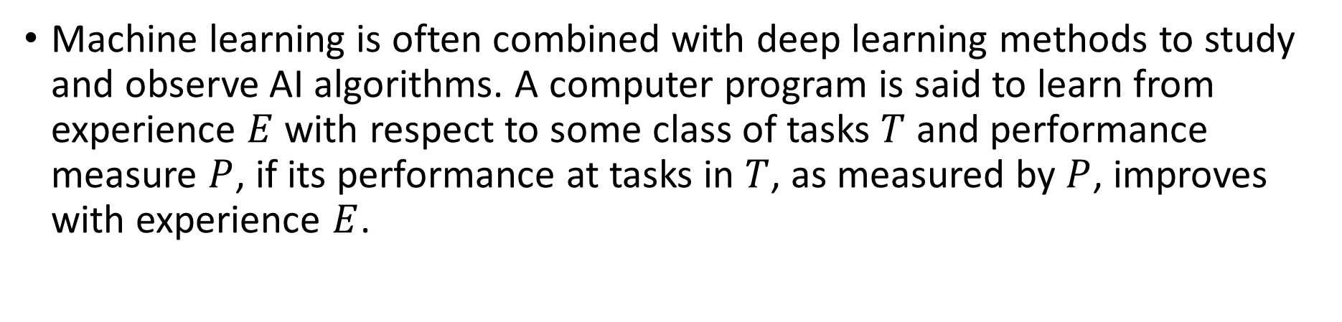
Machine Learning Algorithms
Lecture
03
Machine learning is often combined with deep learning methods to study and observe AI algorithms. A computer program is said to learn from experience $E$ with respect to some class of tasks $T$ and performance measure $P$, if its performance at tasks in $T$, as measured by $P$, improves with experience $E$.
Data
(Experience $E$)
Data
(Experience 𝐸)
Learning algorithm
(Task 𝑇)
Understanding
(Performance
measure 𝑃)
Notes:
Deep learning is a sub-field of machine learning. To understand deep learning, you need to first understand the fundamentals of machine learning.
Task $T$ represents how the machine learning system should process a sample.
Performance measure $P$ is used to evaluate aspects of machine learning such as accuracy and error rate.
Experience $E$: Most learning algorithms can be understood as being allowed to experience an entire dataset. Some machine learning algorithms do not just experience a fixed dataset. For example, reinforcement learning algorithms interact with an environment, so there is a feedback loop between the learning system and its training process. Machine learning algorithms can be broadly categorized as unsupervised or supervised by what kind of experience they are allowed to have during the learning process.
To learn the game of Go:
Experience $E_{1}$: Game with itself- Unsupervised and indirect learning
Experience $E_{2}$: Inquiring Humans during a game with itself – Semi-supervised learning
Experience $E_{3}$: Learning from human historical games - Supervised and direct learning

Slide 4
Machine Learning Algorithms Cont.
Lecture
03
Experience
Historical data
Summarize
Train
Input
Predict
Input
Predict
New problem
New data
Future attributes
Rules
Future
Model

Slide 5
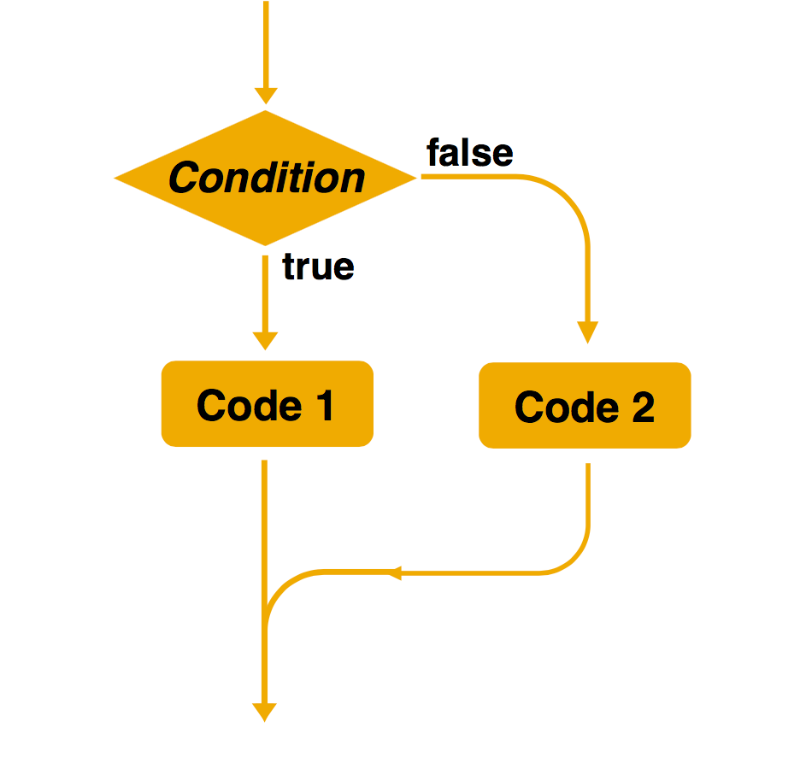
Differences Between Machine Learning Algorithms and Traditional Rule-based Methods
Lecture
Created by: Jim Liang
03
Rule-based method
Machine learning
Training data
Machine learning
New data
Model
Prediction
Models are trained on samples.
Decision-making rules are complex or difficult to describe.
Machines automatically learn rules.
Explicit programming is used to solve problems.
Rules can be manually determined.

Slide 6



When to Use Machine Learning
Lecture
03
Machine learning provides solutions to complex problems, or those involving a large amount of data whose distribution function cannot be determined.
Consider the following scenarios:
Rules are complex or difficult to describe, for example, speech recognition.
Task rules change over time, for example, part-of-speech tagging, in which new words or word meanings can be generated at any time.
Data distribution changes over time and programs need to adapt to new data constantly, for example, sales trend forecast.

Slide 7
When to Use Machine Learning Cont.
Lecture
03
High
Manual rules
Machine learning algorithms
Complexity of rules
Simple questions
Rule-based algorithms
Low
Small
Large
Scale of the problem

Slide 8
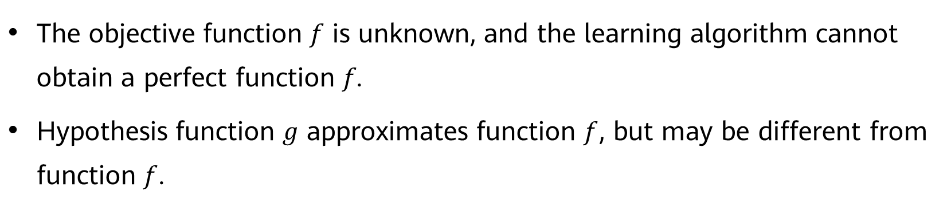
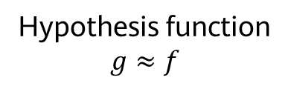
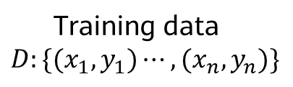
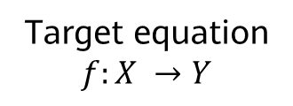
Rationale of Machine Learning Algorithms
Lecture
03
Target equation
$$f:X →Y$$
Ideal
Actual
Training data
$$D:\{(x_{1},y_{1})⋯,{(x}_{n},y_{n})\}$$
Learning algorithm
Hypothesis function
$$g≈f$$
The objective function 𝑓 is unknown, and the learning algorithm cannot obtain a perfect function 𝑓.
Hypothesis function 𝑔 approximates function $f$, but may be different from function $f$.

Slide 9
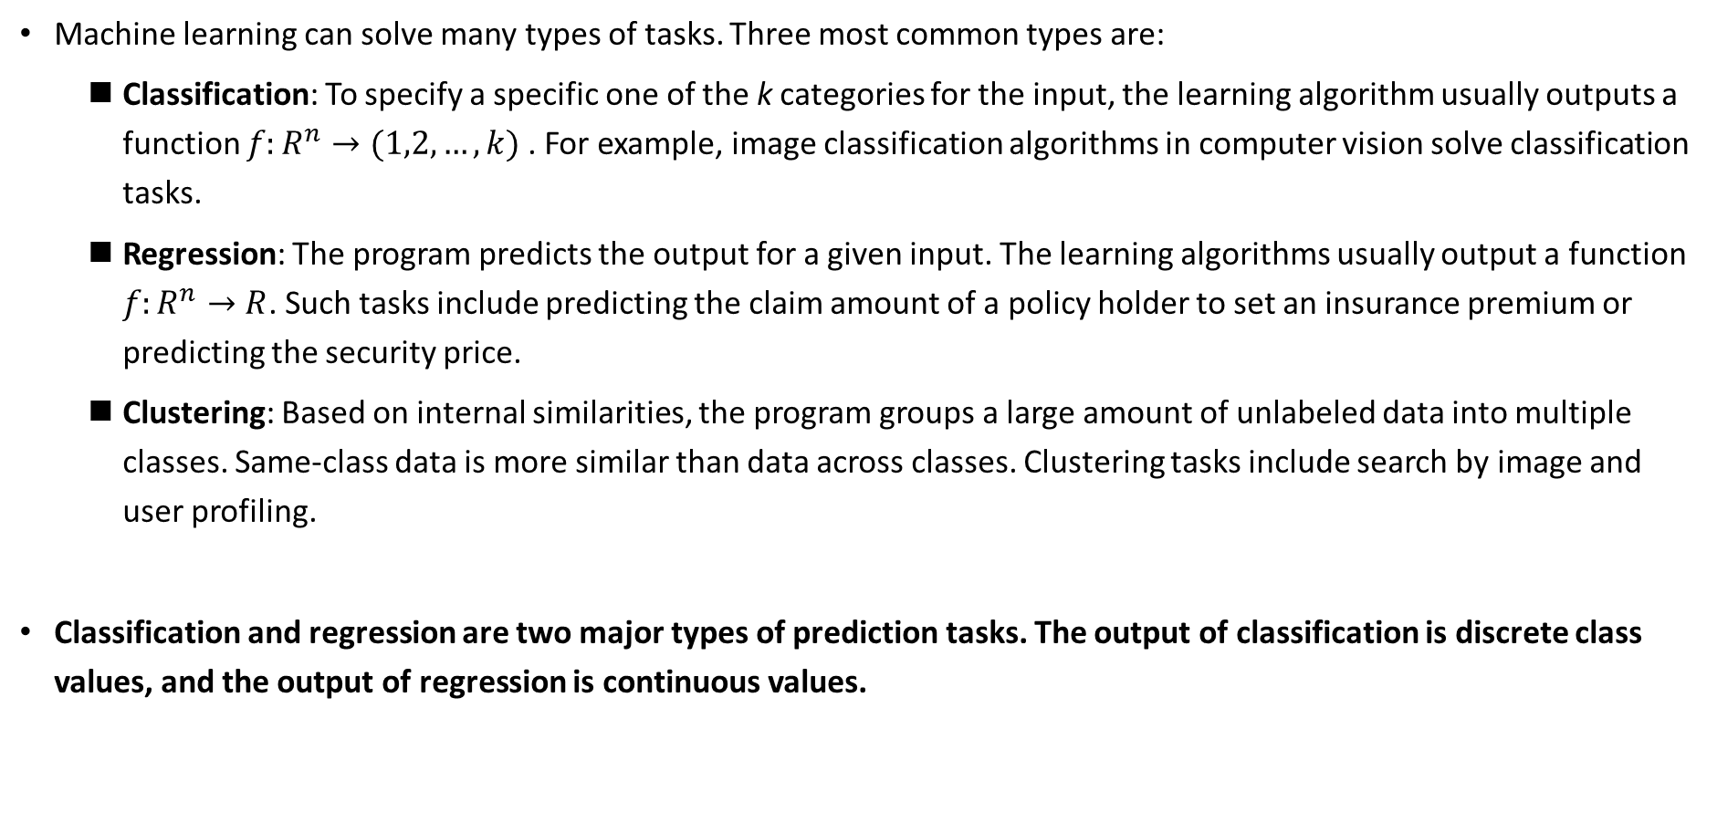
Main Problems Solved by Machine Learning
Lecture
03
Machine learning can solve many types of tasks. Three most common types are:
  Classification: To specify a specific one of the k categories for the input, the learning algorithm usually outputs a function $f:R^{n}→(1,2,…,k)$. For example, image classification algorithms in computer vision solve classification tasks.
  Regression: The program predicts the output for a given input. The learning algorithms usually output a function $f:R^{n}→R$. Such tasks include predicting the claim amount of a policy holder to set an insurance premium or predicting the security price.
  Clustering: Based on internal similarities, the program groups a large amount of unlabeled data into multiple classes. Same-class data is more similar than data across classes. Clustering tasks include search by image and user profiling.
Classification and regression are two major types of prediction tasks. The output of classification is discrete class values, and the output of regression is continuous values.

Slide 10
Lecture
03
Machine Learning Algorithms
Types of Machine Learning
Machine Learning Process
Important Machine Learning Concepts
Common Machine Learning Algorithms

Slide 11
Types of Machine Learning
Lecture
03
Supervised learning: The program takes a known set of samples and trains an optimal model to generate predictions. Then, the trained model maps all inputs to outputs and performs simple judgment on the outputs. In this way, unknown data is classified.
Unsupervised learning: The program builds a model based on unlabeled input data. For example, a clustering model groups objects based on similarities. Unsupervised learning algorithms model the highly similar samples, calculate the similarity between new and existing samples, and classify new samples by similarity.
Semi-supervised learning: The program trains a model through a combination of a small amount of labeled data and a large amount of unlabeled data.
Reinforcement learning: The learning systems learn behavior from the environment to maximize the value of reward (reinforcement) signal function. Reinforcement learning differs from supervised learning of connectionism in that, instead of telling the system the correct action, the environment provides scalar reinforcement signals to evaluate its actions.
Machine learning evolution is producing new machine learning types, for example, self-supervised learning, contrastive learning, generative learning.
Notes:
Supervised learning: We give a computer a bunch of choice questions (training samples) and provide standard answers. The computer tries to adjust its model parameters to make their predictions close to standard answers. In this way, the computer learns how to deal with this type of problem. Then the computer can help us reply to choice questions whose answers are not given (test samples).
Unsupervised learning: We give a computer a bunch of choice questions (training samples), but do not provide standard answers. The computer tries to analyze the relationships between these questions and classify them. It does not know the answers to these questions, but it thinks that the answers to the questions in the same category should be the same.
Semi-supervised learning: Traditional supervised learning uses a large number of labeled training samples to create a model for predicting the labels of new samples. For example, in a classification task, a label indicates the category of a sample while in a regression task, a label is a real-value output of the sample. As data storage capabilities are developing, we can easily obtain a large amount of unlabeled data from many tasks. However, labeling the data is labor-consuming and time-consuming. For example, for web page recommendation, users need to label web pages they like, but only a few users are willing to spend a lot of time doing this. Then we get limited labeled web page data and a large amount of unlabeled web page data.

Slide 12
Supervised Learning
Lecture
03
Data features
Labels
Feature 1
······
Feature n
Target
Supervised learning algorithm
Feature 1
······
Feature n
Target
Feature 1
······
Feature n
Target
Weather | Temperature | Wind Speed
Sunny | High | High
Rainy | Low | Medium
Sunny | Low | Low
Suitable for Exercise
Yes
No
Yes

Slide 13
Supervised Learning - Regression
Lecture
03
Regression reflects the features of sample attributes in a dataset. A function is used to express the sample mapping relationship and further discover the dependency between attributes. Examples include:
  How much money can I make from stocks next week?
  What will the temperature be on Tuesday?
Monday | Tuesday
38° | ?

Slide 14
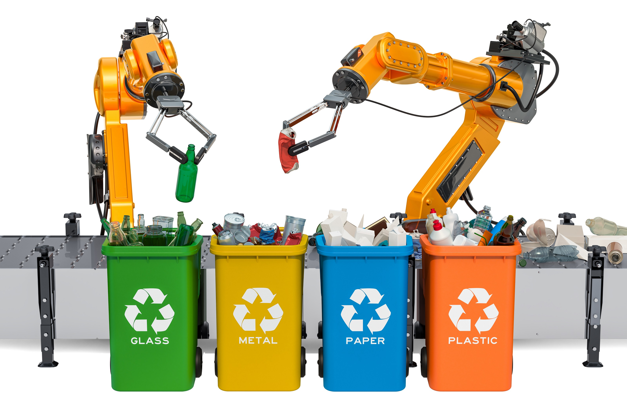
Supervised Learning - Classification
Lecture
03
Classification uses a classification model to map samples in a dataset to a given category.
  What category of garbage does the plastic bottle belong to?
  Is the email a spam?

Slide 15
Unsupervised Learning
Lecture
03
Data features
Feature 1
······
Feature n
Unsupervised learning algorithm
Intra-cluster similarity
Feature 1
······
Feature n
Feature 1
······
Feature n
Monthly Sales Volume | Product | Sale Duration
1000-2000 | Badminton racket | 6:00-12:00
500-1000 | Basketball | 18:00-24:00
1000-2000 | Game console | 00:00-6:00
Category
Cluster 1
Cluster 2

Slide 16

Unsupervised Learning - Clustering
Lecture
03
Clustering uses a clustering model to classify samples in a dataset into several categories based on similarity.
  Defining fish of the same species.
  Recommending movies for users.

Slide 17
Semi-supervised Learning
Lecture
03
Data features
Labels
Feature 1
······
Feature n
Target
Semi-supervised learning algorithm
Feature 1
······
Feature n
Unknown
Feature 1
······
Feature n
Unknown
Weather | Temperature | Wind Speed
Sunny | High | High
Rainy | Low | Medium
Sunny | Low | Low
Suitable for Exercise
Yes
/
/

Slide 18





Reinforcement Learning
Lecture
03
A reinforcement learning model learns from the environment, takes actions, and adjusts the actions based on a system of rewards.
Model
Status $s_{t}$
Reward $r_{t}$
Action $a_{t}$
$$r_{t+1}$$
$$s_{t+1}$$
Environment
Notes:
Reinforcement learning uses a series of actions to maximize the reward function to learn a model.
Both good and bad behavior can help reinforcement learning models learn.
Example: Autonomous vehicles learn by continuously interacting with the environment

Slide 19
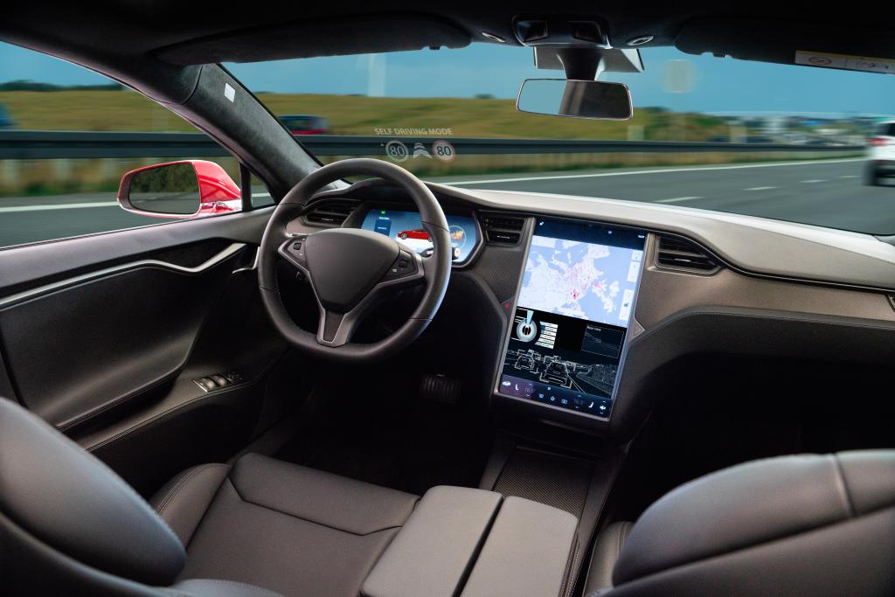
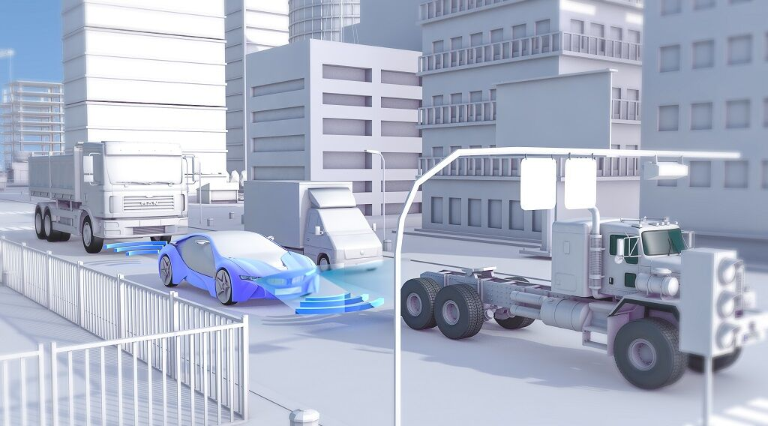
Reinforcement Learning - Best Action
Lecture
03
Reinforcement learning always tries to find the best action.
  Autonomous vehicles: The traffic lights are flashing yellow. Should the vehicle brake or accelerate?
  Robot vacuum: The battery level is 10%, and a small area is not cleaned. Should the robot continue cleaning or recharge?

Slide 20
Lecture
03
Machine Learning Algorithms
Types of Machine Learning
Machine Learning Process
Important Machine Learning Concepts
Common Machine Learning Algorithms

Slide 21
Machine Learning Process
Lecture
03
Feature extraction and selection
Model deployment and integration
Data Collecting
Data Preparation
Model training
Model evaluation
Feedback and iteration

Slide 22
Data Collecting
Lecture
03
▪ Data in the real world can be of numerous types & formats
  ▪ Structured or unstructured
  ▪ Readable or obfuscated
  ▪ Small or big
▪ Goal:
  ▪ Have a good plan for data gathering to save time
  ▪ Beneficial during analysis & modeling
▪ A good data collection plan should include:
  ▪ Data Formats
  ▪ Data Sources
  ▪ Data Types

Slide 23
Data Format:
Lecture
03
▪ Many data formats are acceptable for storing information
1. CSV or TXT: Most widely used data exchange formats for storing
tabular data containing many rows & columns
2. Microsoft Excel format (.xls or .xlsx): Most popular data file
format in the business world.
3. Markup languages: Provide a system for annotating a document
with a specific syntactic structure. Includes TeX, HTML, XML &
XHTML forms
4. JSON: Widely used data interchange format in many application
programming interfaces, e.g., Facebook Graph API, Google Maps,
and Twitter API.

Slide 24
Data Sources:
Lecture
03
▪ Structured:
  ▪ Every row & column is well defined within a connected schematic tables in a
  database.
  ▪ E.g., CSV & Excel files
▪ Semi-structured:
  ▪ A significant move away from the traditional Relational Database
  Management System (RDBMS) paradigms, where data is stored with
  predefined schema
  ▪ E.g., JSON & XML formats
▪ Unstructured:
  ▪ Images, videos, web logs & click stream
  ▪ Textual data generated from human interactions, e.g., Twitter Sentiment
  Analysis on tweets

Slide 25
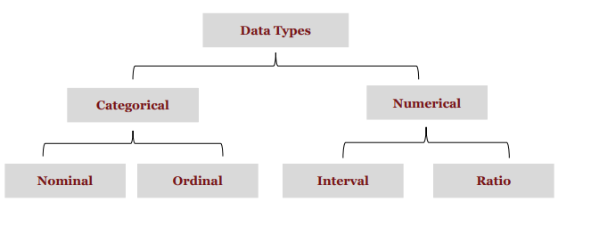
Data Types :
Lecture
03
Continuous
Discrete
Interval
Ratio

Slide 26
Data Types : Qualitative (Categorical data)
Lecture
03
▪ Nominal:
  ▪ Uses names or symbols to distinguish objects, e.g., Hair color {auburn, black,
  blond, brown, grey, red, white}.
  ▪ Has no order
  ▪ Binary: Nominal attribute with only 2 states {yes or no}
    ▪ Symmetric binary: Outcomes are equally valuable & carry same weight,
    e.g., gender
    ▪ Asymmetric binary: when outcomes are not equally important, e.g.,
    medical test (positive vs. negative)
▪ Ordinal:
  ▪ Uses values to provide meaningful order (ranking) to objects but magnitude
  between successive values is not known
  ▪ E.g., Size {small, medium, large}, grades, army rankings

Slide 27
Data Types : Quantitative (Numerical)
Lecture
03
Continuous vs. Discrete Data
Discrete
  ▪ Countable finite set of values, e.g.,
  houses, workers
  ▪ Represented as integers
Continuous
  ▪ Are measured, e.g., height, weight
  ▪ Typically represented as floating-point
    ▪ Interval:
      ▪ Uses equal-sized units of measurement
      ▪ Values have order
      ▪ Has no true zero point or fixed beginning, i.e., total absence of the variable of interest, e.g., calendar dates
      ▪ Operations: +, -
    ▪ Ratio:
      ▪ Numeric attributes with a true zero point
      ▪ Values are ordered, e.g., age, distance covered by a car
      ▪ Operations: +, -, /, x

Slide 28
Machine Learning Basic Concept - Dataset
Lecture
03
Dataset: collection of data used in machine learning tasks, where each piece of data is called a sample. Items or attributes that reflect the presentation or nature of a sample in a particular aspect are called features.
  Training set: dataset used in the training process, where each sample is called a training sample. Learning (or training) is the process of building a model from data.
  Test set: dataset used in the testing process, where each sample is called a test sample. Testing refers to the process, during which the learned model is used for prediction.

Slide 29
Data Overview
Lecture
03
Typical dataset composition
Feature 1
Feature 2
Feature 3
Label
No. | Area | Location | Orientation | House Price
1 | 100 | 8 | South | 1000
2 | 120 | 9 | Southwest | 1300
3 | 60 | 6 | North | 700
4 | 80 | 9 | Southeast | 1100
5 | 95 | 3 | South | 850
Training set
Test set

Slide 30
Importance of Data Processing (Preparation)
Lecture
03
Data is crucial to models and determines the scope of model capabilities. All good models require good data.
Data preprocessing
Data cleansing
Data standardization
Fill in missing values, and detect and eliminate noise and other abnormal points
Standardize data to reduce noise and improve model accuracy
Data dimension reduction
Simplify data attributes to avoid the curse of dimensionality

Slide 31
Data Cleansing
Lecture
03
Most machine learning models process features, which are usually numeric representations of input variables that can be used in the model.
In most cases, only preprocessed data can be used by algorithms. Data preprocessing involves the following operations:
  Data filtering
  Data loss handling
  Handling of possible error or abnormal values
  Merging of data from multiple sources
  Data consolidation

Slide 32
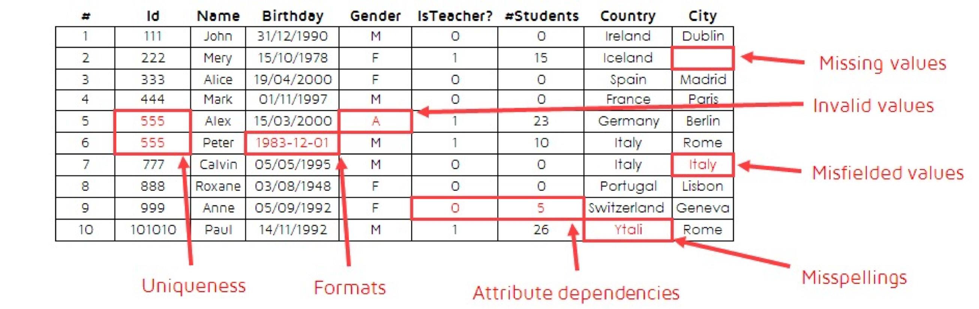
Lecture
Data Cleansing- Dirty Data
03
Raw data usually contains data quality problems:
  Incompleteness: Incomplete data or lack of relevant attributes or values.
  Noise: Data contains incorrect records or abnormal points.
  Inconsistency: Data contains conflicting records.
Missing value
Invalid value
Misfielded value
Invalid duplicate items
Incorrect format
Dependent attributes
Misspelling

Slide 33
Lecture
How to Handle Missing Data
03
1. Ignore :
  ▪ Usually done when class label is missing (during classification) — not effective when the % of missing values/attribute varies considerably.
2. Fill in the missing value manually:
  ▪ Tedious + Infeasible
3. Fill in missing value automatically:
  ▪ Replace with a global constant such as a label like “unknown”
4. Fill missing value with measure of central tendency:
  ▪ For normal data distribution (Symmetric), use the mean
  ▪ For skewed data distribution (Asymmetric), use the median

Slide 34
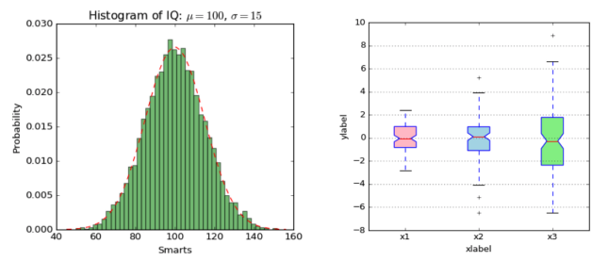
Data visualization Very important in Data Analysis Explore data Report insights https://www.w3schools.com/python/matplotlib_intro.asp https://matplotlib.org/stable/tutorials/index.html
Lecture
Data Visualization
03

Slide 35
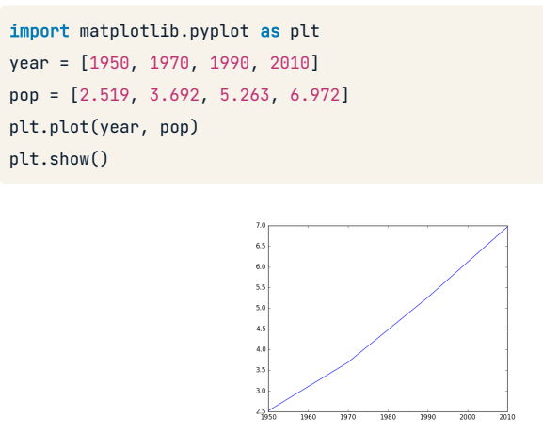
Matplotlib Library:
Lecture
03
Install using pip:
  !pip install matplotlib
  Matplotlib graphs your data on Figures
  each of which can contain one or more Axes, an area where points can be specified in terms of x-y coordinates (or theta-r in a polar plot, x-y-z in a 3D plot, etc.).
  The simplest way of creating a Figure with an Axes is using pyplot.subplots. We can then use Axes.plot to draw some data on the Axes.
  plt.show() is used to get this Figure to display

Slide 36
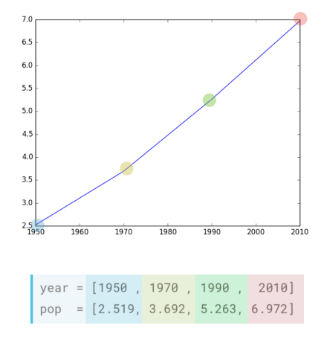
Matplotlib Library:
Lecture
03

Slide 37
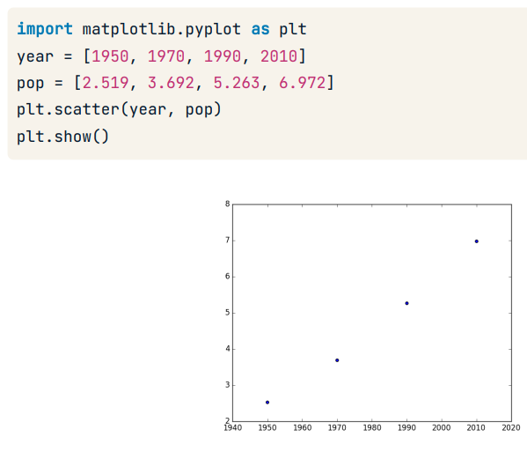
Matplotlib Library-Scatter plot:
Lecture
03
  A scatter plot is a diagram where each value in the data set is represented by a dot.
  The Matplotlib module has a method for drawing scatter plots .scatter(x,y), it needs two arrays of the same length, one for the values of the x-axis, and one for the values of the y-axis.

Slide 38
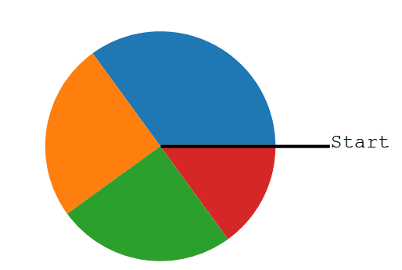
Matplotlib Library-Pie Charts:
Lecture
03
With Pyplot, you can use the pie() function to draw pie charts
import matplotlib.pyplot as plt
y = [35, 25, 25, 15]
plt.pie(y)
plt.show()
By default, the plotting of the first wedge starts from the x-axis and moves counterclockwise:

Slide 39
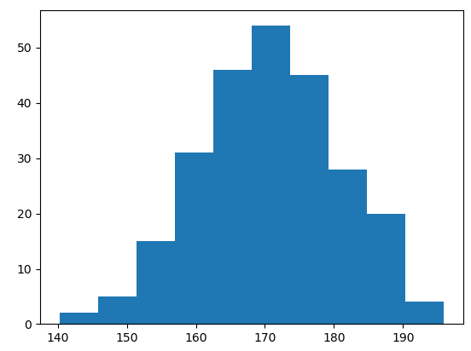
Matplotlib Library- Histogram :
Lecture
03
A histogram is a graph showing frequency distributions.
It is a graph showing the number of observations within each given interval.
Example: Say you ask for the height of 250 people; you might end up with a histogram like this
You can read from the histogram that there are approximately:
2 people from 140 to 145cm
5 people from 145 to 150cm
15 people from 151 to 156cm
31 people from 157 to 162cm
46 people from 163 to 168cm
53 people from 168 to 173cm
45 people from 173 to 178cm
28 people from 179 to 184cm
21 people from 185 to 190cm
4 people from 190 to 195cm

Slide 40
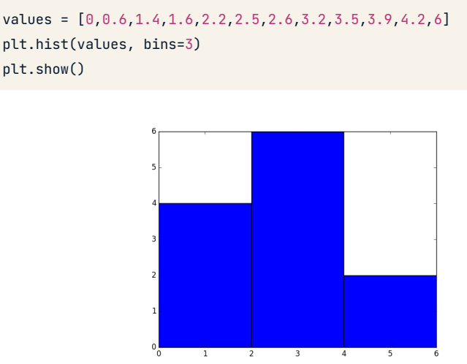
Matplotlib Library-Histogram:
Lecture
03
In Matplotlib, we use the hist() function to create histograms.
The hist() function will use an array of numbers to create a histogram, the array is sent into the function as an argument.

Slide 41
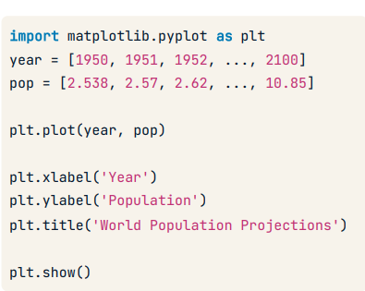
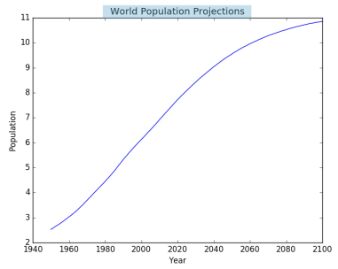
Matplotlib Library-Title:
Lecture
03
With Pyplot, you can use the xlabel() and ylabel() functions to set a label for the x- and y-axis
and title() to set a graph title .

Slide 42
Data Conversion
Lecture
03
Preprocessed data needs to be converted into a representation suitable for machine learning models. The following are typically used to convert data:
  Encoding categorical data into numerals for classification
  Converting numeric data into categorical data to reduce the values of variables (for example, segmenting age data)
  Other data:
    Embedding words into text to convert them into word vectors (Typically, models such as word2vec and BERT are used.)
    Image data processing, such as color space conversion, grayscale image conversion, geometric conversion, Haar-like features, and image enhancement
  Feature engineering:
    Normalizing and standardizing features to ensure that different input variables of a model fall into the same value range
    Feature augmentation: combining or converting the existing variables to generate new features, such as averages.

Slide 43
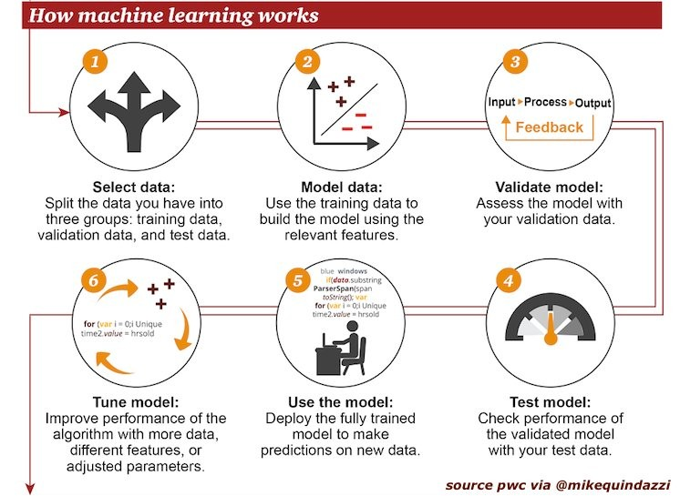
Lecture
03
Overall Process of Building an AI Model
Model building process
1 2 3
Split data
Split the dataset into training, validation, and test sets.
Train the model
Use data that is processed by data cleansing and feature engineering.
Validate the model
Use the validation set to evaluate the model effectiveness.
6
5
4
Tune the model
Continuously tune the model based on actual data of the service.
Deploy the model
Deployed in actual production scenarios.
Test the model
Use the test set to evaluate the generalization capability of the model.

Slide 44

Supervised Learning Example - Learning Phase
Lecture
03
Use a classification model to determine whether a person is a basketball player based on specific features.
Features (attributes)
Target (label)
Service data
Name | City | Age | Label
Mike | Miami | 42 | yes
Jerry | New York | 32 | no
Bryan | Orlando | 18 | no
Patricia | Miami | 45 | yes
Elodie | Phoenix | 35 | no
Remy | Chicago | 72 | yes
John | New York | 48 | yes
Training set
Data used by the model to determine the relationships between features and targets.
(Cleansed features and labels)
Split
Task: Use a classification model to determine whether a person is a basketball player using specific features
Test set
New data for evaluating model effectiveness.
Train the model
Each feature or set of features provides a judgment basis for the model.
Notes:
Model example

Slide 45
Supervised Learning Example - Prediction Phase
Lecture
03
Name | City | Age | Label
Marine | Miami | 45 | ?
Julien | Miami | 52 | ?
Fred | Orlando | 20 | ?
Michelle | Boston | 34 | ?
Nicolas | Phoenix | 90 | ?
Unknown data
Recent data cannot determine whether they are a basketball player.
New data
IF city = Miami → Probability = +0.7
IF city= Orlando → Probability = +0.2
IF age > 42 → Probability = +0.05*age + 0.06
IF age <= 42 → Probability = +0.01*age + 0.02
Apply the model
Name | City | Age | Prediction
Marine | Miami | 45 | 0.3
Julien | Miami | 52 | 0.9
Fred | Orlando | 20 | 0.6
Michelle | Boston | 34 | 0.5
Nicolas | Phoenix | 90 | 0.4
New data
Predicted possibility
Use the model against new data to predict the possibility of them being basketball players.
Predicted data
Notes:
Model example
The model here is similar to the decision tree model.

Slide 46

What Is a Good Model?
Lecture
03
Generalization
  The accuracy of predictions based on actual data
Explain ability
  Predicted results are easy to explain
Prediction speed
  The time needed to make a prediction
Notes:
Which factors are used to judge a model?
Generalization capability is the most important.

Slide 47
Model Effectiveness (1)
Lecture
03
Generalization capability: Machine learning aims to ensure models perform well on new samples, not just those used for training. Generalization capability, also called robustness, is the extent to which a learned model can be applied to new samples.
Error is the difference between the prediction of a learned model on a sample and the actual result of the sample.
  Training error is the error of the model on the training set.
  Generalization error is the error of the model on new samples. Obviously, we prefer a model with a smaller generalization error.
Underfitting: The training error is large.
Overfitting: The training error of a trained model is small while the generalization error is large.
Notes:
Once the form of a problem's hypothesis is given, all possible functions constitute a space, which is hypothesis space. The problem of machine learning is searching for a suitable fitting function in a hypothesis space.
Overfitting: It occurs frequently in complex mathematical models. To prevent overfitting, we can simplify mathematical models, end training before overfitting, or use dropout/weight decay methods.
Underfitting: It occurs if the mathematical model is too simple or the training time is too short. To solve the underfitting problem, use a more complex model or extend the training time.

Slide 48
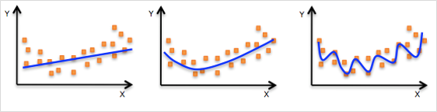
Model Effectiveness (2)
Lecture
03
Model capacity, also known as model complexity, is the capability of the model to fit various functions.
  With sufficient capacity to handle task complexity and training data volumes, the algorithm results are optimal.
  Models with an insufficient capacity cannot handle complex tasks because underfitting may occur.
  Models with a large capacity can handle complex tasks, but overfitting may occur when the capacity is greater than the amount required by a task.
Underfitting:
features not learned
Overfitting:
noises learned
Good fitting
Notes:
The effective capacity is restricted by algorithms, parameters, and regularization.

Slide 49
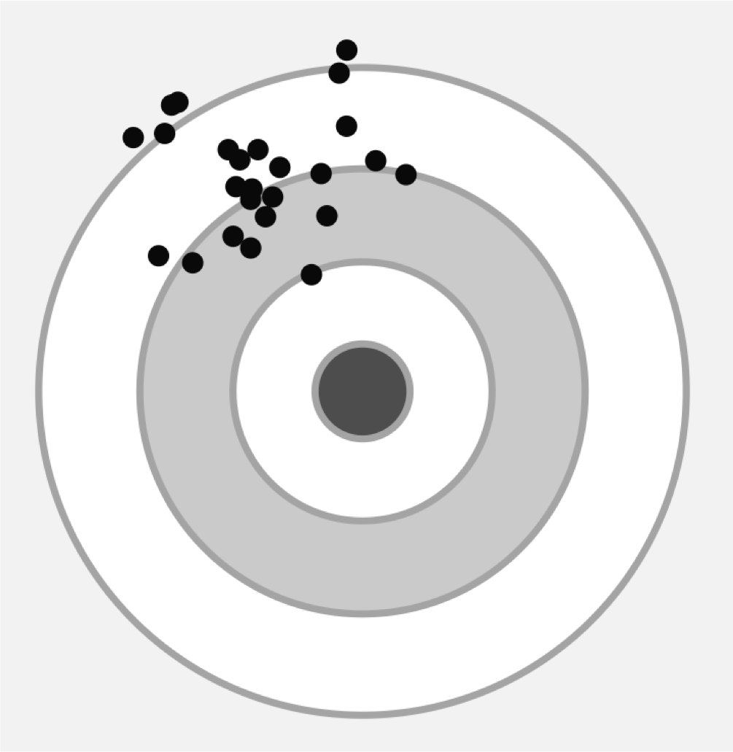
Cause of Overfitting - Errors
Lecture
03
Prediction error = Bias² + Variance + Ineliminable error
In general, the two main factors of prediction error are variance and bias.
Variance:
  How much a prediction result deviates from the mean
  Variance is caused by the sensitivity of the model to small fluctuations in a training set.
Bias:
  Difference between the average of the predicted values and the actual values.
Variance
Bias
Notes:
About the ineliminable error
Theoretically, if there is infinite amount of data and a perfect model, the error can be eliminated.
In practice, no model is perfect, and our data volume is limited.

Slide 50
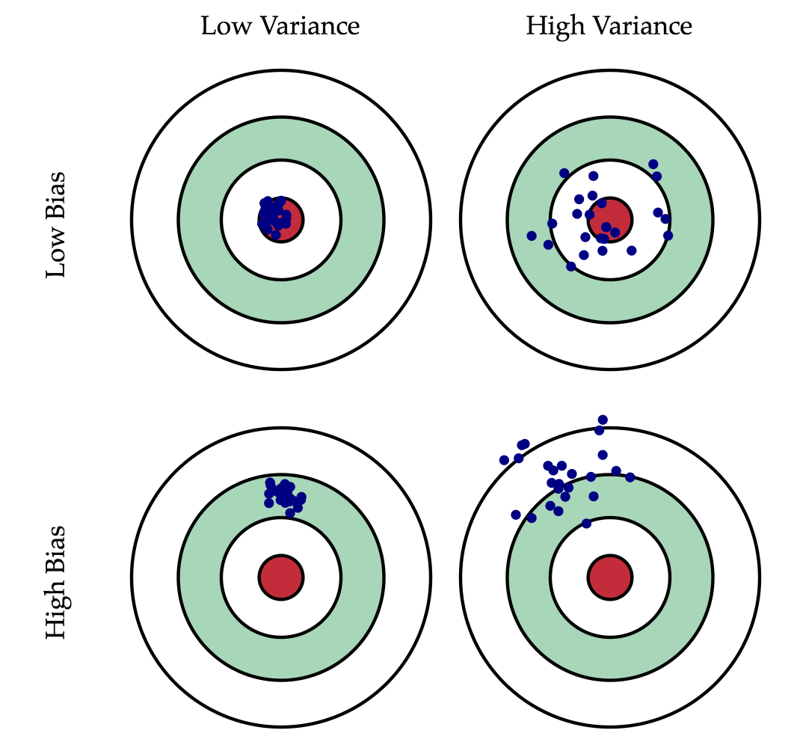
Variance and Bias
Lecture
03
Different combinations of variance and bias are as follows:
  Low bias & low variance ➜ good model
  Low bias & high variance ➜ inadequate model
  High bias & low variance ➜ inadequate model
  High bias & high variance ➜ bad model
An ideal model can accurately capture the rules in the training data and be generalized to invisible (new) data. However, it is impossible for a model to complete both tasks at the same time.

Slide 51
Complexity and Errors of Models
Lecture
03
The more complex a model is, the smaller its training error is.
As the model complexity increases, the test error decreases before increasing again, forming a convex curve.
Error
Test error
Training error
Model complexity

Slide 52
Lecture
03
Machine Learning Algorithms
Types of Machine Learning
Machine Learning Process
Important Machine Learning Concepts
Common Machine Learning Algorithms

Slide 53
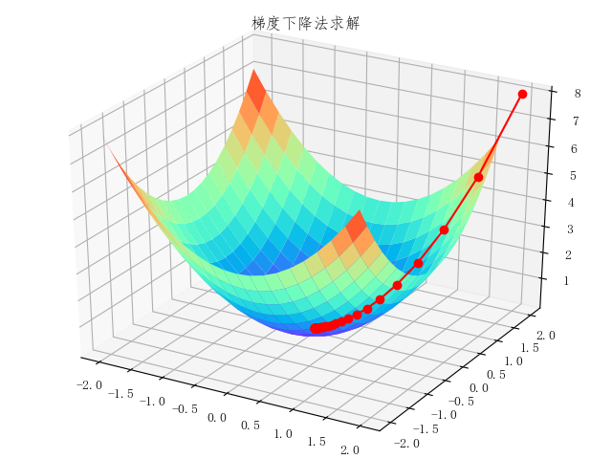
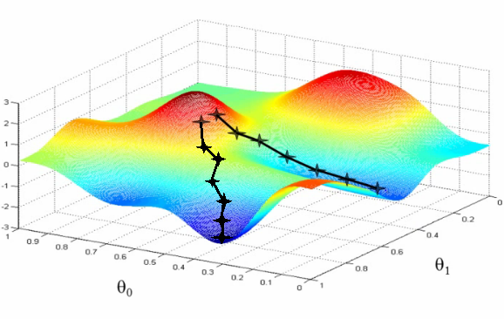
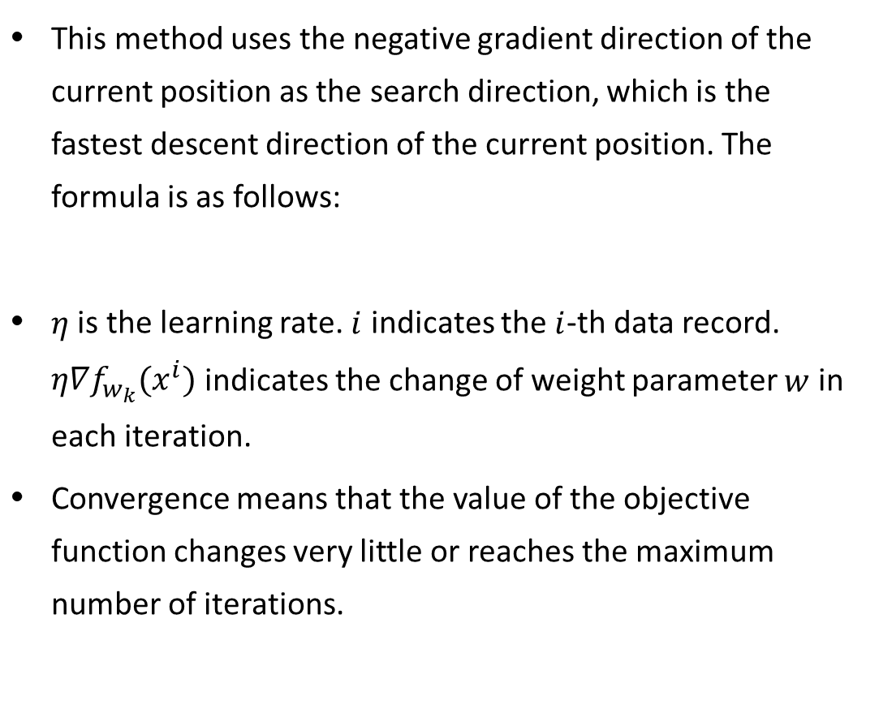
Machine Learning Training Methods - Gradient Descent
Lecture
03
This method uses the negative gradient direction of the current position as the search direction, which is the fastest descent direction of the current position. The formula is as follows:
$η$ is the learning rate. $i$ indicates the $i$-th data record. $η∇f_{w_{k}}(x^{i})$ indicates the change of weight parameter $w$ in each iteration.
Convergence means that the value of the objective function changes very little or reaches the maximum number of iterations.
Notes:
Typically, the gradient descent method shows a decreasing descent in a very small range close to the target point, but the gradient may fluctuate in a specific range of the target point.

Slide 54
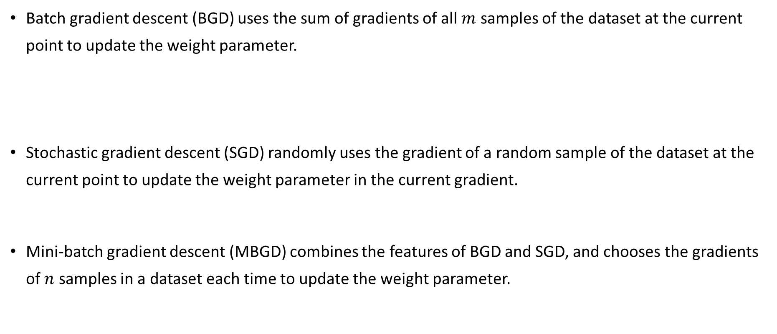
Machine Learning Training Methods - Gradient Descent (2)
Lecture
03
Batch gradient descent (BGD) uses the sum of gradients of all $m$ samples of the dataset at the current point to update the weight parameter.
Stochastic gradient descent (SGD) randomly uses the gradient of a random sample of the dataset at the current point to update the weight parameter in the current gradient.
Mini-batch gradient descent (MBGD) combines the features of BGD and SGD, and chooses the gradients of $n$ samples in a dataset each time to update the weight parameter.

Slide 55
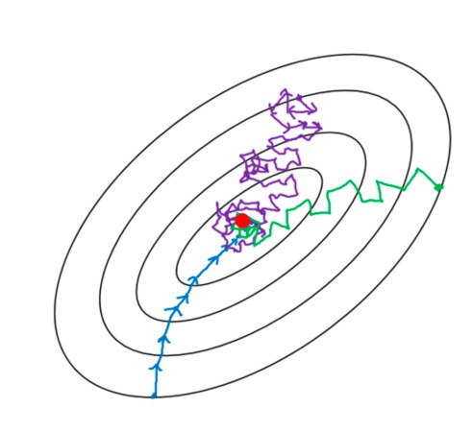
Machine Learning Training Methods - Gradient Descent (3)
Lecture
03
Comparison of gradient descent methods
  SGD randomly chooses samples for each training pass, causing instability. As a result, the loss function fluctuates or even produces reverse displacement during the process of dropping to the minimum.
  BGD is the most stable, but it consumes too many compute resources. MBGD is a balance between BGD and SGD.
BGD
Use all training samples for each training pass.
SGD
One training sample is used for each training pass.
MBGD
A certain number of training samples are used for each training pass.

Slide 56
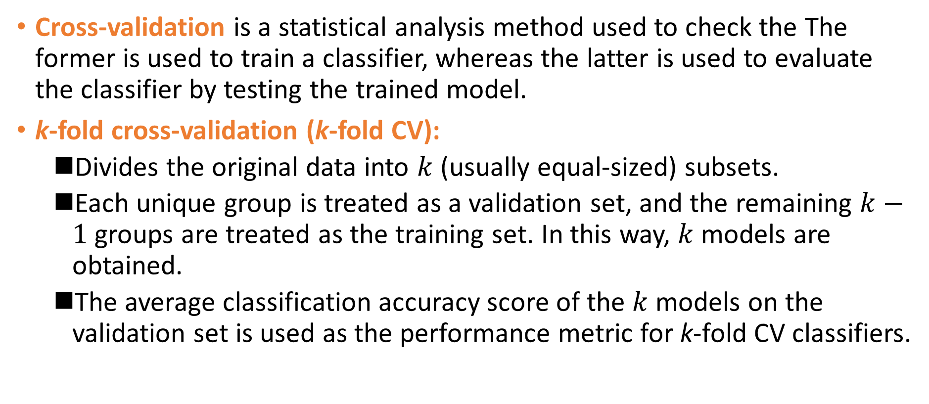
Cross-Validation
Lecture
03
Cross-validation is a statistical analysis method used to check the The former is used to train a classifier, whereas the latter is used to evaluate the classifier by testing the trained model.
k-fold cross-validation (k-fold CV):
  Divides the original data into $k$ (usually equal-sized) subsets.
  Each unique group is treated as a validation set, and the remaining $k−1$ groups are treated as the training set. In this way, $k$ models are obtained.
  The average classification accuracy score of the $k$ models on the validation set is used as the performance metric for k-fold CV classifiers.
Notes:
After a dataset is divided into a fixed training set and a fixed test set, if the test set error is small, there is a problem. A small test set implies statistical uncertainty around the estimated mean test error, making it difficult to claim that $A$ algorithm works better than $B$ algorithm on the given task. When the dataset has hundreds of thousands of samples or more, this is not a serious problem. When the dataset is too small, alternative procedures enable one to use all the samples in the estimation of the mean test error, at the price of increased computational workload.
In k-fold CV, $k$ is typically greater than or equal to 2. It usually starts from 3 and is set to 2 only when the original dataset is small. k-fold CV can effectively avoid over-learning and under-learning, and the final result is also persuasive.

Slide 57
Cross-Validation (2)
Lecture
03
Full dataset
Training set
Test set
Training set
Validation set
Test set
Note: k in k-fold CV is a hyperparameter.

Slide 58
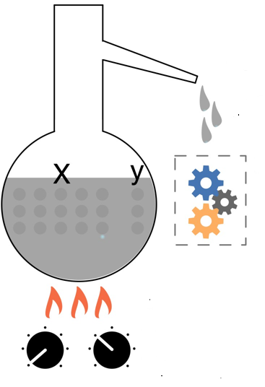
Parameters and Hyperparameters
Lecture
03
A model contains not only parameters but also hyperparameters. Hyperparameters enable the model to learn the optimal configurations of the parameters.
  Parameters are automatically learned by models.
  Hyperparameters are manually set.
Parameters are "distilled" from data.
Model
Train
Use hyperparameters to control training

Slide 59
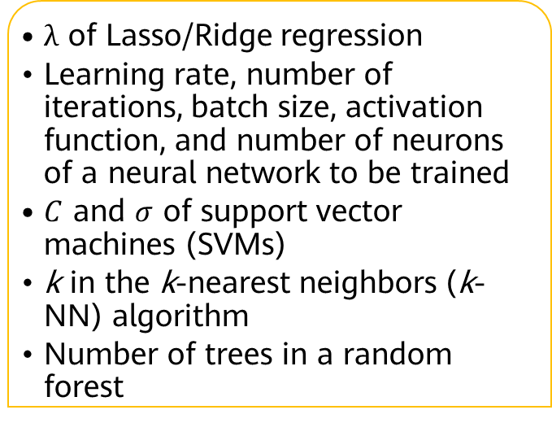
Hyperparameters
Lecture
03
  Commonly used for model parameter estimation.
  Specified by the user.
  Set heuristically.
  Often tuned for a given predictive modeling problem.
  $λ$ of Lasso/Ridge regression
  Learning rate, number of iterations, batch size, activation function, and number of neurons of a neural network to be trained
  $C$ and $σ$ of support vector machines (SVMs)
  k in the k-nearest neighbors (k-NN) algorithm
  Number of trees in a random forest
Hyperparameters are configurations outside the model.
Common hyperparameters
Notes:
Parameters are a part of a model that is learned from historical training data and key to machine learning algorithms. They have the following characteristics:
They are required by a model to make predictions.
Their values define the model functions.
They are learned or estimated from data.
They are often not set manually by the user.
They are often saved as a part of the learned model.
Examples:
Weights in an artificial neural network
Support vectors in a SVM
Coefficients in linear regression or logistic regression

Slide 60
Hyperparameter Search Process and Methods
Lecture
03
  Divide a dataset into a training set, validation set, and test set.
  Optimize the model parameters using the training set based on the model performance metrics.
  Search for model hyperparameters using the validation set based on model performance metrics.
  Perform step 2 and step 3 alternately until model parameters and hyperparameters are determined and assess the model using the test set.
Hyperparameter search general process
Search algorithms
(step 3)
  Grid search
  Random search
  Heuristic intelligent search
  Bayesian search

Slide 61
Lecture
03
Machine Learning Algorithms
Types of Machine Learning
Machine Learning Process
Important Machine Learning Concepts
Common Machine Learning Algorithms

Slide 62
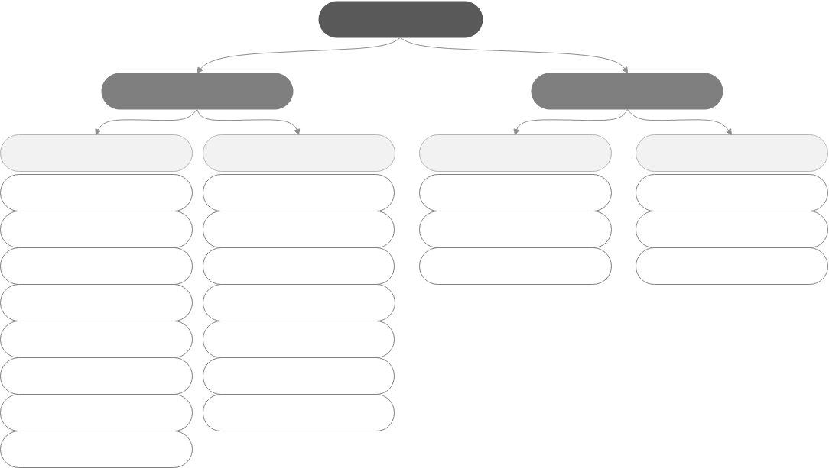
Machine Learning Algorithm Overview
Lecture
03
Machine learning
Supervised learning
Unsupervised learning
Classification
Regression
Clustering
Other
Logistic regression
Linear regression
k-means clustering
Association rule
SVM
SVM
Hierarchical clustering
Principal component analysis
Neural network
Neural network
Density-based clustering
Gaussian mixture modeling
Decision tree
Decision tree
Random forest
Random forest
Gradient boosted decision tree (GBDT)
GBDT
k-NN
k-NN
Naive Bayes

Slide 63


