Slide 1


Creative and Scientific Thinking
Prepared by Prof. Shereen Taie
CRE252
Information Technology Department
Lecture 8

Slide 2




Creative and Scientific
Thinking
Lecture 8
CRE252
Information Technology Department
Prepared by
Prof. Shereen Taie
www.midocean.ae

Slide 3
Learning Objectives:
Individual Techniques for Generating Solutions
Group Techniques for Generating Solutions
Alternative solutions
Chapter
03
www.midocean.ae

Slide 4

Chapter
Individual Techniques for Generating Solutions
03
www.midocean.ae

Slide 5
Why Mind Map?
Organize thoughts when brainstorming
Effective method of taking notes
Harnesses the full range of skills– word, image, number, logic, rhythm, color and spatial awareness
Aid creativity, memory, and specifically the recall of information.
Chapter
03
www.midocean.ae

Slide 6
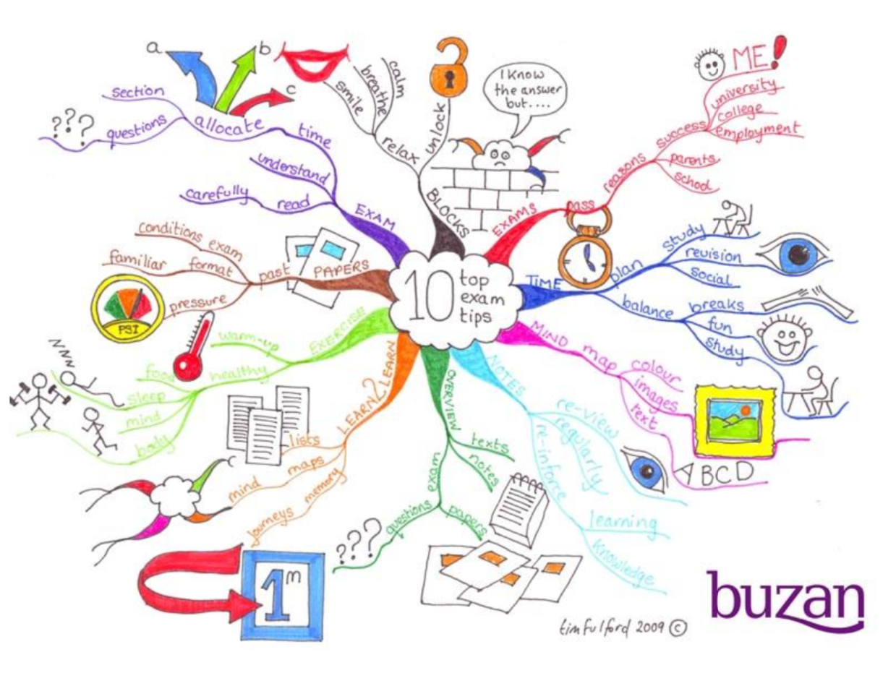
Chapter
03
www.midocean.ae

Slide 7
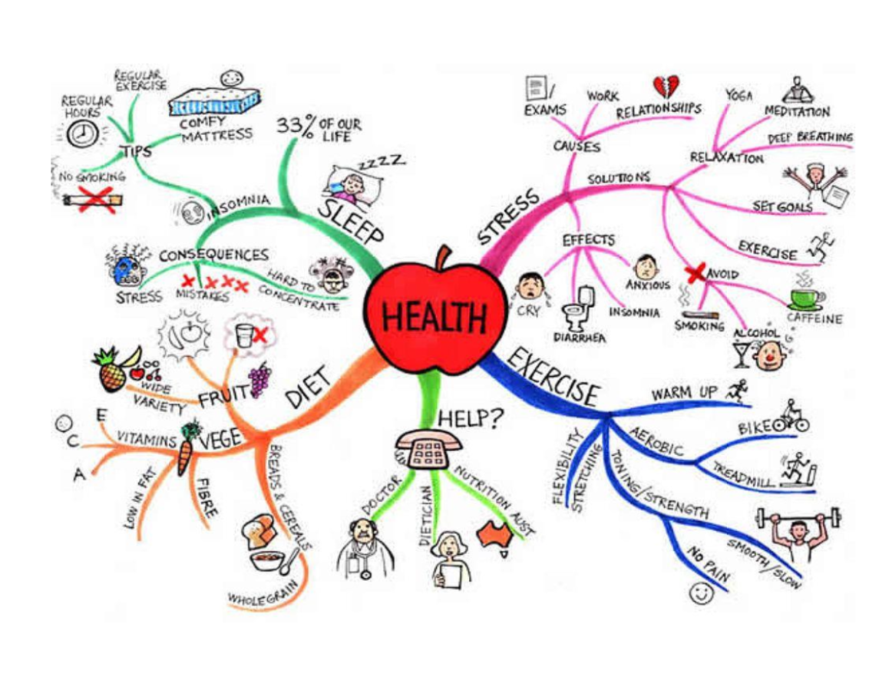
Chapter
03
www.midocean.ae

Slide 8
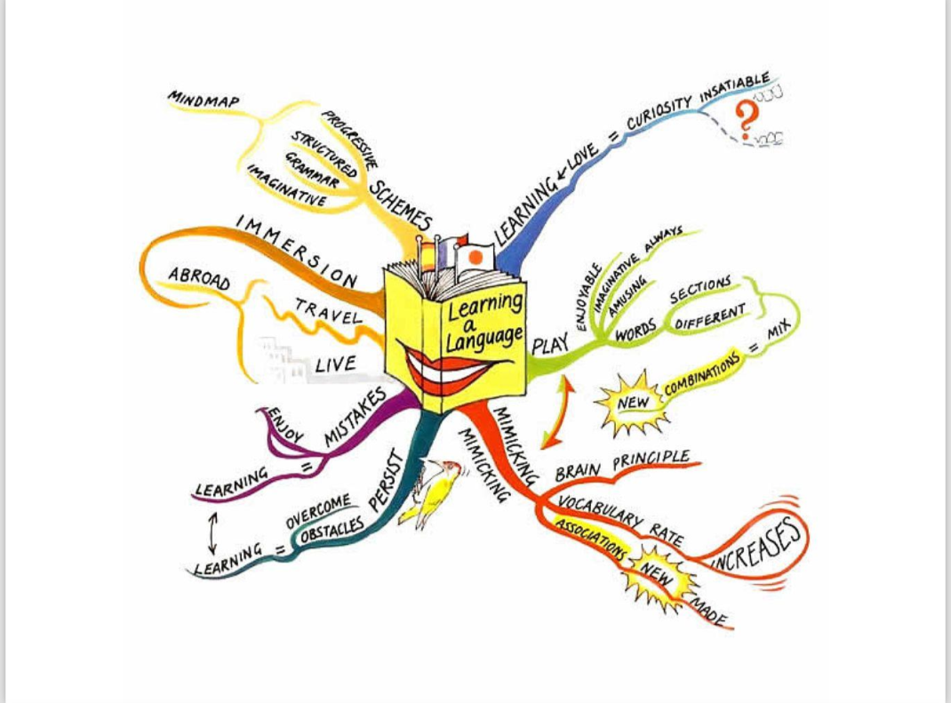
Chapter
03
www.midocean.ae

Slide 9
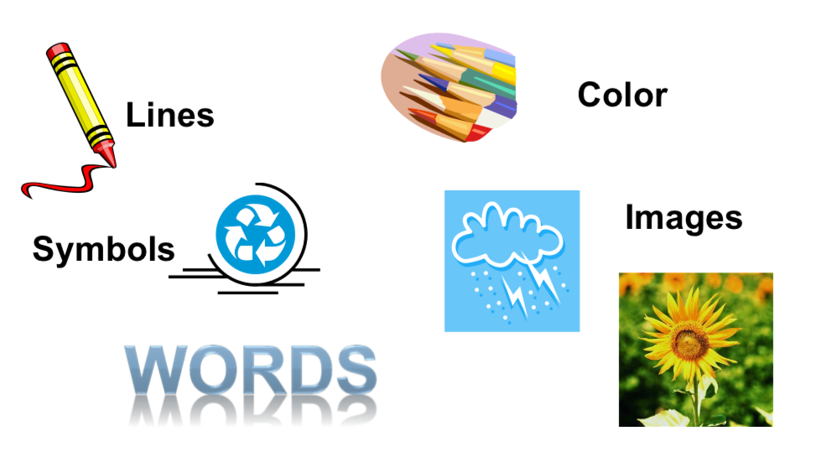
Mind Maps Use:
Chapter
03
www.midocean.ae

Slide 10
7 Steps: Mind Mapping
Start
Main idea
Use colors throughout
Connect main branches
Chapter
03
www.midocean.ae

Slide 11
7 Steps: Mind Mapping
5. Curved branches
6. Use one keyword
7. Use images
Chapter
03
www.midocean.ae

Slide 12
7 Steps: Mind Mapping:
1. Start in the center of a blank page turned sideways.
Give your brain freedom to spread out in all directions
Chapter
03
www.midocean.ae

Slide 13

7 Steps: Mind Mapping:
1. Start in the center of a blank page turned sideways.
Chapter
03
www.midocean.ae

Slide 14
7 Steps: Mind Mapping:
2. Use an image or picture for your main idea.
An image helps your imagination. It is more interesting and keeps your focused helping you to concentrate.
Chapter
03
www.midocean.ae

Slide 15
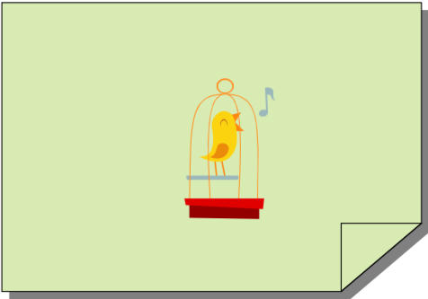
7 Steps: Mind Mapping:
2. Use an image or picture for your main idea.
Chapter
03
www.midocean.ae

Slide 16
7 Steps: Mind Mapping:
3. Use colors throughout.
Colors are as exciting to your Brain as are images.
Color will add energy to your creative thinking.
Chapter
03
www.midocean.ae

Slide 17
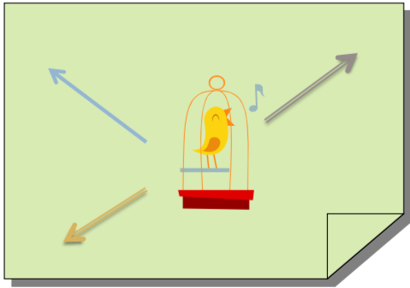
7 Steps: Mind Mapping:
3. Use colors throughout.
Chapter
03
www.midocean.ae

Slide 18
7 Steps: Mind Mapping:
4. Connect your main branches to the central image etc.
Your brain works by association. It likes to link two (or three, or four) things together.
Chapter
03
www.midocean.ae

Slide 19
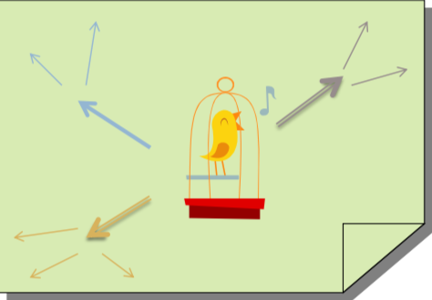
7 Steps: Mind Mapping:
4. Connect your main branches to the central image etc.
Chapter
03
www.midocean.ae

Slide 20
7 Steps: Mind Mapping:
5. Make your branches curved instead of straight lined.
Having nothing but straight lines is boring to your brain.
Chapter
03
www.midocean.ae

Slide 21
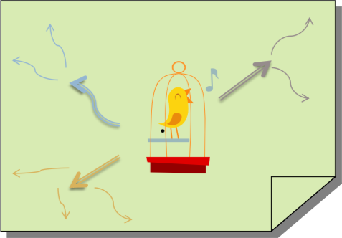
7 Steps: Mind Mapping:
5. Make your branches curved instead of straight lined.
Chapter
03
www.midocean.ae

Slide 22
7 Steps: Mind Mapping:
6. Use one key word per line
Single words give your Mind Map more power and flexibility.
Chapter
03
www.midocean.ae

Slide 23
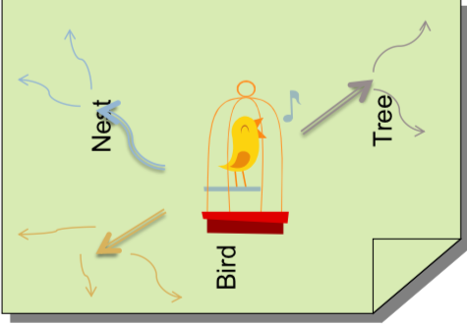
7 Steps: Mind Mapping:
6. Use one key word per line
Chapter
03
www.midocean.ae

Slide 24
7 Steps: Mind Mapping:
7. Use images throughout
Each image, like the central image, is worth a thousand words!
Chapter
03
www.midocean.ae

Slide 25
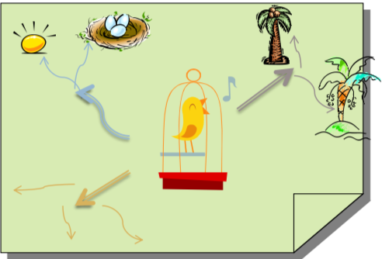
7 Steps: Mind Mapping:
7. Use images throughout
Chapter
03
www.midocean.ae

Slide 26
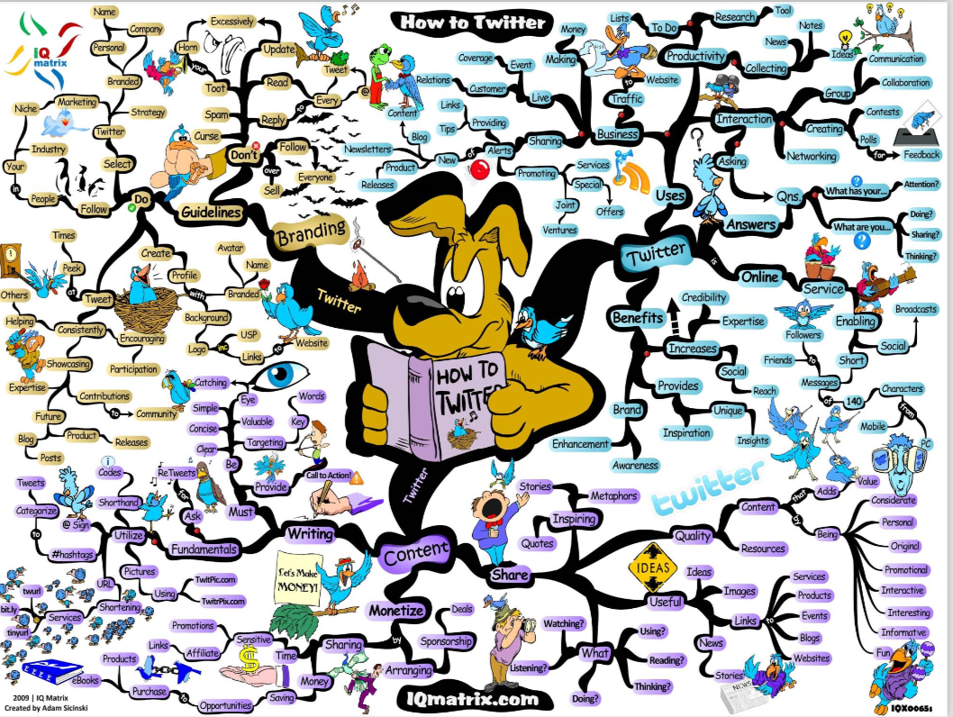
Chapter
03
www.midocean.ae

Slide 27
Chapter
Group Techniques for Generating Solutions
03
www.midocean.ae

Slide 28

Brainstorming:
Is a group creativity technique designed to generate a large number of ideas for the solution to a problem
Chapter
03
www.midocean.ae

Slide 29
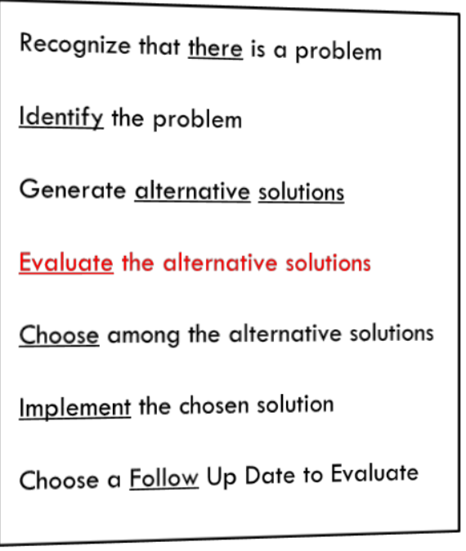
4.Evaluate the Alternative solutions.
When you have come up with at least a dozen wild and crazy ideas – now is the time to constructively evaluate each one:
Chapter
03
www.midocean.ae

Slide 30
4.Evaluate the Alternative solutions.
This is the time to suggest both the strengths and the weaknesses of each idea.
What are the risks?
Chapter
03
www.midocean.ae

Slide 31
4.Evaluate the Alternative solutions.
Are costs in keeping with the benefits?
Will the solution create new problems?
Which will provide the optimum solution?
Chapter
03
www.midocean.ae

Slide 32
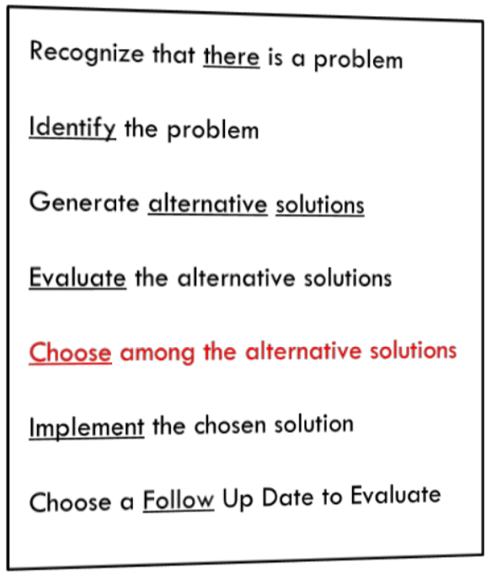
5.Choosing Among Alternative Solutions
How practical is the idea?
Is it realistic?
How cost-effective is it?
Chapter
03
www.midocean.ae

Slide 33
5.Choosing Among Alternative Solutions
Can it be easily implemented by a limited number of individuals, or does it require that large numbers of other people be convinced that it is a good idea? Will they be easy to convince?
Chapter
03
www.midocean.ae

Slide 34
5.Choosing Among Alternative Solutions
Is the idea consistent with the directions already undertaken by the organization?
Chapter
03
www.midocean.ae

Slide 35
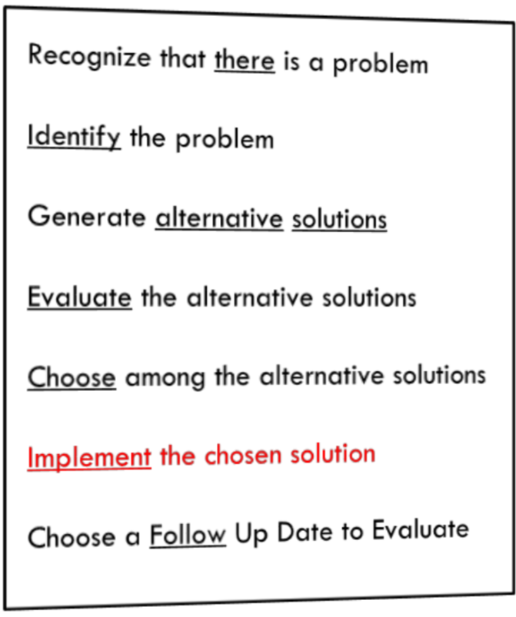
6.Implement the Chosen Solution
What resources are needed?
Who else within the organization needs to approve the solution to the problem, and what will it take to win their approval?
Chapter
03
www.midocean.ae

Slide 36
6.Implement the Chosen Solution
What are the steps in implementation?
When will the various phases of implementation take place?
How will the results be reported and verified?
Chapter
03
www.midocean.ae

Slide 37
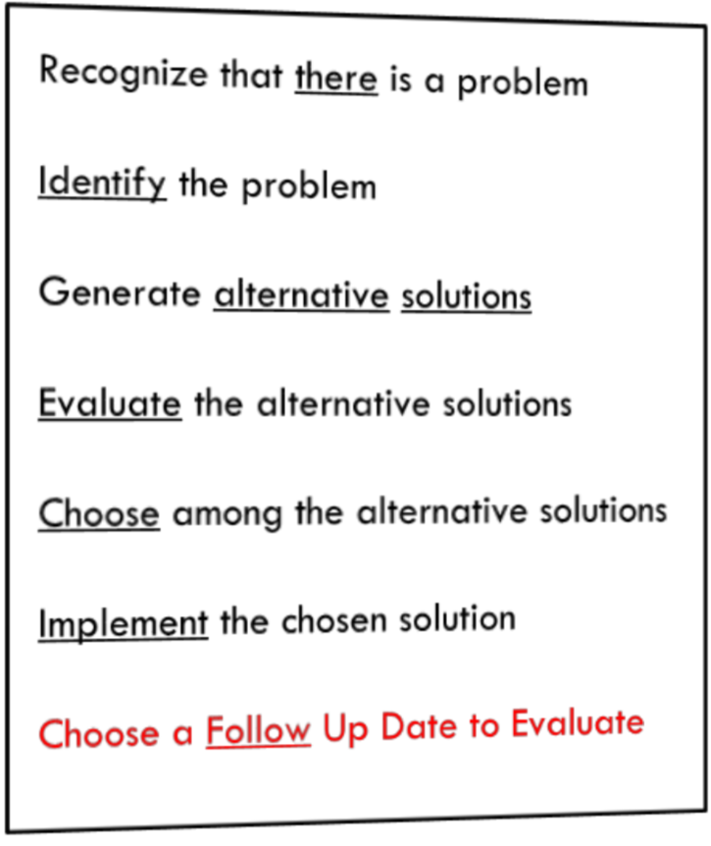
7. Choose a Follow Up Date to Evaluate
Test the solution against the desired results.
This is very important! To make sure the chosen solution has solved the conflict to everyone’s satisfaction, set a date to evaluate how the solution is working.
Chapter
03
www.midocean.ae

Slide 38
7. Choose a Follow Up Date to Evaluate
Let’s say the solution isn’t working, now is not the time to blame. Now is the time to go back and modify your solution or return to Step #5 and choose another solution to try.
Chapter
03
www.midocean.ae

Slide 39
7. Choose a Follow Up Date to Evaluate
Now that you have selected another solution be sure to set another new follow up date to evaluate your progress.
Chapter
03
www.midocean.ae

Slide 40
Decision Making
Chapter
04
www.midocean.ae

Slide 41
WHY DO WE NEED TO MAKE GOOD DECISIONS?
To achieve your goals.
To avoid mistakes.
“No one makes the right decision every time. But by developing your decision-making skills, you can increase your success rate!“
Chapter
04
www.midocean.ae

Slide 42
Chapter
04
Decision Making Definition
www.midocean.ae

Slide 43
Decision Making Definition
Is a task you perform when there are different things you can do and you pick one of them.
Remember: you make lots of decisions everyday
Chapter
04
www.midocean.ae

Slide 44



Thank You

