Slide 1


Slide 2


Slide 3
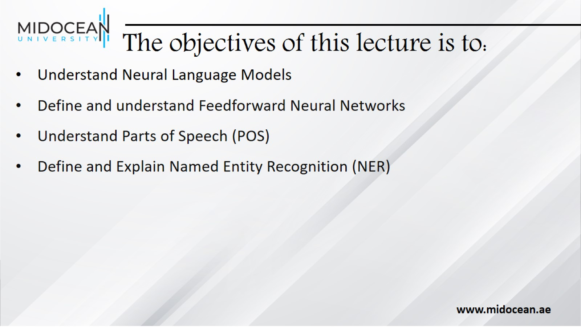
The objectives of this lecture is to:

Slide 4

Neural Language Models

Slide 5
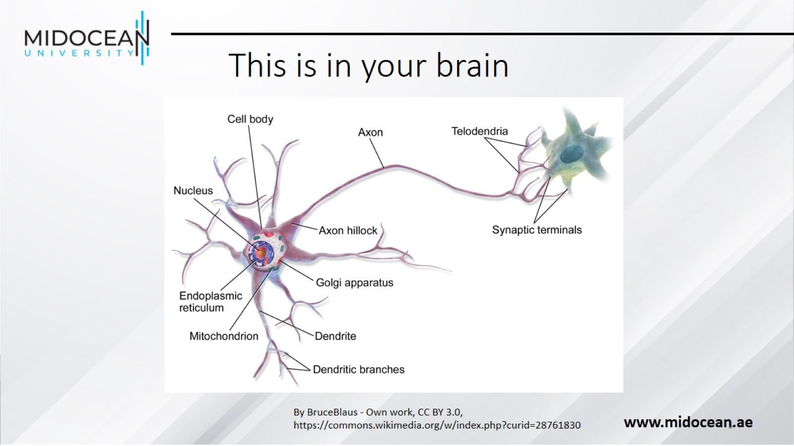
This is in your brain

Slide 6
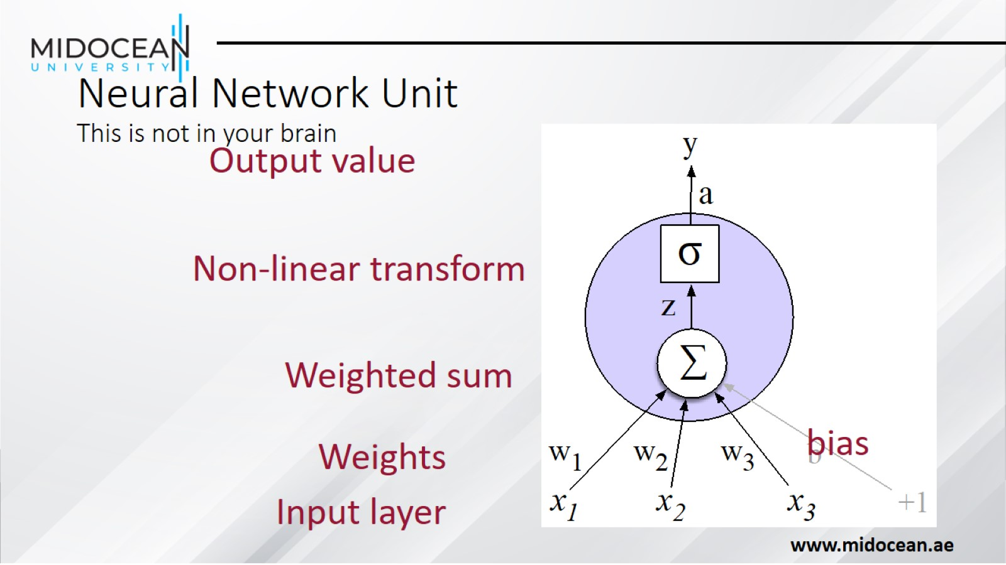
Neural Network Unit
This is not in your brain

Slide 7
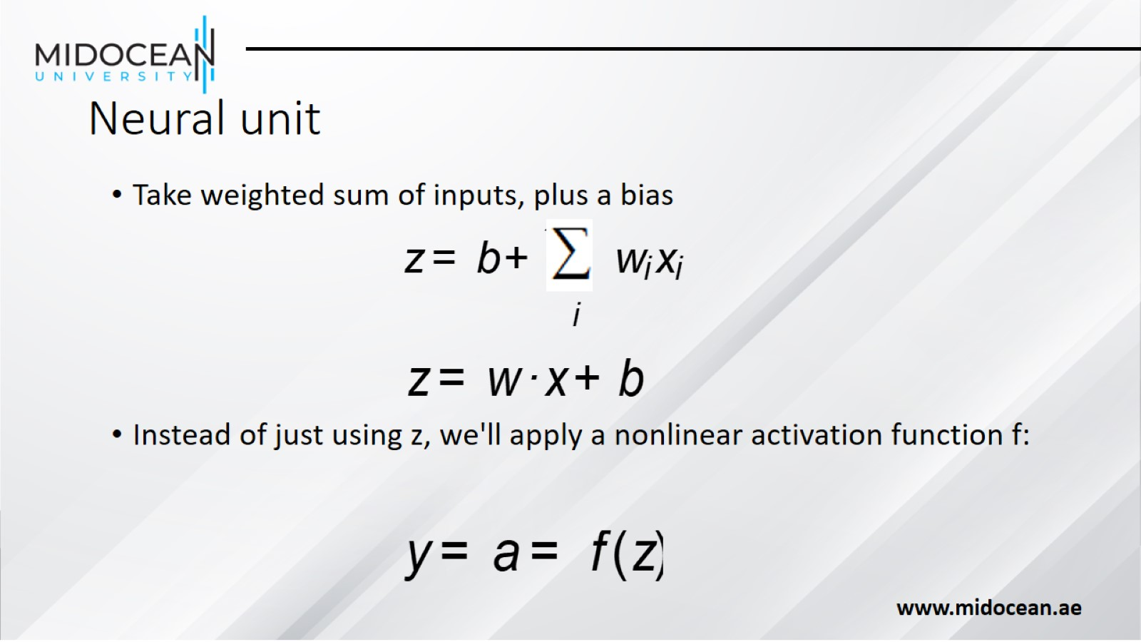
Neural unit

Slide 8
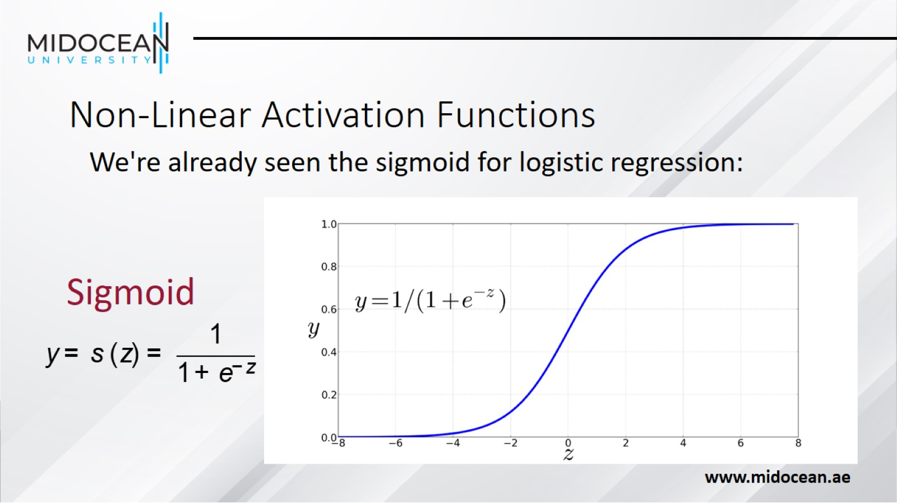
Non-Linear Activation Functions

Slide 9
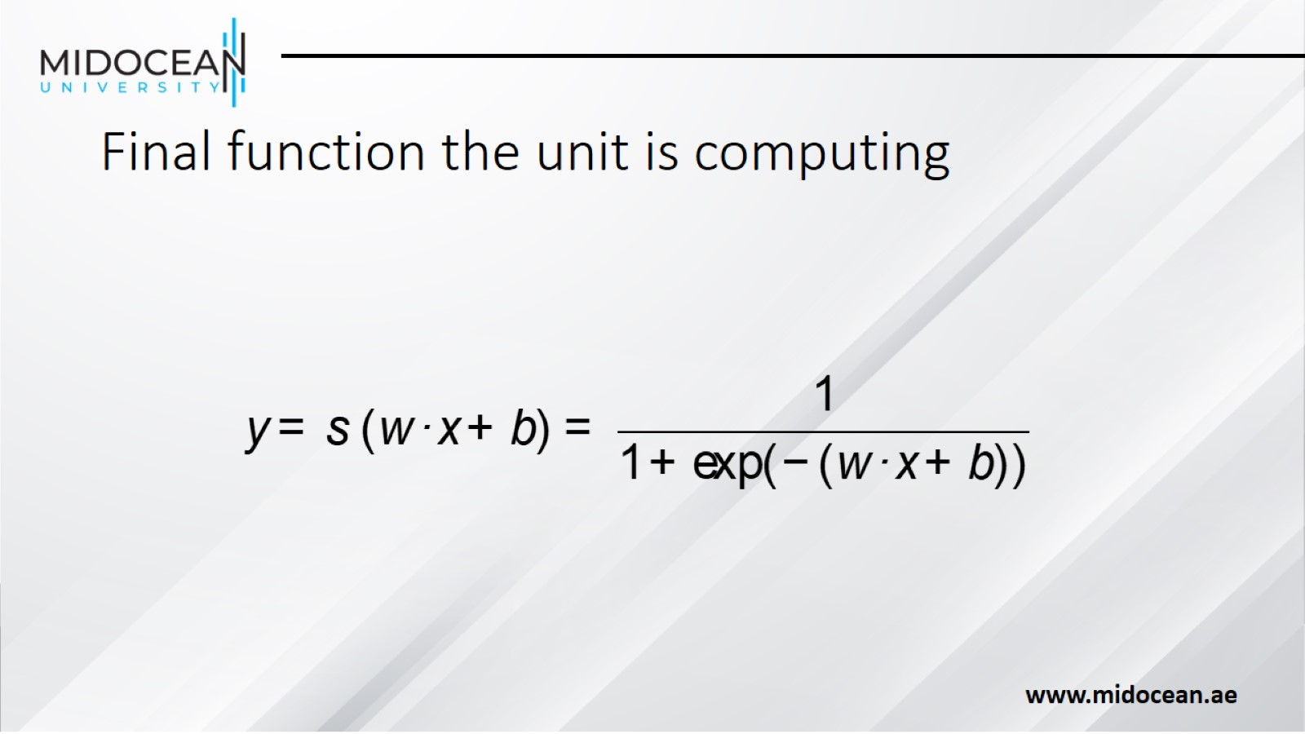
Final function the unit is computing

Slide 10
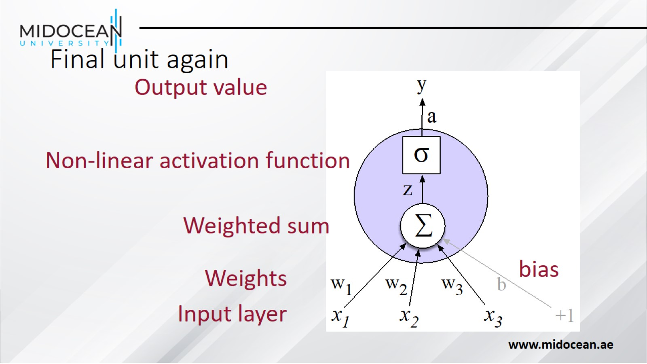
Final unit again

Slide 11
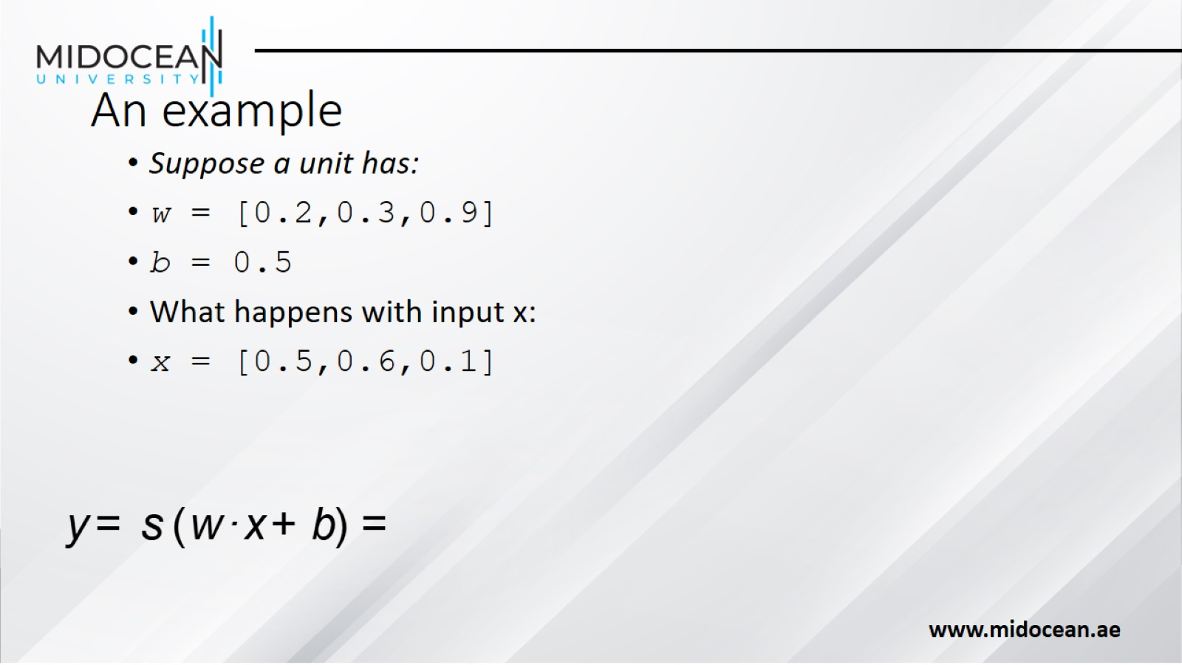
An example

Slide 12
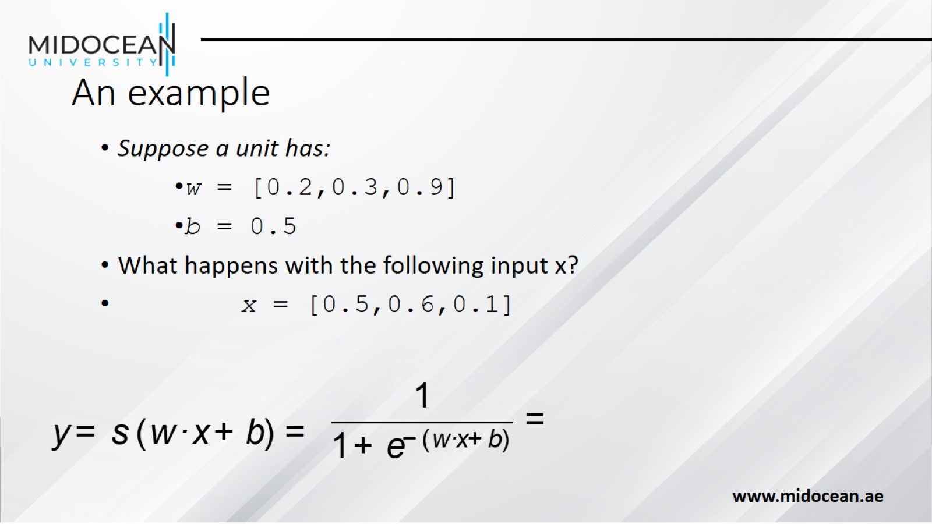
An example

Slide 13
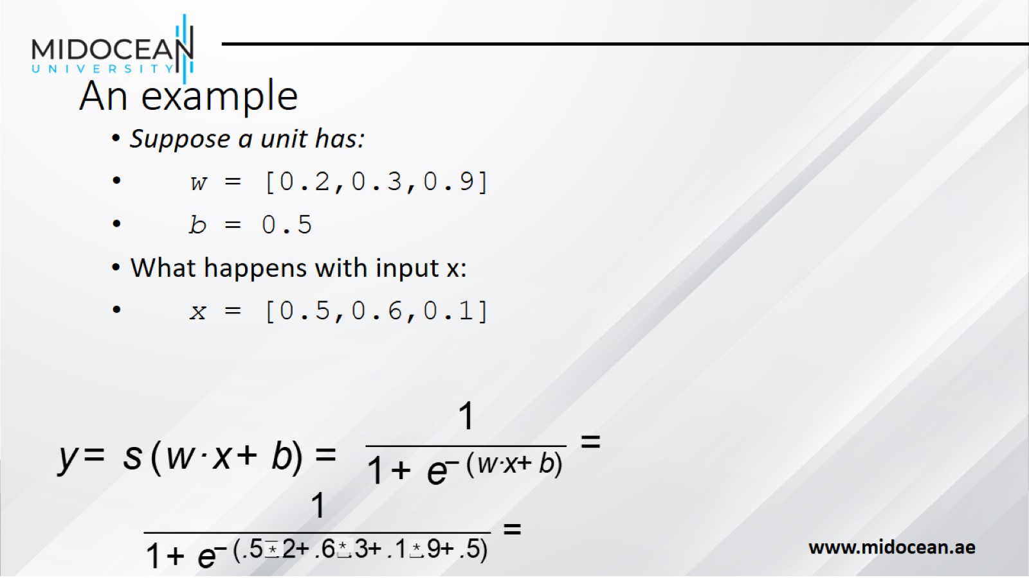
An example

Slide 14
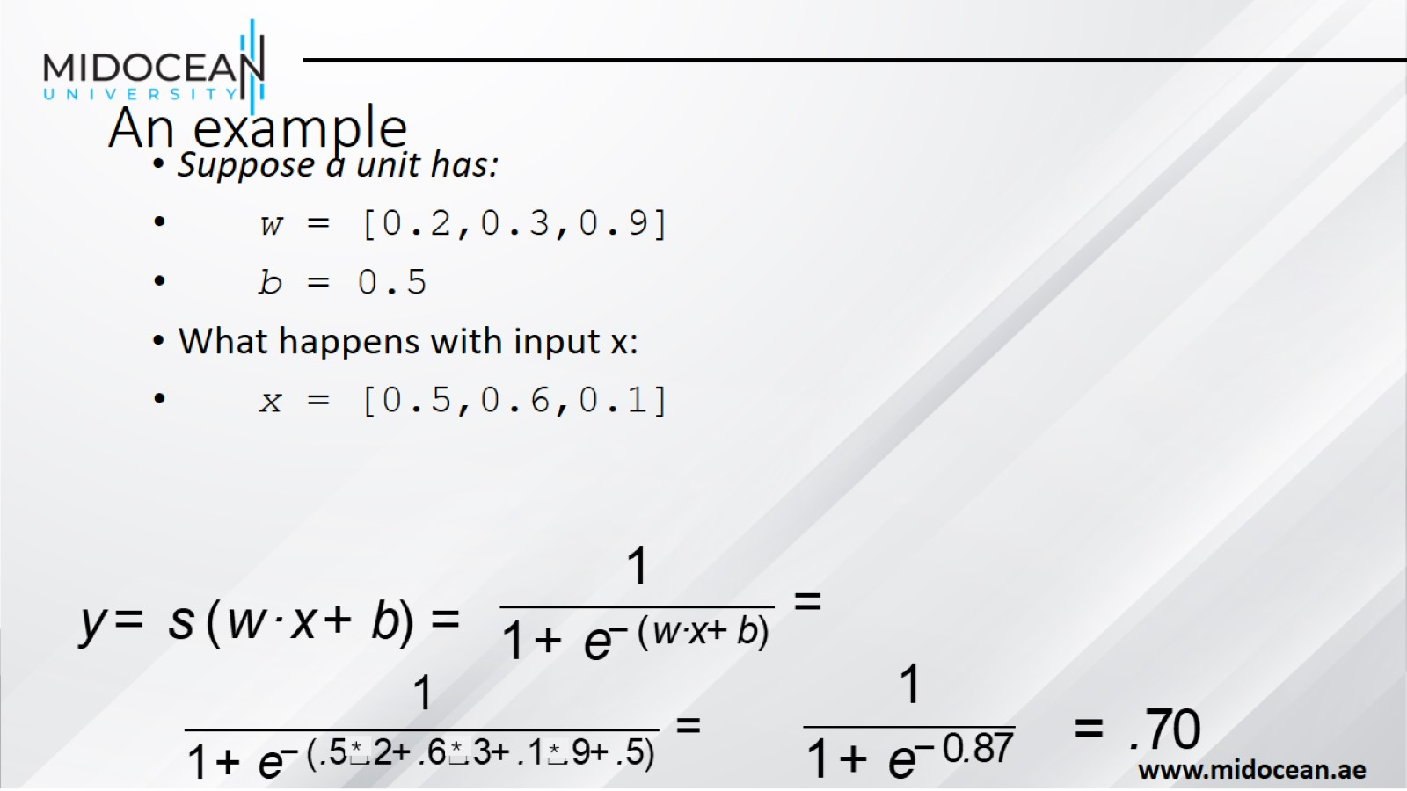
An example

Slide 15
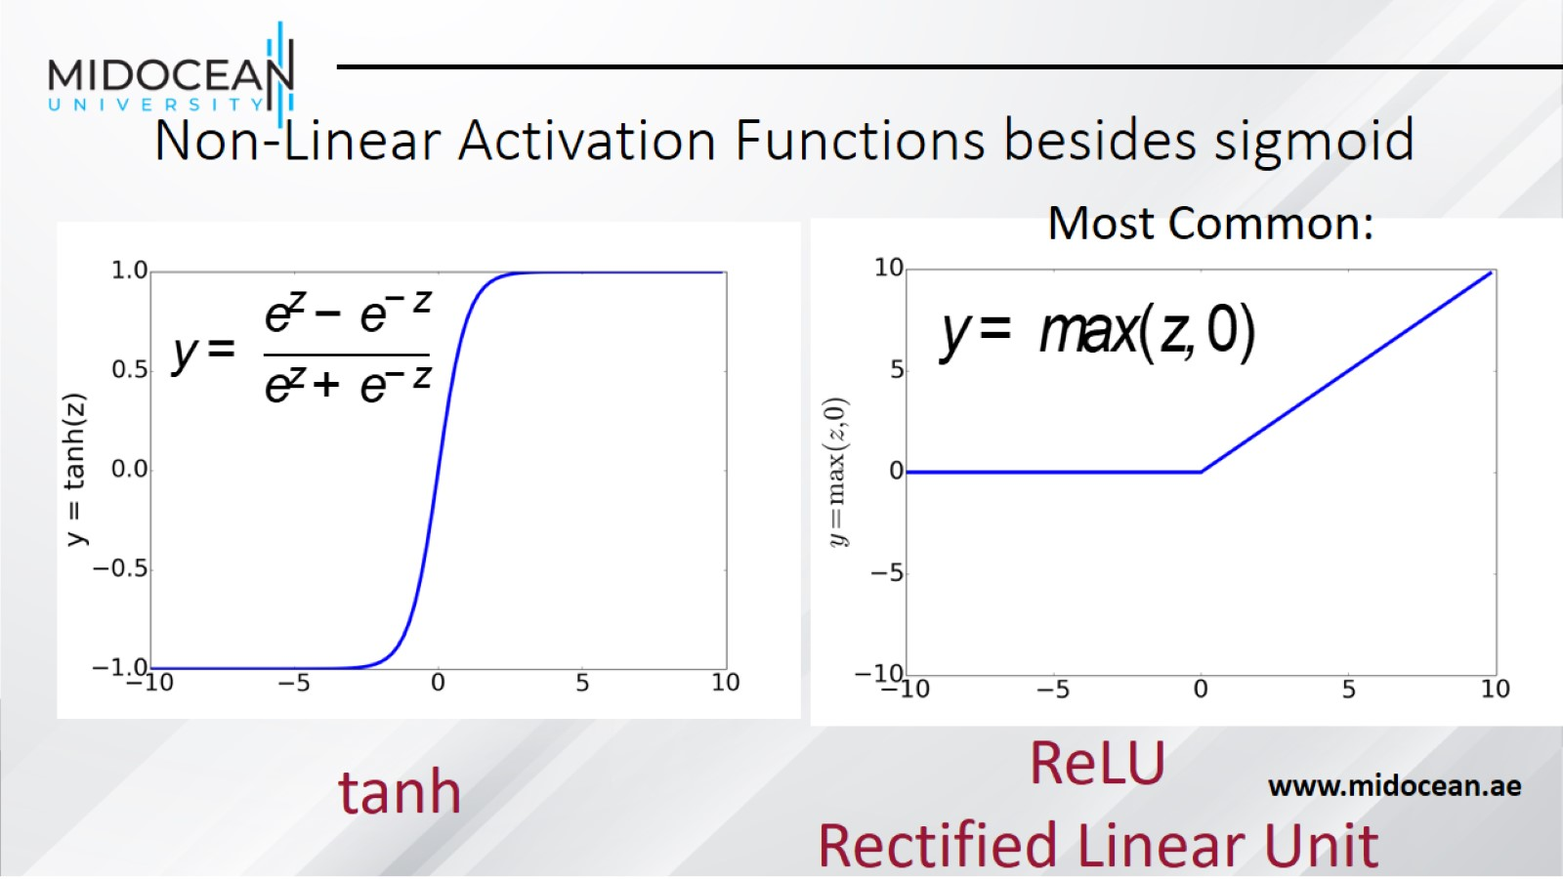
Non-Linear Activation Functions besides sigmoid

Slide 16
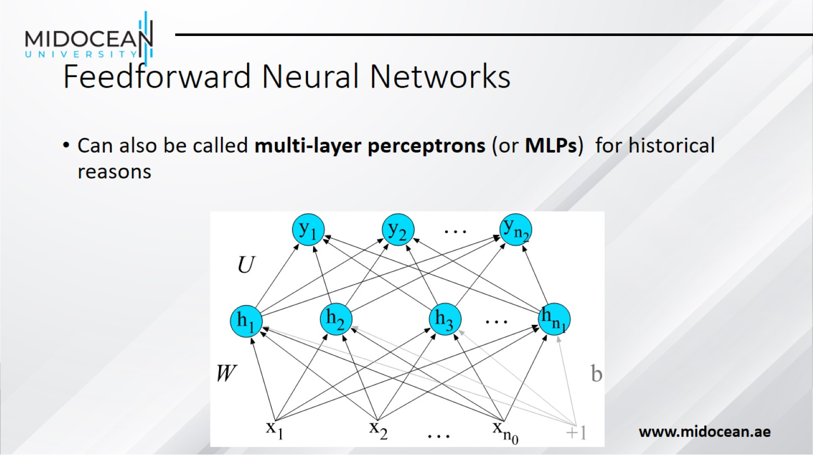
Feedforward Neural Networks

Slide 17
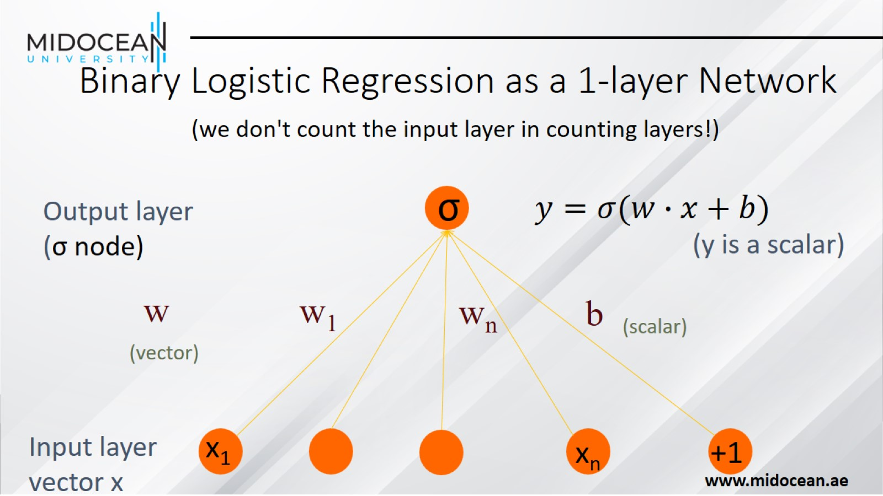
Binary Logistic Regression as a 1-layer Network

Slide 18
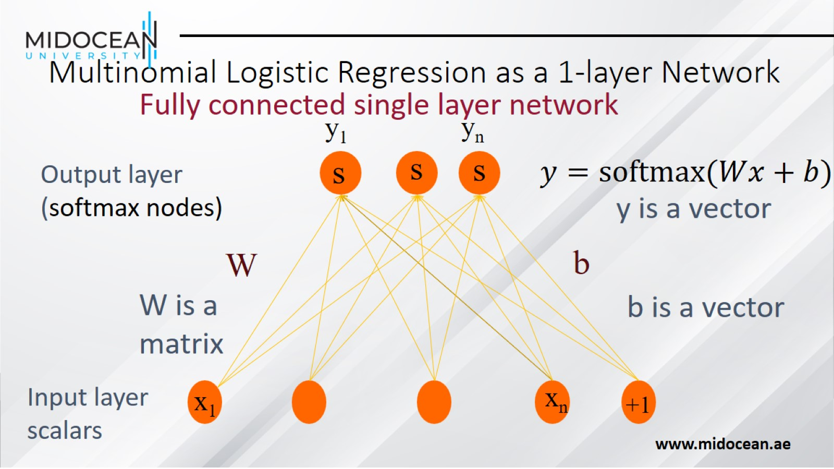
Multinomial Logistic Regression as a 1-layer Network

Slide 19
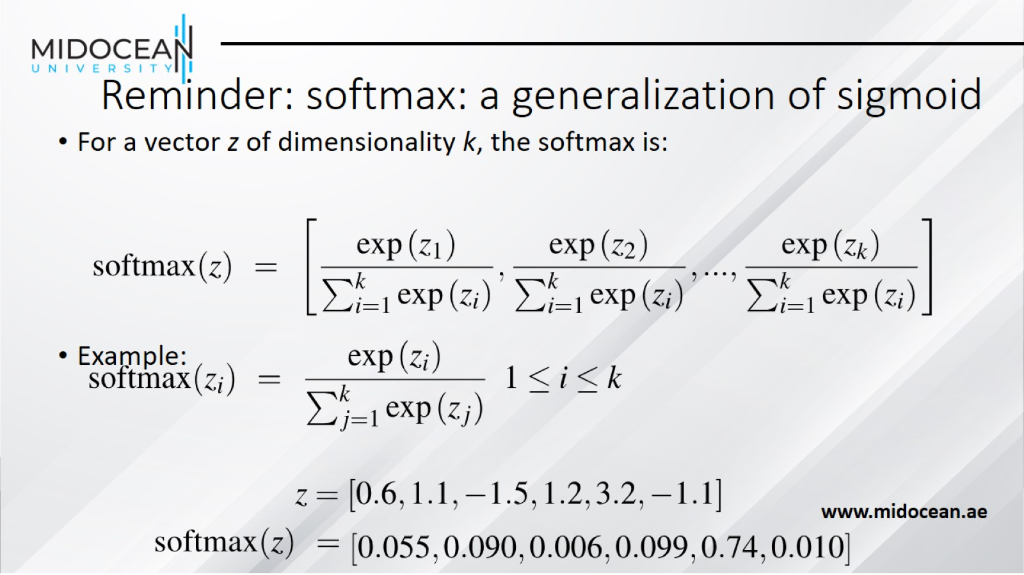
Reminder: softmax: a generalization of sigmoid

Slide 20
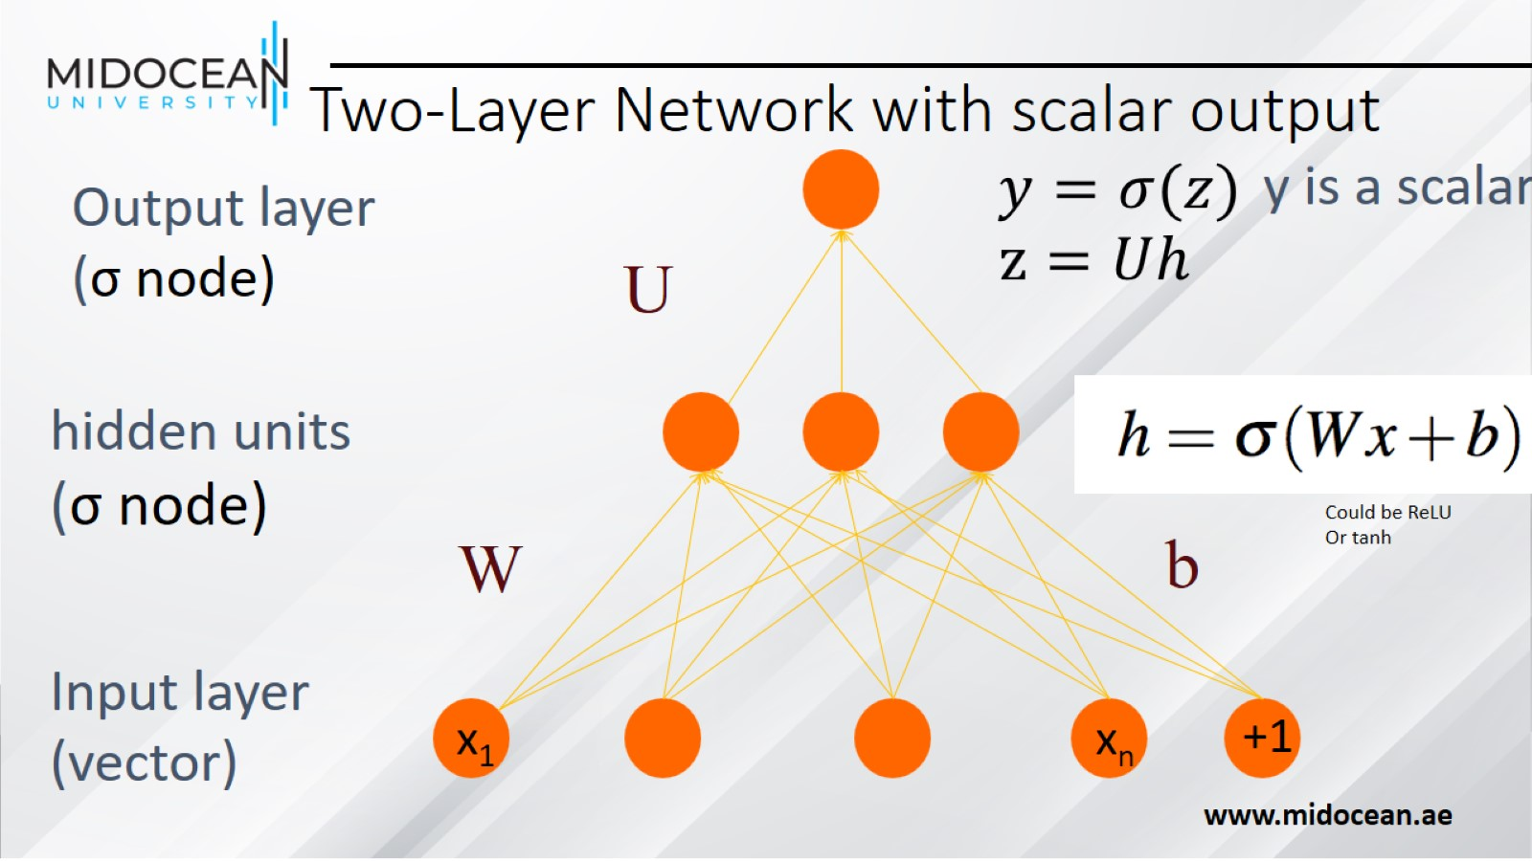
Two-Layer Network with scalar output

Slide 21
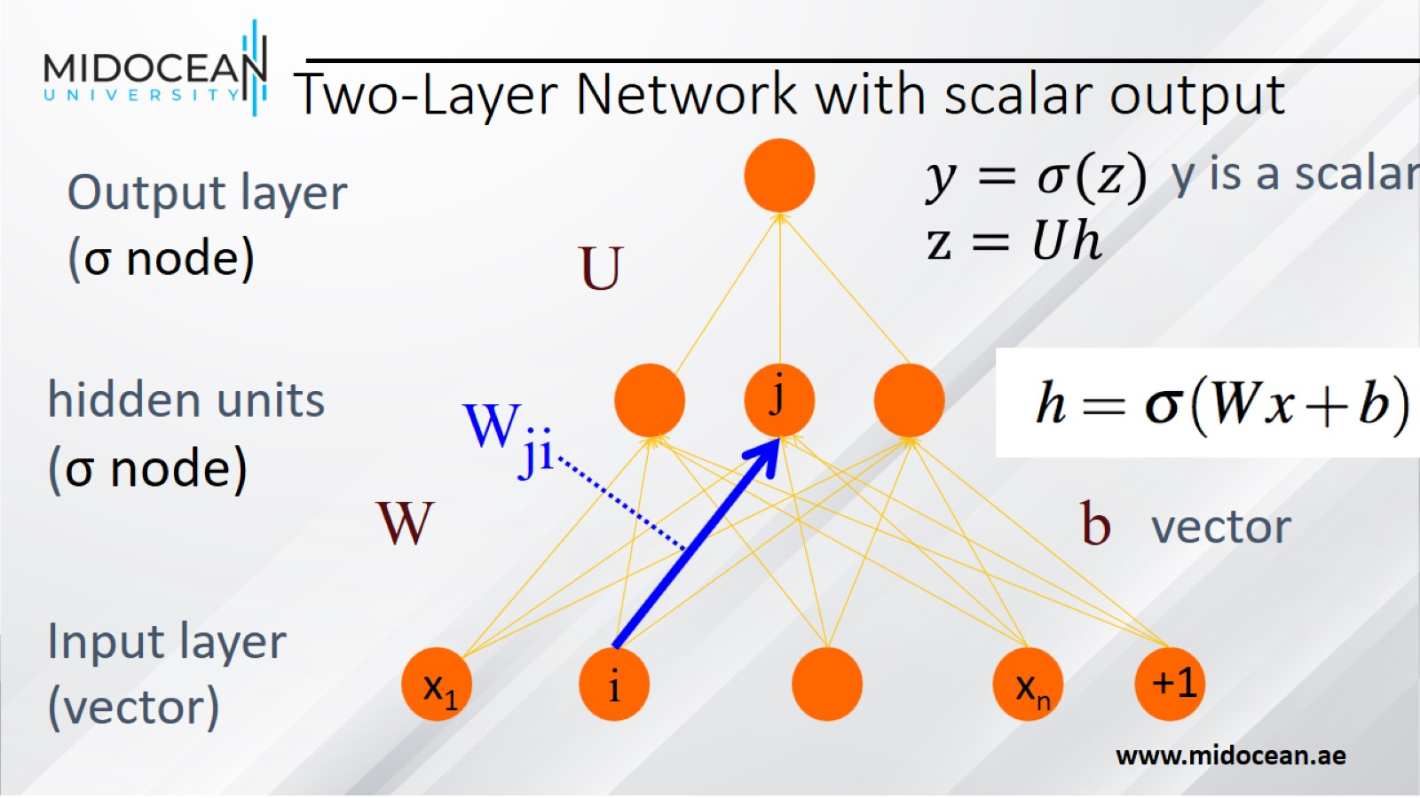
Two-Layer Network with scalar output

Slide 22
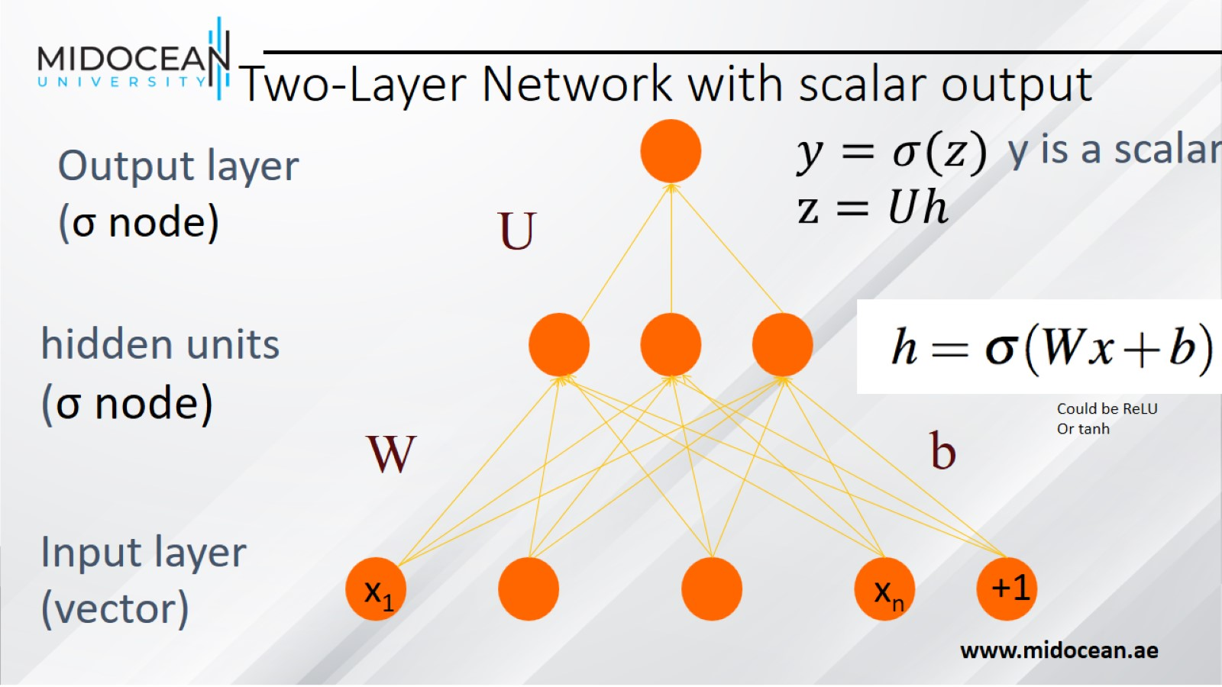
Two-Layer Network with scalar output

Slide 23
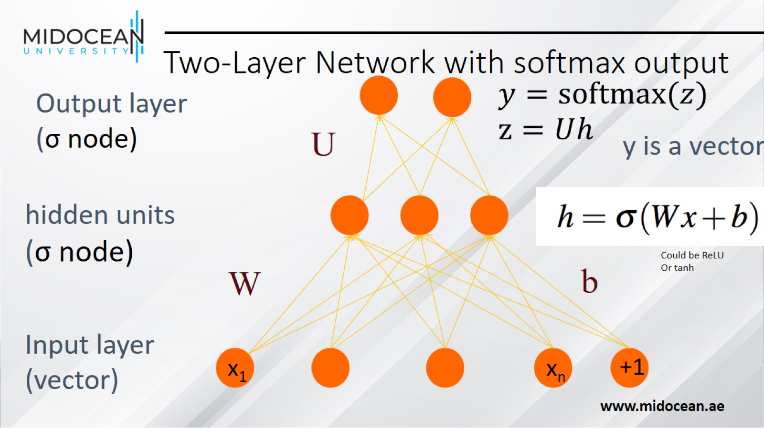
Two-Layer Network with softmax output

Slide 24
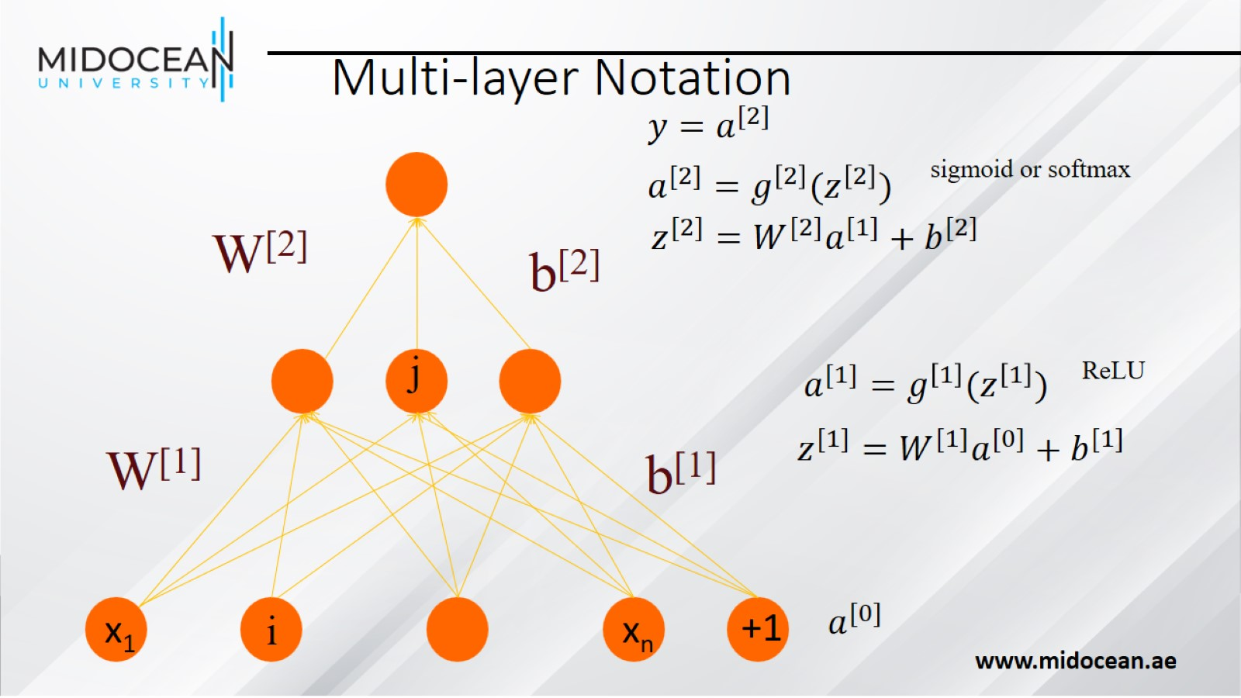
Multi-layer Notation

Slide 25
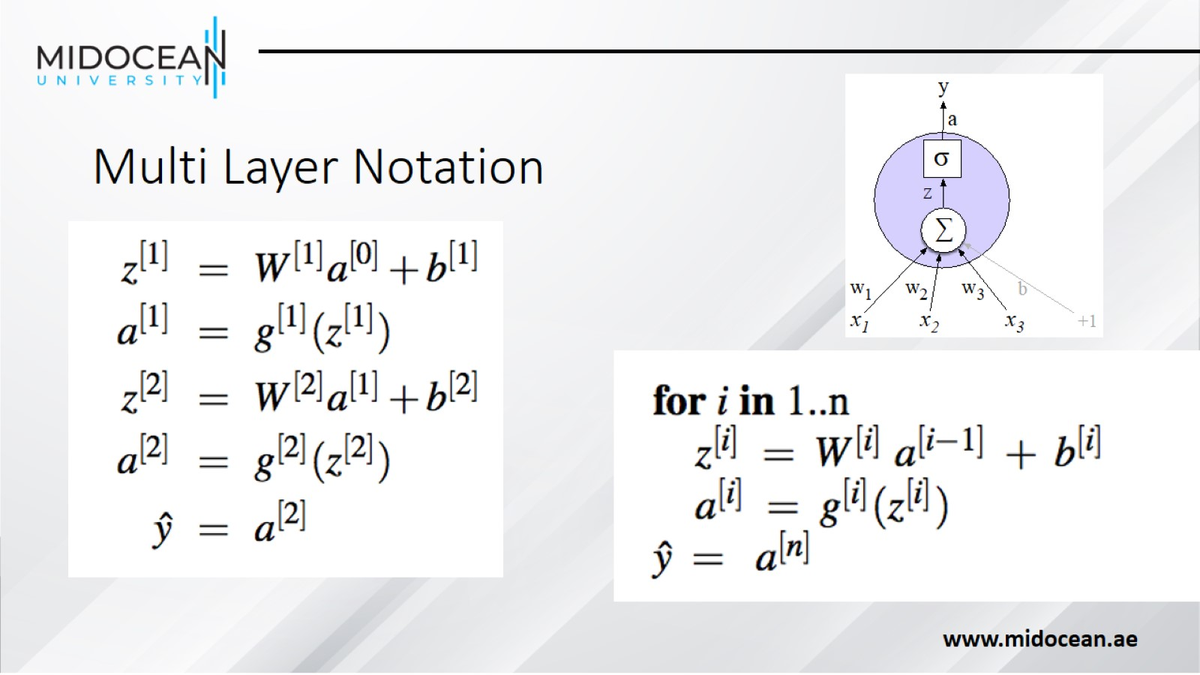
Multi Layer Notation

Slide 26
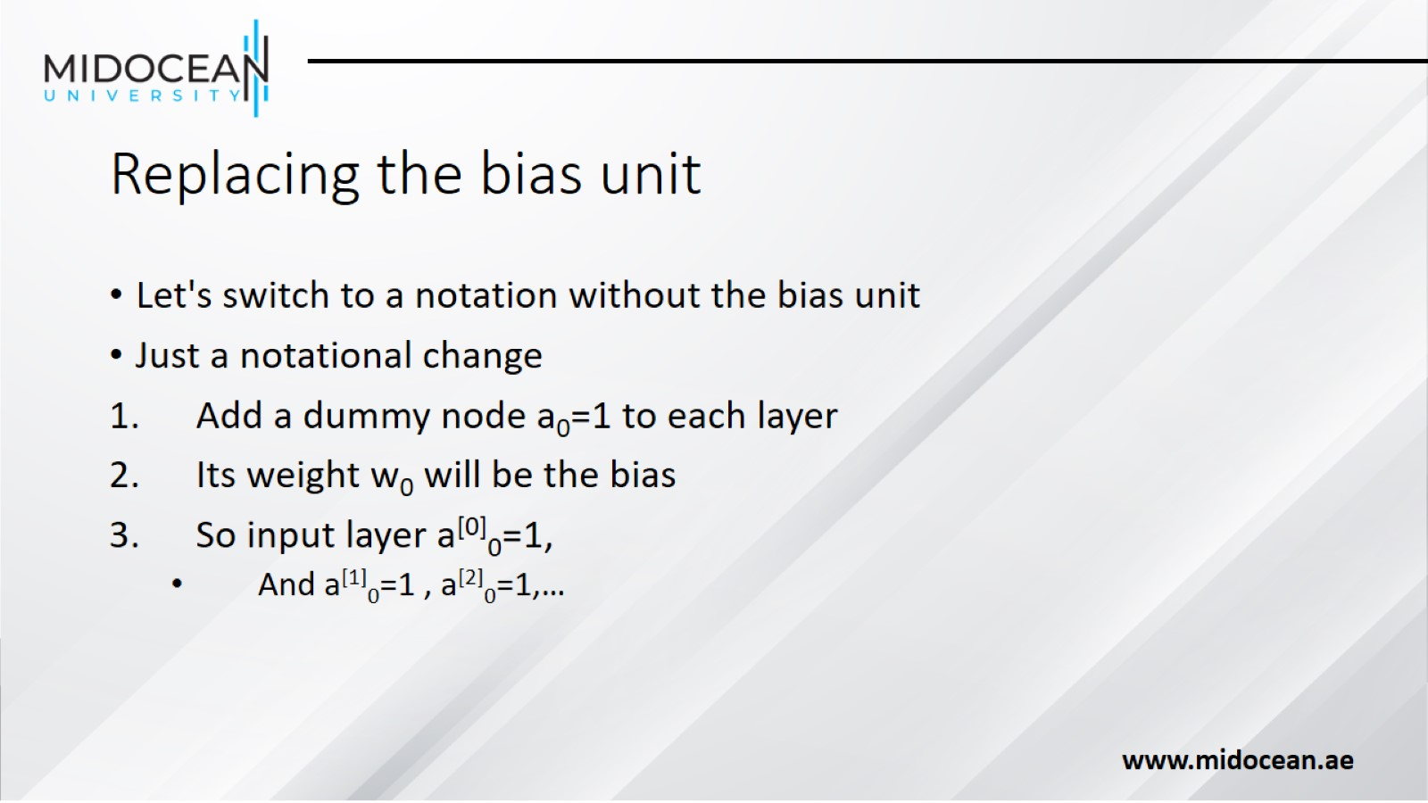
Replacing the bias unit

Slide 27
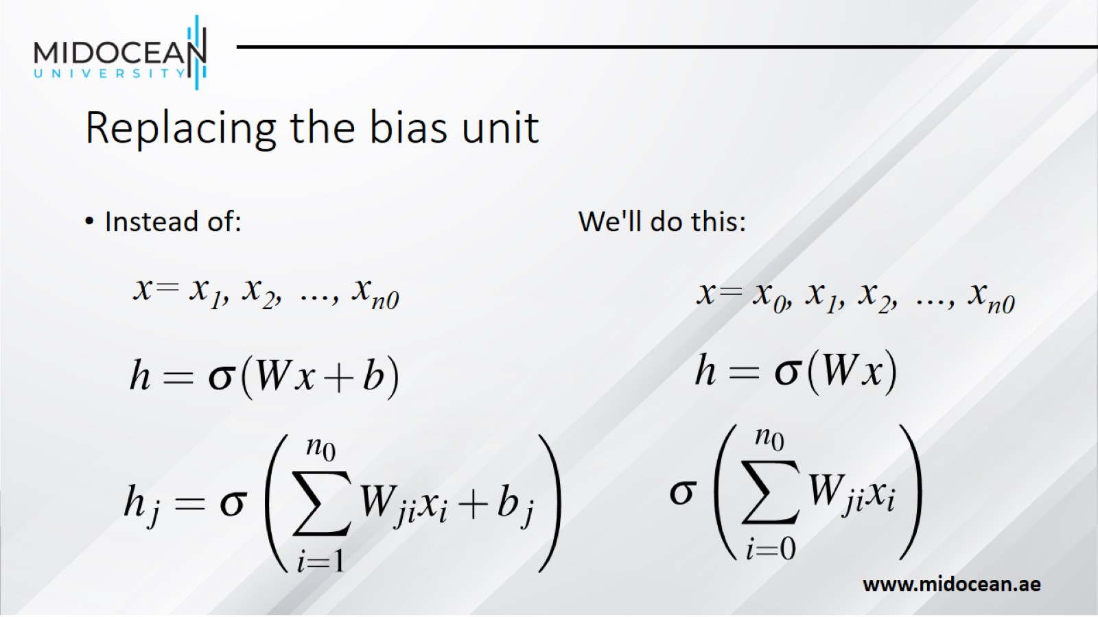
Replacing the bias unit

Slide 28
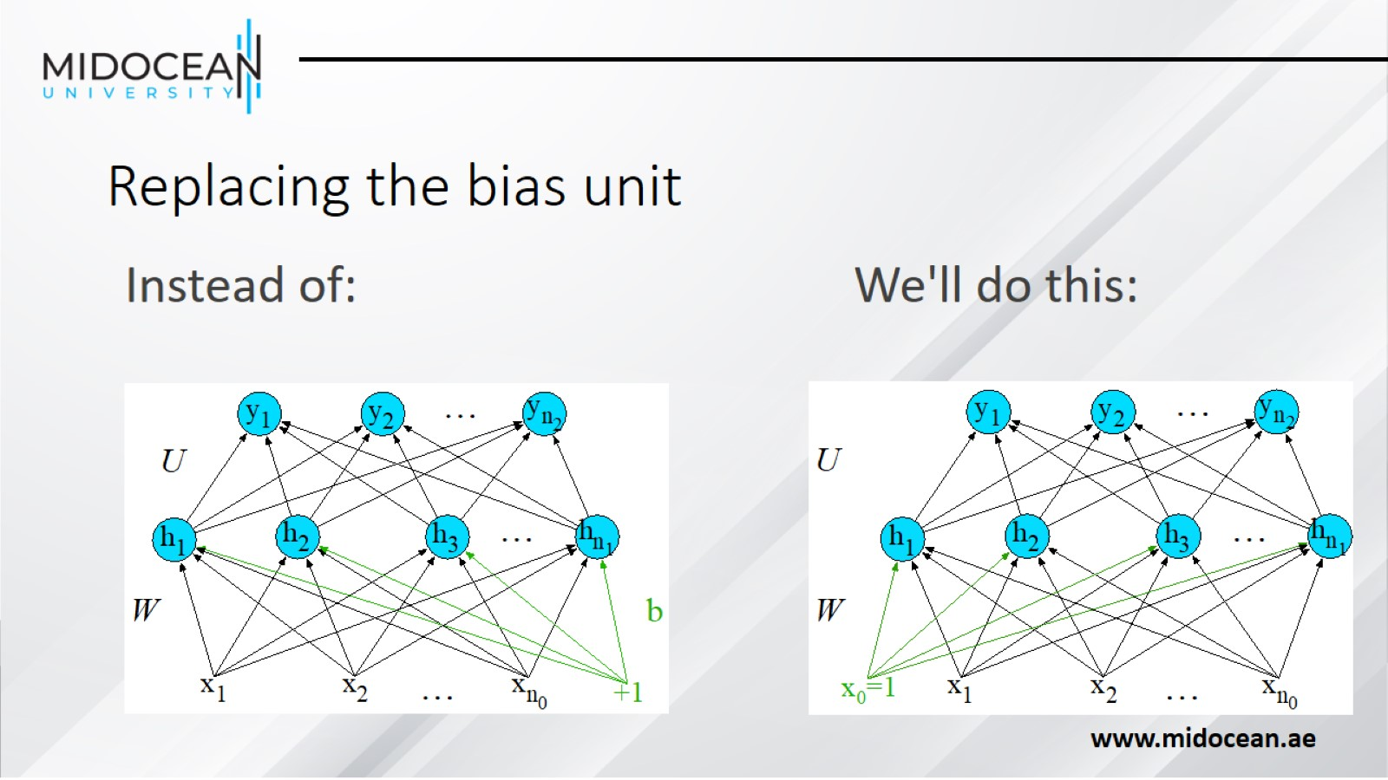
Replacing the bias unit

Slide 29
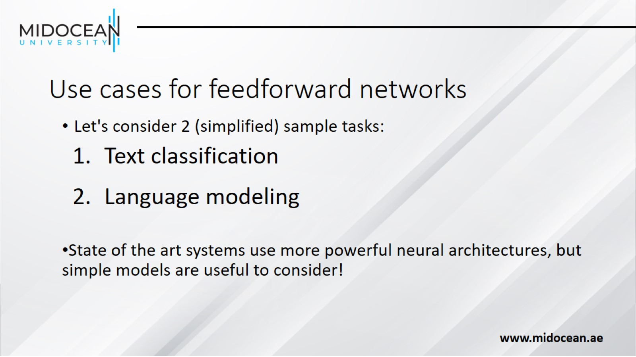
Use cases for feedforward networks

Slide 30
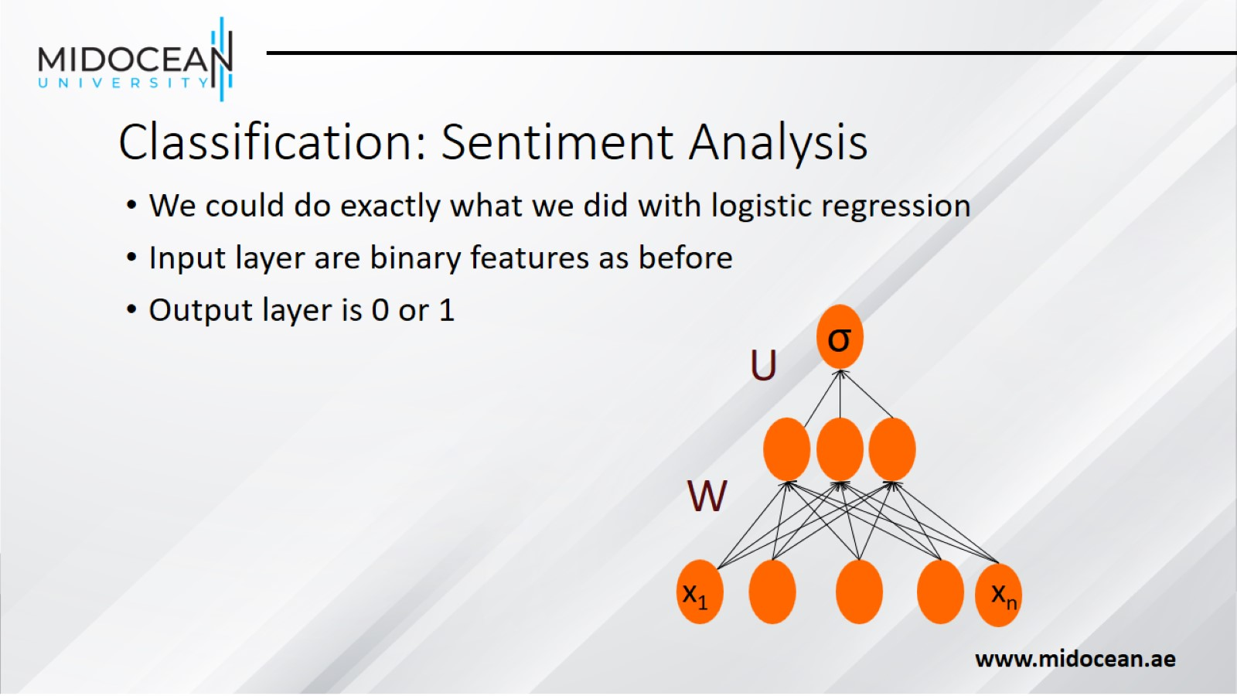
Classification: Sentiment Analysis

Slide 31
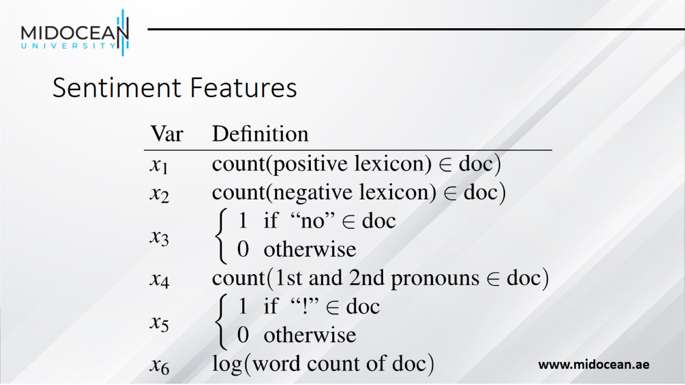
Sentiment Features

Slide 32
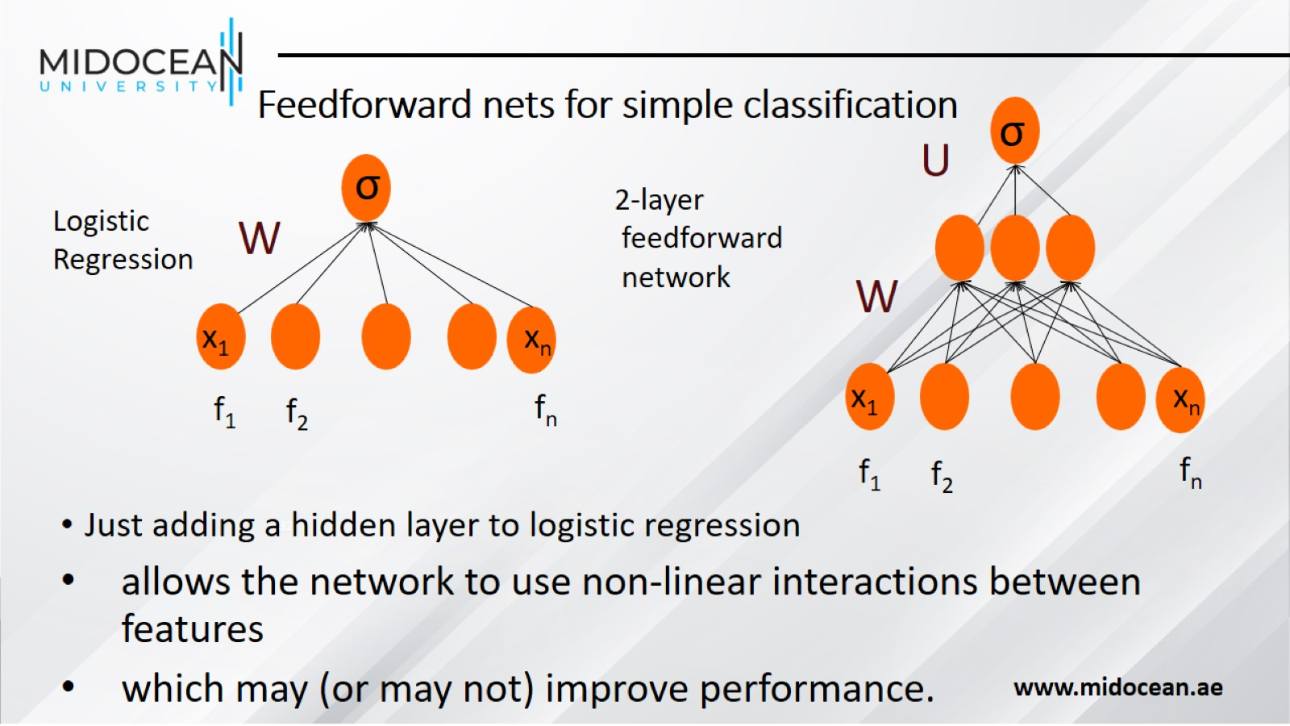
Feedforward nets for simple classification

Slide 33
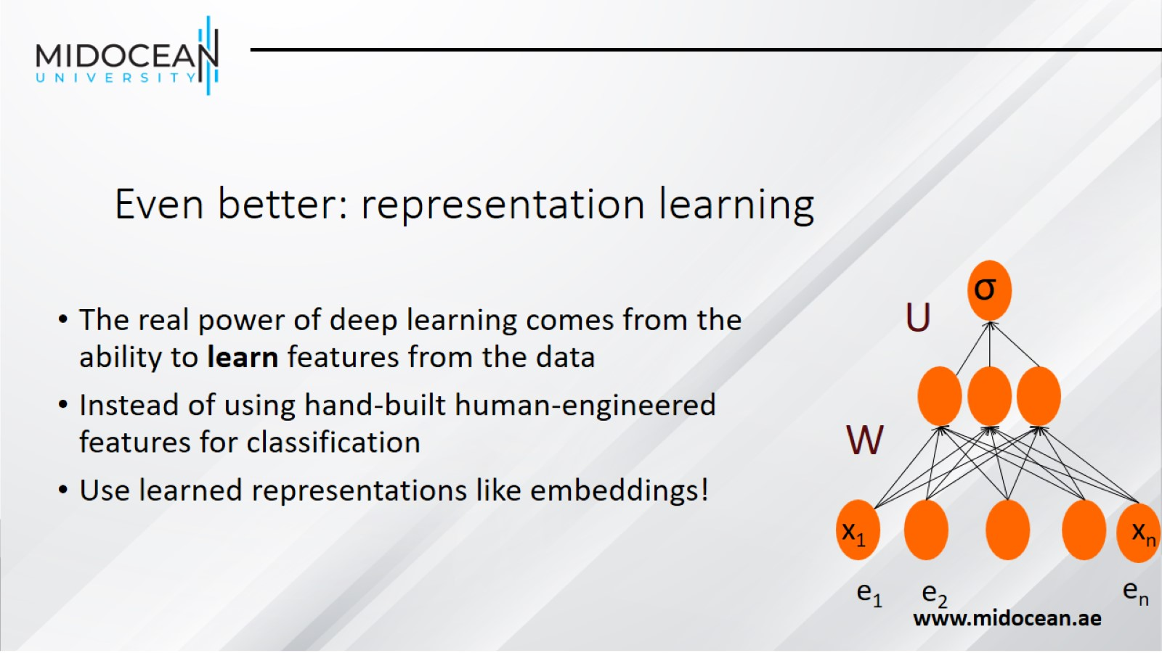
Even better: representation learning

Slide 34
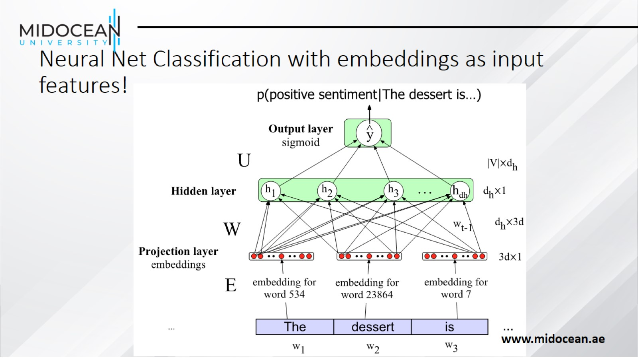
Neural Net Classification with embeddings as input features!

Slide 35
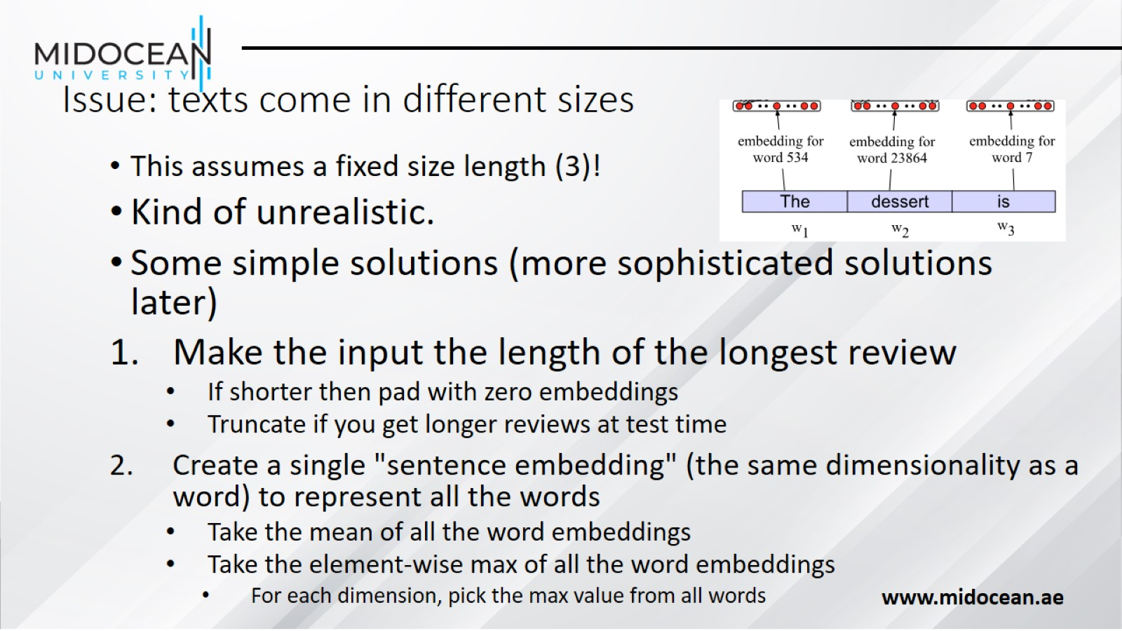
Issue: texts come in different sizes

Slide 36
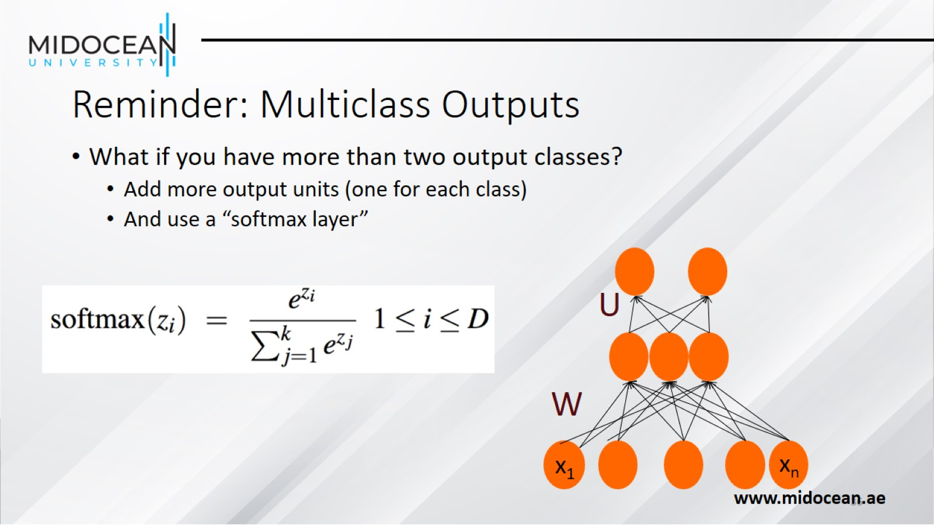
Reminder: Multiclass Outputs

Slide 37
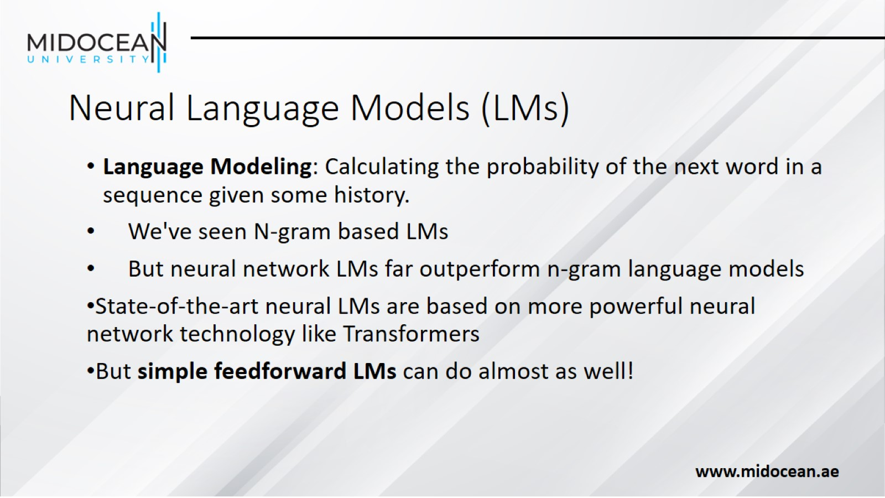
Neural Language Models (LMs)

Slide 38
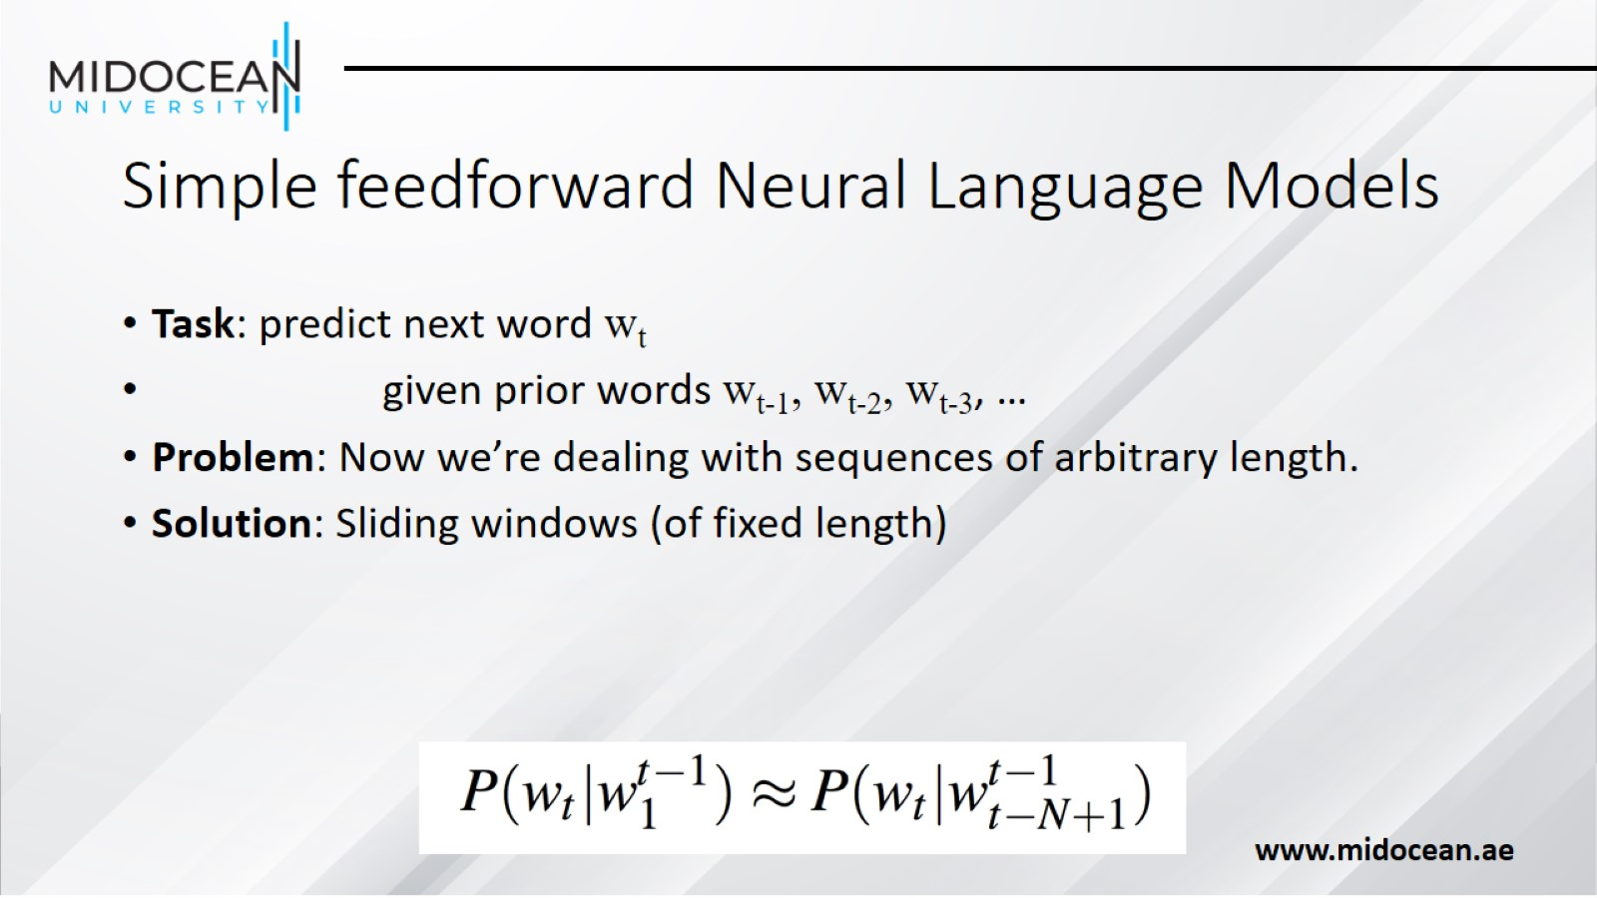
Simple feedforward Neural Language Models

Slide 39
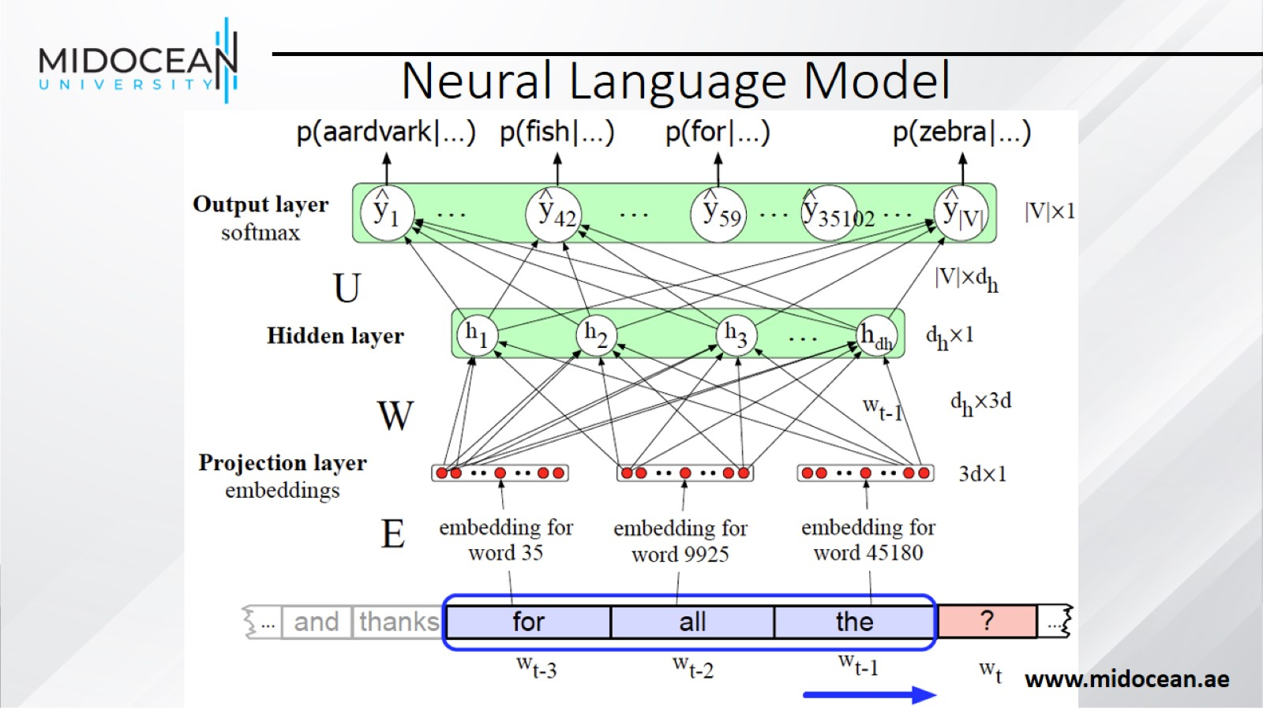
Neural Language Model

Slide 40
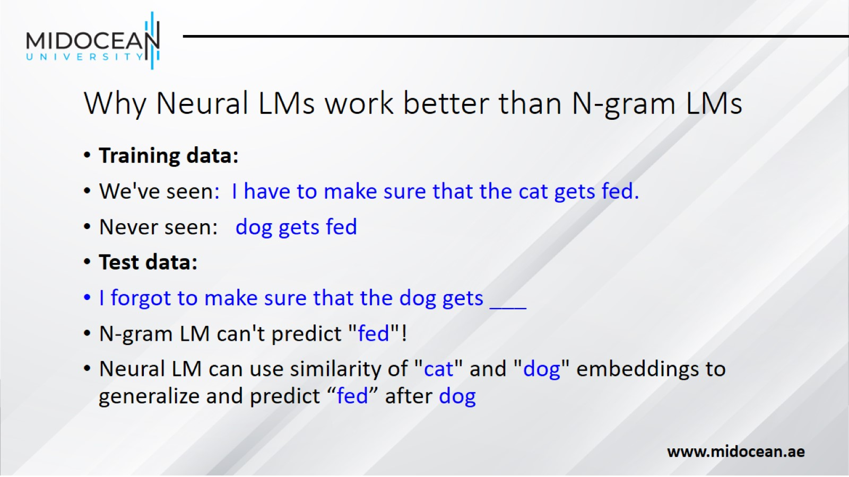
Why Neural LMs work better than N-gram LMs

Slide 41


Slide 42
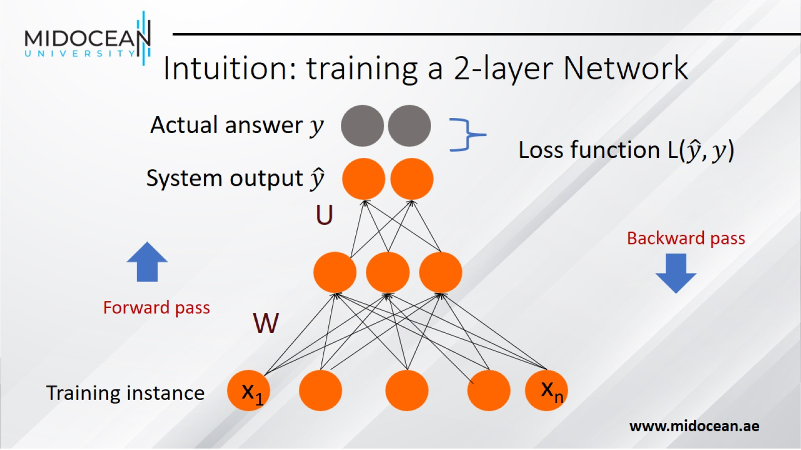
Intuition: training a 2-layer Network

Slide 43
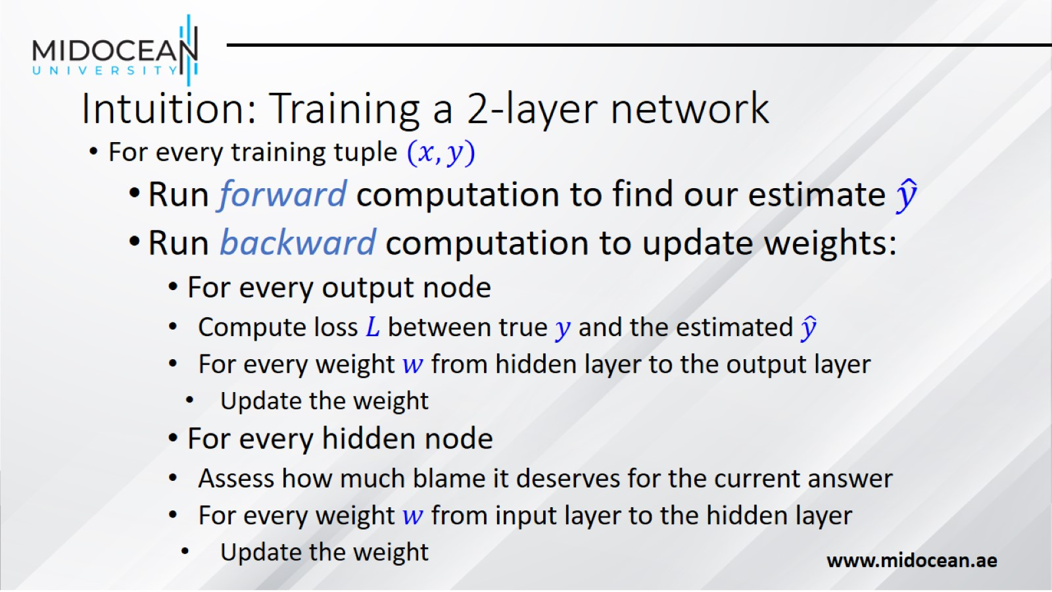
Intuition: Training a 2-layer network

Slide 44
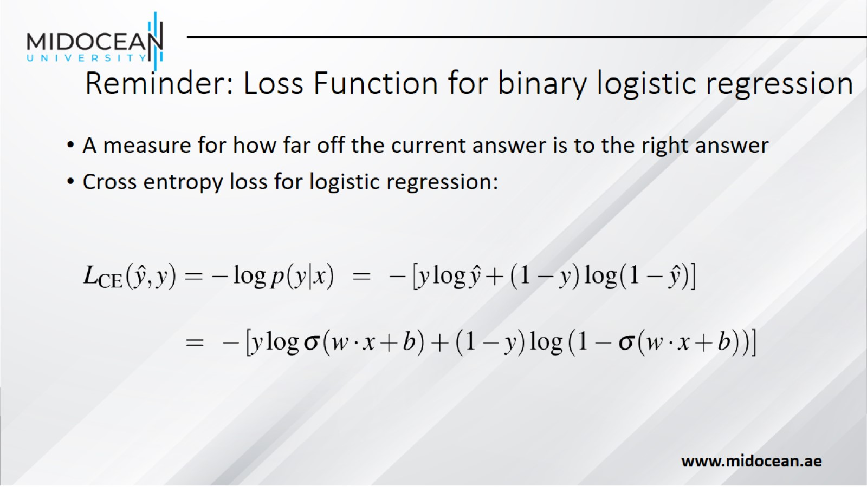
Reminder: Loss Function for binary logistic regression

Slide 45
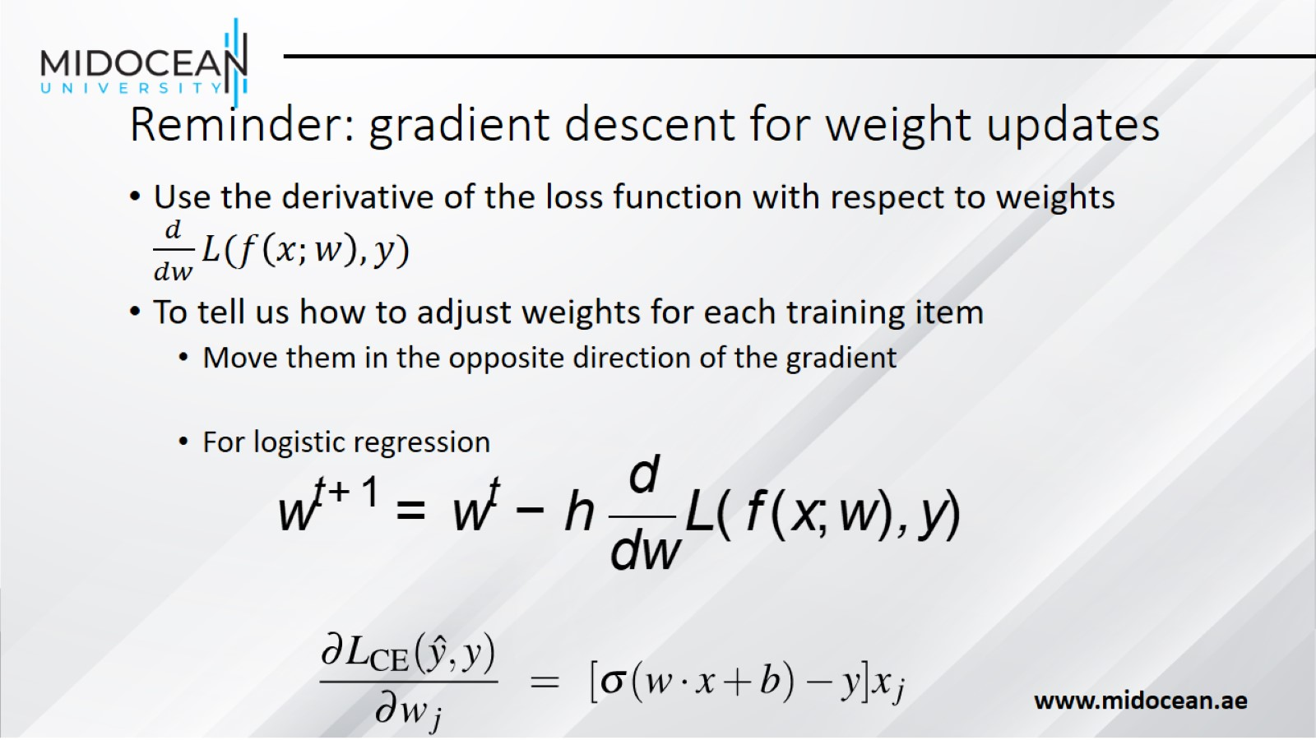
Reminder: gradient descent for weight updates

Slide 46
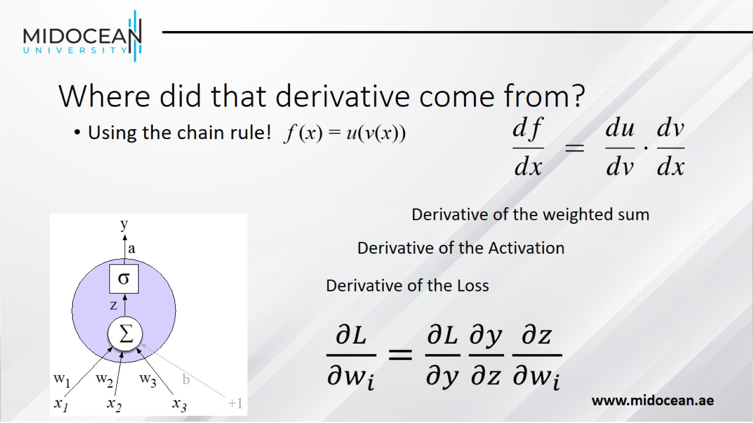
Where did that derivative come from?

Slide 47
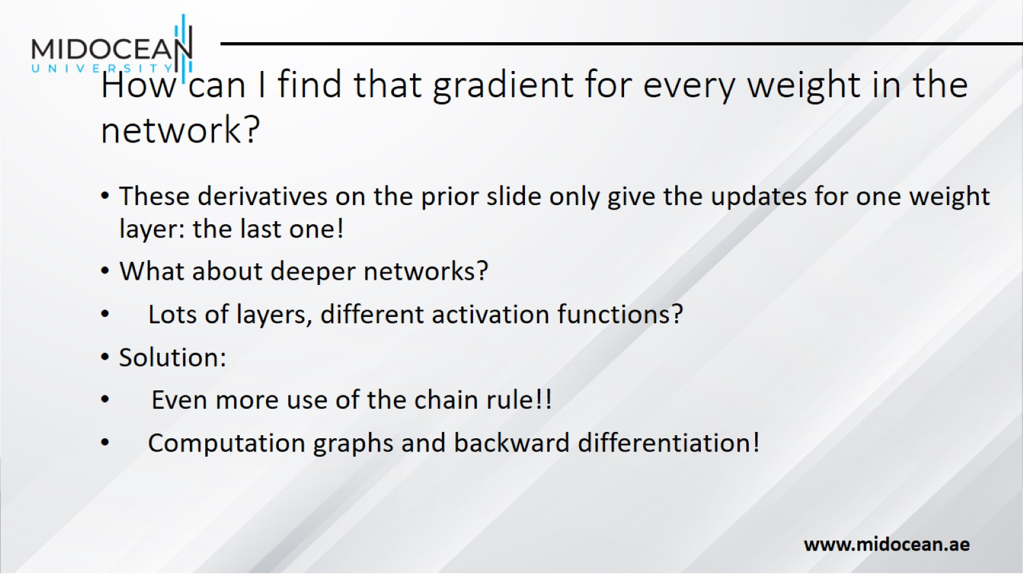
How can I find that gradient for every weight in the network?

Slide 48


Slide 49
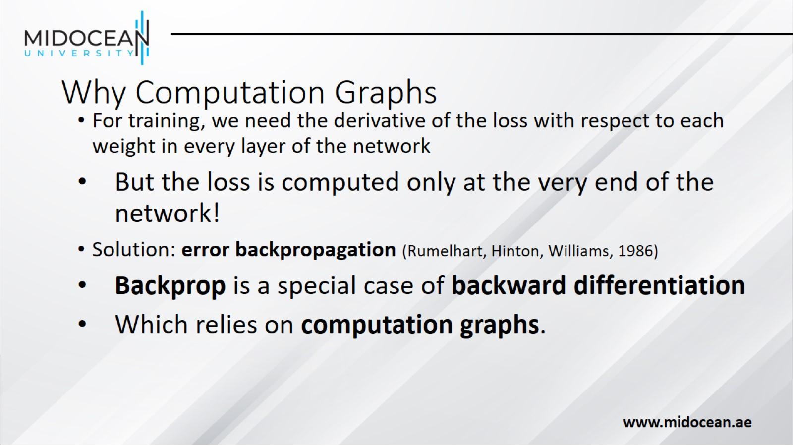
Why Computation Graphs

Slide 50

Computation Graphs

Slide 51
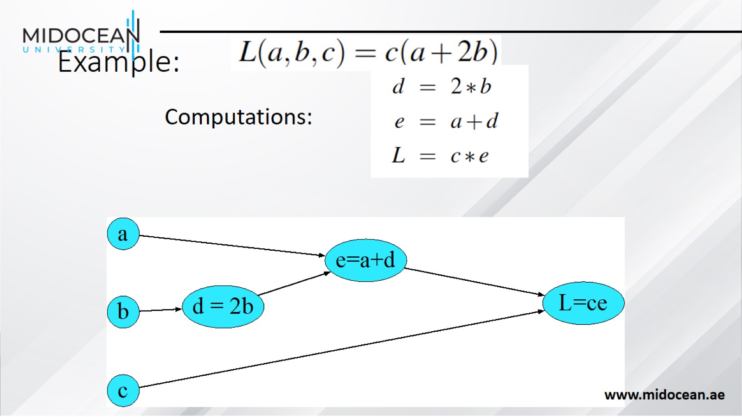
Example:

Slide 52
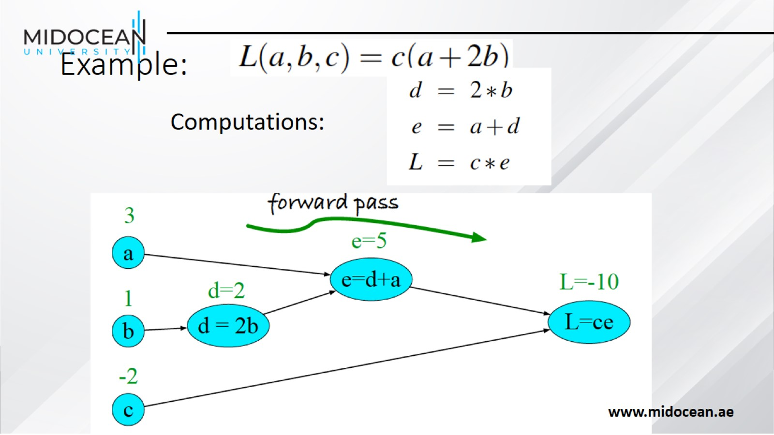
Example:

Slide 53
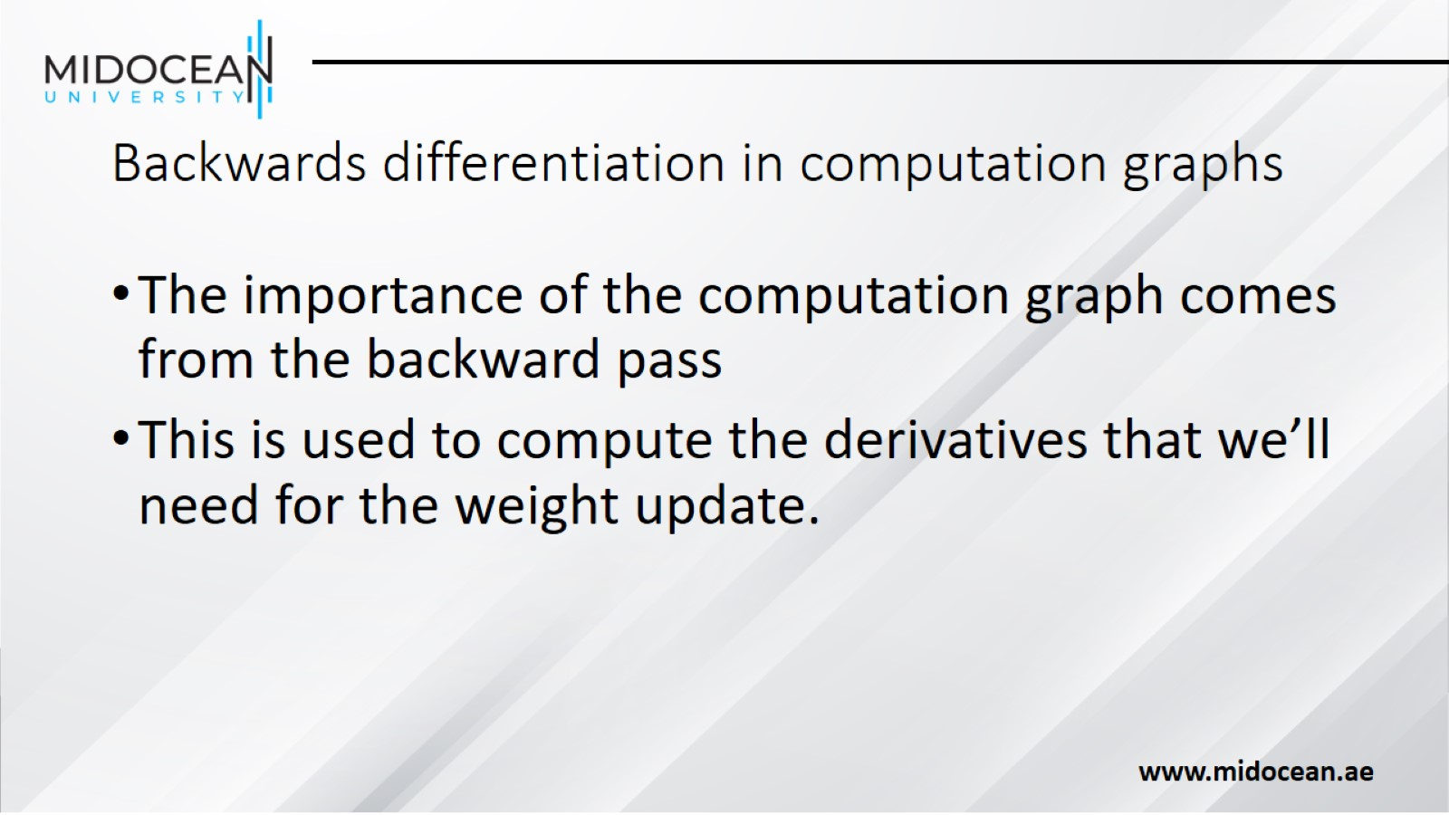
Backwards differentiation in computation graphs

Slide 54
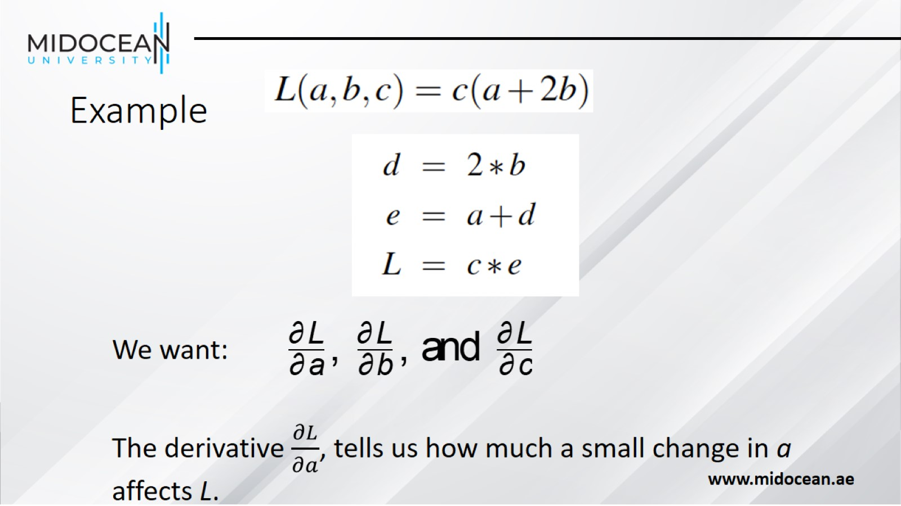
Example

Slide 55
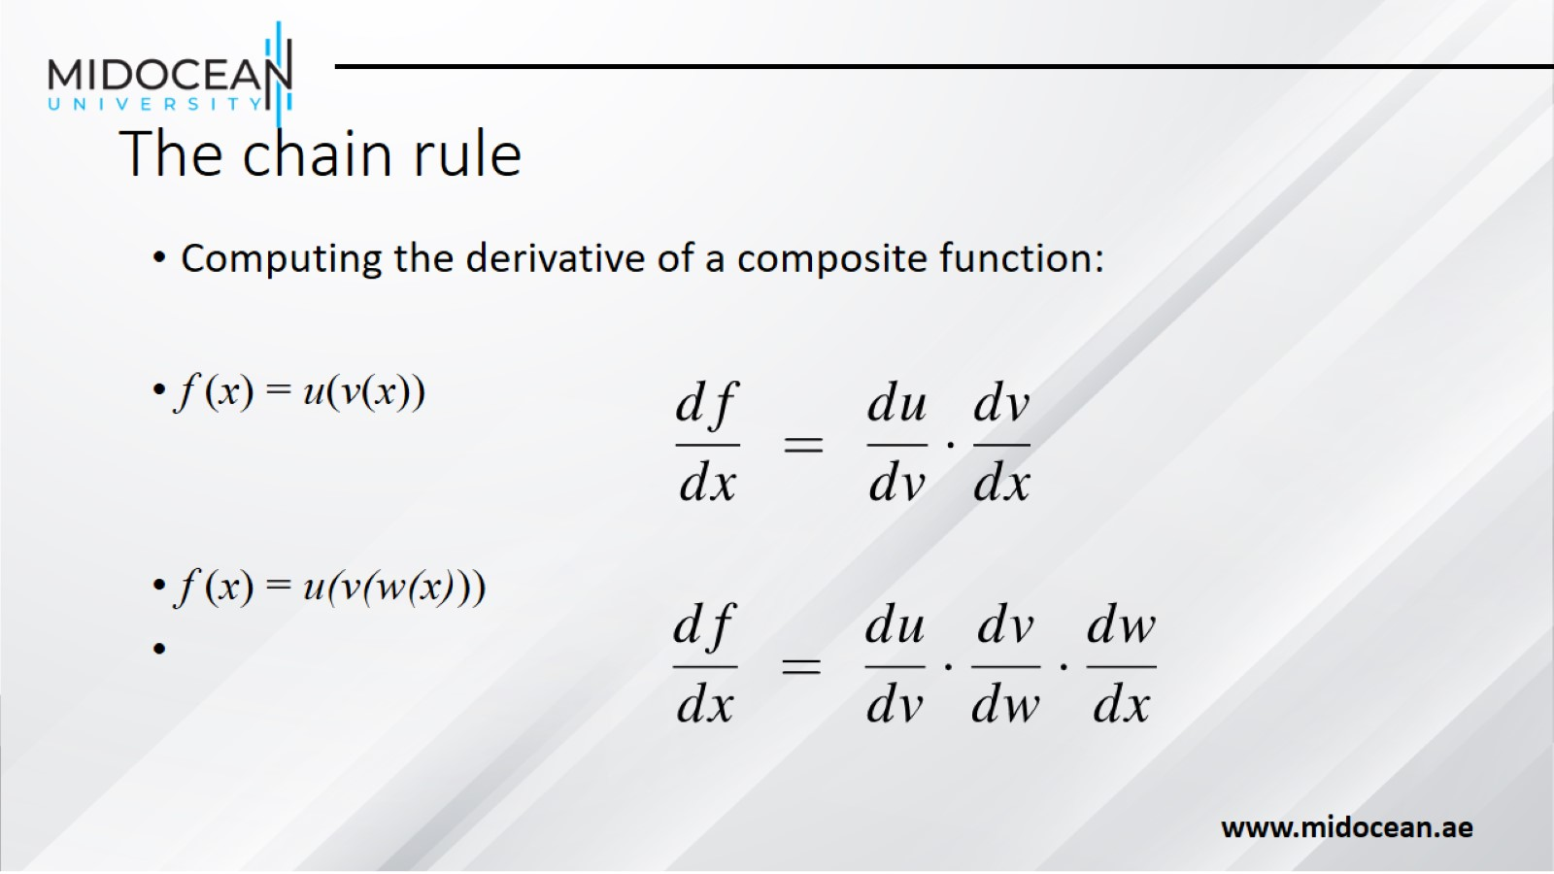
The chain rule

Slide 56
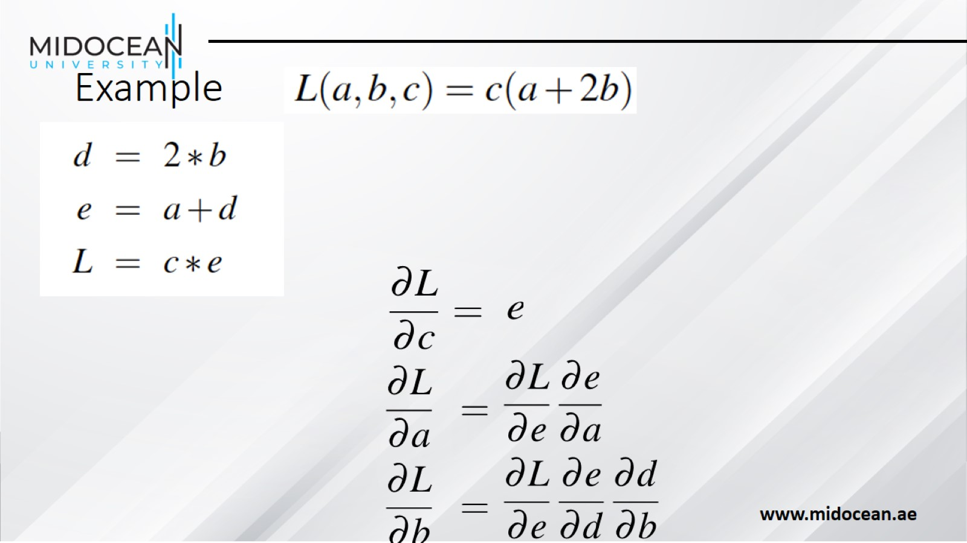
Example

Slide 57

Example

Slide 58

Example

Slide 59

Example

Slide 60

Backward differentiation on a two layer network

Slide 61

Backward differentiation on a two layer network

Slide 62

Backward differentiation on a 2-layer network

Slide 63


Starting off the backward pass: $\frac{∂L}{∂z}$
(I'll write $a$ f$or a^{[2]}$ and $z$ for $z^{[2]}$ )

Slide 64

Summary

Slide 65

Parts of Speech

Slide 66

Two classes of words: Open vs. Closed

Slide 67


Slide 68

Part-of-Speech Tagging

Slide 69

Part-of-Speech Tagging

Slide 70

"Universal Dependencies" Tagset

Slide 71

Sample "Tagged" English sentences

Slide 72

Why Part of Speech Tagging?

Slide 73

How difficult is POS tagging in English?

Slide 74

POS tagging performance in English

Slide 75

Sources of information for POS tagging

Slide 76

Standard algorithms for POS tagging

Slide 77

Named Entities

Slide 78

Named Entity tagging

Slide 79

NER output

Slide 80

Why NER?

Slide 81

Why NER is hard

Slide 82

BIO Tagging

Slide 83

BIO Tagging

Slide 84

BIO Tagging

Slide 85

Standard algorithms for NER

Slide 86

Summary

Slide 87


