Slide 1


College of Management
Business Ethics
Lecturer: Dr. Raef Baraka
PMG 750
Lecture 05

Slide 2

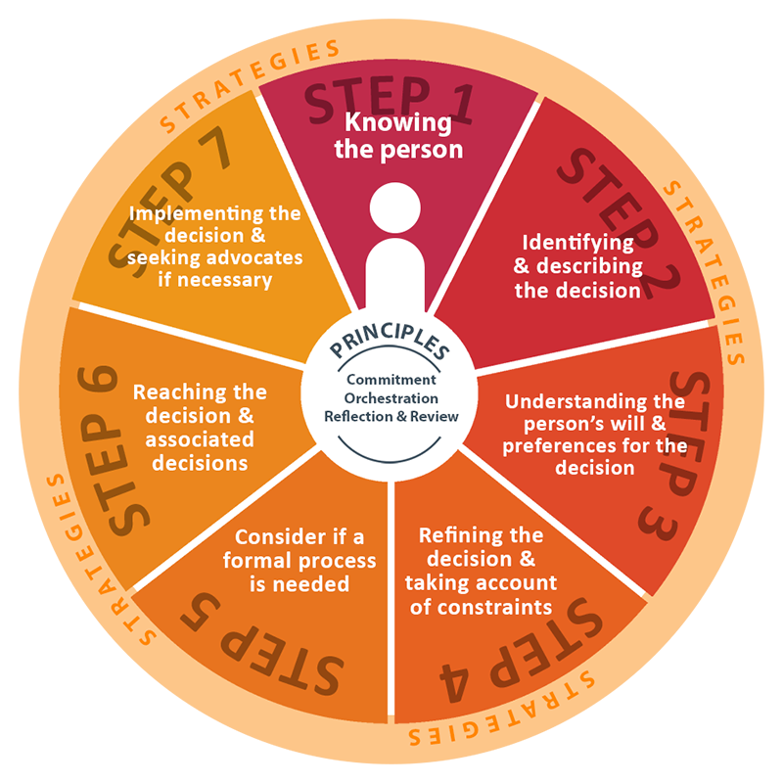
Chapter 5: ETHICAL DECISION MAKING
CHAPTER OBJECTIVES:
Provide a comprehensive model for ethical decision making in business.
Examine ethical issue intensity as an important element in the ethical decision-making process.
Introduce individual factors that influence business ethical decision-making.
Introduce organizational factors that influence business ethical decision-making.

Slide 3
Chapter 5: ETHICAL DECISION MAKING
CHAPTER OBJECTIVES:
Explore the role of opportunity in ethical decision-making in business.
Understand normative considerations in ethical decision making.
Recognize the role of institutions in normative decision making.
Examine the importance of morals and values to ethical decision making.

Slide 4
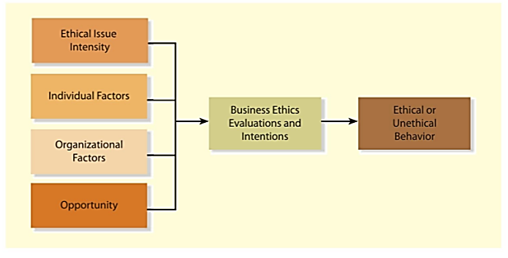
ETHICAL DECISION MAKING
A FRAMEWORK FOR ETHICAL DECISION-MAKING IN BUSINESS

Slide 5
ETHICAL DECISION MAKING
A Framework For Ethical Decision-Making In Business
The ethical decision-making process in business includes ethical issue intensity, individual factors, and organizational factors such as corporate culture and opportunity.
All these interrelated factors influence the evaluations of and intentions behind the decisions that produce ethical or unethical behavior.
The following model does not describe how to make ethical decisions, but it does help you to understand the factors and processes related to ethical decision-making.

Slide 6
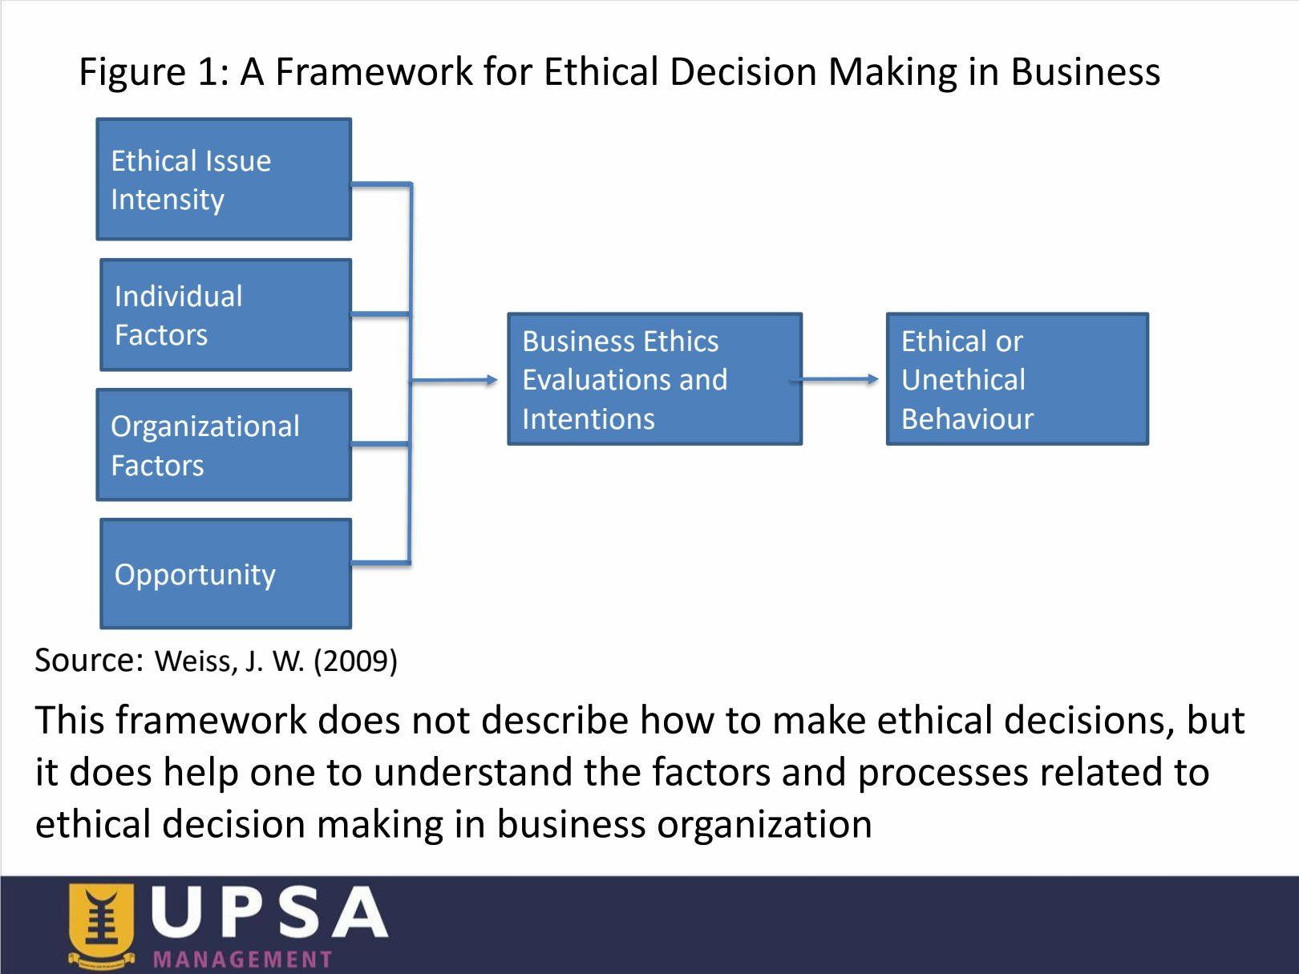
ETHICAL DECISION MAKING
A Framework For Ethical Decision-Making in Business

Slide 7
ETHICAL DECISION MAKING
1. Ethical Issue Intensity
The intensity of an ethical issue relates to its perceived importance to the decision maker.
Ethical issue intensity can be defined as the relevance or importance of an event or decision in the eyes of the individual, work group, and/or organization.
It is personal and temporal in character to accommodate values, beliefs, needs, perceptions, the special characteristics of the situation, and the personal pressures prevailing at a particular place and time.
Ethical issue intensity reflects the ethical sensitivity of the individual and/or the work group facing the ethical decision-making process.

Slide 8
ETHICAL DECISION MAKING
1. Ethical Issue Intensity
The intensity of an ethical issue relates to its perceived importance to the decision maker.
Research suggests that individuals are subject to six “spheres of influence” when confronted with ethical choices: the workplace, family, religion, legal system, community, and profession.
The level of importance of each to the businessperson influences and varies depending on how important the decision maker perceives the issue to be.
Additionally, individuals’ moral or value intensity increases their perceptiveness of potential ethical problems, which in turn reduces their intention to act unethically.

Slide 9
ETHICAL DECISION MAKING
1. Ethical Issue Intensity
Ethical awareness is the ability to perceive whether a situation or decision has an ethical dimension.
Costly problems can be avoided if employees are able to first recognize whether a situation has an ethical component.
However, ethical awareness can be difficult in an environment where employees work in their own areas of expertise with the same types of people.
It is easier to overlook certain issues requiring an ethical decision, particularly if the decision becomes a routine part of the job.
Moral intensity relates to individuals’ perceptions of social pressure and the harm they believe their decisions will have on others.

Slide 10
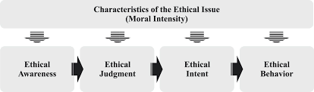
ETHICAL DECISION MAKING
1. Ethical Issue Intensity

Slide 11
ETHICAL DECISION MAKING
2. Individual Factors
When people need to resolve issues in their daily lives, they often base their decisions on their own values and morals of right or wrong.
They generally learn these through the socialization process, interacting with family members, social groups, religion, and in their formal education.
Good personal values or morals have been found to decrease unethical practices and increase positive work behavior.
Research regarding individual factors that affect ethical awareness, judgment, intent, and behavior includes gender, education, work experience, nationality, age, and locus of control.

Slide 12
ETHICAL DECISION MAKING
2. Individual Factors
When people need to resolve issues in their daily lives, they often base their decisions on their own values and morals of right or wrong.
Gender:
Extensive research regarding the link between gender and ethical decision-making shows that in many aspects, there are no differences between men and women.
However, when differences are found, women are generally more ethical than men.
By “more ethical,” we mean women seem to be more sensitive to ethical scenarios and less tolerant of unethical actions.

Slide 13
ETHICAL DECISION MAKING
2. Individual Factors
When people need to resolve issues in their daily lives, they often base their decisions on their own values and morals of right or wrong.
Gender:
One study found that women and men had different foundations for making ethical decisions: women rely on relationships; men rely on justice or equity.
In another study on gender and intentions for fraudulent financial reporting, females reported higher intentions to report than male participants.
As more and more women work in managerial positions, these findings may become increasingly significant.

Slide 14
ETHICAL DECISION MAKING
2. Individual Factors
When people need to resolve issues in their daily lives, they often base their decisions on their own values and morals of right or wrong.
Education:
Education is also a significant factor in the ethical decision-making process.
The important point to remember is that education does not reflect experience.
Work experience is defined as the number of years in a specific job, occupation, and/or industry.
Generally, the more education or work experience people have, the better they are at making ethical decisions.

Slide 15
ETHICAL DECISION MAKING
2. Individual Factors
When people need to resolve issues in their daily lives, they often base their decisions on their own values and morals of right or wrong.
Nationality:
Nationality is the legal relationship between a person and the country in which he or she is born.
How nationality affects ethics is somewhat hard to interpret.
Because of cultural differences, it is impossible to state that ethical decision making in an organizational context will differ significantly among individuals of different nationalities.
Companies look for people who make good decisions regardless of nationality.

Slide 16
ETHICAL DECISION MAKING
2. Individual Factors
When people need to resolve issues in their daily lives, they often base their decisions on their own values and morals of right or wrong.
Age:
Several decades ago, we believed age was positively correlated with ethical decision making. In other words, the older you are, the more ethical you are.
Based on a global survey, 73% Generation Y (born in the 1980s and early 1990s) feel unethical behavior can be justified to help an organization survive.
In addition, 20 percent said they could justify paying bribes.

Slide 17
ETHICAL DECISION MAKING
2. Individual Factors
When people need to resolve issues in their daily lives, they often base their decisions on their own values and morals of right or wrong.
Age:
We believe older employees with more experience have greater knowledge to deal with complex industry-specific ethical issues.
Younger managers are far more influenced by organizational culture than older managers.

Slide 18
ETHICAL DECISION MAKING
2. Individual Factors
When people need to resolve issues in their daily lives, they often base their decisions on their own values and morals of right or wrong.
Locus of control:
Locus of control relates to individual differences in relation to a generalized belief about how one is affected by internal versus external events or reinforcements.
In other words, the concept relates to how people view themselves in relation to power.
There are two loci of control: External control (Externals) and Internal control (Internals).

Slide 19
ETHICAL DECISION MAKING
2. Individual Factors
When people need to resolve issues in their daily lives, they often base their decisions on their own values and morals of right or wrong.
Locus of control:
Those who believe in external control (externals) see themselves as going with the flow because that is all they can do. They believe the events in their lives are due to uncontrollable forces.
They consider the results or outcomes depend on luck, chance, and powerful people in their company.
In addition, they believe the probability of being able to control their lives by their own actions and efforts is low

Slide 20
ETHICAL DECISION MAKING
2. Individual Factors
When people need to resolve issues in their daily lives, they often base their decisions on their own values and morals of right or wrong.
Locus of control:
Conversely, those who believe in internal control (internals) believe they control the events in their lives by their own effort and skill, viewing themselves as masters of their destinies and trusting in their capacity to influence their environment..
One study that found a relationship between locus of control and ethical decision making concluded that internals were positively correlated, whereas externals were negatively correlated with ethical decisions.

Slide 21
ETHICAL DECISION MAKING
2. Individual Factors
When people need to resolve issues in their daily lives, they often base their decisions on their own values and morals of right or wrong.
Locus of control:
In other words, those who believe they formed their own destiny were more ethical than those who believed their fate was in the hands of others.
Classifying someone as being entirely internal or entirely external is probably impossible.
Most people have experienced situations where they were influenced by others—particularly authority figures—to engage in questionable actions, as well as other situations where they adhered to what they knew was the correct choice.
This does not mean that externals are unethical, or that internals are ethical individuals.

Slide 22
ETHICAL DECISION MAKING
3. Organizational Factors
In the workplace, the organization’s values often have greater influence on decisions than a person’s own values.
Ethical choices in business are most often made jointly, in work groups and committees, or in conversations and discussions with coworkers.
Employees approach ethical issues on the basis of what they learned not only from their own backgrounds but also from others in the organization.
The outcome of this learning process depends on the strength of personal values, the opportunities to behave unethically, and the exposure to others who behave ethically or unethically.

Slide 23
ETHICAL DECISION MAKING
3. Organizational Factors
In the workplace, the organization’s values often have greater influence on decisions than a person’s own values.
An alignment between a person’s own values and the values of the organization
help create positive work attitudes and organizational outcomes.
Research has further demonstrated that congruence in personal and organizational values is related to commitment, satisfaction, motivation, ethics, work stress, and anxiety.
Although people outside the organization, such as family members and friends, also influence decision makers, the organization develops a personality that helps determine what is and is not ethical

Slide 24
ETHICAL DECISION MAKING
3. Organizational Factors
In the workplace, the organization’s values often have greater influence on decisions than a person’s own values..
Corporate culture:
Corporate culture can be defined as a set of values, norms, and artifacts, including ways of solving problems that members (employees) of an organization share.
As time passes, stakeholders come to view the company or organization as a living organism with a mind and will of its own.

Slide 25
ETHICAL DECISION MAKING
3. Organizational Factors
In the workplace, the organization’s values often have greater influence on decisions than a person’s own values..
Corporate culture:
One way organizations can determine the ethicalness of their corporate cultures is by having the company go back to their mission statement or goals and objectives.
These goals and objectives are often developed by various stakeholders, such as investors, employees, customers, and suppliers.
Comparing the firm’s activities with its mission statement, goals, and objectives helps the organization understand whether it is staying true to its values.

Slide 26
ETHICAL DECISION MAKING
3. Organizational Factors
In the workplace, the organization’s values often have greater influence on decisions than a person’s own values..
Corporate culture:
Additionally, most industries have trade associations that disseminate guidelines developed over time from others in the industry. These rules help guide the decision-making process as well.
The interaction between the company’s internal rules and regulations and industry guidelines forms the basis of whether a business is making ethical or unethical decisions. It also gives an organization an idea of how an ethical or unethical culture may look.

Slide 27
ETHICAL DECISION MAKING
3. Organizational Factors
In the workplace, the organization’s values often have greater influence on decisions than a person’s own values..
Corporate culture:
An important component of corporate or organizational culture is the company’s conduct and whether it defines it as ethical or unethical.
Corporate culture involves values and norms that prescribe a wide range of behavior for organizational members, while ethical culture reflects the integrity of decisions made and is a function of many factors, including corporate policies, top management’s leadership on ethical issues, the influence of coworkers, and the opportunity for unethical behavior.

Slide 28
ETHICAL DECISION MAKING
3. Organizational Factors
In the workplace, the organization’s values often have greater influence on decisions than a person’s own values..
Corporate culture:
Communication is also important in the creation of an effective ethical culture.
There is a positive correlation between effective communication and empowerment, and the development of an organizational ethical culture.
Corporate culture and ethical culture are closely associated with the idea that significant others within the organization help determine ethical decisions within that organization.

Slide 29
ETHICAL DECISION MAKING
3. Organizational Factors
In the workplace, the organization’s values often have greater influence on decisions than a person’s own values..
Corporate culture:
Corporate culture and ethical culture are closely associated with the idea that significant others within the organization help determine ethical decisions within that organization.

Slide 30
ETHICAL DECISION MAKING
3. Organizational Factors
In the workplace, the organization’s values often have greater influence on decisions than a person’s own values..
Influence of Organizational Values:
Employees are more influenced by the organization’s values than their own when making ethical decisions.
Decision-Making in Groups:
Ethical choices are often made through group interactions, work committees, and peer discussions—not in isolation.
Value Alignment:
Congruence between personal and organizational values improves job satisfaction, motivation, ethical behavior, and reduces stress.

Slide 31
ETHICAL DECISION MAKING
3. Organizational Factors
In the workplace, the organization’s values often have greater influence on decisions than a person’s own values..
Ethical Culture:
A subset of corporate culture focused on integrity and ethical behavior, influenced by leadership, communication, policies, and peer behavior.
Mission Statements and Industry Guidelines:
Comparing actions with the mission statement and industry codes helps assess ethical alignment.
Subcultures in Departments:
Departments like sales may develop their own subcultures and face unique ethical pressures due to their function and isolation.

Slide 32
ETHICAL DECISION MAKING
3. Organizational Factors
In the workplace, the organization’s values often have greater influence on decisions than a person’s own values..
Significant Others:
Peers, managers, and coworkers have a strong daily influence on ethical decisions through formal and informal guidance.
Obedience to Authority:
Employees may follow unethical orders from superiors due to respect for authority or fear of consequences.
Reward Systems:
When rewards are focused only on financial outcomes, ethical behavior may be neglected or compromised.

Slide 33
ETHICAL DECISION MAKING
4. Opportunity
Opportunity describes the conditions in an organization that limit or permit ethical or unethical behavior.
Opportunity results from conditions that either provide rewards, whether internal or external, or fail to erect barriers against unethical behavior.
Opportunity relates to individuals’ immediate job context—where they work, who they work with, and the nature of the work.
The immediate job context includes the motivational “carrots and sticks” that superiors use to influence employee behavior.
Pay raises, bonuses, and public recognition act as carrots, or positive reinforcements, whereas demotions, firings, reprimands, and pay penalties act as sticks, or negative reinforcements.

Slide 34
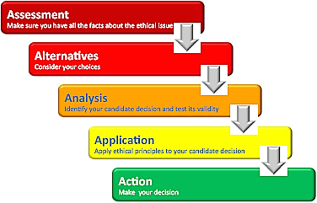
ETHICAL DECISION MAKING
UNDERSTANDING ETHICAL DECISION MAKING

Slide 35
ETHICAL DECISION MAKING
Understanding Ethical Decision Making
Our organizational ethical decision-making framework demonstrates the many factors that influence decisions as ethical or unethical.
Ethical issue intensity, individual factors, organizational factors, and opportunity result in business ethics evaluations and decisions.
An organizational ethical culture is shaped by effective leadership.
Without top-level support for ethical behavior, the opportunity for employees to engage in their own personal approaches to business decision making will evolve.
An ethical corporate culture needs shared values along with proper oversight to monitor the complex ethical decisions being made by employees.

Slide 36
ETHICAL DECISION MAKING
Understanding Ethical Decision Making
It requires the establishment of a strong ethics program to educate and develop compliance policies.
Normative dimensions are also important to ethical decision making. Normative perspectives set forth ideal goals to which organizations should aspire.
Normative considerations also provide the foundation needed to develop organizational principles and values, the building blocks of a firm’s ethical culture.

Slide 37
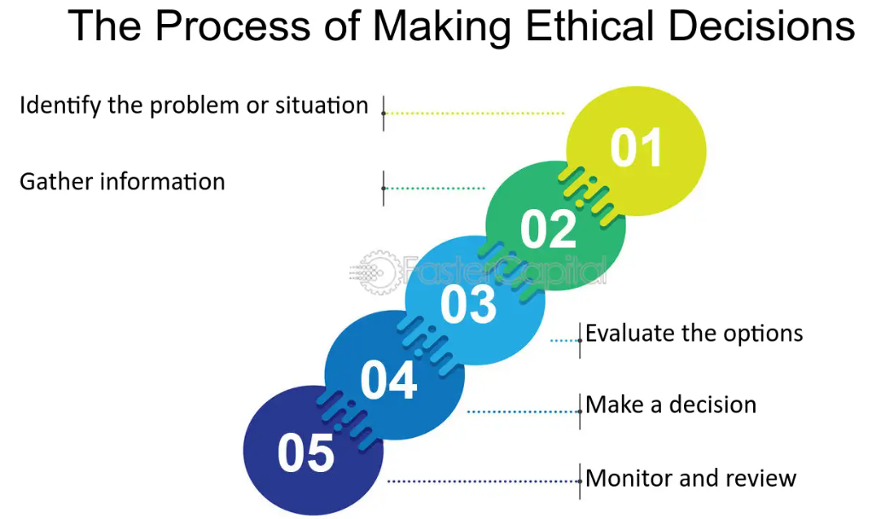
ETHICAL DECISION MAKING
Understanding Ethical Decision Making
The Process of Making Ethical Decisions:

Slide 38
ETHICAL DECISION MAKING
Understanding Ethical Decision Making
The Process of Making Ethical Decisions:
Identify the problem or situation:
Before making an ethical decision, it is essential to identify the problem or situation that needs to be addressed.
This can involve gathering information from various sources, including employees, customers, and other stakeholders.
Once the problem has been identified, it is important to assess the severity of the situation and determine the potential impact on the business and its stakeholders.

Slide 39
ETHICAL DECISION MAKING
Understanding Ethical Decision Making
The Process of Making Ethical Decisions:
Gather information:
Once the problem has been identified, it is essential to gather as much information as possible about the situation.
This can involve researching relevant laws and regulations, consulting with experts in the field, and gathering data from various sources.
The more information that is available, the better the decision-making process will be.

Slide 40
ETHICAL DECISION MAKING
Understanding Ethical Decision Making
The Process of Making Ethical Decisions:
Evaluate the options:
After gathering all of the necessary information, it is essential to evaluate the various options that are available.
This can involve considering the potential consequences of each option, including the impact on the business, its stakeholders, and society as a whole.
It is important to consider both short-term and long-term consequences when evaluating options.

Slide 41
ETHICAL DECISION MAKING
Understanding Ethical Decision Making
The Process of Making Ethical Decisions:
Make a decision:
Once all of the options have been evaluated, it is time to make a decision.
This can involve choosing the option that provides the greatest benefit to the business and its stakeholders while minimizing harm to society.
It is important to consider the values and principles that guide ethical decision-making when making the final decision.

Slide 42
ETHICAL DECISION MAKING
Understanding Ethical Decision Making
The Process of Making Ethical Decisions:
Monitor and review:
After the decision has been made, it is essential to monitor and review the situation to ensure that it is having the desired effect.
This can involve gathering feedback from stakeholders and making adjustments as necessary.
It is important to be open to feedback and willing to make changes if necessary to ensure that the decision is ethical and effective.

Slide 43



Thank You

