Slide 1

Risk Management
Prepared by Dr. Dalia Hosni
Lecture3
MGM 510
Risk Management

Slide 2

Lecture 3
What is Risk Management?
Good management practice
Process steps that enable improvement in decision making
A logical and systematic approach
Identifying opportunities
Avoiding or minimising losses

Slide 3
Lecture 3
What is Risk Management?
Risk Management is the name given to a logical and systematic method of identifying, analyzing, treating and monitoring the risks involved in any activity or process.

Slide 4
Lecture 3
What is Risk Management?
Risk Management is a methodology that helps managers make best use of their available resources

Slide 5

Lecture 3
Risk Management – why do we need it?
Promotes good management
May be a legal requirement depending upon industry or sector
Resources available are limited – therefore a focused response to Risk Management is needed

Slide 6
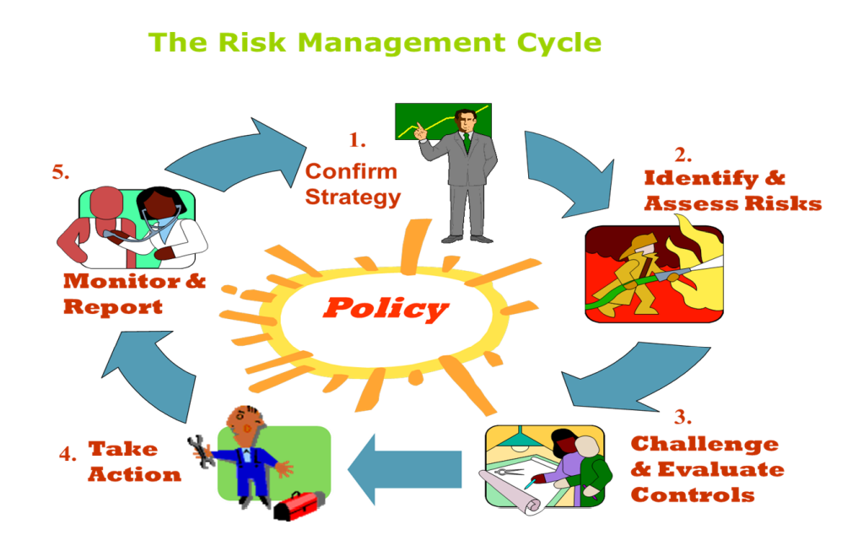
Lecture 3
Risk Management

Slide 7
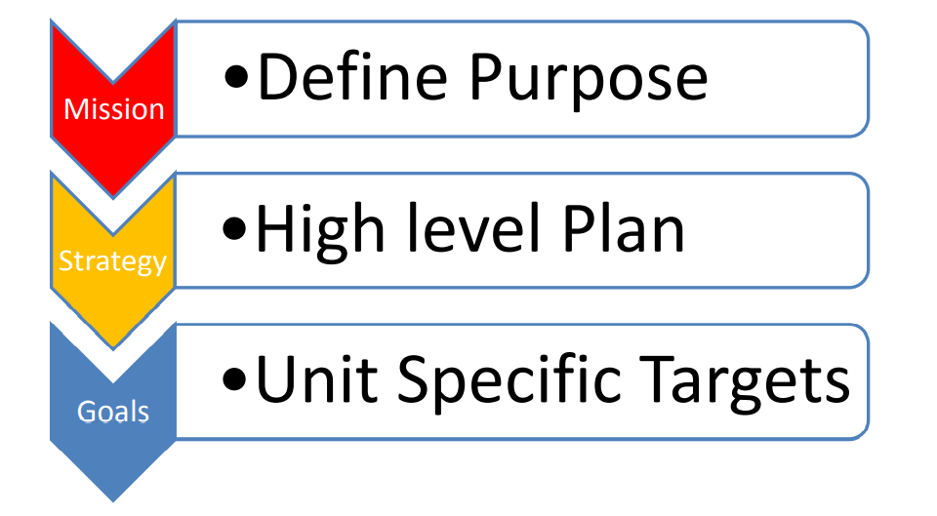
Lecture 3
Risk Management
Risk Management Cycle – Step 1

Slide 8
Lecture 3
Risk Management
Risk Management Cycle – Step 2
Risk Identification – what are the threats and uncertainties associated with my organization’s or units objectives?
Separate out the risk into its cause & possible effect
Be concise & clear
Do not concentrate on symptoms only

Slide 9

Lecture 3
Types of Project Risk

Slide 10
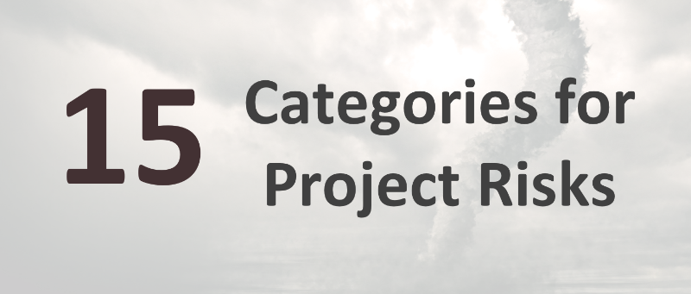
Chapter
01
Types of Project Risk
Beyond the basics of what “risk” means, project managers should also know the different types of risks they may encounter. Depending on the project type, the factors that should be considered will differ.
So, let’s jump straight in and look at these categories for project risks..

Slide 11
Chapter
01
Types of Project Risk
1- Political:
Most projects will be affected by organizational politics, but you should also be aware of the possibilities of impact from local or national politics (or even international politics, if that’s appropriate for your project).
A change in government will affect policy decisions and potentially funding, especially for projects with an element of public sector work or those working with government bodies.

Slide 12
Chapter
01
Types of Project Risk
2- Economic
The economy has a huge impact on businesses, and that filters down to have an impact on certain projects.
3- Technological: Technology is moving on at a rapid speed, and it’s possible that technological changes could make your project more or less viable over a period of time. This should be built into your approach to managing volatile projects. There are also risks relating to using new technology for the first time, or in an immature way.

Slide 13
Chapter
01
Types of Project Risk
4- Legal:
Your Legal team or advisors should be connected to changes in the law and regulations affecting your industry. These may have implications for projects that should be considered. A risk resulting from legal changes that may mean your project is no longer viable.
5- Market:
Some industries have a more stable marketplace than others, and you’ll know your own market well. Risks relating to your position in the market, the demand for your goods and services and the rise of new competitors can all affect your project.

Slide 14
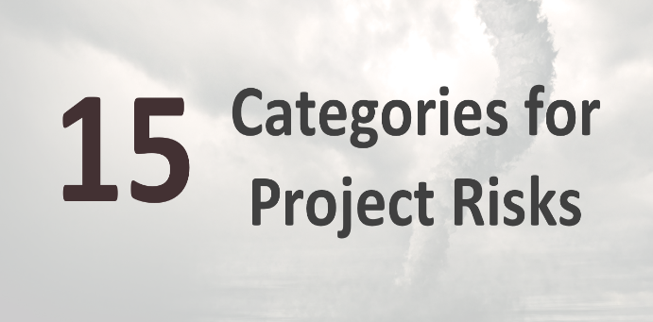
Chapter
01
Types of Project Risk
6- Supply Chain: Internal External
Rarely these days will you do a project that has no reliance on anyone else. Whether that’s the manufacturer of a critical part for your product, or a vendor supplying you with cloud-based software, our organizations are more linked together than ever before.
This creates risk, because when one part of the supply chain fails, the downstream implications can be significant. A supplier going bankrupt could put your project back months. Bad weather on the other side of the world could lead to crucial electrical components failing to make it your manufacturing plant on time.
Supply chain risk can also be internal, as your project team will rely on other departments to provide subject matter expertise to the project. If the people or services you need from your own staff are delayed, this can also affect the success of your project.

Slide 15
Chapter
01
Types of Project Risk
7- Organizational
This type of risk relates to changes in the organizational structure. This might apply if you have a change of leadership, which might in turn lead to a change in strategic direction. It’s crucial to make sure project teams are aware of these risks and then what to do if they happen, because something like this could quickly make a project unviable
8- Operations
These risks relate to impacts on how your business is run. That could be anything from risk that would impact the ability to keep a critical process running in the factory through to making sure the project goes ahead without impacting your customer services.

Slide 16
Chapter
01
Types of Project Risk
9- Environmental:
Environmental risks range from those that could expose your organization to fines or even legislative action, such as illegal dumping, through to ensuring that your internal environmental policies are adhered to.
Risks in this category are likely to be heavily tied to your position on corporate and social responsibility, and can also affect reputational risk, for example if your business is seen to be polluting.
10- Financial
Financial risks on projects relate to funding cycles, access to funding and making sure that the cash flow is available to pay invoices on time. It’s prudent to consider financial risks to projects because if there are problems in this area, projects could stall, putting all prior investment at risk of being wasted.

Slide 17
Chapter
01
Types of Project Risk
11- Resources:
Specifically, non-people resources. This kind of risk relates to whether you can get access to the equipment, materials and other resources required to deliver the project in a timely fashion. Risks around delivery of equipment or the inability to source specialist materials would fall into this category.
12- Staffing:
Alongside non-people resources, you also have to consider staffing risks. These are things like the right people not being available at the right time due to other projects overrunning, or lack of expertise within your business. It would also extend to the risk of staff sickness, and poorly timed vacations.

Slide 18
Chapter
01
Types of Project Risk
13- Scheduling :
Risks in this category affect the project timeline. A common risk here is that a task turns out to be more complicated than expected, and so it takes longer. This would add delay to the schedule if the task is on the critical path.
14- Reputation:
focusing on the public face of your business, think about the impact on investors and on your own staff.
15- Other
It’s useful to have an ‘other’ category!

Slide 19
Chapter
01
Types of Project Risk
Organizational
Operations
Environmental
Supply chain
Market
Legal
Political
Economic
Technological
Financial
Resources
Staffing
Scheduling
Reputation
Other

Slide 20
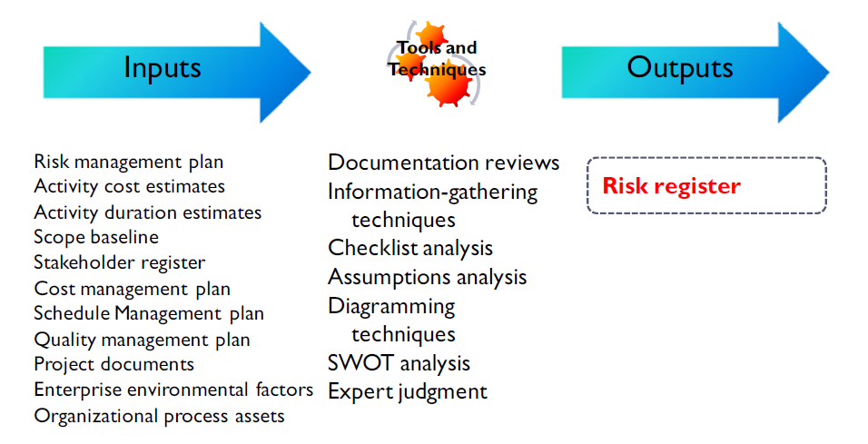
Chapter
02
identify risk

Slide 21
Lecture 3
The Risk Management process:
Identify the risks
Defining types of risk, for instance, ‘Strategic’ risks to the goals and objectives of the organization.
Identifying the stakeholders, (i.e.,who is involved or affected).
Past events, future developments.
Monitor and review
Communicate & consult

Slide 22
Chapter
01
Types of Project Risk
There are several types of risks that occur frequently, regardless of the specifics of the project. These common types of risk include:
Cost: The risk of events that impact the budget, especially those that cause the project to be completed over budget. Errors in cost estimation commonly generate risk in addition to external factors.
Schedule: The risk of unplanned scheduling conflicts, such as events that cause the project to be delayed. Scope creep is a common reason for scheduling issues and project delays.
Performance: The risk of events that cause the project to produce results that are inconsistent with the project specifications.

Slide 23
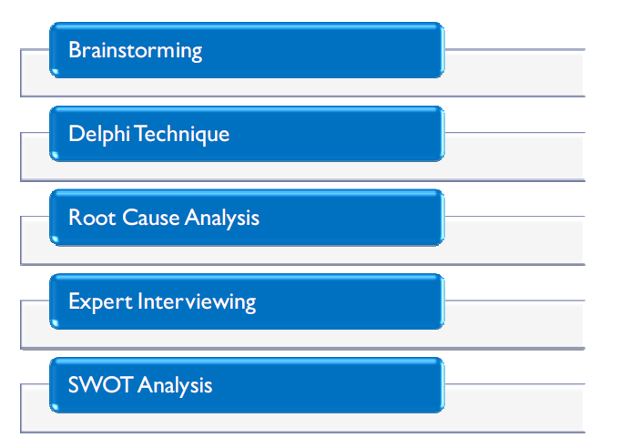
Chapter
02
Risk Information Gathering Techniques
The above-mentioned risk information gathering techniques are well established and have been in use for many years.

Slide 24
Chapter
02
Risk Information Gathering Techniques
Brainstorming and Delphi
Brainstorming is a technique developed by Alex Osborn, The four fundamental steps to brainstorming are as follows:
Focus on quantity: The idea is to facilitate problem solving through the concept, quantity breeds quality. The idea assumes that the greater the number of ideas generated, the greater the chance of producing an effective solution.
Withhold criticism: In brainstorming, criticism of ideas generated is postponed until the team is
ready to analyze the input. Instead, participants focus on extending or adding to ideas. By
suspending judgment, participants will feel free to generate unusual ideas.
Welcome unusual ideas: To get a good and long list of ideas, unusual ideas are welcomed. They can be generated by looking from new perspectives and suspending assumptions. These new ways of thinking may provide better solutions.
Combine and improve ideas: Good ideas may be combined synergistically, to form a single
improved good idea, as suggested by the counterintuitive "1+1=3". It is believed to stimulate
the building of ideas by a process of association.

Slide 25
Chapter
02
Risk Information Gathering Techniques
Delphi Technique
The Delphi Technique was developed by the RAND Corporation (an acronym for Research ANd
Development) in the 1960s and was created as an interactive forecasting method that relies on a panel
of independent experts. Usually, all participants maintain anonymity. Their identity is not revealed even
after the completion of the final report. This stops them from dominating others and using their
authority or personality. This frees participants from their personal biases, minimizing the "bandwagon
effect" or "halo effect", allowing them to freely express their opinions, encouraging open critique and
admitting errors by revising earlier judgments.

Slide 26
Chapter
02
Risk Information Gathering Techniques
Root Cause Analysis (RCA) and Expert Interviewing
The RCA Technique RCA is a reactive method of problem detection and solving, initially. The analysis is performed after an event has occurred. This allows practitioners to identify process ‘triggers’, so that RCA becomes a proactive method. In other words, RCA is able to forecast the possibility of an event before it might occur.
Expert Interviewing is the process of interviewing subject matter experts to obtain critical information
for the project.

Slide 27
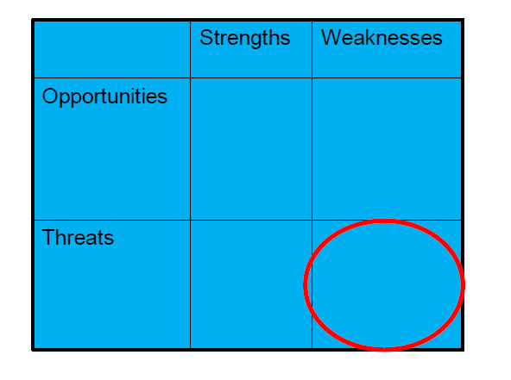
Chapter
02
Risk Information Gathering Techniques
SWOT Analysis
This one analysis is generally set up as a grid with strengths and weaknesses as the two major columns,
and opportunities and threats as the two major rows in the grid.
The idea is to see where the organization's strengths and weaknesses play against opportunities and threats using the four following comparisons:

Slide 28
Chapter
02
Risk Information Gathering Techniques
SWOT Analysis
Strengths-Opportunities - identifies how organizational strengths help the organization to capitalize on opportunities
Weaknesses-Opportunities - identifies organizational weaknesses, from the perspective of making the necessary improvements, to enable the organization to capitalize on opportunities
Strengths-Threats - identifies how our organizational strengths help us deal with competitors or threatening situations
Weaknesses-Threats - identifies how our organizational weaknesses leave us vulnerable to external competition or threats

Slide 29
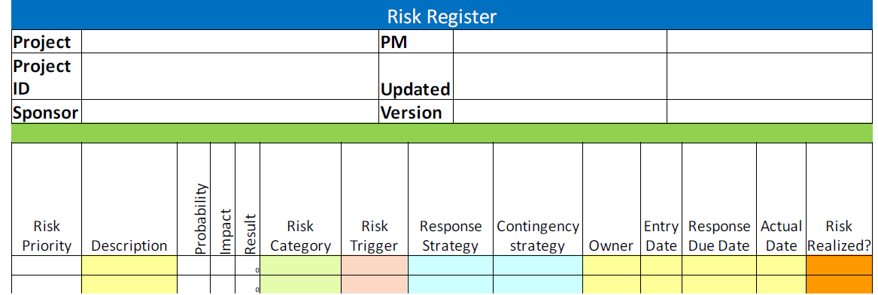
Chapter
02
The Risk Register

Slide 30
Chapter
02
The Risk Register
The risk register becomes a key planning tool for the project. Understand that although a risk identifies only the probability of an event occurring, the possibility of the event is deemed to be real, true and requires assistance in monitoring.
The risk register : contains a description of the risk, it's probability, its impact in dollars, a category of risk, the triggering event that indicates the risk is about to occur, the risk response strategy, the risk owner, the date the risk was identified, a due date for resolution and most importantly, the risk’s priority.
Note
Any risk with a probability percentage of 70% or greater is no longer a risk, it’s an issue!

Slide 31
Lecture 3
Risk Register content
A Risk Register is a management tool used to record relevant details relating to risks.
It is a database of information on risks.
Best kept simple to begin with!

Slide 32
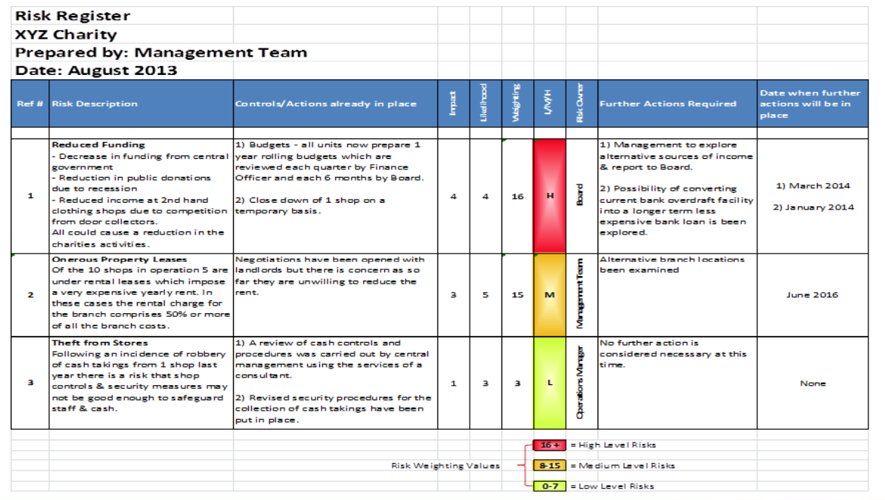
Lecture 3
Risk Register Example

Slide 33
Lecture 3
Commonly Used Risk Management Examples
Risk Avoidance
Customer Credit Risk Management
Industry-Specific Strategy
Elimination of Contract Risk
Compliance Risks
Market Risk
Safety Risks
Information Security Risk
Risk Transfer

