Slide 1



Organizational Behavior and Projects
PMG421
Prepared by Mrs. Deena Ibrahim
Lecture 3
Pioneers and Paradigms
Project Quality Planning

Slide 2




Chapter 3, Pioneers Paradigms
Joseph M. Juran | W. Edwards Deming |  |  | Walter Shewhart
Philip B. Crosby | Genichi Taguchi |  |  | Kaoru Ishikawa
Paradigms
Baldrige National Quality Program |  | ISO 9000 |  | Six Sigma
Chapter 4, Project Quality Planning
1. Quality Management Plan | Quality Planning |  | Quality Management
4. Identifying Requirements | 3. Prioritizing Customers |  | 2. Identifying Customers
7. Identifying Standards | 6. Quality Planning and Project Planning |  | 5. Prioritizing Requirements
III. Summary

Slide 3
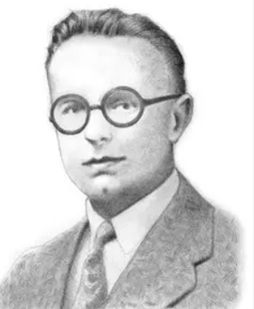


Shewhart was mentioned previously in Chapter 2. Shewhart has been called “the father of statistical quality control.” He met with W. Edwards Deming and Joseph Juran and mentored them both in their early careers.
Edwards Deming, Deming is perhaps the best-known quality pioneer. His approach to quality was statistically based, but focused on responsibilities of management.
Joseph M. Juran, also presented quality lectures in Japan. His approach to quality focused on strategic and planning issues. He believed that poor quality results from inadequate or ineffective planning, so he proposed the Juran Trilogy, a three step approach to quality that includes quality planning, quality control, and quality improvement.

Slide 4

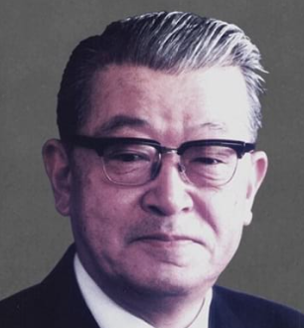
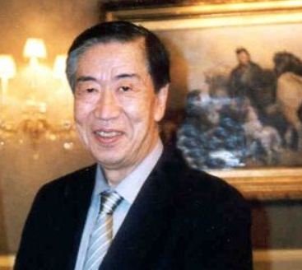
Philip B. Crosby, Quality was a result of prevention of defects, not inspection and subsequent correction of defects. He believed that the goal of any process should be zero defects, and this term soon became a widespread mantra in government and industry.
Kaoru Ishikawa, He brought customers into the quality equation, redirecting focus to them rather than the methods of production. He emphasized training and education of workers as a foundation of quality. He created quality circles, increasing the role of workers in solving problems and identifying opportunities for improvement.
Genichi Taguchi, the best known for his innovative approach to quality known as “the Taguchi method.” It is a follow-on to Shewhart’s work in statistics and Deming’s work in quality improvement.

Slide 5

Paradigms
Evolving quality concepts are captured in a number of formalized frameworks. Project managers should be aware of several of the principal paradigms. Not all may be applicable to a particular project. Each may provide some benefit, depending on the goals of the project team.

Slide 6
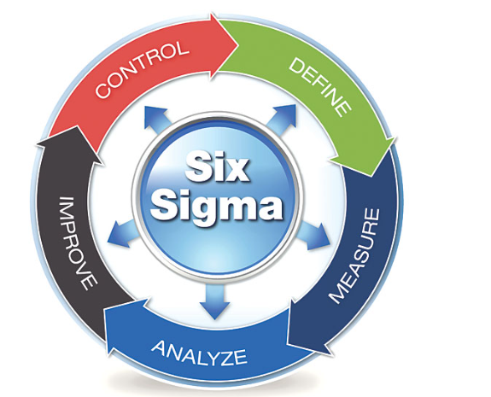
Six Sigma,
EVOLVED by Motorola company.
The name comes from the Greek letter sigma (σ), which used in statistics and quality as a symbol for standard deviation.
Six Sigma depends on data-based decisions, so data, facts, and figures play a key role. Standard quality tools and statistical tools are employed throughout implementation.

Slide 7
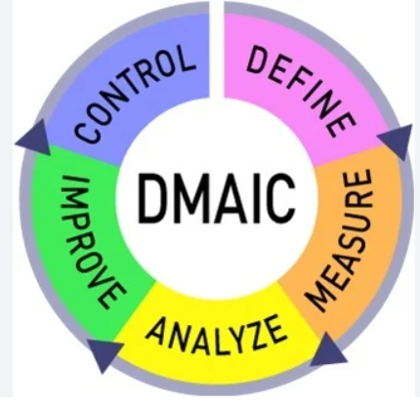
These tools are all integrated into a standard methodology designated by the acronym “DMAIC,” for define, measure, analyze, improve, and control:
◆ Define customers and requirements.
◆ Measure things critical to quality.
◆ Analyze baseline, opportunities, objectives, and root causes.
◆ Improve the process.
◆ Control the process.

Slide 8

ISO 9000,
The International Organization for Standardization (ISO) is a global body headquartered in Geneva, Switzerland that develops consensus standards for worldwide use.
The ISO 9000-series of standards addresses quality management systems. The series includes three standards:
ISO 9000, Quality management systems — Fundamentals and vocabulary.
ISO 9001, Quality management systems — Requirements.
ISO 9004, Quality management systems — Guidelines for performance improvements.

Slide 9

Baldrige National Quality Program,
The Baldrige National Quality Program is a public-private partnership administered by the National Institute of Standards and Technology, an agency of the U.S. Department of Commerce. Its goal is to improve performance of U.S. organizations. It recognizes outstanding quality performance with the annual Malcolm Baldrige National Quality Award.

Slide 10

Project Quality Planning

Slide 11
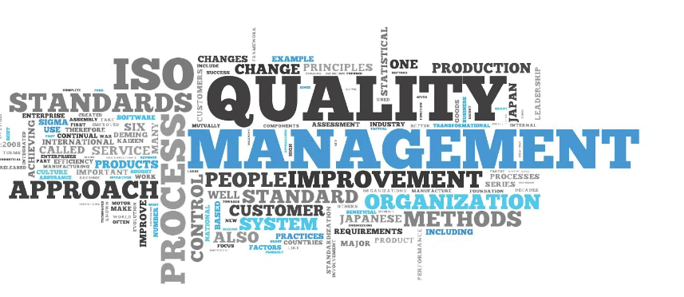
Quality Management,
The PMBOK® Guide describes three elements of quality management: quality planning, quality assurance, and quality control. The PMBOK® Guide states that quality management processes “…include all the activities of the performing organization that determine quality policies, objectives, and responsibilities so that the project will satisfy the needs for which it was undertaken.”

Slide 12

Quality Planning,
The PMBOK® Guide defines quality planning as “…identifying which quality standards are relevant to the project and determining how to satisfy them.” This activity is the foundation for quality being planned in, not inspected in. Project managers need not, and must not, depend on inspection and correction to achieve project quality. Instead, they should use conformance and prevention to achieve quality. Project managers should, through planning, design in and build in quality.

Slide 13
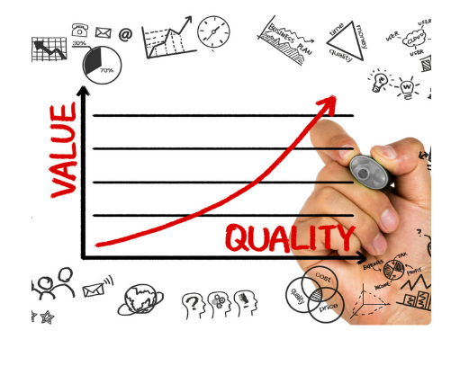
1- Quality Management Plan
The basic document for project quality is the quality management plan. It may be best for project teams to craft an individual quality management plan that fits the needs of the project, not just the format of a published template. A general framework for quality management plans includes four elements:
Quality policy.
Who is in charge?
Where are we going?
How are we going to get there?

Slide 14

Quality policy,
This expresses the intended direction of a performing organization with regard to quality.
Who is in charge?
This question is one of three that lie at the heart of quality management. It is not just the name of the project manager. A complete answer addresses project and organizational infrastructure and describes participants, reporting chains, and responsibilities.

Slide 15

Where are we going?
Managing quality effectively depends on specific performance targets. Goals provide broad descriptions of what the project is expected to achieve.
How are we going to get there?
This part of the plan should describe the people available, participating organizational elements, tools to be used, and, of course, the budget that provides funding for all quality activities.

Slide 16

2. Identifying Customers,
Identifying customers is not a matter of guesswork. Identification involves four steps:
Analyze the contract, As a first step, analyzing the contract will identify an important external customer, the paying client. This analysis may also identify an end user.
Analyze the project team and organization , This is the step that identifies internal customers.

Slide 17

Analyze product use, This step starts with the end user and goes a bit further to identify more specifically who will use the product and how they will use it. Analyzing product use may also disclose hidden customers.
Analyze the means of production, This is important whether the project involves manufacturing a product, delivering a service, or performing some intellectual or administrative activity. This step may add additional internal customers that were missed when analyzing the project team and organization.

Slide 18
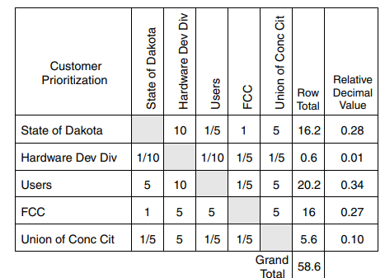
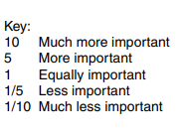
3- Prioritizing Customers,
The project team must prioritize customers. The purpose is not to identify customers to be ignored or eliminated. The resulting priorities should be a source for reflection.
The importance of prioritization demands a rigorous, disciplined process. One such approach is the L-shaped matrix, in which customers are compared to each other on a one-to-one basis.
The L-Shaped Matrix

Slide 19

4. Identifying Requirements,
Customers are sources of requirements that must be met for project success. Project and organizational elements, including suppliers and subcontractors, are also sources of requirements. Users and affected groups provide additional requirements, often of great importance to the project team. Defining requirements may require research, interviews, and analysis. It is best to involve the whole team in this process.

Slide 20
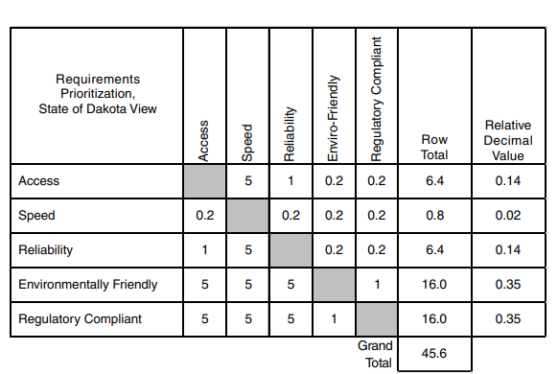
3- Prioritizing Requirements,
The first step has already been completed. We have prioritized customers using an L-shaped matrix. The next step is to prioritize requirements by comparing requirements to each other from the view of each individual customer. We put ourselves “in the shoes” of each customer and prepare an L-shaped matrix that compares requirements to each other considering the view of that customer.
Requirements Prioritization Matrix

Slide 21

6. Quality Planning and Project Planning,
It is essential that these steps of customer and requirement prioritization be completed early in the project, before the project plan or project design has been completed. Not doing so may result in a project plan that takes you someplace you did not want to go. This completes the second step in the quality journey.

Slide 22
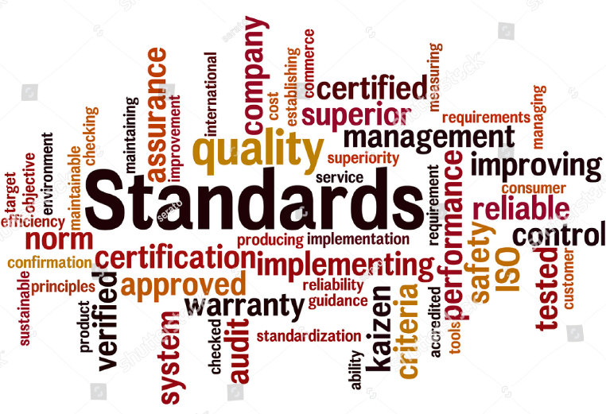
7. Identifying Standards,
Standards may be viewed in two ways.
- In the traditional view, a standard is a prescribed way of doing something. The PMI® definition of quality planning says that the project team must identify prescribed ways of doing things that are relevant to project implementation.
- As explicit targets to be met or quantifiable definitions of generally stated requirements.

Slide 23

Metrics are a means of measurement for determining the degree of conformance to specifications. They will be discussed under quality assurance.
Standards guide project implementation. They describe how the project team should or must employ processes.

Slide 24
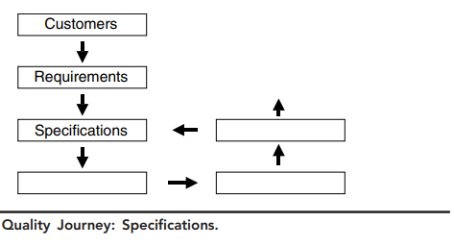
Quality Journey

Slide 25

◆ Walter Shewhart developed statistical techniques for analyzing, understanding, and controlling process variation.
◆ W. Edwards Deming, His view was that quality is a responsibility of management.
◆ Joseph Juran’s view of quality focused on strategic and planning issues
◆ Kaoru Ishikawa brought a new focus on customers, training, and total employee involvement to quality.
◆ Genichi Taguchi developed the Taguchi method that includes a quality loss function and robust design to achieve quality.

Slide 26
◆ Six Sigma is a framework for quality.
◆ ISO 9000 is a series of international consensus standards for quality management systems.
◆ The Malcolm Baldrige National Quality Award is a U.S. national award that recognizes quality performance.
◆ Quality management includes quality planning, quality assurance, quality control, and quality improvement.
◆ The quality management plan is part of the project plan.
◆ Quality planning is identifying which quality standards are relevant to the project and how to satisfy them.
◆ Quality planning is the foundation that allows quality to be planned in, not inspected in.
.

Slide 27
◆ Customers are the base in project quality.
◆ Identifying customers is the first step in a seven-step quality journey that provides a general framework for quality management.
◆ Identifying requirements is the second step in the quality journey.
◆ Customer and requirement identification and prioritization should be performed early in project planning so the project starts in the right direction.
◆ Identifying specifications is the third step in the quality journey.
◆ Standards are closely related to specifications. Standards address how something is to be done. Specifications provide specific targets for performance.

Slide 28


Slide 29


