Slide 1




Project Leadership
Lecture 10
PMG 511
Ch10 – Leadership and Communication Success for Teams and Stakeholders
Prepared by
Dr Hakem Sharari
www.midocean.ae

Slide 2
Chapter
Learning Outcomes
10
Effective Communication?
The Importance of Project Communication.
Leaders and communication.
Basic Communication Concepts.
Leadership communication skills in the workplace.
Communications within the Team: Meeting Success.
Communicating with Metrics and Reports.
Ethics in Communication.
Stakeholder Expectation Management.
How to improve leadership communication skills?
Summary and Conclusions.
Self-assessment.
www.midocean.ae

Slide 3
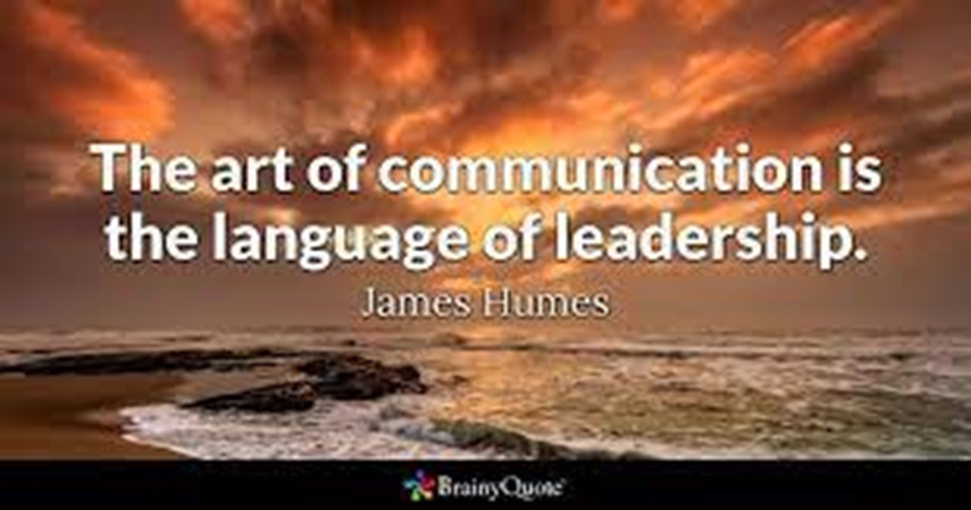
Chapter
10
www.midocean.ae

Slide 4
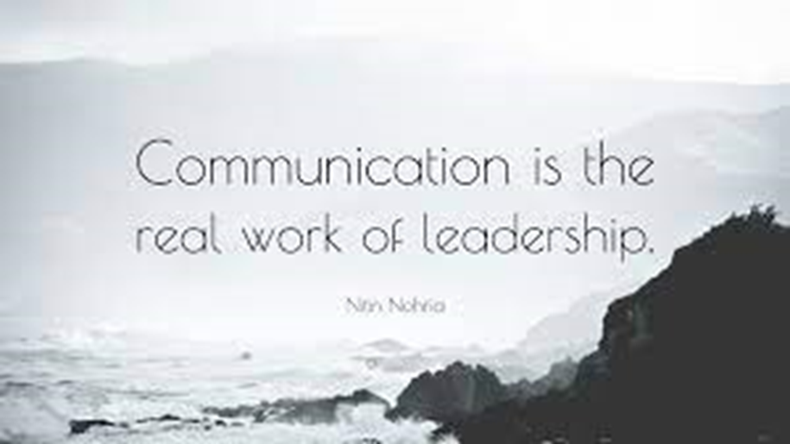
Chapter
10
www.midocean.ae

Slide 5
Chapter
Effective Communication
10
www.midocean.ae

Slide 6

Chapter
Effective Communication
10
Communication is a transfer of understanding and meaning from one person to another.
Effective Communication is defined as the ability to convey information to another effectively and efficiently.
www.midocean.ae

Slide 7
Chapter
The Importance of Project Communication
10
www.midocean.ae

Slide 8

Chapter
Why Project Communication?
10
Important because:
Stakeholders affect projects whether you communicate or not.
Because of technology, customers expect more interaction.
Team members:
  Leadership and motivation factors can have a huge effect on the project.
  Often are split between multiple projects.
Interactive communication is considered ideal.
www.midocean.ae

Slide 9
Chapter
Good Project Communication
10
Good communication is usually effective communication.
Large organizations which develop inadequate communication (diseconomies of scale) may address this by:
Developing flatter structures of management.
Creating a more empowered workforce.
Offering better employee training for different cultural and linguistic attitudes.
Controlling the volume of communication.
Limiting communication to those who need the information rather than copying it widely.
www.midocean.ae

Slide 10
Chapter
Successful Project Communication
10
If communication is successful:
Change is encouraged and transitions are easier .
Commitment is developed among staff (and therefore enhances motivation).
Co-ordination within the organization is more effective (therefore ensuring that the efficient implementation of plans and strategies).
Roles and responsibilities are clarified.
If communication is not successful:
Problems are not identified and addressed.
Leaders becoming isolated and follow events rather than shaping them.
Department rivalries develop.
Motivation and morale may be affected.
Bureaucracy becomes endemic and decision making slows.
Profit falls.
www.midocean.ae

Slide 11
Chapter
Leaders and Communication
10
www.midocean.ae

Slide 12
Chapter
Leaders and Communication?
10
Strong leadership communication skills can foster trust, instill motivation and help team members be as productive as possible.
Leadership communication skills are important because they:
Promote collaboration among team members and between teams.
Ensure communication channels between team members and leaders remain open and effective.
Make sure team members clearly understand their responsibilities.
Increase the productivity of team members.
Help employees remain focused on goals and outcomes.
www.midocean.ae

Slide 13
Chapter
Effective Leadership and Effective Communication
10
With an increase in leader’s portfolio there is a need to improvise communication skills to match the leader’s horizon and to become much more effective all possible situations.
The biggest challenge of the leader is to win the trust of his team, efficient leaders it is easy to earn trust because they know the value and importance of building and sustaining trust.
Communications plays significant role in building trust by creating an environment which empowers leaders to lead efficiently motivating employees to work and achieving the ultimate goal.
www.midocean.ae

Slide 14

Chapter
Effective Leadership and Effective Communication
10
A communicative leader is one who engages employees in dialogue, actively shares and seeks feedback, practices participative decision-making, and is perceived as open and involved.
www.midocean.ae

Slide 15

Chapter
Are You a Communicative Leader?
10
www.midocean.ae

Slide 16
Chapter
Leadership Communication
10
Leadership communication is defined as inspiring and encouraging an individual or a group by systematic and meaningful sharing of information by using excellent communication skills.
Leadership communication is a complex process which starts from developing strategy for communicating, writing precisely and then Speaking effectively to control difficult situations.
www.midocean.ae

Slide 17
Chapter
Leadership Communication Outcomes
10
Leadership communication has three major aspects: Core, Managerial, and Corporate.
The Core Aspects Approach includes writing and speaking: these are the individualized skills and are required to be expanded, to lead and manage bigger groups or teams.
Expressive cultural understandings, listening patiently, team management and team meetings, providing training facilities and mentoring are the skills which aid to manage huge groups and are Managerial Aspect Approach of leadership communication.
The Corporate Aspects Approach are the skills required at much higher levels of leadership, and there is a need to interact with an external sphere, skills which are most needed: maintain employee relations, communication during change and crises.
www.midocean.ae

Slide 18
Chapter
Basic Communication Concepts
10
www.midocean.ae

Slide 19
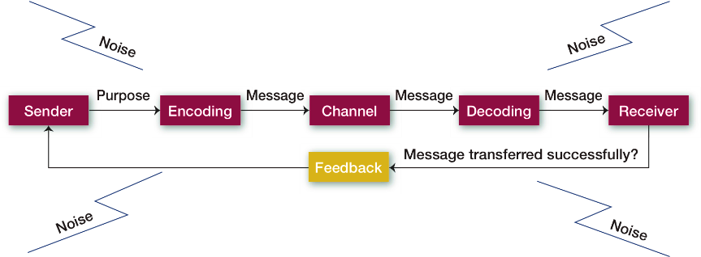
Chapter
The Communication Process
10
www.midocean.ae

Slide 20
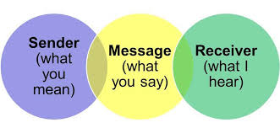
Chapter
The Communication Process
10
Depicts the seven-part communication process of transferring and understanding meaning: (1) the communication source or sender; (2) encoding; (3) the message; (4) the channel; (5) decoding; (6) the receiver; and (7) feedback.
The sender is the source of the communication.
Encoding means converting a message into symbolic form.
The message is the purpose to be conveyed in the communication.
The channel is the medium by which a message travels.
Decoding means translating a received message.
The receiver is the recipient of the communication.
Feedback is checking to see how successfully a message has been transferred.
www.midocean.ae

Slide 21
Chapter
Factors Affecting Encoding
10
  The source initiates a message by encoding a thought. Four conditions affect the encoded message: skill, attitudes, knowledge, and social cultural system.
  Skill: determines a person’s total communicative success and includes speaking, reading, listening, and reasoning skills.
  Attitudes: Skill Attitudes influence our behavior.
  Knowledge: Knowledge of the subject matters allows us to communicate more clearly or, if our knowledge is quite extensive, to confuse our receiver with overly complex information.
  Social cultural system: our beliefs and values—influences each of us as a communicative source.
www.midocean.ae

Slide 22
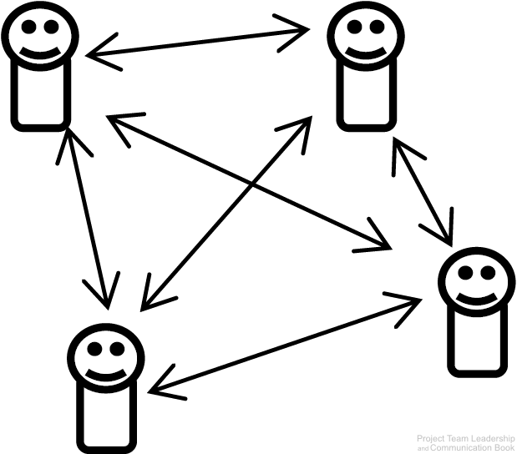
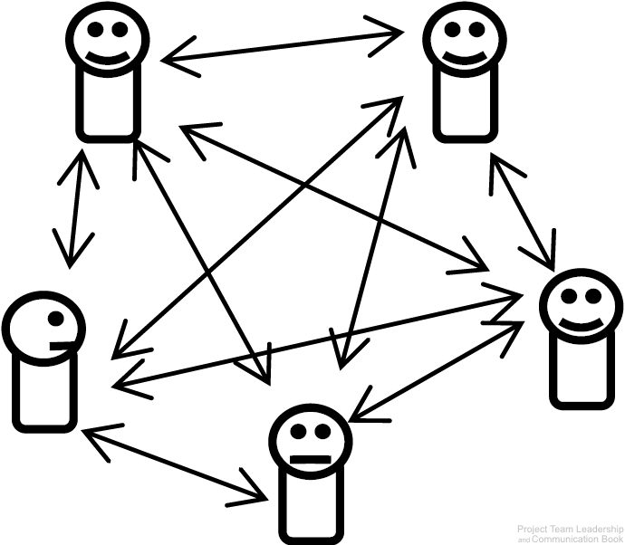
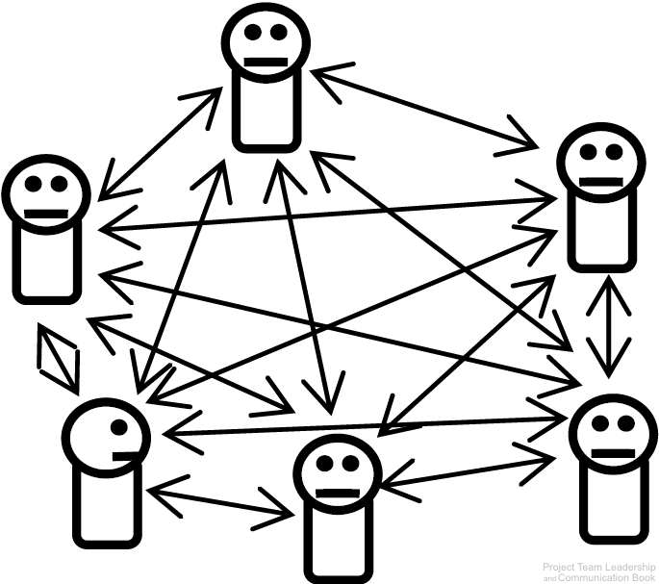
Chapter
Channels of Communication
10
A communication channel is the path through which a communication must travel.
Leaders and team members must maintain channels of communication with each other.
As the number of team members increase, the number of channels increases much quicker.
6 Channels
10 Channels
15 Channels
www.midocean.ae

Slide 23
Chapter
Communication Channels
10
The source selects either a formal or informal channel through which the message travels.
Formal channels are established by the organization, transmit job-related messages, and traditionally follow the authority network within the organization. Personal or social messages follow the informal channels in the organization.
Level of Complexity of communication channel need a needs a smart leader to avoid any single point of failure.
www.midocean.ae

Slide 24
Chapter
Communication Concepts
10
There are dozens of communication channels available at any given time:
Face-to-Face
Message Boards
Social Media
Multi-Channel
Online Video Posts
Text Messages
Email
Video Conference
Postal Mail
Television
Print Media
Photo Sharing
Instant Messages
Written Notes
Advertisement
Telephone
Blogs
and many more
www.midocean.ae

Slide 25

Chapter
Communication Concepts
10
Additionally, there are types or categories of communication:
Internal / External
Formal / Informal
Vertical / Horizontal
Written / Oral
Verbal / Nonverbal / Paralingual
www.midocean.ae

Slide 26

Chapter
Communication Concepts
10
And there are potential blockers to communication efforts:
Language and Culture
Interruptions
Technical Issues
Distractions such as fatigue
Negativity or hostility
Context known by only one party
Incorrect assumptions
Receiver not actively listening
www.midocean.ae

Slide 27

Chapter
The Grapevine
10
www.midocean.ae

Slide 28
Chapter
Decoding and Feedback
10
Decoding:
Translating a received message.
Feedback:
Checking to see how successfully a message has been transferred.
www.midocean.ae

Slide 29
Chapter
Push/Pull/Hybrid Communication
10
Interactive Communication is ideal, but not always available or practical.
Push/Pull Communication share a weakness: Sender is only sure it was sent, not if it was received or understood
  Push Communication is one-way communication sent to one or more recipients
    Email, radio broadcasts, and postal main are common examples
  Pull Communication allows the recipient(s) to receive the communication at will
    Websites and bulletin boards are common examples
Hybrid Communication combines push and pull communication, capturing the strengths of both
  Sending an email which includes a link to a website or file storage area is a common example
  By pushing the communication which includes the ability for the recipient to pull in the future, the sender increases the chance that the recipient(s) will receive the message
www.midocean.ae

Slide 30
Chapter
Leadership Communication Skills in the Workplace
10
www.midocean.ae

Slide 31

Chapter
Leadership Communication Skills in the Workplace
10
Here are six steps to help you communicate effectively as a leader:
Clearly define goals for each team member.
Be proactive.
Streamline your method of communication with your team.
Stay in constant contact with your team.
Set deadlines and follow up.
www.midocean.ae

Slide 32
Chapter
Key Principles of Communicative Leadership
10
Communicative leaders coach and enable employees to be self- managing.
Communicative leaders provide structures that facilitate the work.
Communicative leaders set clear expectations for quality, productivity, and professionalism.
Communicative leaders are approachable, respectful, and express concern for employees.
Communicative leaders actively engage in problem solving, follow up on feedback, and advocate for the unit.
Communicative leaders convey direction and assist others in achieving their goals.
Communicative leaders actively engage in framing of messages and events.
Communicative leaders enable and support sensemaking.
www.midocean.ae

Slide 33
Chapter
Leadership Styles Influencing Communication
10
As we already know that communication has a great impact on effective leadership precisely the same is the case with leadership styles. Different leadership styles also influence communication process.
    Style According to the Situation
    Under every situation the communication gets affected as some situations demand direct and strict communication and in other situation leader has to opt for indirect ways of communication. This can even make communication an effective process sometimes or may lead to mis-communication.
www.midocean.ae

Slide 34
Chapter
Leadership Styles Influencing Communication
10
2. Goal Oriented Leadership Style
    Team Involvement, effective listening, clear and timely communication is the main feature of this style. This style of leadership makes communication an effective communication.
    3. Employee Orientated Leadership Style
    The active category includes those employees who are self-motivated and enthusiastic to work hard for accomplishing the tasks given to them. Another one is those who need regular motivation and encouragement to perform their duties. The leader has to make strategies in accordance to employees to make them attached to their work.
www.midocean.ae

Slide 35

Chapter
Communicative Leadership Styles
10
    Listen First
    The Teacher
    The Motivator
    The Coach
    Assertive
    Directive
    Advisory
    Hands-Off
Find Your Style?
www.midocean.ae

Slide 36

Chapter
Examples of Leadership Communication Skills
10
The following are a few leadership communication skills that can make you a more effective leader when practiced in the workplace:
Active listening
Storytelling
Adaptability
Motivation
Open-mindedness
Empathy
Delegation
Positivity
Awareness
Nonverbal communication
www.midocean.ae

Slide 37
Chapter
Communications Within the Team: Meeting Success
10
www.midocean.ae

Slide 38

Chapter
Meeting Issues
10
Meetings have many common complaints:
  “My time could be better spent”
    Discussion or debate is out of control.
    Facilitator unprepared.
    Bad timing (time of day, week, business cycle).
  “Most of what was discussed wasn’t relevant to me”
    The subject isn’t appropriate for a meeting (“status meetings”)
    The wrong attendees.
  “It felt disorganized”
    Attendees are unprepared.
    Distractions / Poor timing.
    Interpersonal issues.
www.midocean.ae

Slide 39
Chapter
Meeting Success
10
Manage time properly
  Proper advanced notice, proper frequency of meetings.
  Time management in the meeting so that topics are not over or under-discussed.
Prepare beforehand
  Prepare and send agenda (many templates are available online or within organizations)
    Names, roles, location, date/time.
    Objective / purpose for the meeting.
    Schedule of topics with specific timeframes.
  Ensure technology (projector, online meeting software, document storage) is all set.
Document and follow up
  Record and publish clear meeting results, decisions, and action items.
  Ensure that important stakeholders receive and acknowledge documentation.
www.midocean.ae

Slide 40
Chapter
Meeting Agenda
10
Meeting Title / Subject |  | Date, Time, Location, Online/Telephone Details |  |  | Facilitator/Called By Name
Attendee Names and Titles |  |  | In-Meeting Roles (Presenter, Timekeeper, Note keeper)
Start Time – End Time | Facilitator /Presenter Name(s) |  |  | Subject / Discussion Topic / Notes
Start Time – End Time | Facilitator /Presenter Name(s) |  |  | Subject / Discussion Topic / Notes
Start Time – End Time | Facilitator /Presenter Name(s) |  |  | Subject / Discussion Topic / Notes
Start Time – End Time | Facilitator /Presenter Name(s) |  |  | Subject / Discussion Topic / Notes
Where meeting minutes, actions, decisions, etc. are stored after the meeting
www.midocean.ae

Slide 41
Chapter
Communicating With Metrics and Reports
10
www.midocean.ae

Slide 42
Chapter
Communicating Metrics and Reports for Leaders
10
Metrics are a useful quantitative representation of a project attribute, which help leaders or team members make decisions about the project
  Private metrics are known only to the team and risk misinterpretation if shared
  Public metrics are designed to be shared outside the team for comparison across projects
Reports are more complex representations of the project designed to be communicated to stakeholders and typically contain multiple metrics.
Making metrics and reports useful requires attention to several aspects:
  Level of detail as well as ethical and appropriate interpretation for stakeholders.
  Choosing an appropriate communication channel.
  Considering the role of the recipient, as well as their preferences.
  An appropriate understanding of what the information.
www.midocean.ae

Slide 43
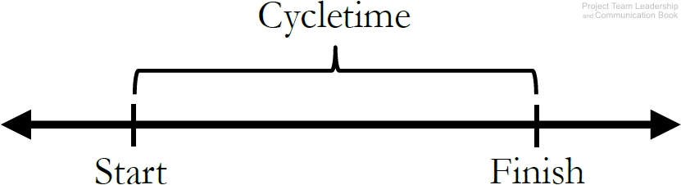
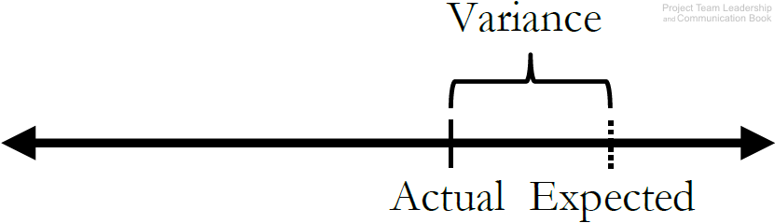
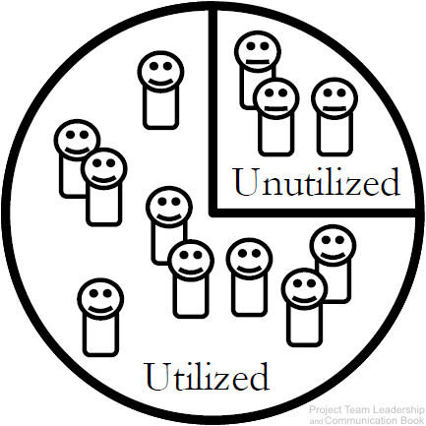
Chapter
Example Project Metrics (1 of 2)
10
Cycletime measures the average amount of time it takes to complete a cycle. Defining a ‘cycle’ is up to the team – it can be a single phase or the entire project.
Schedule or Cost Variance demonstrates how far the expected value (baseline) is from the actual value. Related to a project’s Earned Value.
Resource Utilization tracks how effectively of the team’s available work hours are being utilized. A percentage significantly below 100% may indicate wasted time, and over 100% could lead to burn-out. Similar metrics exist for other (non-human) resources.
www.midocean.ae

Slide 44
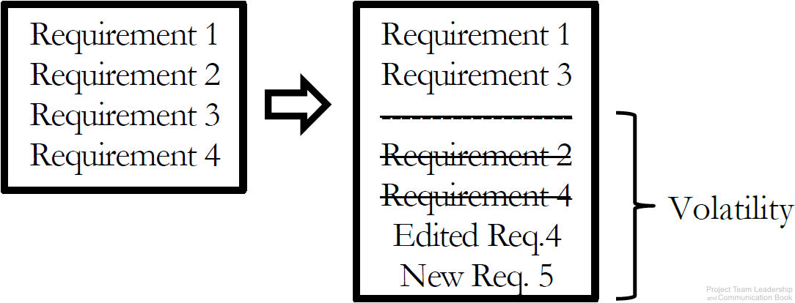
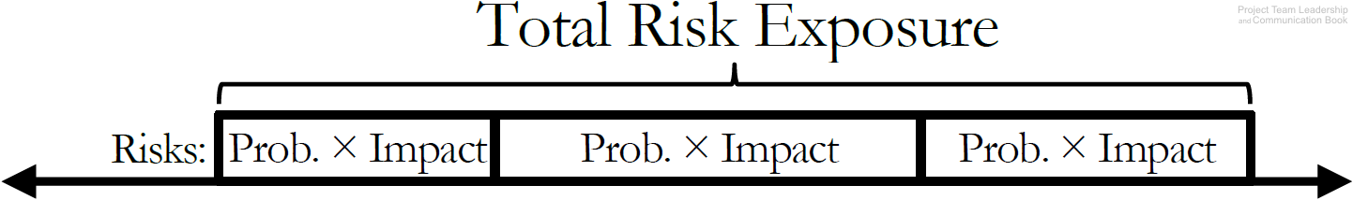
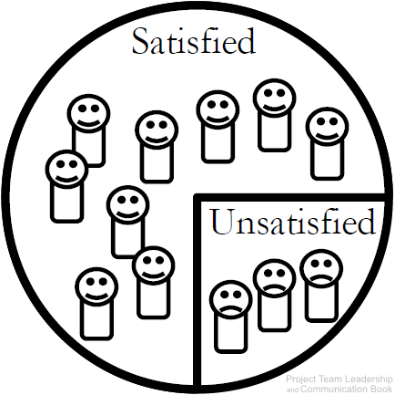
Chapter
Example Project Metrics (2 of 2)
10
Requirements/Specifications Volatility measures the number of changes to requirements/specifications as the project proceeds. These changes often have significant impacts on the productivity of the team.
Total Risk Exposure is the sum of a project’s individual risk exposures. The result is the expected total impact to resources or schedule.
Customer Satisfaction is an important metric to many organizations. Measured in various ways (surveys, etc.). Understanding why customer satisfaction is where it is represents a much more difficult task.
www.midocean.ae

Slide 45
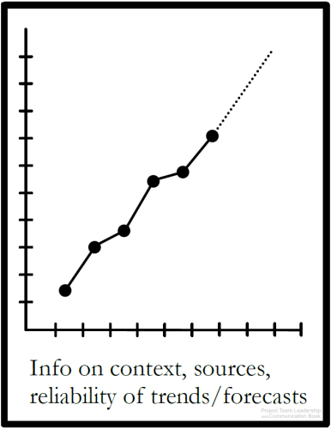
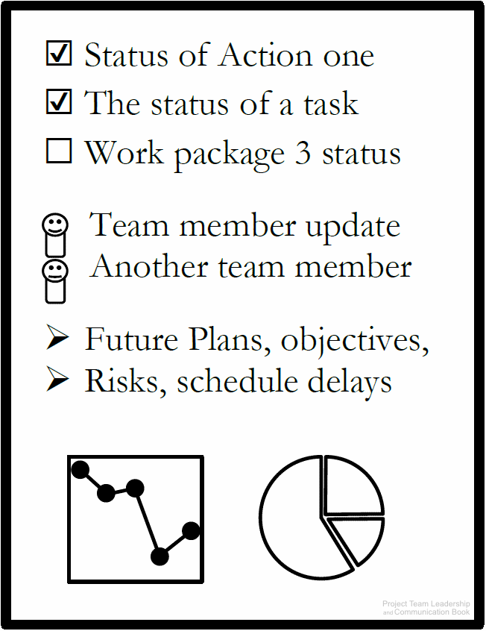
Chapter
Example Project Reports (1 of 3)
10
Trend/Forecasting Reports extrapolate important project data, giving insight into important factors of the project.
  Is performance improving or deteriorating?
Status Reports indicate the overall condition of a project.
  Overall health
  Schedule/budget status
  Issues/risks
Almost any relevant metric can be included
Completed Since Last Report | Plans For Current Period
Risks & Issues | Needs & Discussion
Quad Charts are a useful example of a status report
  Limited to one side of one page or one presentation slide
  Will the data and its forecast factor into important decisions?
Sources, justifications, and expected ranges help make the report more relevant/readable
Automatically generated reports can be extremely useful here
Data/Metrics: Cycletime, Schedule, Cost, etc.
www.midocean.ae

Slide 46
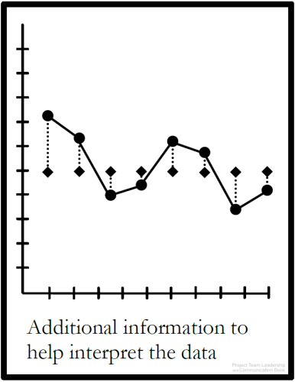
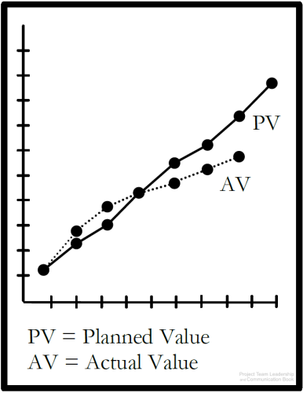
Chapter
Example Project Reports (2 of 3)
10
Earned Value Reports are similar to Trend/Fore-casting and Variance Reports, but follow a specific method.
  Actual, or “Earned Value” are plotted against expected value.
Variance Reports measure how actual results compare to the expected value, or “baseline.”
Both overspending and “underspeinding” time or resources can represent a problem
  In an “ideal” project, both graphed lines would match perfectly. A gap indicates variance
Some project management software automatically generates this report
Data/Metrics: Earned Value, Planned Value
The expected values may not always be constant/linear. Projects often plan to work and spend resources at varying rates
Often, more data is included to provide clarity
Data/Metrics: Schedule Variance, Cost Variance, analysis/clarification where needed
www.midocean.ae

Slide 47
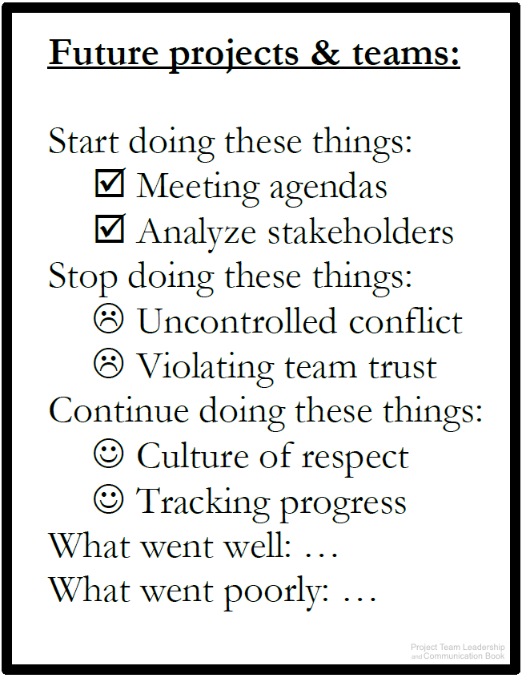
Chapter
Example Project Reports (3 of 3)
10
Lessons Learned Reports present an opportunity for the project team to review, document, learn from, and communicate what went well and what went poorly throughout the project.
  Often three questions are asked:
    What should the team start doing?
    What should the team stop doing?
    What should the team continue doing?
  Also known as a “Postmortem,” which implies lessons learned activities are only completed at the end of a project. In reality, they should happen throughout, and team can benefit immediately
  Previous Lessons Learned reports can also benefit teams completing projects in the future
www.midocean.ae

Slide 48
Chapter
Communicating With Metrics and Reports
10
www.midocean.ae

Slide 49

Chapter
Ethical Communication
10
Presented material that contains all the relevant information, is true in every sense, and is not deceptive in any way.
www.midocean.ae

Slide 50
Chapter
Ethical Communication
10
Communication presents the majority of ethical decisions for most individuals
Ethics focus on truthfulness
  Honesty before the project begins
    Ensuring that the project team and stakeholders are presented with an honest view of circumstances
  Trying to understand the truth
    Remember that perceptions can be inaccurate. Seek the whole truth
  Being truthful in all communications
    Stressful or less-than-ideal circumstances make this difficulty. Trust is built in the bad times, not the good
  Creating an environment where others tell the truth
    As a leader or peer, consistently telling the truth communicates to others that truthfulness is the only acceptable option
www.midocean.ae

Slide 51
Chapter
Stakeholder Expectation Management
10
www.midocean.ae

Slide 52
Chapter
Stakeholder Expectation Management
10
Stakeholders fall into 2 groups
  Those who affect the project: often the most apparent to the team and the most demanding
  Those who are affected by the project: often easier to ignore
Expectations have a direct connection to perception, and perception is influenced by communication. Several factors can affect this:
  Stakeholders’ previous projects and experiences.
  Patterns of communication and normal rhythms of the organizational environment.
  Expectations of individual stakeholders: simply asking is often most effective here
  Previous commitments made by the project team. These should be carefully recorded and considered
  Hard data: numbers (metrics, reports, etc.) and appropriate context are extremely valuable
www.midocean.ae

Slide 53
Chapter
How To Improve Leadership Communication Skills?
10
www.midocean.ae

Slide 54
Chapter
How To Improve Leadership Communication Skills?
10
The following are steps you can take to improve your leadership communication skills:
Have a purpose for your communication. Before you speak or send correspondence, make sure you have a clear goal, so your message stays focused.
Make sure your team members fully understand your agenda. Explain the objective of the conversation so your team members understand their responsibilities and what you expect of them.
Choose your words carefully. Each word you use should have a specific purpose for a more straightforward message. Think before you speak, and reread and written communication before you send it.
Eliminate fillers from your vocabulary. Reducing fillers, such as "um," can make you seem more confident and composed when you speak. If you need to, you can take a short pause before completing a thought instead of filling the space.
www.midocean.ae

Slide 55
Chapter
Summary and Conclusions
10
www.midocean.ae

Slide 56
Chapter
Summary and Conclusions
10
Teams may not give communication enough consideration because in general communication is a large part of everyday life
Communication requires careful planning, and should consider factors such as the appropriate channel and potential blockers.
Carefully consider whether interactive, push, pull, and hybrid communication types are appropriate
External communication affects the expectations of stakeholders
Communication represents the majority of ethical considerations for project teams
When communicating with metrics and reports, special consideration must be given to how they are perceived. Provide appropriate interpretation and context.
How to improve leadership communication skills?
www.midocean.ae

Slide 57
Chapter
Resources
10
Project Team Leadership and Communication by Samuel Malachowsky, 2018.
www.midocean.ae

Slide 58

Chapter
Reference
10
www.midocean.ae

Slide 59


Thank You

