Slide 1
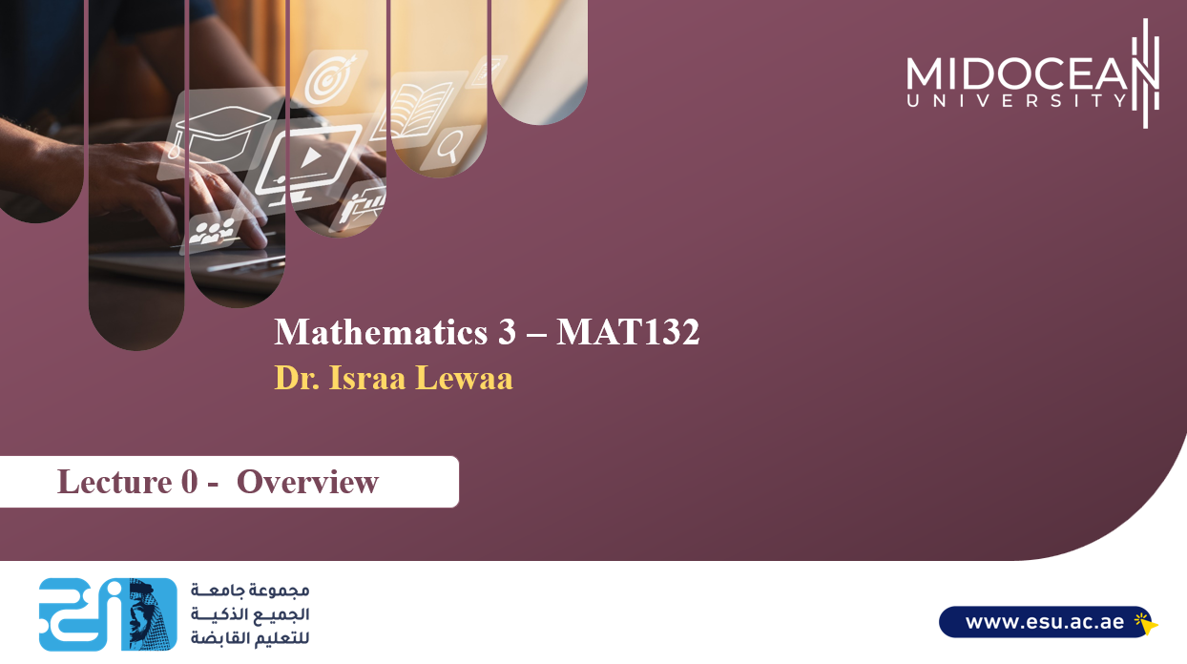

Slide 2


Welcome
Welcome
Welcome Back!
Second Trimaster 2023

Slide 3
Who Am I ?
Who Am I?
Dr. Israa Lewaa
  Lecturer in Statistics and Mathematics
    Ph.D from Faculty of Economics and Political Science, Cairo University, Statistics Department.
    Thesis: “Statistical data integration Using A latent Class Model”.
    M.Sc from Faculty of Economics and Political Science, Cairo University, Statistics Department.
    B.Sc from Faculty of Economics and Political Science, Cairo University, Statistics Department.

Slide 4
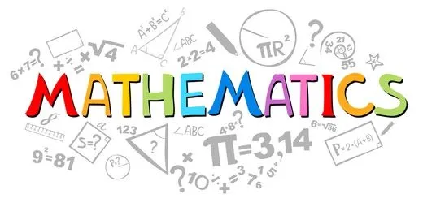
The course that will be taught
The course that will be taught
Mathematics 3

Slide 5
Primary Goal of This Course
Primary Goal of This Course
This course aims to:
  Provide students with concepts of
Differential Equations
‎Fourier series, Fourier transform (FT).
Discrete Fourier transform (DFT).
Fast Fourier ‎transform(FFT)
Applications in computer science using MATLAB.
Interpolating polynomial and least ‎squares.‎

Slide 6
Learning Resources
Learning Resources:
Credit Hours:
3 credit hours.
  Required Textbook:
  CALCULUS, 6th edition , Swokowski, Olinick , Pence PWS Publishing Company
  Essential References:
Proakis, J. G. (2007). Digital signal processing: principles, algorithms, and applications, 4/E. Pearson Education India.‏
Gayev, Y. A., & Nesterenko, B. N. (2006). MATLAB for Math and Programming (Textbook). Zaporizhzhia: Polygraph.‏‏

Slide 7
Lecture Structure
  Lecture Structure:
Units of Course Contents
Module | Course Unit | No.of. Weeks | Contact Hours
1 | Lecture_1_Differential Equations: Part 1 | 1st | 3
2 | Lecture_2_Differential Equations: Part 2 | 2nd | 3
3 | Lecture_3_Differential Equations: Part 3 | 3 | 3
4 | Lecture_4_Fourier series and Fourier transform (FT) | 4 | 3
5 | Lecture_5_Discrete Fourier transform (DFT). | 5 | 3
6 | Lecture_6_Fast Fourier ‎transform(FFT) | 6 | 3
7 | Lecture_7_Applications in computer science using MATLAB: Part 1 | 7 | 3
8 | Lecture_8_Applications in computer science using MATLAB: Part 2 | 8 | 3
9 | Lecture_9_Applications in computer science using MATLAB: Part 3 | 9 | 3
10 | Lecture_10_Interpolating polynomial and least ‎squares | 10 | 3

Slide 8

Course Information
Course Information
Short Exam
  80% marks
    Count of short Exam 10 (Weekly)
    8 Marks for each of short Exam.
  20% Final Examination

Slide 9
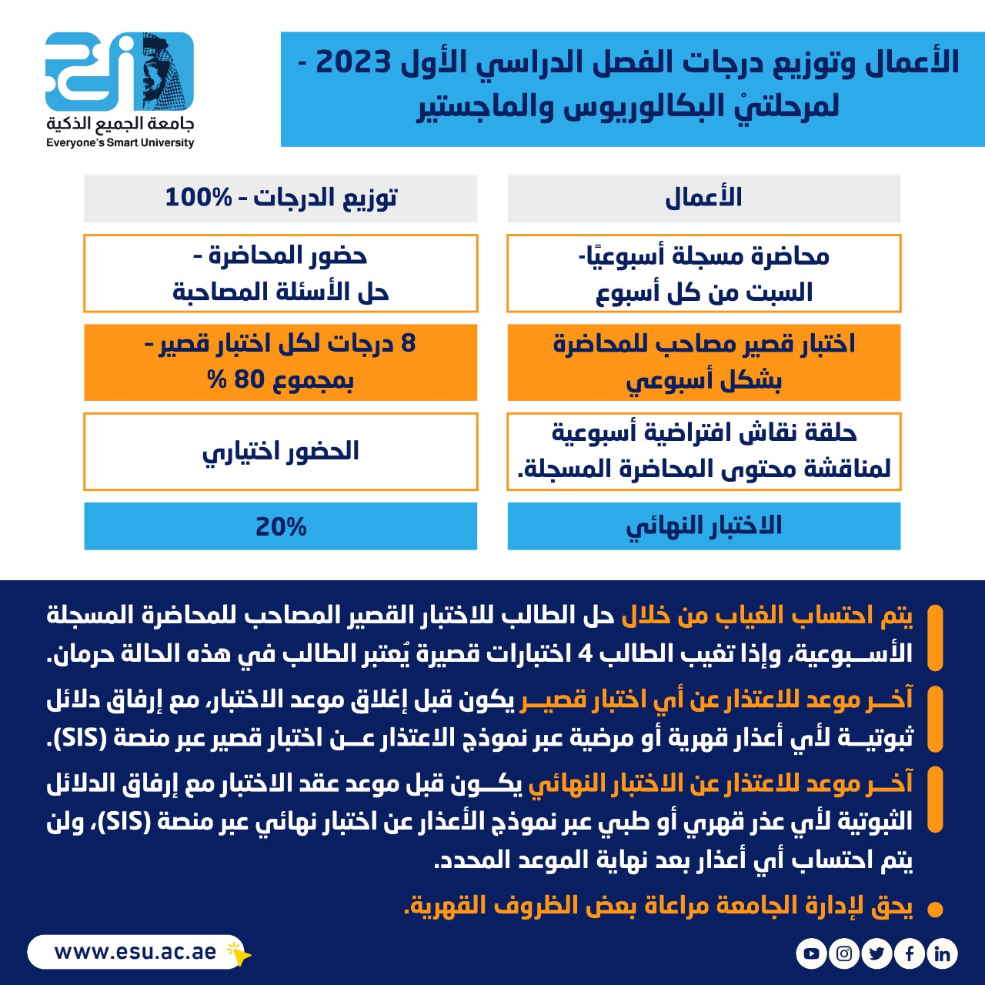
Assessment Method
Assessment Method
-- اللغة الأساسية في المحاضرات هي:
اللغة الإنجليزية
-- الاختبارات باللغة الإنجليزية مع وجود
ترجمة للسؤال.

Slide 10
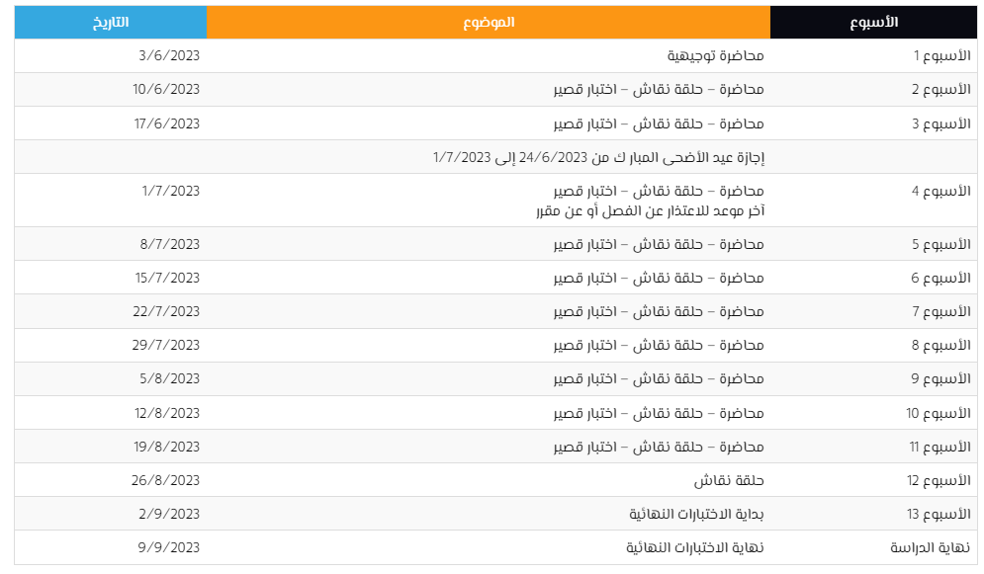
Academic Calendar
First Trimaster 2023 Academic
Calendar
Everyone's smart university

Slide 11
Lecture Timing
Academic Calendar
عبر برنامج ZOOM
سيتم تثبيت رابط حلقة النقاش على صفحة المقرر
رابط حلقة النقاش وموعدها مرفوع على صفحة المودل ستكون حلقة وحيدة كل أسبوع

Slide 12


