Slide 1



Introduction to Digital Media
Collaborative Digital Media
DGM 711
Lecture 7
Prepared by
Dr. Shereen Kedwany

Slide 2

Reminder
Lecture 6
Digital media, and social media platforms in particular, are important instruments through which individuals implement active strategies of identity building.
social media are one of the “stages” from which individuals represent their own identity and perform the continuous work of identity construction
The so‐called “digital afterlife can create a kind of “immortality” in which the digital identity of the deceased survives his death .
The use of digital media as social spaces is not neutral, but rather influenced by social factors such as age, gender, ethnicity, or class, Like “digital natives” and “digital immigrants”.
Algorithms reinforce inequalities.
The “algorithmic identity based on algorithmic evaluations of our online behavior.
Forms of sociality mediated by digital technologies have been faced with many critiques.

Slide 3

Outline
Lecture 7
I. Digital Collaboration .
II. Culture of Participation .
III. Examples of Collaborative Digital Media.
VI. The Dilemma of Participation.
V. Conclusion.

Slide 4

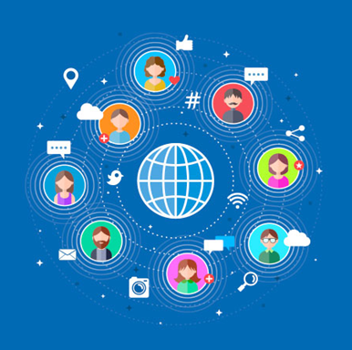
Lecture 7
I. Digital Collaboration :
Digital technologies facilitate the active participation of individuals in media production .
The content generated by internet users is critical to the success of web corporations and has transformed traditional mass media.
Free software, open-source applications, and Wikipedia are examples of digital collaboration that rely on a culture of participation.
Yet the value created through collaborative processes is often appropriated by digital corporations.

Slide 5


Lecture 7
I. Digital Collaboration :
Among the technological, economic, and organizational transformations of information society, an important place is occupied by the increased user participation and active collaboration in content production.
This evolution is part of the trend toward broadening access to information and using it to democratize productive and political processes, a core element of the information society project.
In its most recent incarnations, such expansion has repercussions on all areas of cultural production and beyond, from journalism to science, from software production to marketing.

Slide 6

Lecture 7
I. Digital Collaboration :
Most digital services are in fact interactive and allow for public participation or even rely fully on forms of production completely entrusted to users.
Digital platforms offer possibilities for users to become content producers or contribute to assessing and improving the content provided by a service.

Slide 7

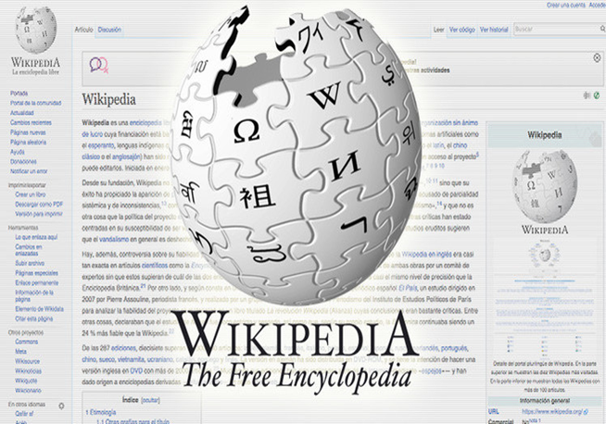


Lecture 7
I. Digital Collaboration :
Wikipedia is written and edited by its users;
Instagram would not exist without the content produced and posted by its public.
Hotels are ranked on TripAdvisor thanks to an aggregation of their clients’ reviews.

Slide 8

Lecture 7
II. Culture of Participation :
Tools such as social media, blogs, video streaming services, wikis, tagging systems, and resources for information sharing represent the technical basis of this transformation which, however, relies on a set of legal and cultural changes too (Benkler 2006).
Legal systems have adapted copyright laws to facilitate the spread of self‐publishing platforms such as YouTube.

Slide 9
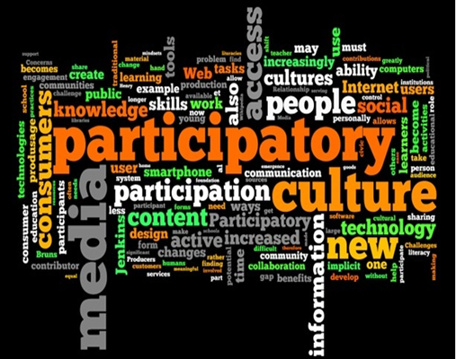
Lecture 7
II. Culture of Participation :
At the same time, collaboration on such platforms would not be possible without the spread of a culture of participation that has become an integral part of processes of information and knowledge production.

Slide 10

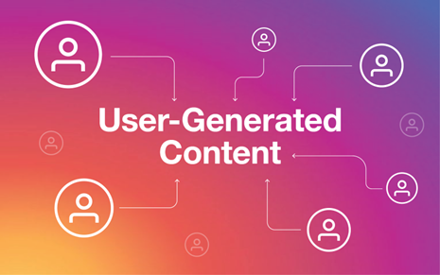

Lecture 7
II. Culture of Participation :
According to theorists like Henry Jenkins (2006), a culture of participation via digital media is based on the removal of barriers to the expression of creativity, on willingness to share content, and on the feeling that one’s contribution is valuable to a community.
One of the most common definitions of the outcome of these processes is user‐generated content.

Slide 11
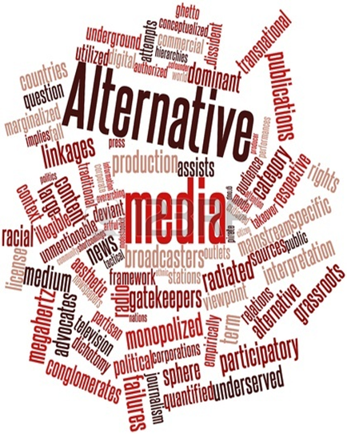
Lecture 7
II. Culture of Participation :
This is not fully new, as media participation preceded digital media.
For example, forms of public participation in media production have been at the center of alternative media such as community radio stations or independent newspapers for decades, as these alternative media saw public participation as a chance to establish democratic forms of communication and exit the sphere of commercial mass media.

Slide 12
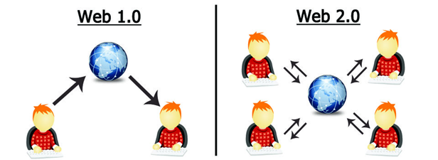
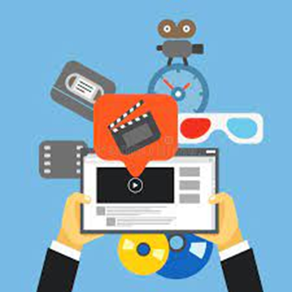
Lecture 7
II. Culture of Participation :
However, technological and economic changes related to digital media have furthered these forms of interaction with the media industry.
In fact, the phenomenon has exploded since the 2000s, with the transition from static forms of one‐way digital communication to more collaborative web services, which deeply changed the media and cultural industry (Harrison and Barthel 2009).

Slide 13
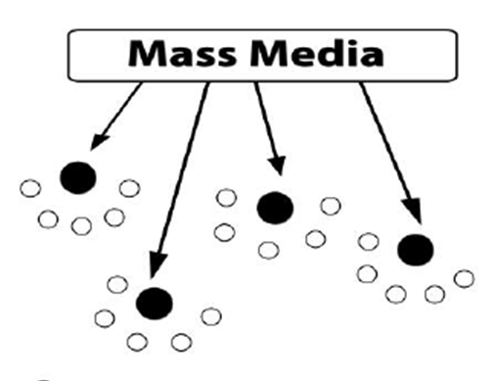
Lecture 7
II. Culture of Participation :
The content of broadcast media such as television and press is directed from a central hub that produces and sends the message to many peripheral receivers.
The audience of broadcast media can choose what content to read or watch, but cannot contribute personally or provide direct feedback to content producers.

Slide 14

Lecture 7
II. Culture of Participation :
In the early years of the emergence of the commercial internet many online services had similar features.
They widened the range of choices available to the public, but did not provide new possibilities to become an active part of communication processes.
Today, however, digital applications and services enable a higher level of interaction between users and the service itself.
The user assumes a central role, as everyone has the opportunity not only to enjoy content, but to create and edit it too.

Slide 15


Lecture 7
III. Examples of collaborative Digital Media:
Examples of collaborative applications are many and very different, but all emphasize participation, content creation, and information sharing.
Blogs are online diaries or journals, which compose what has been called the blogosphere, that is, an environment made up of blogs in communication with each other.
This is strongly intertwined with social media, rating systems, and microblogging platforms such as X(Twitter).

Slide 16

Lecture 7
III. Examples of collaborative Digital Media:
Thanks to blogging platforms such as WordPress, producing a blog does not require specific technical skills.
Therefore, writing for a public is no longer reserved to journalists and other professional writers.
https://wordpress.com/

Slide 17

Lecture 7
III. Examples of collaborative Digital Media:
Wikis are collective writing softwares, which allow multiple users to simultaneously work on the same text or document:
The best-known example of a wiki‐based service is Wikipedia, the non‐profit online encyclopedia written collaboratively by thousands of users around the world.

Slide 18


Lecture 7
III. Examples of collaborative Digital Media:
Commercial services like YouTube or Instagram allow users to publish, tag, and share videos and photos, respectively.

Slide 19

Lecture 7
III. Examples of collaborative Digital Media:
The success of these services is due not only to the use of software for online publishing, but also to the spread of low‐cost equipment such as cameras, as well as software for video or photo editing, which can be installed on most personal computers and phones.

Slide 20

Lecture 7
III. Examples of collaborative Digital Media:
Online marketplaces and stores, such as eBay or Amazon, use the information produced by their users to improve their service.
On Amazon, customers write reviews or rate commodities, thus providing valuable information which the platform aggregates and uses to present its products to other clients.

Slide 21
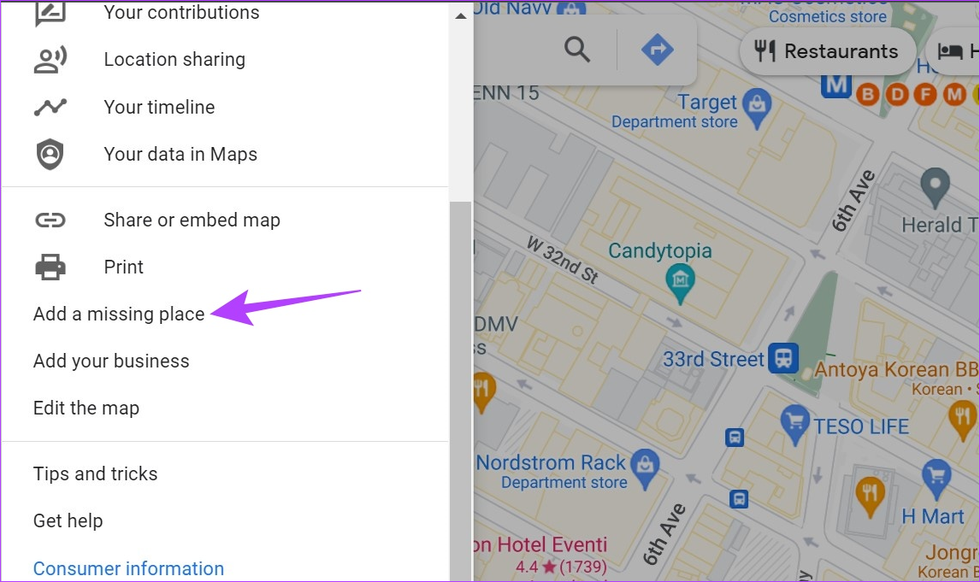

Lecture 7
III. Examples of collaborative Digital Media:
Mashup services are not too different, as they facilitate the aggregation of information from different sources to create a site or application.
A popular example is Google Maps, an interactive map service to which users can add information, thus creating customized maps that aggregate information from users and other websites.

Slide 22


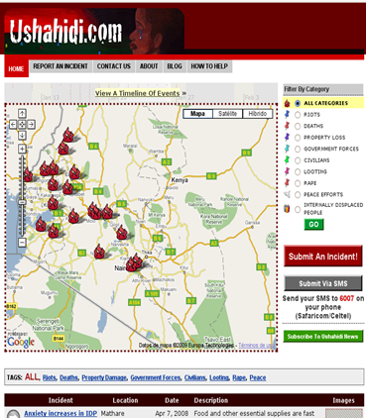
Lecture 7
III. Examples of collaborative Digital Media:
Another mashup platform that takes advantage of the possibilities opened up by the spread of smartphones is Ushahidi, a non‐profit service that creates interactive maps by aggregating information sent via email and SMS.
Ushahidi has played a crucial role in events in which traditional media were blocked or rendered inoperable by natural events, as in the case of the earthquake in Haiti in 2010.
In both cases, Ushahidi used the information and evidence provided by its users to create maps that anyone could consult and contribute to, making them evolve in real time (Okolloh 2009).

Slide 23

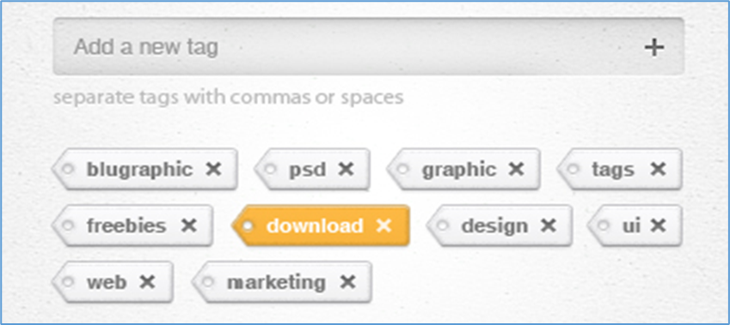
Lecture 7
III. Examples of collaborative Digital Media:
Through tagging technologies, users can associate content with a label that allows other users (or software) to understand what type of content it is, to what it is connected, and so on.

Slide 24
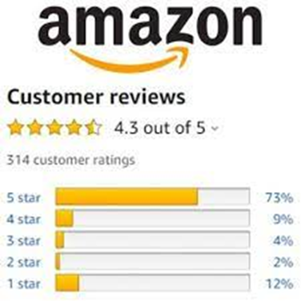


Lecture 7
III. Examples of collaborative Digital Media:
Rating systems permit individuals to vote on, or rather provide a numerical rating to, a certain piece of content.
This is how Amazon works, but many other platforms for reviews have integrated rating systems.
Think of how ratings are produced for restaurants on Yelp, or for university teachers on RateMyProfessors.com.
Rating systems work when many individuals assess something, and therefore the overall “grade” attributed, for example, to a restaurant on Yelp is an aggregate result rather than a single review.
The participation of many users makes rating systems more reliable and limits the effect of incorrect or biased reviews.

Slide 25


Lecture 7
III. Examples of collaborative Digital Media:
The emergence of collaborative media is not just a matter of technology.
Together with the birth of collaborative software and platforms we have witnessed the emergence of a culture of participation that leads consumers to contribute more directly to information production, breaking out from the canonical dynamics of the cultural industry.

Slide 26
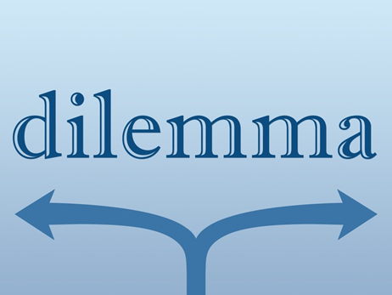
Lecture 7
VI. The Dilemma of Participation:
Early research on collaborative media and participatory cultures, especially in the 2000s, tended to paint these collective production processes via digital media as forms of democratization of the media environment, in line with recurrent promises of the information society.
However, this idealized vision was soon criticized for its lack of attention to the underlying dynamics of power.
The very use of the word “participation” can be seen as problematic.

Slide 27

Lecture 7
VI. The Dilemma of Participation:
In political theory, the concept of participation implies a redistribution of power to citizens through democratic decision‐ making processes and egalitarian social relations .
If we accept this view, however, we must realize that digital media users contribute only marginally to decision‐making processes.
Indeed, the cultural industry and interactive digital services are not fully participatory.

Slide 28

Lecture 7
VI. The Dilemma of Participation:
For example, authors who have used democratic theory to analyze collaborative media have stressed the difference between access, interaction, and participation (Carpentier 2012).
In this model, the simple ability to access information through digital media is different from the opportunity to interact to exchange or produce content, which happens every time.

Slide 29

Lecture 7
VI. The Dilemma of Participation:
We rate on Yelp or use a hashtag on Instagram; instead, forms of participation characterize services such as Wikipedia, whose users may at least partially contribute to deciding about the evolution of the encyclopedia, or decision‐making platforms .
Let us analyze more in detail some of the organizational and political factors that determine the difference between simple content sharing or production and forms of collaboration that fulfill the idea of participation in a collective project .

Slide 30

Lecture 7
VI. The Dilemma of Participation:
Intentionality: are participants aware of taking part in a partnership and do they share an interest in the collective goals or is the content they create simply aggregated or managed by others?
Control of modality: can users question the rules of participation, or must they accept them passively?
Ownership: who owns the result of a collaboration and derives a profit from it?
Accessibility: who can participate and how?
Equality: are there hierarchies or do all participants have equal weight in decision‐making?

Slide 31

Lecture 7
VI. The Dilemma of Participation:
Analyzing processes of digital sharing and collaboration according to these variables permits a distinction between democratic participation and cases in which the individual and collective work of users is aggregated for profit purposes by private companies, removing power and decisions from the users.

Slide 32
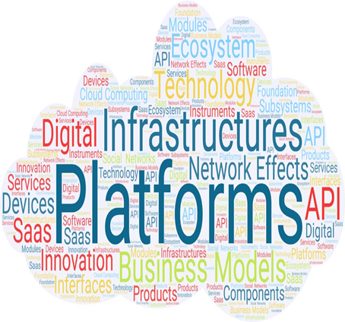
Lecture 7
VI. The Dilemma of Participation:
The companies that manage services like YouTube, Facebook, or Yelp tend to define their services as platforms not only to describe them from a technological point of view, but also to reiterate that these services are open for users to produce and share content they have created themselves.
Indeed, the word “platform” refers to a horizontal structure on which one can stand in order to be heard and seen.
Through this metaphor services based on user contributions, such as social media or content sharing services, are explicitly presented as neutral and democratic spaces that facilitate horizontal communication.

Slide 33

Lecture 7
VI. The Dilemma of Participation:
Creativity and participation in collective digital production processes, however, are part of an ideology that is geared toward specific commercial purposes.
In fact, most social media companies are based on the exploitation of user‐generated content, such as photos (Instagram), videos (YouTube), or reviews (Yelp).
Presenting themselves as platforms for free expression and communication is therefore functional to the economic goals of the companies that run these services.
In addition, these services use this rhetoric of neutrality to avoid being held responsible for any illegal content published by users, such as pirated movies or hate speech (Gillespie 2010).

Slide 34

Lecture 7
VI. The Dilemma of Participation:
Platforms based on users’ collective participation thus allow the emergence of new forms of collaboration among masses of users for non‐commercial purposes, but the latter can also be used by corporations within their business model.
In the case of a commercial service such as YouTube, users may retain ownership over a piece of content they produced, but the company has specific rights, for example the ability to couple a user‐produced video with a commercial.

Slide 35
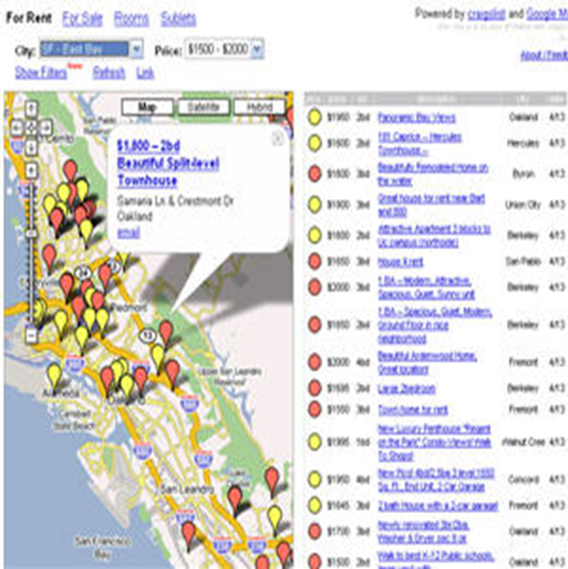
Lecture 7
VI. The Dilemma of Participation:
In a mashup map such as Google Maps, users of Android phones generate the data used to update the map and make it relevant for other users, but their contributions are merely aggregated algorithmically: users have little power over the processes underpinning Google Maps.
Processes of data capture and surveillance engendered in social media services mean that users passively participate in improving a platform but do not have the power to decide on the purpose of their role.

Slide 36


Lecture 7
VI. The Dilemma of Participation:
Furthermore, researchers who have focused on other factors, such as gender, language, or ethnicity, have questioned the accessibility and equality of collaborative media.
Anyone can write or correct a Wikipedia entry or become an editor, but this does not mean that the online encyclopedia is perfectly democratic.
On the contrary, it is gendered so as to favor male participation (Ford and Wajcman 2017).

Slide 37
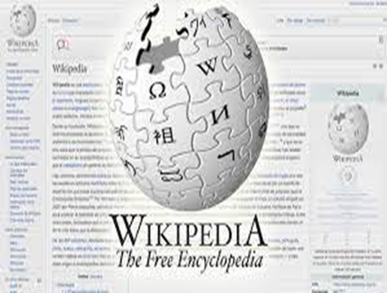

Lecture 7
VI. The Dilemma of Participation:
For example, the majority of its editors, who have veto power on new entries and can ban a participant or remove a piece of content, are white men.
Because of this imbalance, Wikipedia has proved relatively adverse to such topics as feminism (Reagle and Rhue 2011).

Slide 38

Lecture 7
VI. The Dilemma of Participation:
These examples call into question the idea that open technologies and collaborative media per se ensure the development of democratic forms of mediated collaboration.
Finally, participation entails a tension between the idea of increased individual autonomy on the one hand, and belonging to a collective process on the other (Kelty 2016).

Slide 39


Conclusion
Lecture 7
Digital technologies facilitate the active participation of individuals in media production.
Digital collaborations rely on the culture of participation.
Digital platforms offer possibilities for users to become content producers or contribute to assessing and improving the content provided by a service.
Wikipedia, social media and mashup services are examples of digital collaboration.
Legal systems have adapted copyright laws to facilitate the spread of self‐publishing platforms such as YouTube.
Digital media users contribute only marginally to decision‐making processes.
The work of users is aggregated for profit purposes by private companies, removing power and decisions from the users.

Slide 40



Thank You

