Slide 1

Overview of communication
Chapter 1
Business Champions
School
CMM201
Communication skills

Slide 2
Section 2
Communication process and elements
Communication models
Lecture
Introduction
Section 1
What Communication is?
History of communication
Principles of communication

Slide 3
Miscommunications!

Slide 4
Global stories
In the early 2000s, Phillip Morris had an epic PR failure within the larger public health discussion of smoking.
Allies accidentally bomb the wrong city in World War II

Slide 5
Top mistakes you might think of!
If I say the words, they should understand.
I can turn “on” being a great communicator.
I can improvise my communication, so no need to prepare.
I’m good at talking, so public speaking should be easy.
Some people aren’t born to be great communicators.

Slide 6
Why we study communication?
For personal life
Communication Influences Your Thinking about Yourself and Others
Communication Influences How You Learn
Communication helps you build relationships

Slide 7
Why we study communication?
For business life
Communication helps you impress others in the interview
Communication helps you get the job
Communication develops you level
Communication Represents You and Your Employer

Slide 8
Section 1

Slide 9
What is communication

Slide 10
What is communication
Communication Defined
Communication is the collaborative process of using messages to create and participate in social reality. The most important aspects of our lives—our individual identities, relationships, organizations, communities, cultures, and ideas—are accomplished through com­munication. Each of these aspects is a part of social reality, or the set of social judgments members of a group agree upon. Social realities emerge through social interaction. Therefore, communication enables us to actualize possi­bility and achieve change and growth, both for ourselves and for our communities.

Slide 11
What is communication
Communication is collaborative
The word communication comes from the Latin prefix co- (with, or together) and root word munia (sharing, giving, servicing). Therefore, communication requires the involvement of others. Just like many other things that you cannot do without the cooperation of others, such as sing a duet, be in a marriage, or count as a bas­ketball team, you cannot communicate by yourself. Communication is a collective activity in which people work jointly to create and share meaning. Although we sometimes say “I communicated” or “You communicated,” in reality, communica­tion is not something that an I or a You can do alone. Communication must be accomplished by a We.

Slide 12
What is communication
Communication is a process
Communication is a dynamic, ongoing process. Unlike a thing, which is static, a process unfolds over time. As individuals exchange and interpret messages, their communication develops a particular history. The messages used in the past influ­ence the nature and the interpretation of the messages used in the present and the future.

Slide 13
What is communication
Communication involves messages
Messages rely on a common system of symbols, signs, and gestures to carry information and to generate shared mean­ings between participants. Individuals give unique contribu­tions to communication interactions in the form of the verbal and/or nonverbal messages they use.

Slide 14
What is communication
Communication is participatory
In addition to playing a role in the creation of social reality, communication allows us to participate, or take part, in social reality. When people communicate, they rely on shared understandings to accomplish objectives. Communication allows us to entertain, persuade, inform, comfort, regulate, and support one another. The fact that communication involves both creation and participation demon­strates communication is fundamentally dual-natured. Communication makes and does. The ancient Greeks referred to the making and doing functions of communication as poiesis and praxis. Historically, most scholars and everyday people have paid more attention to communication praxis, or how communi­cation can be used as an instrument to accomplish things. Recently, however, the creative (poiesis) aspect of communication has received greater appreciation.

Slide 15
What is communication
Communication is creative
Creativity is the act of transforming new and imagined ideas into reality. It sometimes appears that the process of communication merely conveys information about the world “as it is,” or that the messages we use simply describe a reality that already exists. In actuality, communication shapes and creates new social realities for ourselves and for oth­ers. Anyone who has witnessed the power of a label such as bully, loser, or genius to alter perceptions and reinforce behaviors has seen firsthand the ways in which communication creates reality.

Slide 16
History of communication
Everything has a history.

Slide 17

Ancient communication
Ancient man was forced to be creative with communication and keep it consistent to maintain a common understanding. When speech originated around 500,000 BCE, communication was changed, but the system was not perfect and needed assistance.
While verbal communication was used in ancient times, symbols and images were still used to portray information. The earliest proven form of this is cave paintings. These images usually included scenes of hunting wild animals or stencils of human hands.

Slide 18
Ancient communication
People during ancient times can often be depicted as savage and unintelligent, but the opposite is true. The communication crafted during this period moved from simple drawings of people and animals to visual communication that could express entire ideas with one symbol. Their brain power fueled the original use of all types of communication that evolved into the channels we use today.
While communication saw a lot of advancements during ancient times, that was only the beginning.

Slide 19
15th and 16th century communication
Communication saw new developments between ancient times and the 15th century. But if we dove into all of that, our entire history would be reading or writing about communication’s history. While it is interesting, we’ve all got things to do. So I’ll keep it brief: For the most part, communication before the 15th century included verbal communication and limited written communication. People spoke to each other and wrote handwritten notes for an individual or a group.

Slide 20
15th and 16th century communication
This all changed after the printing press was invented. The Bi Sheng and Wang Chen dynasties in China invented the first printing press in the 1300s, removing the need to hand write all paper messages. About 150 years later, Johannes Gutenberg of Germany crafted a modernized version of the printing press that was able to mass produce printed materials.

Slide 21
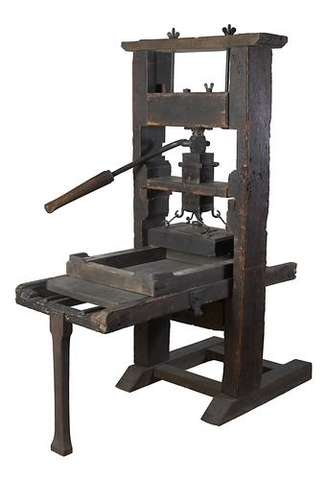
15th and 16th century communication
The invention of the printing press gave people the ability to conveniently produce large amounts of written material, but more importantly, it supported the flow of information among people. That is the true purpose of communication: sending and receiving messages. And eventually, that also became possible.

Slide 22
17th century communication
The continued popularity of written communication caused the Printing Revolution to spill into the 17th century. Scientists were still publishing their discoveries and authors continued to tell stories, but at the same time, a lot was happening in the world.
War, famine, and domination became regular concerns of 17th century people. Mentions of these events stirred up a lot of curiosity among people that were out of the geographical loop. In 1690, the newspaper was invented to accommodate those people. Cities all over the world got into the habit of publishing a newspaper with local and international news to keep people informed.

Slide 23
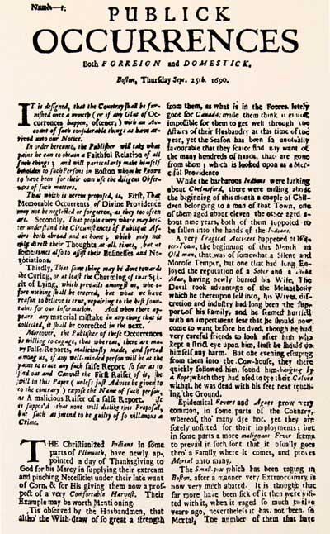
17th century communication
Before the 17th century, information was known and recorded, but options to release it were limited. With newspapers acting as a primary source of information, communication in the 17th century began to reflect the modern day communication model of sender and receiver.

Slide 24
18th century communication
In the 18th century, the public postal system was established. Letters were sent before this time period, but the system was flawed and inefficient. Delivery could take months, and even when the mail did reach its destination, it was left at a random public place.
Benjamin Franklin’s involvement in the U.S. postal system made the delivery of mail more productive. Routes were established to boost efficiency, post offices were created to keep drop off and pick up locations consistent, and costs were set in place to make the business profitable.

Slide 25
19th century communication
As the 19th century came around, the great minds working towards improving communication took a large step. Electricity was incorporated into communication channels, coining the term telecommunications.
Telecommunications is the sending and receiving of information using electronic means. This can include wire, radio, or any other electromagnetic device. The combination of electricity and communication sparked the beginning of a long wave of innovations.

Slide 26
20th century communication
Radio and television became a great source of information in the early 1900s. Not only did they provide musical entertainment, but they also delivered news, sports, and weather to listeners.
The telephone became mobile in 1981, but the word mobile is used loosely here. The first versions of the mobile telephone were not intended to be carried around on your person like they are now. They were heavy duty pieces of equipment that were usually only found in cars and trains.

Slide 27
20th century communication
The computer was invented towards the beginning of the 20th century, but the features for communication were not created until the mid to late 1900s. In 1965, online written communication expanded into email, completely changing the game. To make it even more enticing for users, these systems soon adapted the means to share entire files or photographs.

Slide 28
21th century communication
There is increased diversity in today’s workplace. Co-workers and employers have to cope with great diversity in age, cultural and gender. In the 21st century workplace, communication both verbal and non-verbal is at the foundation of everything we do. No matter how poor one might be in communication, it is easy to learn the skill of communication with the right training. To become a competent communicator, you have to embrace the diversity brought about by cultural differences. To become an overall communicator there are target certain areas that are crucial, and they include verbal and non-verbal cues and behaviours, behaviour patterns, confidence, conflict resolution, leadership, team building, the function and process of communication, criticism and constructive feedback and communicating more effectively with technology.

Slide 29
21th century communication
Communication in the 21st century has significantly changed as compared to communication in the 20th and 19th centuries. Keeping in touch with one another has been the trademark of the 21st century. In this century, there are various forms of communications that meant to connect people to each other. For example, text messaging is a phenomenon of the 21st century. Although texting does not involve face to face contact, healthy relationships have emerged just from texting. When used effectively, messaging can be a very crucial means of communicating and relaying information between people.

Slide 30
21th century communication
With the global technology advancement, there is a great shift in communication in the 21st century. There has been the development of social media platforms where people engage in charts and exchange ideas and life experiences. These social media platforms have changed the world into a global community. When used effectively, they are a good way of communicating and relaying information between people.

Slide 31
Principles of Communication

Slide 32
Principles of Communication
Clarity
The principle of clarity means the communicator should use such a language which is easy to understand. The message must be understood by the receiver. The words used should be simple and unambiguous. The language should not create any confusion or misunderstanding. Language is the medium of communication; hence it should be clear and understandable.

Slide 33
Principles of Communication
Clarity
Dear James,
I would like to talk to you about the new client’s project, which the engineering team had discussed yesterday. I might need the help of John from your team.
Regards,
Kevin
What kind of help?
Who is this client?
What is the project?
What did they discuss?

Slide 34
Principles of Communication
Consistency
The communicator must carefully take into account that the information to be communicated should be complete and adequate in all respect. Inadequate and incomplete message creates confusion and delays the action to be taken. The adequate information must be consistent with the organizational objectives, plans, policies and procedures. The message which is inconsistent may play havoc and distort the corporate interests.

Slide 35
Consistency
Principles of Communication
Hi Suzanne
I think we need to talk about the CSR campaign, I mean the one which we need to do as a quarterly exercise. I think it is a great way of enhancing our brand image. Basically, it would just be a visit to an orphanage but we can sort of do other things too. For instance, we could take the kids out for a short trip to a nearby park or zoo. Let us sit and talk tomorrow.
Regards
Jennifer

Slide 36
Consistency
Principles of Communication
As yourself these questions:
Are there any adjectives or “filler words” that you can delete? You can often eliminate words like “for instance,” “you see,” “definitely,” “kind of,” “literally,” “basically,” or “I mean.”?
Are there any unnecessary sentences?
Have you repeated the point several times, in different ways?

Slide 37
Correct
Principles of Communication
The understanding of your audience is directly proportional to the correctness of your ideas. Because correct communication of thoughts and ideas is also an error-free form of communication. There are many ways to achieve this correctness in your sentences.

Slide 38
Correct
Principles of Communication
One is through a technical understanding of your thoughts and ideas. Further, the names and titles that you have mentioned should be correct. Because of correctness the confidence level of yours as well as your audience increases. It has more impact.

Slide 39
Principles of Communication
Correct
As yourself these questions:
Do the technical terms you use fit your audience’s level of education or knowledge?
Have you checked your writing for grammatical errors? Remember, spell checkers won’t catch everything?
Are all names and titles spelled correctly?

Slide 40
Concrete
Principles of Communication
Concreteness refers to the idea of being clear and particular. It avoids the basic fuzziness and general in your ideas and thoughts. Concreteness also adds to your confidence level.
Concreteness is supported by figures and facts thus it gives your ideas a boost. As it involves clear words only, it helps in increasing your reputation. There are little to none chances that your message is misinterpreted.

Slide 41
Concrete
Principles of Communication
“Hilltop Resort is the jewel of the western hills. Take a break from your work. Escape from life’s chaos and stress. Relax and rejuvenate yourself at Hilltop. Go back fresh and energized!”
“Hilltop Resort is the best resort. Do come to us on your next holiday”

Slide 42
Complete
Principles of Communication
A message or an idea is complete when the audience has everything that they want to be informed. Also, this gives an authority to them to move to call of action.
The complete communication generally involves the call to action, which helps the readers understand what you want to imply to them. It also includes all the facts and figures in the sentences.
Due to complete communication, the reputation is enhanced for an organization. A complete communication also involves additional information whenever or wherever it is required. Thus, it leaves no room for doubt in the mind of the readers and audiences. It also helps in persuading the audience.

Slide 43
Complete
Principles of Communication
Hi all,
Let us meet tomorrow at 11am at Conference room 3 to discuss the product (Milk) launch event. We will have to decide the keynote speakers and complete the event invite draft tomorrow. Please be there on time.
Thanks
Hi all,
Let us meet tomorrow to discuss the product launch event. Please be there on time.
Thanks

Slide 44
Complete
Principles of Communication
As yourself these questions:
Does your message include a “call to action,” so that your audience clearly knows what you want them to do?
Have you included all relevant information – contact names, dates, times, locations, and so on?

Slide 45
Courteous
Principles of Communication
Courtesy is the respect that we show to others and in business communication also it means the same thing. You should show respect to your reader by having courteous communication. The individual while sending the message should be polite, sincere, enthusiastic, and reflective.
Being courteous means that you have taken into consideration the feeling receiver as well as your own. It also shows that you are positive and your focus is on the audience. Courteous messages are not at all biased.

Slide 46
Courteous
Principles of Communication
Hi Drew,
I really do not appreciate how your IT team ignores the requests of my team alone. My team is an important function in this organization too and we have our own IT requirement. Can you ensure that your team responds promptly to my team’s requests hereon?
Regards
Stanley

Slide 47
Courteous
Principles of Communication
Hi Drew,
I understand that the IT team is swamped with work and gets requests from every department in the organization. My team, however, is working on a high-priority project and I would greatly appreciate if you could ask your team members to respond to my team’s queries promptly and help us complete this project on time. Please do let me know if you need anything from me.
Regards
Stanley

Slide 48
Coherent
Principles of Communication
The messages that you send should be logical and that is why coherent communication is important. The message involves certain ideas and thoughts and thus when they are coherent than only they are able to convey the main idea of the message. All the points that you have mentioned should be relevant to the topic and connected.

Slide 49
Coherent
Principles of Communication
Dear Nam,
Thanks for submitting the industry report. Finn will give you some feedback on it. Finn also wanted to find out if you will be available for the client meeting tomorrow. We will be discussing the budget for the next phase of the project.
Regards
Shirley

Slide 50
Coherent
Principles of Communication
Dear Nam,
Thanks for submitting the industry report. Finn will give you some feedback on it. You will be receiving an email from him with detailed comments.
Regards
Shirley

Slide 51
Section 2

Slide 52
Communication process & Elements

Slide 53
Communication process
The sender decides the message to be transmitted
The sender encodes the message
The sender selects the a appropriate channel of communication
The receiver receives the message
The receiver decodes the message
The receiver provides feedback to the sender

Slide 54
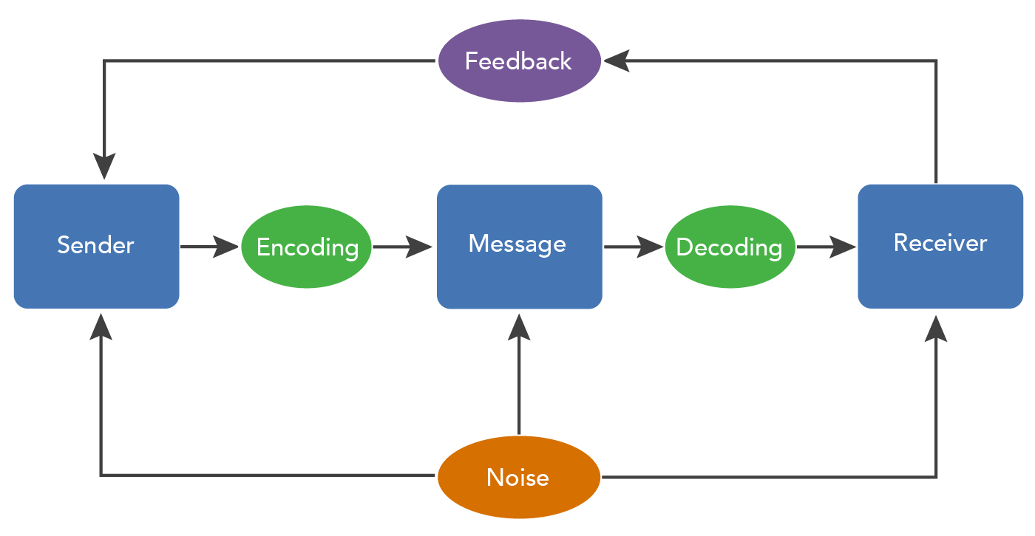
Communication process

Slide 55
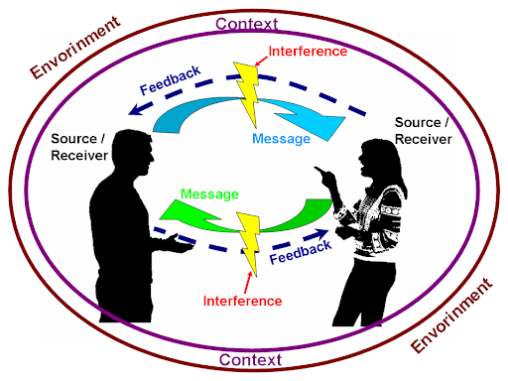
Eight Essential components of communication
Sender
Message
Channel
Receiver
Feedback
Environment
Context
Interference

Slide 56
Eight Essential components of communication
Sender
He/she is the one who wants to share information with someone else, usually for some intended purpose. The Sender is responsible for "encoding" the information into a message and then transmitting it.
Encoding is putting the targeted message into appropriate medium which may be verbal or non-verbal depending upon the situation, time, space and nature of the message to be sent. The sender puts the message into a series of symbols, pictures or words which will be communicated to the intended receiver. Encoding is an important step in the communication process as wrong and inappropriate encoding may defeat the true intent of the communication process.
Encoding

Slide 57
Eight Essential components of communication
Sender
As source encoder, our communication skill levels determine on communication fidelity in two ways:
1
They affect our ability to analyze our purpose and intentions, our ability to say some thing when we
communicate.
2
They affect our ability to encode messages which express what we intend.

Slide 58
Eight Essential components of communication
Sender
There are at least four kinds of factors within the source, which can increase the fidelity in communication. These are:
1
Communication skills.
2
Attitude.
3
Knowledge level.
4
Socio-cultural system.

Slide 59
Eight Essential components of communication
Message
The Message is the encoded information the Sender wants to share with the Receiver.
There are three factors that should be taken into account considering the message:
Message code
Content
Treatment
which has to do with the way in which
symbols are structured?
the way in which the message is presented, that is frequency and emphasis.
the selection of material to express the
purpose.

Slide 60
Eight Essential components of communication
Channel
The channel is the way in which a message or messages travel between sender and receiver.
We can distinguish between two main forms of communication.
Verbal communication
Oral
Visual
Written
Electronic
talking to oneself
maps
reports
fax
discussion
graphic
letters
E-mail
advertisement
telephone calls
papers
social media
signals

Slide 61
Eight Essential components of communication
Channel
Non-Verbal communication
Such as body movement facial expression and voice etc.
Forms of communication
Intrapersonal Communication
Interpersonal Communication
It is a communication transaction that takes place within the individual, this is the silent talking all of us do to ourselves such as thinking, remembering, dreaming and deciding. Intrapersonal communication is made possible because man become object to himself. That is he both produces and receives to same message. This type of communication fills more time in our experience because in every communication are always subject to our own private interpretation.
It is the process of face-to-face interaction between sender and receiver such as group meetings, interviews, conversations among individuals. It has the advantage of a two-way communication with immediate feedback.

Slide 62
Eight Essential components of communication
Channel
Channel dimension
These dimensions permit the investigator to evaluate the effectiveness of different communication channels these dimensions include:
Channel Credibility
Channel feedback
Channel Availability
Channel Permanency
Channel Multiplicative Power
Channel Involvement

Slide 63
Eight Essential components of communication
Channel
dimension
Channel Credibility
It is the expertness and trustworthiness of a channel as perceived by the receivers. Channel credibility is directly linked to communicator and audience characteristics however, print media are perceived by member of upper socio– economic grouping as being more credible, while television is perceived as more credible by lower socio-economic groupings.
Channel feedback
It is known as the opportunity a channel provides for the receiver to respond immediately and to affect the source of the message in communication process. Face-to-face communication tends to facilitate

Slide 64
Eight Essential components of communication
Channel
dimension
Channel Involvement
It is the effort required by all senses in order to receive information from a communication channel, face-to-face communication offers the greatest possibility for involvement where print media offer the least possibility for involvement.
Channel Availability
The frequency and extent to which a channel may be used to reach a given audience. In some geographic areas, some channels may not be available such as television in mountained areas or print media in highly illiterate areas.

Slide 65
Eight Essential components of communication
Channel
dimension
Channel Permanency
The ability of a communication channel over time to carry the message. Print media have this dimension but contrast radio does not.
Channel Multiplicative Power
The channel ability to cover areas with speed and timeliness. The mass media can multiply a message and make it available to large numbers of people while face-to-face communication is low in this dimension.

Slide 66
Eight Essential components of communication
Receiver
The Receiver is the intended target of the message sent by the Sender. The Receiver is responsible for "decoding" the message and interpreting it.
Decoding refers to interpreting or converting the sent message into intelligible language. It simply means comprehending the message. The receiver after receiving the message interprets it and tries to understand it in the best possible manner.
Decoding

Slide 67
Eight Essential components of communication
Feedback
Feedback is composed of messages the receiver sends back to the source. Verbal or nonverbal, all these feedback signals allow the source to see how well, how accurately (or how poorly and inaccurately) the message was received. Feedback also provides an opportunity for the receiver or audience to ask for clarification, to agree or disagree, or to indicate that the source could make the message more interesting.
Types
Negative Feedback or corrective comments about past behavior
Positive Feedback or affirming comments about future behavior

Slide 68
Eight Essential components of communication
Environment
The environment is the atmosphere, physical and psychological, where you send and receive messages
Context
The context of the communication interaction involves the setting, scene, and expectations of the individuals involved.

Slide 69
Eight Essential components of communication
Interference
Interference is anything that blocks or changes the source’s intended meaning of the message.
Channel Noise: This type of noise includes any disturbance, which interferes with the physical transmission of the message. In mass communication, channel noise includes static on the radio, ink in the newspaper, a rolling screen in television, or type too small to read in a magazine. In interpersonal communication, someone speaking in a room over another conversation, a door shutting etc.
Types

Slide 70
Eight Essential components of communication
Interference
Interference is anything that blocks or changes the source’s intended meaning of the message.
Semantic Noise: This type of noise results in the wrong interpretation of messages, even though the message is received exactly as it was sent such as words too difficult, subject too difficult for receiver to understand also differences of selected meaning of words between the message sender and a receiver. for example receiver thinking that the words prints to something different than that is intended by the sender. One word may have many different interpretations.
Types

Slide 71
Communication models

Slide 72
Communication models
Transmission Model
Interaction Model
Transaction Model

Slide 73
Effectiveness of Communication models
Communication models are authentic outcomes of systematic study of various aspects of communication. A model of communication gives a wholesome understanding of a system or structure by which people can understand similar systems or structure.
Consider the following important points related to the importance of communication models −
Communication models help identify and understand the components and relationship of the communication process being studied.
They are used for research and investigation in the field of communication.
Models are pictorial representation of communication process.

Slide 74
Effectiveness of Communication models
Consider the following important points related to the importance of communication models −
Models represent new ideas and thought on various aspects of communication which helps us to plan for effective communication system. They act as stimulant for the researchers and students of communication.
As communicating is a rigid process to understand, communication model can be an essential source to understand such rigidity.
Models help explain a phenomena by providing information in a simplified way which otherwise be complicated or ambiguous.
Models predict for more effective communication in future. They also predict the success or failure of a particular communication process.

Slide 75
Thank you

