Slide 1


Decision Making
Prepared by Dr. Ahmad AL-Naimi
Orientation session

Slide 2


Decision Making
Decision making is the process of making choices by identifying a decision, gathering information, and assessing alternative resolutions
www.midocean.ae

Slide 3


Chapter
Management decisions are often complex because they involve
01
1. Risk and uncertainty
2. Multiple objectives
3. A complex structure
4. Multiple stakeholders
www.midocean.ae

Slide 4
Management decisions are often complex because they involve
Chapter
01
1. Risk & Uncertainty
Risk Versus Uncertainty. Risk, as it is generally understood by health and safety risk analysts, measures the probability and severity of loss or injury. Uncertainty , on the other hand, refers to a lack of definite knowledge, a lack of sureness; doubt is its closest synonym.
2. Multi-objective decision making (MODM),
also known as multi-criteria decision making, is a systematic procedure targeting at supporting decision makers faced with conflicting evaluations. The procedure aims at highlighting these conflicts and deriving a way to come to a compromise in a more transparent manner.
www.midocean.ae

Slide 5
Management decisions are often complex because they involve
Chapter
01
3. A complex structure
Decision making are usually made at three levels in an organization strategic, tactical and operational levels. Hence, we have three types of decisions based on these three levels. Strategic decisions are executive-level decisions.
4. Multiple stakeholders
Stakeholders are anyone who is affected by, interested in, or has influence over your decision. They can be internal or external to your organization, such as customers, employees, managers, partners, suppliers, regulators, or community members
www.midocean.ae

Slide 6
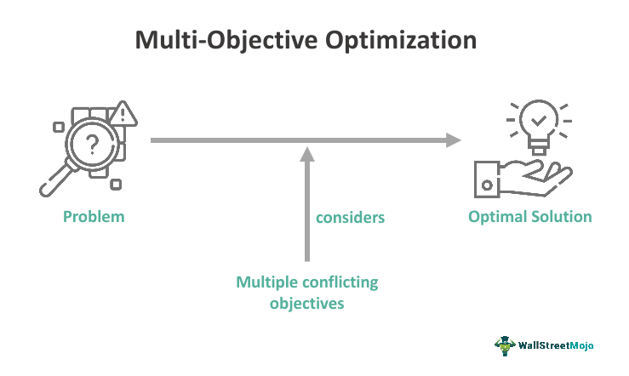
Chapter
Examples of decisions involving multiple objectives
02
Choosing a holiday
  liveliest nightlife
  least crowded beaches
  most sunshine
  most modern hotels
  lowest cost
Choosing a company to supply goods
  best after-sales service
  fastest delivery time
  lowest prices
  best reputation for reliability
www.midocean.ae

Slide 7
Examples of decisions involving multiple objectives
Chapter
02
What is decision-making in multiple objectives?
Choosing a strategy in the face of multiple objectives often requires the navigation of trade-offs among the objectives. In other words, different solutions may perform better than others with respect to particular objectives.
www.midocean.ae

Slide 8
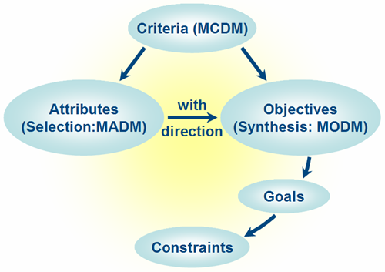
Chapter
03
Objectives and Attributes
The foundation for any decision is a clear statement of objectives. Attributes clarify the meaning of each objective and are required to measure the consequences of different alternatives. Unfortunately, insufficient thought typically is given to the choice of attributes.
www.midocean.ae

Slide 9
Chapter
Objectives and Attributes
03
What are attributes in decision-making?
All decision-making attributes can be divided into two types. One is qualitative attributes, and the other is quantitative attributes. Quantitative attributes should be preferred when a set of attributes is built since their values can be easily obtained.
What is an objective in decision-making?
An objective decision is one which is not influenced by one's personal feelings, perspectives, interests and biases. Instead, it considers only verifiable facts and all stakeholders' interests (perhaps equally). It may even respect stakeholders who have yet to be born, animals and the Earth as a whole.
www.midocean.ae

Slide 10
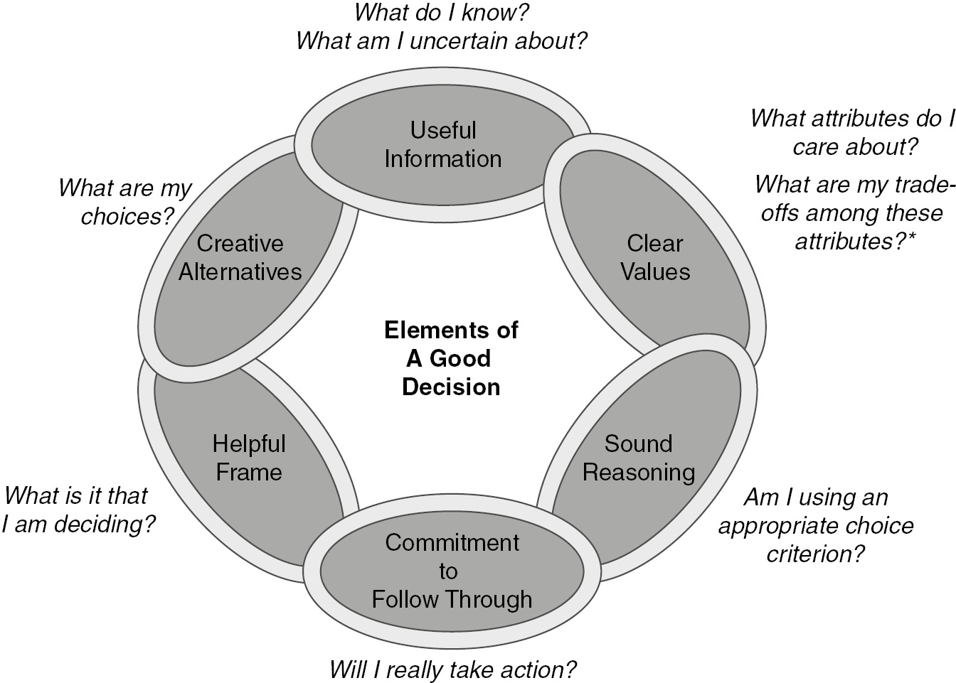
Chapter
Decisions involving multiple objectives: Alternatives to SMART
04
The Multi-Objective Decision Making method is a systematic decision making process. It allows a decision maker to define a decision, define their own value system, frame the context and evaluate the decision in a systematic manner.
www.midocean.ae

Slide 11
Decisions involving multiple objectives: Alternatives to SMART
Chapter
04
What is the SMART method of multi-attribute rating technique?
The SMART technique is based on a linear additive model. This means that an overall value of a given alternative is calculated as the total sum of the performance score (value) of each criterion (attribute) multiplied with the weight of that criterion.
www.midocean.ae

Slide 12
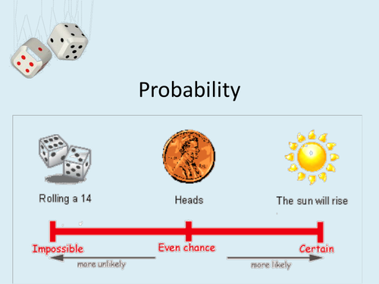
Chapter
05
Introduction to Probability
Probability means possibility. It is a branch of mathematics that deals with the occurrence of a random event. The value is expressed from zero to one. Probability has been introduced in Math to predict how likely events are to happen.
www.midocean.ae

Slide 13
Chapter
Introduction to Probability
05
How can probability help us in making wise decisions?
You can calculate the probability that an event will happen by dividing the number of ways that the event can happen by the number of total possibilities. Probability can help you to make better decisions, such as deciding whether or not to play a game where the outcome may not be immediately obvious.
www.midocean.ae

Slide 14
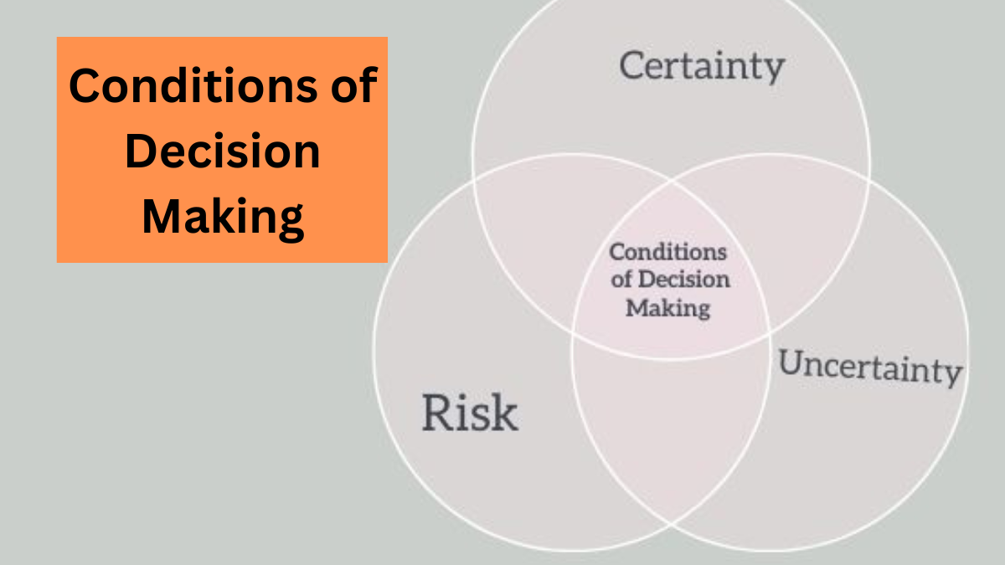
Chapter
06
Decision making under uncertainty
In the prototypical formulation of decision making under uncertainty, an individual decision maker (DM) must choose one among a set of actions, whose consequences depend on some unknown state of the world.
www.midocean.ae

Slide 15
Chapter
Decision making under uncertainty
06
How can you make decision when there are uncertainty?
5 tips for making decisions in uncertain situations
  Have a vision of what you wish to achieve, rather than comparing alternatives.
  Form a group within which dissenting voices can make themselves heard.
  Act rapidly.
  Do not wait for more information before taking action.
  Create options and boost reversibility.
www.midocean.ae

Slide 16
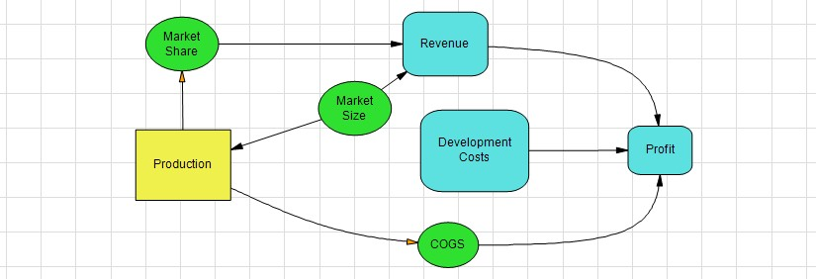
Chapter
07
Decision Trees and Influence Diagrams
An influence diagram is a general representation of key identified risks, alternatives, and outcomes in a way that represents their interconnectivities and relative ordering
www.midocean.ae

Slide 17
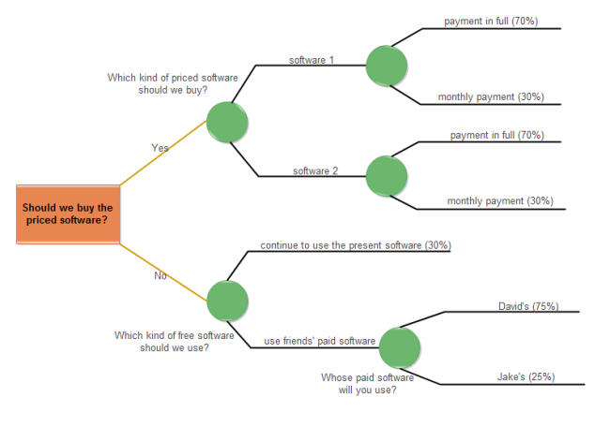
Chapter
07
Decision Trees and Influence Diagrams
A decision tree diagram is a type of flowchart that simplifies the decision-making process by breaking down the different paths of action available. Decision trees also showcase the potential outcomes involved with each path of action.
www.midocean.ae

Slide 18
Decision Trees and Influence Diagrams
Chapter
07
How to do influence diagrams?
Influence diagrams can be developed from a systems map by adding arrows and can be used as the starting point for a multiple cause diagram.
How to do decision trees?
Follow these five steps to create a decision tree diagram to analyze uncertain outcomes and reach the most logical solution.
Start with your idea. Begin your diagram with one main idea or decision.
Add chance and decision nodes.
Expand until you reach end points.
Calculate tree values.
Evaluate outcomes.
www.midocean.ae

Slide 19
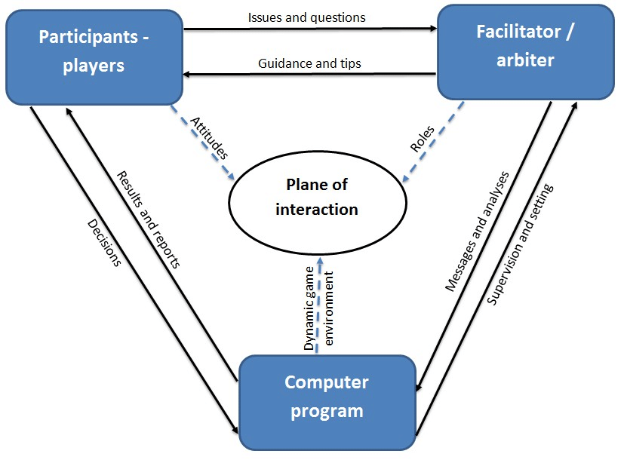
Chapter
08
Applying Simulation to Decision Problems
Simulation techniques consist in sampling the input and characterizing the uncertainty of the corresponding output. This is notably the case of the crude Monte Carlo method that is well suited to characterize events whose associated probabilities are not too low with respect to the simulation budget.
www.midocean.ae

Slide 20
Applying Simulation to Decision Problems
Chapter
08
What are the applications of simulation method in solving management decision problems?
Simulation provides a safe environment for experimentation and allows students to try out new ideas without jeopardizing real-world operations. Additionally, simulation can be used to compare different approaches to operations management and to find the most efficient and effective solutions.
www.midocean.ae

Slide 21


Thank You

