Slide 1


Introduction to
Research Methods
Prepared by Associate Professor/ Ahmed Rageh Ismail
MGM333
Introduction to research methods
Lecture 0

Slide 2

Importance and Purpose of Research
Research is formalized curiosity.
Purpose of the course
- Provide a reference guide for the research process.
- Emphasize the essential nature of research skills for business students.
Significance
- Facilitates the identification and solution of workplace problems.

Slide 3
Goals and Approach of the Course
Aims
- Provide insight into the research process.
- Present choices and opportunities in research endeavors.
- Encourage the development of individual research approaches.
Philosophy
- Research as an adventure and a joy.
- Promote infinite curiosity and desire to discover the unknown.

Slide 4
Approach
- Draw on established research practices.
- Encourage a critical approach and experimentation within the research context.
Challenges
- Emphasize the ongoing exploration of investigative strategies.

Slide 5

The Research Hierarchy
Figure 0.1 describes relationships between various levels of the research hierarchy.

Slide 6
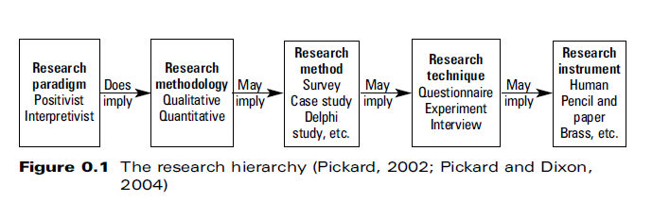

Slide 7
Paradigms
Paradigms are 'constellation of beliefs, values, techniques' shared by a scientific community (Kuhn, 1970, 146).
Provide solutions or exemplars for solving scientific problems (Seale, 1998, 12).
Paradigms guide the subject, activity, and nature of research outputs (Corbetta, 2003, 11).

Slide 8
Paradigms and Methodologies
Paradigm implies a methodology;
worldview often dictates research nature.
Ideally, the research question should dictate the nature of the 'asking'.

Slide 9
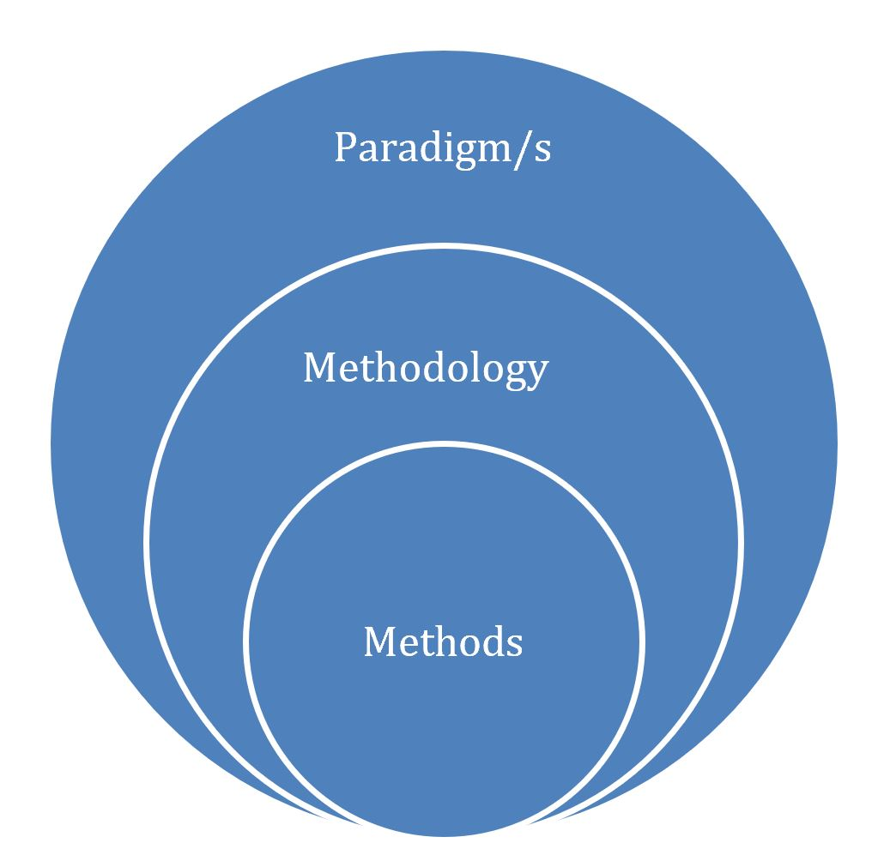

Slide 10
Paradigm: Positivism vs. Interpretivism
Positivism: This paradigm is based on the idea that the social world can be studied with the same scientific methods used in the natural sciences.
Methodology: Uses quantitative methods such as surveys, experiments, and statistical analysis to test hypotheses.
Worldview: Positivists believe in objective reality that can be measured and quantified.
Research Nature: Research under this paradigm seeks to identify general laws and patterns in social behavior through empirical, objective observation and analysis.

Slide 11
Interpretivism: This paradigm emphasizes understanding the subjective meaning of social phenomena from the perspective of those experiencing it.
Methodology: Employs qualitative methods such as interviews, ethnography, and participant observation to gain in-depth insights.
Worldview: Interpretivists believe that reality is socially constructed and can only be understood through the subjective experiences of individuals.
Research Nature: Research focuses on understanding the meaning and context of social phenomena, often prioritizing depth over generalizability.

Slide 12
Research Question: How do social media platforms influence political engagement among young adults?
Nature of the 'Asking’
This question could be approached using a mixed-methods strategy, as it involves both the measurement of engagement levels and the exploration of user experiences.
Methodology
Quantitative: Use surveys to measure the frequency and types of political engagement (e.g., signing petitions, attending protests) among young adults who use social media.
Qualitative: Conduct in-depth interviews to understand how and why young adults engage with political content on social media, and how it affects their political views and actions.

Slide 13
Research Methodology Overview
Theoretical Perspective:
- Overall nature of the research activity.
- Applied to various aspects of the research process.
Fundamental Methodologies:
- Qualitative
- Quantitative
Methodology:
- Perspective or angle on the research question.
- Does not necessarily imply a particular research method.

Slide 14
Qualitative vs Quantitative Angles
Quantitative Angle
- Focuses on 'how many?', 'how often?', 'when?'
Qualitative Angle
- Focuses on 'why?', 'how?', 'how do they feel about it?'

Slide 15
Research Method
Definition
- Bounded system for empirical investigation, often called a 'strategy'.
- Research method is defined by the driving purpose, not techniques.
Examples of Research Methods
- Case study
- Survey
- Action research
- And more

Slide 16
Research Techniques
Definition
- Individual data collection techniques within a method.
Examples of Techniques
- Interviews
- Questionnaires
- Focus groups
Clarification
- Techniques are not confined to specific methods.
- Research design should remain flexible for discovery and innovation.

Slide 17
Research Instruments
Definition
- Device designed or trained to collect necessary data.
Examples of Instruments
- 'Pencil and paper' instruments: physical or online questionnaires
- 'Human' instruments: researchers collecting data in natural settings
Usage
- Instruments vary based on the type of research and setting.

Slide 18
Overview of Contents - Part 1
Part 1: Starting the Research Process
- Focus on generic issues necessary for most research investigations.
- Brief discussion of three major research paradigms in information science.
Purpose
- Provide an overview of current thinking within the field.
- Discuss qualitative and quantitative methodologies and their rigour.

Slide 19
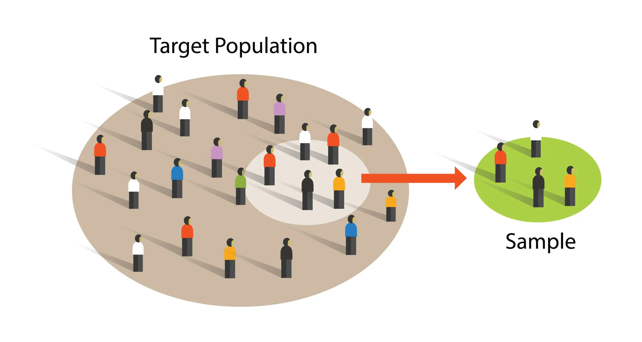
Key Topics in Part 1
Key Topics Covered
- Literature reviewing
- Defining the research
- Sampling
- Preparing a research proposal

Slide 20

Overview of Contents - Part 2
Part 2: Research Methods
- Focus on various research methods and potential approaches.
- Describes a research method and its suitable questions.
- Instructions on designing each method.

Slide 21

Overview of Contents - Part 3
Data Collection Techniques
- Focus on techniques for social or 'person-centred' research.
- Includes techniques for examining and developing systems.
- Discusses 'virtual' research techniques as adaptations of conventional ones.

Slide 22
Part 4: Data Analysis and Research Presentation
Introduction to Data Analysis:
Focus on both quantitative and qualitative analysis techniques.
Brief overview of statistical analysis techniques.
Application of appropriate procedures to gathered data.

Slide 23
Qualitative Analysis
Discussion on narrative analysis and other qualitative methods.
Importance of understanding the context and nuances in qualitative data.

Slide 24
Quantitative analysis
Involves the systematic examination of measurable data using statistical, mathematical, or computational techniques.
It is often used to identify patterns, make predictions, and test hypotheses through numerical and statistical methods.

Slide 25


Slide 26
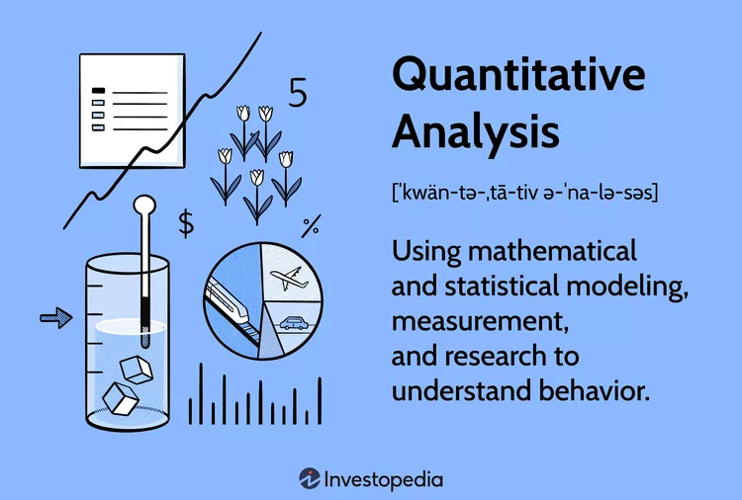

Slide 27
Challenges in Research Presentation
Highlight the difficulty many researchers face in effectively presenting their research.
Emphasize the importance of clear and impactful communication of research findings.
Strategies for Effective Presentation
Techniques for structuring and organizing research outputs.
Tips on engaging the audience and conveying key messages succinctly.

Slide 28

Final Thoughts
Importance of passion and continual learning in becoming an expert.
Encouragement to embrace mistakes as learning opportunities.
Invitation to share in the passion and dedication to research.

Slide 29



Thank You

