Slide 1


Principles of
Accounting
Prepared by
Dr. Hoda Metwally
MGM 227
Lecture 9

Slide 2

Capital Structure and Dividend Policy Decisions

Slide 3
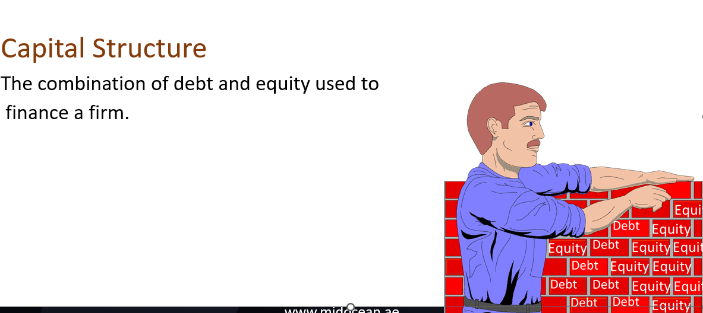
Capital = Equity
= Stockholder’s equity
=Owner’s equity

Slide 4
Target capital structure
The optimal mix of debt, preferred stock, and common equity with which the firm plans to finance its investments May change over time
Trade-off between risk and return to achieve goal of maximizing the price of the stock

Slide 5
Corporate Equity Capital
Corporate equity capital is the ﬁnancial capital supplied by the owners of a corporation.
Common stock represents ownership shares in a corporation. Ownership gives common stockholders certain rights and privileges that bondholders do not have. Common shareholders can vote to select the corporation’s board of directors. The board of directors, in turn, exercises general control over the ﬁrm. In addition to voting for the board, common shareholders may vote on major issues facing the ﬁrm, such as mergers.

Slide 6
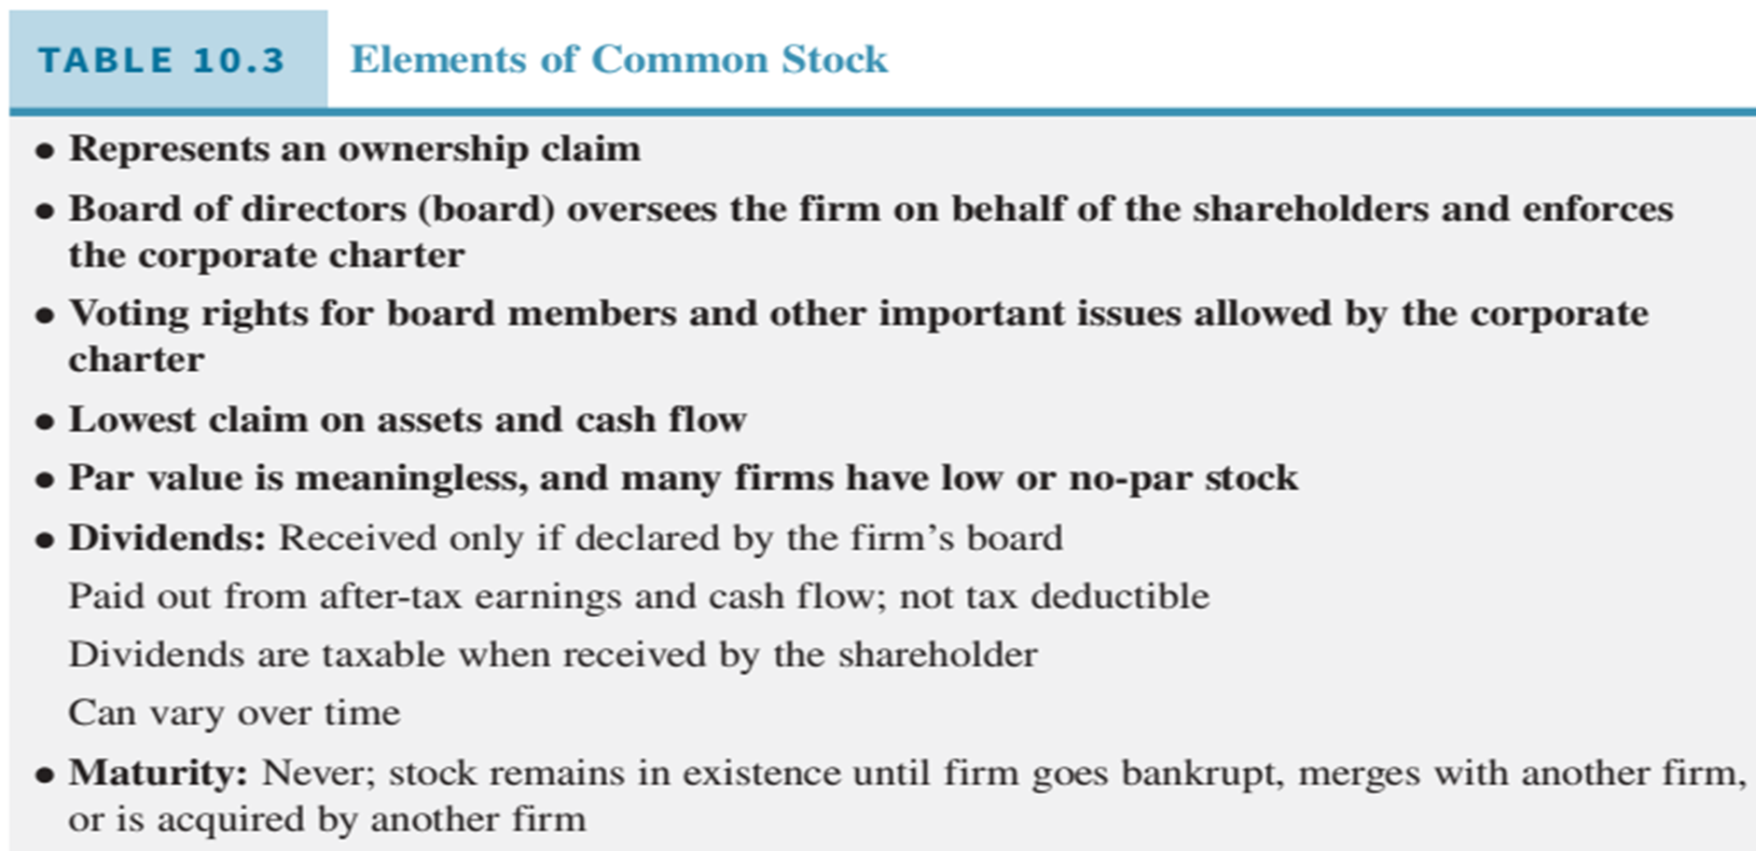

Slide 7
The common shareholders have a claim on all business proﬁts that remain after the holders of all other classes of debt and equity securities have received their returns. But the ﬁrm may wish to retain some of those proﬁts to reinvest in the ﬁrm to ﬁnance modernization, expansion, and growth. When so declared by the board of directors, owners of a ﬁrm’s common stock receive dividend payments. The dividend is typically a cash payment that allows shareholders to receive some income from their investment. To many investors, an attractive characteristic of common stock dividends is their potential to increase over time. As a ﬁrm achieves success, its proﬁts should grow and the shareholders can expect to see the dollar amount of their dividends rise. Of course, success and growth are not guaranteed. A ﬁrm may experience poor earnings or losses, in which case shareholders bear the risk of smaller dividends or the elimination of dividend payments until the ﬁrm’s ﬁnancial situation improves.

Slide 8
Preferred stock is an equity security that has a preference, or senior claim, to the ﬁrm’s earnings and assets over common stock. Preferred shareholders must receive their ﬁxed dividend before common shareholders can receive a dividend. In liquidation, the claims of the preferred shareholders are to be satisﬁed before common shareholders receive any proceeds. In contrast with common stock, preferred stock generally carries a stated ﬁxed dividend. The dividend is speciﬁed as a percentage of par value or as a ﬁxed number of dollars per year.

Slide 9
Factors Influence Capital Structure Decisions
1. Firm’s business risk
2. Firm’s tax position
3. Financial flexibility
4. Managerial attitude

Slide 10
Business Risk:
The risk associated with projections of a firm’s future return
on assets (ROA) or return on equity (ROE) if the firm uses no debt.
Depends on several factors
  1. Sales variability - volume and price
  2. Input price variability
  3. Ability to adjust output prices
  4. The extent to which costs are fixed
  (operating leverage)

Slide 11
Financial Risk:
The portion of stockholder’s risk, over and above basic
business risk, resulting from the manner in which the firm
is financed.
Financial risk results from using financial leverage.
The extent to which fixed-income securities (debt and
preferred stock) are used in a firm’s capital structure.

Slide 12
Determining the Optimal Capital Structure
Maximize the price of the firm’s stock
Changes in use of debt will cause changes in earnings per
share, and thus, in the stock price
Cost of debt varies with capital structure
Financial leverage increases risk

Slide 13
The Effect of Capital Structure on Stock Prices and the Cost of Capital
Earnings per share (EPS) indifference analysis
  at lower sales, EPS is higher with stock financing
  at higher sales, EPS favors debt financing
Maximizing EPS is not the same as maximizing stock price
Stock risk (Beta) increases with debt

Slide 14
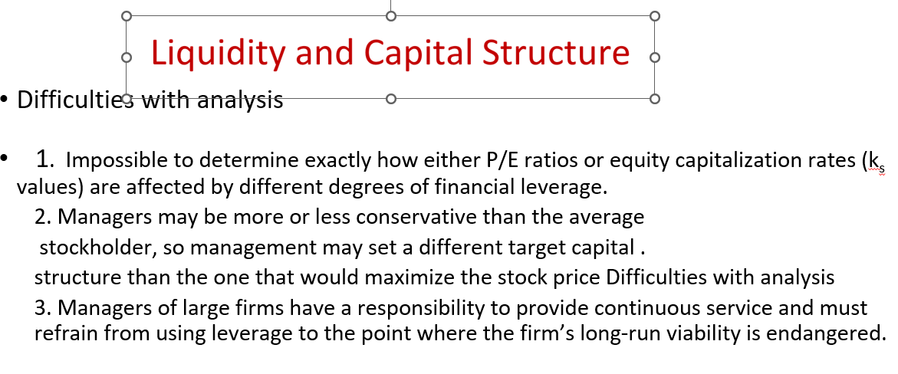

Slide 15
Capital Structure Theory
1. Tax benefit/bankruptcy cost trade-off theory
2. Signaling theory

Slide 16
Trade-Off Theory
1. Interest is tax-deductible expense, therefore less expensive than common or preferred stock
2. Interest rates rise as debt/assets ratio increases; tax rates fall at high debt levels; probability of bankruptcy increases as debt/assets ratio increases
3. Debt level below which the effects in point (2) are immaterial, but beyond this point the higher interest rates reduce the tax benefits and even further the bankruptcy costs lower the value of the stock.
4. Theory and empirical evidence support these ideas, but the points cannot be identified precisely
5. Many large, successful firms use much less debt than the theory suggests leading to the development of signaling theory

Slide 17
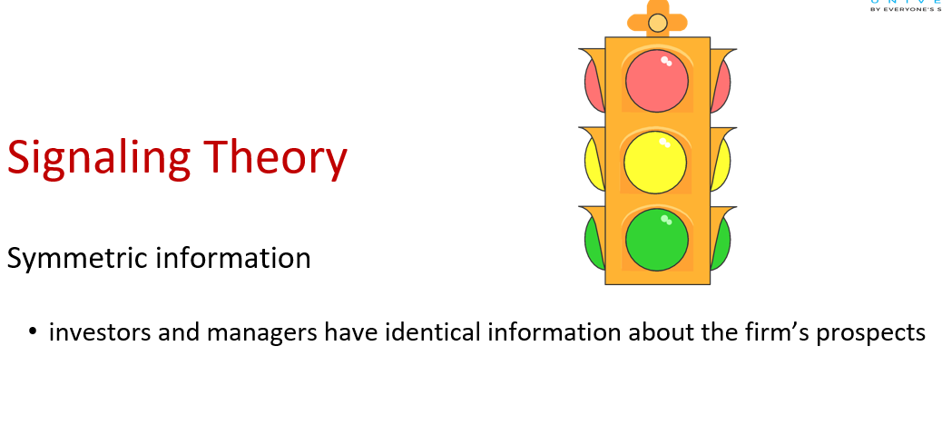

Slide 18
Signaling theory:
Asymmetric information
managers have better information about their firm’s prospects than
do outside investors
Signal
  an action taken by a firm’s management that provides clues to investors about how management views the firm’s prospects

Slide 19
Reserve borrowing capacity
  The ability to borrow money at a reasonable cost when good investment opportunities arise.
  Firms often use less debt than “optimal” to ensure that they can obtain debt capital later if it is needed

Slide 20
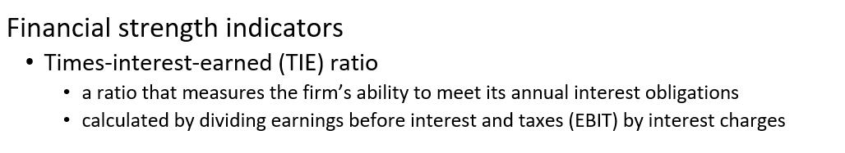

Slide 21
Variations in Capital Structures among Firms
Wide variations in use of financial leverage among industries and firms within an industry
  TIE ratio measures how safe the debt is
    percentage of debt
    interest rate on debt
    company’s profitability

Slide 22
Dividends
payments made to stockholders from the firm’s earnings, whether those earnings were generated in the current period or in previous periods.
Dividends affect capital structure
  retaining earnings increases common equity relative to debt
  financing with retained earnings is cheaper than issuing new common equity

Slide 23
Dividend Policy and Stock Value
Dividend irrelevance theory
  theory that a firm’s dividend policy has no effect on either its value or its cost of capital
  investors value dividends and capital gains equally

Slide 24
Optimal dividend policy
  the dividend policy that strikes a balance between current dividends and future growth and maximizes the firm’s stock price
Dividend relevance theory
  the value of a firm is affected by its dividend policy
  the optimal dividend policy is the one that maximizes the firm’s value

Slide 25
Information content (Signaling)
  Signaling hypothesis says that investors regard dividend changes as signals of management’s earnings forecasts

Slide 26
Types of dividend payments
  Residual dividend policy
    a policy in which the dividend paid is set equal to the earnings minus the amount of retained earnings necessary to finance the firm’s optimal capital budget.
  Stable, predictable dividend policy
    payment of a specific dollar dividend each year, or
    periodically increase the dividend at a constant rate
the annual dividend is fairly predictable by investors .

Slide 27
  Constant payout ratio
    percentage of earnings, such as 50%
    must watch out for reductions not to signal permanent decline in earnings.

Slide 28
Dividends and Stock Repurchases
Dividends are not a legal obligation of the ﬁrm and may be skipped, decreased, increased, stopped, and started according to the collective wisdom of the corporation’s board of directors. When they are paid, they are typically paid on a quarterly basis, four times over the course of a year.
Many ﬁrms oﬀer shareholders the choice to receive a check for the amount of their dividends or to reinvest the dividends in the ﬁrm’s stock

Slide 29
. Dividend reinvestment plans (DRIPs) allow shareholders to purchase additional shares automatically with all or part of the investor’s dividends. Fractional shares can be purchased and DRIP purchases have no or low commissions. Suppose an investor owns suﬃcient shares to receive $10 in dividends on a stock from its quarterly declared dividend. If the stock price is $25, the DRIP program allows the investor to purchase $10/$25, or a 0.40 share of the ﬁrm’s stock. If the stock price is $8, the investor’s reinvested dividends will purchase $10/$8 or 1.25 shares of the stock. Whether the dividends are received as cash or reinvested, the investor must pay taxes on them.

Slide 30
Most ﬁrms that issue dividends try to maintain a consistent dividend payout ratio, which is dividends per share divided by earnings per share (EPS). The dividend payout ratio for example, Microsoft company’s dividend is $1.44 per share divided by earnings per share, $1.48:
Dividend payout ratio = $1.44/$1.48 = 0.97 or 97 percent
This is quite high. If this were the case, Microsoft likely expects its earnings to rise in the coming year. Rare is the ﬁrm that wants to continually return all of its earnings to shareholders as dividends; typically, funds are retained to ﬁnance growth and expansion.

Slide 31
A key component of the “how much?” decision is what level of dividends is sustainable over time? A ﬁrm does not want to announce it will begin paying dividends and then have to reduce or eliminate the dividend at a later time due to the need to conserve cash. Dividends are thought to send a signal to investors about management’s view of the future cash-generating ability of the ﬁrm. Managers and the board of directors have private information about the strategies, competitive responses, and opportunities facing the ﬁrm that are not known to the investing public. Thus, if the ﬁrm increases dividends, that is a positive signal or indicator to the ﬁnancial markets that management believes the future looks stable, or improving, for the ﬁrm. A reduction in dividends is taken to be a pessimistic indicator of the ﬁrm’s future, so ﬁrms set dividend levels so future reductions are unlikely given their current perspective on the ﬁrm’s future.

Slide 32
Factors Influencing Dividend Policy
1. Constraints on dividend payments
  debt contract restrictions
  cannot exceed “retained earnings”
  cash availability
  IRS restrictions on improperly accumulated retained earnings

Slide 33
2. Investment opportunities
  large capital budgeting projects affect dividend-payout ratios
3. Alternative sources of capital
  flotation costs
  increasing capital costs
  ownership dilution

Slide 34
Capital Structures and Dividend Policies Around the World
Companies in Italy and Japan use more debt than companies in the United States or Canada, but companies in the United Kingdom use the least amount.
Different accounting practices make comparisons difficult
Gap has narrowed in recent years
Dividend-payout ratios vary greatly also

Slide 35
Logical analysis would indicate that:
1. Tax codes generally favor use of debt in developed countries
2. In countries where capital gains are not taxed, investors should show a preference for stocks compared with countries that have capital gains taxes
3. Investor preferences should lead to relatively low equity capital costs in those countries that do not tax capital gains
Reality does not match these conclusions

Slide 36
What about risk, especially bankruptcy costs?
Foreign banks are closely linked to corporations that borrow from them, and have substantial influence over the management of the debtor firms
Equity monitoring costs are comparatively low in the United States
These indicate that U.S. firms should have more equity and less debt than firms in countries such as Japan and Germany

Slide 37
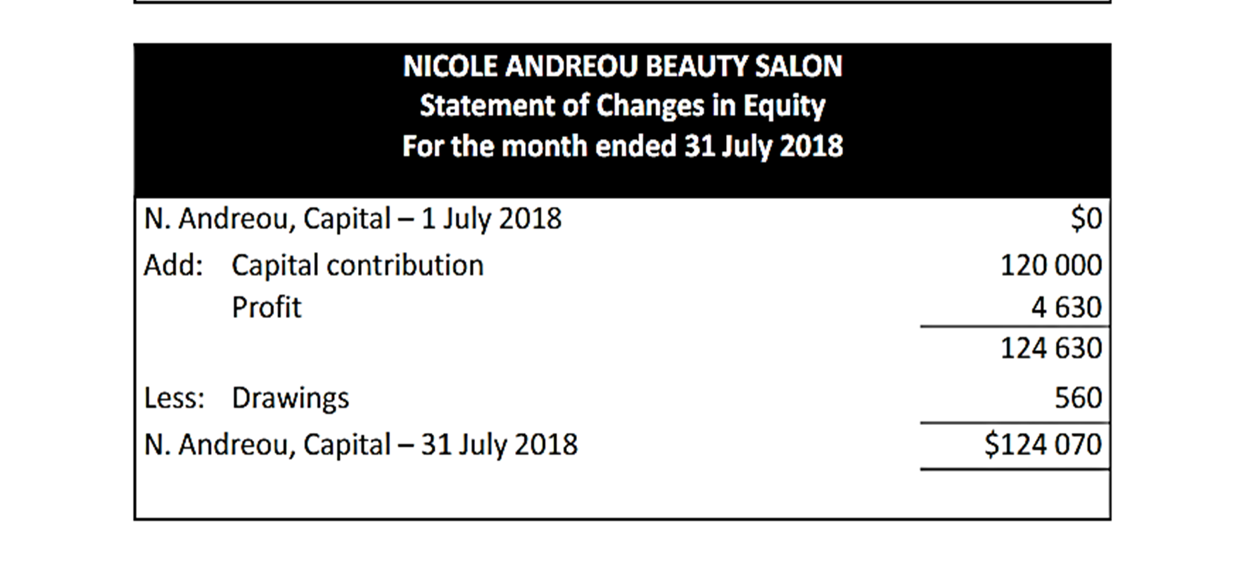

Slide 38
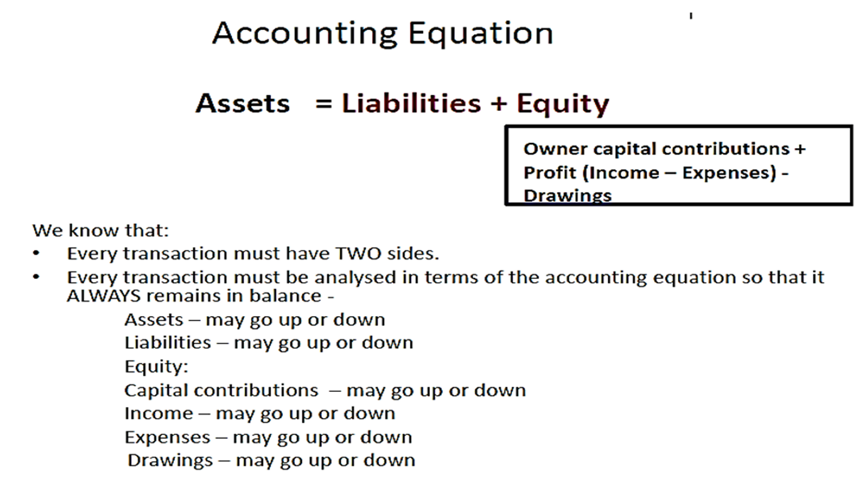

Slide 39
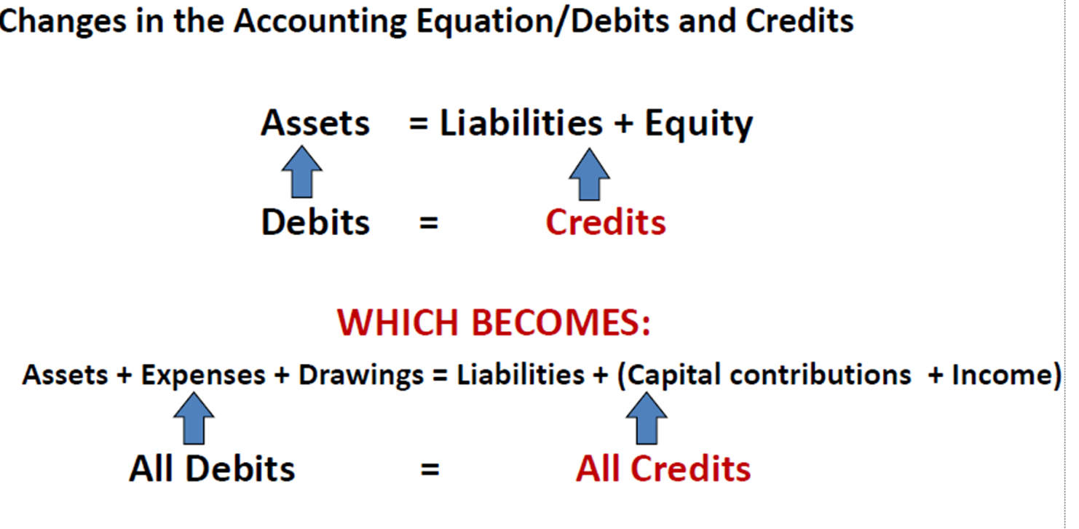


Slide 40



Thank You

