Slide 1


Slide 2

Management of Technologies
Section 2
MANAGING TECHNOLOGY AND KNOWLEDGE ACROSS ORGANISATIONAL INTERFACES
Lecture
Section 1
A MOBILE INTERNET MARKET

Slide 3
Section 1
A MOBILE INTERNET MARKET

Slide 4
Management of Technologies
A MOBILE INTERNET MARKET
A huge number of new terminal types and many operating systems are entering the market. Access network technologies like GPRS, UMTS and Wireless-LAN are competing each other. Capabilities to react to changing environmental conditions define the success of a firm.
Technology evolves through periods of incremental change and technological breakthroughs. The Mobile Internet and Wireless Technologies open a completely new environment for firms to re-create or re-innovate their business concepts and improve their operational efficiency. The innovation of new business concepts based on technological opportunities is a new way of improving the competitiveness of a firm. This does not require the firm to create new markets; it just has to invent a more efficient way of approaching the market.

Slide 5
Management of Technologies
A MOBILE INTERNET MARKET
Wireless E-Business is defined as an Internet initiative, consisting of a wireless component, that transforms business relationships, whether those relationships be business-to-consumer, business-to-business, intra-business, or even consumer-to-consumer.
Finnish firms are starting to build new applications based on the Wireless EBusiness. Correct technology selection is crucial for the best return on investment as well as the manageability of the systems and user support. If the firm manages to choose its own infrastructure so that it satisfies most of the needs of the firm's applications, the return on the investment will be the best. On the other hand, technology selection contains a risk if the firm 1chooses a technology path, which dies out and the switching costs to new technologies are high.

Slide 6
Management of Technologies
A MOBILE INTERNET MARKET
Companies planning to integrate wireless devices into their current infrastructure should take the following three steps: 1) conduct an inventory of current technology to determine what exists and how much is being spent, 2) constantly raise the question of how wireless technology can be used to modify current and short term plans, and finally, 3) ensure that the current or planned architecture includes wireless technology.
By using lead users and the process developed for the Group Decision Support Systems (GDSS) laboratory based on earlier case studies and similar types of developed, we assisted lead user groups to create a large amount of beneficial, future Wireless E-Business applications and new business concepts for themselves.

Slide 7
Management of Technologies
A MOBILE INTERNET MARKET
CUSTOMER INVOLVEMENT AND LEAD USERS
Having the customer closely involved during new product development can greatly increase the success rate of new products. Still, many companies do not effectively bring the customer into their new product development process.
we note that users are strongly steeped in their present experience. others suggest that "Customers are notoriously lacking in foresight”. Conventional users or customers are not likely to be able to articulate needs for new types of products, or to be able to easily evaluate the significance of new product concepts or technologies.

Slide 8
Management of Technologies
A MOBILE INTERNET MARKET
CUSTOMER INVOLVEMENT AND LEAD USERS
Having the customer closely involved during new product development can greatly increase the success rate of new products. Still, many companies do not effectively bring the customer into their new product development process.
Lead users expect to benefit significantly by finding a solution to their needs. They are not the same as “early adopters” i.e. people who purchase an existing product or service - lead users have needs for products or services that do not exist yet.

Slide 9
Management of Technologies
A MOBILE INTERNET MARKET
DECISION MAKING UNDER RISK AND UNCERTAINTY
According to Turban and Aronson (2001) “in decision making under uncertainty, the decision maker considers situations in which several outcomes are possible for each course of action. In contrast to the risk situation, in this case the decision maker does not know, or cannot estimate, the probability of occurrence of the possible outcomes. Decision-making under uncertainty is more difficult because of insufficient information. Modeling of such situations involves assessment of the decision maker’s attitude toward risk.”

Slide 10
Management of Technologies
A MOBILE INTERNET MARKET
TECHNOLOGY SELECTION BASED ON CUSTOMER AND APPLICATION NEEDS
Steele (1989:8) defines technologies as 'knowledge of how to do things' or 'capabilities that an enterprise needs in order to provide its customers with the goods and services it proposes to offer, both now and in the future'. Respectively, from the point of view of a firm's applications, technologies should satisfy application specific needs.
Technology selection can be defined as a management process of making choices between a numbers of distinct technology alternatives and maintaining an appropriate technological infrastructure (technologies, technological capabilities and resources) for a firm. Technology is used to satisfy the needs of firm's applications, and through applications the needs of customers. Technology selection under distinct technology alternatives and distinct applications is illustrated.

Slide 11
Management of Technologies
A MOBILE INTERNET MARKET
TECHNOLOGY SELECTION BASED ON CUSTOMER AND APPLICATION NEEDS
Independent and fragmented choices:
Applications are considered against technologies one by one. This leads to sub-optimal use of resources, and may result in a too wide technology pool, with too many needed technological capabilities.
"Single bet“:
A firm commits to one technology only; all applications are carried out with that technology. This approach contains high risk, if a wrong technology path is selected. Switching costs to new technologies high.

Slide 12
Management of Technologies
A MOBILE INTERNET MARKET
TECHNOLOGY SELECTION BASED ON CUSTOMER AND APPLICATION NEEDS
Optimal portfolio approach:
Optimal portfolio approach enables portfolio management of applications and technologies simultaneously with lowered risk. A firm needs to maintain a rich portfolio of potential application ideas together with a valid set of technology alternatives. The optimal portfolio approach is applied.
Technology diversification:
In the technology diversification approach alternative technologies are defined for each of the applications. It is possible to cover a broader set of application specific needs, e.g. different access possibilities to a service offering. This approach provides enhanced flexibility in technology, but does not adequately take into account the portfolio view on applications.

Slide 13
Management of Technologies
A MOBILE INTERNET MARKET
METHDOLOGY OF SEARCHING FOR THE RIGHT APPLICATION
Quality Function Deployment (QFD) has been widely used in product development but it has not been applied largely in technology. The general approach, called House of Quality, contains five tables, Customer needs and benefits, Planning matrix, Technical matrix, Technical response and Technical correlations.
In our study customer needs and benefits, as well as the planning matrix were created in the GDSS sessions. The Application requirement matrix in our study corresponds to the Technical matrix, and the technology Selection matrix to the Technical response matrix.

Slide 14
Management of Technologies
A MOBILE INTERNET MARKET
METHDOLOGY OF SEARCHING FOR THE RIGHT APPLICATION
We used the following steps to define the best technology configuration for a multitude of the application requirements:
a. Identify customers' future application needs.
b. Define application requirements.
c. Identify present and future technologies available (terminals, access).
d. Define technology capabilities and restrictions.
e. Fill in application requirements - technology matrix.
f. Summarize technologies servicing best application requirements.

Slide 15
Management of Technologies
A MOBILE INTERNET MARKET
Application requirements matrix
For each of the innovations we defined application requirements consisting of:
i. user's terminal requirements (capabilities like weight, size, screen, input method, etc.),
ii. application requirements defined by data processing and transfer during the use (capabilities like processor speed, memory, access network transfer speed, etc.),
iii. security requirements (user and data transfer),
iv. support requirements (user, application and technology support), and
v. availability and coverage of the services (terminal, access networks and security).

Slide 16
Management of Technologies
A MOBILE INTERNET MARKET
Technology selection matrix
The application requirement matrix was then applied to each technology. Each technology was given values 0, 1, 3 or 9 representing the fit of the technology to the requirements for each of the ideas. The values represented explanations: 0 no fit at all, 1 slight or very limited fit, 3 moderate fit and 9 strong fit (adapted and modified from. The matrix method is explained in a simplified model in Table 1.

Slide 17
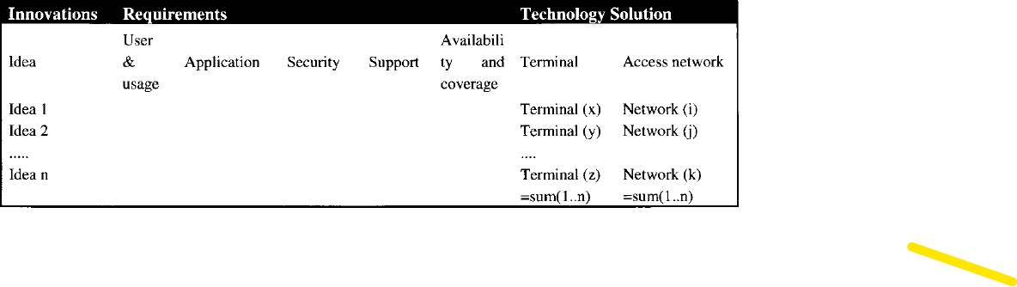

Slide 18
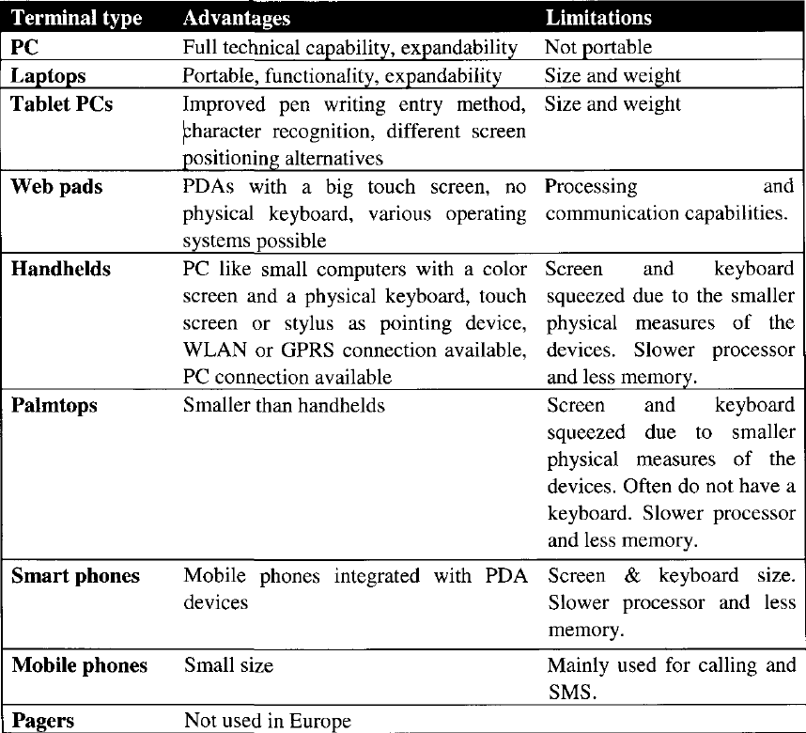

Slide 19
Management of Technologies
A MOBILE INTERNET MARKET
Technology selection matrix
PCs have full technical capabilities and extendibility, but they are not portable.
Laptops are portable, i.e. mobile PCs. Laptops have the best functionality and extendibility, but they are restricted by their size and weight from the user requirements' point of view.
Tablet PCs are similar to Laptops; they have improved pen writing entry method and character recognition. Web pads are defined as PDAs with a big touch screen without a physical keyboard.

Slide 20
Management of Technologies
A MOBILE INTERNET MARKET
Technology selection matrix
They use operating systems developed for mobile devices, such as MS Windows for Handheld PCs, MS Windows CE, Mobile Linux or Symbian (EPOC).
Handheld PC's are defined as PDAs with a keyboard as the primary input device and they are most suitably operated with both hands on the input device. Handhelds have basic connections, such as PC-card (PCMCIA) or CF-card (Compact Flash) slots for network adapters, providing access to network connections.

Slide 21
Management of Technologies
A MOBILE INTERNET MARKET
Technology selection matrix
Palmtops are smaller than handhelds. Their screens are vertically positioned even though they can often be converted programmatically. They have a touch screen input and the display is almost the size of the whole device, typically some hundreds of pixels in height and width. The entry method is normally touch-screen, stylus and character recognition.
Palmtops are smaller than handhelds. Their screens are vertically positioned even though they can often be converted programmatically. They have a touch screen input and the display is almost the size of the whole device, typically some hundreds of pixels in height and width. The entry method is normally touch-screen, stylus and character recognition.
Smartphones are mobile phones integrated with PDA devices. They have a small keyboard, a color screen and inbuilt radio access. They offer at least the basic PPM tools such as memos, contacts/address book, calendar, email, web browser, spreadsheets, and maybe other small office features such as presentation and database tools. They also have full mobile phone features integrated to the device, and so have at least the mobile networks available for data transfer.

Slide 22
Management of Technologies
A MOBILE INTERNET MARKET
Technology selection matrix
Mobile phones are mainly phones, but include today data communication capabilities. They are small, and therefore the functionality is restricted by size.

Slide 23
Section 2
MANAGING TECHNOLOGY AND KNOWLEDGE ACROSS ORGANISATIONAL INTERFACES

Slide 24
Management of Technologies
A major challenge in the rapid acquisition and effective deployment of technology for business benefit is the management of technology across organisational interfaces.
Symptoms of this problem include well-documented failures of technology transfer, mergers and acquisitions and in the introduction of new products, all of which involve multiple interfaces. These interfaces or boundaries may be within the firm, for example between business units or functions such as R&D, engineering, production and marketing, or between business processes or other organisational elements.

Slide 25
Management of Technologies
Equally, the organisational boundaries may be between firms as in the case of mergers and acquisitions, joint ventures and subcontracting. It is accepted that such interfaces cannot all be removed and thus need to be managed creatively.
The focus of this exploratory research is therefore on establishing whether it is possible to identify and characterise the interfaces of the firm where key problems often occur in activities such as technology insertion, new product development, systems integration, strategy and planning. The outputs of this early work will be used to draw preliminary implications for improved management and the scope of further research.

Slide 26
Management of Technologies
Management context
The effectiveness, productivity, efficiency or excellence of organisations continues to be concern to practitioners, consultants and researchers. "It has served as a unifying theme for over a century of research on the management and design of organisations, yet the empirical research has not yet contributed to the development of a universal theory of organisational effectiveness", according to Lewin and Minton in 1986 and is still true today. There is, however, agreement on some of the barriers to improved effectiveness.

Slide 27
Management of Technologies
Management context
These include the internal and external interfaces of the organisation which can corrupt and impede the flow of knowledge and technology. Taking a systems perspective, a boundary can be seen as a filter, or set of social norms, which selects both the kind and rate of flow of inputs and outputs to and from a set of components interacting with each other and making up the system.

Slide 28
Management of Technologies
Management context
The increasing unpredictability of events and fluidity of boundaries in terms of work roles, works groups, organisations and even industries (Ashkenas et al, 1995) can contribute to a lack of understanding and commitment on the part of personnel. This exacerbates situations such as the structural problem of 'managing part-whole relationships' in the process of innovation, where individuals lose sight of the whole innovation effort. Managing the flow of technology was raised over twenty years ago as a key issue (Allen, 1977) in terms of the importance of proximity for effective communication between R&D personnel.

Slide 29
Management of Technologies
Management context
Since then, the internal organisational interfaces between business units, multiple sites and functions such as R&D, engineering, production and marketing have been extensively researched and it is interesting to consider the context of these studies. The main bodies of literature tend to address these 'traditional' interfaces one at a time in key areas of technology management such as integrated strategy development, technology transfer, innovation and R&D management. These are considered briefly below.

Slide 30
Management of Technologies
Management context
Integrated strategy development links technology and other inputs into business planning. There is a need to manage firm competencies across business units rather than being restricted to one SBU and running the risk that the overall technology and skill portfolio becomes 'invisible'. A contrasting approach focuses on creating a dialogue between commercial and technological functions for effective strategy formulation.

Slide 31
Management of Technologies
Management context
Technology transfer is a dynamic process and includes the consideration of 'givers' and 'receivers' on either side of an interface and the incentives that motivate each group. Examples include the study of 'mobility' of manufacturing expertise between sites and identifying factors which influence transfer success. Work focusing on transfers between functions examine the effectiveness of moving people and methods of neutralising barriers by matching them with specific promoters.

Slide 32
Management of Technologies
Management context
Innovation, new product development and R&D management literature covers considerations such as integration, communication and, increasingly, the importance of knowledge in spanning business unit, site and functional boundaries. In addition to these established areas there is increasing interest in 'new' organizational forms. These include process-based management, networks knowledge-based structures collaborative new product development and small, growing enterprises.

Slide 33
Management of Technologies
Management context
The role of formal and informal knowledge management roles (e.g. teams, senior positions and 'gatekeepers') and how the flow of knowledge, including technological knowledge, is controlled and facilitated are becoming even more important. This suggests that there is a need to build on existing research by taking a fresh view of organisational interfaces in the technology management and knowledge-based context. In particular, it is proposed that a number of types of interfaces exist within and impinge upon even simple, technologically related activities.

Slide 34
Management of Technologies
Management context
Due to changing organisational structures and ways of working, these interfaces are likely to be more complex and diffuse than previously found. The relevance to manufacturing companies suggests that the outcomes of the work should be biased towards practical application.

Slide 35
Management of Technologies
The influence of the organisational behaviour perspective
The field of organisational behaviour has been defined as the study of human behaviour in organisations. From this perspective, Winner identifies three broad but distinct uses of the term technology:
• apparatus (physical device) technique (human skill)
• organisation (social arrangement)

Slide 36
Management of Technologies
The influence of the organisational behaviour perspective
Two key bodies of literature are those of organisational change and sociotechnical systems. Organisational change processes can be expressed in terms of boundaries and relationships, using the language of open systems concepts, while sociotechnical systems are one strand of systems theory. The open system engages its external environment through the exchange of matter, energy and information. In the case of discharges, this includes waste and product achievement.
The socio-technical systems view considers inputs, throughputs and output processes as being sustained by both men and technology. The smallest unit of a socio-technical system is taken to be an 'operation' that produces an observable modification of some aspect of the system.

Slide 37
Management of Technologies
The influence of the organisational behaviour perspective
System change is a complex affair involving internal and external boundaries, internal and external relationships (Alderfer, 1976). It has been proposed that the primary source of change is external to a system. Arnold et al. (1998) describe two extreme approaches to organisational change: 'stable/turbulent environment' and the 'planned/emergent'.
Burns and Stalker (1961), in their research into the management of innovation, identified firms that were able (organic) and unable (mechanistic) to respond to changes in their environment and these correspond quite closely to Alderfer's (1976) distinction between internally open and internally closed organisations. Lewin's equilibrium (1951) of forces for and against change include a set of organisational restraining factors such as strength of culture, rigidity of structure, sunk costs, lack of resources, contractual agreements, strongly held beliefs and recipes for evaluating corporate activities.

Slide 38
Management of Technologies
Further analysis of boundaries
New knowledge in product development can be considered both a barrier to, and a source of, innovation, as the way specialist knowledge is necessarily structured within functions can lead to difficulties, or knowledge boundaries, when working across functions Boundary objects can be used to make boundary issues tangible, where boundary objects can be artefacts, documents and vocabulary that help different communities build a shared understanding.
Organisational life is about fulfilling roles as boss, subordinate, team leader, team member, mentor, colleague, etc. Role conflicts can exist within individual employees, such as functional role and project role and role transitions can be seen as boundary crossing activities.

Slide 39
Management of Technologies
Further analysis of boundaries
Communication as a cross boundary process is raised by many authors, for example in the context of work, structure and the use of communication technologies, personal boundary spanning, and networks and green innovation.

Slide 40
Management of Technologies
METHOD
The investigation is based on the preliminary examination of three research questions which may form the basis of a more extensive research programme:
How can organisational interfaces be identified and characterised?
What are the key interfaces in managing technology within the firm?
What are the implications for managing technology more effectively?

Slide 41

What I expect from you?
merna@esu.ac.ae

Slide 42


