Slide 1



Master of Science in Artificial intelligence
Lecture 0
Orientation show
عرض توجيهي
AI511
Foundations of Artificial Intelligence
Prepared by
Prof. Lamiaa Fattouh Ibrahim
www.midocean.ae

Slide 2

بسم الله الرحمن الرحيم
اللهم صلي و سلم و بارك على اشرف المرسلين سيدنا محمد و على ال و اصحابه افضل التسليم
يسعدني أن أرحب بكم ترحيبا خاصا في مستهل هذا الفصل الدراسي الجديد، الذي نتطلع فيه إلى المزيد من العمل المثمر والجاد من أجل بلوغ الأهداف التي
اجتمعنا من أجلها في هذا الصرح العلمي العظيم، راجيا من الله العلي القدير أن يوفقنا جميعا لتأدية مهامنا الأكاديمية والإدارية
والتربوية على الوجه الذي يحبه و يرضاه.
كل عام و انتم بخير
www.midocean.ae

Slide 3
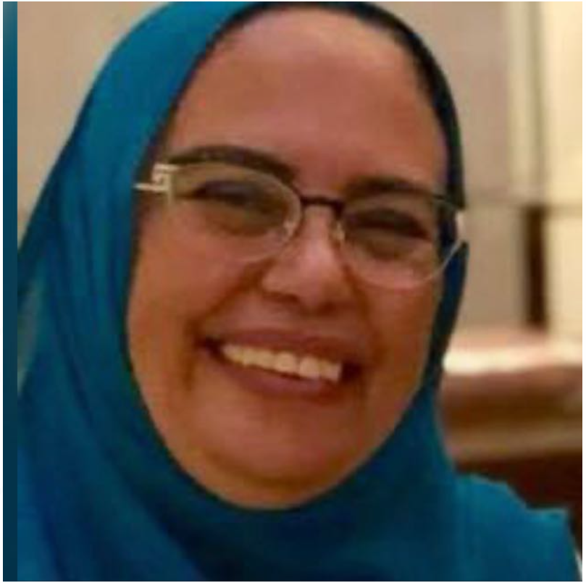
Who Am I?
Prof. Lamiaa Fattouh Ibrahim
  Professor in Artificial Intelligence
Dean of Faculty of Informatics Midocean University
Professor Department of Computer Science – Faculty of Graduate Studies for Statistical Research - Cairo University.

Slide 4
Who Am I?
Vice Dean for Education and Student Affairs, Faculty of Information Systems and Computer Science, October 6 University.
Head of Department of Computer Science – Faculty of Graduate Studies for Statistical Research - Cairo University
Professor in the Information Technology Department, Faculty of Computing and Information Technology, King Abdulaziz University from 2004 to 2018.

Slide 5
Who Am I?
  Doctor of Philosophy Ph.D. Cairo University. Faculty of Engineering. Electronics and Electrical Communications department 1999.
  Master: Ain Shams University. Faculty of Engineering. Computer & Systems Engineering department 1993.
  Master: Ecole National Superieur de Telecommunication ENST France, Paris 1987.
B.S.c: Ain Shams University. Faculty of Engineering. Electrical Engineering Department Computer & Automatic Control department

Slide 6
Who Am I?
Over 37 years of experience in the fields of network design engineering and artificial intelligence, focusing on applying knowledge base and data mining techniques in wired and wireless network planning.
Published papers in many international journals and international conferences in the areas of networks, data mining, and wired and mobile network planning.

Slide 7



Contact information
  How to reach me
    By email at lamiaa@esu.ac.ae
  Office hours
  Discussion Time (Monday at 9:00 PM) every week
https://scholar.google.com/citations?user=nT5sDzUAAAAJ&hl=en
https://www.scopus.com/authid/detail.uri?authorId=6701449773
https://orcid.org/my-orcid?orcid=0000-0001-5671-8941

Slide 8
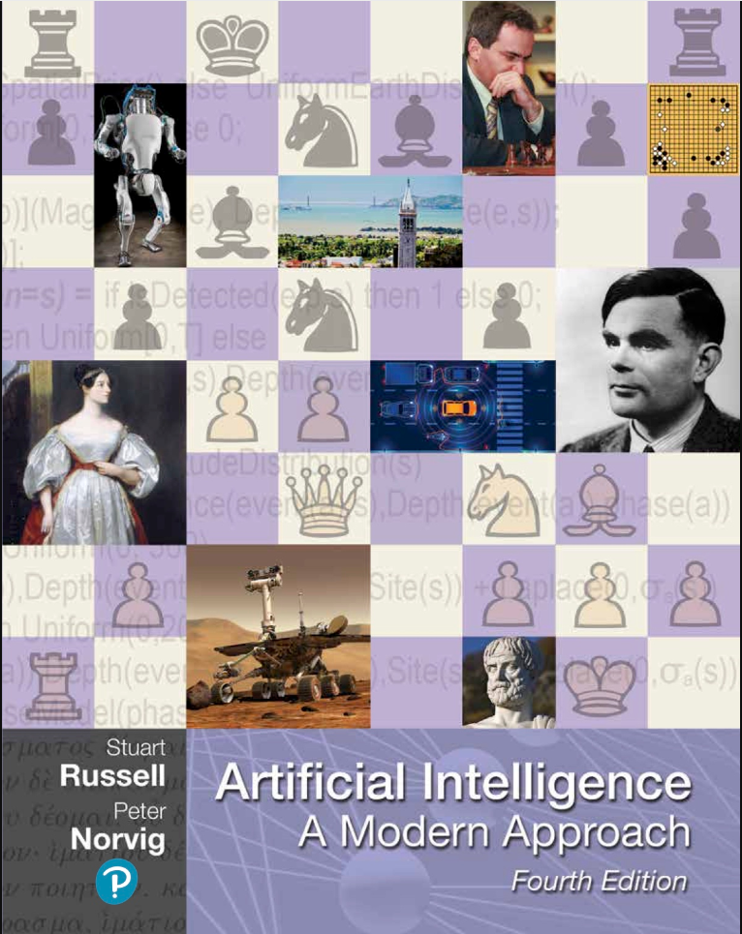

Learning Resources:
  Required Textbook:
Stuart J. Russell and Peter Norvig, "Artificial Intelligence: A Modern Approach," Third Edition (2010), by Pearson Education Inc.

Slide 9
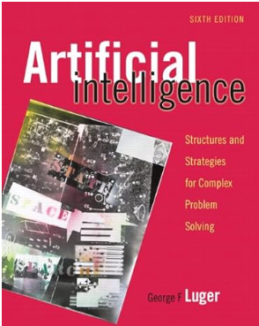
George F. Luger, "Artificial Intelligence: Structures and strategies
for complex problem solving, " 6th, 2008, Pearson Education

Slide 10
Description of the course:
The course "Foundations of Artificial Intelligence" introduces the core concepts and techniques underlying AI. It explores various topics related to AI, including problem-solving, knowledge representation, reasoning.
Students will gain a solid understanding of the foundational concepts and principles of AI, including the goals, applications, and limitations of AI systems.

Slide 11
Learning Outcomes
Upon successful completion of this course, students should be able to:
Learn the basic introduction to Artificial Intelligence AI.
Study the core topics of knowledge representation.
Study problem-solving and search algorithms.
Learns case-based reasoning – reasoning with uncertain or incomplete knowledge.
Learn and discuses Intelligent agent, Genetic algorithm.
Overview of AI languages
Overview of AI Application Areas and expert systems.

Slide 12
Course Schedule Model
Lecture # | Covered
Lecture 0 | Orientation week.
Lecture 1 | Introduction to AI
Lecture 2 | Search As a Problem-Solving Technique in AI
Lecture 3 | Propositional Calculus
Lecture 4 | Predicate Calculus
Lecture 5 | Knowledge Representation
Lecture 6 | Reasoning
Lecture 7 | Production Systems
Lecture 8 | Heuristics in Games
Lecture 9 | Expert Systems, Language of AI
Lecture 10 | Applications such as computer vision, robotics and natural language processing
Lecture 11 | Revision
Lecture 12 | Final Exam

Slide 13


Academic Calendar
الفترة الزمنية التعليمية في الفصل الدراسي الثالث تكون مدة ١٣أسبوع
(منهم أسبوع للاختبار النهائي)
Introduction to Information Technology, Prof. Lamiaa Fattouh Ibrahim, Spring 2022-2023

Slide 14
Course Information
  Assessment Method:
Short Exam
  80% marks
    Count of short Exam 10 (Weekly)
    8 Marks for every each of short Exam.
  20% Final Examination

Slide 15
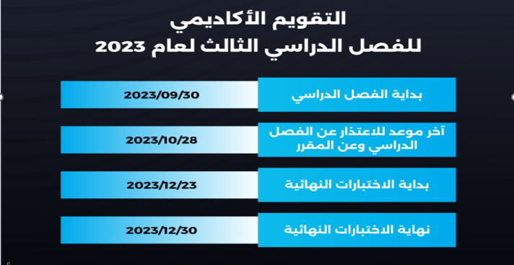
Academic Calendar
Introduction to Information Technology, Prof. Lamiaa Fattouh Ibrahim, Spring 2022-2023

Slide 16
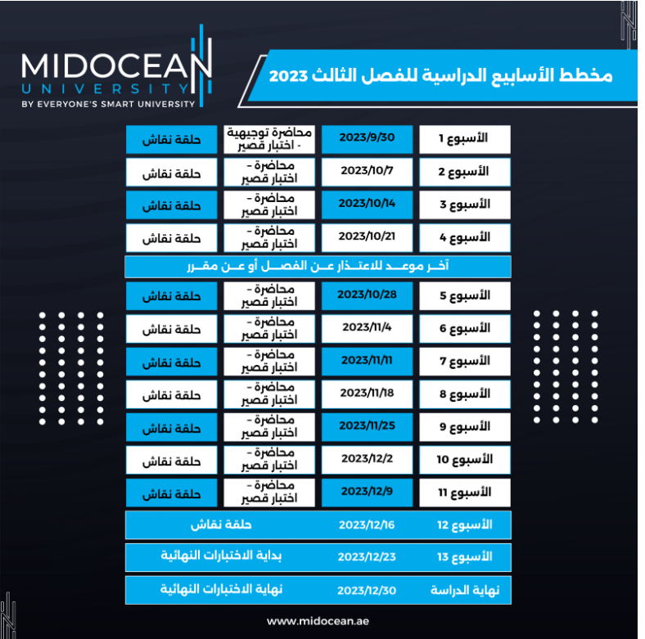
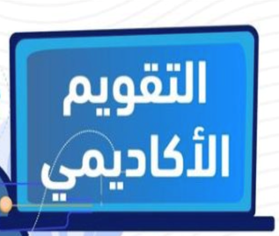
Academic Calendar

Slide 17
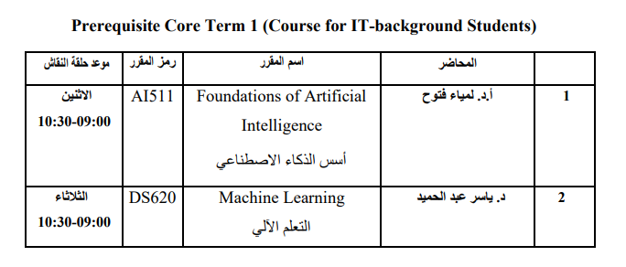
عبر برنامج ZOOM
سيتم تثبيت رابط حلقة النقاش على صفحة المقرر

Slide 18
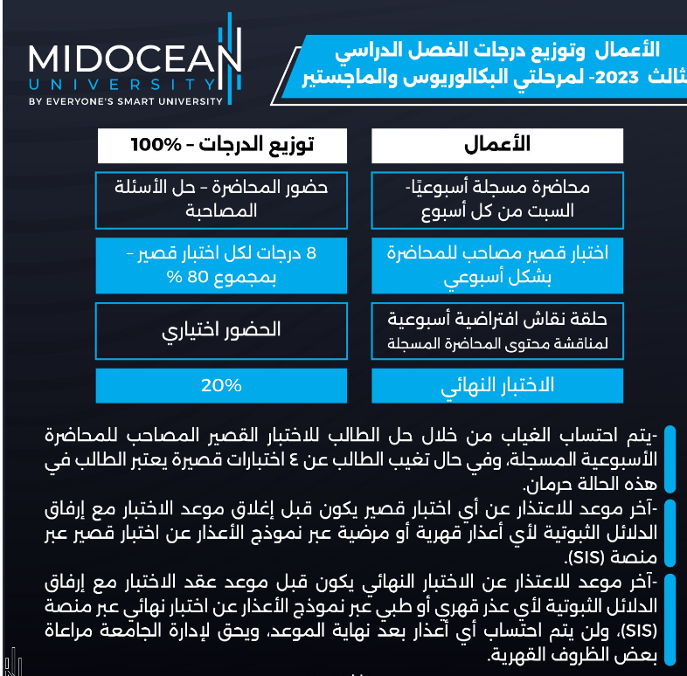
-- اللغة الأساسية في المحاضرات هي:
اللغة الإنجليزية
-- الاختبارات باللغة الإنجليزية مع وجود
ترجمة للسؤال.

Slide 19

Introduction to Information Technology, Prof. Lamiaa Fattouh Ibrahim, Spring 2022-2023

Slide 20


Thank You

