Slide 1


Advanced Project Management
PMG 506
Lecture 2
Strategic Management
and Project Selection

Slide 2


Lecture
Strategic Management and Project Selection
02
Strategic Management and Project Selection

Slide 3

Lecture
Strategic Management and Project Selection
02
With so many ongoing projects it becomes difficult for smaller projects to get adequate support, or even the attention of senior management.

Slide 4
Lecture
Strategic Management and Project Selection
02
Three common problems in organizations trying to manage multiple projects are:
1-Delays in one project cause delays in other projects because of common resource needs or technological dependencies.
2-The inefficient use of corporate resources results in peaks and valleys of resource utilization.
3- Bottlenecks in resource availability or lack of required technological inputs result in project delays that depend on those scarce resources or technology.

Slide 5
Lecture
Strategic Management and Project Selection
02
This enforce the need for Project Management Office (PMO).
It is expected that the PMO will promote those projects that capitalize on the organization’s strengths, offer a competitive advantage, and mutually support each other, while avoiding those with resource or technology needs in areas where the organization has no desire for development.
Given that the organization has an appropriate mission statement and strategy, projects must be selected that are consistent with the strategic goals of the organization.

Slide 6
Lecture
Strategic Management and Project Selection
02
Project selection
Project selection is the process of evaluating individual projects or groups of projects and then choosing to implement some set of them so that the objectives of the parent organization will be achieved.

Slide 7
Lecture
Strategic Management and Project Selection
02
Project selection
Because considerable uncertainty may surround one’s initial notions of precisely how most projects will be carried out, what resources will be required, and how long it will take to complete the project, we will introduce risk analysis
The project manager who does not understand what a given project is expected to contribute to the parent organization lacks critical information needed to manage the project in order to optimize its contribution to the parent organization

Slide 8
Lecture
Strategic Management and Project Selection
02
2.1 PROJECT MANAGEMENT MATURITY
Project management maturity is a measure of the organization’s project managers mastery of the skills required to manage projects competently.
A number of consulting firms, as well as scholars, have devised formal maturity measures including:
IPMA, PMI, PM3® and others.

Slide 9
Lecture
Strategic Management and Project Selection
02
2.2 PROJECT SELECTION AND CRITERIA OF CHOICE
Project selection is the process of evaluating proposed projects or groups of projects, and then choosing to implement some set of them so that the objectives of the parent organization will be achieved.
This systematic process can be applied to any area of the organization’s business in which choices must be made between competing alternatives.
It is critically important to the success of the PM that he or she fully understands the parent organization’s objectives in undertaking a project that the PM is expected to lead.

Slide 10
Lecture
Strategic Management and Project Selection
02
Most of the decisions that the PM is forced to make will have an impact on the degree to which the project contributes to those objectives the parent organization expected from the project.
Modelling the problem is the process of carving away the unwanted reality from the bones of a problem.
many models include graphs, analogies, diagrams, as well as flow graph and network models to help solve scheduling problems, and symbolic (mathematical) models for a number of purposes.

Slide 11
Lecture
Strategic Management and Project Selection
02
2.2 PROJECT SELECTION AND CRITERIA OF CHOICE
If the input data for a model are not known precisely, we often use probabilistic information; that is, the model is said to be stochastic rather than deterministic.
When a firm chooses a project selection model, the following criteria are most important:
Realism The model should reflect the reality of the firm’s decision situation. It should also take into account the realities of the firm’s limitations on facilities, capital, personnel, and so forth, and include factors that reflect project technical and market risks: performance, cost, time, customer rejection, and implementation.

Slide 12
Lecture
Strategic Management and Project Selection
02
2.2 PROJECT SELECTION AND CRITERIA OF CHOICE
2. Capability The model should be sophisticated enough to deal with the relevant factors: multiple time periods, situations both internal and external to the project (e.g., strikes, interest rate changes), and so on.
3. Flexibility The model should give valid results within the range of conditions that the firm might experience. It should be easy to modify in response to changes.
4. Ease of use The model should be reasonably convenient, not take a long time to execute, and be easy to use and understand. It should not require special interpretation, data that are difficult to acquire, excessive personnel, or unavailable equipment.

Slide 13
Lecture
Strategic Management and Project Selection
02
2.2 PROJECT SELECTION AND CRITERIA OF CHOICE
5. Cost Data-gathering and modelling costs should be low relative to the cost of the project and less than the potential benefits of the project. All costs should be considered, including the costs of data management and of running the model.
6. Easy computerization It should be easy and convenient to gather and store the information in a computer database, and to manipulate data in the model through use of a widely available, standard computer package such as Excel®

Slide 14
Lecture
Strategic Management and Project Selection
02
2.3 THE NATURE OF PROJECT SELECTION MODELS
There are two basic types of project selection models, numeric and nonnumeric. Both are widely used. Many organizations use both at the same time, or they use models that are combinations of the two.
Nonnumeric models, as the name implies, do not use numbers as inputs.
Numeric models do, but the criteria being measured may be either objective or subjective.

Slide 15
Lecture
Strategic Management and Project Selection
02
2.3 THE NATURE OF PROJECT SELECTION MODELS
It is important to remember that the qualities of a project may be represented by numbers, and that subjective measures are not necessarily less useful or reliable than objective measures.
Never forgetting two critically important, but often overlooked, facts:
• Models do not make decisions—people do.
• All models, however sophisticated, are only partial representations of the reality they are meant to reflect.

Slide 16
Lecture
Strategic Management and Project Selection
02
2.4 TYPES OF PROJECT SELECTION MODELS
Nonnumeric Models:
The Sacred Cow The project is suggested by a senior and powerful official in the organization with a simple comment such as, “If you have a chance, why don’t you look into…,” The immediate result of this bland statement is the creation of a “project” to investigate whatever the boss has suggested. The project is “sacred” in the sense that it will be maintained until successfully concluded, or until the boss, personally, recognizes the idea as a failure and terminates it.

Slide 17
Lecture
Strategic Management and Project Selection
02
2.4 TYPES OF PROJECT SELECTION MODELS
The Operating Necessity If a flood is threatening the plant, a project to build a protective dike does not require much formal evaluation, which is an example of this scenario.
If the project is required in order to keep the system operating, the primary question becomes: Is the system worth saving at the estimated cost of the project? If the answer is yes, project costs will be examined to make sure they are kept as low as is consistent with project success, but the project will be funded.

Slide 18
Lecture
Strategic Management and Project Selection
02
2.4 TYPES OF PROJECT SELECTION MODELS
Nonnumeric Models:
The Competitive Necessity Is the company decision to go for some projects if the firm want to maintain its competitive position in the market area.
Investment in an operating necessity project takes precedence over a competitive necessity project, but both types of projects may bypass the more careful numeric analysis used for projects deemed to be less urgent or less important to the survival of the firm.

Slide 19
Lecture
Strategic Management and Project Selection
02
2.4 TYPES OF PROJECT SELECTION MODELS
The Product Line Extension A project to develop and distribute new products would be judged on the degree to which it fits the firm’s existing product line, fills a gap, strengthens a weak link, or extends the line in a new, desirable direction. Sometimes careful calculations of profitability are not required. Decision makers can act on their beliefs about what will be the likely impact on the total system performance if the new product is added to the line.

Slide 20
Lecture
Strategic Management and Project Selection
02
2.4 TYPES OF PROJECT SELECTION MODELS
Nonnumeric Models:
Comparative Benefit Model Senior management would like to select a subset of the projects that would most benefit the firm, but the projects do not seem to be easily comparable.
The organization has no formal method of selecting projects, but members of the Selection Committee think that some projects will benefit the firm more than others, even if they have no precise way to define or measure “benefit.”

Slide 21
Lecture
Strategic Management and Project Selection
02
2.4 TYPES OF PROJECT SELECTION MODELS
The Q-Sort is one of the most straightforward. First, the projects are divided into three groups—good, fair, and poor—according to their relative merits. If any group has more than eight members, it is subdivided into two categories, such as fair-plus and fair-minus. When all categories have eight or fewer members, the projects within each category are ordered from best to worst. Again, the order is determined on the basis of relative merit. The rater may use specific criteria to rank each project, or may simply use general overall judgment.

Slide 22
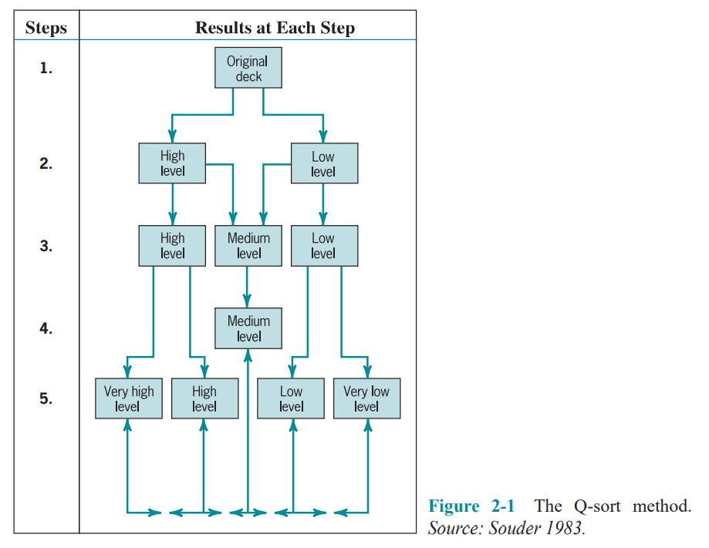
Lecture
Strategic Management and Project Selection
02
2.4 TYPES OF PROJECT SELECTION MODELS

Slide 23
Lecture
Strategic Management and Project Selection
02
2.4 TYPES OF PROJECT SELECTION MODELS
Numeric Models: Profit/Profitability
A large majority of all firms using project evaluation and selection models use profitability as the sole measure of acceptability.

Slide 24
Lecture
Strategic Management and Project Selection
02
2.4 TYPES OF PROJECT SELECTION MODELS
Payback Period The payback period for a project is the initial fixed investment in the project divided by the estimated annual net cash inflows from the project. The ratio of these quantities is the number of years required for the project to repay its initial fixed investment.

Slide 25
Lecture
Strategic Management and Project Selection
02
2.4 TYPES OF PROJECT SELECTION MODELS
Payback Period
For example, assume a project costs $100,000 to implement and has annual net cash inflows of $25,000. Then
Payback period = $100,000/$25,000 =4 years
This method assumes that the cash inflows will persist at least long enough to pay back the investment, and it ignores any cash inflows beyond the payback period. The method also serves as an (inadequate) proxy for risk. The faster the investment is recovered, the less the risk to which the firm is exposed.

Slide 26
Lecture
Strategic Management and Project Selection
02
2.4 TYPES OF PROJECT SELECTION MODELS
Numeric Models: Profit/Profitability
Discounted Cash Flow Also referred to as the net present value (NPV) method, the discounted cash flow method determines the net present value of all cash flows by discounting them by the required rate of return (also known as the hurdle rate, cutoff rate, and similar terms) as follows:

Slide 27
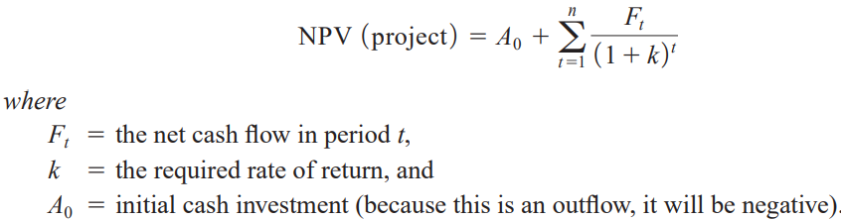
Lecture
Strategic Management and Project Selection
02
Discounted Cash Flow:

Slide 28

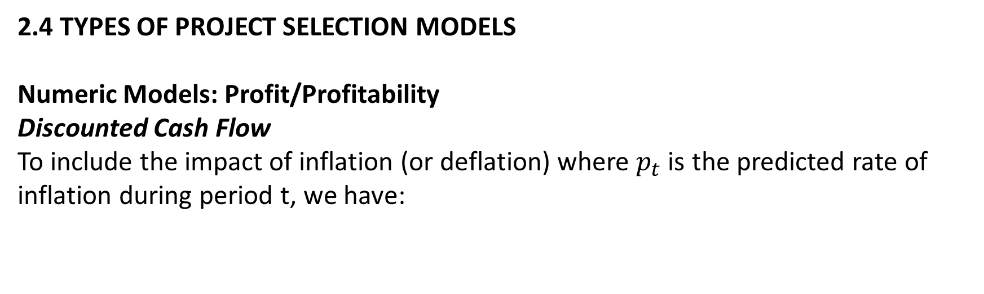
Lecture
Strategic Management and Project Selection
02
2.4 TYPES OF PROJECT SELECTION MODELS
Numeric Models: Profit/Profitability
Discounted Cash Flow
To include the impact of inflation (or deflation) where $p_{t}$ is the predicted rate of inflation during period t, we have:

Slide 29
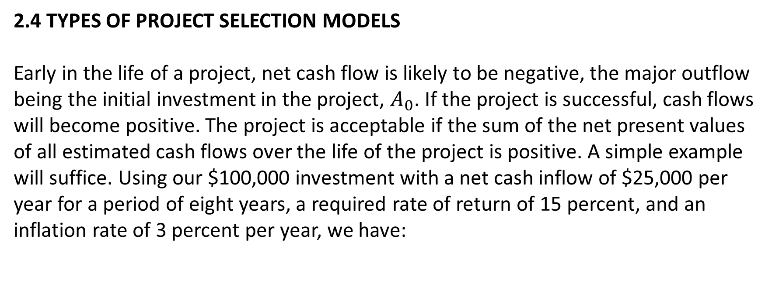
Lecture
Strategic Management and Project Selection
02
2.4 TYPES OF PROJECT SELECTION MODELS
Early in the life of a project, net cash flow is likely to be negative, the major outflow being the initial investment in the project, $A_{0}$. If the project is successful, cash flows will become positive. The project is acceptable if the sum of the net present values of all estimated cash flows over the life of the project is positive. A simple example will suffice. Using our $100,000 investment with a net cash inflow of $25,000 per year for a period of eight years, a required rate of return of 15 percent, and an inflation rate of 3 percent per year, we have:

Slide 30
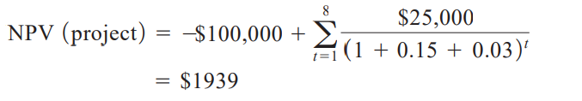
Lecture
Strategic Management and Project Selection
02
2.4 TYPES OF PROJECT SELECTION MODELS
Numeric Models: Profit/Profitability
Discounted Cash Flow
Because the present value of the inflows is greater than the present value of the outflow i.e, the net present value is positive, the project is deemed acceptable.

Slide 31
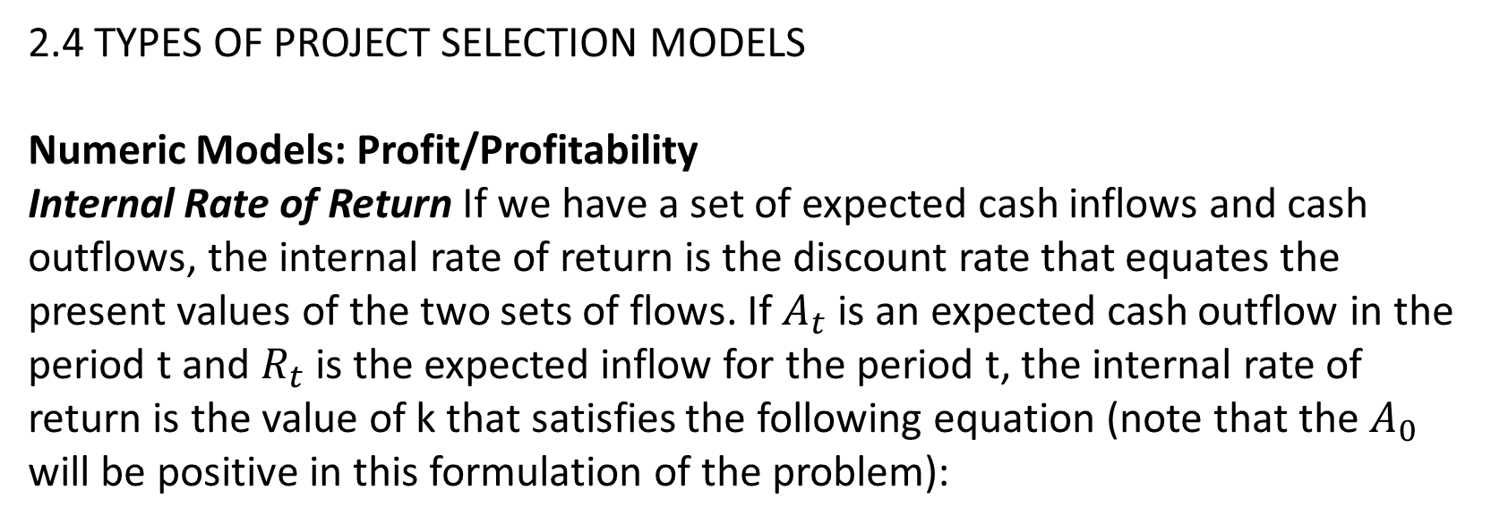
Lecture
Strategic Management and Project Selection
02
2.4 TYPES OF PROJECT SELECTION MODELS
Numeric Models: Profit/Profitability
Internal Rate of Return If we have a set of expected cash inflows and cash outflows, the internal rate of return is the discount rate that equates the present values of the two sets of flows. If $A_{t}$ is an expected cash outflow in the period t and $R_{t}$ is the expected inflow for the period t, the internal rate of return is the value of k that satisfies the following equation (note that the $A_{0}$ will be positive in this formulation of the problem):

Slide 32

Lecture
Strategic Management and Project Selection
02
The value of k is found by trial and error.
The value of k is found by trial and error.
2.4 TYPES OF PROJECT SELECTION MODELS
Numeric Models: Profit/Profitability
Internal Rate of Return
The value of k is found by trial and error.

Slide 33
Lecture
Strategic Management and Project Selection
02
2.4 TYPES OF PROJECT SELECTION MODELS
Numeric Models: Profit/Profitability
Profitability Index Also known as the benefit–cost ratio, the profitability index is the net present value of all future expected cash flows divided by the initial cash investment. (Some firms do not discount the cash flows in making this calculation.) If this ratio is greater than 1.0, the project may be accepted.

Slide 34
Lecture
Strategic Management and Project Selection
02
Other Profitability Models There are a great many variations of the models just described. These variations fall into three general categories:
those that subdivide net cash flow into the elements that comprise the net flow.
(2) those that include specific terms to introduce risk (or uncertainty, which is treated as risk) into the evaluation.
(3) those that extend the analysis to consider effects that the project might have on other projects or activities in the organization.
Several comments are in order about all the profit-profitability numeric models.

Slide 35
Lecture
Strategic Management and Project Selection
02
2.4 TYPES OF PROJECT SELECTION MODELS
Numeric Models: Profit/Profitability
First, let us consider their advantages:
1. The undiscounted models are simple to use and understand.
2. All use readily available accounting data to determine the cash flows.
3. Model output is in terms familiar to business decision makers.
4. With a few exceptions, model output is on an “absolute” profit/profitability scale and allows “absolute” go/no-go decisions.
5. Some profit models can be amended to account for project risk.

Slide 36
Lecture
Strategic Management and Project Selection
02
2.4 TYPES OF PROJECT SELECTION MODELS
Numeric Models: Profit/Profitability
The disadvantages of these models are the following:
1. These models ignore all nonmonetary factors except risk.
2. Models that do not include discounting ignore the timing of the cash flows and the time value of money.
3. Models that reduce cash flows to their present value are strongly biased toward the short run.

Slide 37
Lecture
Strategic Management and Project Selection
02
2.4 TYPES OF PROJECT SELECTION MODELS
Numeric Models: Profit/Profitability
2.4 TYPES OF PROJECT SELECTION MODELS
Numeric Models: Profit/Profitability
5. The internal rate of return model can result in multiple solutions.
6. All are sensitive to errors in the input data for the early years of the project.
7. All discounting models are nonlinear, and the effects of changes (or errors) in the variables or parameters are generally not obvious to most decision makers.

Slide 38
Lecture
Strategic Management and Project Selection
02
2.4 TYPES OF PROJECT SELECTION MODELS
Numeric Models: Profit/Profitability
8. All these models depend for input on a determination of cash flows, but it is not clear exactly how the concept of cash flow is properly defined for the purpose of evaluating projects.
In general, the net present value models are preferred to the internal rate of return models. Despite wide use, financial models rarely include nonfinancial outcomes in their benefits and costs.

Slide 39
Lecture
Strategic Management and Project Selection
02
2.4 TYPES OF PROJECT SELECTION MODELS
Numeric Models: Profit/Profitability
Real Options Recently, a project selection model was developed based on a notion well known in financial markets. When one invests, one foregoes the value of alternative future investments.
Economists refer to the value of an opportunity foregone as the “opportunity cost” of the investment made.

Slide 40


Thank You

