Slide 1



Project Planning
Lecture 1
PMG202
Project Preparation and Implementation Plan
Prepared by
Lec. Dina ElWakkad

Slide 2


Learning Outcomes
At the end of this chapter, students should be able to:
1- Identify the stages of project preparation and implementation plan
2- Familiarity with the project life cycle
3- Define Break-even analysis in decision-making to achieve profit
4- Knowing the conditions necessary for the success of the project
.

Slide 3
1- Stages of project preparation and implementation plan
.

Slide 4
Stages of project preparation and implementation plan
(1) Choosing the appropriate project idea
(2) Willingness to work to complete the project
(3) Having technical ability to manage projects
  Project specific technical expertise
  Information and knowledge about the project
  Previous training in a similar project
  Administrative and behavioral skill in dealing with others.
.

Slide 5
Stages of project preparation and implementation plan
(4) Carrying out a preliminary feasibility study for the project idea
  Market need
  Projects like yours
  Phases of operations of project activities
(5) Is the project idea promising success?
(6) Is the necessary financing available for the project (self - loan)
.

Slide 6
Stages of project preparation and implementation plan
(7) Preparing a detailed feasibility study, which includes:
  Environmental study: Is the project compatible with the environment?
  Marketing study: Does the project fill a certain volume of demand for the product?
  Technical study: What are the raw materials and what technological and technical methods are used?
  Financial study: Is the project's financial budget capable of covering production costs?
  An economic study: Will the project achieve a reasonable profit margin in addition to the costs?
  Social study: Will the project achieve a social return that will benefit the community, the consumer, or the target group?
.

Slide 7
Stages of project preparation and implementation plan
(8) Preparing a timetable for the project
  Setting detailed steps and priorities for the project's work and activities
  Preparing the site and equipping it with the required specifications
  Determine the time periods for the completion of work
  Determine the costs of each work or activity
.

Slide 8
Stages of project preparation and implementation plan
(9) The stage of implementation and preparation, which includes:
  Establishing the project according to the schedule
  Purchase and installation of machinery and equipment
  Operational and production tests
  Marketing and selling
.

Slide 9
Stages of project preparation and implementation plan
(10) The follow-up and evaluation phase, which includes:
  Business
  time
  Spending
  Implementation rate and whether there is a problem
  Correction to ensure that the project objective is achieved
.

Slide 10
2- Project Life Cycle
.

Slide 11
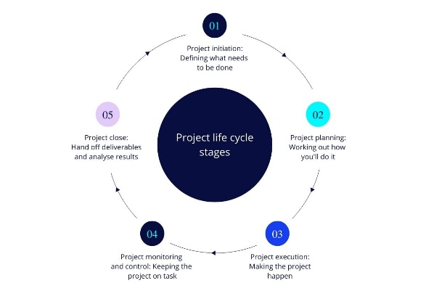
Project Life Cycle
.

Slide 12
Project Life Cycle
Define: The project goals, rules, approach, and cost-schedule-quality equilibrium are agreed upon by the stakeholders.
.

Slide 13
Project Life Cycle
Plan: A plan is developed for the project. As each project is unique, this must be repeated every time for each project. This stage implies that the work to be done is identified, and split up into workable pieces, the time required for each piece and the entire project is estimated, resources are assigned to the work to be done, costs are budgeted, risks are identified, and risk management plans are set up, and many other activities
.

Slide 14
Project Life Cycle
Execute: This is the stage where the actual work is being executed. During the execution stage, the goal of project management is to keep the project on track and ensure that execution is done efficiently.
.

Slide 15
Project Life Cycle
Close: This stage entails activities to make the transition to the next phase (operations or another project), to establish formal closure in the eyes of the customer, and to review project successes and failures in order to learn for future projects
.

Slide 16
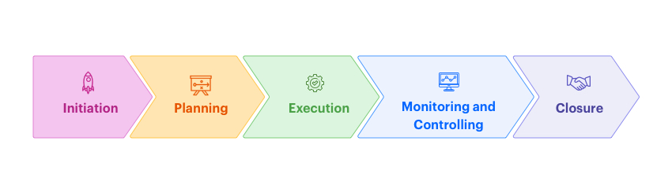
Project Life Cycle
.

Slide 17
3- Break-even analysis in decision making
.

Slide 18
Break-even analysis in decision making
Breakeven:
The point at which total sales equal total costs (TR = TC)
The break-even point is an easy and effective way to know the feasibility of a project or any new process
.

Slide 19
Break-even analysis in decision making
Break-even analysis is based on variable costs and fixed costs
Variable costs: such as the cost of labor, the cost of raw materials, and others
Fixed costs: These are the costs that are fixed even if there is a change in the outputs, such as the rent of the building or the rent of tools and insurance and others.
.

Slide 20
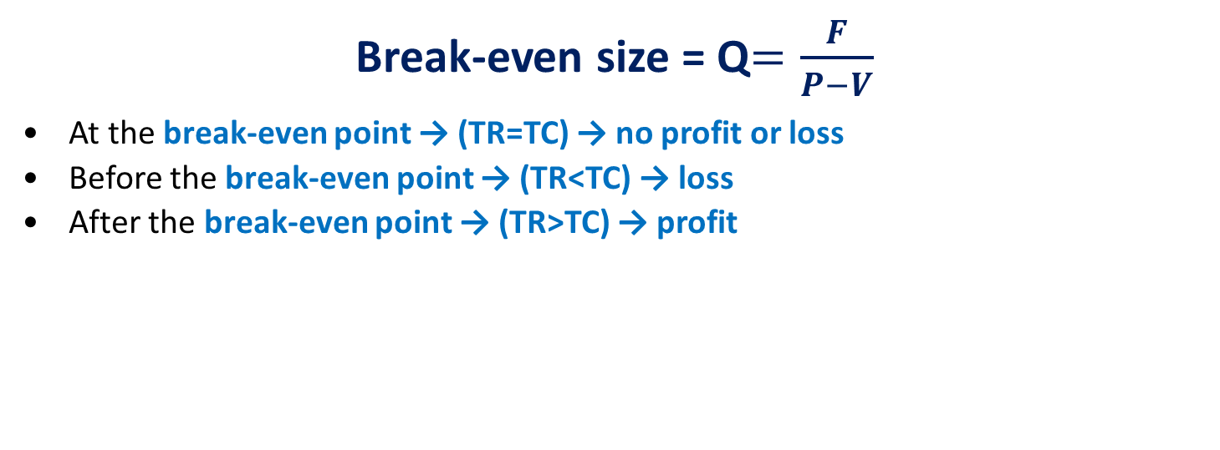
Break-even analysis in decision making
Break-even size = Q$=\frac{F}{P−V}$
At the break-even point → (TR=TC) → no profit or loss
Before the break-even point → (TR<TC) → loss
After the break-even point → (TR>TC) → profit
.

Slide 21
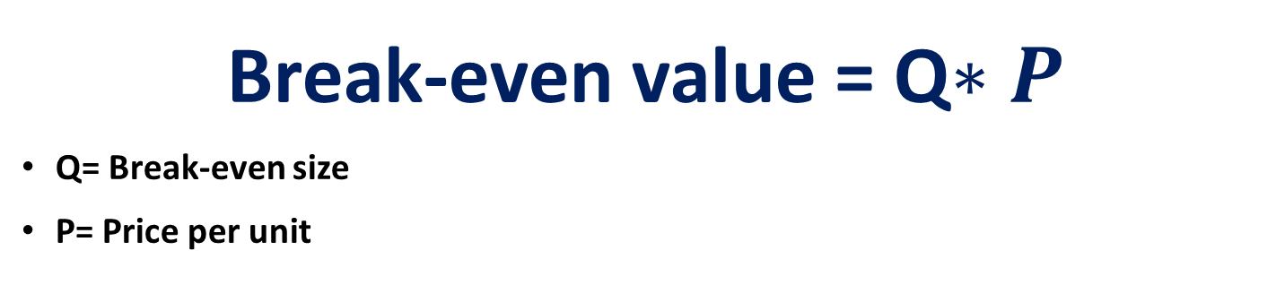
Break-even analysis in decision making
Break-even value = Q$∗P$
Q= Break-even size
P= Price per unit
.

Slide 22
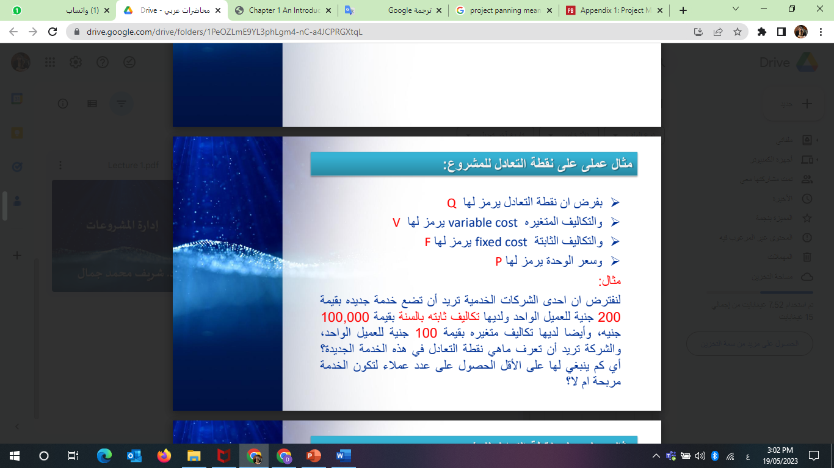
Break-even analysis in decision making
EX1:
.

Slide 23
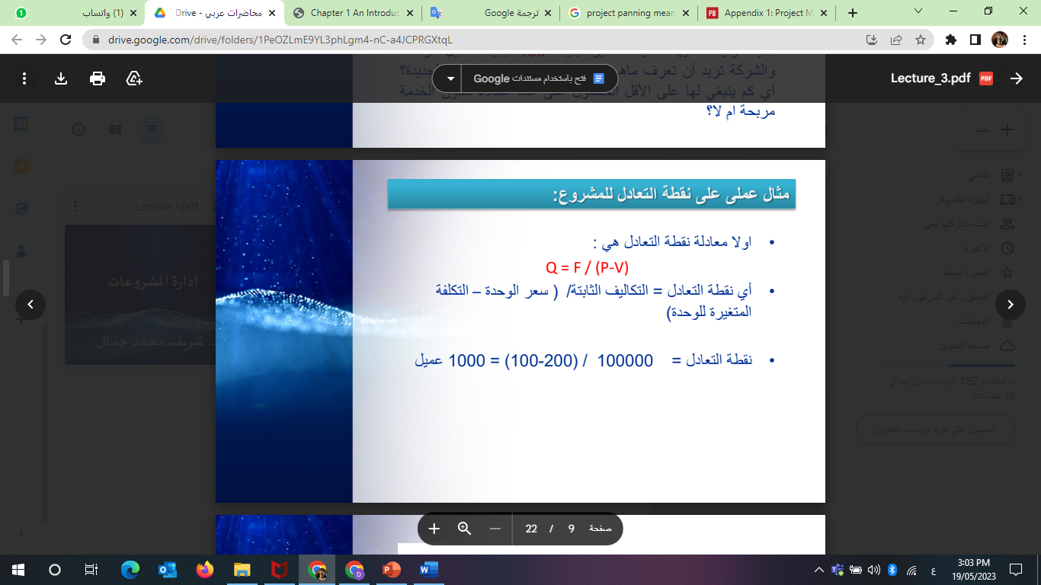
Break-even analysis in decision making
The answer:
.

Slide 24
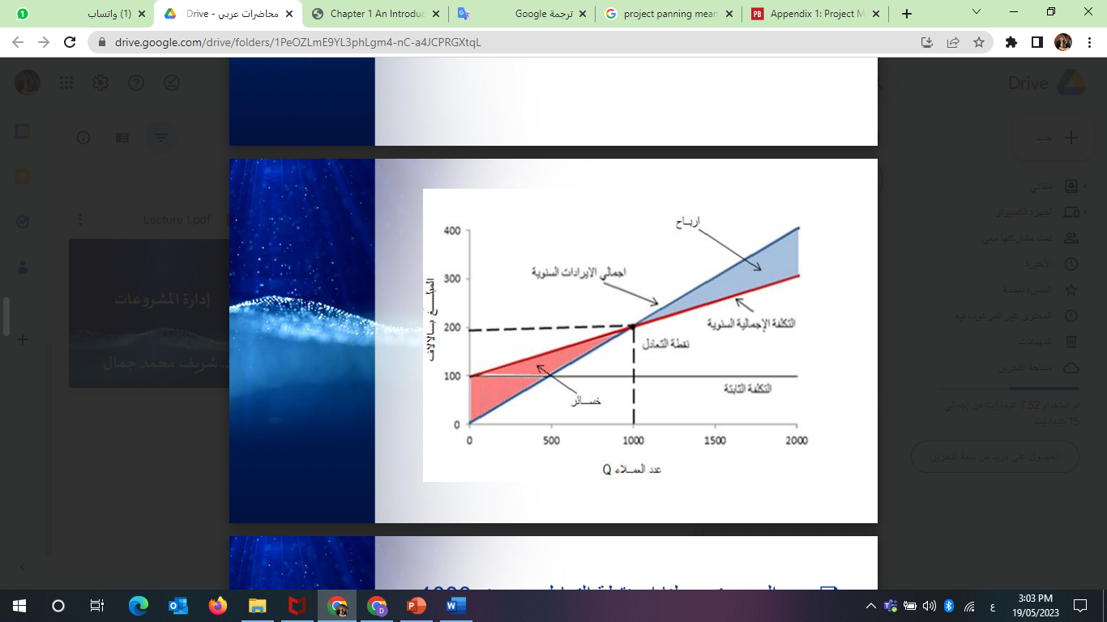
Break-even analysis in decision making
The answer:
.

Slide 25
Break-even analysis in decision making
From the previous figure, it is clear to us that:
The break-even point is at 1000 customers with a price of 200, where there is no profit or loss. (TR=TC)
That is, if the number of workers rises above 1000, there will be profits, (TR>TC)
When the number of workers decreases to less than 1000 customers, there will be losses. (TR<TC)
Based on the results and the fee shown to us on this new service that will be provided, more than 1000 customers must be obtained for this new service to cross the break-even point to be profitable.
.

Slide 26
Break-even analysis in decision making
Ex 2 :
A Café has a place to sell its products in the city center.
The average price of a cup of coffee is $1.49 (P = 1.49)
and the average variable cost is $0.36. (V = 0.36)
The average fixed cost is $1,300 per month (F = 1300)
on average What is the size, and value of break-even sales?
.

Slide 27
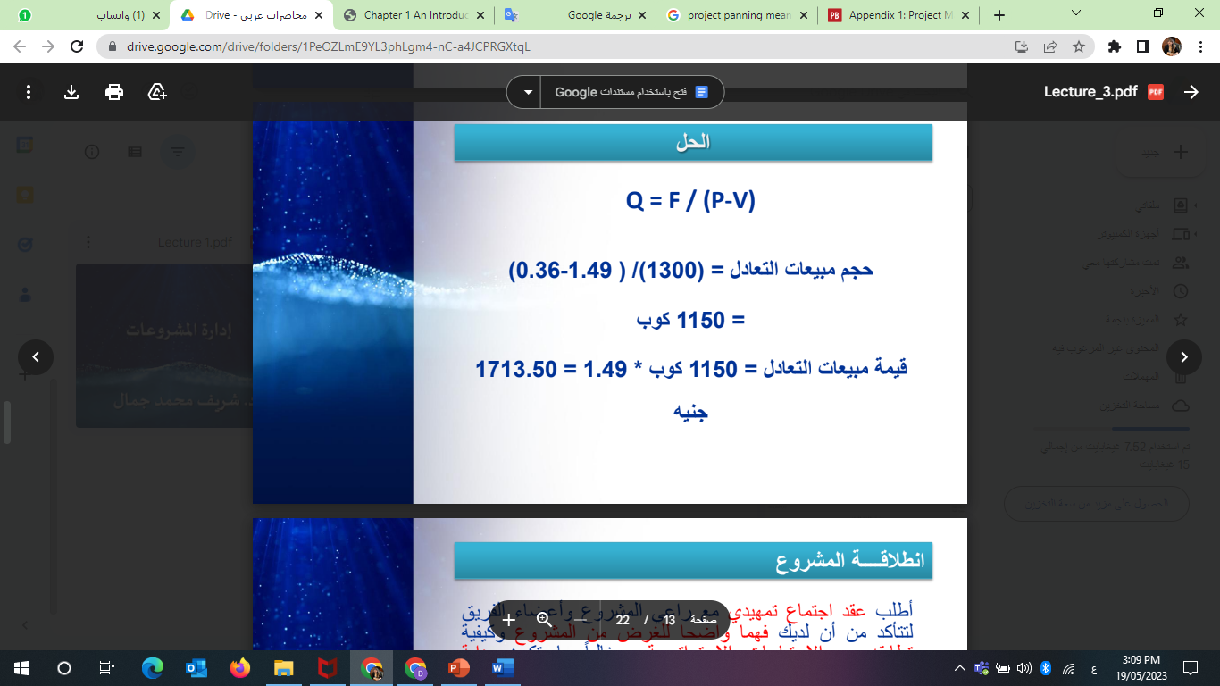
Break-even analysis in decision making
The answer:
.

Slide 28
4- When is a project successful?
.

Slide 29
When is a project successful?
The traditional view of project success consists of three parts and is also called the iron triangle or triple constraint:
The project is executed on time.
The project is executed within budget.
The project produces an outcome of high quality. This consists of two dimensions:
  Product Scope: What is the product supposed to do?
  Performance: How well does the provided functionality work?
.

Slide 30
When is a project successful?
These three aspects of project success are not independent of each other.
On the contrary, typically improving one criterion implies delivering short on one of the other criteria
- e.g., if one wants to execute the same project in less time, one needs more resources (higher budget) or one has to lower the specifications of the deliverable.
.

Slide 31
Summary
1- Stages of project preparation and implementation plan
2- Project Life Cycle
3- Break-even analysis in decision making
4- When is a project successful?
.

Slide 32

.

Slide 33
Questions
Having technical ability to manage projects means------- Existence of technical expertise specific to the project Having a market need Determine the time periods for completing the work. All answers are correct
The detailed feasibility study for the project includes---- All answers are correct. environmental study Technical study Economic study
.

Slide 34
Questions
Environmental feasibility study means----------- Is the project compatible with the environment? What are the raw materials and what technological and artistic methods are used? Does the project fill a certain size of the demand for the product? Will the project achieve a reasonable profit margin in addition to costs?
Marketing feasibility study means----------- Does the project fill a certain size of the demand for the product? Is the project compatible with the environment? What are the raw materials and what technological and artistic methods are used? Will the project achieve a reasonable profit margin in addition to costs?
.

Slide 35
Questions
Technical feasibility study means----------- What are the raw materials and what technological and technical methods are used? Does the project fill a certain size of the demand for the product? Is the project compatible with the environment? Will the project achieve a reasonable profit margin in addition to costs?
Financial feasibility study means----------- Is the project's financial budget able to cover production costs? Does the project fill a certain size of the demand for the product? Is the project compatible with the environment? Will the project achieve a reasonable profit margin in addition to costs?
.

Slide 36
Questions
Economic feasibility study means----------- Will the project achieve a reasonable profit margin in addition to costs? Is the project's financial budget able to cover production costs? Does the project fill a certain size of the demand for the product? Is the project compatible with the environment?
The implementation and preparation phase includes---- All answers are correct. Implementation of the project according to the schedule Purchase and installation of machinery and equipment Operational and production tests
.

Slide 37
Questions
Break-even point analysis based on---------- Variable costs and fixed costs Only variable costs Fixed costs only Variable costs, fixed costs, and selling quantity
The traditional view of project success consists of -------- All answers are correct. The project is executed on time. The project is executed within budget. The project produces an outcome of high quality.
.

Slide 38
Questions
The project life cycle starts from---- Initiation Planning Execution Monitoring and controlling
The project life cycle ends by ------ closure Initiation Planning Execution
.

Slide 39
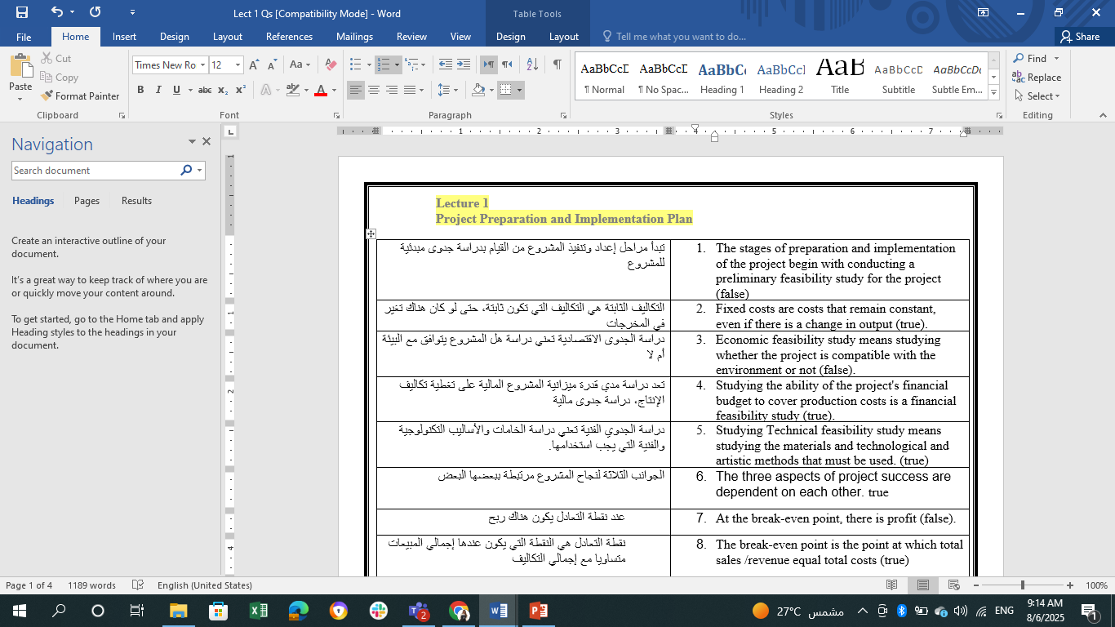
Questions
.

Slide 40
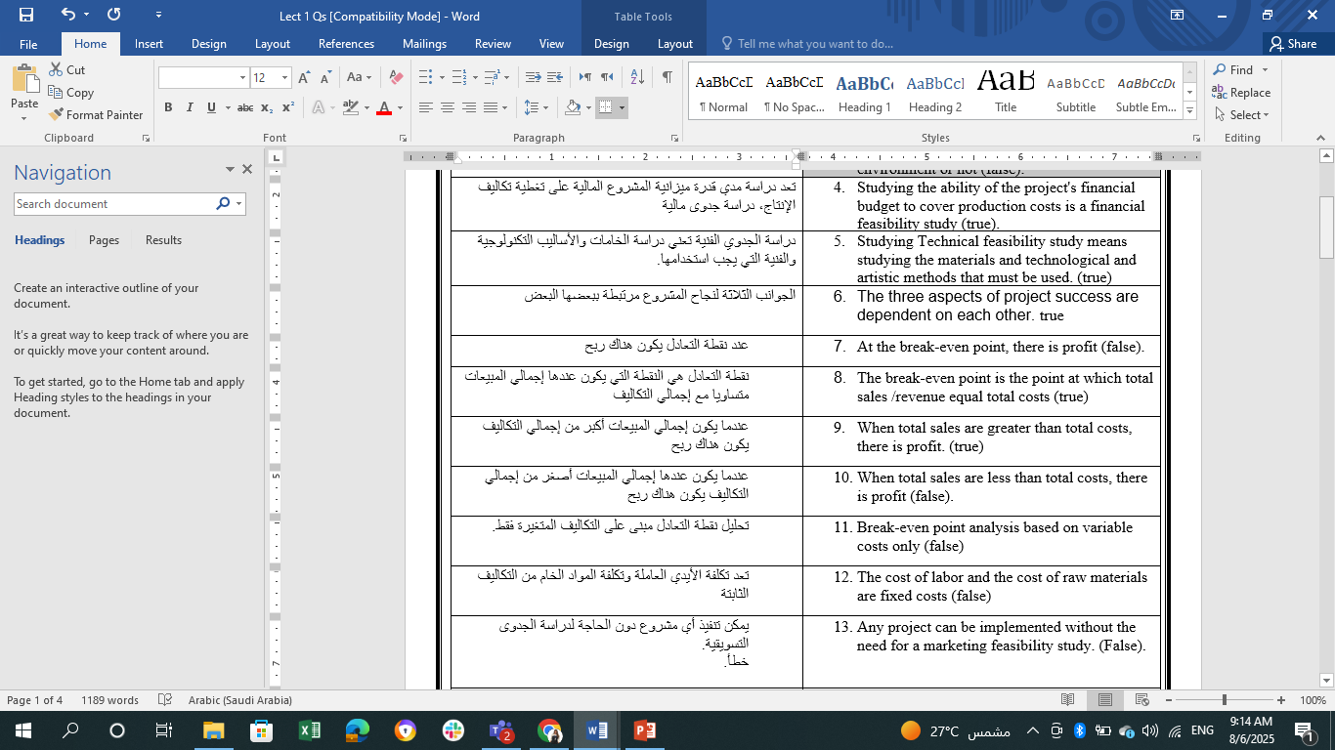
Questions
.

Slide 41
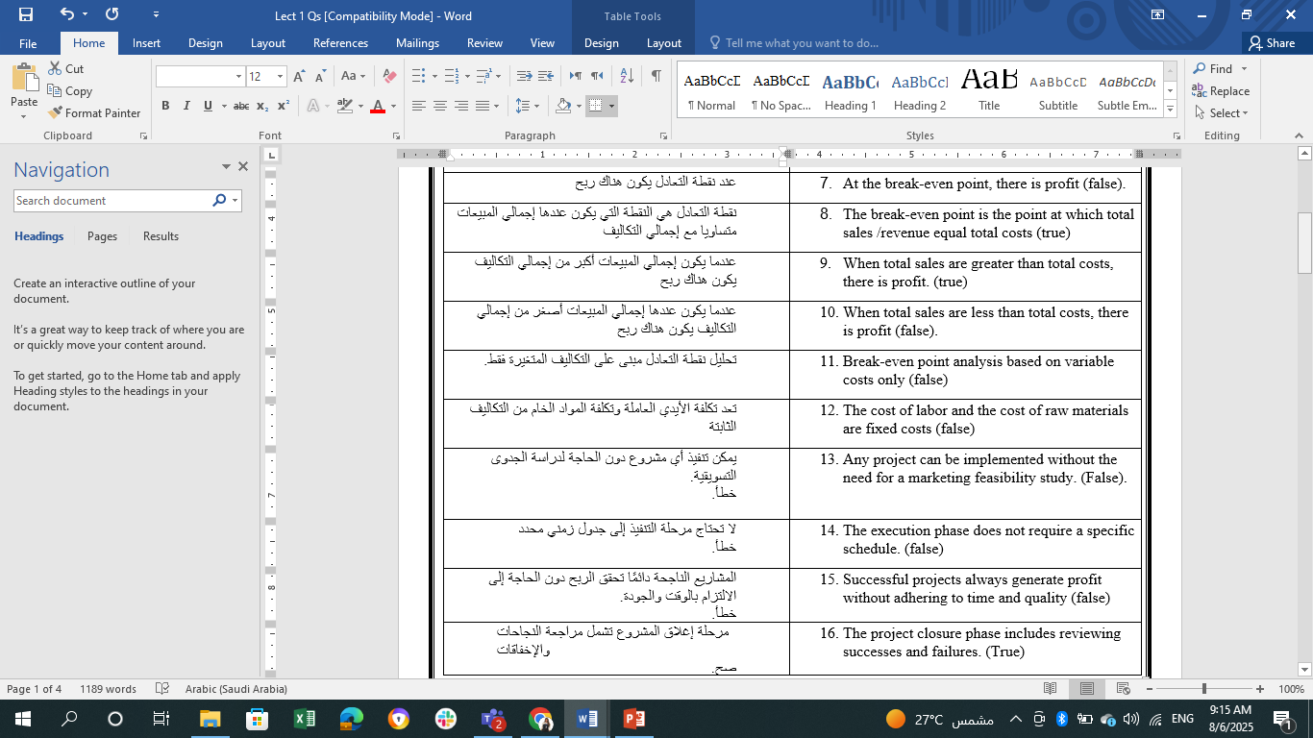
Questions
.

Slide 42
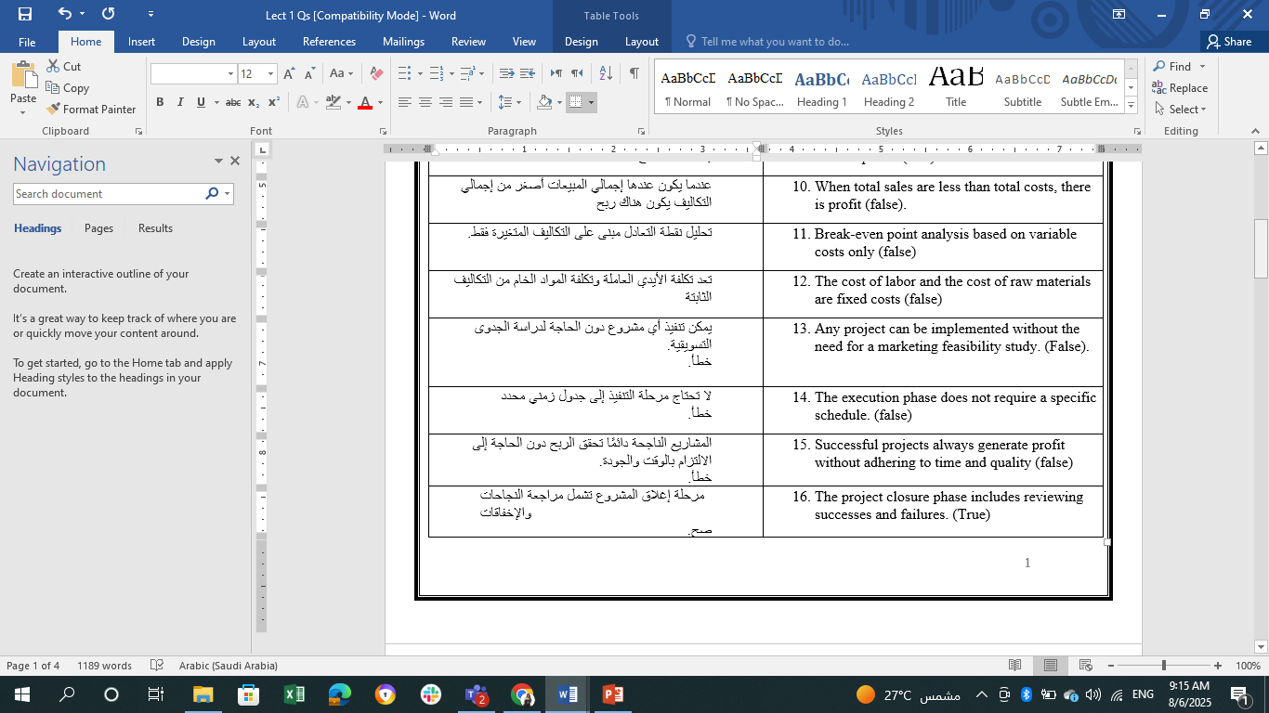
Questions
.

Slide 43
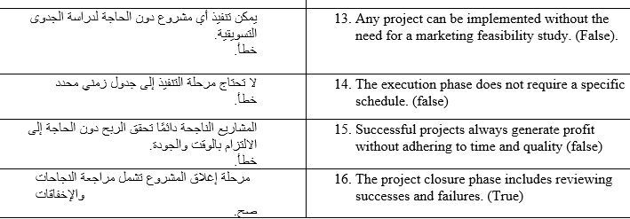
Questions
.

Slide 44


Thank You

