Slide 1


College of Management
Business Ethics
Lecturer: Dr. Raef Baraka
PMG 750
Lecture 06

Slide 2

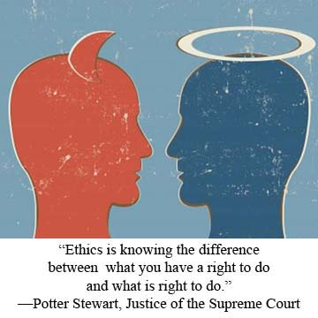
Chapter 6: INDIVIDUAL FACTORS: MORAL PHILOSOPHIES AND VALUES
CHAPTER OBJECTIVES:
Understand how moral philosophies and values influence individual and group ethical decision-making in business.
Compare and contrast the teleological, deontological, virtue, and justice perspectives of moral philosophy.
Discuss the impact of philosophies on business ethics.

Slide 3
Chapter 6: INDIVIDUAL FACTORS: MORAL PHILOSOPHIES AND VALUES
CHAPTER OBJECTIVES:
Recognize the stages of cognitive moral development and its shortcomings.
Introduce white-collar crime as it relates to moral philosophies, values, and corporate culture.

Slide 4
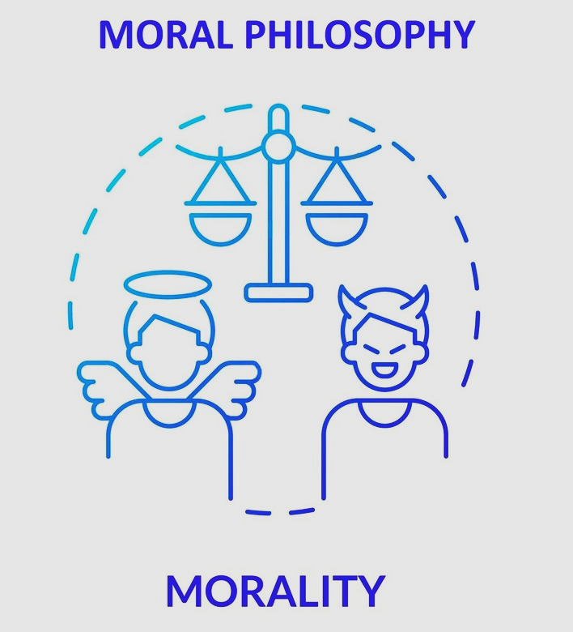
INDIVIDUAL FACTORS: MORAL PHILOSOPHIES AND VALUES
MORAL PHILOSOPHY DEFINED

Slide 5
INDIVIDUAL FACTORS: MORAL PHILOSOPHIES AND VALUES
Moral Philosophy Defined
When people talk about philosophy, they usually refer to the general system of values by which they live.
Moral philosophy, on the other hand, refers to the specific principles or values people use to decide what is right and wrong.
It is important to understand the distinction between moral philosophies and business ethics.
Moral philosophies are person-specific, while business ethics is based on decisions made by groups or when carrying out tasks to meet business objectives.
A moral philosophy is a person’s principles and values.

Slide 6
INDIVIDUAL FACTORS: MORAL PHILOSOPHIES AND VALUES
Moral Philosophy Defined
In the context of business, ethics refers to what the group, firm, or organization defines as right or wrong actions that pertain to its business operations and the objective of profits, earnings per share, or some other financial measure of success.
Moral philosophies are guidelines for “determining how conflicts in human interests are to be settled and for optimizing the mutual benefit of people living together in groups.
These philosophies direct people as they formulate business strategies and resolve specific ethical issues. However, there is no single moral philosophy that everyone accepts. Moral philosophies are often used to defend a particular type of economic system and individuals’ behavior within these systems.

Slide 7
INDIVIDUAL FACTORS: MORAL PHILOSOPHIES AND VALUES
Moral Philosophy Defined
People facing ethical issues often base their decisions on their own morals, values, or principles of right or wrong, most of which they learned through the socialization process with the help of family members, social groups, religions, and formal education.
Individual factors that influence decision making include personal moral philosophies.
Ethical dilemmas arise in problem-solving situations when the rules governing decision-making are vague or in conflict.
In real-life situations, there is no substitute for an individual’s own critical thinking and ability to accept responsibility for his or her decisions.

Slide 8
INDIVIDUAL FACTORS: MORAL PHILOSOPHIES AND VALUES
Moral Philosophy Defined
In reality, the decision maker would probably have many more factors to consider in making his or her choice and thus might reach a different decision,
We introduce the concept of goodness and several types of moral philosophy:
  teleology,
  deontology,
  the relativist perspective,
  virtue ethics, and
  justice
To appreciate moral philosophy, you must understand the different perspectives on the notion of goodness.

Slide 9
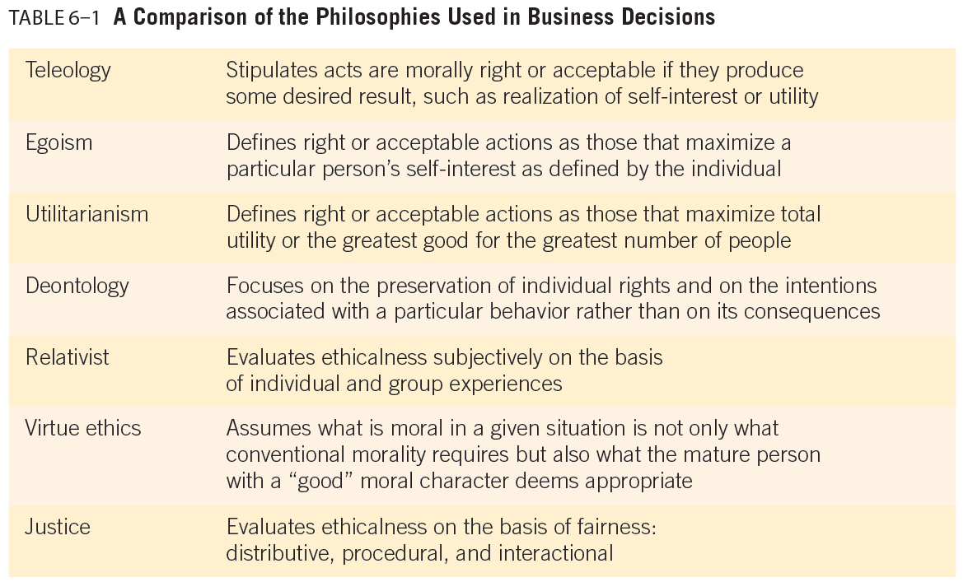
INDIVIDUAL FACTORS: MORAL PHILOSOPHIES AND VALUES

Slide 10

INDIVIDUAL FACTORS: MORAL PHILOSOPHIES AND VALUES
THE CONCEPT OF GOODNESS

Slide 11
INDIVIDUAL FACTORS: MORAL PHILOSOPHIES AND VALUES
The concept of goodness
Two basic concepts of goodness are monism and pluralism:
Monists believe only one thing is intrinsically good, and
Pluralists believe two or more things are intrinsically good.
Monists are often characterized by hedonism—the idea that pleasure is the ultimate good, or the best moral end involves the greatest balance of pleasure over pain.
Hedonism defines right or acceptable behavior as that which maximizes personal pleasure.
Moral philosophers describe those who believe more pleasure is better as quantitative hedonists and those who believe it is possible to get too much of a good thing (such as pleasure) as qualitative hedonists.

Slide 12
INDIVIDUAL FACTORS: MORAL PHILOSOPHIES AND VALUES
The concept of goodness
Pluralists, often referred to as non-hedonists, take the opposite position that no one thing is intrinsically good.
For example, a pluralist might view beauty, aesthetic experience, knowledge, and personal affection as ultimate goods.
Plato argued that the good life is a mixture of
(1) moderation and fitness,
(2) proportion and beauty,
(3) intelligence and wisdom,
(4) sciences and arts, and
(5) pure pleasures of the soul.

Slide 13
INDIVIDUAL FACTORS: MORAL PHILOSOPHIES AND VALUES
The concept of goodness
Discussion of moral value often revolves around the nature of goodness, but theories of moral obligation change the question to “What makes an action right or obligatory?”
Goodness theories typically focus on the result of actions and the goodness or happiness created by them.
Obligation theories emphasize the means and motives by which actions are justified and are divided into the categories of teleology and deontology.

Slide 14
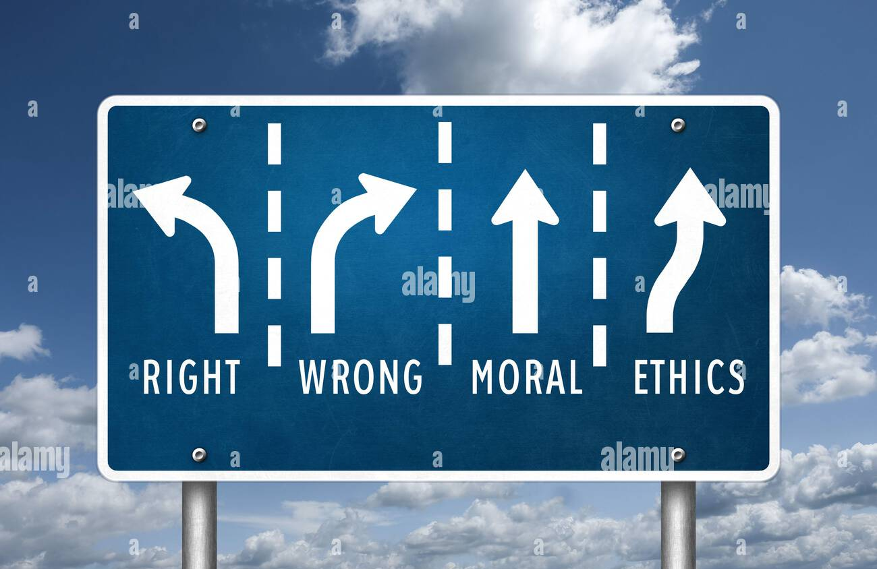
INDIVIDUAL FACTORS: MORAL PHILOSOPHIES AND VALUES
MORAL PHILOSOPHIES

Slide 15
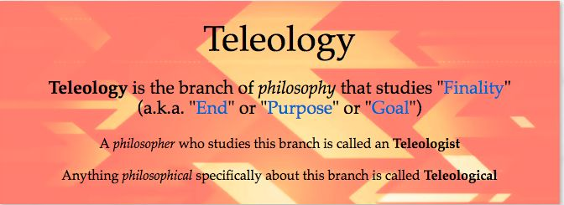
INDIVIDUAL FACTORS: MORAL PHILOSOPHIES AND VALUES
1. Moral Philosophy: Teleology

Slide 16
INDIVIDUAL FACTORS: MORAL PHILOSOPHIES AND VALUES
1. Moral Philosophy: Teleology
Teleology (from the Greek word for “end” or “purpose”) refers to moral philosophies in which an act is considered morally right or acceptable if it produces some desired result, such as pleasure, knowledge, career growth, the realization of self-interest, utility, wealth, or even fame.
Teleological philosophies assess the moral worth of a behavior by looking at its consequences, and thus, moral philosophers today often refer to these theories as consequentialism.
Two important teleological philosophies that often guide decision-making in individual business decisions are egoism and utilitarianism.

Slide 17
INDIVIDUAL FACTORS: MORAL PHILOSOPHIES AND VALUES
1. Moral Philosophy: Teleology
Egoism defines right or acceptable behavior in terms of its consequences for the individual.
Egoists believe they should make decisions that maximize their own self-interest, which is defined differently by each individual.
Depending on the egoist, self-interest may be construed as physical well-being, power, pleasure, fame, a satisfying career, a good family life, wealth, or something else.
In an ethical decision-making situation, an egoist will probably choose the alternative that contributes most to his or her self-interest.

Slide 18
INDIVIDUAL FACTORS: MORAL PHILOSOPHIES AND VALUES
1. Moral Philosophy: Teleology
Utilitarianism is concerned with consequences, but unlike the egoist, the utilitarian seeks the greatest good for the greatest number of people.
Utilitarians believe they should make decisions that result in the greatest total utility or the greatest benefit for all those affected by a decision.
For instance, one might use a utilitarianism perspective to argue for companies that legally sell harmful products, such as tobacco, guns, or alcohol.
It has been argued that, despite their drawbacks, allowing them to be sold legally is less harmful than having them sold illegally and unregulated.
Utilitarian decision making relies on a systematic comparison of the costs and benefits to all affected parties.

Slide 19
INDIVIDUAL FACTORS: MORAL PHILOSOPHIES AND VALUES
1. Moral Philosophy: Teleology
Using such a cost–benefit analysis, a utilitarian decision maker calculates the utility of the consequences of all possible alternatives and then selects the one that results in the greatest benefit.
In evaluating an action’s consequences, utilitarians must consider all of the potential costs and benefits for all of the people affected by a decision.
Utilitarians use various criteria to evaluate the morality of an action.
Some utilitarian philosophers argue that general rules should be followed to decide which action is best.
These rule utilitarians determine behavior based on principles or rules designed to promote the greatest utility, rather than on individual examinations of each situation they encounter.

Slide 20

INDIVIDUAL FACTORS: MORAL PHILOSOPHIES AND VALUES
2. Moral Philosophy: Deontology

Slide 21
INDIVIDUAL FACTORS: MORAL PHILOSOPHIES AND VALUES
2. Moral Philosophy: Deontology
Deontology (from the Greek word for “ethics”) refers to moral philosophies that focus on the rights of individuals and the intentions associated with a particular behavior rather than its consequences.
Fundamental to deontological theory is the idea that equal respect must be given to all persons.
Unlike utilitarians, deontologists argue that there are some things we should not do, even to maximize utility.
For example, deontologists would consider it wrong to kill an innocent person or commit a serious injustice against someone, no matter how much greater social utility might result from doing so, because such an action would infringe on individual rights.

Slide 22
INDIVIDUAL FACTORS: MORAL PHILOSOPHIES AND VALUES
2. Moral Philosophy: Deontology
The utilitarian, however, might consider an action resulting in a person’s death acceptable if that action leads to some greater benefit.
Deontological philosophies regard certain behaviors as inherently right, and the determination of this rightness focuses on the individual actor, not on society.
Therefore, these perspectives are sometimes referred to as non-consequentialism, a system of ethics based on respect for persons.
The term nature is crucial for deontologists.
In general, deontologists regard the nature of moral principles as permanent and stable, and they believe compliance with these principles defines ethicalness..

Slide 23
INDIVIDUAL FACTORS: MORAL PHILOSOPHIES AND VALUES
2. Moral Philosophy: Deontology
Deontologists believe individuals have certain absolute rights, including freedom of conscience, freedom of consent, freedom of privacy, freedom of speech, and due process.
To decide if a behavior is ethical, deontologists look for conformity to moral principles.
For example, if a manufacturing worker becomes ill or dies as a result of conditions in the workplace, a deontologist might argue that the company must modify its production processes to correct the condition, no matter what the cost, even if it means bankrupting the company and thus causing all workers to lose their jobs.

Slide 24
INDIVIDUAL FACTORS: MORAL PHILOSOPHIES AND VALUES
2. Moral Philosophy: Deontology
Deontologists believe individuals have certain absolute rights, including freedom of conscience, freedom of consent, freedom of privacy, freedom of speech, and due process.
To decide if a behavior is ethical, deontologists look for conformity to moral principles.
For example, if a manufacturing worker becomes ill or dies as a result of conditions in the workplace, a deontologist might argue that the company must modify its production processes to correct the condition, no matter what the cost, even if it means bankrupting the company and thus causing all workers to lose their jobs.
In contrast, a utilitarian would analyze all the costs and benefits of modifying production processes and make a decision on that basis.

Slide 25
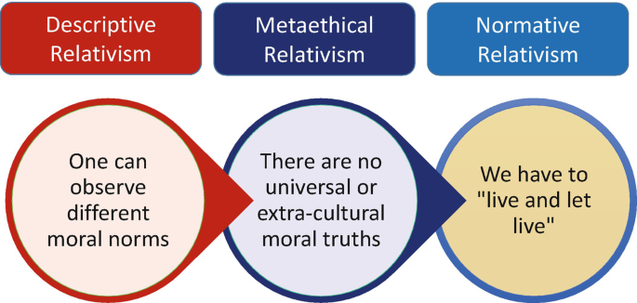
INDIVIDUAL FACTORS: MORAL PHILOSOPHIES AND VALUES
3. Moral Philosophy: Relativist Perspective

Slide 26
INDIVIDUAL FACTORS: MORAL PHILOSOPHIES AND VALUES
3. Moral Philosophy: Relativist Perspective
The Relativist Perspective of ethical behavior is derived subjectively from the experiences of individuals and groups.
Relativists use themselves or the people around them as their basis for defining ethical standards, and the various forms of relativism include descriptive, meta-ethical, and normative.
Descriptive relativism relates to observations of other cultures. Different cultures exhibit different norms, customs, and values, but these observations say nothing about the higher questions of ethical justification. At this point, meta-ethical relativism comes into play.

Slide 27
INDIVIDUAL FACTORS: MORAL PHILOSOPHIES AND VALUES
3. Moral Philosophy: Relativist Perspective
The Relativist Perspective of ethical behavior is derived subjectively from the experiences of individuals and groups.
Meta-ethical relativism proposes that people naturally see situations from their own perspectives, and there is no objective way of resolving ethical disputes between different value systems and individuals.
Simply put, one culture’s moral philosophy cannot logically be preferred to another’s because no meaningful basis for comparison exists.
Because ethical rules are embedded in a specific culture, the values and behaviors of people in one culture do not generally influence the behaviors of people in another culture.

Slide 28
INDIVIDUAL FACTORS: MORAL PHILOSOPHIES AND VALUES
3. Moral Philosophy: Relativist Perspective
The Relativist Perspective of ethical behavior is derived subjectively from the experiences of individuals and groups.
Normative relativism: At the individual level of reasoning, we have normative relativism. Normative relativists assume one person’s opinion is as good as another’s.
Basic relativism acknowledges that we live in a world in which people have many different views and bases from which to justify decisions as right or wrong.
The relativist looks to the interacting groups and tries to determine probable solutions based on group consensus.

Slide 29
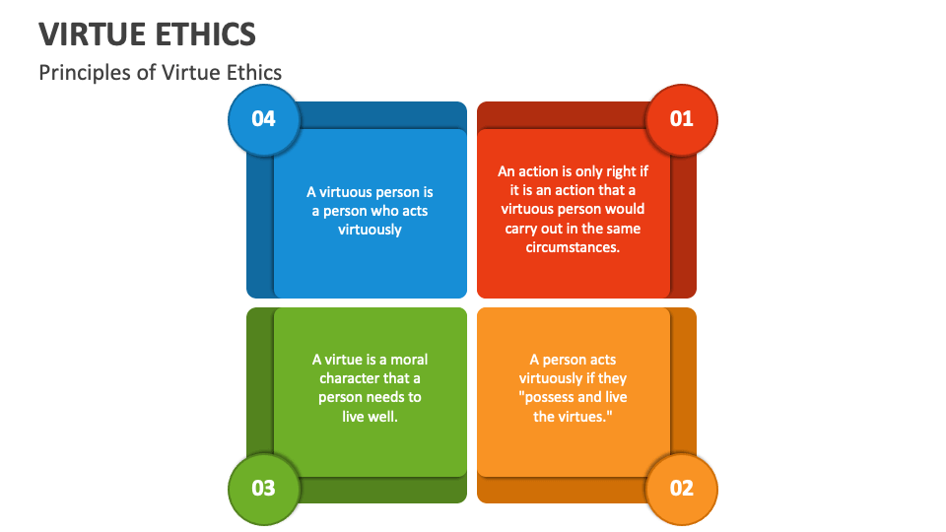
INDIVIDUAL FACTORS: MORAL PHILOSOPHIES AND VALUES
4. Moral Philosophy: Virtue Ethics

Slide 30
INDIVIDUAL FACTORS: MORAL PHILOSOPHIES AND VALUES
4. Moral Philosophy: Virtue Ethics
Virtue ethics argues that ethical behavior involves not only adhering to conventional moral standards but also considering what a mature person with a “good” moral character would deem appropriate in a given situation..
A virtue represents an acquired disposition valued as a part of an individual’s character.
As individuals develop socially, they come to behave in ways they consider to be moral.
A person with the virtue of honesty will be disposed to tell the truth because it is considered to be the right approach in terms of human communication.

Slide 31
INDIVIDUAL FACTORS: MORAL PHILOSOPHIES AND VALUES
4. Moral Philosophy: Virtue Ethics
The virtue ethics approach to business can be summarized as follows:
Good corporate ethics programs encourage individual virtue and integrity.
By the employee’s role in the community (organization), these virtues form a good person.
An individual’s ultimate purpose is to serve society’s demands and the public good and be rewarded in his or her career.
The well-being of the community goes hand in hand with individual excellence.
The elements of virtue most important to business transactions are trust, self-control, empathy, fairness, and truthfulness.

Slide 32
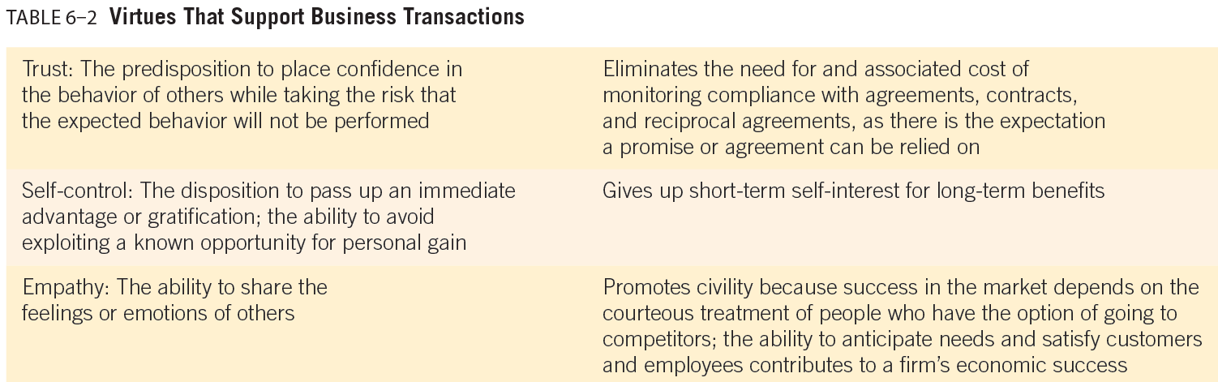
INDIVIDUAL FACTORS: MORAL PHILOSOPHIES AND VALUES
4. Moral Philosophy: Virtue Ethics

Slide 33
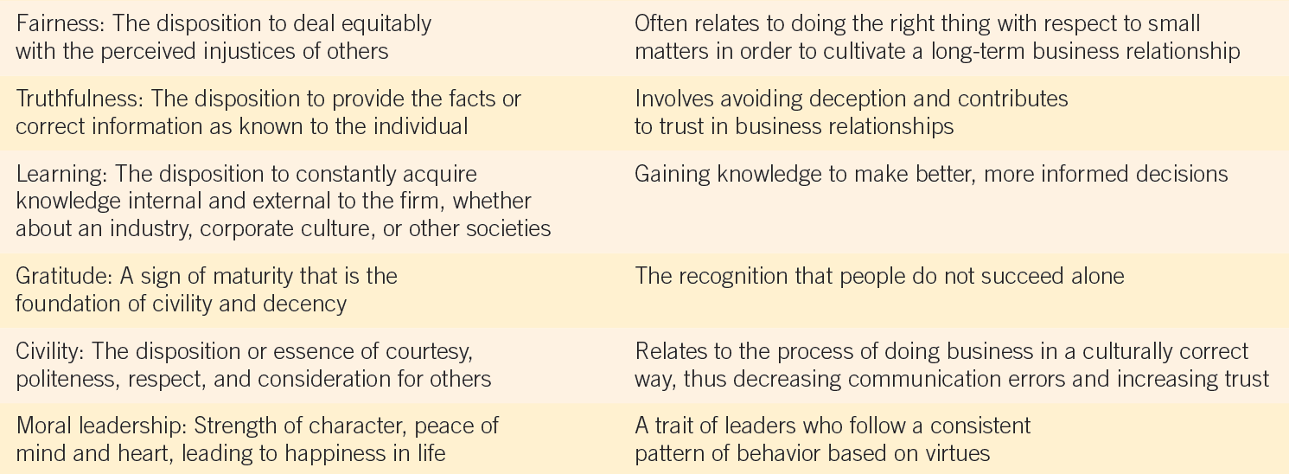
INDIVIDUAL FACTORS: MORAL PHILOSOPHIES AND VALUES
4. Moral Philosophy: Virtue Ethics

Slide 34

INDIVIDUAL FACTORS: MORAL PHILOSOPHIES AND VALUES
5. Moral Philosophy: Justice

Slide 35
INDIVIDUAL FACTORS: MORAL PHILOSOPHIES AND VALUES
5. Moral Philosophy: Justice
Justice is fair treatment and due reward in accordance with ethical or legal standards, including the disposition to deal with perceived injustices of others.
The justice of a situation is based on the perceived rights of individuals and on the intentions of the people involved in a business interaction.
In other words, justice relates to the issue of what individuals feel they are due based on their rights and performance in the workplace.
For this reason, justice is more likely to be based on deontological moral philosophies than on teleological or utilitarian philosophies.
Three types of justice provide a framework for evaluating different situations (see Table 6–3).

Slide 36
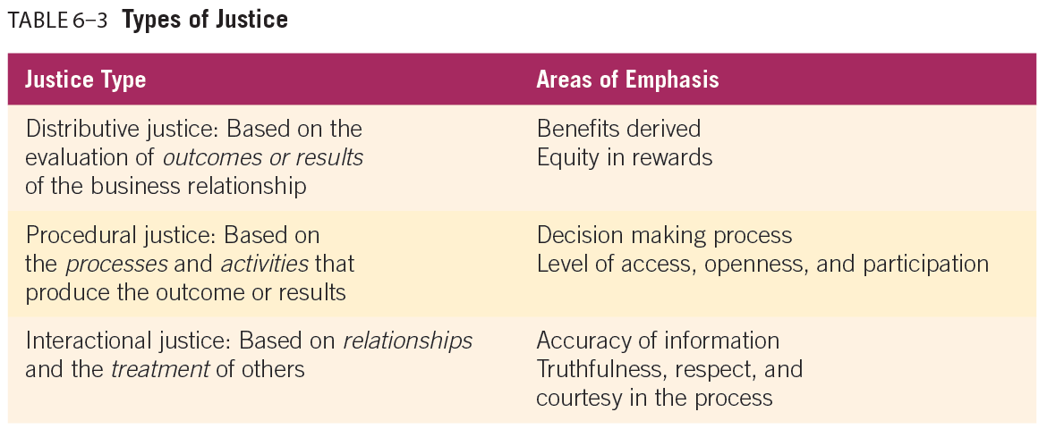
INDIVIDUAL FACTORS: MORAL PHILOSOPHIES AND VALUES
5. Moral Philosophy: Justice

Slide 37
INDIVIDUAL FACTORS: MORAL PHILOSOPHIES AND VALUES
5. Moral Philosophy: Justice
Three types of justice provide a framework for evaluating different situations:
Distributive justice is based on the evaluation of the outcomes or results of a business relationship. If some employees feel they are paid less than their coworkers for the same work, they have concerns about distributive justice.
Distributive justice is difficult to effect when one member of the business exchange intends to take advantage of the relationship.
A boss who forces his employees to do more work so he can take more time off would be unjust because he is taking advantage of his position. Situations such as this cause an imbalance in distributive justice

Slide 38
INDIVIDUAL FACTORS: MORAL PHILOSOPHIES AND VALUES
5. Moral Philosophy: Justice
Three types of justice provide a framework for evaluating different situations:
Procedural justice considers the processes and activities that produce a particular outcome.
A climate that emphasizes procedural justice positively influences employees’ attitudes and behaviors toward work-group cohesion.
The visibility of supervisors’ and the work group’s perceptions of their own cohesiveness are products of a climate of procedural justice.
When there is strong employee support for decisions, decision makers, organizations, and outcomes, procedural justice is less important to the individual.

Slide 39
INDIVIDUAL FACTORS: MORAL PHILOSOPHIES AND VALUES
5. Moral Philosophy: Justice
Three types of justice provide a framework for evaluating different situations:
Procedural justice considers the processes and activities that produce a particular outcome.
In contrast, when employees’ support for decisions, decision makers, organizations, or outcomes is not very strong, then procedural justice becomes more important.

Slide 40
INDIVIDUAL FACTORS: MORAL PHILOSOPHIES AND VALUES
5. Moral Philosophy: Justice
Three types of justice provide a framework for evaluating different situations:
Interactional justice is based on the relationships between organizational members, including the way employees and management treat one another.
Interactional justice is linked to fairness within member interactions.
Although interactional justice often refers to how managers treat their subordinates, employees can also be guilty of creating interactional justice disputes
For example, many employees admit they stay home when they are not really sick if they feel they can get away with it.
Such workplace absenteeism costs businesses millions of dollars each year.

Slide 41



Thank You

