Slide 1


Slide 2


Slide 3
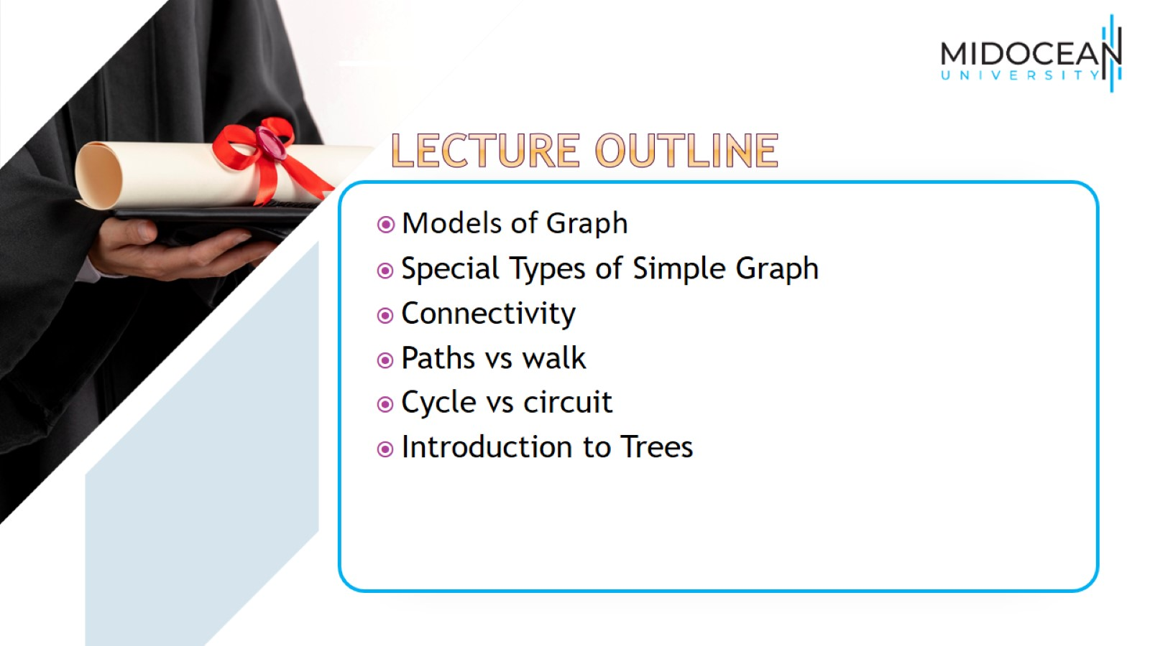

Slide 4
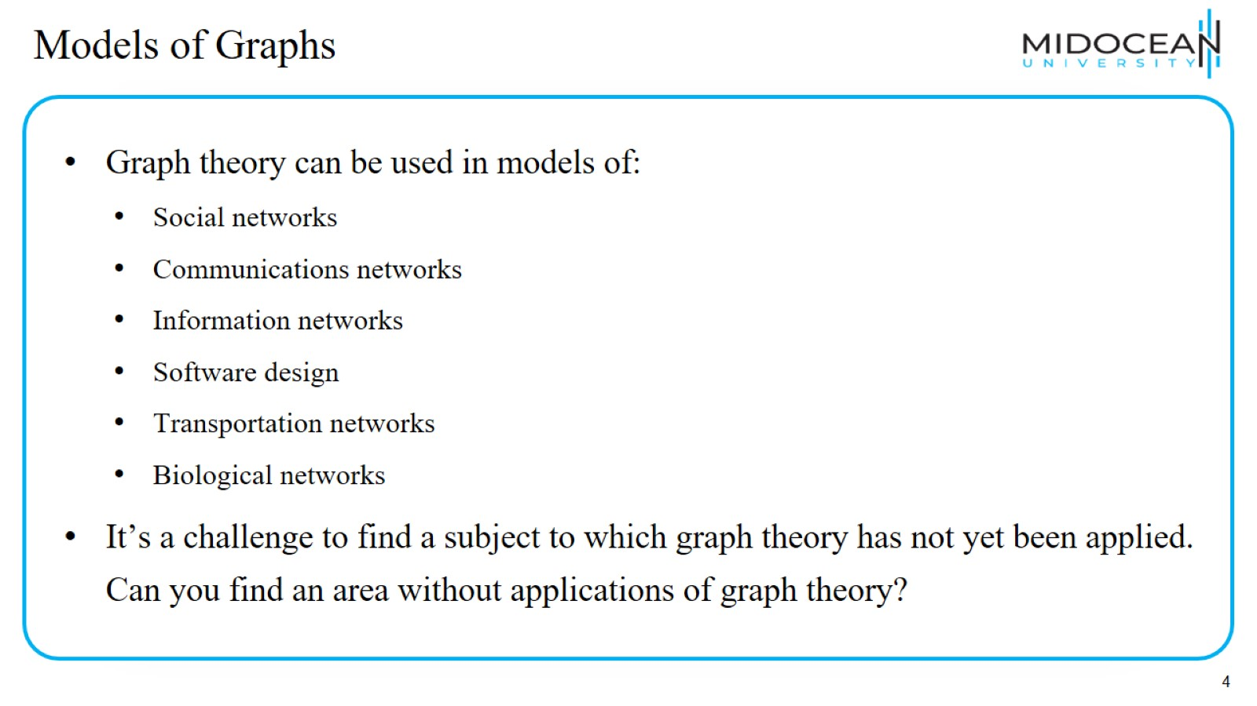
Models of Graphs

Slide 5
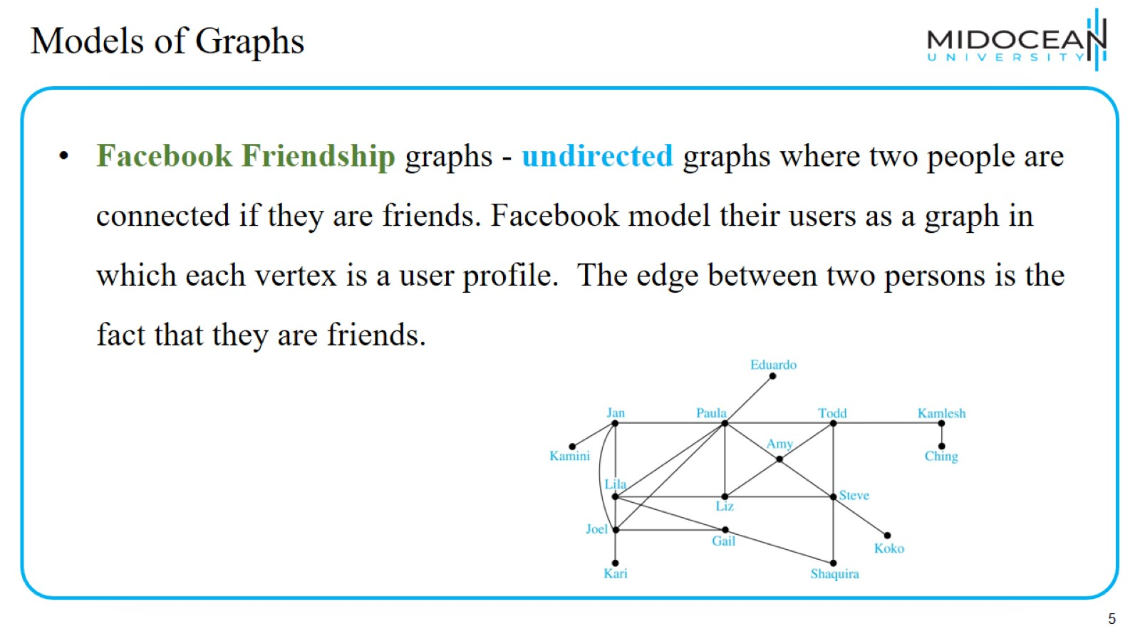
Models of Graphs

Slide 6
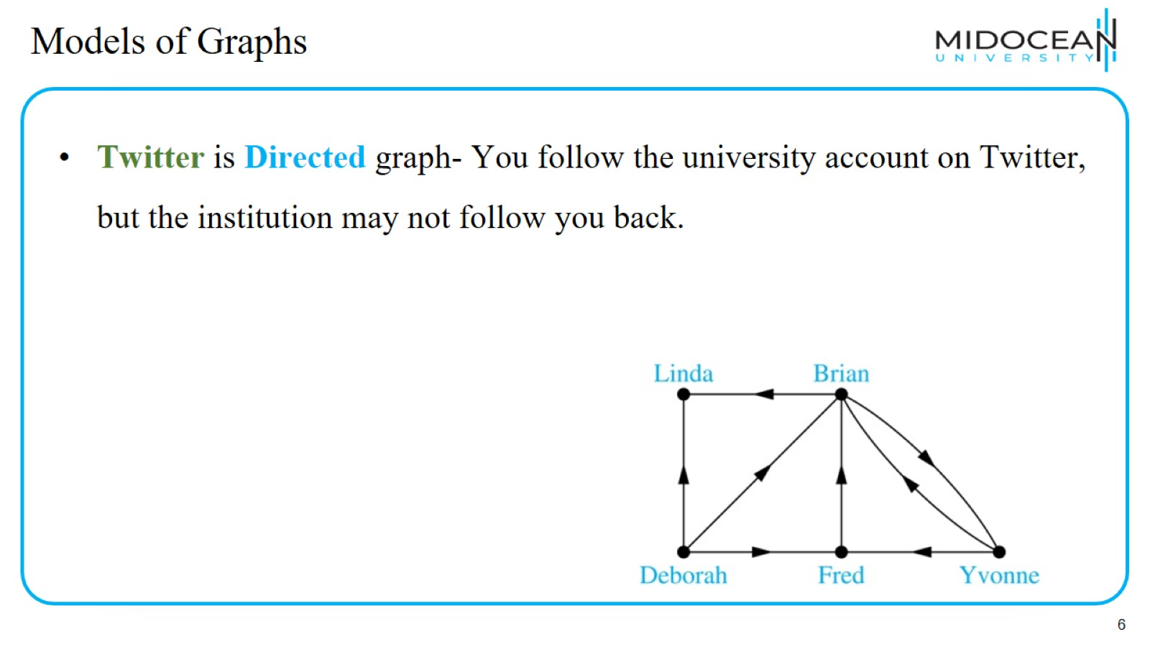
Models of Graphs

Slide 7
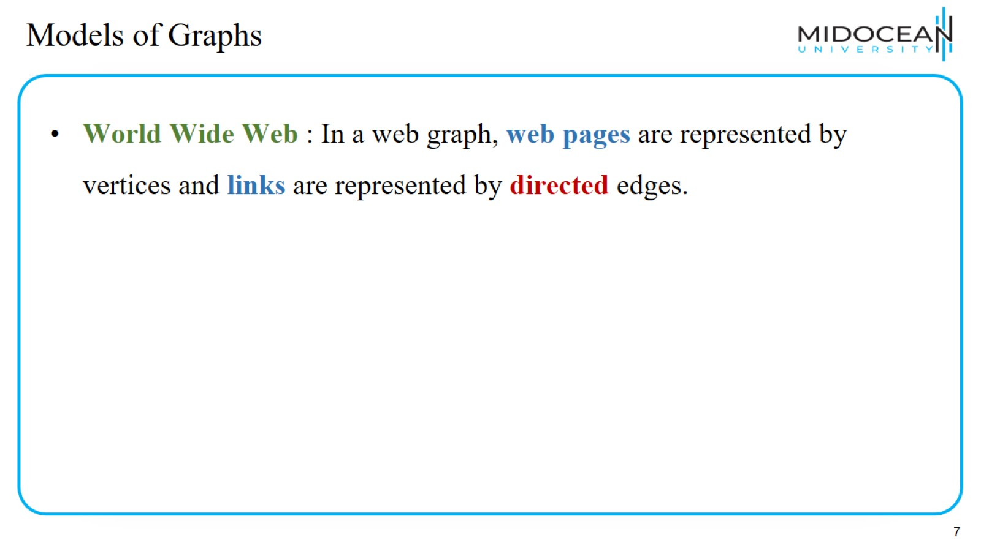
Models of Graphs

Slide 8
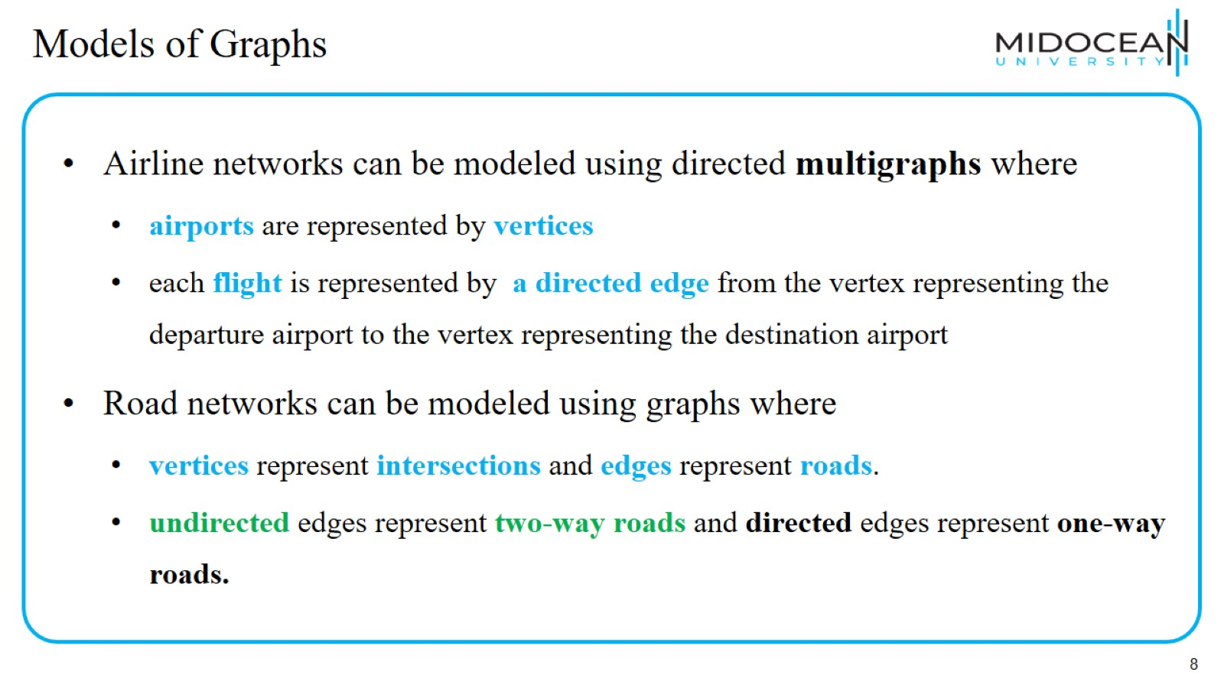
Models of Graphs

Slide 9
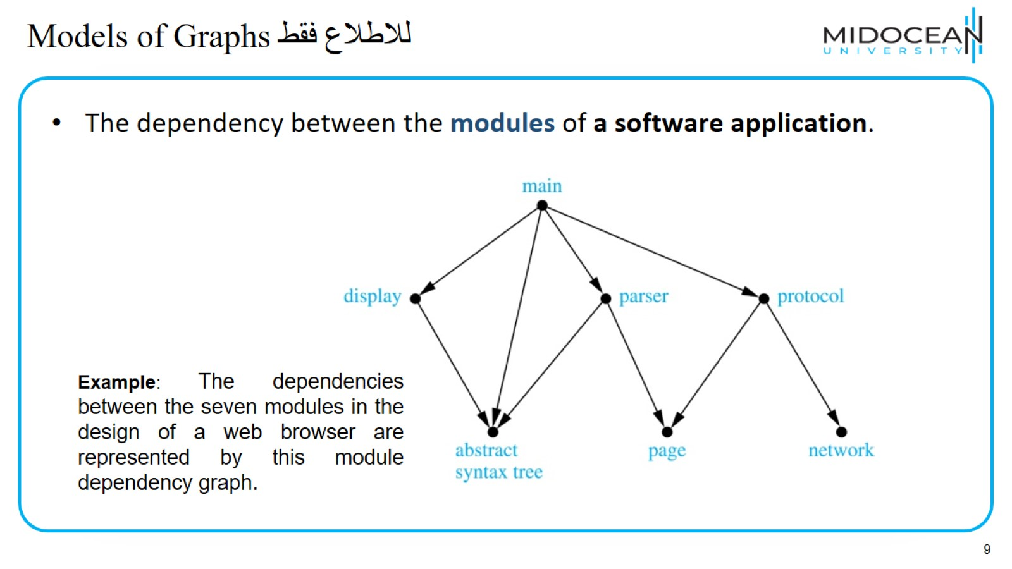
Models of Graphsللاطلاع فقط

Slide 10
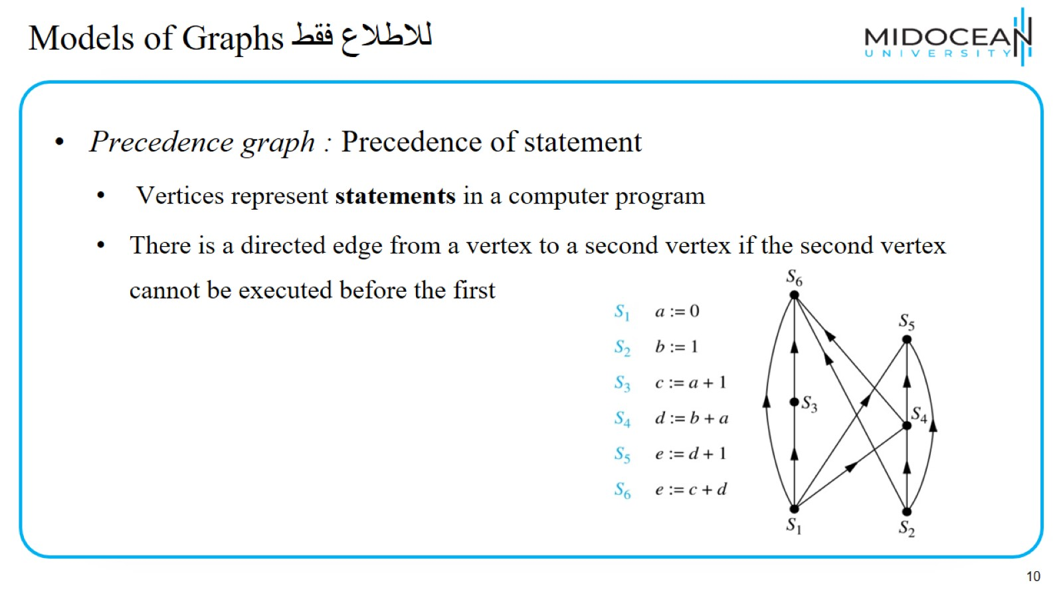
Models of Graphsللاطلاع فقط

Slide 11
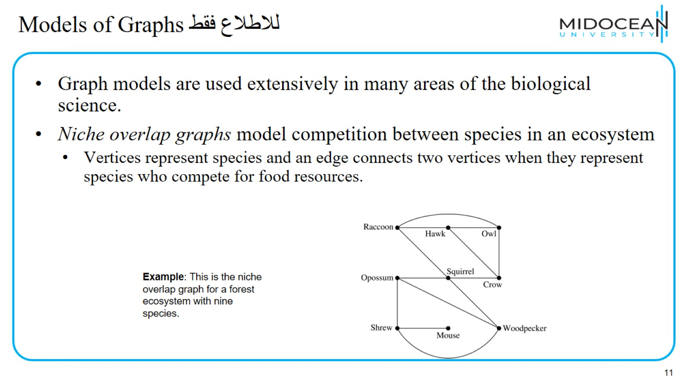
Models of Graphsللاطلاع فقط

Slide 12
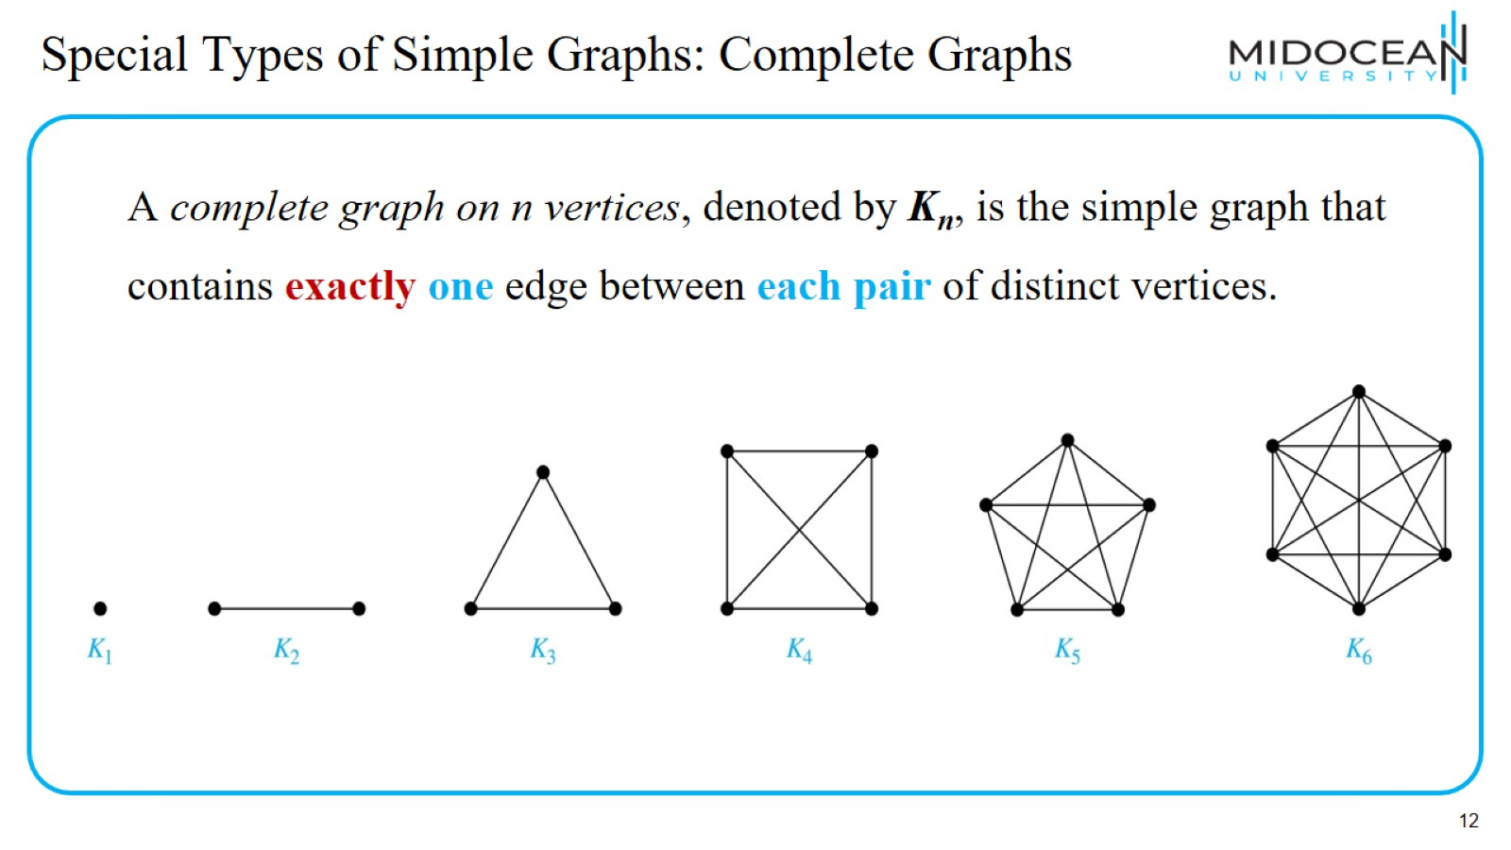
Special Types of Simple Graphs: Complete Graphs

Slide 13
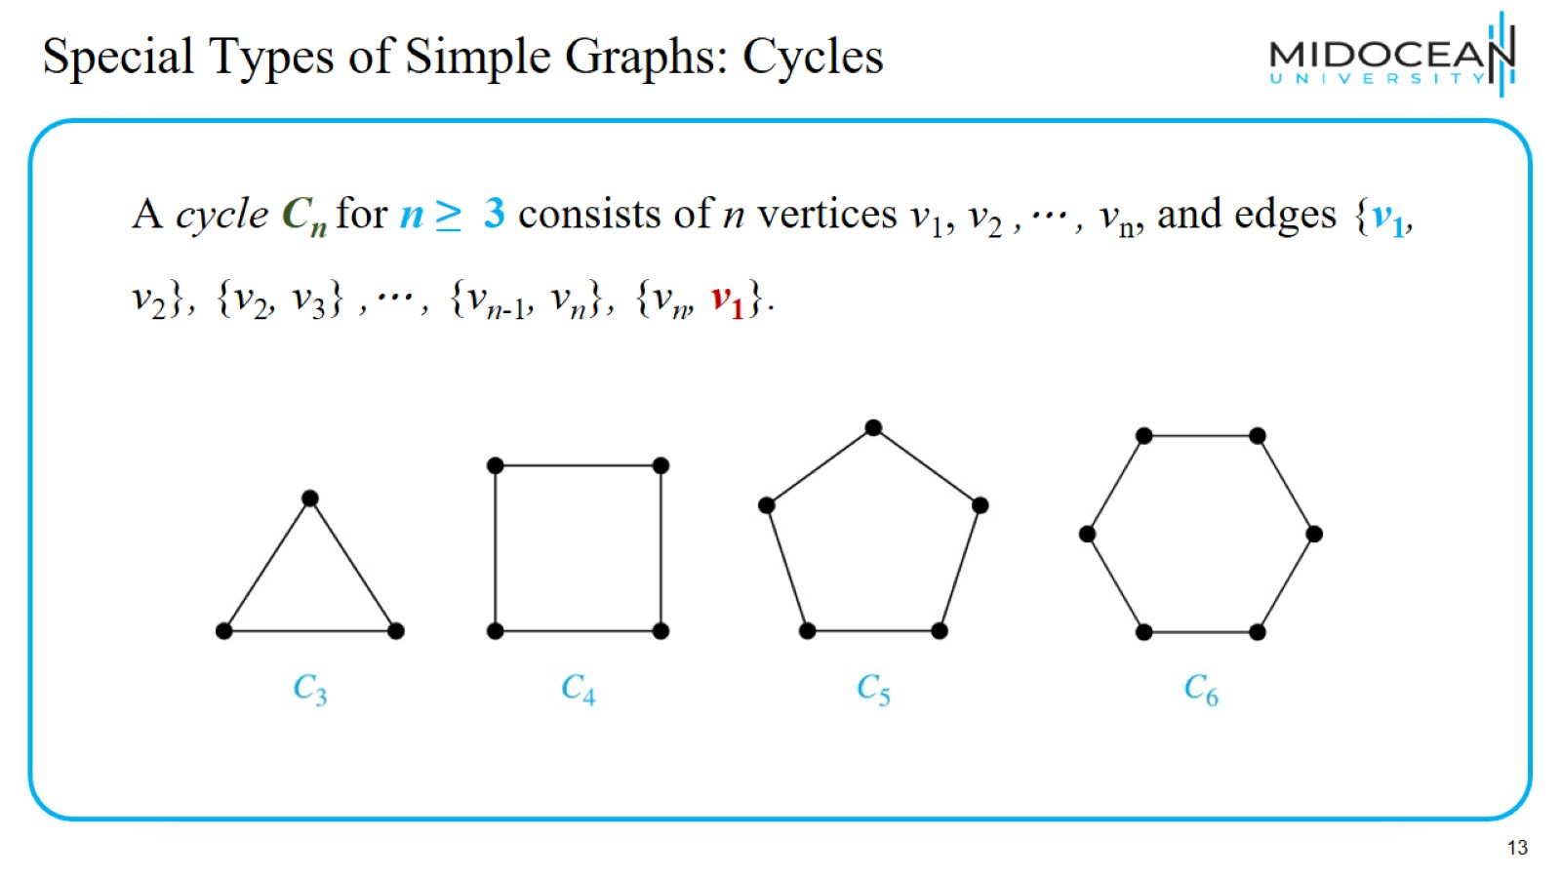
Special Types of Simple Graphs: Cycles

Slide 14
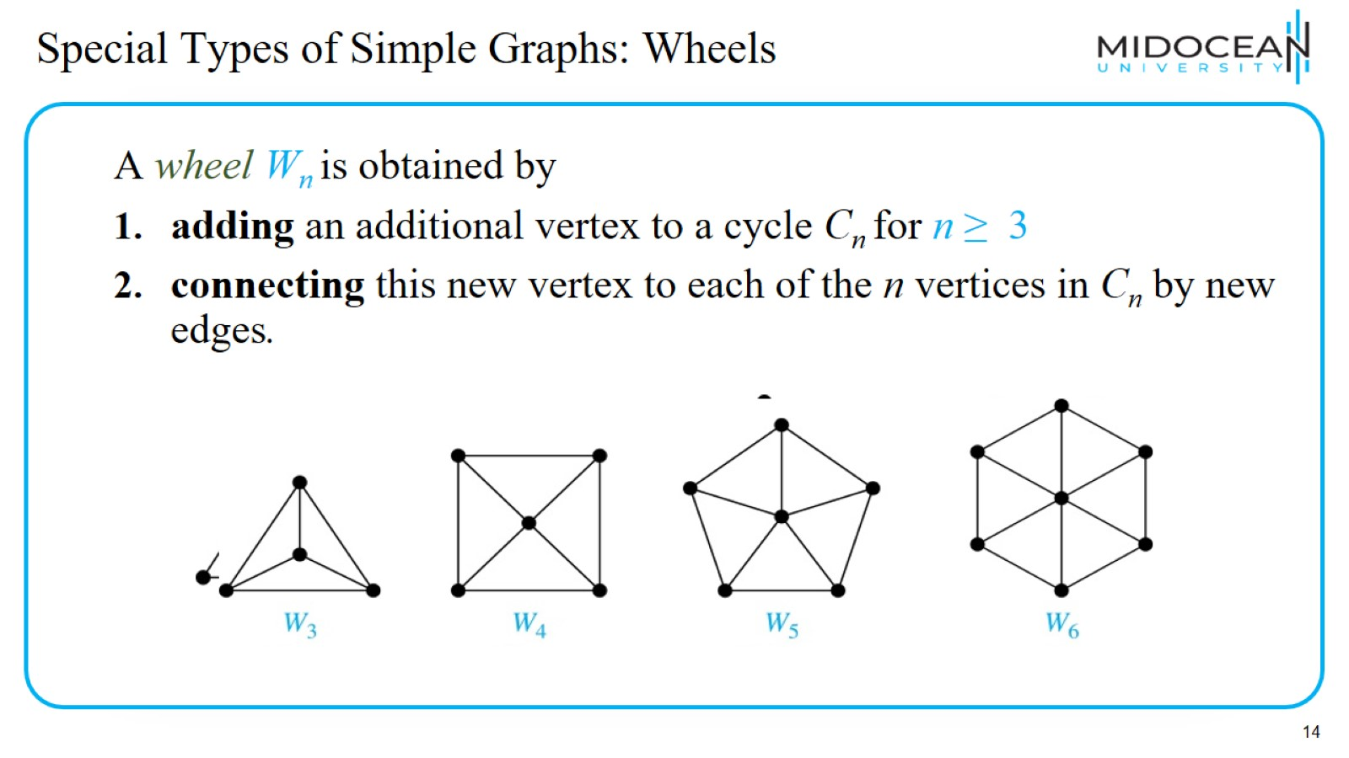
Special Types of Simple Graphs: Wheels

Slide 15
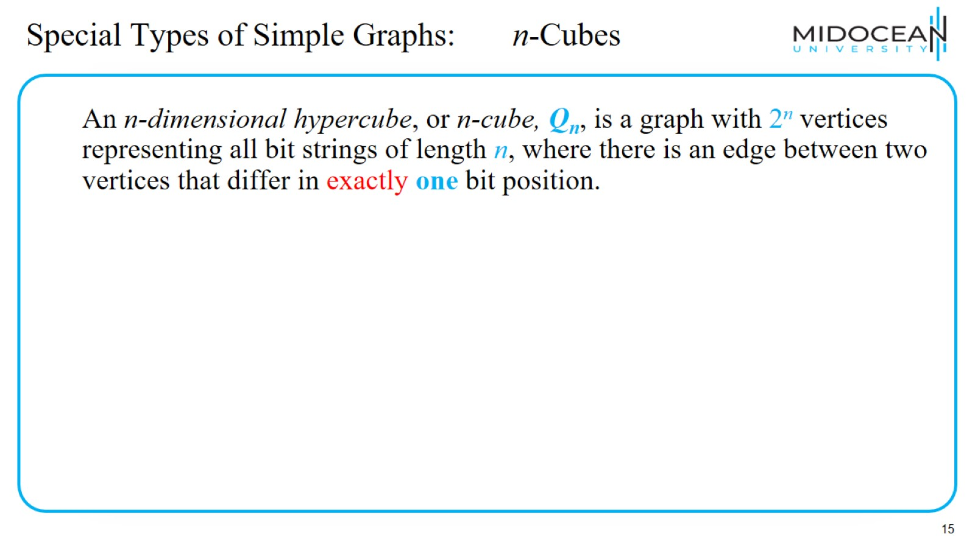
Special Types of Simple Graphs: n-Cubes

Slide 16
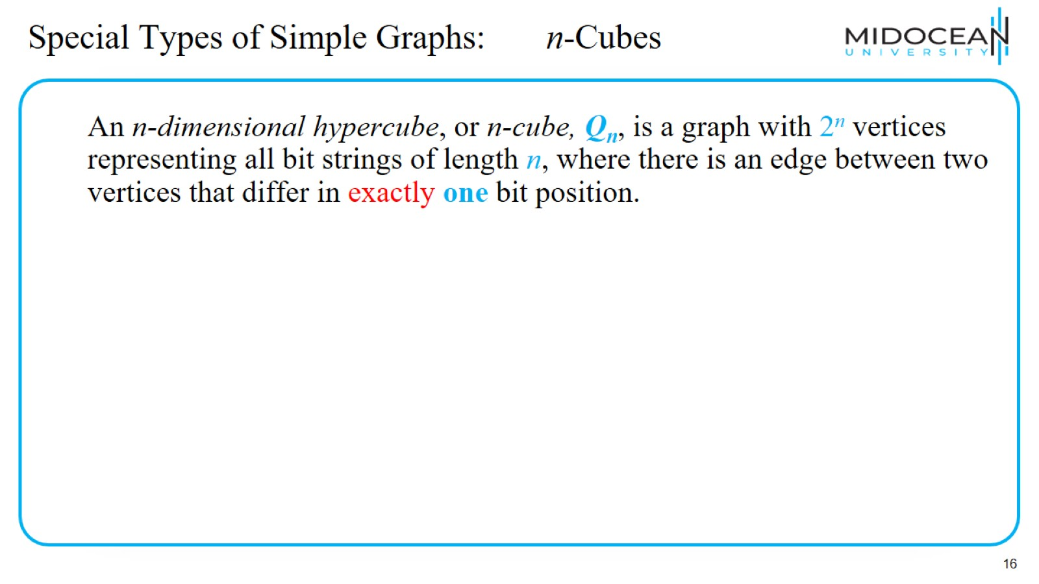
Special Types of Simple Graphs: n-Cubes

Slide 17
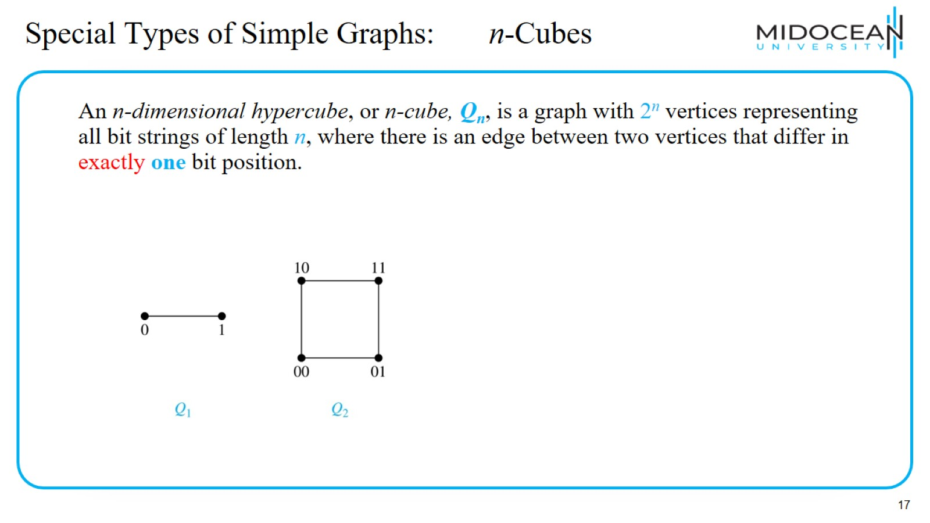
Special Types of Simple Graphs: n-Cubes

Slide 18
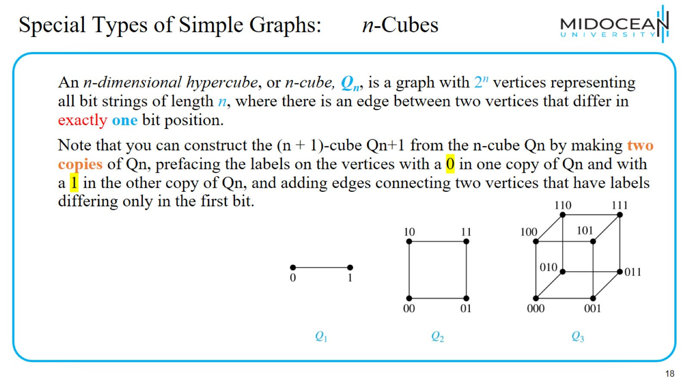
Special Types of Simple Graphs: n-Cubes

Slide 19
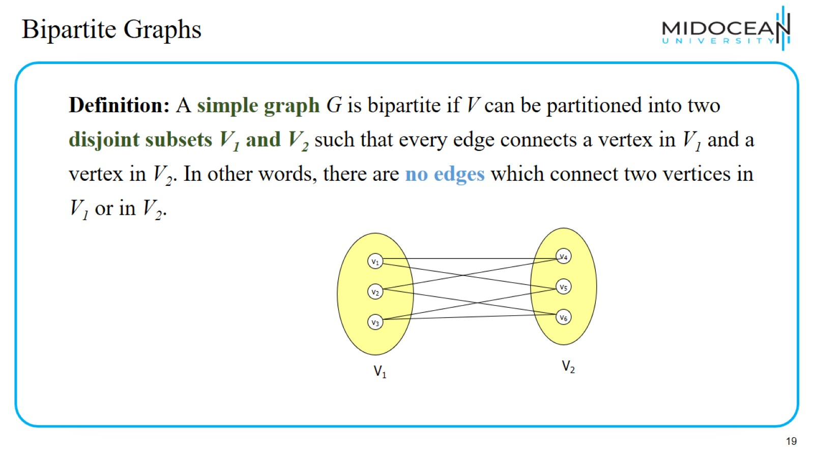
Bipartite Graphs

Slide 20
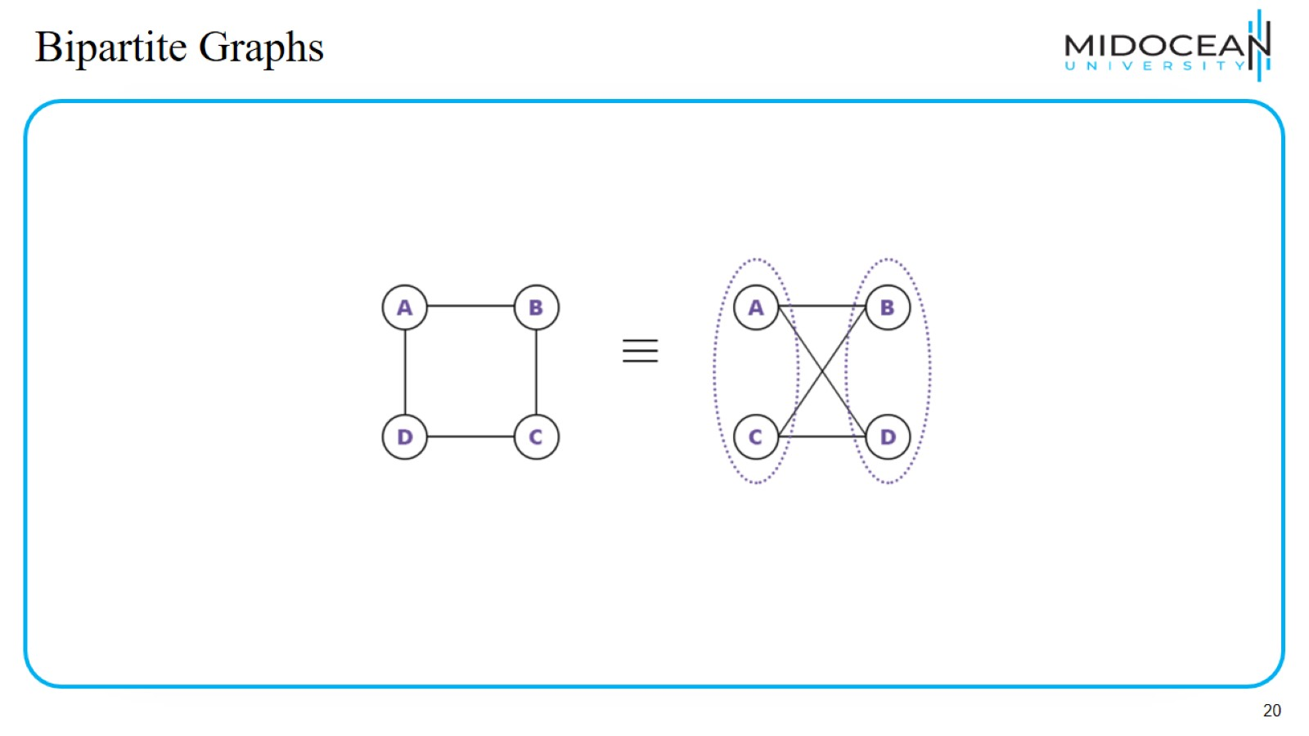
Bipartite Graphs

Slide 21
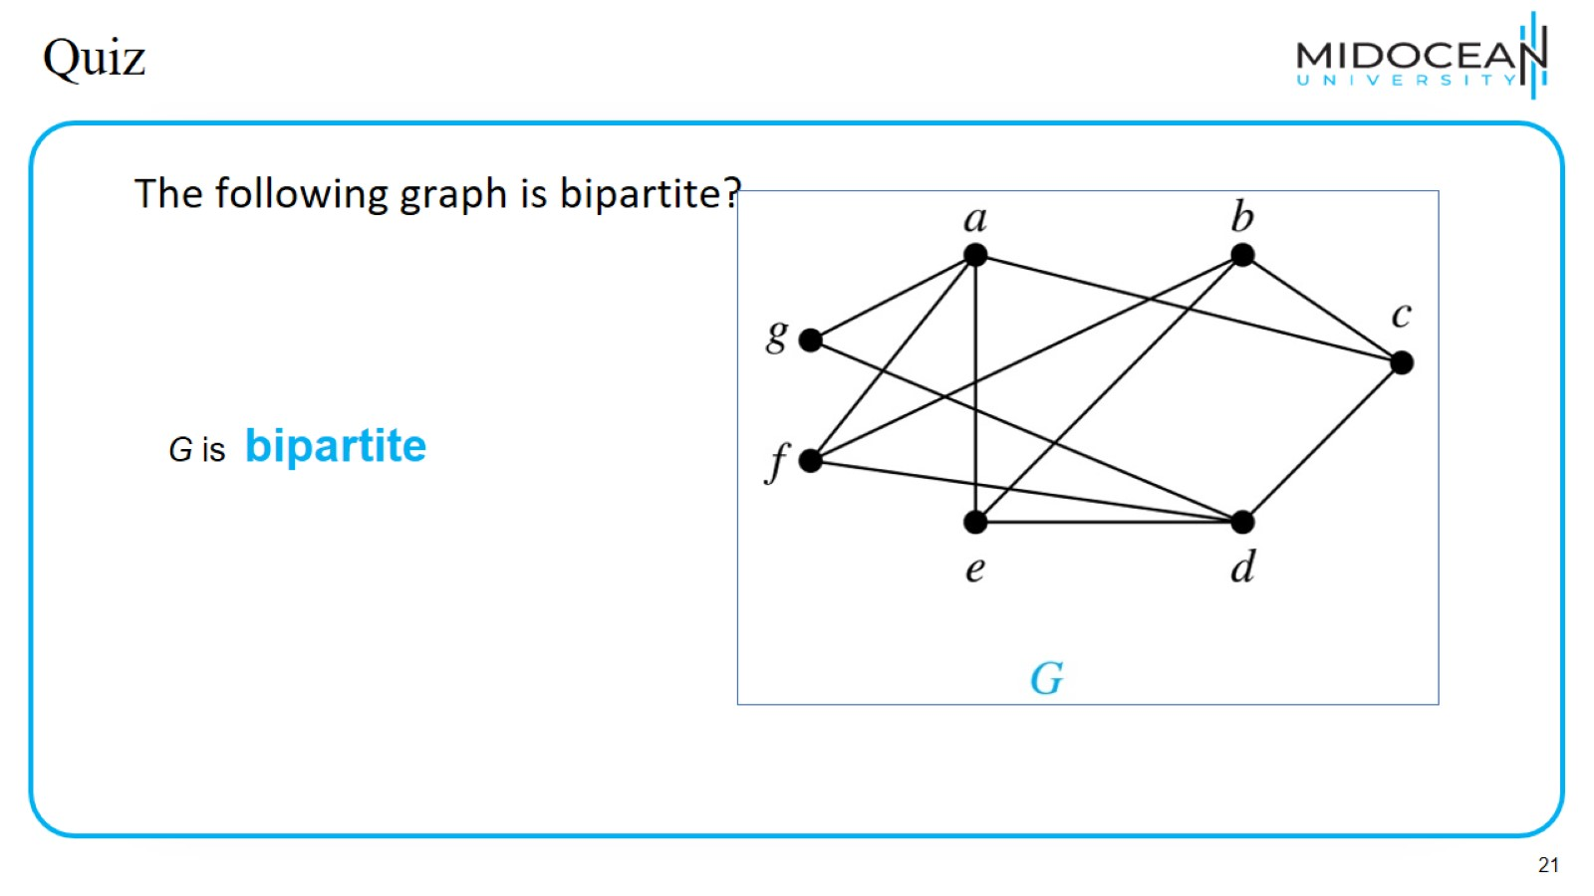
Quiz

Slide 22
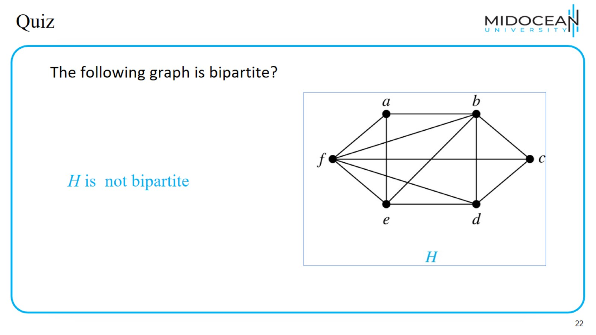
Quiz

Slide 23
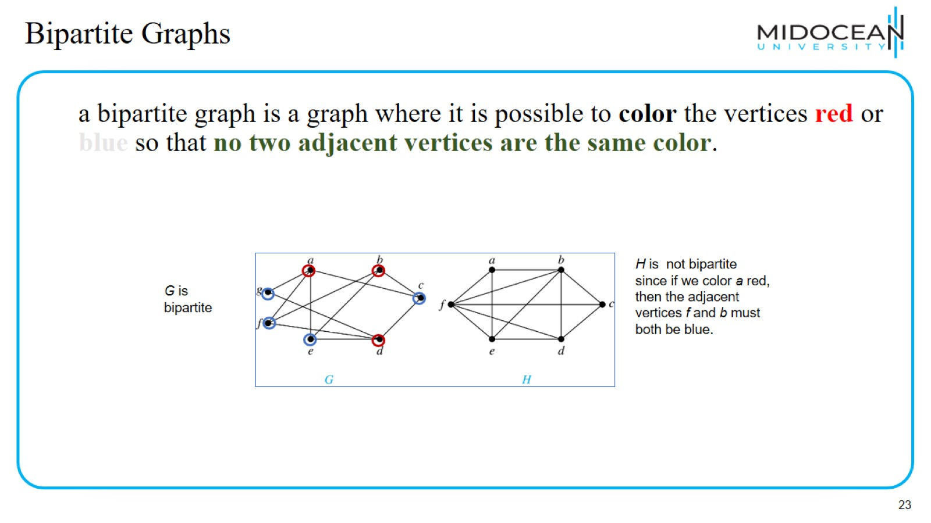
Bipartite Graphs

Slide 24
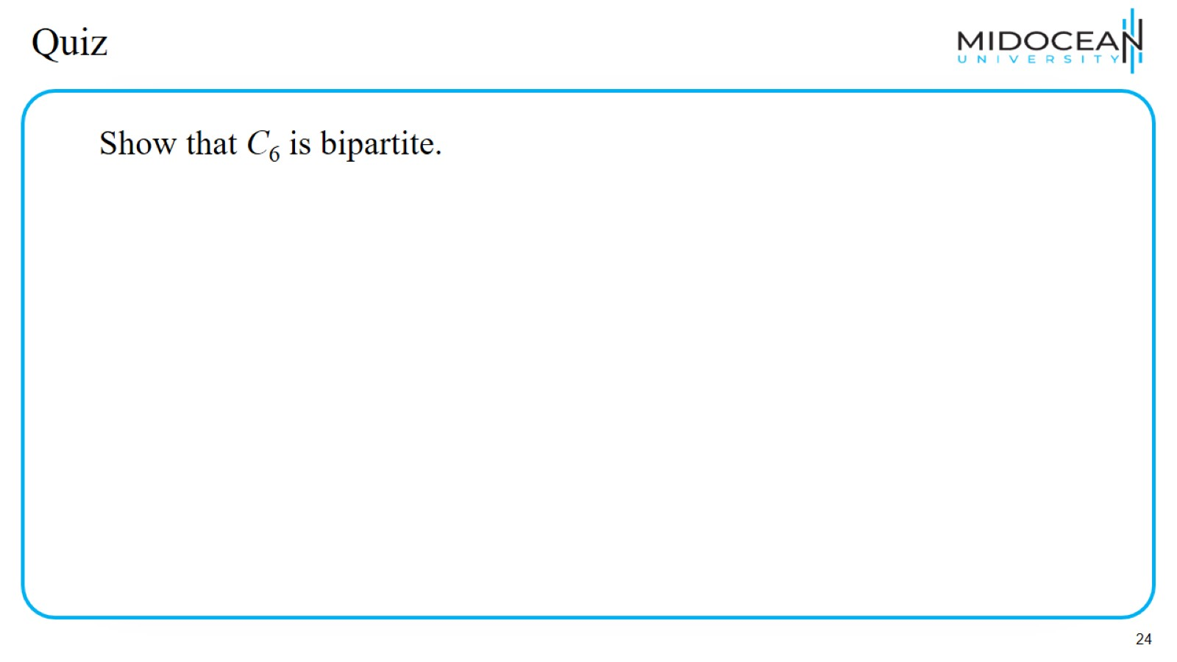
Quiz

Slide 25
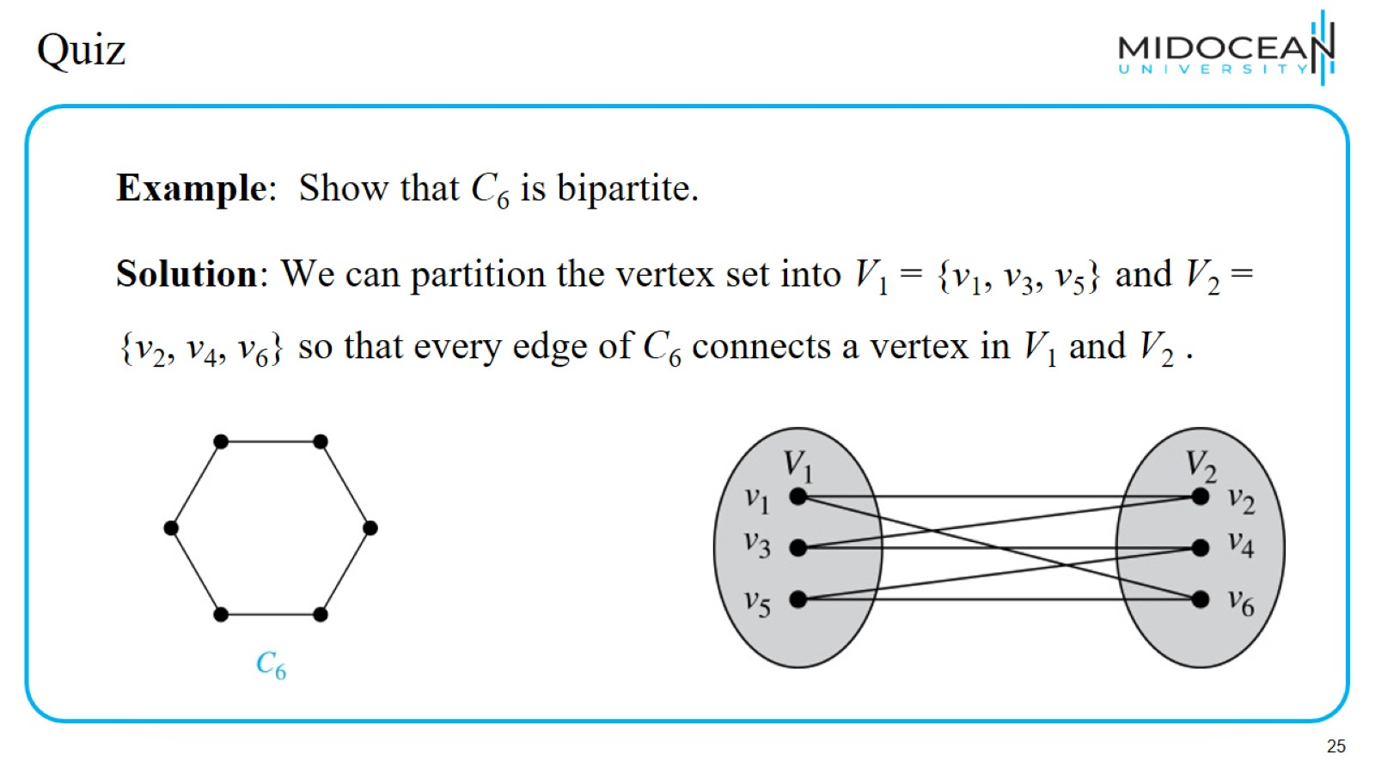
Quiz

Slide 26
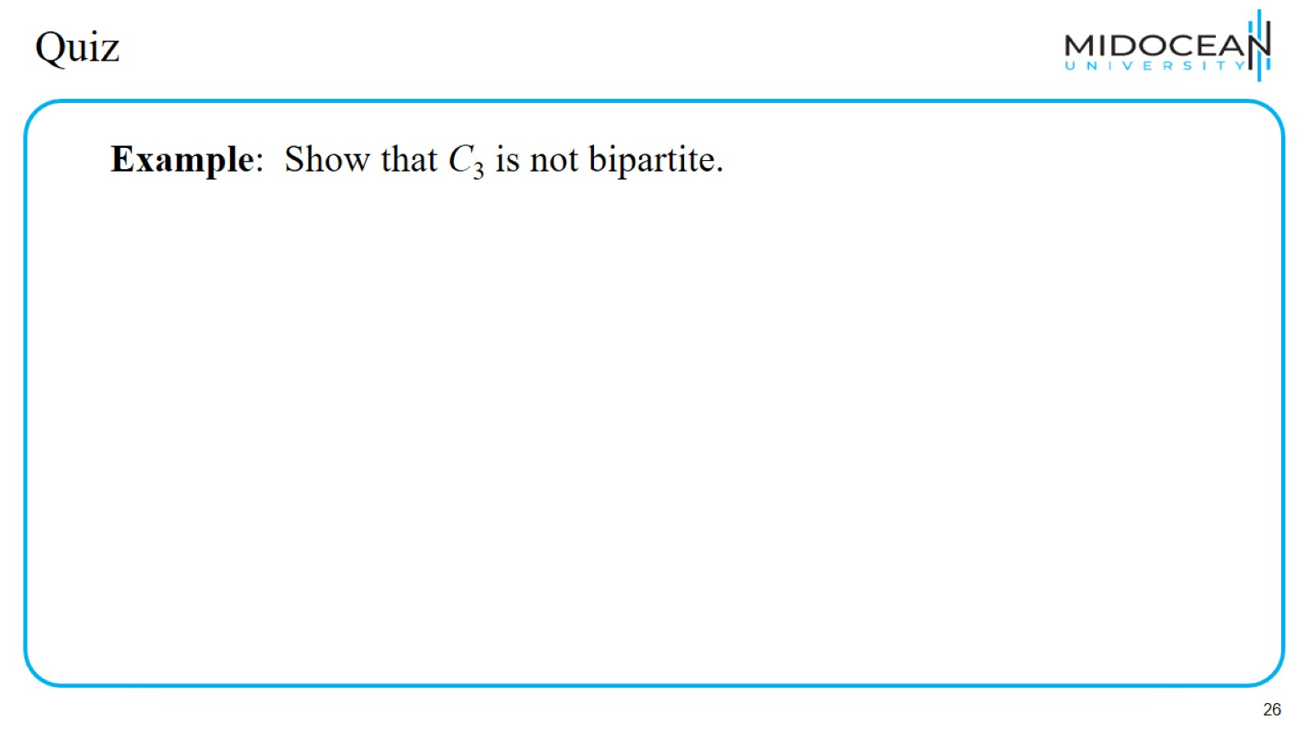
Quiz

Slide 27
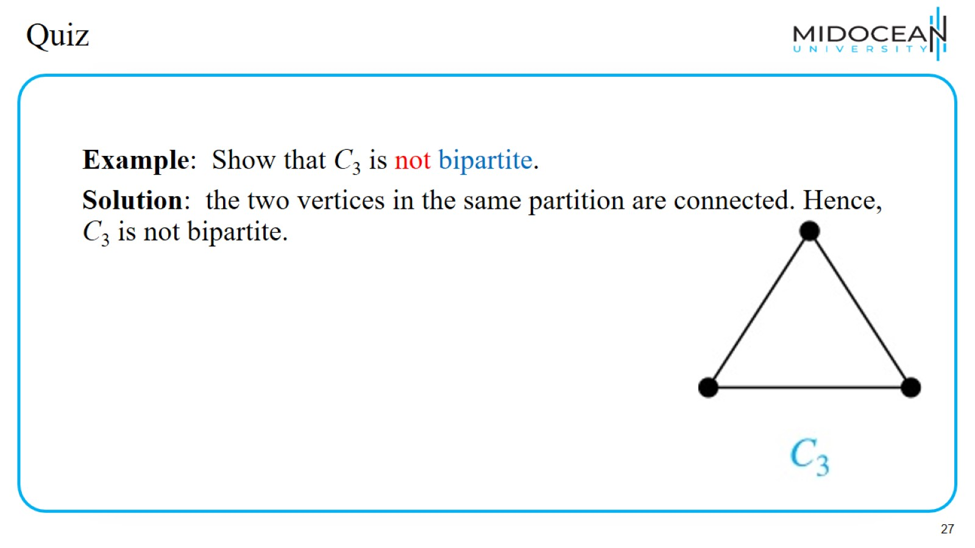
Quiz

Slide 28
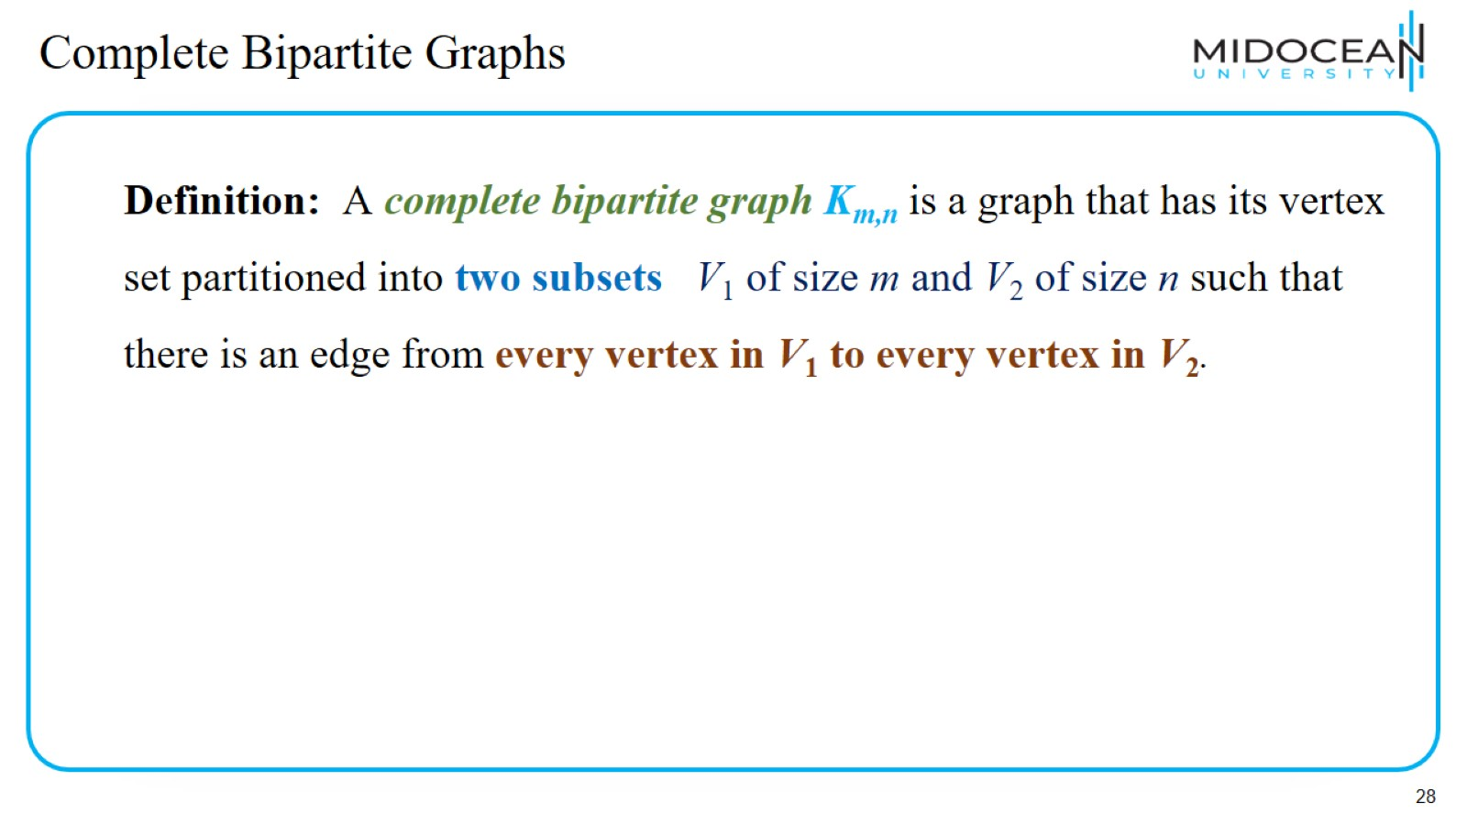
Complete Bipartite Graphs

Slide 29
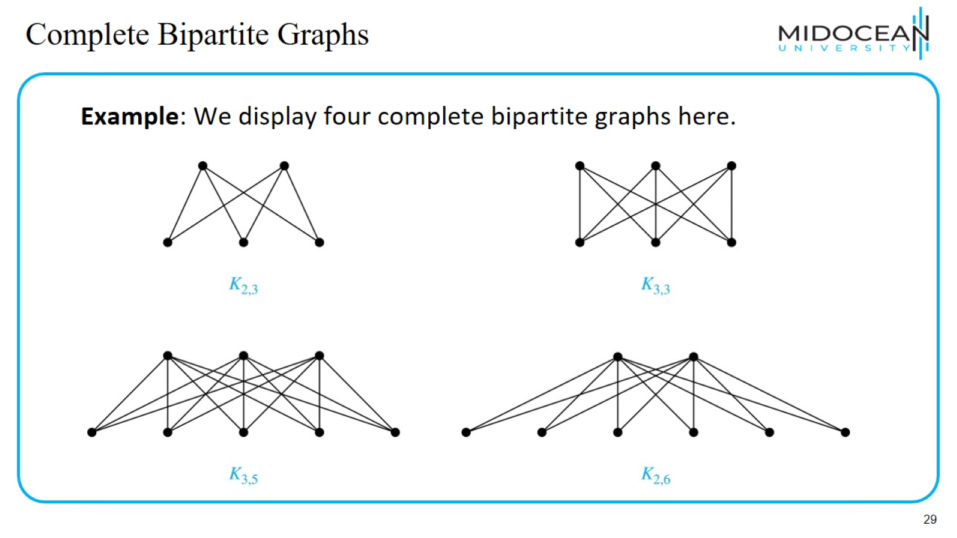
Complete Bipartite Graphs

Slide 30
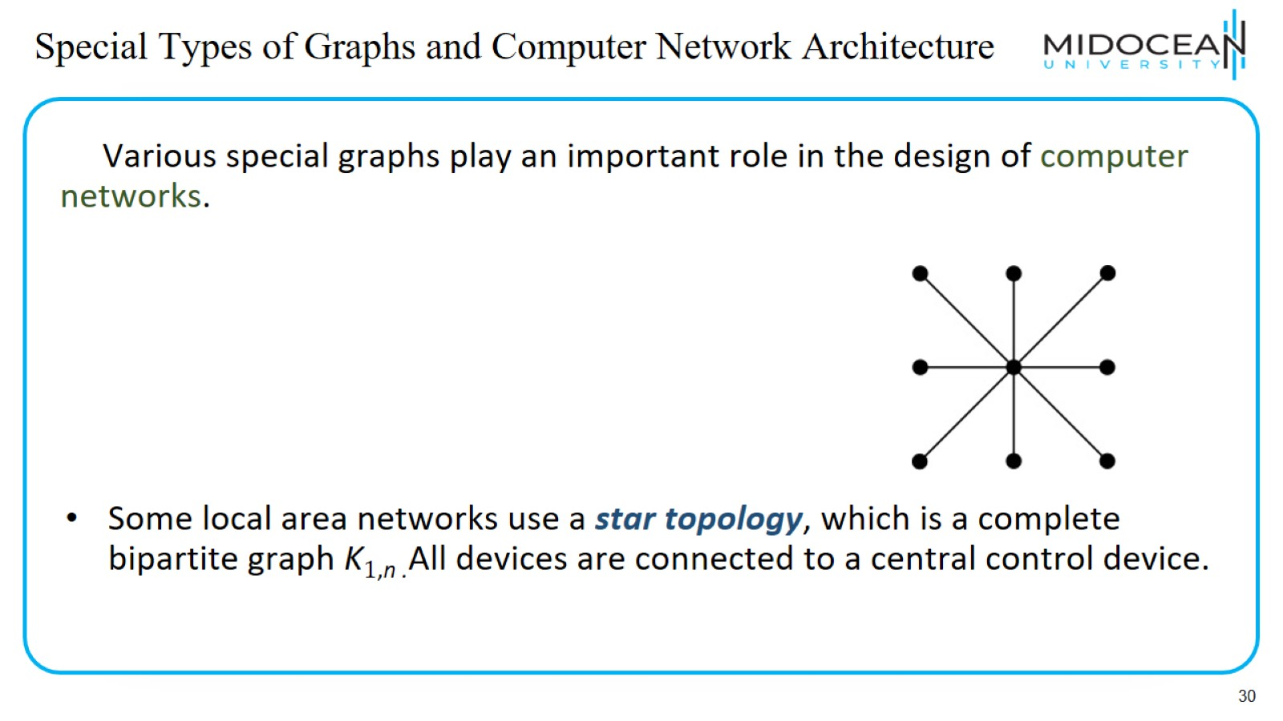
Special Types of Graphs and Computer Network Architecture

Slide 31
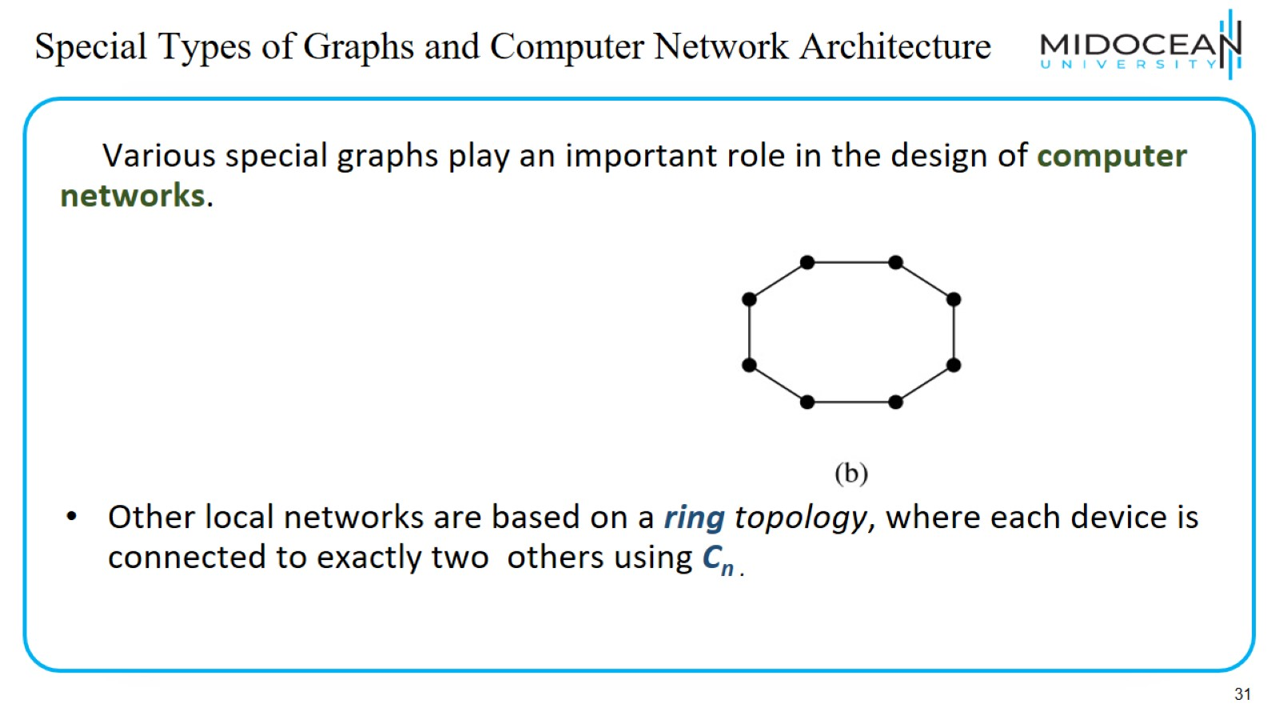
Special Types of Graphs and Computer Network Architecture

Slide 32
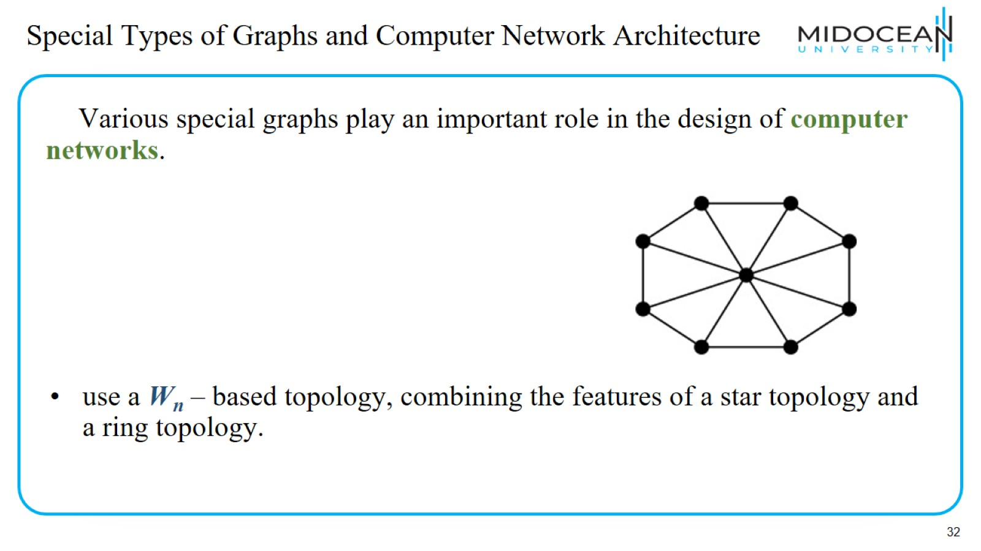
Special Types of Graphs and Computer Network Architecture

Slide 33
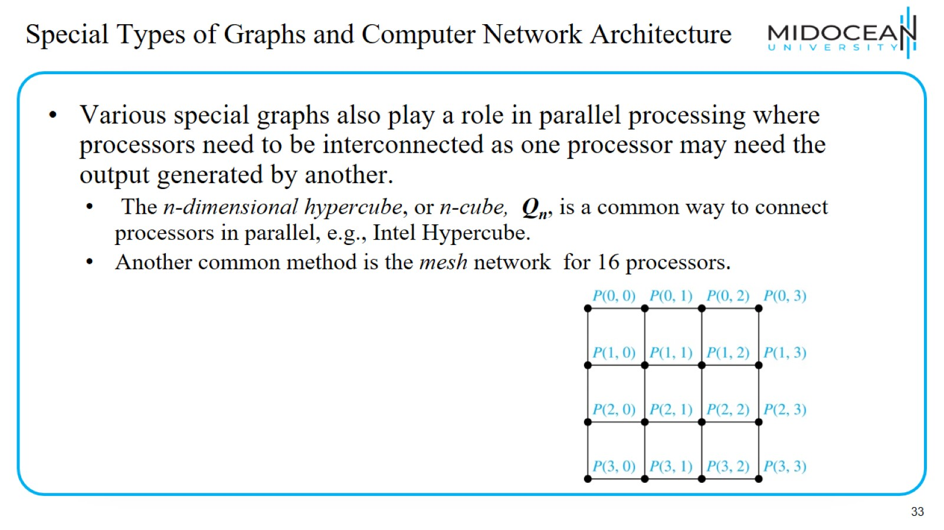
Special Types of Graphs and Computer Network Architecture

Slide 34
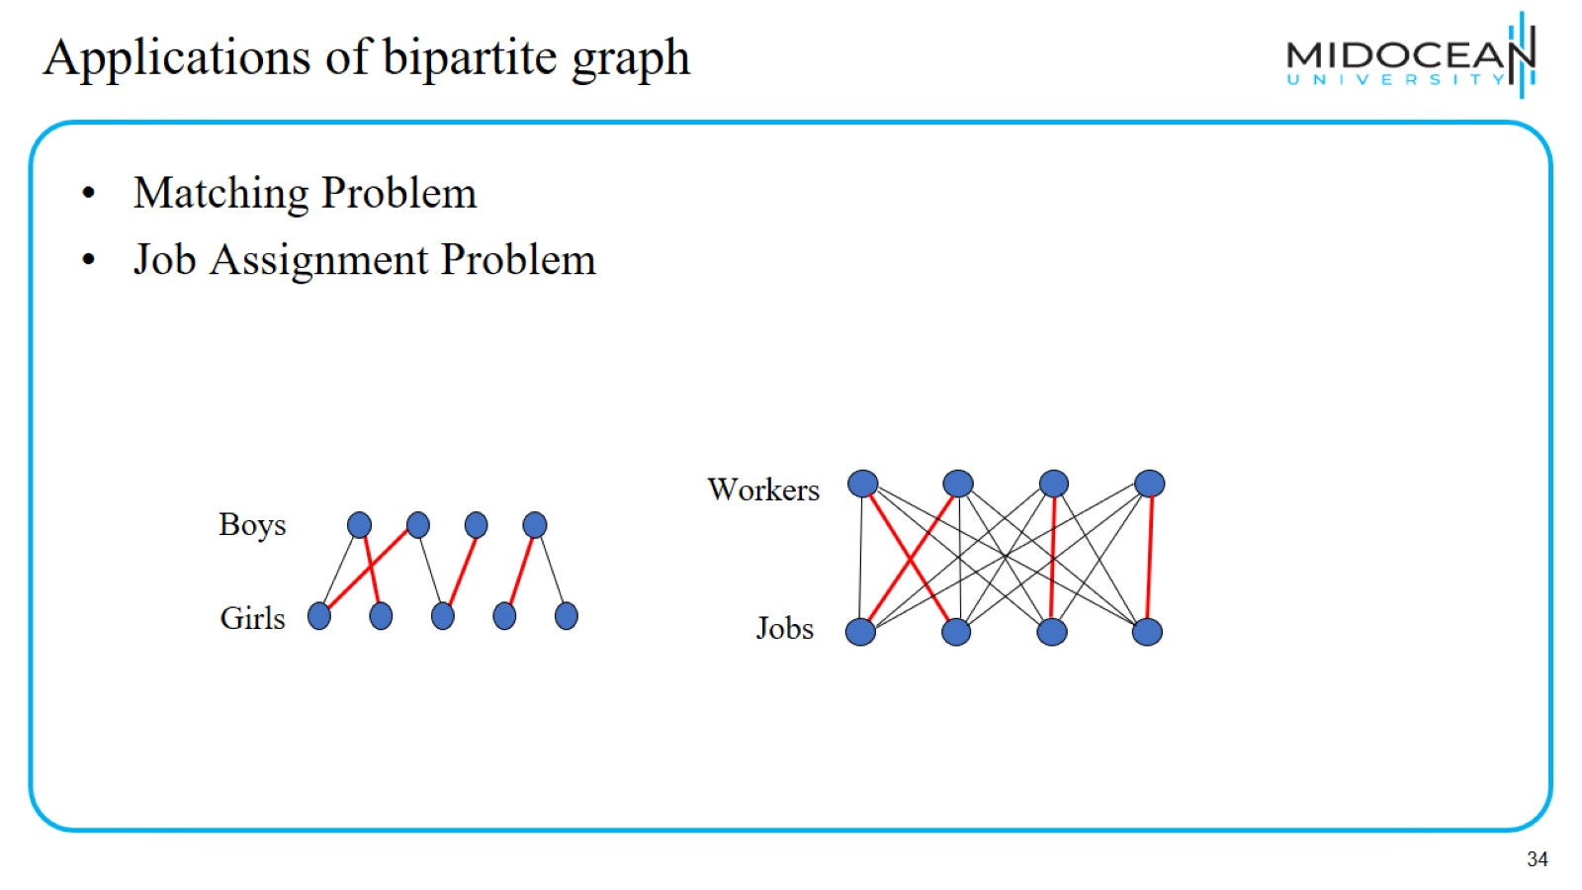
Applications of bipartite graph

Slide 35
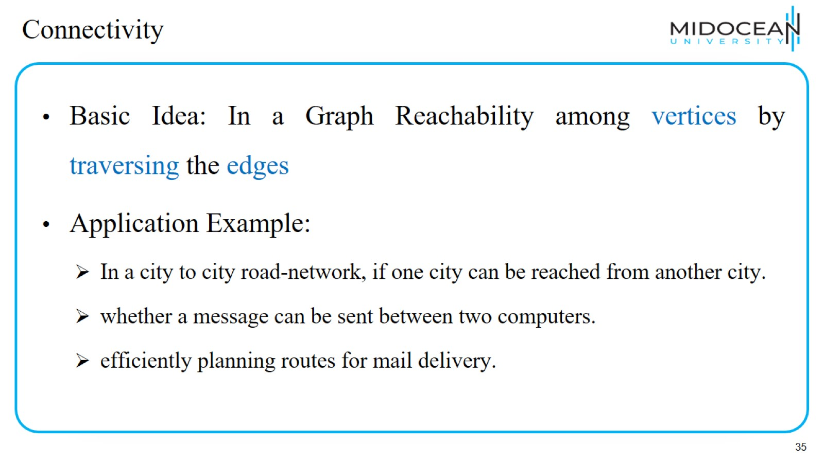
Connectivity

Slide 36
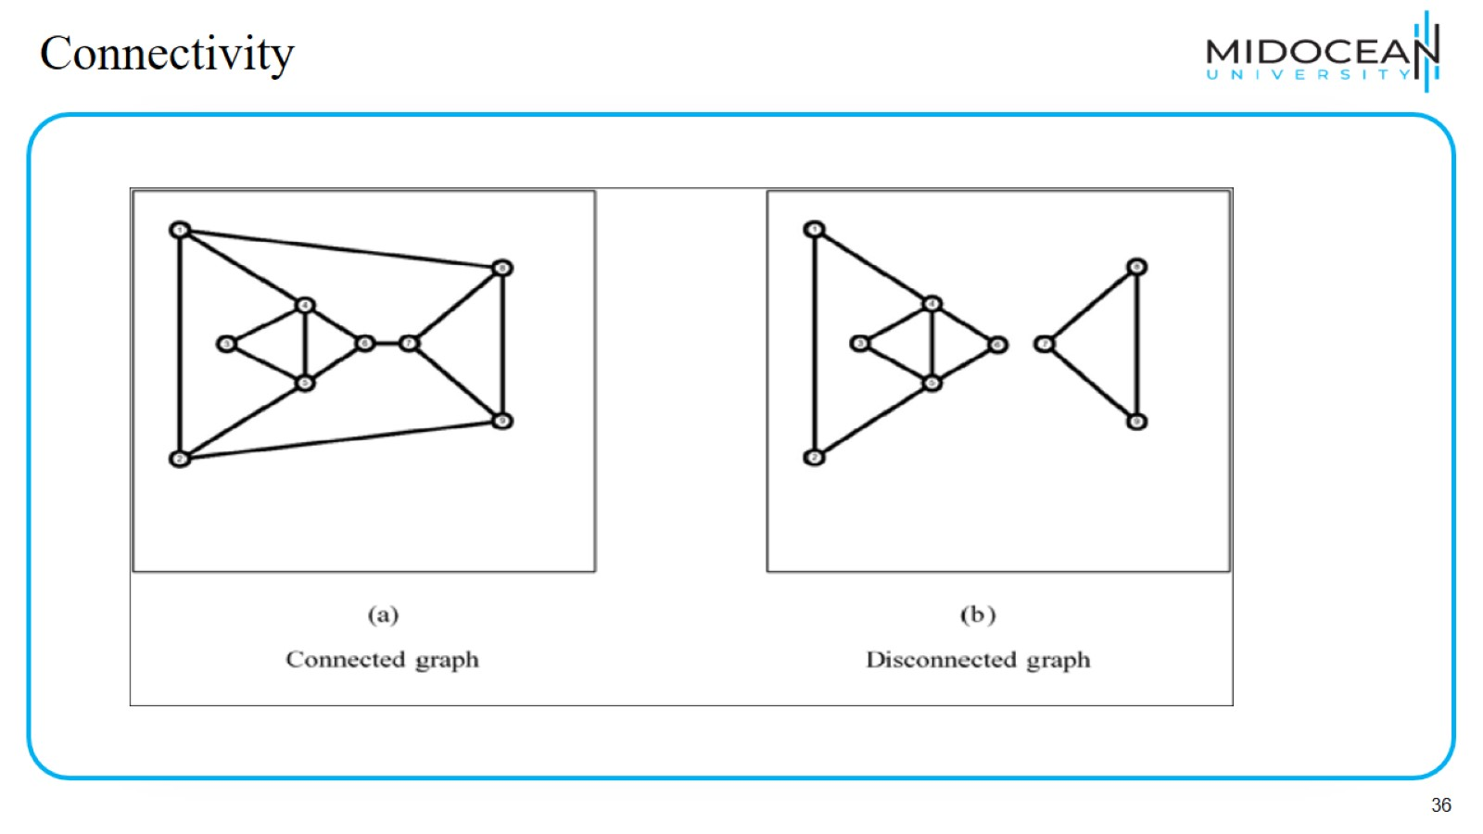
Connectivity

Slide 37
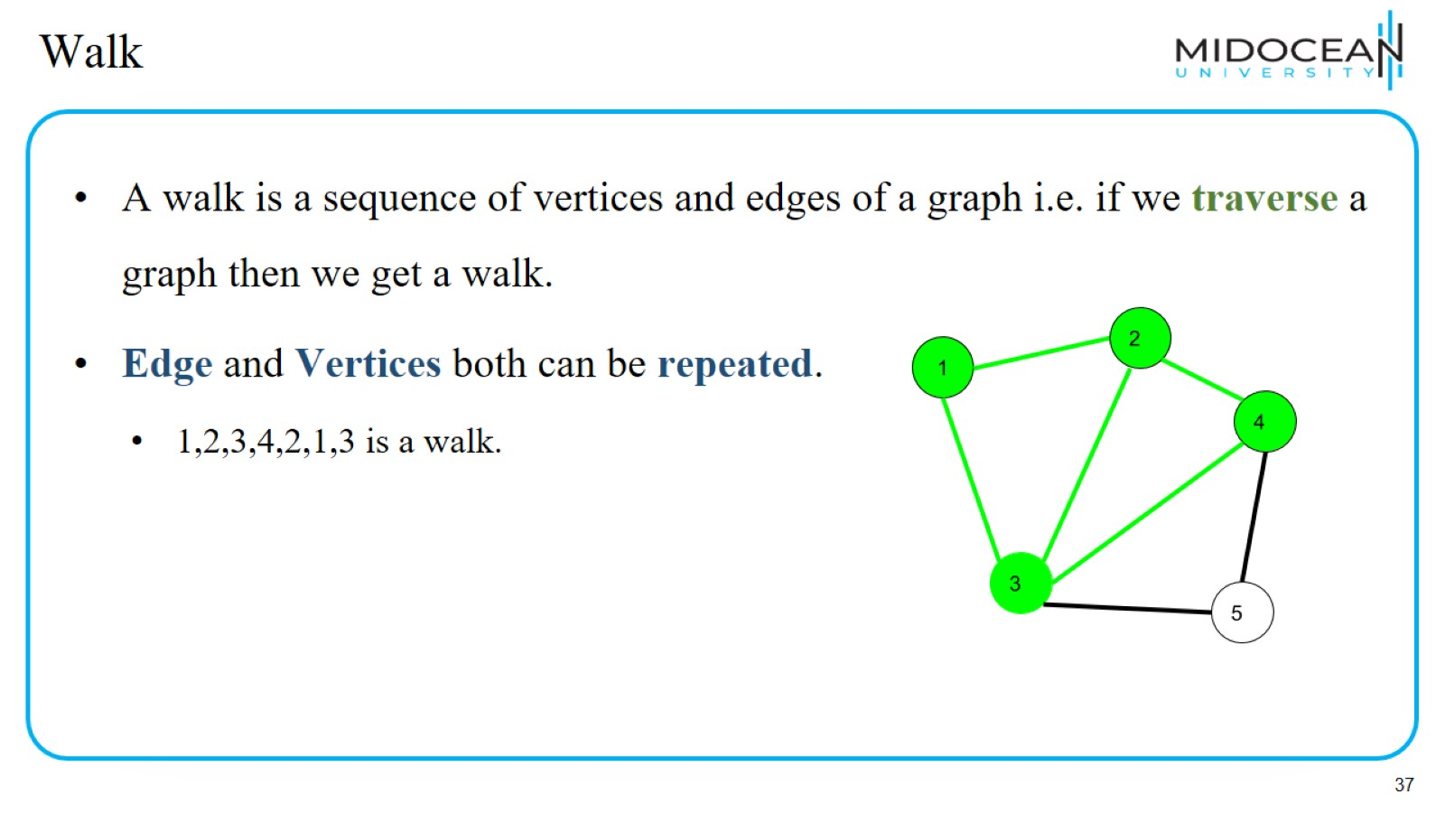
Walk

Slide 38
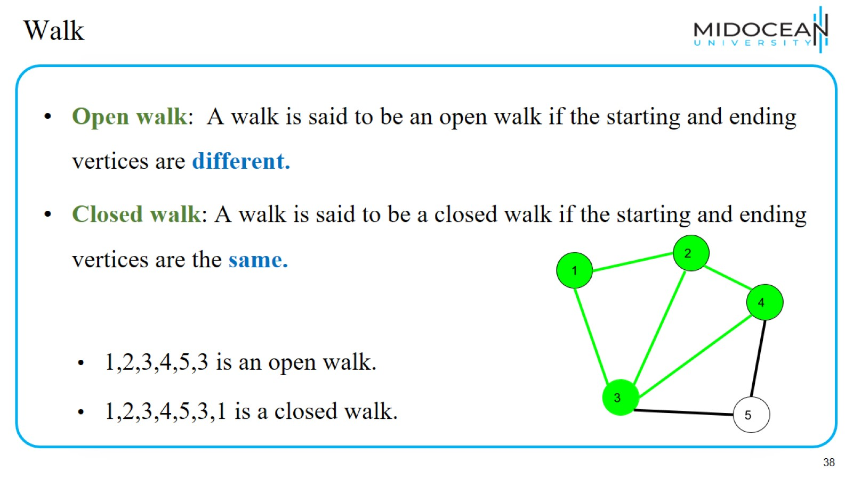
Walk

Slide 39
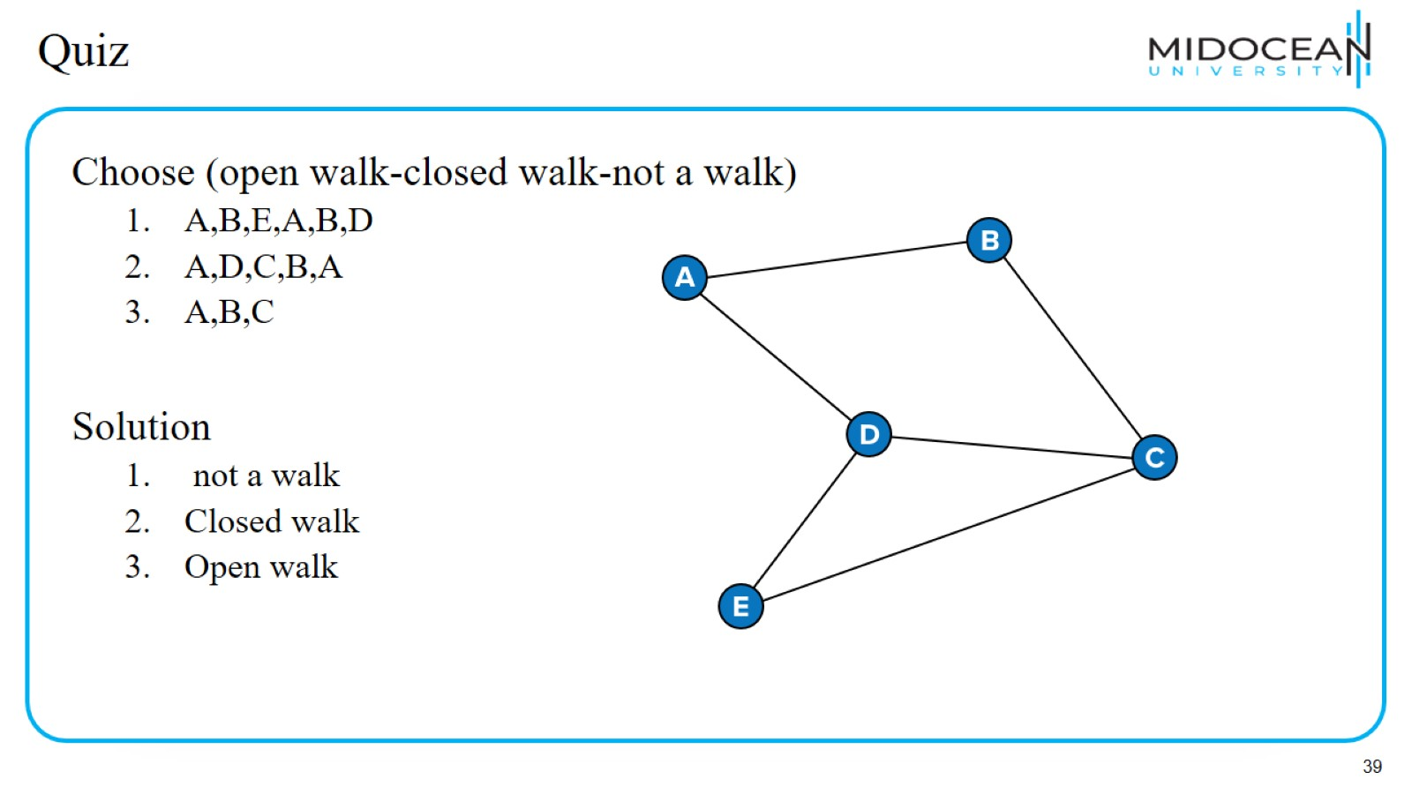
Quiz

Slide 40
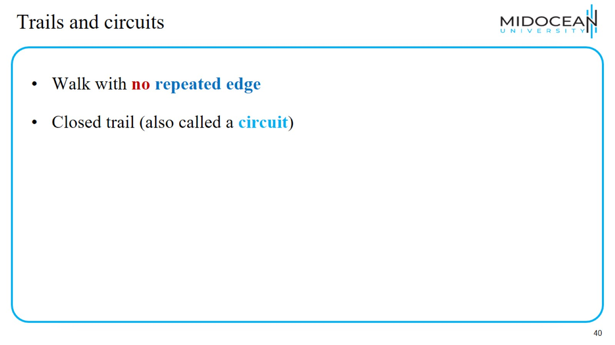
Trails and circuits

Slide 41
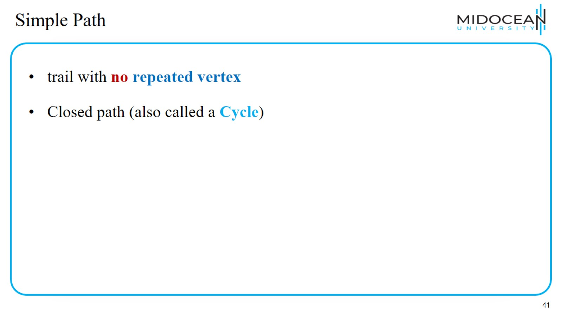
Simple Path

Slide 42
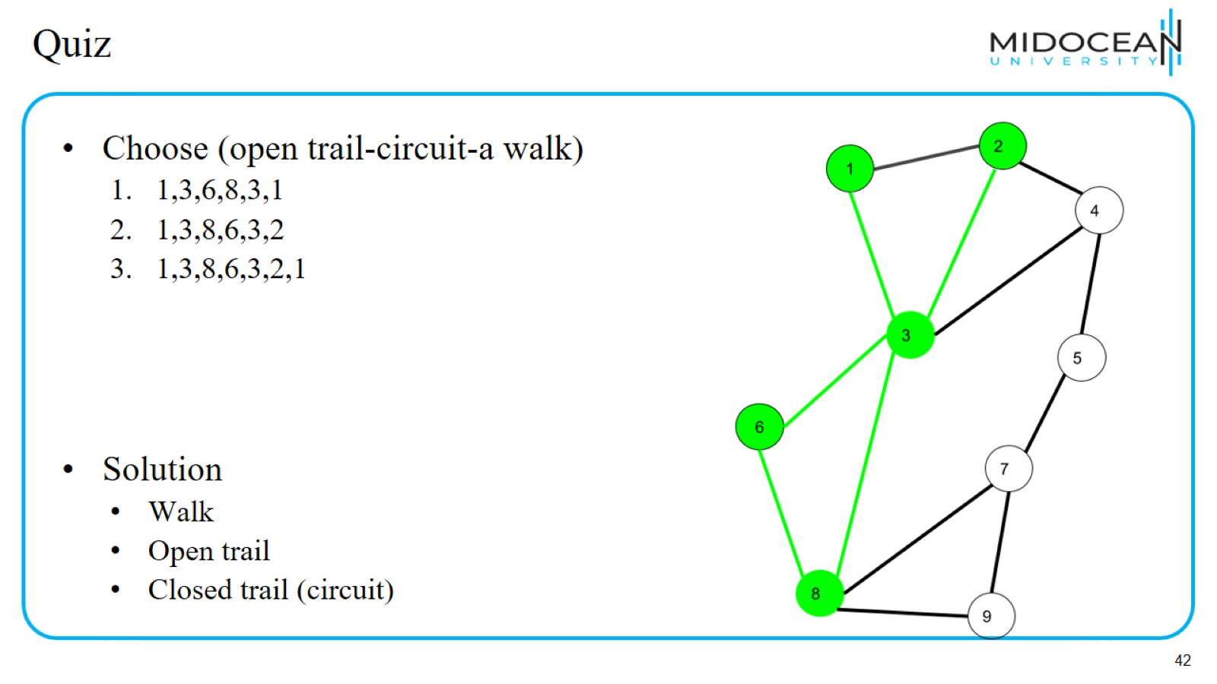
Quiz

Slide 43
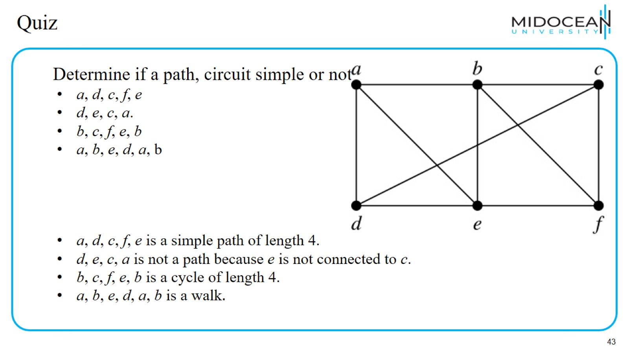
Quiz

Slide 44
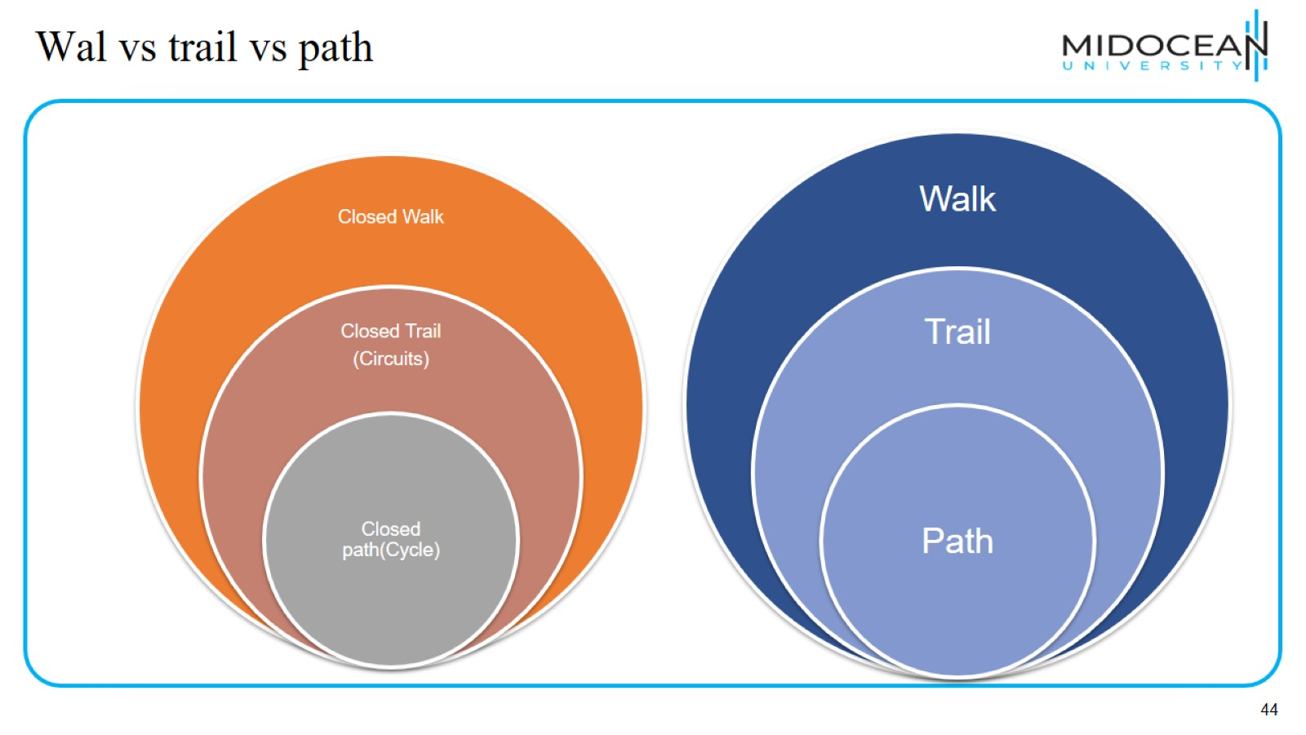
Wal vs trail vs path

Slide 45
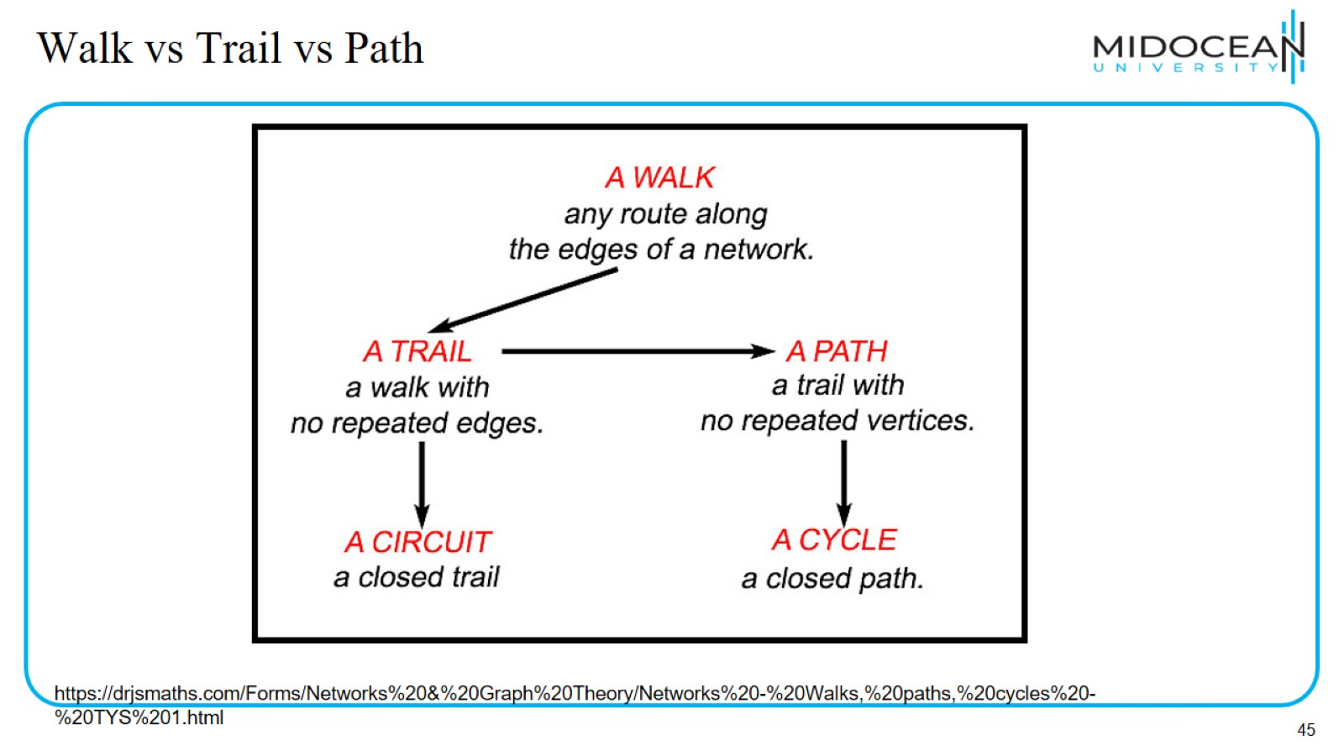
Walk vs Trail vs Path

Slide 46
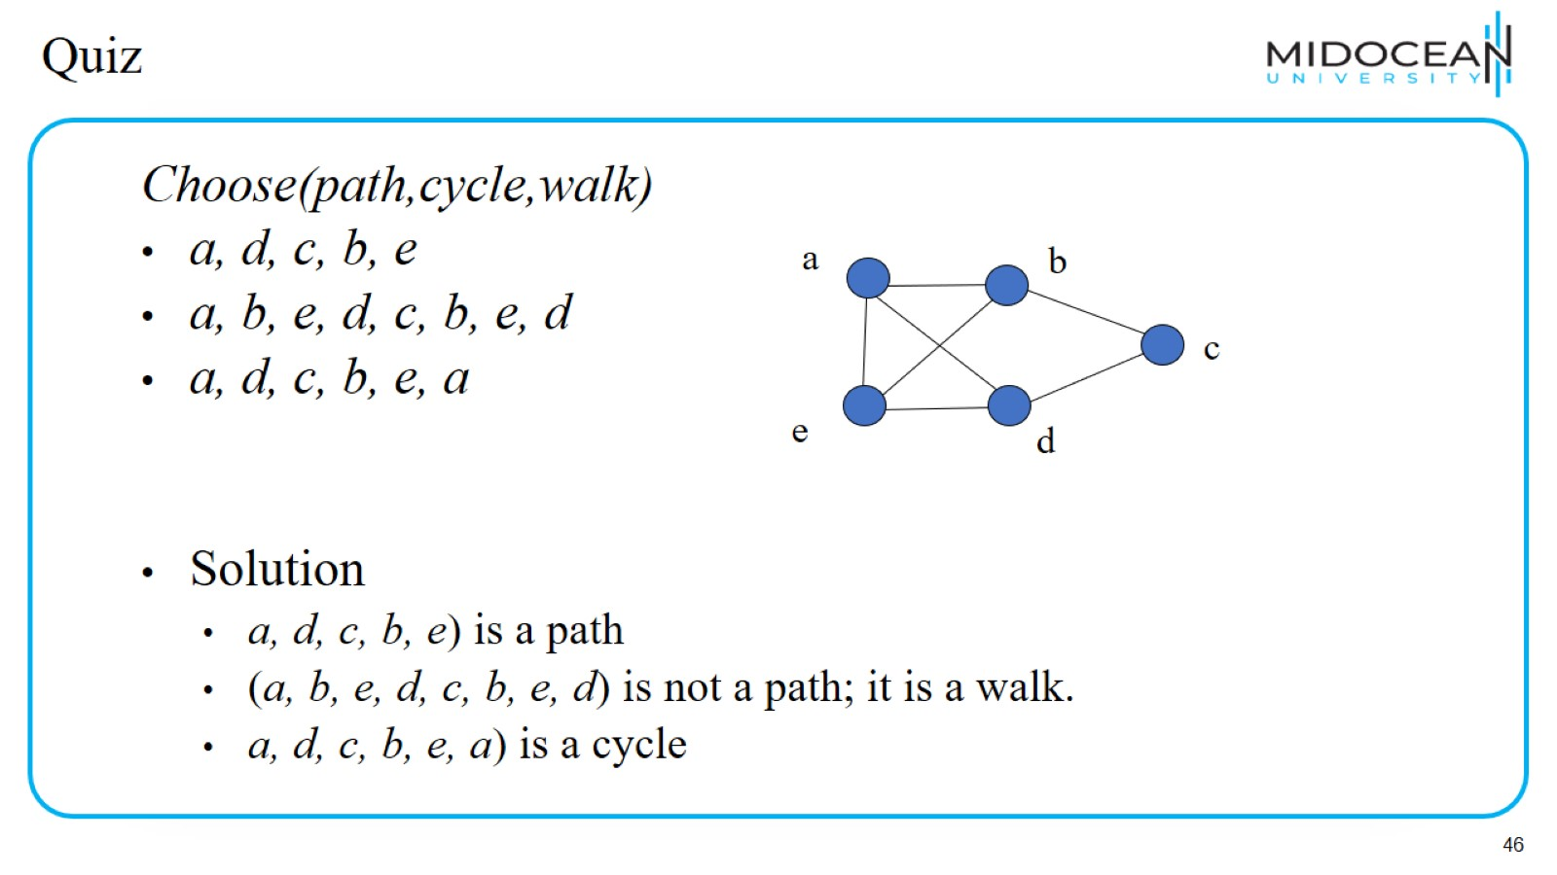
Quiz

Slide 47
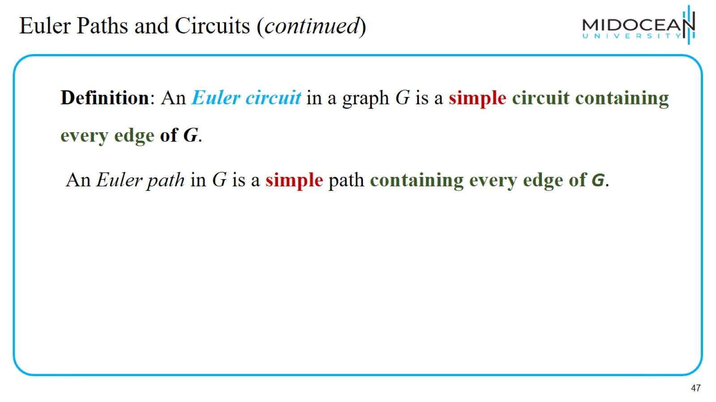
Euler Paths and Circuits (continued)

Slide 48
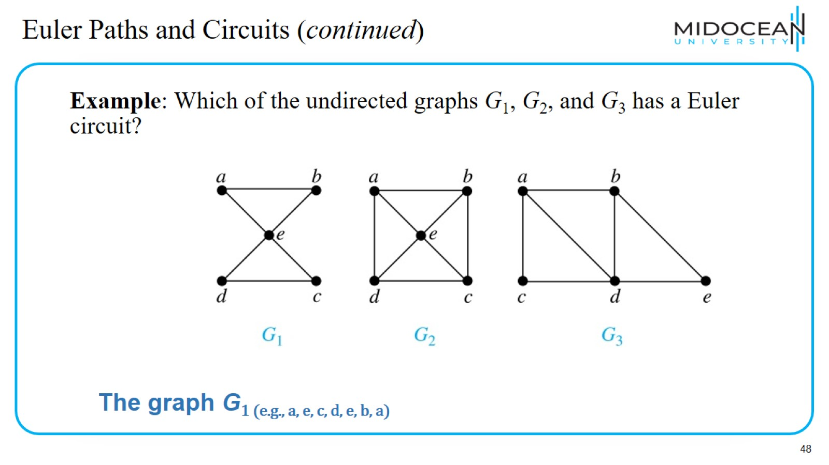
Euler Paths and Circuits (continued)

Slide 49
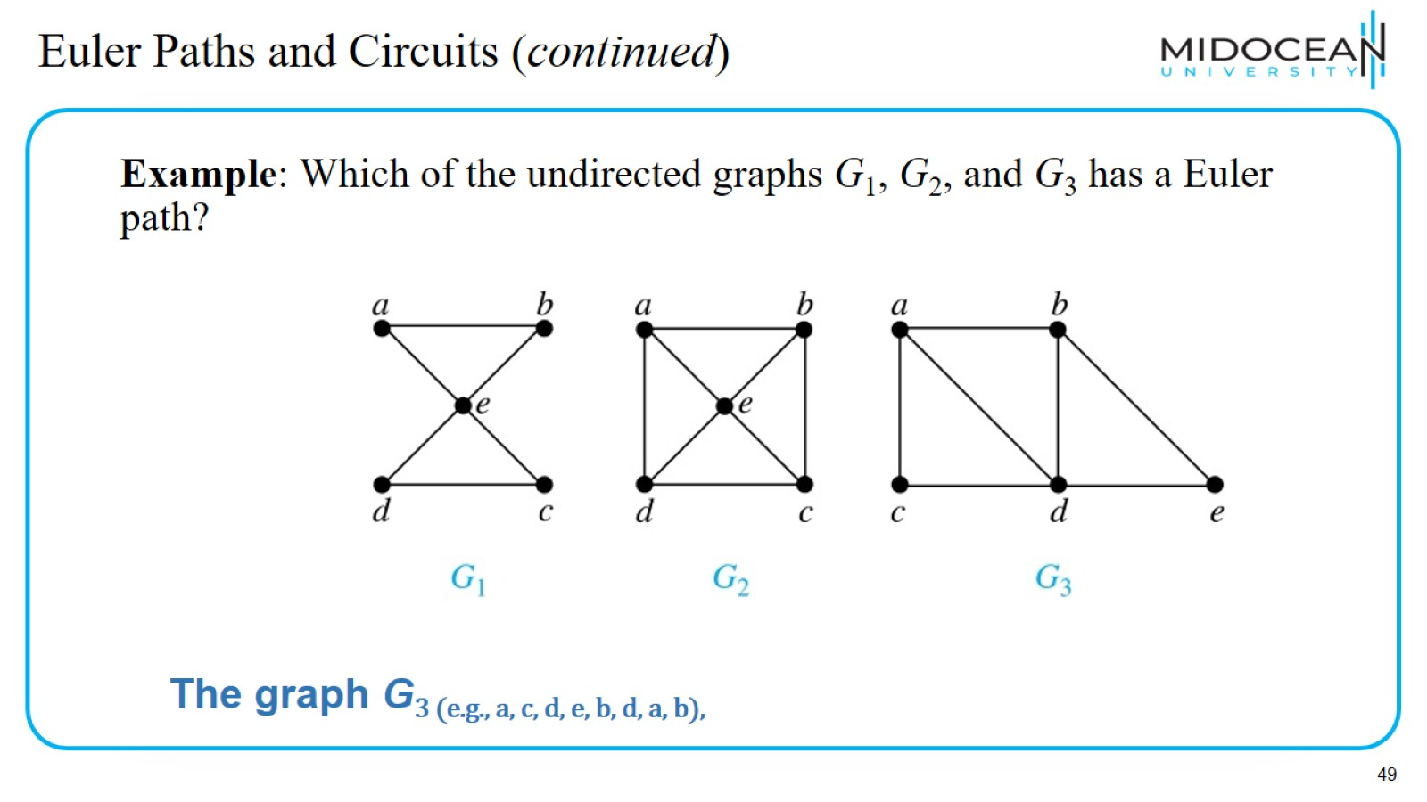
Euler Paths and Circuits (continued)

Slide 50
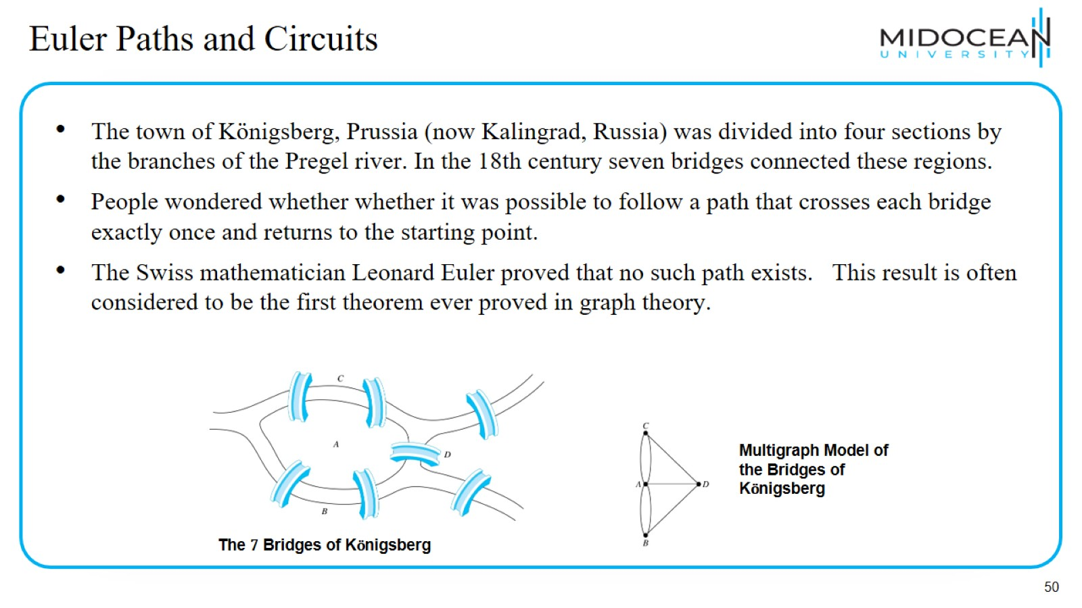
Euler Paths and Circuits

Slide 51
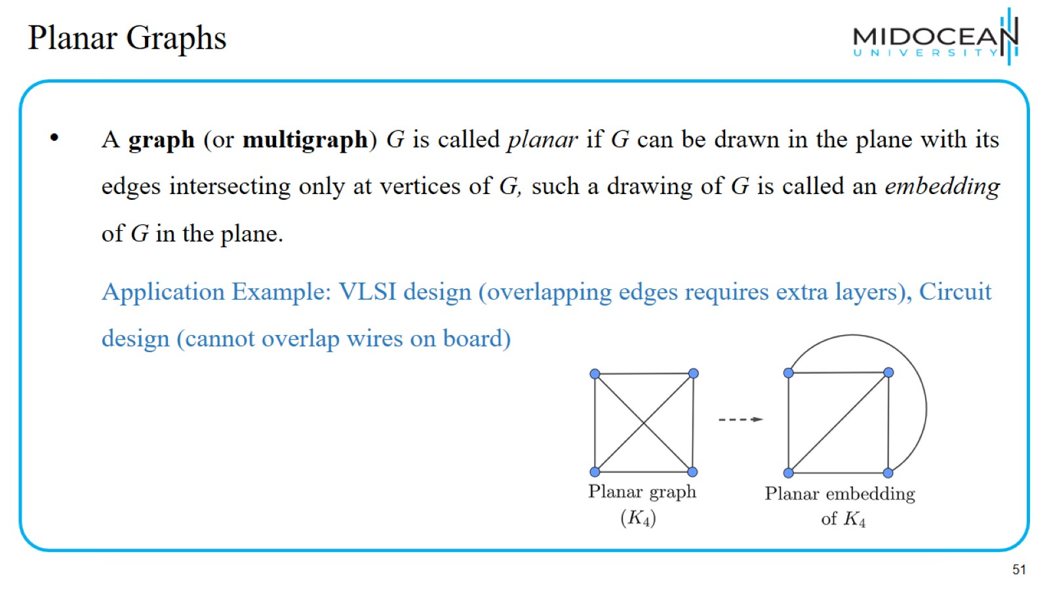
Planar Graphs

Slide 52
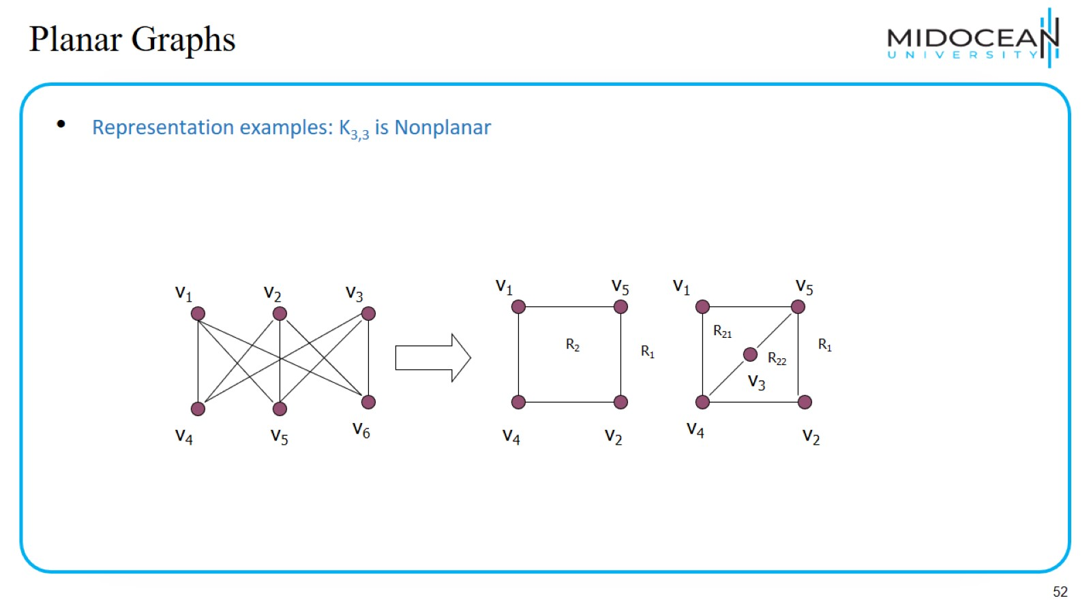
Planar Graphs

Slide 53

Graph Coloring Problem

Slide 54

Vertex Coloring Problem

Slide 55

Trees

Slide 56

Trees

Slide 57

Tree Terminology

Slide 58

Recap

Slide 59

Quiz

Slide 60

Quiz

Slide 61

Quiz

Slide 62

Quiz

Slide 63

Quiz

Slide 64

Quiz

Slide 65

Quiz

Slide 66

Quiz

Slide 67

Quiz

Slide 68

Quiz

Slide 69

Quiz

Slide 70

Quiz

Slide 71

Quiz

Slide 72


Slide 73

Quiz

Slide 74

Quiz

Slide 75


