Slide 1


Cybersecurity Law and Policy
Prepared by Dr. Kamal Alieyan
Lecture 7

Slide 2



Risk in
Cybersecurity
Lecture 7
Prepared by
Dr. Kamal Alieyan

Slide 3

Lecture Objective
To understand the concept of cyber risks.
To analyzing risks, assessing risks, and managing risks, and how are they significant for ensuring security in organizations and cyberspace.
To understand risk remediation, and some use cases involving cyber risks.

Slide 4
Lecture topics
7.1 INTRODUCTION TO CYBER RISKS
7.2 CYBER ATTACKS AND THEIR BUSINESS SIGNIFICANCE
7.3 KEY CYBER RISKS AND THREATS
7.4 WHO SHOULD OWN CYBERSECURITY RISK?
7.5 CYBERSECURITY RISK IDENTIFICATION AND MANAGEMENT
7.6 RISK IDENTIFICATION USING SWOT ANALYSIS
7.7 RISK ANALYSIS
7.8 RISK ASSESSMENT
7.9 RISK ASSESSMENT FRAMEWORKS
7.10 RISK MANAGEMENT
7.11 RISK MANAGEMENT FRAMEWORK
7.12 RISK REMEDIATION

Slide 5

Chapter
7.1 INTRODUCTION TO CYBER RISKS
07
The cyber risk defined as any risk that may result due to financial losses, any kind of disruption, or damage to the reputation of an organization.
This often leads to the failure of an organization’s information technology (IT) systems.
Cyber risk could materialize in a variety of ways.
Some of these ways are listed as follows:
  Deliberately breaching security to gain access to information systems
  Unauthorized access to information
  Unintentional breaches of security
  Accidental breaches of security
  Poor system integrity promoting operational IT risks
  Unsatisfactory management of cyber risks that may support an assortment of cybercrimes.

Slide 6
Chapter
7.1 INTRODUCTION TO CYBER RISKS
07
It is a well-known fact that businesses commonly find themselves in the middle of unpleasant situations when they struggle to recover lost assets in order to prevent theft in the future.
Regardless of whether a business is big or small, cybercrime could be lurking just around the corner.
Recently, more and more small businesses are being targeted by cybercriminals, therefore, without the right preventative measures in place, it could aggravate even further.
Hence it is necessary to get more familiar with the cyber risks that organizations may face.
It is often seen that the more sophisticated and extensive a business digital operations are, the greater the chances of cyber risks being involved.

Slide 7
Chapter
7.1 INTRODUCTION TO CYBER RISKS
07
The following are some elements that contribute to elevation of cyber risks:
  Employees or customers accessing the organizational systems from remote locations.
  Staff making utilization of organization-owned devices at their homes or while traveling.
  Employee access to administrative privileges on the organization’s network or computers.
  A policy emphasizing on the use of bring your own device (BYOD) in the workplace.
  Accessing public buildings without authorization.
  Employees using computers for accessing bank accounts or initiating monetary transactions.
  Employees neglecting certain policies regarding regular updating of passwords.
  Critical information that may be lost as a result of a network disaster.
  Neglecting to review the company’s cybersecurity policies from time to time.

Slide 8
Chapter
7.1 INTRODUCTION TO CYBER RISKS
07
All businesses come across the risks of cyber breaches at some point during their life cycle.
However, understanding the level of risks, the factors that led to the risks, and the origin of threats, i.e., source of the threats may be significantly effective in preparing a productive response.
With organizations becoming more and more technology and business driven, they become more prone to attacks and threats.
This is a direct result of the expanding dependence on networks, systems, programs, social media, and information globally.
This in turn makes data breaches an increasingly common affair in cyberspace.
Cyber-attacks may have a negative business sway, and these frequently emerge from deficiently secured information.

Slide 9
Chapter
7.1 INTRODUCTION TO CYBER RISKS
07
Global connectivity and increased use of cloud services with poor default security parameters often lead to an increased risk of cyber-attacks outside the organization.
IT risk management may effectively address how access control needs to be complemented by sophisticated cybersecurity professionals, software, and cybersecurity risk management.
With sophisticated attacks, it may not be sufficient to bank upon traditional IT professionals and security controls for information security.
There is an urgent need for sophisticated threat intelligence tools and security programs that may assist in reducing an organization’s cyber risk and potential attack surfaces.
Decision-makers in the organizations must take into account assessments when dealing with third-party vendors.
There is likewise a need to present risk mitigation techniques and cyber incident response (IR) plans in associations for when a breach may take place.
Figure 6.1 is a manifestation of how cyber risks may be initiated.

Slide 10
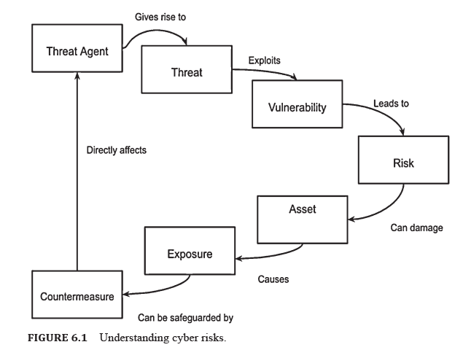
7.1 INTRODUCTION TO CYBER RISKS

Slide 11
Chapter
7.1 INTRODUCTION TO CYBER RISKS
07
Threat Agent might be characterized as an individual or group that can exhibit a threat.
It is necessary to determine who could exploit the assets of an organization and how they might use them against the organization. Therefore, a threat agent may also be thought of as a technique utilized in penetrating the security of an office, operation, or framework by abusing a weakness.
Cyber threats are cybersecurity circumstances or events that are capable of causing harm by way of their outcome.
A very common threat is a social-engineering or phishing attack.
Cybersecurity threats are actualized by threat actors. These threat actors may be individuals or entities who have the potential to initiate a threat.
Although natural disasters, and other environmental and political events, may often constitute threats, they are not considered threat actors.

Slide 12
Chapter
7.1 INTRODUCTION TO CYBER RISKS
07
Some basic threat actors are monetarily propelled lawbreakers (cybercriminals), politically spurred activists, nation-states and competitors.
In an office environment, careless employees and disgruntled employees are threat actors.
Vulnerabilities consider as a weaknesses in a system that have the potential to make threat results conceivable and are possibly significantly riskier.
A single vulnerability is enough to exploit a system. Consider a simple structured query language (SQL) Injection attack that could give an assailant full command over delicate information.
Instances of basic vulnerability are SQL injection, Cross-site Scripting, server misconfigurations, delicate information communicated in plaintext, and that is just the beginning.
Ordinarily, risks are mistaken for threats despite the fact that there is a slight contrast between them.

Slide 13
Chapter
7.1 INTRODUCTION TO CYBER RISKS
07
A cybersecurity risk may be a combination of a threat probability and loss/impact.
This loss impact is usually in the financial terms, however, evaluating a breach is not easy.
Essentially, this translates to the following:
Risk = Threat Probability × Potential Loss
The situation of risk must be avoided due to the losses that result from that scenario.
Let us consider a hypothetical example showing that the risk construction is a given scenario.
A very common vulnerability is SQL Injection, which enables data theft, which is a significant threat.
Attackers who are motivated financially could serve as threat actors here.
Also, the loss of sensitive data will not only impact the organization in monetary terms, but will also affect its reputation.

Slide 14
Chapter
07
7.1 INTRODUCTION TO CYBER RISKS
This may be effective in the prevention and mitigation of security breaches.
Effective risk assessment and risk management rely on good understanding. It takes into account designing efficient security solutions based on threat intelligence, and may also be responsible for building a viable security strategy and a cybersecurity system.
Threat agents may be responsible for generating threats which often leads to vulnerabilities being exploited.
Once vulnerabilities are exploited, it leads to cyber risk.
Cyber risks have the capability to damage assets, and this may lead to exposure.
This calls for safeguarding the system, which may be performed using countermeasures.

Slide 15
7.1 INTRODUCTION TO CYBER RISKS

Slide 16
Chapter
07
7.2 CYBER ATTACKS AND THEIR BUSINESS SIGNIFICAVCE
Regardless of being helpful, numerous IT arrangements are lacking for giving cyber-attack assurance from complex attacks and poor configuration.
With the uncontrolled multiplication of innovation and growth of technology, there is more unapproved access to the organization than ever before.
There is a tremendous increase in information provided to third parties by means of supply chains, customers, and other providers.
With organizations increasingly storing, organizations are progressively storing enormous volumes of personally identifiable information (PII). For this, they are depending on external cloud providers that should be designed accurately so as to adequately secure information.
This leads to added risk; additionally, there is an increase in the number of devices that are always connected in data exchange.

Slide 17
Chapter
07
7.2 CYBER ATTACKS AND THEIR BUSINESS SIGNIFICAVCE
With organizations globalizing and the web of employees, customers, and third-party vendors increasing, there is also an increase in expectations of instant access to information.
Consumers expect instant real-time access to data from anywhere. The consequence is an exponential increment in the attack surface for malware, weaknesses, and every other exploit.
Unexpected cyber threats may emerge from threatening unfamiliar powers, contenders, organized hackers, insiders, poor configuration, and third-party vendors.
This makes organizations rely on software that may not only assist their third-party vendors but can also continuously monitor for data breaches. The need of recognizing, tending to, and conveying a potential breach is more noteworthy than the preventive estimation of customary, repetitive IT security controls.
Data breaches have a massive, negative business impact. This is because of the insufficiently protected data.

Slide 18
Chapter
07
7.2 CYBER ATTACKS AND THEIR BUSINESS SIGNIFICAVCE
A good risk management strategy is external monitoring of risks through third and 4th-party vendor risk assessments. But, there is also a need for a comprehensive IT security management, without which an organization is prone to financial, legal, and reputational risk.
Cybercrimes are additionally known to target businesses.
Emerging new technologies based on IoT give rise to some of the biggest cyber threats.
As the network keeps on expanding and more devices are added to the network for developing greater connectivity, cyber risks also increase. Thus security measures need to evolve, too.
Some common reasons why businesses fall victim to cyber-attacks are as follows:
  Staff shortcomings may make an organization vulnerable.
  Cloud computing provokes security.
  Ransomware can infiltrate networks.

Slide 19
7.3 KEY CYBER RISKS AND THREATS
Cybersecurity is applicable to all systems that contribute to an organizations business operations and objectives. Also applied to an organizations compliance with regulations and laws.
Organizations plans and actualize cybersecurity controls for ensuring the integrity, confidentiality, and availability of information assets.
Cyberattacks, they may be committed as financial frauds, data theft, activist causes, and upset basic infrastructure.
The common sources of cyber threats are as follows:
    Nation-states
    Cybercriminals
    Hacktivists
    Insiders
    Service providers
    Developers of substandard products and services

Slide 20
7.3 KEY CYBER RISKS AND THREATS
To understand the cyber risk profile of an organization, it is necessary to identify the kind of information that would be valuable to outsiders. Hackers target data that can cause critical disturbance.
It is important to know the data has the capability of causing monetary or reputational harm to the organization if it somehow happened to be obtained or made open.
One such information is PII that includes names, social security numbers, and biometric records.
The following may be considered as potential targets to cybercriminals:
    Customer data
    Employee data
    Intellectual property (IP)
    Product quality and safety
    Contract terms and pricing
    Strategic planning
    Financial data

Slide 21
Chapter
7.4 WHO SHOULD OWN CYBERSECURITY RISK?
07
Cybersecurity risk management is usually set by leadership which may incorporate an organization’s board of directors in the planning processes.
Most organizations will also include a Chief Information Security Officer (CISO).
The CISO establishes and maintains the enterprise vision.
The CISO plans the strategies and programs to ensure that the information assets and customer data may be adequately protected.
Some common cyber defense operations that are undertaken by a CISO are as follows:
    Administering security procedures
    Training and testing
    Maintaining secure device configurations
    Up-to-date software
    Vulnerability patches
    Deploying intrusion detection systems and establishing penetration testing
    Configuring secure networks to manage and protect business networks

Slide 22
Chapter
7.4 WHO SHOULD OWN CYBERSECURITY RISK?
07
  Deploying programs that may be useful for data protection and loss prevention
  Deploying programs that will perform system monitoring for risks
  Restricting access to least required privilege for employees
  Encrypting data when required
  Configuring cloud services
  Implementing vulnerability management programs
  Recruiting and retaining cybersecurity professionals
It is significant for all degrees of an organization to comprehend its role in managing cyber risk.
Since vulnerabilities can come from any employee, it is fundamental to an organization’s IT security to continually educate employees.
The employees must be educated on how to avoid common security pitfalls that may cause data breaches or other cyber incidents.
The National Institute of Standards and Technology’s (NIST) cybersecurity framework (CSF) provides some of the best practices to manage cybersecurity risk.

Slide 23
Chapter
7.5 CYBERSECURITY RIDK IDENTIFICATION
AND MANAGEMENT
07
Risk identification the process of identifying and assessing threats to an organization, its operations, and its workforce.
It takes into account assessing IT security threats.
These threats may be in the form of malware and ransomware, accidents, natural disasters, and other potentially harmful events. The aim of such threats is to disrupt business operations.
Hence it is important for companies to develop risk management plans.
Companies that develop robust risk management plans conveniently minimize the impact of such threats, whenever they occur.

Slide 24
Chapter
7.5 CYBERSECURITY RIDK IDENTIFICATION
AND MANAGEMENT
07
The process of risk identification and management includes five core steps which are risk identification, risk analysis, risk evaluation, risk treatment, and risk monitoring.
Risk Identification: The primary objective of risk identification is to unveil what, where, when, why, and how something could affect an organization’s ability to operate. For example, the possibility of wildfire may have an impact over a business located in central California. The consequences could be disruption in business operations.
Risk Analysis: The procedure of risk analysis is utilized for researching the likelihood that a risk event may happen. Risk analysis additionally investigates the possible results of the related events. Considering the California wildfire example, it may be asserted that safety managers could be responsible for assessing how much rainfall has occurred over the past few months. This may give an idea with respect to the degree of harm the organization may confront if a similar situation takes place in the future.

Slide 25
Chapter
7.5 CYBERSECURITY RIDK IDENTIFICATION
AND MANAGEMENT
07
Risk Evaluation: It is responsible for comparing the magnitude or intensity of each risk. It also ranks them according to prominence and consequence. Considering the same example, the effects of the wildfire could be weighed against the effects of a possible earthquake or landslide. Undergoing risk evaluation, the event that is identified to have a higher likelihood of occurring and causing harm, would rank higher.
Risk Treatment: Or risk response planning takes into account risk mitigation strategies, preventative care, and emergency courses of action which are made based on the surveyed estimation of each risk. Considering the wildfire example, risk managers may decide to house extra network servers offsite, so business activities could in any case continue if an onsite server is harmed. In addition, the risk manager may likewise create evacuation plans for employees.
Risk Monitoring: Risk monitoring is a constant procedure that adjusts and changes after some time. Repeating and continually monitoring the procedures can help guarantee maximum coverage of known and obscure risks.

Slide 26
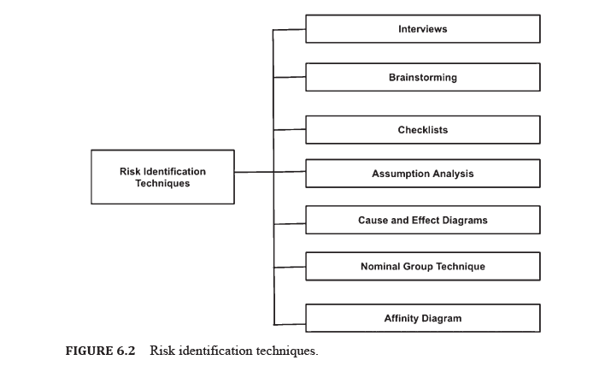
7.5 CYBERSECURITY RIDK IDENTIFICATION
AND MANAGEMENT
There are numerous ways to identify risks.
Project managers (PM) often combine techniques to identify risks.
Some of the risk identification techniques are as follows:

Slide 27
Chapter
7.5 CYBERSECURITY RIDK IDENTIFICATION
AND MANAGEMENT
07
An organization must identify the factors contributing to risks. The factors can be both internal as well as external.
Risk identification can be performed in many different ways like:
Strategic Risk Identification:
This may be used to identify risks that arise from strategic choices made by an organization.
  Strategic risk identification must precede the finalization of strategic choices. This is to guarantee that potential risk issues are factored into the decision-making process for choosing the correct alternatives.
  Risks inherent to the chosen key decisions must be archived, surveyed, and overseen through the typical working of the arrangement of risk management.
  Strategic risks must be reviewed from time-to-time following changes in strategy, considering new and emerging risks.

Slide 28
Chapter
7.5 CYBERSECURITY RIDK IDENTIFICATION
AND MANAGEMENT
07
2. Operational Risk Identification:
This is targeted to recognize risks inside the organizations functioning and operations:
  Operational risk identification is responsible for establishing vulnerabilities which are generally introduced by employees. Many times they are introduced by internal processes and systems, contractors, regulatory authorities and external events.
  Operational risk identification must be an embedded continuous process. This is because it is responsible for identifying new and emerging risks and considering shifts in the already existing risks through mechanisms like management and committee meetings, environmental scanning, process reviews.
  Operational risk identification must be repeated time and again, quarterly or yearly, especially when changes occur. This is helpful in recognizing new and rising risks.

Slide 29
Chapter
7.5 CYBERSECURITY RIDK IDENTIFICATION
AND MANAGEMENT
07
3. Project Risk Identification:
It is responsible for identifying risks that are inherent to particular projects: project risks ought to be distinguished for every significant task, covering the entire lifecycle:
  Project risks must be identified for all major projects. They should cover the whole lifecycle of the project.
  In the case of long-term projects, reviewing must be performed at least once a year for identifying new and emerging risks.

Slide 30
Chapter
7.5 CYBERSECURITY RIDK IDENTIFICATION
AND MANAGEMENT
07
Before starting with the risk identification process, it is necessary to have knowledge of the business. For identifying risks that an organization may be prone to, there may be a need to learn from past experience as well as experiences of others. Only then can one come up with the best strategy for responding to the risks.
The first thing to consider is the objectives of the institution, both implicit and explicit.
Identifying emerging opportunities may also play an important role in risk identification.
Although an organization will never be 100% risk free, it is necessary to establish controls.
While working on the risk identification process, it is equally important to pay attention to identifying potential opportunities. Exploiting such opportunities may also improve an organization’s performance.

Slide 31
Chapter
7.5 CYBERSECURITY RIDK IDENTIFICATION
AND MANAGEMENT
07
There are several steps to effectively identify risks in an organization. Some of these have been mentioned as follows:.
  Understanding What to Consider When Identifying Risks
  Gathering Information from Different Sources to Identify Risks
  Applying Risk Identification Tools and Techniques
  Documenting the Risks Identified
  Documenting the Risk Identification Process

Slide 32



Thank You

