Slide 1


Project Time Management
مقرر: إداره وقت المشروع
Prepared by Dr. Amira Elfekky
PMG 212
Lecture 07

Slide 2
Agenda
Productivity
Introduction to Productivity in Construction
Understanding Productivity vs. Production
Measuring Productivity (Production Model Example)
Productivity Index (PI)
Controllable Factors Affecting Productivity
Uncontrollable Factors Affecting Productivity
The Results of Uncontrolled Obstacles
Project Management: 1985–2009
Lifecycle Phase for Project Management Maturity
Project Vs Product
Maturity and Excellence
Success Factors
The Many Faces of Failure

Slide 3
Agenda
Productivity
Introduction to Productivity in Construction
Understanding Productivity vs. Production
Measuring Productivity (Production Model Example)
Productivity Index (PI)
Controllable Factors Affecting Productivity
Uncontrollable Factors Affecting Productivity
The Results of Uncontrolled Obstacles
Project Management: 1985–2009
Lifecycle Phase for Project Management Maturity
Project Vs Product
Maturity and Excellence
Success Factors
The Many Faces of Failure

Slide 4
Chapter
Introduction to Productivity in Construction
07
Labor is the primary driver of construction project performance.
Productivity directly influences CPI (Cost Performance Index) and SPI (Schedule Performance Index).
Productivity measures efficiency — output per unit of input.
In construction, productivity typically varies over time.
Effective labor management determines project success or failure.

Slide 5
Agenda
Productivity
Introduction to Productivity in Construction
Understanding Productivity vs. Production
Measuring Productivity (Production Model Example)
Productivity Index (PI)
Controllable Factors Affecting Productivity
Uncontrollable Factors Affecting Productivity
The Results of Uncontrolled Obstacles
Project Management: 1985–2009
Lifecycle Phase for Project Management Maturity
Project Vs Product
Maturity and Excellence
Success Factors
The Many Faces of Failure

Slide 6
Chapter
Understanding Productivity vs. Production
07
Production = Total units of work completed.
Productivity = Rate of production (units per labor-hour).
A project can meet production targets but fail productivity targets.
Example: 100 ft installed using double the planned labor = lower productivity.
Productivity impacts earned value and contractor profitability.

Slide 7
Agenda
Productivity
Introduction to Productivity in Construction
Understanding Productivity vs. Production
Measuring Productivity (Production Model Example)
Productivity Index (PI)
Controllable Factors Affecting Productivity
Uncontrollable Factors Affecting Productivity
The Results of Uncontrolled Obstacles
Project Management: 1985–2009
Lifecycle Phase for Project Management Maturity
Project Vs Product
Maturity and Excellence
Success Factors
The Many Faces of Failure

Slide 8
Chapter
Measuring Productivity (Production Model Example)
07
Daily Output Example: 100 LF per 8-hour workday.
Crew Example: 2 workers × 8 hours = 16 labor-hours.
Productivity = 100 LF ÷ 16 labor-hours.
Result = 6.25 LF per labor-hour.
Productivity models help quantify efficiency mathematically.

Slide 9
Agenda
Productivity
Introduction to Productivity in Construction
Understanding Productivity vs. Production
Measuring Productivity (Production Model Example)
Productivity Index (PI)
Controllable Factors Affecting Productivity
Uncontrollable Factors Affecting Productivity
The Results of Uncontrolled Obstacles
Project Management: 1985–2009
Lifecycle Phase for Project Management Maturity
Project Vs Product
Maturity and Excellence
Success Factors
The Many Faces of Failure

Slide 10
Chapter
Productivity Index (PI)
07
PI compares planned vs. actual performance.
Formula: PI = Budgeted Work Hours (BWH) ÷ Actual Work Hours (AWH).
PI > 1 → Better than planned performance.
PI < 1 → Underperformance.
Most accurate when applied at labor cost element level.

Slide 11
Agenda
Productivity
Introduction to Productivity in Construction
Understanding Productivity vs. Production
Measuring Productivity (Production Model Example)
Productivity Index (PI)
Controllable Factors Affecting Productivity
Uncontrollable Factors Affecting Productivity
The Results of Uncontrolled Obstacles
Project Management: 1985–2009
Lifecycle Phase for Project Management Maturity
Project Vs Product
Maturity and Excellence
Success Factors
The Many Faces of Failure

Slide 12
Chapter
Controllable Factors Affecting Productivity
07
Proper planning and task analysis.
Availability of materials, tools, and equipment.
Clear communication and effective supervision.
Adequate training and appropriate crew size.
Safe and well-organized work environment.

Slide 13
Agenda
Productivity
Introduction to Productivity in Construction
Understanding Productivity vs. Production
Measuring Productivity (Production Model Example)
Productivity Index (PI)
Controllable Factors Affecting Productivity
Uncontrollable Factors Affecting Productivity
The Results of Uncontrolled Obstacles
Project Management: 1985–2009
Lifecycle Phase for Project Management Maturity
Project Vs Product
Maturity and Excellence
Success Factors
The Many Faces of Failure

Slide 14
Chapter
Uncontrollable Factors Affecting Productivity
07
Weather conditions and environmental factors.
Worker health and personal issues.
Economic conditions and regional factors.
Strikes or work stoppages.
Owner/client scope changes.

Slide 15
Agenda
Productivity
Introduction to Productivity in Construction
Understanding Productivity vs. Production
Measuring Productivity (Production Model Example)
Productivity Index (PI)
Controllable Factors Affecting Productivity
Uncontrollable Factors Affecting Productivity
The Results of Uncontrolled Obstacles
Project Management: 1985–2009
Lifecycle Phase for Project Management Maturity
Project Vs Product
Maturity and Excellence
Success Factors
The Many Faces of Failure

Slide 16
Chapter
The Results of Uncontrolled Obstacles
07
New products introduced into the marketplace too late
Temptation اغراء to make hasty متعجلdecisions that prove to be costly.
Management insisting on earlier and greater return on investment
Greater difficulty in establishing on-target objectives in real time
Problems in relating cost to technical performance and scheduling during the execution of the project

Slide 17
Chapter
The Results of Uncontrolled Obstacles
07
Decreased profits
Increased manpower needs
Cost overruns, schedule delays, and penalty payments occurring earlier and earlier
An inability to cope with new technology
R&D results too late to benefit existing product lines

Slide 18
Agenda
Productivity
Introduction to Productivity in Construction
Understanding Productivity vs. Production
Measuring Productivity (Production Model Example)
Productivity Index (PI)
Controllable Factors Affecting Productivity
Uncontrollable Factors Affecting Productivity
The Results of Uncontrolled Obstacles
Project Management: 1985–2009
Lifecycle Phase for Project Management Maturity
Project Vs Product
Maturity and Excellence
Success Factors
The Many Faces of Failure

Slide 19
Chapter
Project Management: 1985–2009
07
About markets, production methods, costs and scientific potentials are related to investment decisions.
All of these factors have combined to produce a king-size managerial headache.
There are just too many crucial decisions to have them all processed and resolved through regular line hierarchy at the top of the organization.

Slide 20
Chapter
Project Management: 1985–2009
07
Providing the project manager with integrative responsibility resulted in:
● Total accountability assumed by a single person
● Project rather than functional dedication
● A requirement for coordination across functional interfaces
● Proper utilization of integrated planning and control

Slide 21
Chapter
Project Management: 1985–2009
07
By the 1990s, companies had begun to realize that implementing project management was a necessity, not a choice.
The question was not how to implement project management, but how fast could it be done?

Slide 22
Agenda
Productivity
Introduction to Productivity in Construction
Understanding Productivity vs. Production
Measuring Productivity (Production Model Example)
Productivity Index (PI)
Controllable Factors Affecting Productivity
Uncontrollable Factors Affecting Productivity
The Results of Uncontrolled Obstacles
Project Management: 1985–2009
Lifecycle Phase for Project Management Maturity
Project Vs Product
Maturity and Excellence
Success Factors
The Many Faces of Failure

Slide 23
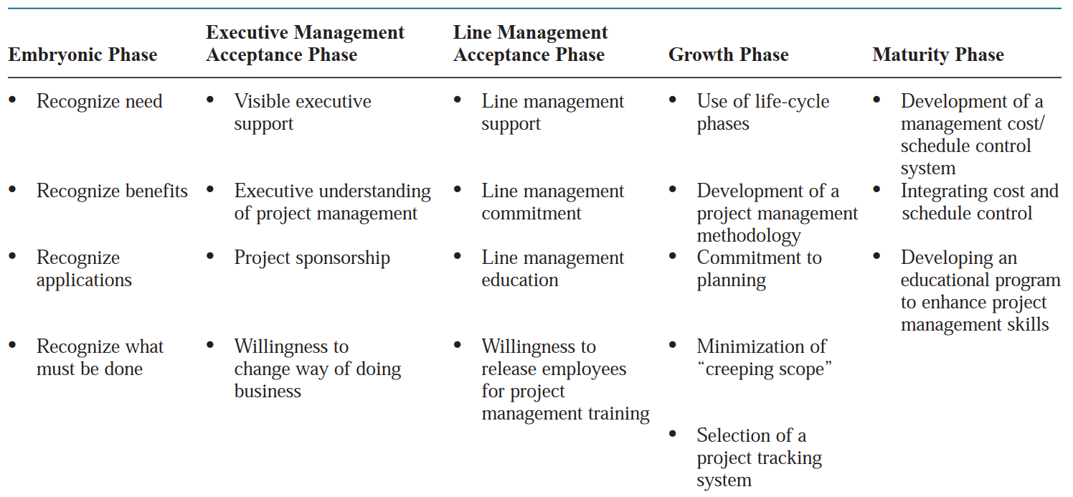
Chapter
Lifecycle Phase for Project Management Maturity
07

Slide 24
Chapter
Lifecycle Phase for Project Management Maturity
07
1- Embryonic Phase
Recognize need → Awareness that projects require structured management.
Recognize benefits → Understanding how project management improves efficiency, reduces risk, and saves cost.
Recognize applications → Identifying where project management can be applied (construction, IT, R&D).
Recognize what must be done → Initial steps: appoint a project leader, define scope, and plan resources.

Slide 25
Chapter
Lifecycle Phase for Project Management Maturity
07
2- Executive Management Acceptance Phase
Visible executive support → Leadership must actively endorse project management.
Understanding project management → Executives realize it is not just paperwork, but a strategic tool.
Project sponsorship → Senior managers allocate funding and resources.
Willingness to change business practices → Acceptance that traditional approaches may need updating.

Slide 26
Chapter
Lifecycle Phase for Project Management Maturity
07
3- Line Management Acceptance Phase
Line management support → Department heads align with project goals.
Commitment from line managers → They assign staff and encourage collaboration.
Line management education → Training managers in project principles and methodologies.
Willingness to release employees for training → Investing in building PM capabilities within the team.

Slide 27
Chapter
Lifecycle Phase for Project Management Maturity
07
4- Growth Phase
Use of life-cycle phases → Projects progress through defined stages (initiation → planning → execution → closure).
Development of methodology → Adoption of formal frameworks (PMBOK, PRINCE2).
Commitment to planning → Emphasis on detailed schedules, budgets, and risk management.
Minimization of “scope creep” → Keeping projects focused on agreed objectives.
Project tracking system → Using software/tools for monitoring progress.

Slide 28
Chapter
Lifecycle Phase for Project Management Maturity
07
5- Maturity Phase
Cost/schedule control system → Implementing earned value management (EVM) and dashboards.
Integrating cost and schedule → Coordinating budgets with timelines for realistic forecasts.
Educational programs → Continuous training and certification (PMP, PgMP, Agile).
Outcome → Sustainable project success and an organizational culture of excellence.

Slide 29
Chapter
The Six Driving Forces that lead recognize the need for Project Management
07
Capital projects
Customer expectations
Competitiveness
Executive understanding
New project development
Efficiency and effectiveness

Slide 30
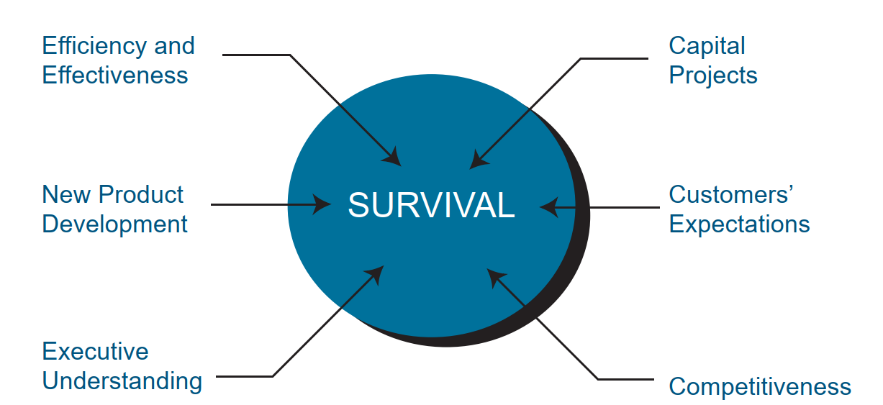
Chapter
The components of survival
07

Slide 31
Agenda
Productivity
Introduction to Productivity in Construction
Understanding Productivity vs. Production
Measuring Productivity (Production Model Example)
Productivity Index (PI)
Controllable Factors Affecting Productivity
Uncontrollable Factors Affecting Productivity
The Results of Uncontrolled Obstacles
Project Management: 1985–2009
Lifecycle Phase for Project Management Maturity
Project Vs Product
Maturity and Excellence
Success Factors
The Many Faces of Failure

Slide 32
Chapter
Project Vs Product
07
Introduction to Scope:
Scope defines the boundaries of what will (and won’t) be done.
Divided into Project Scope and Product Scope.
Helps avoid misunderstandings and scope creep.

Slide 33
Chapter
Project Vs Product
07
Project Scope – Definition
Describes the work required to deliver the final outcome.
Includes all activities, tasks, and deliverables.
Example: “Developing a mobile banking app” → coding, testing, training, deployment.

Slide 34
Chapter
Project Vs Product
07
Product Scope – Definition
Describes the features and characteristics of the deliverable itself.
Focuses on “what the end product will do.”
Example: “Mobile banking app” → fund transfers, bill payments, biometric login, notifications.

Slide 35
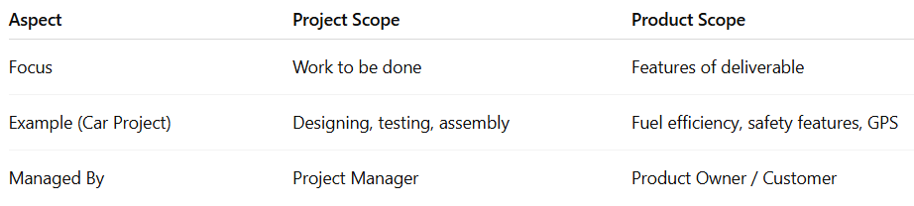
Chapter
Project Vs Product
07
Project Scope vs Product Scope (Comparison)

Slide 36
Chapter
Project Vs Product
07
Project Scope – Key Elements
Scope statement → formal description of work.
WBS (Work Breakdown Structure) → breaking down work into manageable parts.
Deliverables list → clear outputs at each stage.
Exclusions → what is NOT part of the project.

Slide 37
Chapter
Project Vs Product
07
Product Scope – Key Elements
Functional requirements → what the product must do.
Non-functional requirements → performance, quality, security.
Acceptance criteria → conditions for customer sign-off.
User experience (UX) considerations.

Slide 38
Agenda
Productivity
Introduction to Productivity in Construction
Understanding Productivity vs. Production
Measuring Productivity (Production Model Example)
Productivity Index (PI)
Controllable Factors Affecting Productivity
Uncontrollable Factors Affecting Productivity
The Results of Uncontrolled Obstacles
Project Management: 1985–2009
Lifecycle Phase for Project Management Maturity
Project Vs Product
Maturity and Excellence
Success Factors
The Many Faces of Failure

Slide 39
Chapter
Maturity and Excellence
07
Introduction to Maturity in Project Management
Maturity = structured processes, methods, and standards.
Goal → Predictable outcomes & repeatable success.
Not just experience, but systematic improvement.

Slide 40
Chapter
Maturity and Excellence
07
Characteristics of Mature Organizations
Standardized methodology across projects.
Consistent use of tools (MS Project, Jira, Primavera).
Trained workforce with certifications.
Effective governance and risk management.

Slide 41
Chapter
Maturity and Excellence
07
Excellence in Project Management
Continuous stream of successful projects.
Success measured not only in time & cost, but also in customer value.
Creating an environment for success (culture, leadership, tools).

Slide 42
Chapter
Maturity and Excellence
07
Key Factors Driving Excellence
Leadership commitment.
Integration of projects with strategy.
Investment in people (training, certifications).
Knowledge sharing across projects.

Slide 43
Chapter
Maturity and Excellence
07
Path to Excellence
Assess current maturity level.
Develop a roadmap for improvement.
Establish a PMO (Project Management Office).
Promote a continuous learning culture.
Align success with company + customer objectives.

Slide 44
Chapter
Maturity and Excellence
07
● Maturity in project management is the implementation of a standard methodology and accompanying processes such that there exists a high likelihood of repeated successes.
● Organizations excellent in project management are those that create the environment in which there exists a continuous stream of successfully managed projects and where success is measured by what is in the best interest of both the company and the project (i.e.,customer).

Slide 45
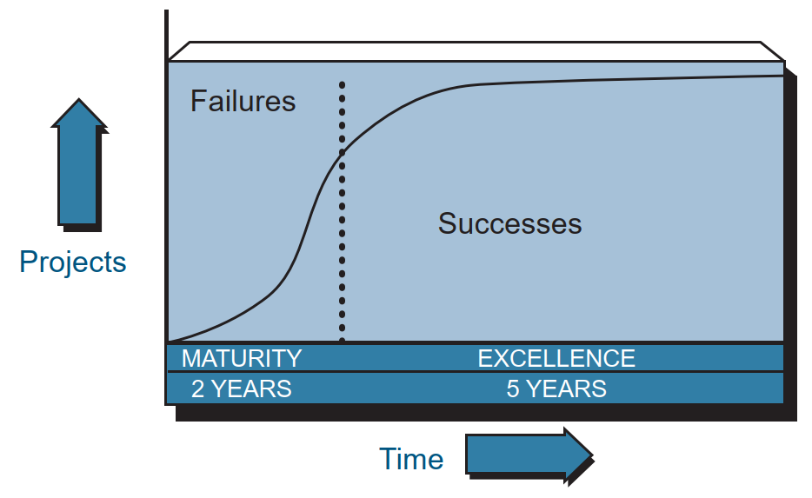
Chapter
The Growth of Excellence.
07

Slide 46
Agenda
Productivity
Introduction to Productivity in Construction
Understanding Productivity vs. Production
Measuring Productivity (Production Model Example)
Productivity Index (PI)
Controllable Factors Affecting Productivity
Uncontrollable Factors Affecting Productivity
The Results of Uncontrolled Obstacles
Project Management: 1985–2009
Lifecycle Phase for Project Management Maturity
Project Vs Product
Maturity and Excellence
Success Factors
The Many Faces of Failure

Slide 47
Chapter
Primary Success Factors
07
• Within time
• Within cost
• Within quality limits
• Accepted by the customer

Slide 48
Chapter
Secondary Success Factors
07
• Follow-on work from this customer
• Using the customer’s name as a reference on your literature
• Commercialization تسويقof a product
• With minimum or mutually agreed upon scope changes
• Without disturbing the main flow of work

Slide 49
Chapter
Secondary Success Factors
07
• Maintaining ethical conduct
• Providing a strategic alignment
• Maintaining a corporate reputation
• Maintaining regulatory agency relations

Slide 50
Agenda
Productivity
Introduction to Productivity in Construction
Understanding Productivity vs. Production
Measuring Productivity (Production Model Example)
Productivity Index (PI)
Controllable Factors Affecting Productivity
Uncontrollable Factors Affecting Productivity
The Results of Uncontrolled Obstacles
Project Management: 1985–2009
Lifecycle Phase for Project Management Maturity
Project Vs Product
Maturity and Excellence
Success Factors
The Many Faces of Failure

Slide 51
Chapter
The Many Faces of Failure
07
● Ineffective planning
● Ineffective scheduling
● Ineffective estimating
● Ineffective cost control
● Project objectives being “moving targets”

Slide 52
Chapter
Components of Failure (pessimistic planning).
07
Project management has planned a level of accomplishment (C) lower than what is achievable given project circumstances and resources (D).
This is a classic under planning situation.
Actual accomplishment (B), however, was less than planned.

Slide 53
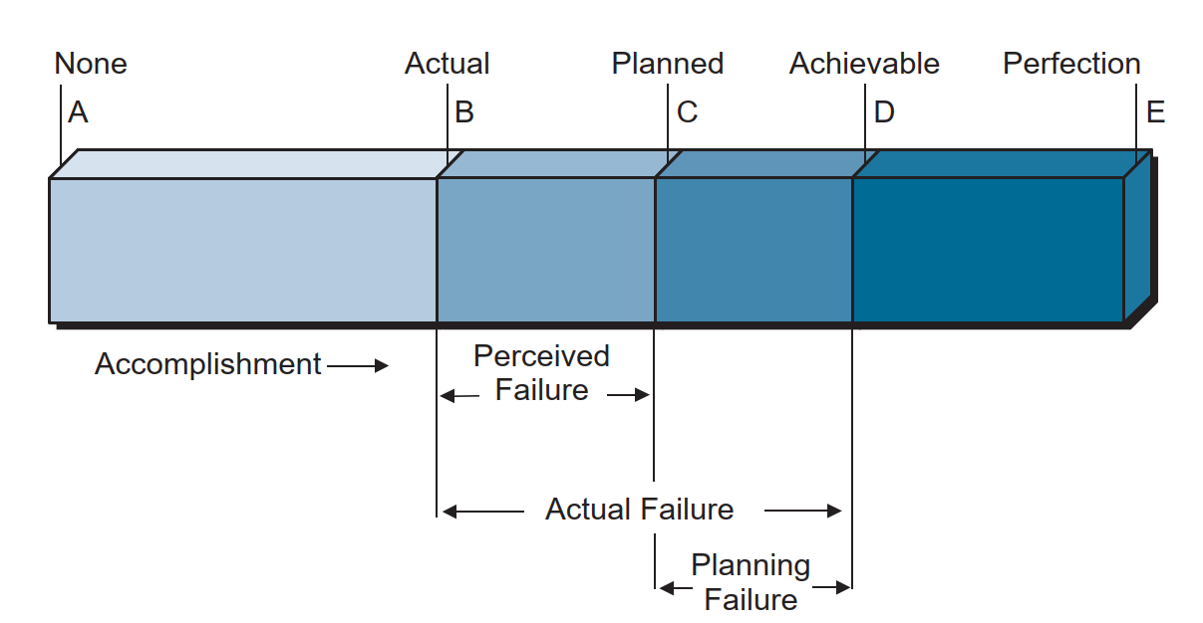
Chapter
Components of Failure (pessimistic planning).
07
0
070
80
100
120

Slide 54
Chapter
Components of failure (optimistic planning).
07
Here, we have planned to accomplish more than is achievable. Planning failure is again assured even if no actual failure occurs. In both of these situations (overplanning and under planning), the actual failure is the same, but the perceived failure can vary considerably.

Slide 55
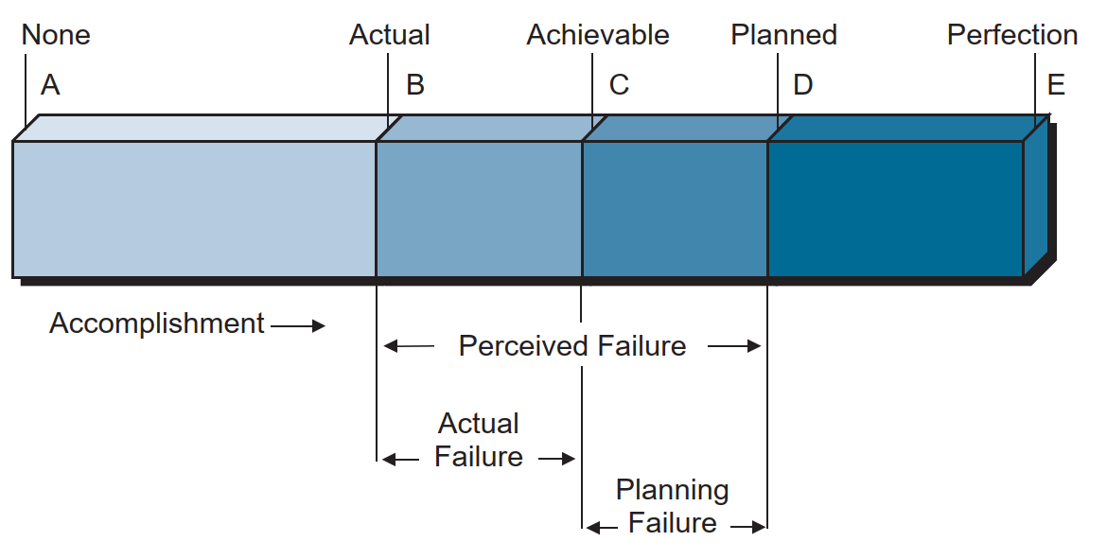
Chapter
Components of failure (optimistic planning).
07
0
070
80
100
120

Slide 56
Chapter
The Many Faces of Failure
07
Today, most project management practitioners focus on the planning failure term.
If this term can be compressed or even eliminated, then the magnitude of the actual failure, should it occur, would be diminished. A good project management methodology helps to reduce this term.
We now believe that the existence of this term is largely due to the project manager’s inability to perform effective risk management.

Slide 57



Thank You

