Slide 1


Artificial Intelligence in Healthcare
Prepared by Dr. Hesham Mousli
MHA621
Healthcare Informatics
Lecture 10

Slide 2

Intended Objectives
Chapter
10
Learn three healthcare analytics types (Descriptive, Diagnostic, Predictive) and their uses.
Explore AI methods (Expert Systems, ML, Neural Networks) in healthcare.
Study AI clinical uses, like disease detection and virtual therapy.
Understand AI in operations, e.g., discharge planning and claims automation.
Discuss AI ethics, including bias, transparency, and regulations.

Slide 3

Levels of Data Analytics in Healthcare

Slide 4
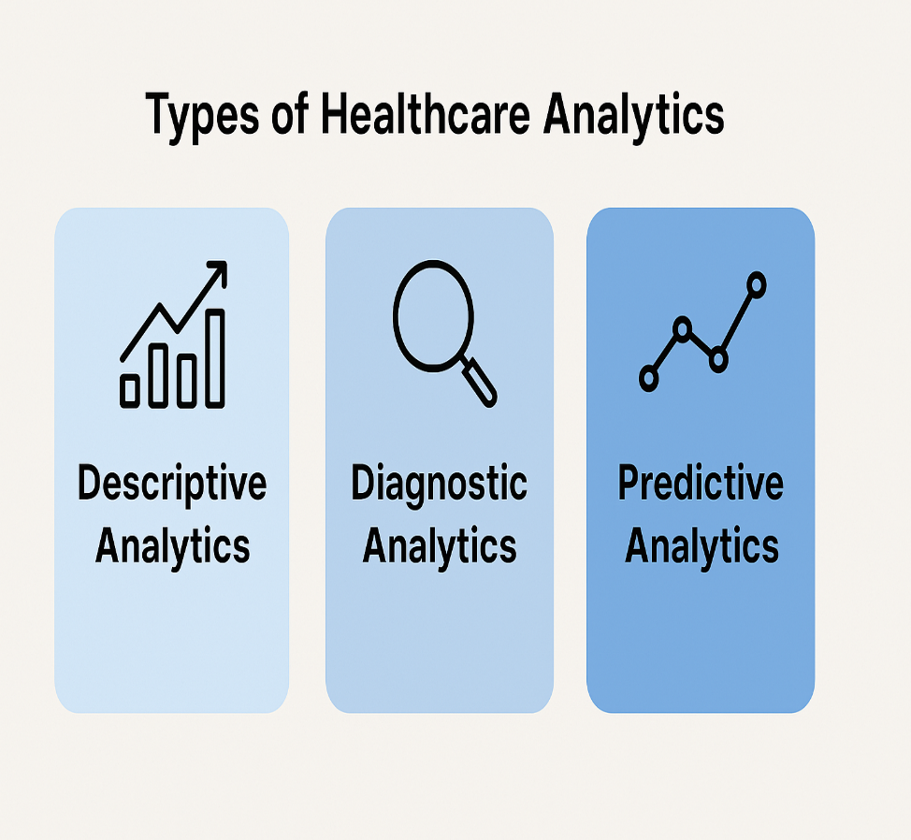
Healthcare Analytics
Chapter
10
Types of Healthcare Analytics:
  Descriptive Analytics.
  Diagnostic Analytics.
  Predictive Analytics.

Slide 5
Healthcare Analytics
Chapter
10
Descriptive Analytics:
  Function:
    Understand past events using current and historical data.
  Tools:
    Patient records, operational reports.
  Importance:
    Measures hospital performance and identifies general healthcare trends.

Slide 6
Healthcare Analytics
Chapter
10
Diagnostic Analytics:
  Function:
    Identify the causes of healthcare-related problems.
  Outcomes:
    Discover the causes behind issues like high post-operative infection rates.
  Benefit:
    Enables preventive action based on insights.

Slide 7
Healthcare Analytics
Chapter
10
Predictive Analytics:
  Function:
    Forecast future outcomes.
  Tools:
    Artificial Intelligence (AI) and Machine Learning (ML).
  Benefit:
    Enables proactive planning and enhances care quality.

Slide 8
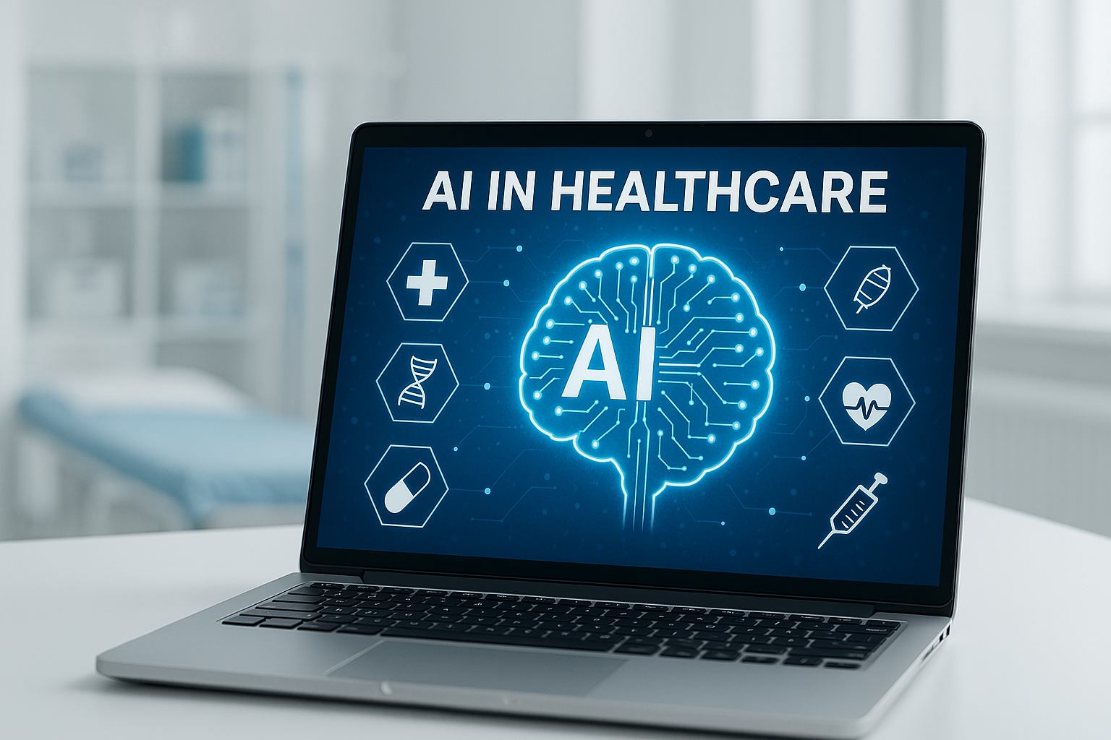
Introduction to AI

Slide 9
Introduction to AI
Chapter
10
What is AI?
  Definition: Machines mimicking human decision-making.
  Quote from Andrew Ng: "AI can perform tasks humans decide in <1 second."
  Donald Knuth’s perspective: AI excels at "thinking" tasks but struggles with reflexive actions (e.g., catching a ball).

Slide 10
AI Categories: Methods & Applications
Chapter
10
AI Methods:
  Expert Systems: Rule-based logic (e.g., early diagnostic tools). Ex.: If the patient has a high fever and positive blood culture, suggest antibiotics for bacterial infection.
  Machine Learning: Learns from patterns in data (e.g., predicting readmission).
  Neural Networks: Mimics brain structure to solve complex tasks (e.g., image recognition).

Slide 11
AI Categories: Methods & Applications
Chapter
10
AI Applications:
  Natural Language Processing (NLP): enables computers to understand, interpret, and generate human language.
  Robotics: combines mechanical systems with AI algorithms to perform tasks with physical movement and environmental interaction.
  Predictive Analytics: Uses statistical models and machine learning to forecast future outcomes based on historical data.

Slide 12
AI vs. Human Capabilities
Chapter
10
AI Strengths:
  Solves complex equations quickly (e.g., differential equations).
  Analyzes massive datasets (e.g., retinal scan analysis for heart disease prediction).
  Operates 24/7 without fatigue (e.g., RPA in insurance claims follow-up).

Slide 13

AI vs. Human Capabilities
Chapter
10
Human Strengths:
  Reflexive actions (e.g., catching a ball, complex motor skills).
  Emotional intelligence & ethics (e.g., palliative care, nuanced patient needs).
  Nuanced pattern recognition: "Chihuahua or Muffin" problem illustrates AI struggles with visual ambiguity.

Slide 14
Clinical Applications of AI

Slide 15

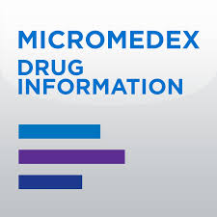
Clinical Decision Support Systems
Chapter
10
Main Function:
  Analyze patient data against large medical databases.
  Provide evidence-based treatment recommendations.
Micromedex with IBM Watson:
  Delivers accurate, comprehensive drug and disease information.
  Enhances the speed and quality of clinical decision-making.

Slide 16


Slide 17
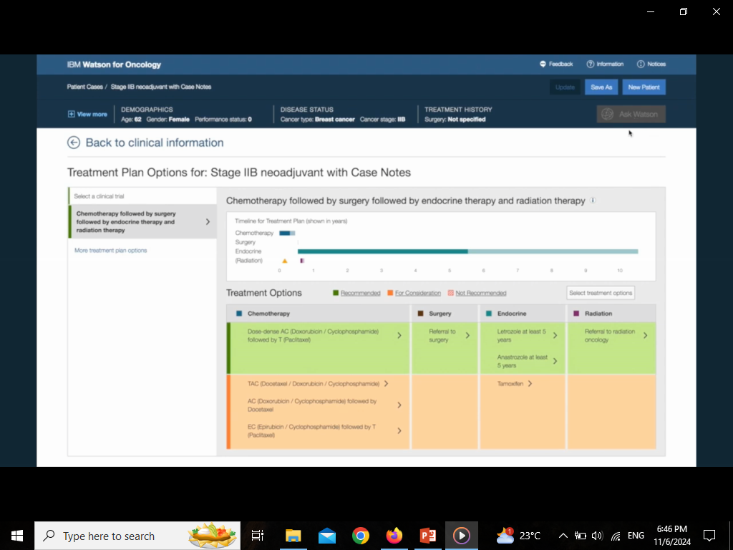

Slide 18
Detecting Diabetic Retinopathy with AI
Chapter
10
Diabetic Retinopathy: A diabetes-related eye disease that can cause blindness.
IDx-DR: First FDA-approved AI tool to detect it.
  Analyzes eye images from a special camera.
  Gives results without a doctor needing to interpret them.
  Detected disease correctly in 87.4% of cases.
  Identified healthy cases correctly in 89.5%.
  Benefit: Makes screening easier in primary care clinics.

Slide 19
AI in Radiology: Breast Cancer Detection
Chapter
10
Google AI model: Trained on thousands of mammograms.
  Detect breast cancer earlier and more accurately.
  Missed fewer cancers (↓9.4% in the US).
  Made fewer false alarms (↓5.7% in the US).
  UK radiologists said it could reduce their workload by 88%.
Takeaway: AI can assist radiologists, saving time and improving accuracy.

Slide 20
Predicting Heart Disease from Eye Images
Chapter
10
Deep Learning AI: Analyzed retinal (eye) scans of over 284,000 people.
  Discovered: Subtle eye features linked to heart disease risk.
  Why it matters:
    Doctors could not previously detect these patterns.
    AI finds hidden clues humans might miss.
  Future potential: Fast, non-invasive heart risk screening using eye scans.

Slide 21
Virtual AI Therapist: “Ellie”
Chapter
10
Ellie: A virtual therapist developed for returning war veterans.
What Ellie does:
  Makes eye contact, nods, and responds like a human.
  Pauses to encourage patients to talk more.
  Doesn’t give therapy: instead, collects data to help real therapists.
  Offers a sense of privacy.
  Helps patients who feel shy or uncomfortable talking to people.
Quote: “After the second question, you forget it’s a robot.”

Slide 22
Operational and Administrative AI

Slide 23
AI Prediction of Discharge Delay Effects
Chapter
10
Problem: Discharges get delayed due to bottlenecks (e.g., late physical therapy sessions, test results).
AI Solution:
  Analyzes historical data (e.g., patient condition, staff availability, past delays).
  Flags high-risk cases early (e.g., "Patient X likely needs therapy scheduling 24hrs earlier to avoid delay").
  Example:
  AI alerts staff if a post-surgery patient’s recovery pace suggests they’ll miss discharge goals without faster physical therapy.

Slide 24
"Nudges" for Resource Prioritization
Chapter
10
What are "Nudges"?
  Simple definition: AI-driven gentle prompts or alerts to guide staff decisions without forcing actions.
  Analogy: Like a GPS suggesting a faster route—you can ignore it, but it optimizes efficiency.

Slide 25
"Nudges" for Resource Prioritization
Chapter
10
What are "Nudges"?
  How It Works:
    AI identifies urgent needs (e.g., MRI for stroke patients) and "nudges" schedulers to prioritize them in queues.
  Example:
    Without Nudge: MRI schedule first-come, first-served.
    With Nudge: AI bumps a critical case to the top, reducing wait times for high-risk patients.

Slide 26

AI leverages predictive analytics, smart automation, and behavioral nudges to optimize healthcare workflows.
Outcome: Faster, data-driven decision-making that reduces costs, minimizes errors, and decreases delays across both patient care and administrative workflows.
Example: An AI prompt like "80% of similar patients benefited from earlier PT, schedule now?"

Slide 27
Automating Claims Follow-Up with RPA
Chapter
10
  Application: AI-driven Robotic Process Automation (RPA) eliminates manual work.
  How it Works: Bots handle repetitive tasks like claims status checks and data entry.
  Result: Processing time drops from 10 minutes to just 1 minute per claim.

Slide 28
Chapter
AI-Optimized Claims Matching
10
  Application: AI analyzes claims and automatically assigns them to nurses based on expertise.
  How it Works: Machine learning matches claims (e.g., surgery, chronic care) with the right specialist.
  Result: Approval rates jump from 43% to 57% with fewer errors and faster payouts.

Slide 29
Chapter
The Impact of AI & RPA
10
  Speed: Near-instant follow-ups vs. slow manual checks.
  Accuracy: AI ensures the right person handles each claim.
  Cost Savings: Less rework, fewer delays, happier customers.

Slide 30
AI and RPA turn claims processing from a slow, error-prone task into a fast, intelligent system so, cutting costs and boosting efficiency.

Slide 31
Challenges and Ethical Considerations

Slide 32
Chapter
Data Bias in AI
10
Risk:
  AI systems trained on non-representative or limited datasets can lead to biased outcomes.
  May result in unequal treatment across different patient groups (e.g., by race, gender, or age).
Fix:
  Use diverse, inclusive datasets that reflect the full patient population.
  Implement regular audits and validations to detect and correct biases.
  Involve interdisciplinary teams to review AI outputs for fairness and accuracy.

Slide 33
Chapter
Black Box Problem in AI
10
Lack of Transparency:
  AI systems may make recommendations without explaining the reasoning behind them.
  Clinicians often cannot trace how the AI reached a specific decision.
Example:
  An AI tool recommends chemotherapy for a patient, contradicting the oncologist’s clinical judgment.
  Raises concerns about over-reliance on AI without understanding the context.

Slide 34
Chapter
Black Box Problem in AI
10
Need for Human Oversight:
  Essential to have options for human override in critical decisions.
  AI should support, not replace, clinical expertise.
Call for Explainable AI:
  Transparency in algorithms is needed to build trust.
  Clinicians should be able to interpret and validate AI recommendations.

Slide 35
Chapter
Regulation and Classification
10
AI as a "Medical Device":
  Debate on whether AI should be classified as a medical device, which would require oversight from regulatory bodies like the FDA.
  Such classification would ensure safety, efficacy, and accountability in AI systems used for medical purposes.

Slide 36
Chapter
Regulation and Classification
10
Dynamic Regulation for Adaptive AI:
  The need for evolving regulations to accommodate the flexibility and adaptability of AI systems.
  AI technology is continuously improving, requiring a regulatory framework that can adapt to new capabilities and applications in healthcare.

Slide 37
Chapter
Wrap Up
10
  Descriptive analytics reviews past data; diagnostic finds causes; predictive forecasts trends.
  AI boosts data tasks (imaging, claims) but lacks human judgment.
  Clinical AI (e.g., IDx-DR, mammography tools) improves accuracy but needs oversight.
  Operational AI cuts delays (discharges) and automates tasks (RPA).

Slide 38
Chapter
Wrap Up
10
  Bias risks exist; fix them with diverse data and audits.
  "Black box" AI needs Transparency and human checks.
  Regulations must adapt to ensure AI safety and fairness.
  AI supports, not replaces, human expertise in healthcare.

Slide 39



Thank You

