Slide 1






Program and Portfolio Management
Prepared by Dr. Sami Alzahrani
Lecture 1
PMG 665
Program and Portfolio Management

Slide 2


PMG 665
Course Discerption
This course addresses the fundamental principles of managing portfolios and programs. Portfolios translate an organization’s business strategy into a collection of activities that can be managed with desired benefits and results. Program management deals with managing several related projects in a cohesive, multi-project environment, and provides benefits that one might not get from managing the projects individually. Both portfolio and program management align projects with business objectives. This course also describes the processes that follow project cost estimation and pricing. Students master how to construct a project budget and how to monitor and control it.

Slide 3
PMG 665
Course Discerption
It covers Achieving Business Advantages through Program Management, Strategic Planning and Program Management: Implementing an Organizational Strategic Vision through a Disciplined Program Management, Change Management: The Good, the Bad and the Ugly, Program Initiation, Benefits Management, The Earned Benefit Method for Controlling Program Performance, Communication and Its Power at the Program Level: Managing Power Brokers with Effective Communication ,Decision Gate Discipline for Programs, Program Risk Management. , Information Structuring “Methodology”: Tools and Techniques for Effective Program Management, Portfolio, Program, and Project Management as Enablers of Innovation, Sustainability Program Management.

Slide 4
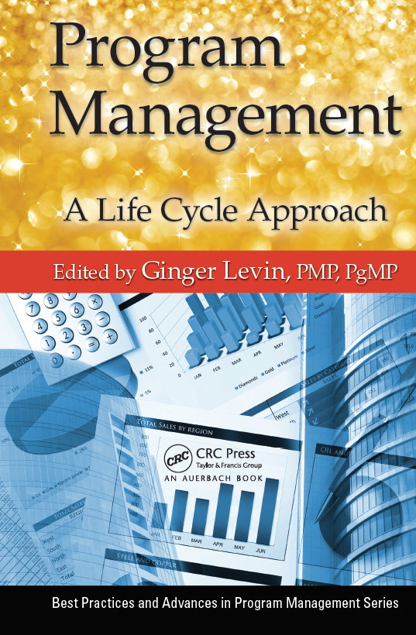
PMG 665
The Main Material & References
The main material and reference for each course will be the textbook mentioned in the course specifications. Lecture notes and slides are additional resources that are prepared by the professor.
Required Textbook: Program Management: A Life Cycle Approach by Ginger Levin

Slide 5
PMG 665
Topics
▪ Achieving Business Advantages through Program Management
▪ Strategic Planning and Program Management: Implementing an Organizational Strategic Vision
through a Disciplined Program Management
▪ Change Management: The Good, the Bad and the Ugly
▪ Program Initiation
▪ Benefits Management
▪ The Earned Benefit Method for Controlling Program Performance
▪ Communication and Its Power at the Program Level: Managing Power Brokers with Effective Communication
▪ Decision Gate Discipline for Programs.
▪ Program Risk Management.
▪ Information Structuring “Methodology”: Tools and Techniques for Effective Program Management.
▪ Portfolio, Program, and Project Management as Enablers of Innovation.
▪ Sustainability Program Management.

Slide 6
PMG 665
Learning Outcomes
▪ Evaluate critical success factors for projects and programs, use these factors to create project portfolios that align with strategic goals of the organization and describe best practices for managing such a portfolio.
▪ Construct a program management plan that describes best practices for the creation and management of programs and how to coordinate activities such as finance, procurement, and risk across programs.
▪ Given a case consisting of a specific set of project contexts and plans within a project portfolio, recommend approaches for managing and balancing resource demands, allocations, and stakeholder expectations across the projects, programs, and the portfolio
▪ Critique the concepts of responsibility‐center accounting and budgeting.
▪ Given a specific project context, which includes a plan, cost, schedule, and deliverable metrics, analyze the project data, classify various project expenditures as capital or operational, and recommend approaches for funding the project.

Slide 7
Chapter
01
Introduction
Advanced organizations and companies that want to stay ahead of the competition have embraced program management as a means to deal with increasing complexity and competitive pressure in the business environment. It provides them with triple win advantages over the competition. But what are those triple advantages?

Slide 8
Chapter
01
Introduction
Predictability and reliability of technical and project execution.
Increased customer satisfaction because of better project performance
Increased return on investment (ROI) because initiatives of large scale, high complexity and substantial risk potential are constantly aligned to overall organizational strategy.

Slide 9
Chapter
01
Introduction
This chapter seeks to shed light on these triple advantages and will explain how organizations can increase their project performance through program management. It will explain how organizations can improve their customer satisfaction by delivering higher quality programs and projects at a reduced overall cost. And last not least, it will explain how businesses can shape more dynamic and more flexible organizations to adapt to shifting environments.

Slide 10
Chapter
01
The case for program management in business
Before considering program management as a tool to advance an organization’s bottom line, it is important to understand where it came from and how it fits into the overall organization. To understand what it is, and what it is not, will help understand what it can do for businesses.

Slide 11
Chapter
01
How Did Program Management Originate?
Program management (programme management in British terminology) as a business discipline is relatively young. Even though its roots go back to the 1950s (the development of a U.S. underwater missile launcher system is often mentioned as the first application of program management practices), it really developed in the 1980s on the civilian side and sought to increase target and financial orientation in government initiatives.

Slide 12
Chapter
01
What is a Program, and What Should be Managed as a Program?
A program is defined by the Project Management Institute (PMI®) (PMI®, 2008) as: “a group of related projects managed in a coordinated way to obtain benefits and control not available from managing them individually”. Benefit, as used in this context, is the combined outcome of component projects and initiatives that aggregate to a common product, advantage or capability. Examples of benefits could be increased profits, improved operations, or growth.

Slide 13
Chapter
01
WHY PROGRAM MANAGEMENT IS IMPORTANT?
Organizations with some degree of proficiency and experience in project management can fall into a complexity trap as the size of the project, the size of the organization, and business risk increases. For example, envision a project that was started to achieve technical or other highly measurable goals. This project can run for a long period of time, even years. The financial and risk exposure can be substantial.

Slide 14
Chapter
01
WHY PROGRAM MANAGEMENT IS IMPORTANT?
While the project team, led by its project manager, does a good job steering the project goals of time, quality and budget (the triple constraint), the environment might have shifted since the project’s kick-off meeting. Even though the project meets its originally set targets, it may no longer be relevant to the changing business needs of the performing organization. Resources are spent in a way that is not optimally aligned with business strategy. Program management can be an excellent choice for an organization to avoid the described trap.

Slide 15
Chapter
01
What is program management’s place in the organization?
It is important to consider how things fit together. There are several pillars in business, some of the most important are:
• Strategic Business Planning
• Portfolio Management
• Program Management
• Project Management
• Operations Management

Slide 16
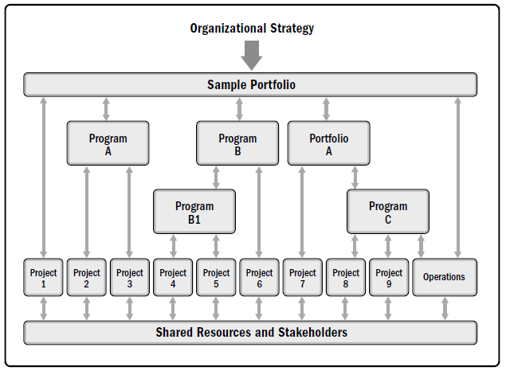
Chapter
01
What is program management’s place in the organization?
Program and project
management focus on
doing programs and
projects the “right” way.
Portfolio management
focuses on doing
the “right” programs and
projects.

Slide 17
Chapter
01
What is program management’s place in the organization?
Project | Program | Portfolio
A project is a temporary endeavor undertaken to create a unique product, service, or result. | A program is a group of related projects, subsidiary programs, and program activities that are managed in a coordinated manner to obtain benefits not available from managing them individually. | A portfolio is a collection of projects, programs, subsidiary portfolios, and operations managed as a group to achieve strategic objectives.
Project managers progressively elaborate high-level information into detailed plans throughout the project life cycle. | Programs are managed using high-level plans that track the interdependencies and progress of program components. Program plans are also used to guide planning at the component level. | Portfolio managers create and maintain necessary processes and communication relative to the aggregate portfolio.
Success is measured by product and project quality, timeliness, budget compliance, and degree of customer satisfaction. | A program’s success is measured by the program’s ability to deliver its intended benefits to an organization. | Success is measured in terms of the aggregate investment performance and benefit realization of the portfolio.

Slide 18
Chapter
01
What is program management’s place in the organization?
These pillars jointly form a networked support structure for project-oriented organizations. Operations own resources, skills and capabilities that are applied to drive project work. Projects create deliverables, as outlined in their charters and scope of work. Programs generate business benefits by governance and ownership of projects and other initiatives. These benefits help achieve top-level organizational strategic goals, that might be grouped and organized with help of portfolio management, see Figure 1.1. below.

Slide 19
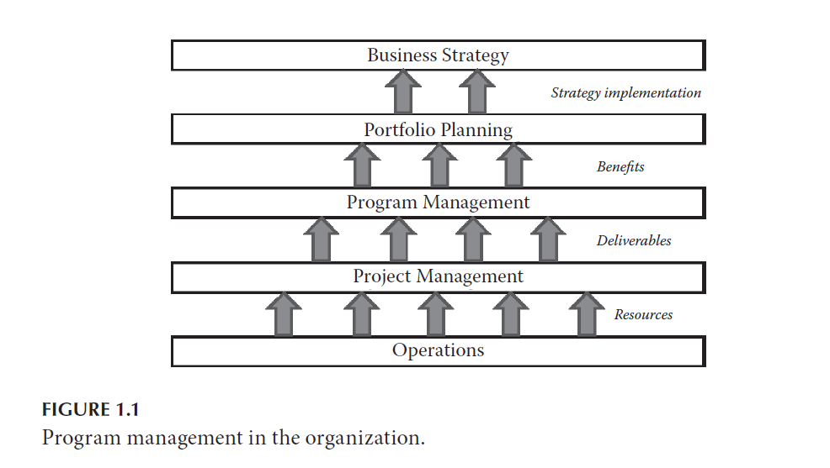
Chapter
01
What is program management’s place in the organization?

Slide 20
Chapter
01
Competitive advantages through program management
Organizations are embracing program management in order to improve their bottom line. Consider how this works, and how organizations can get started with the process of implementing program management for greater returns.

Slide 21
Chapter
01
Competitive advantages through program management
A Starting Point
Originally a technical function, project management was developed as a means to deal with complexity. As a byproduct, it became also a competitive advantage of organizations. By applying project management, the success rate of projects typically increases for organizations. The percentages of goal achievement in time, budget and quality tend to increase. These achievements allow organizations to better predict their costs and help minimize risk and uncertainty.

Slide 22
Chapter
01
The Next Step—Shaping the Structure
As projects and initiatives increase in scale (higher cost, longer durations, and increased complexity), advanced project management techniques and processes allow organizations to balance risks and rewards. Multi-project management, sometimes supported by a Project Management Office or a Program Management Office (PMO) within the organization, increases the likelihood of success and furthermore of not getting overwhelmed by the more demanding business environment.

Slide 23
Chapter
01
What is a PMO?
For many organizations a PMO is the preferred way to organize processes and procedures, everything that has to do with program and project implementation. Whether an organization has two different types of structures for program and project management greatly depends on its size and industry. For many smaller- to medium-sized organizations, a PMO can support both programs and projects at the same time.

Slide 24
Chapter
01
What is a PMO?
A project management office (PMO) is an organizational structure that standardizes the project-related governance processes and facilitates the sharing of resources, methodologies, tools, and techniques.
PMO types:
  Supportive: Provide a consultative role to projects by supplying templates, best practices, training, access to information, and lessons learned from other projects. (low control).
  Controlling: Provide support and require compliance (moderate control).
  Directive: Take control of the projects by directly managing the projects. Project managers are assigned by and report to the PMO. (high control)

Slide 25
Chapter
01
What is a PMO?
Often the head of program management is also (directly or indirectly) in charge of all program and project managers within the organization. This delivery-oriented approach works well for many organizations.
Some of the key goals and duties of a PMO include:
• Provide a formal and administrative infrastructure for programs and projects.
• Define program and project management processes for the organization

Slide 26
Chapter
01
What is a PMO?
• Manage schedules and budgets at the program level
• Set the quality framework for programs and component projects
• Define what success means for programs within the performing organization
• Support an organization-wide management of risks and issues
• Provide governance for component projects and ensure alignment to organizational strategy (PMI®, 2008)

Slide 27
Chapter
01
What is a PMO?
A PMO may have the authority to act as an integral stakeholder and a key decision maker throughout the life of each project in order to keep it aligned with the business objectives.
  Make recommendations.
  Lead knowledge transfer.
  Terminate projects.
  Take other actions, as required.
A primary function of a PMO is to support project managers in a variety of ways:
  Managing shared resources across all projects administered by the PMO.
  Providing project management methodology, best practices, and standards.
  Coaching, mentoring, training, and oversight.
  Monitoring compliance by means of project audits.
  Developing and managing project policies, procedures and templates.
  Coordinating communication across projects.

Slide 28
Chapter
01
Scalable structure and processes
Project management, applied either individually or as multi-project management, however, can be distracted by shifting markets and changing business environments. In many organizations, there are dozens and sometimes hundreds of projects under way at any given time. Each of the projects has its own set of requirements, as outlined in its project charter, the requirements documentation, project management plan, etc. Project managers may do a fine job of meeting their goals within the time, cost and quality constraints.

Slide 29
Chapter
01
How does program management close the gap?
A business cannot be successful in the long term if it lacks strategy. In general, businesses have strategies and strategic goals; however, some of them might be unrealistic. The creation of viable business strategy is not within in the scope of this chapter. It is assumed that a viable strategy exists; actually, experience shows that most of the time businesses do not lack strategy, but instead lack the needed implementation and realization of that strategy.

Slide 30
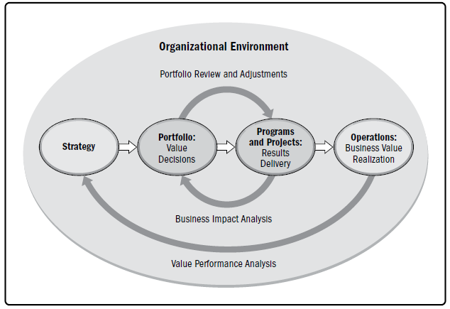
Chapter
01
How does program management close the gap?

Slide 31
Chapter
01
How does program management close the gap?
In order to implement business strategy, several organizational process assets have to be applied. Various departments and business unit functions need to contribute in order to achieve the desired results. It is at this stage, that program management becomes the critical business integrator that helps apply all those resources in a coordinated fashion for maximum results.

Slide 32
Chapter
01
An introduction path for program management
Implementation of program management initially can be a daunting task. Program management has to be rooted deeply within the entire organization to become truly effective. Organizations historically have been better at adopting program management if they previously have achieved a level of proficiency in project management, particularly if multi-project management was practiced successfully. The success rate in its adoption follows a maturity curve.

Slide 33
Chapter
01
An introduction path for program management
Maturing project management typically can be found when project management changes from a merely technical function into a true business contributor. At that point, it not only ensures better predictability in technical delivery but will also provide a strong return on investment for the organization. Evidence can be found when organizations monitor, for example, project execution costs as a percentage of project revenue; see Figure 1.2. below.

Slide 34
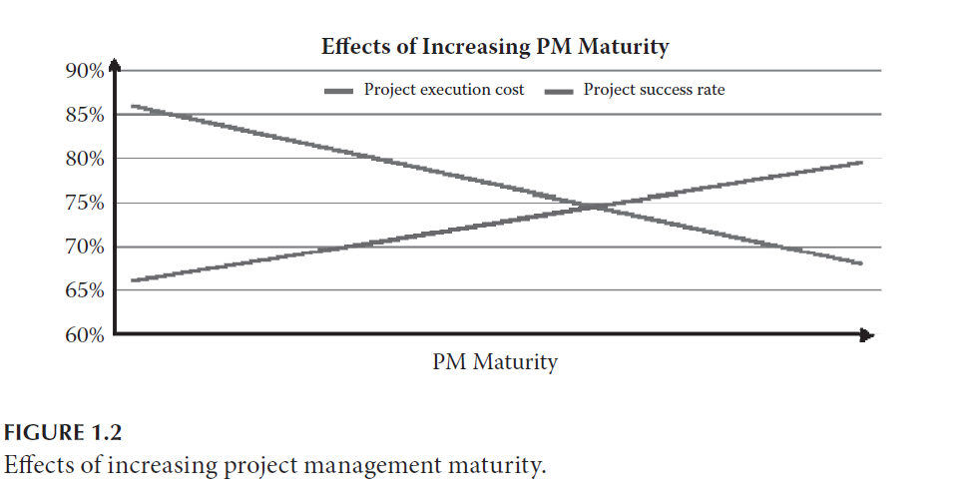
Chapter
01
An introduction path for program management

Slide 35
Chapter
01
An introduction path for program management
could be adjusted to: ‘Increase the quality of sales orders, as measured by the number of open items at the project kick-off meeting’. Then, the organization can establish a benchmark, and going forward, it can determine the trends in terms of the quality of sales orders.

Slide 36
Chapter
01
An introduction path for program management
Based on competent project management practices, the move to multi-project management can be a logical next step. This approach will be the first and important step toward program management. With multi-project management, organizations are enabled to further increase efficiencies in their delivery of projects. This approach can ease the burden on enterprise-wide resource planning by ensuring a more coordinated approach to demand balancing.

Slide 37
Chapter
01
An introduction path for program management
The project demand for resources is bundled, and operational management can better plan for a more strategic picture of project resource demands. By doing so, an organization has the ability to increase the utilization rate of human and other resources, by minimizing both idle time and overtime situations. There is significant cost savings that then is realized; see Figure 1.3.

Slide 38
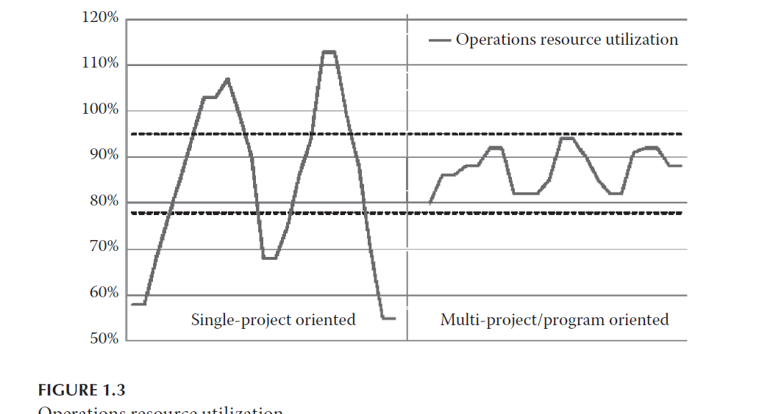
Chapter
01
An introduction path for program management

Slide 39
Chapter
01
An introduction path for program management
implementation is explained in easy to understand terms. A way to outline this approach is to demonstrate ‘how would good look like’. More importantly, what does vision mean to each individual in the organization to make sure it is understood in the same way, which also means vision must be communicated to everyone through consistent messages. A defined communications strategy is required, which is followed whenever the strategic goals of the organization change.

Slide 40
Chapter
01
Specific business benefits of program management
As was presented, program management is a key contributor to overall business success of an organization. At the same time, it only makes sense if there are tangible advantages through the application of program management practices. The following are actual examples to show how businesses have gained a competitive advantage through program management.

Slide 41
Chapter
01
Specific business benefits of program management
• Large-scale projects are often the background of intensive bidding by competing organizations. Gaining efficiency can create a competitive advantage when bidding for such larger scale projects. Take a large scale global re-tooling initiative for example. Several components of this initiative are projects. However, they may be interrelated on a technical, functional, regional or resource level. An organization can try to win this order by bidding on a project-by-project basis and hoping for the best.

Slide 42
Chapter
01
Specific business benefits of program management
• Such large-scale initiatives often span across several countries, and sometimes across continents. Customers with a global corporate organization may award such large-scale global initiatives that span across geographies to the organization that manages these specifics the most effectively. Enterprise-wide program management practices and procedures can include common platforms and processes, networked global IT infrastructure, and common goals and objectives.

Slide 43
Chapter
01
Specific business benefits of program management
• The effects of efficient project and program implementation can also reach beyond the organization. By closely aligning initiatives, and managing their resource demand across projects and programs, organizations have achieved increased levels of utilization of key technical or personnel resources. With some experience, such efficiency gains can directly translate into cost savings.

Slide 44
Chapter
01
Program management focuses on complexities
When program organizations perform at such a high level of predictability and efficiency, they will also resonate with the client base. Program management can take project delivery from a one-off approach into project management that never stops.

Slide 45
Chapter
01
Program management focuses on complexities
The linear, one-off approach transforms into an ongoing, life-cycle oriented partnership for improved mutual results. One way of accomplishing this approach is to have program and project managers retain account or regional ownership, so when the next program or project is authorized, they can more easily execute it.

Slide 46
Chapter
01
TITLE OF SLIDE
Reference
Program Management: A Life Cycle Approach
by Ginger Levin, PMP, PgMP

