Slide 1


Slide 2


Slide 3
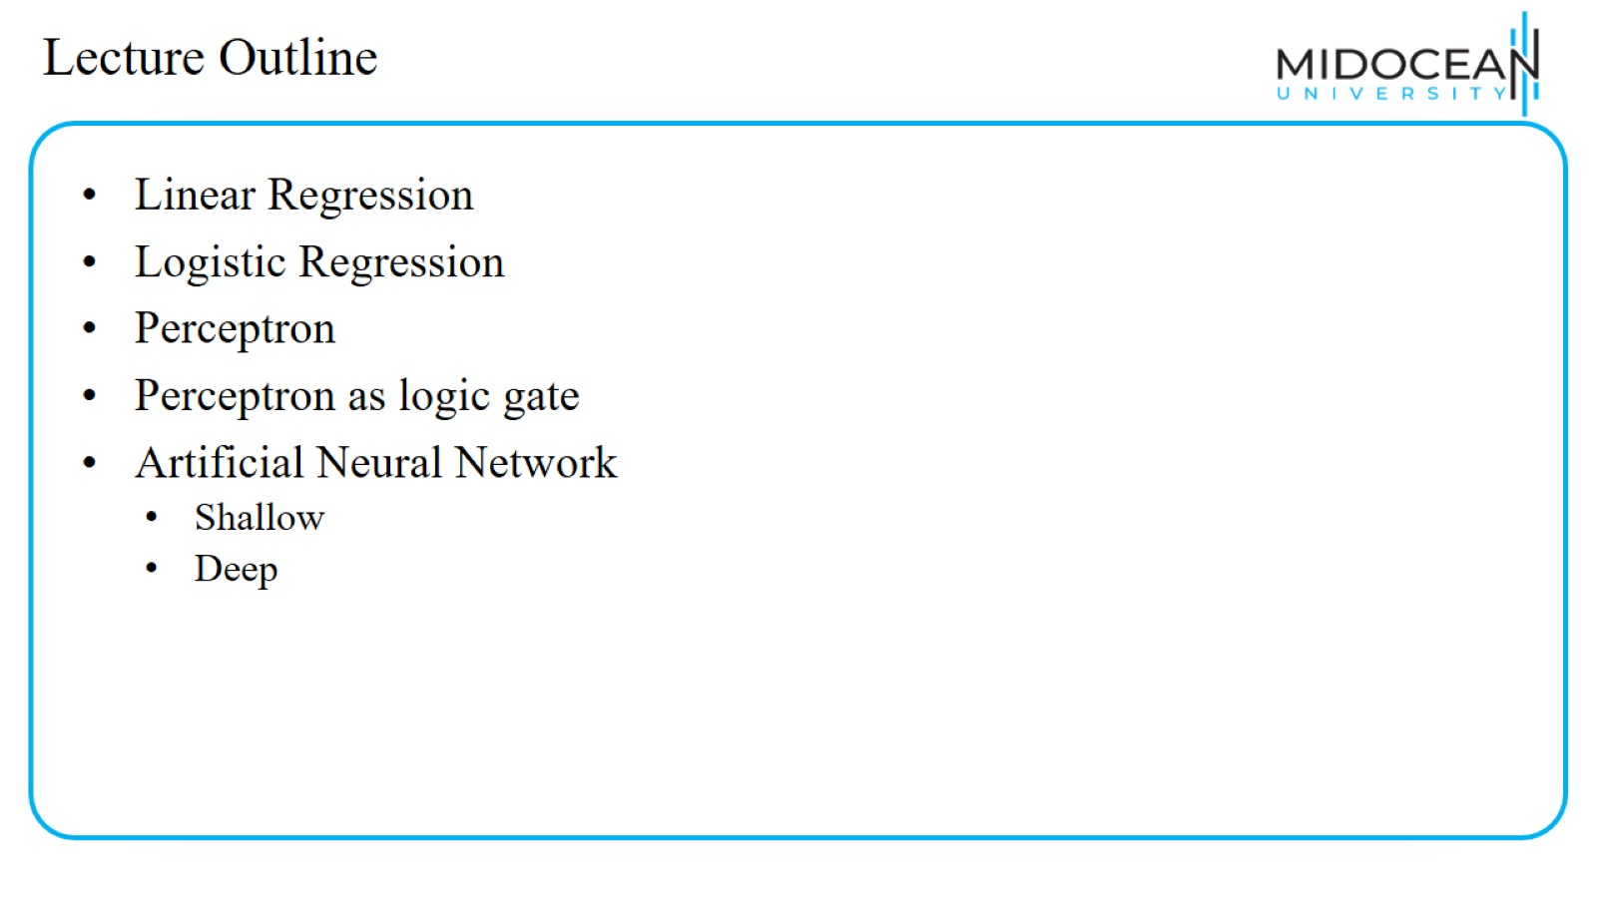
Lecture Outline

Slide 4
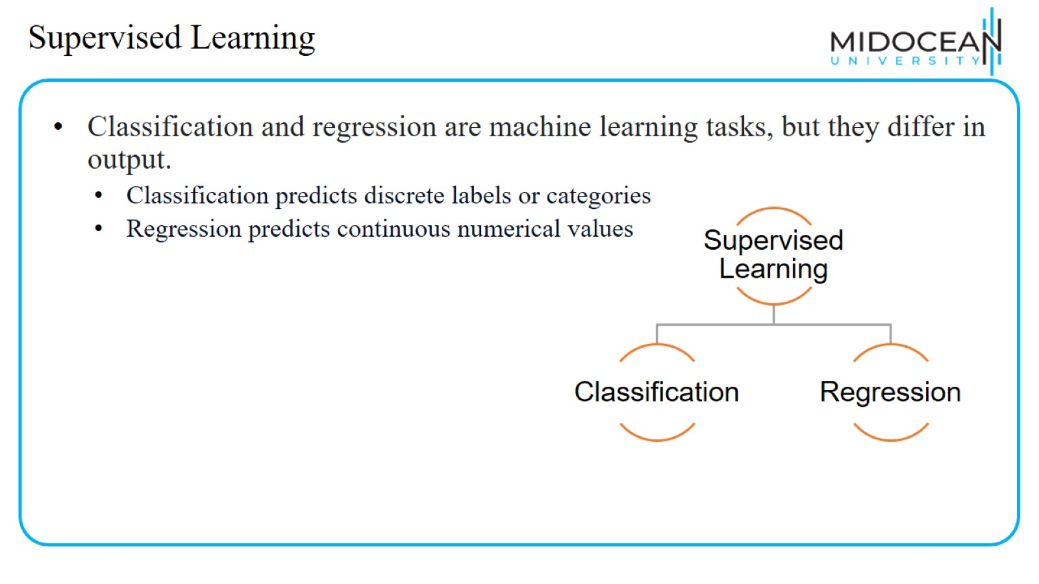
Supervised Learning

Slide 5
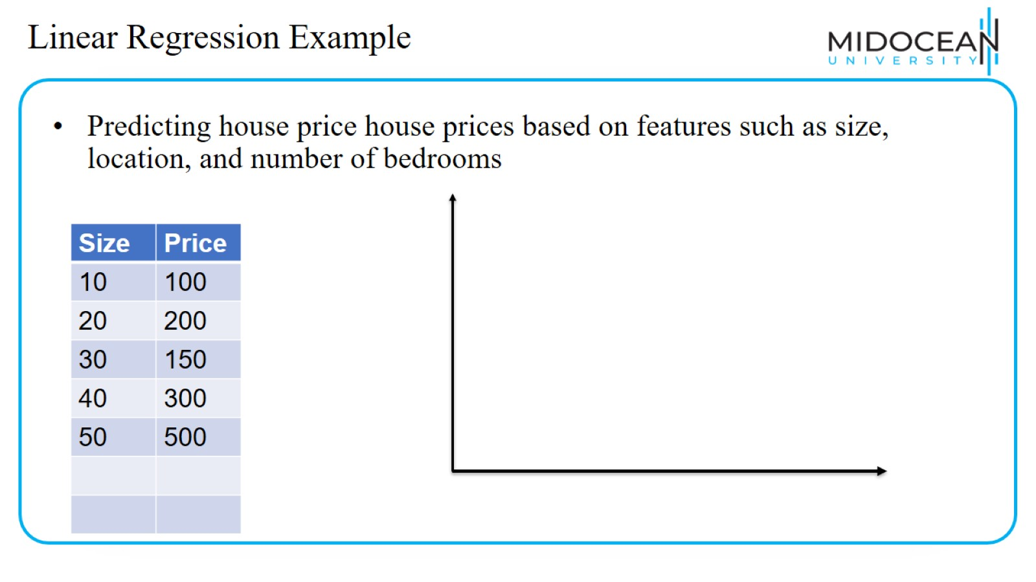
Linear Regression Example

Slide 6
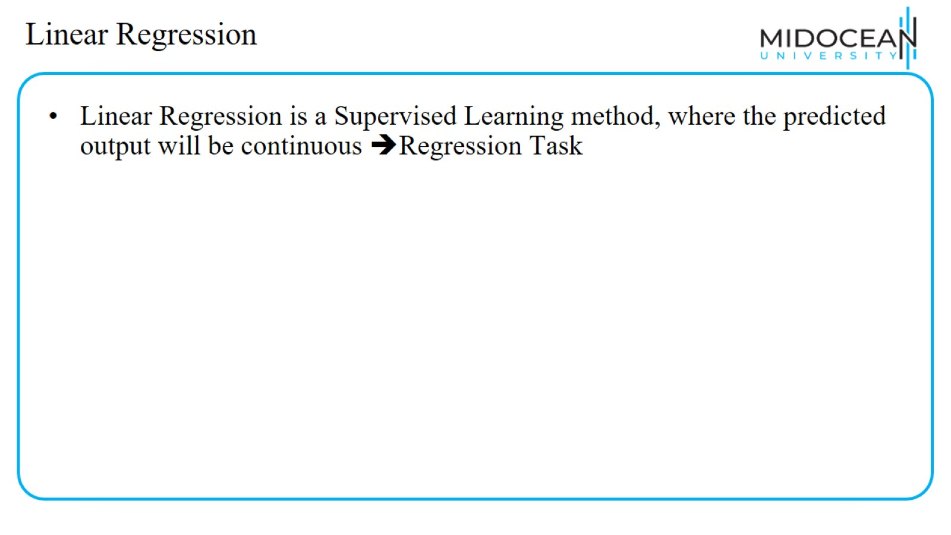
Linear Regression

Slide 7
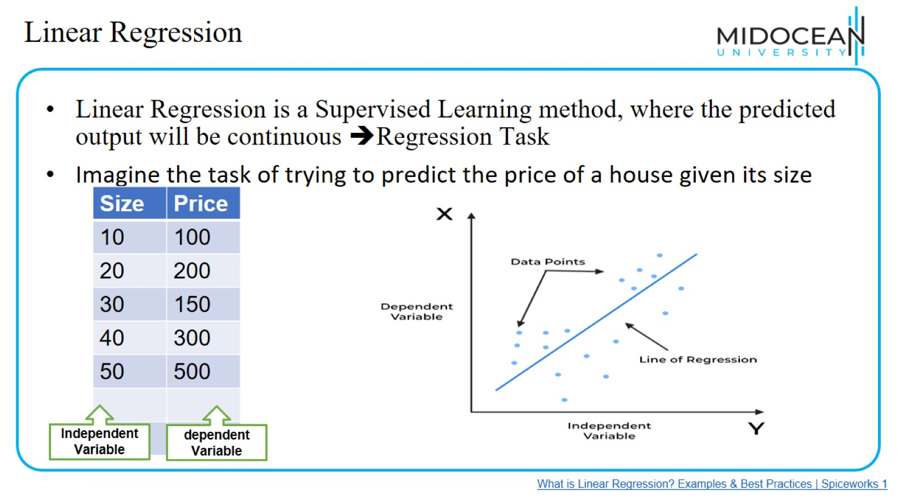
Linear Regression

Slide 8
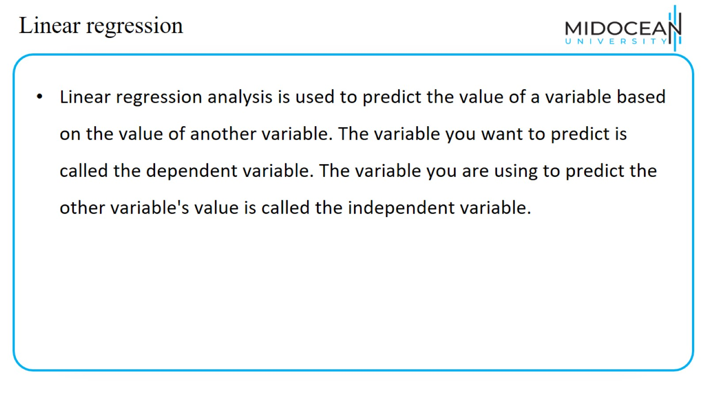
Linear regression

Slide 9
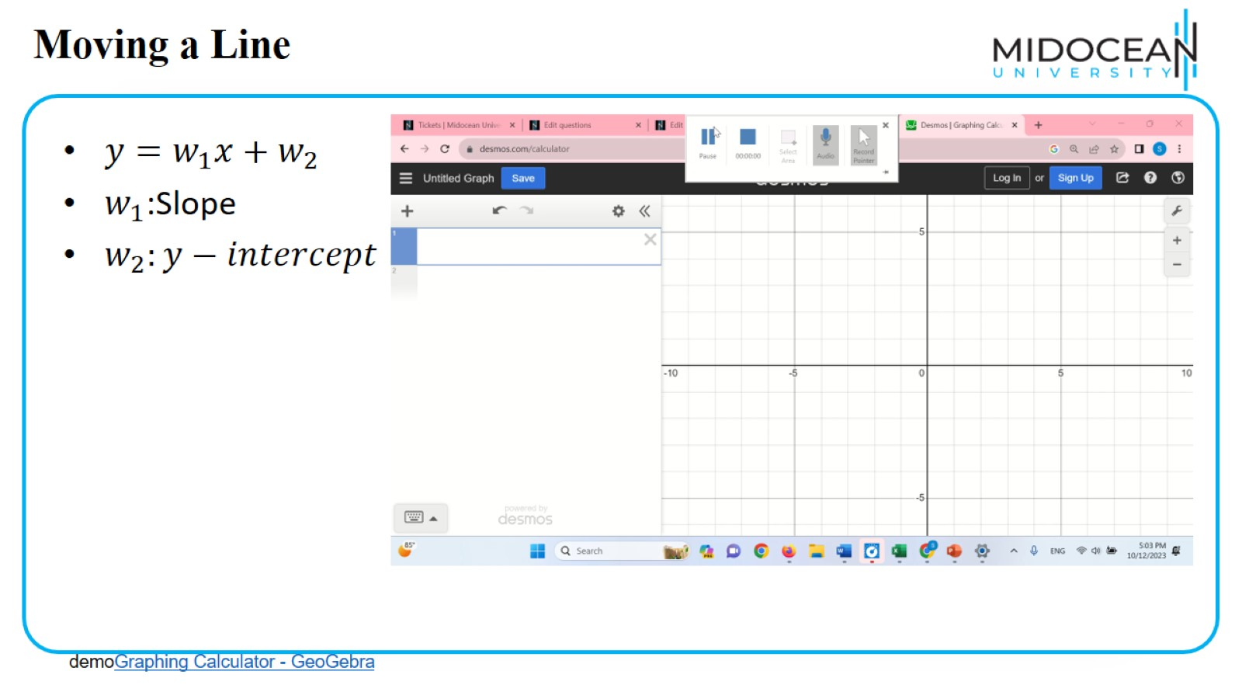
Moving a Line

Slide 10
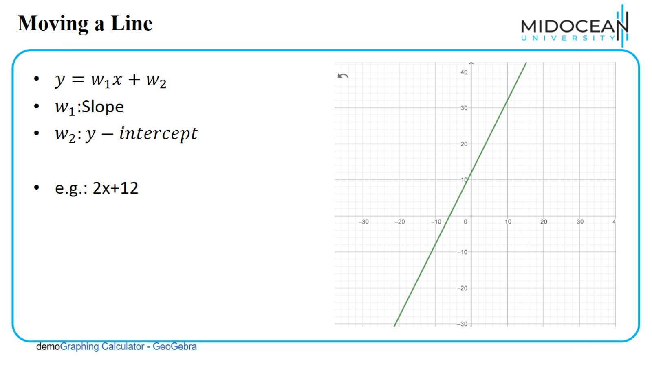
Moving a Line

Slide 11
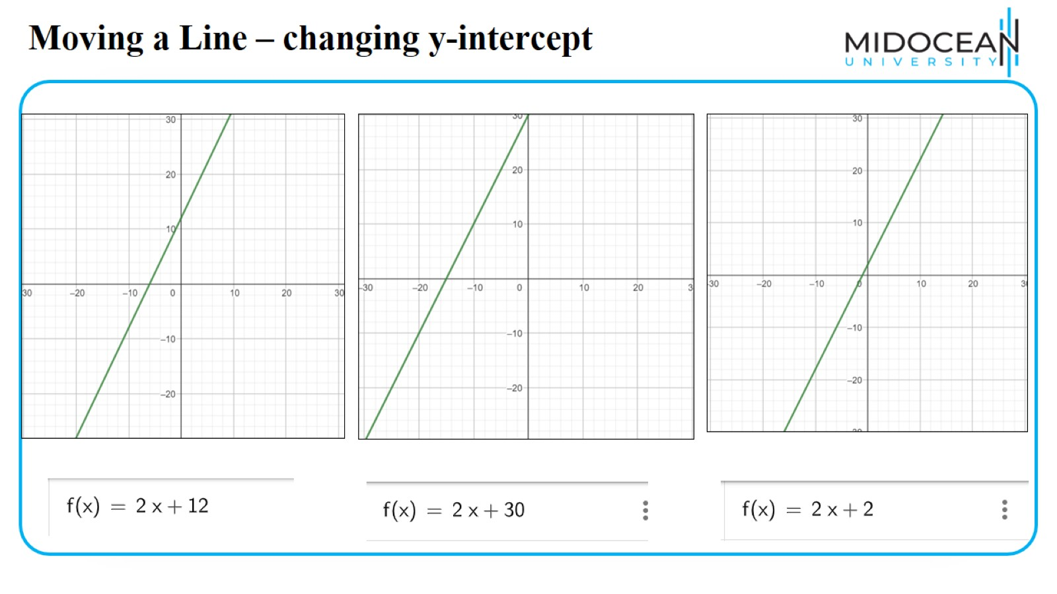
Moving a Line – changing y-intercept

Slide 12
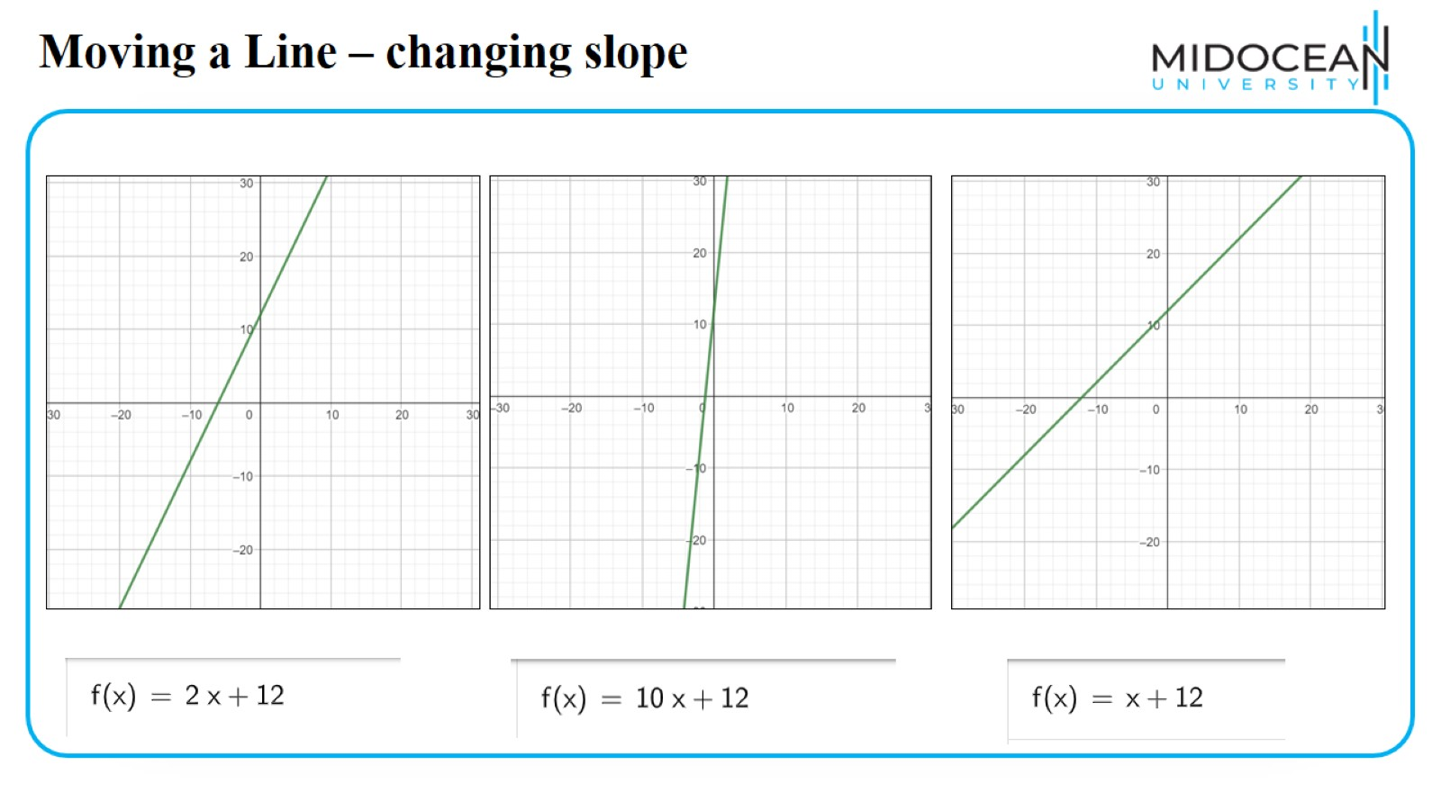
Moving a Line – changing slope

Slide 13
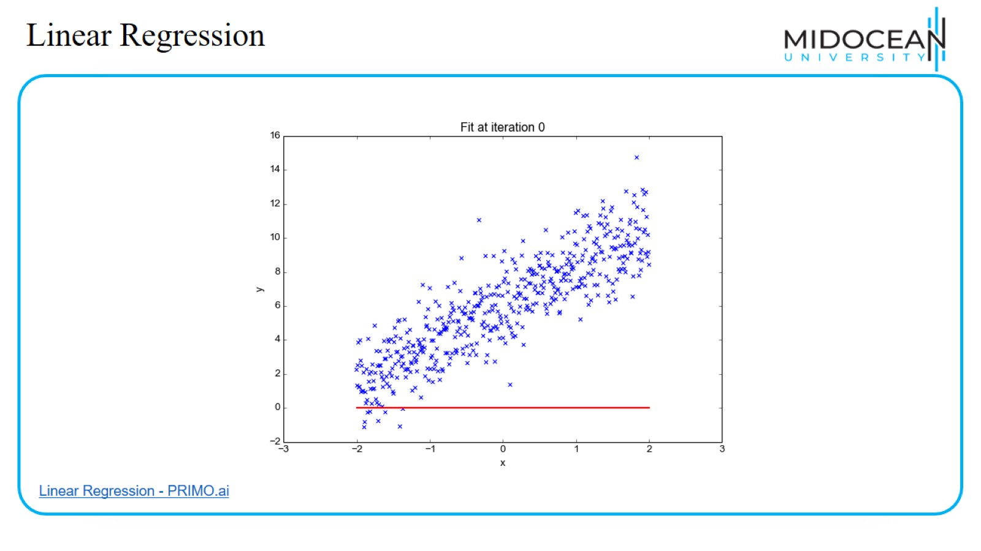
Linear Regression

Slide 14
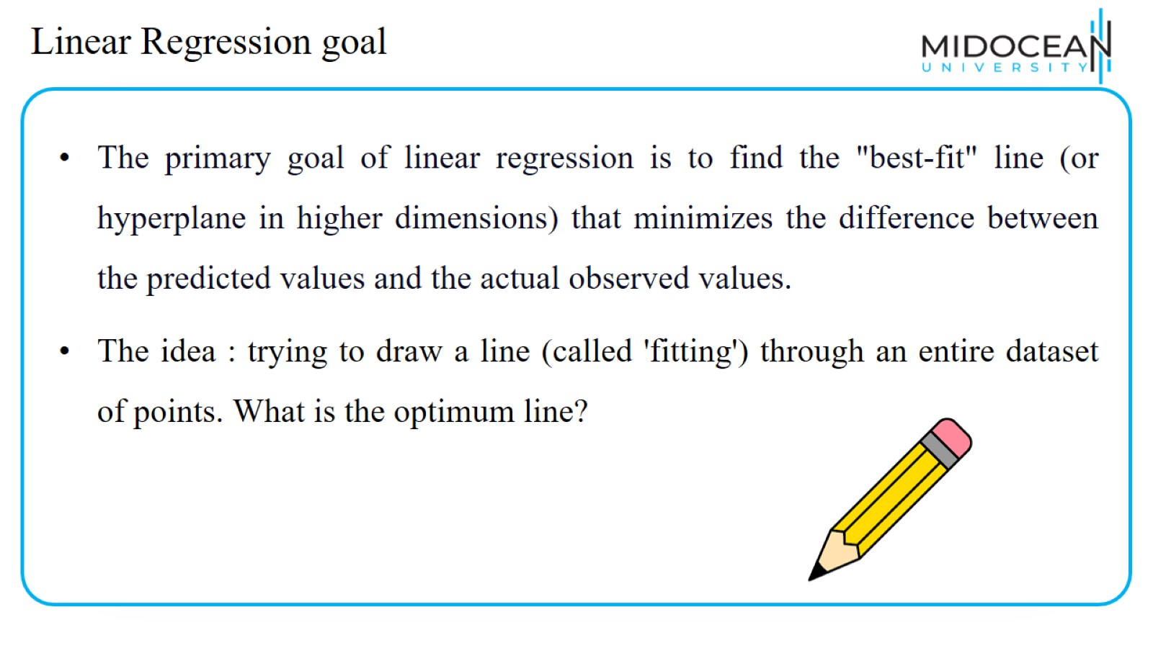
Linear Regression goal

Slide 15
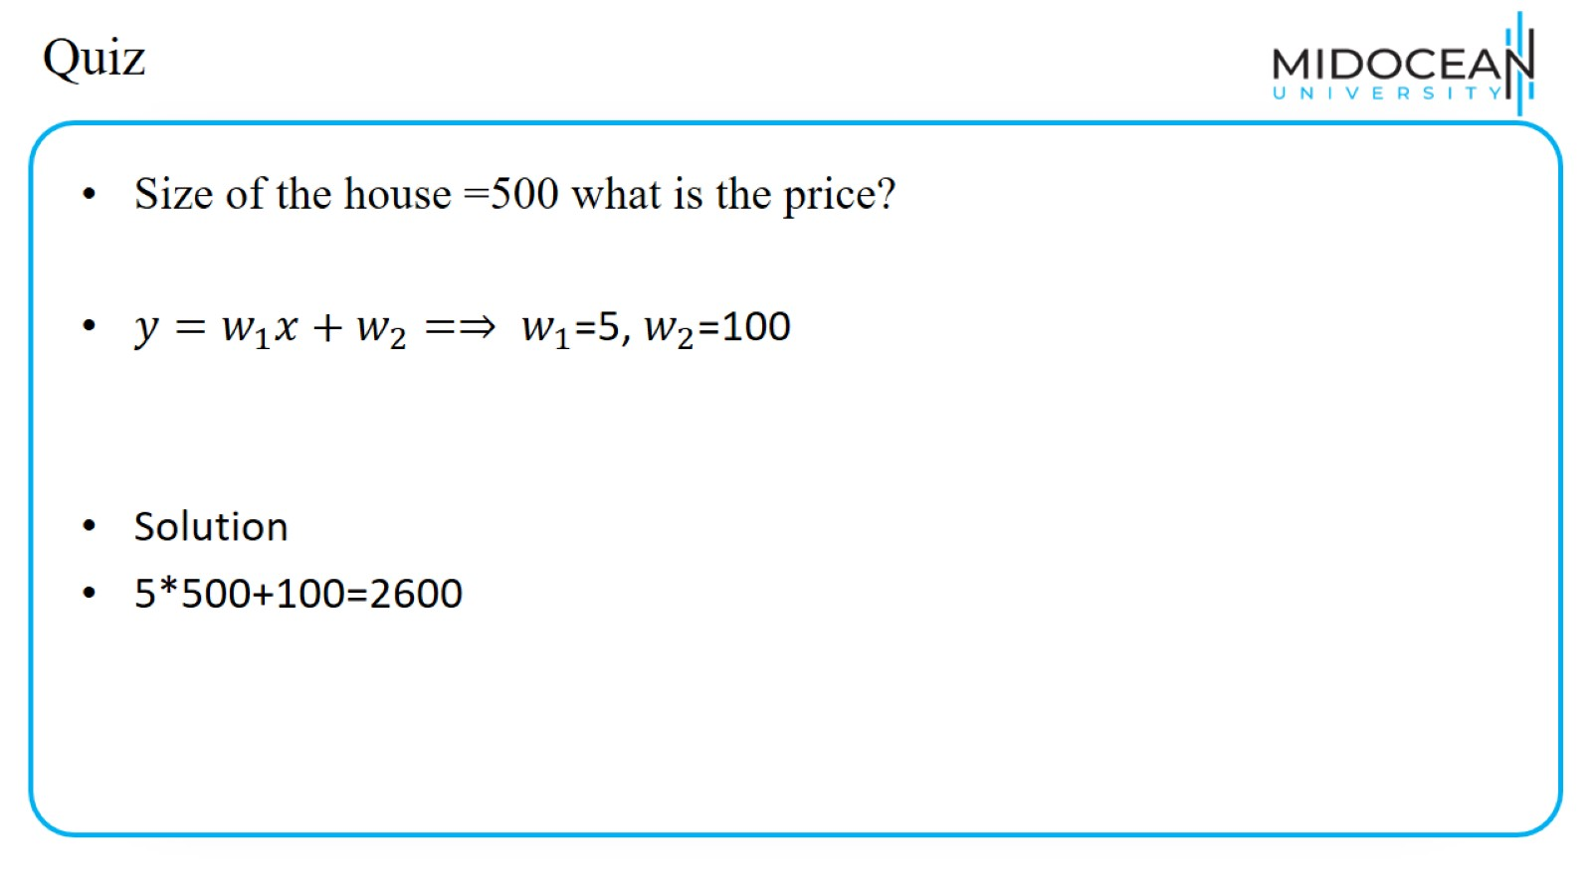
Quiz

Slide 16
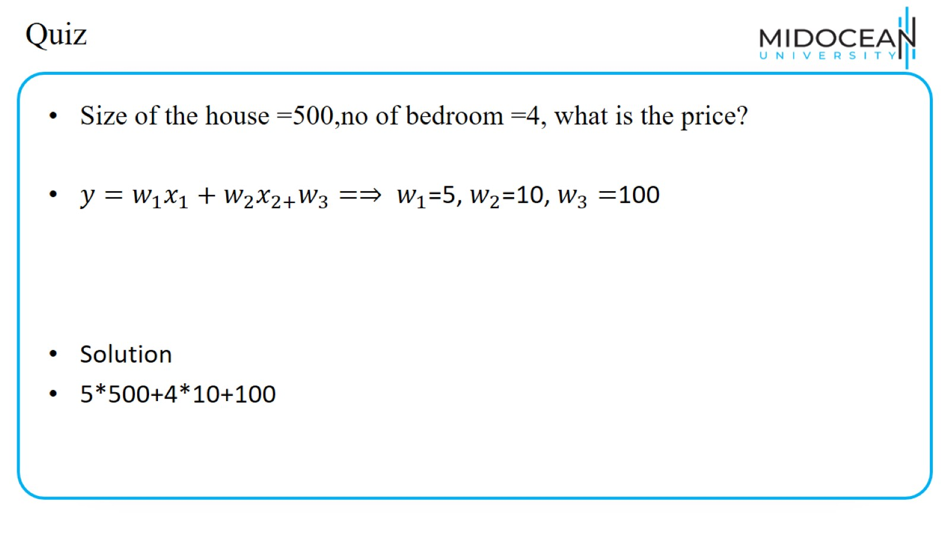
Quiz

Slide 17
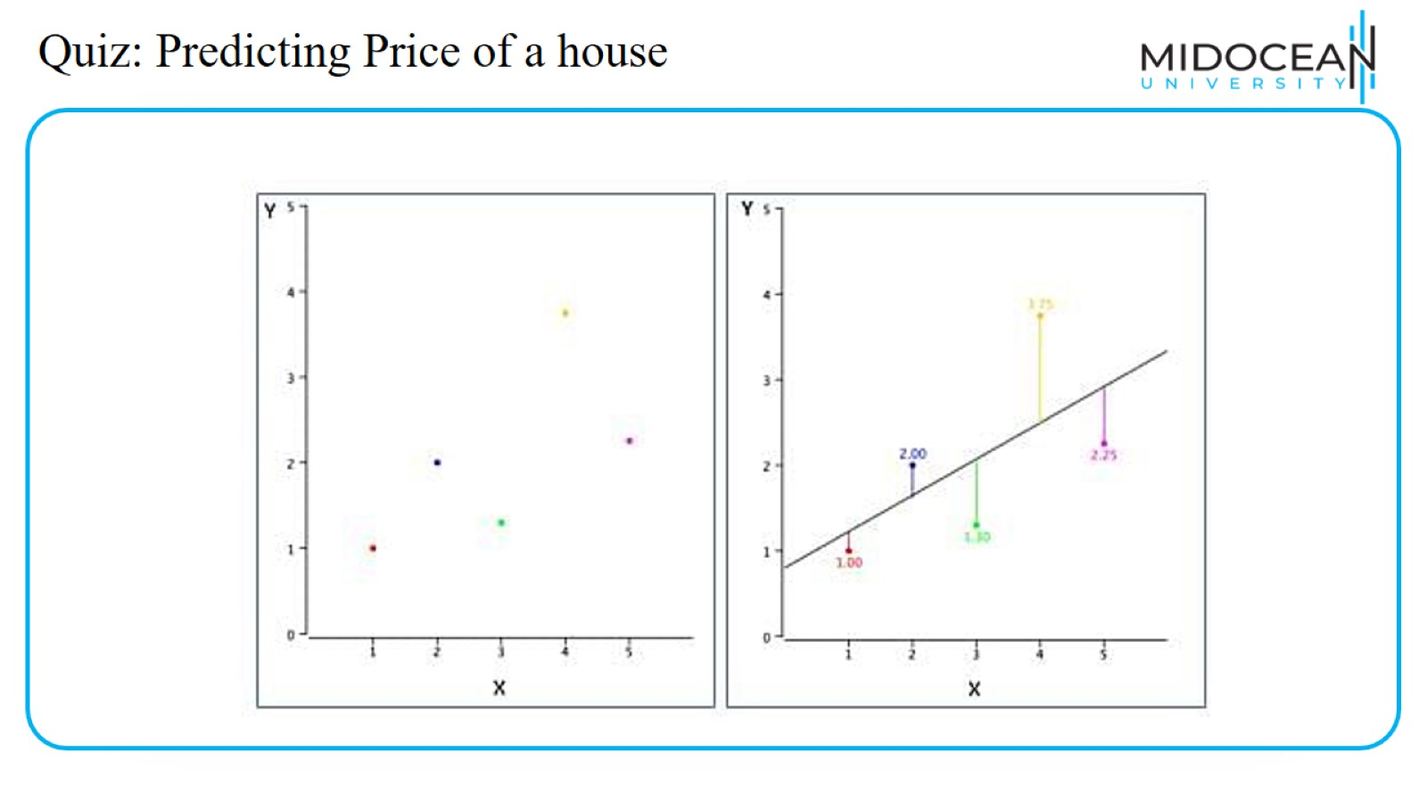
Quiz: Predicting Price of a house

Slide 18
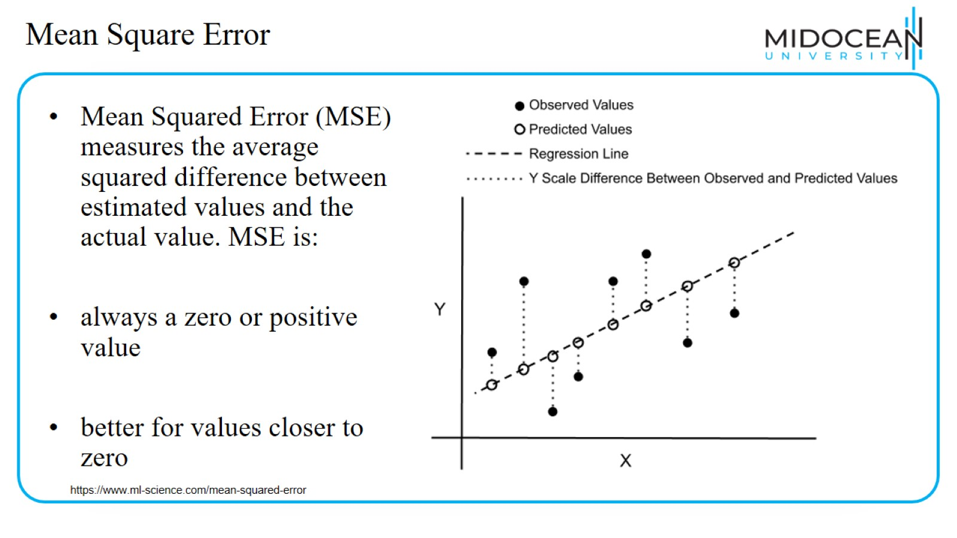
Mean Square Error

Slide 19
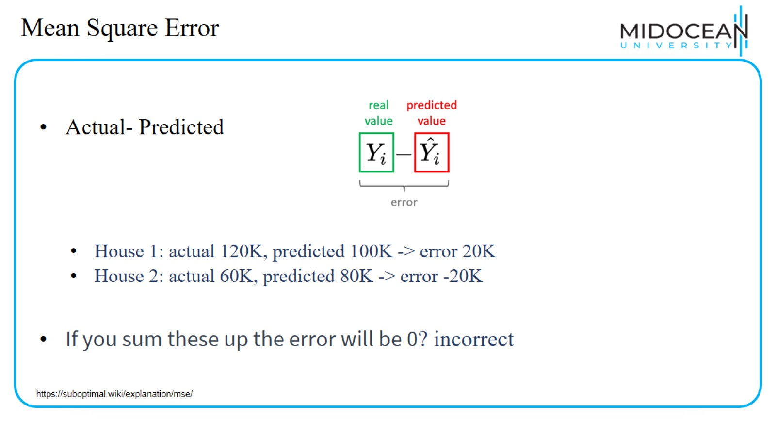
Mean Square Error

Slide 20
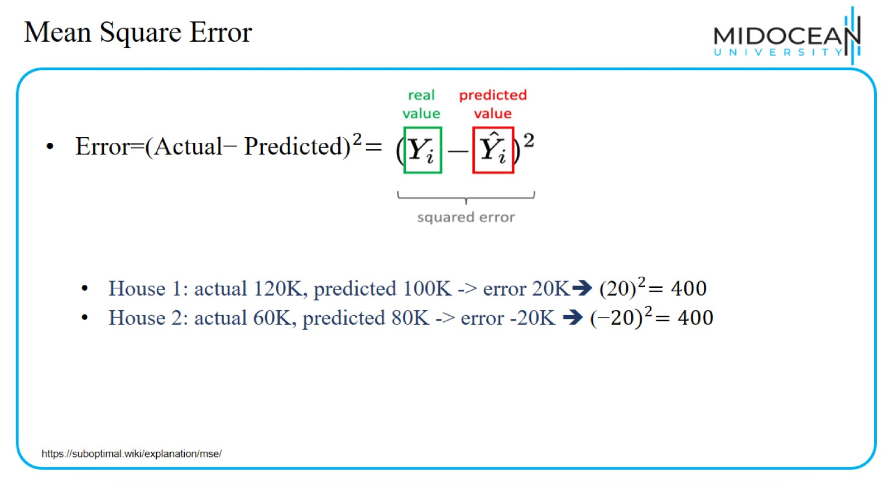
Mean Square Error

Slide 21
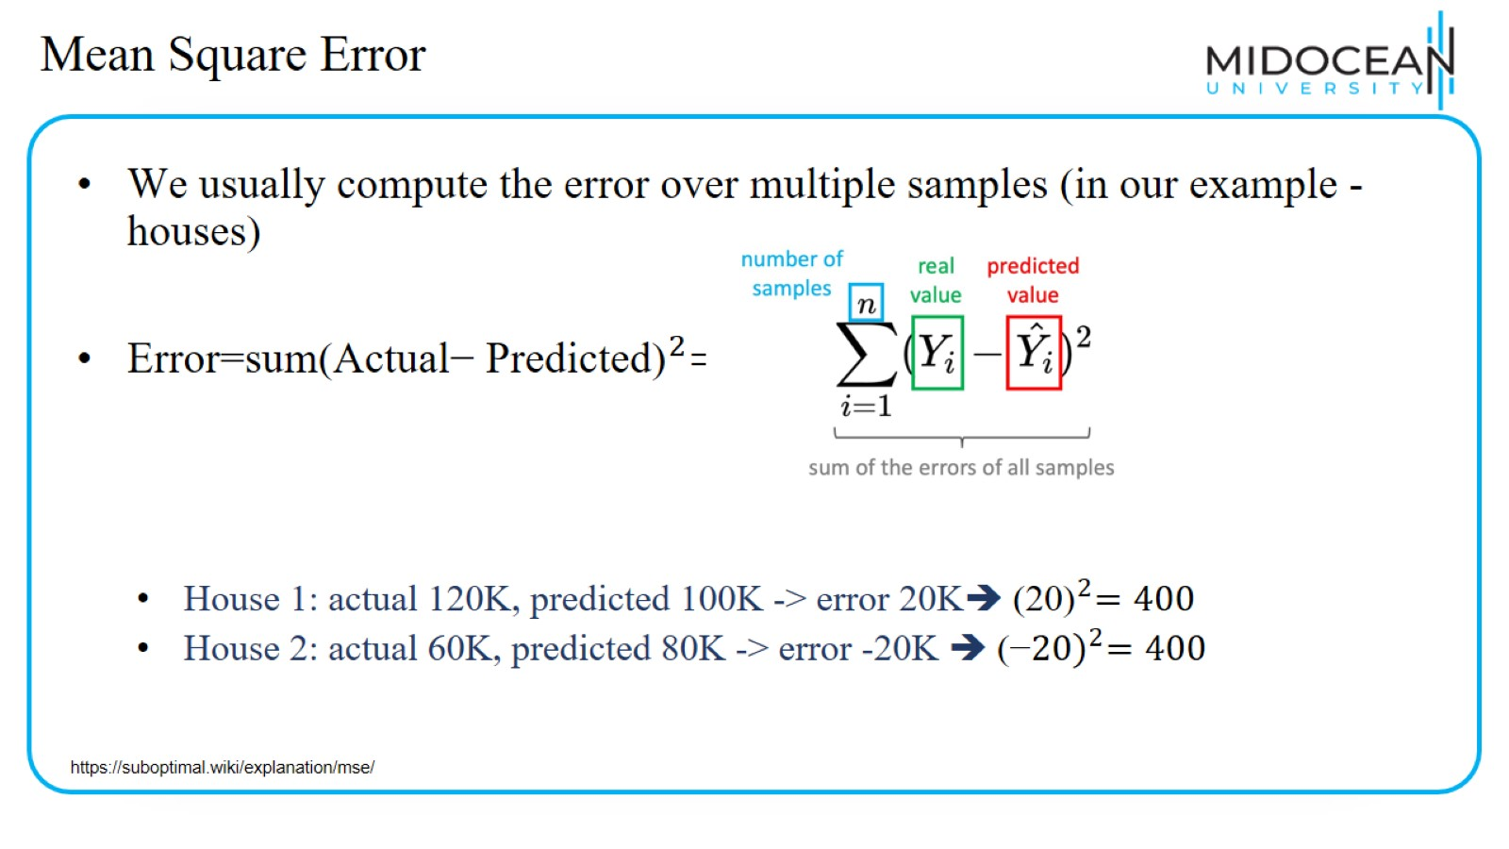
Mean Square Error

Slide 22
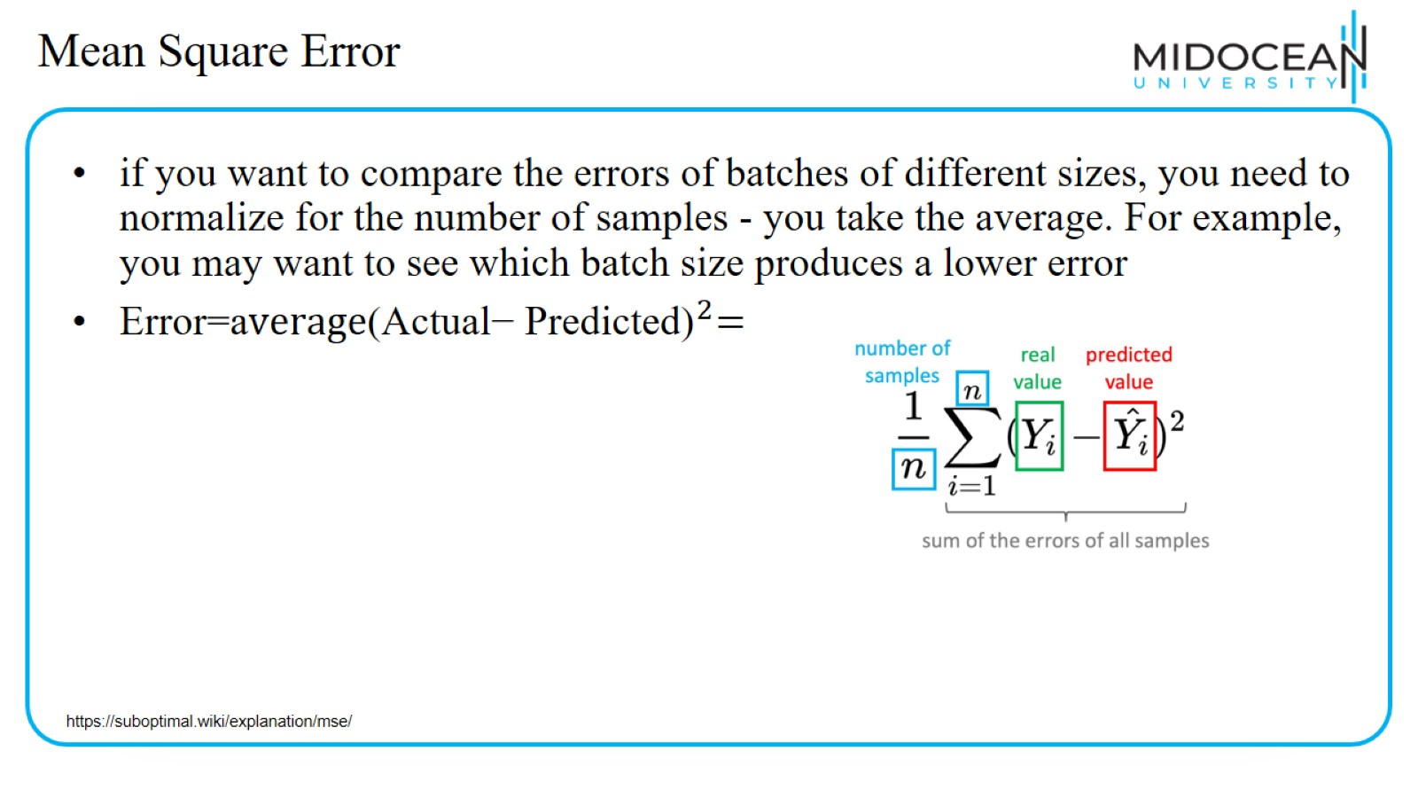
Mean Square Error

Slide 23
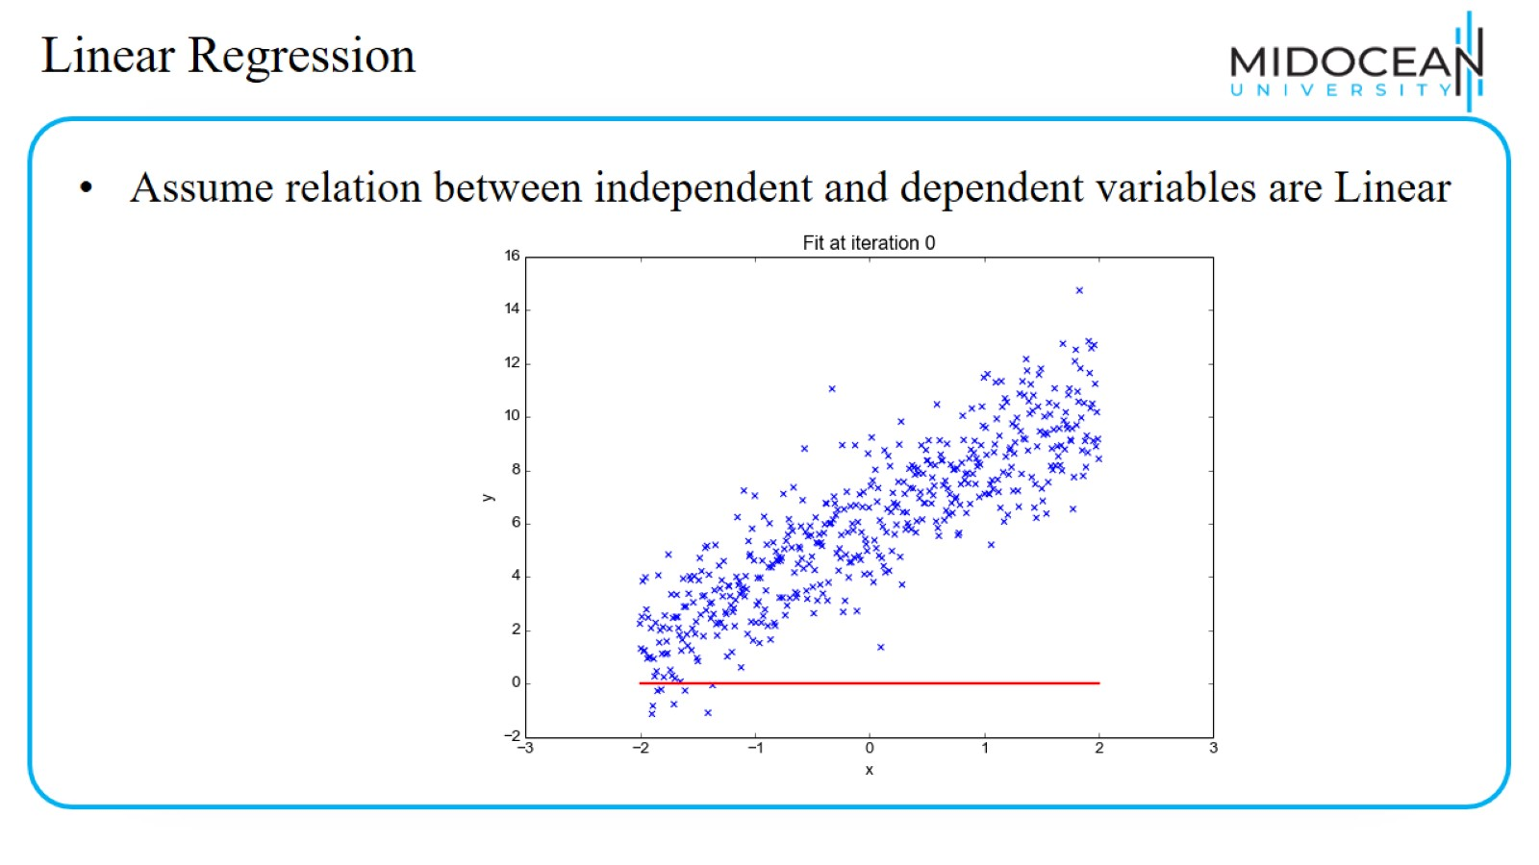
Linear Regression

Slide 24
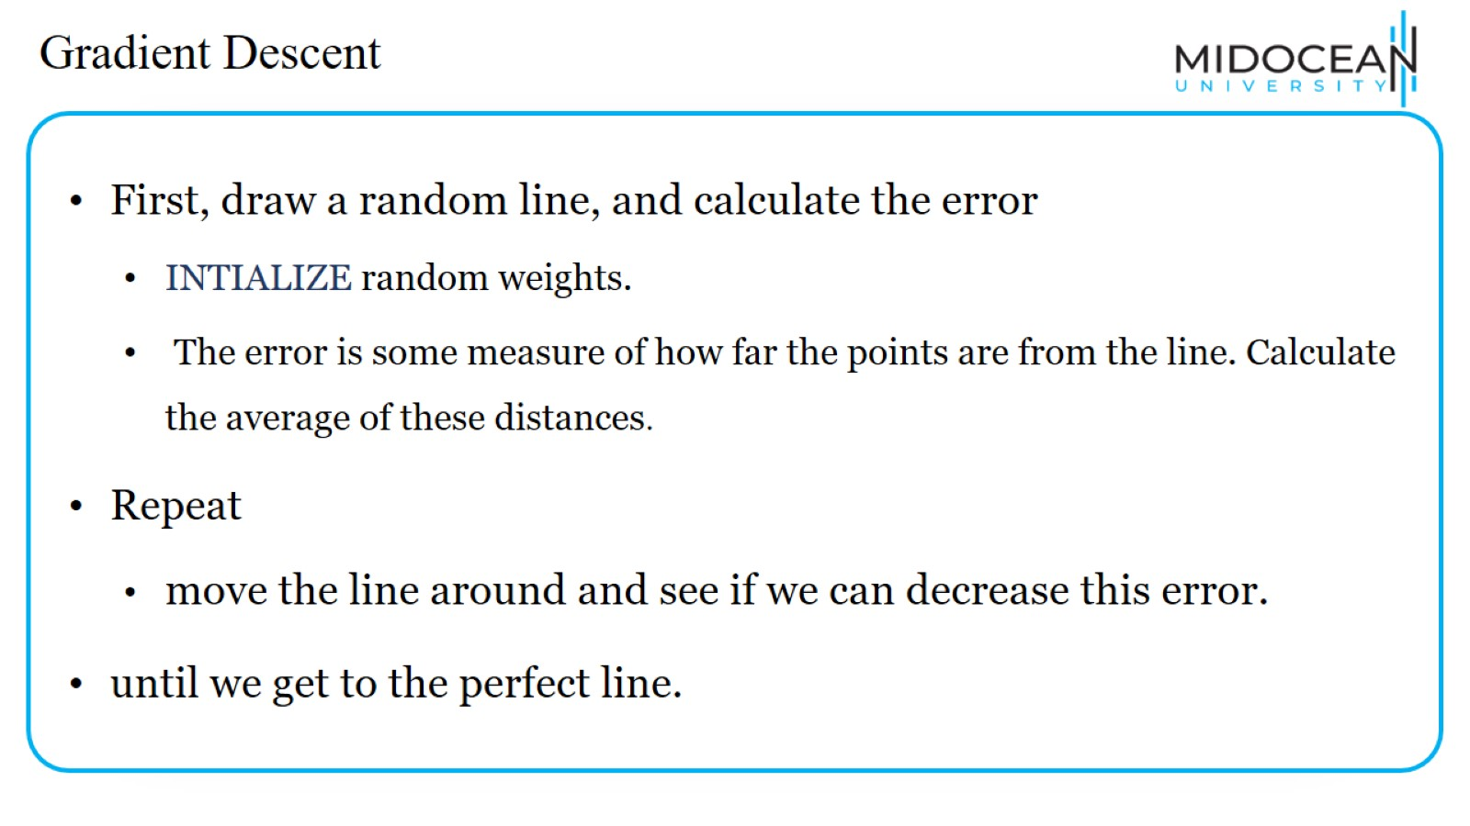
Gradient Descent

Slide 25
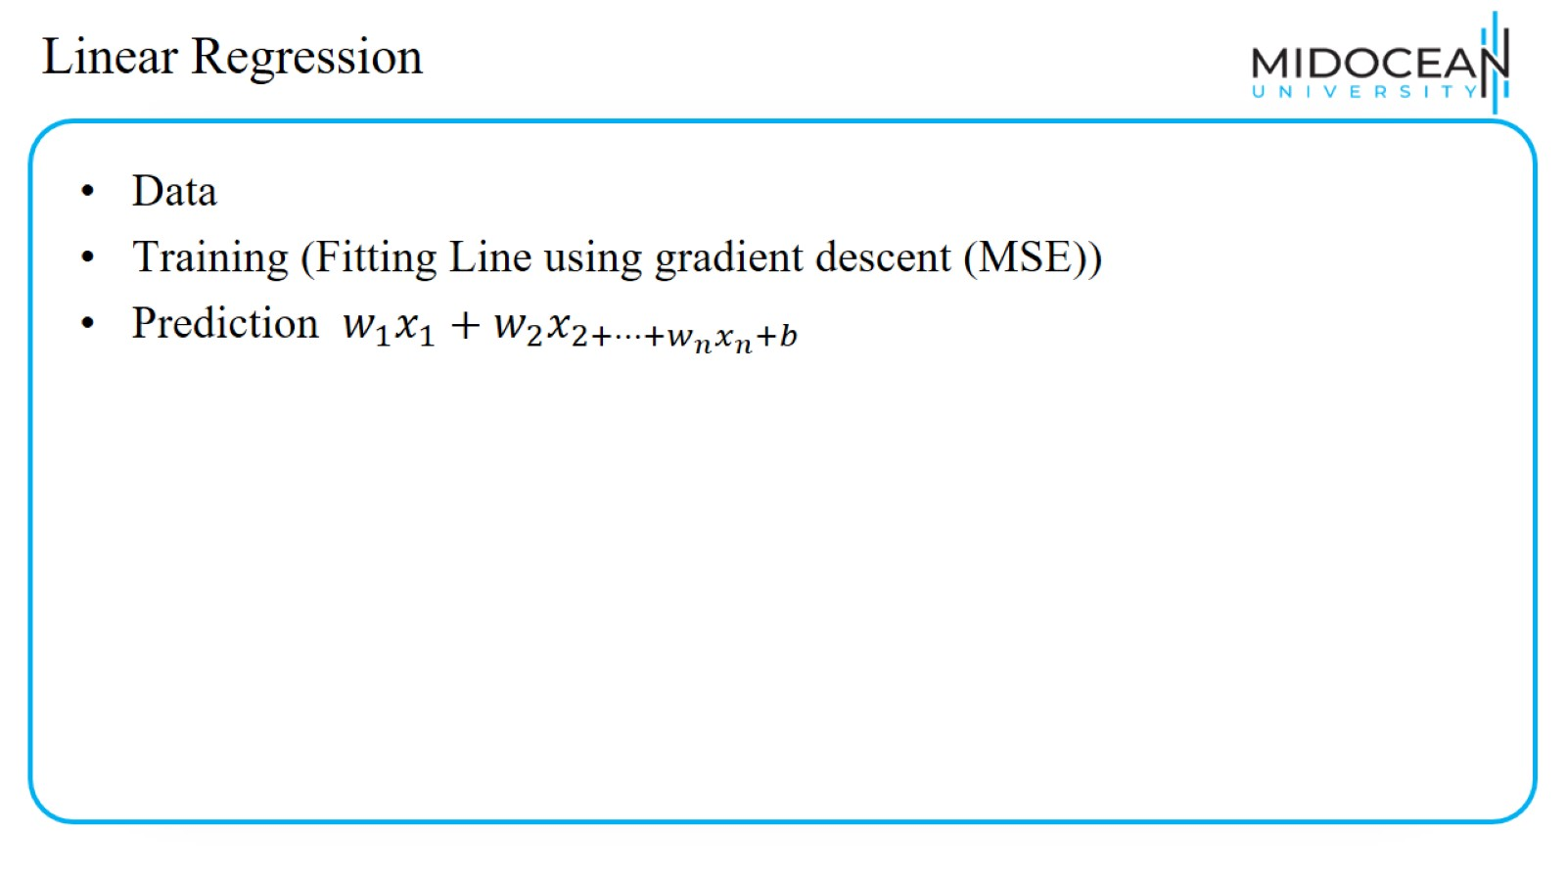
Linear Regression

Slide 26
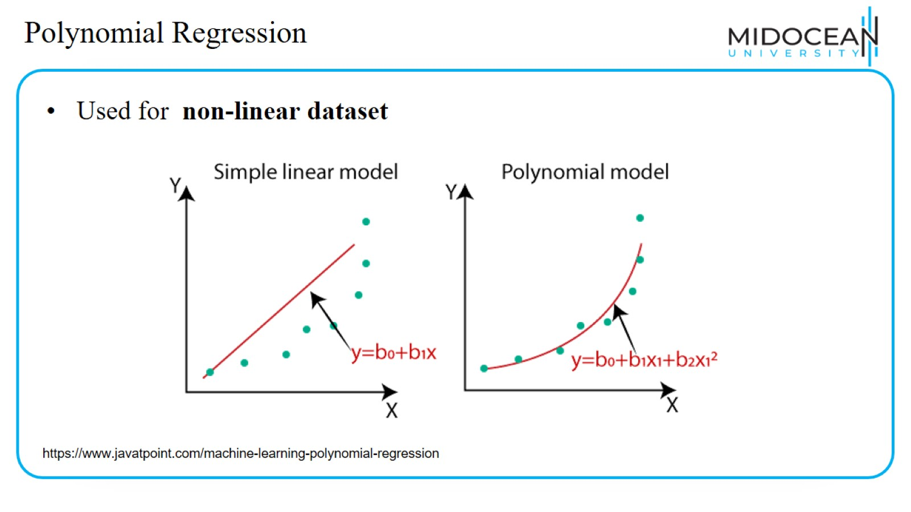
Polynomial Regression

Slide 27
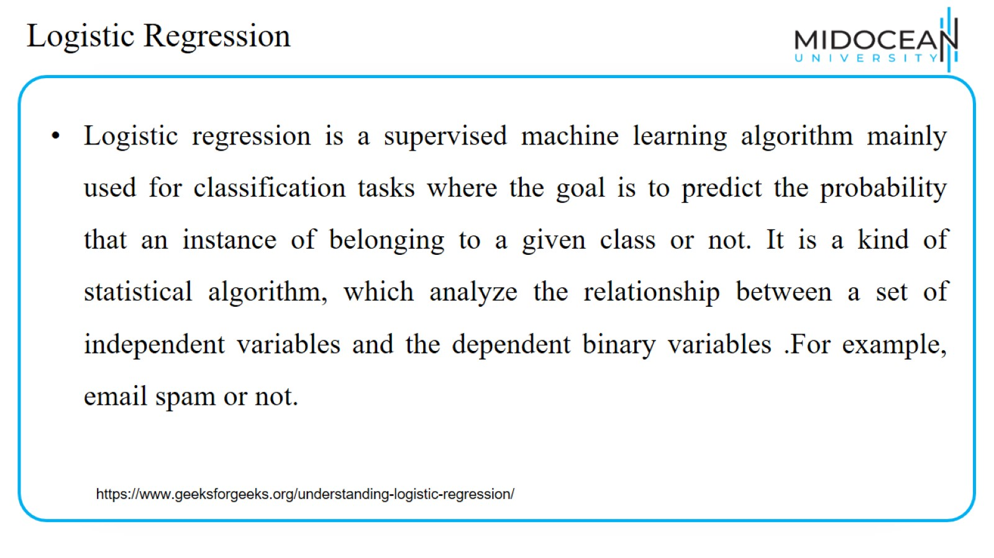
Logistic Regression

Slide 28
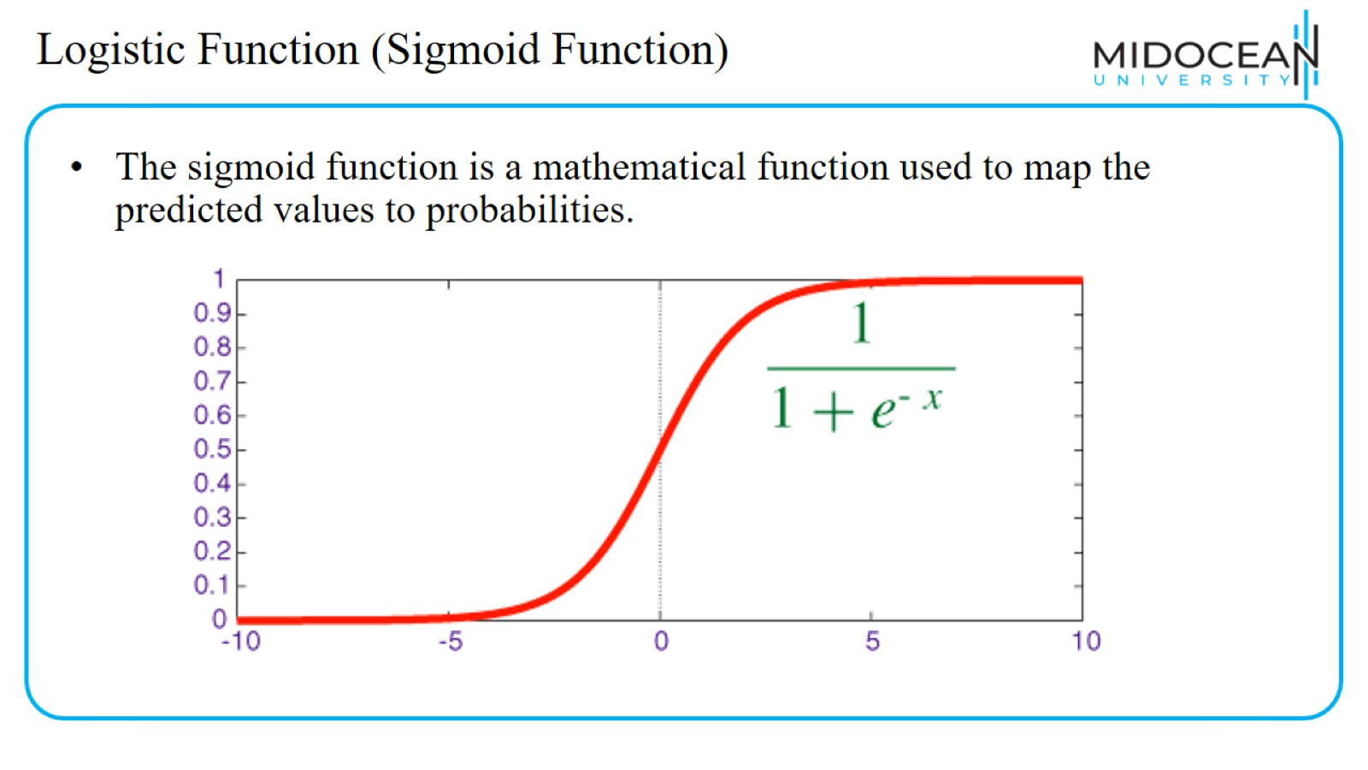
Logistic Function (Sigmoid Function)

Slide 29
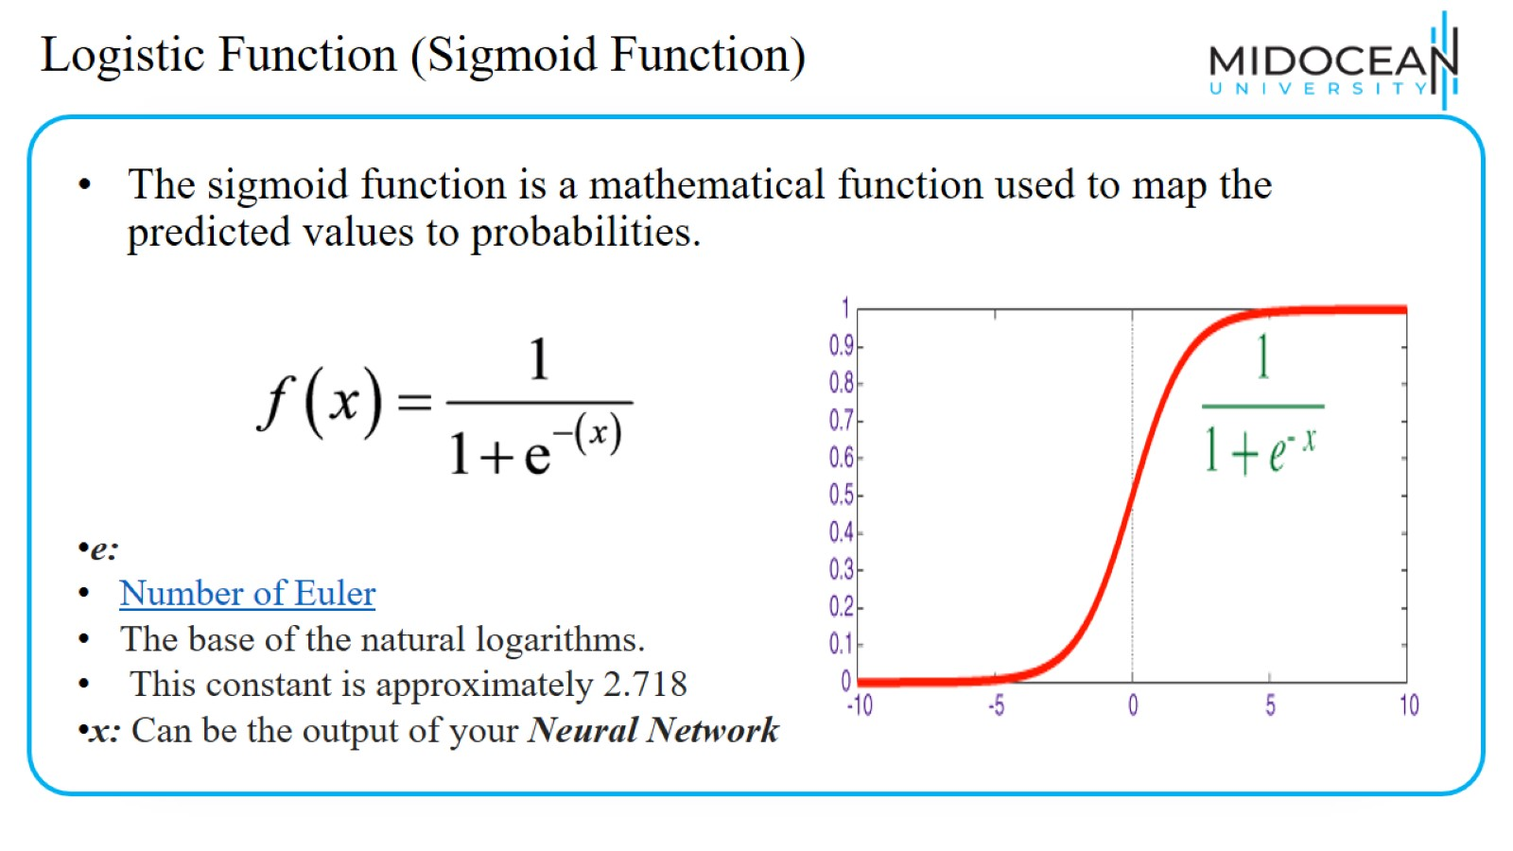
Logistic Function (Sigmoid Function)

Slide 30
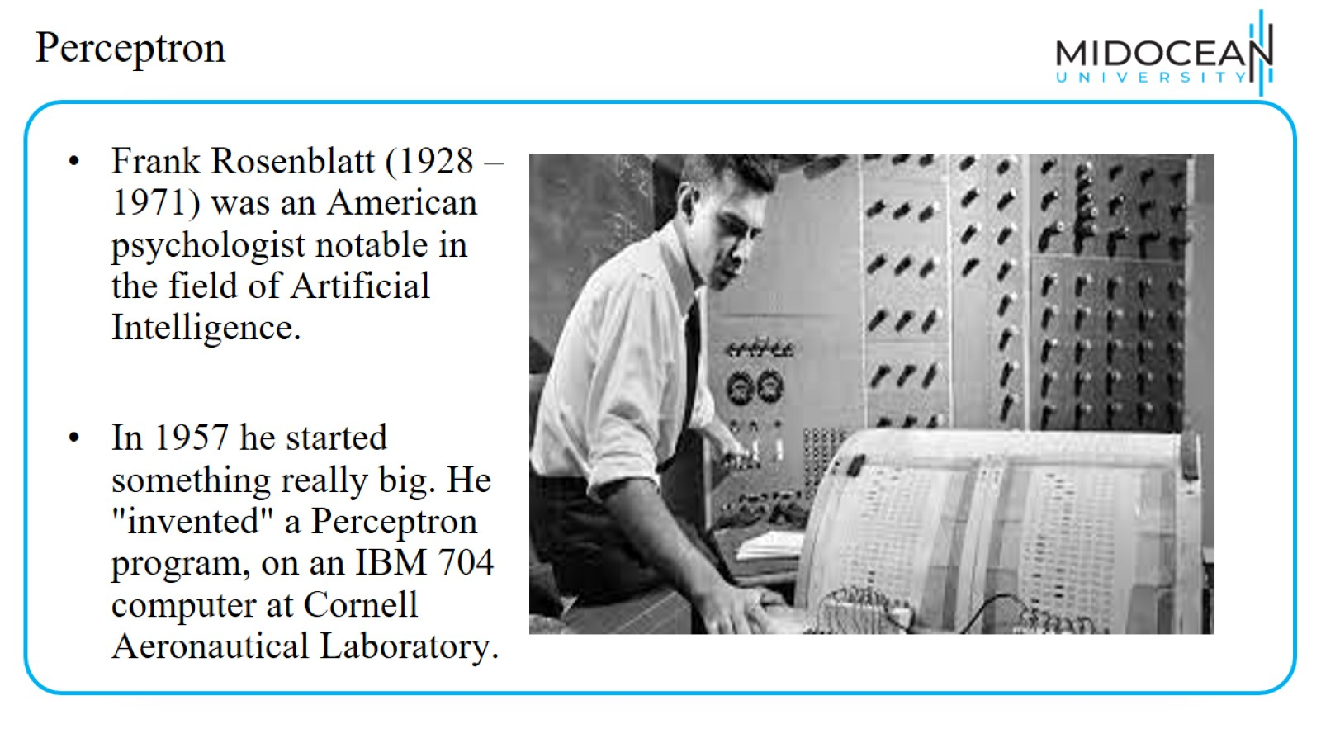
Perceptron

Slide 31
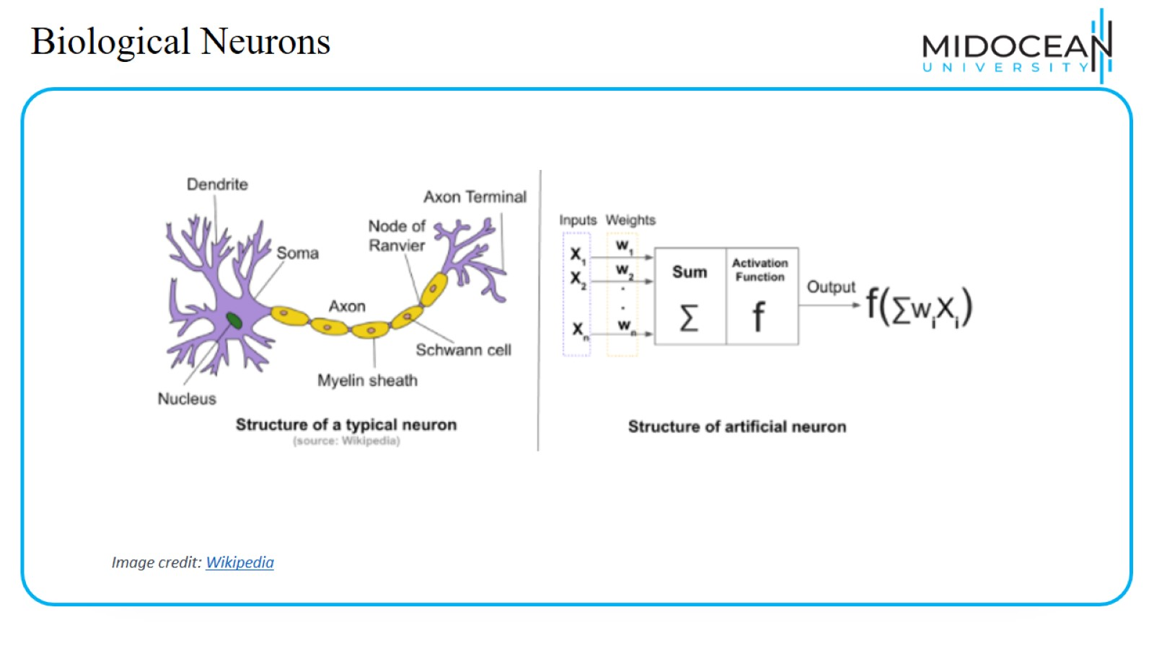
Biological Neurons

Slide 32
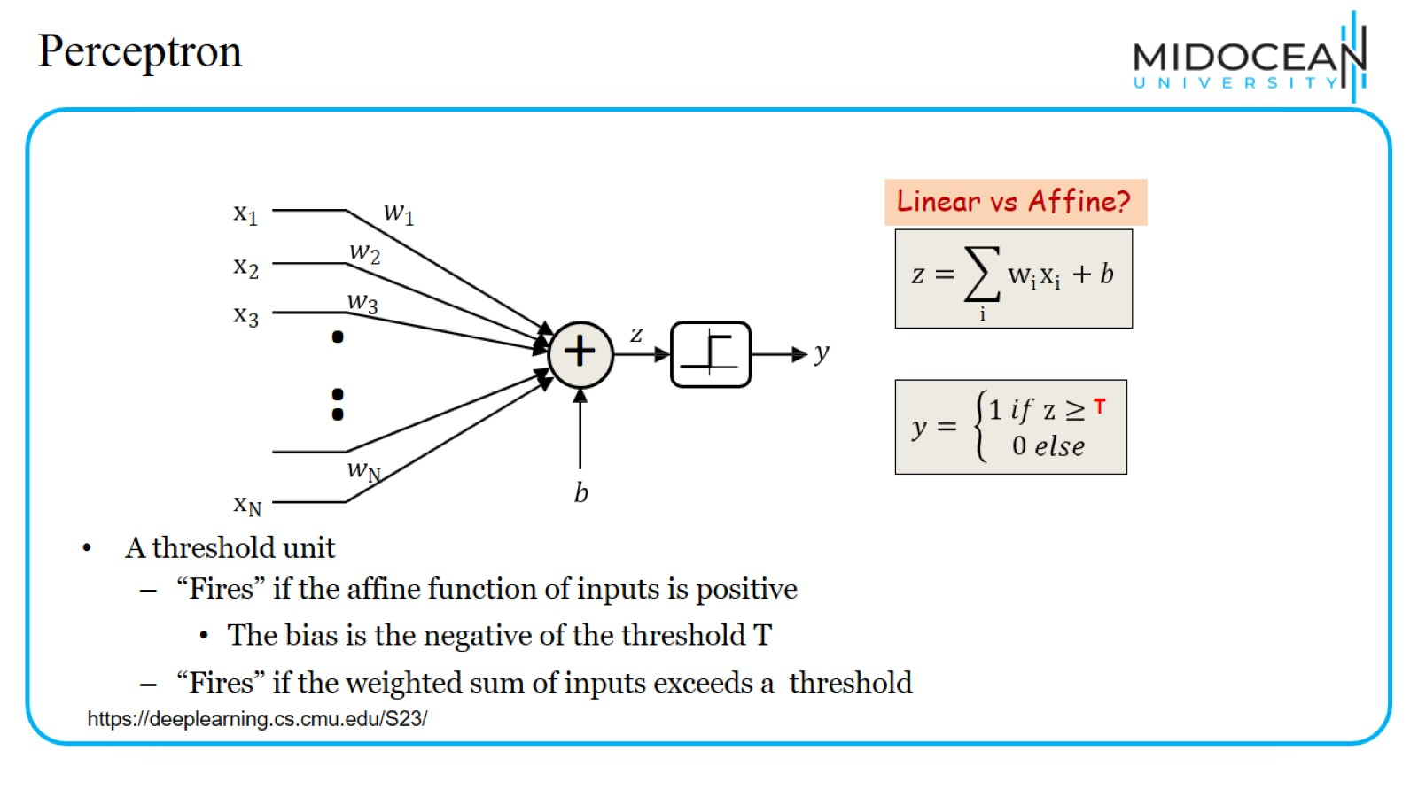
Perceptron

Slide 33
Perceptron

Slide 34
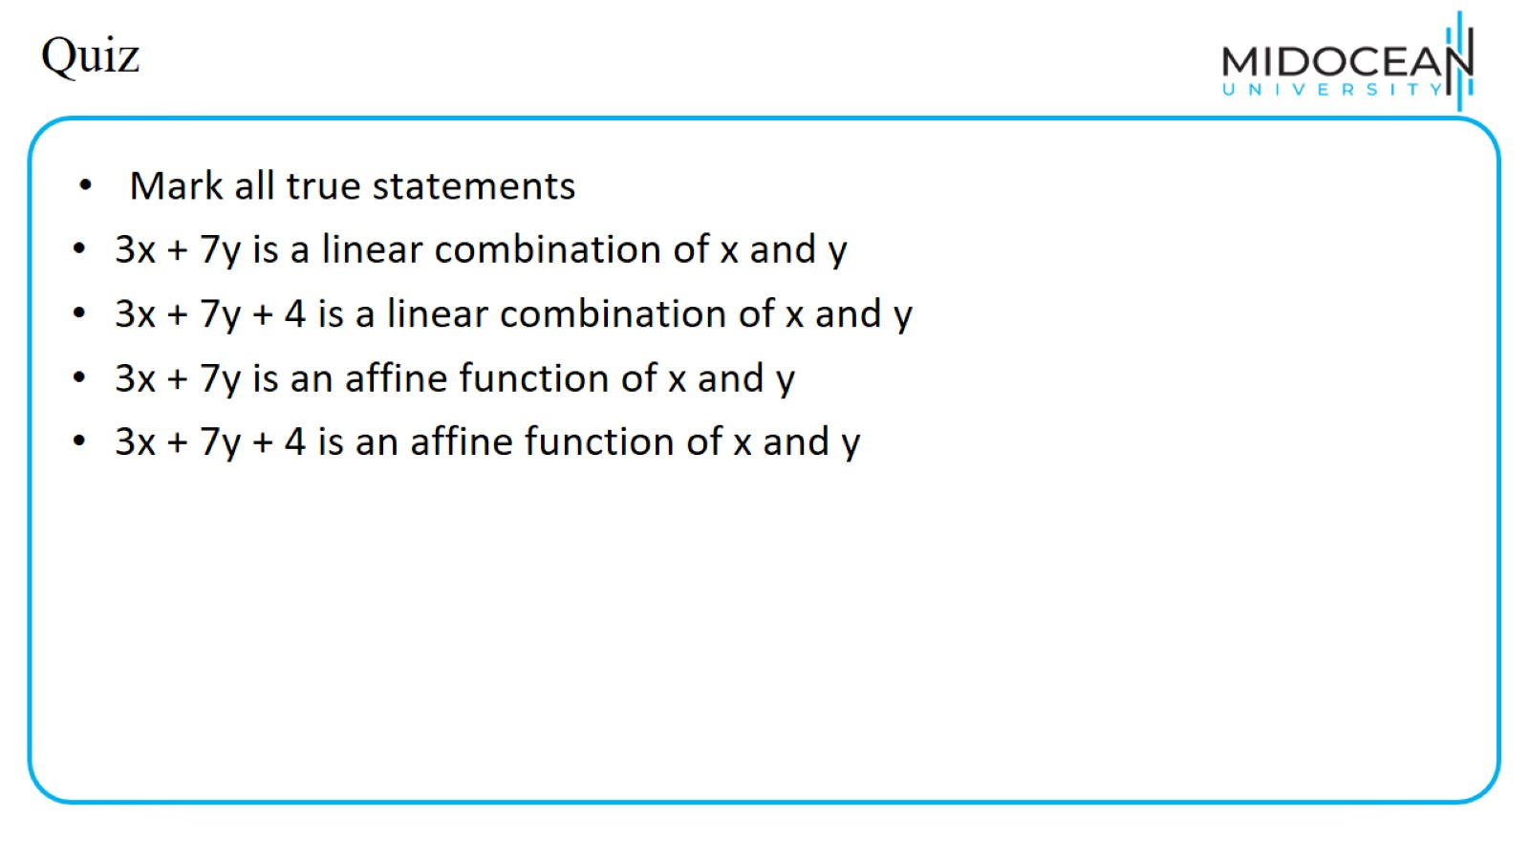
Quiz

Slide 35
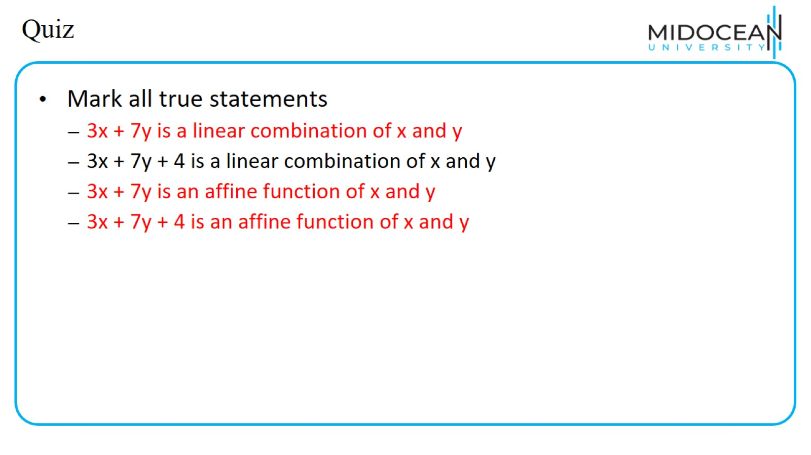
Quiz

Slide 36
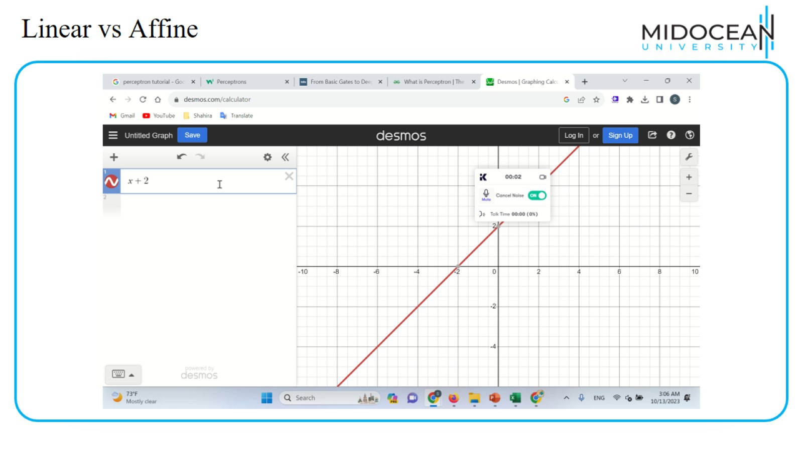
Linear vs Affine

Slide 37
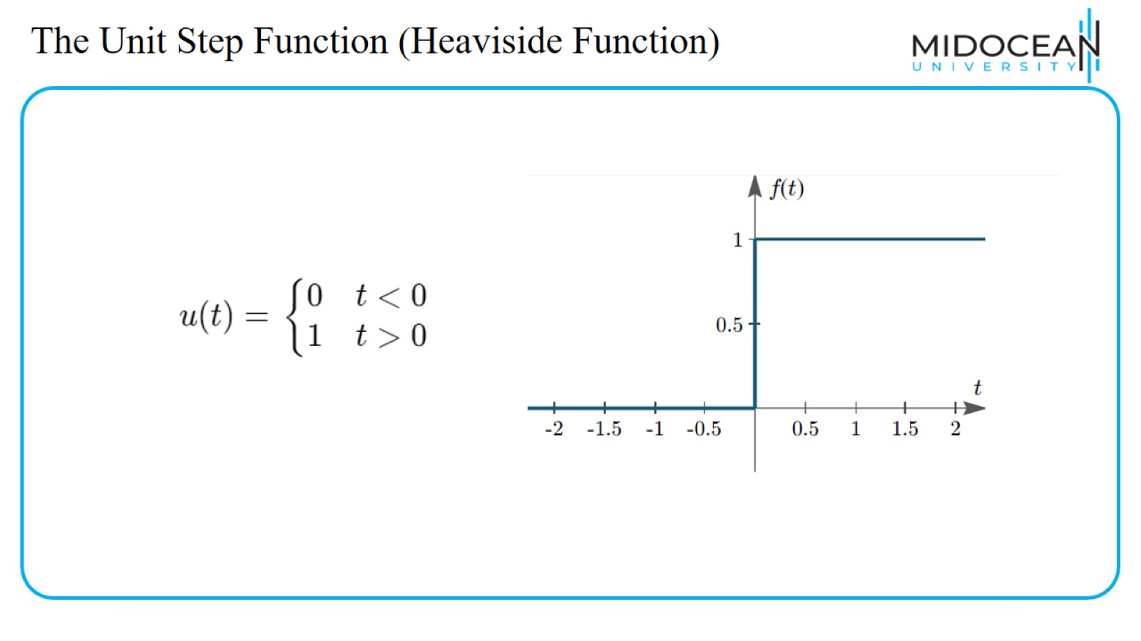
The Unit Step Function (Heaviside Function)

Slide 38
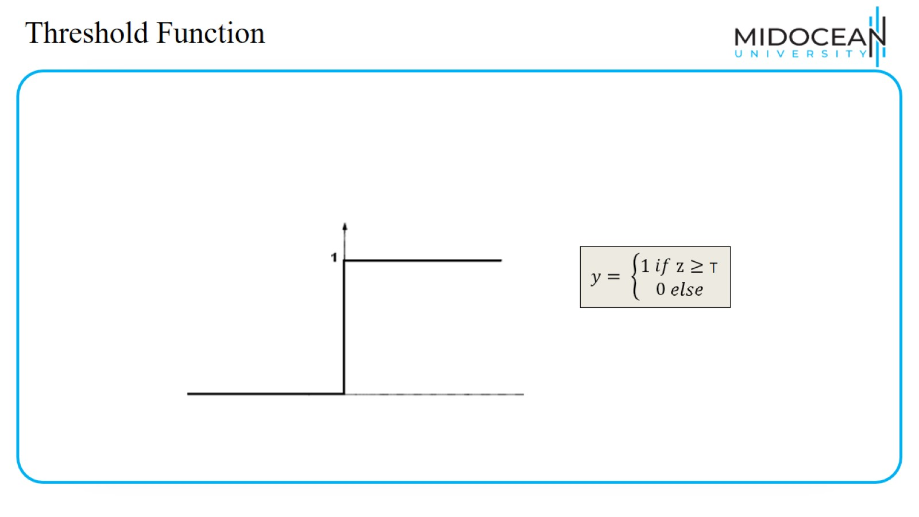
Threshold Function

Slide 39
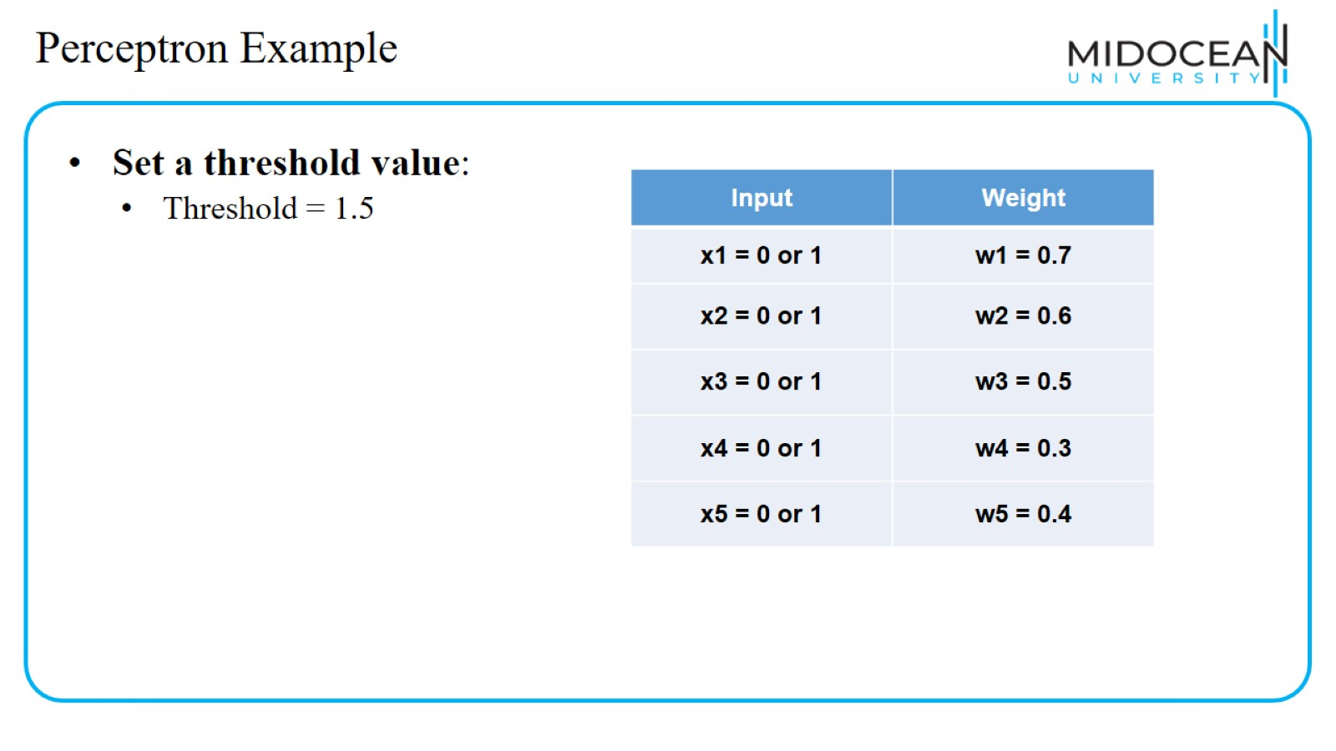
Perceptron Example

Slide 40
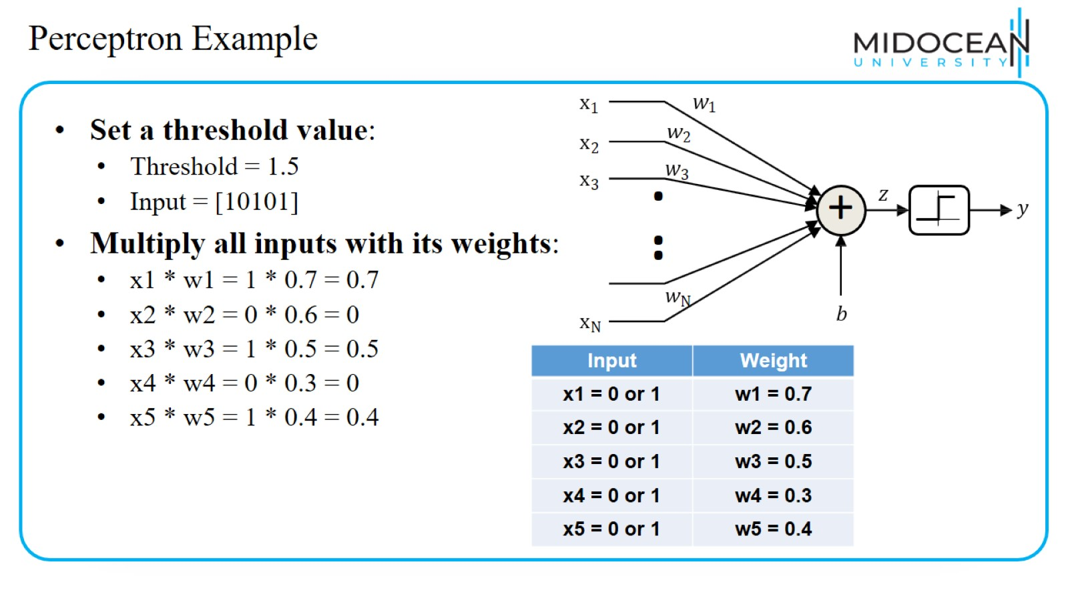
Perceptron Example

Slide 41
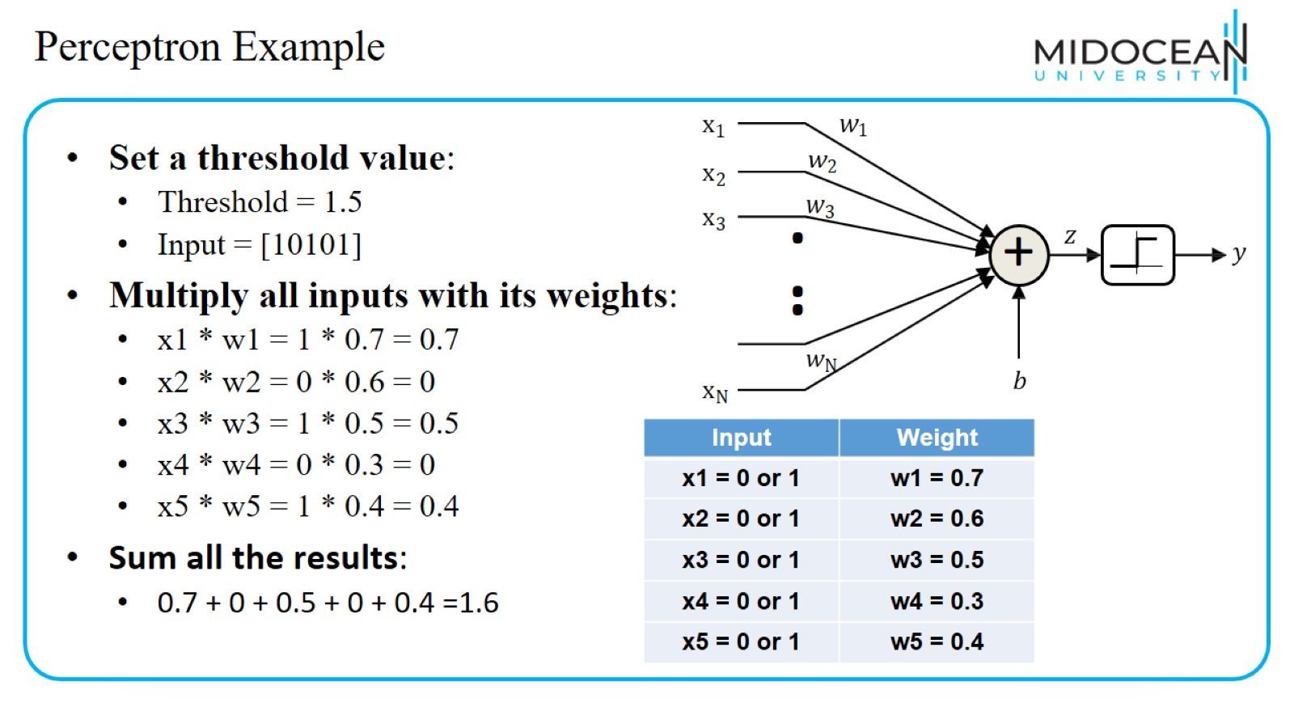
Perceptron Example

Slide 42
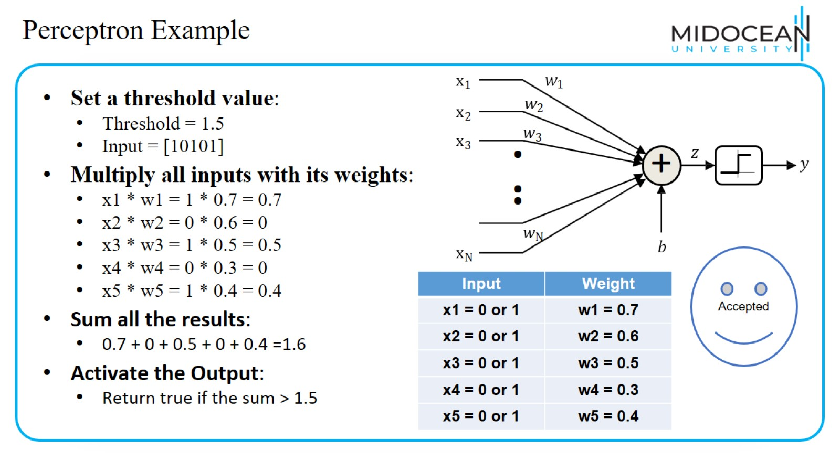
Perceptron Example

Slide 43
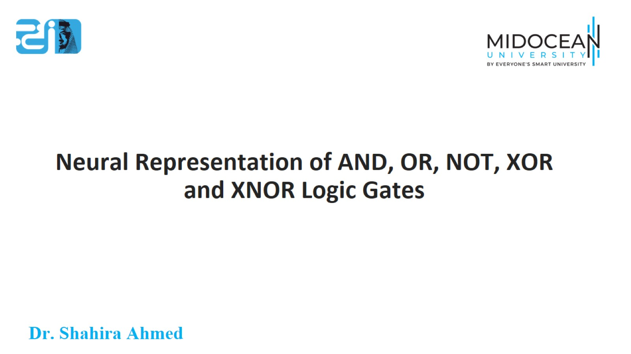
Neural Representation of AND, OR, NOT, XOR and XNOR Logic Gates

Slide 44
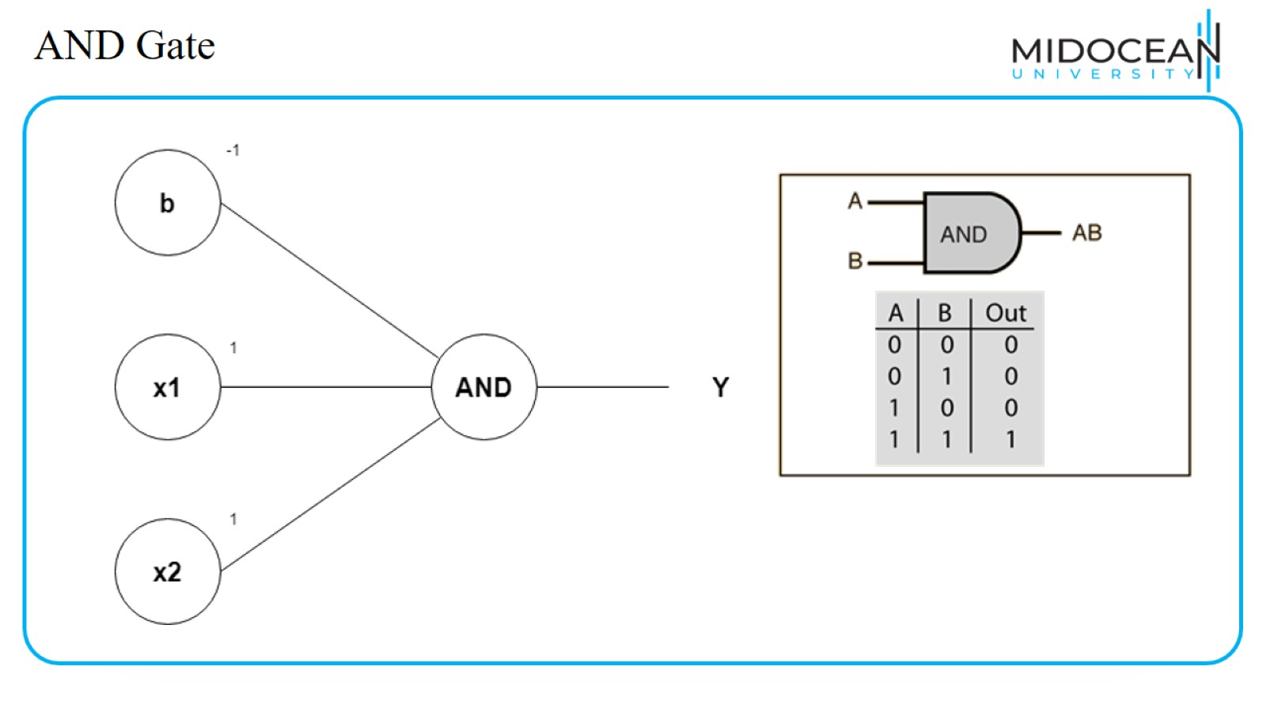
AND Gate

Slide 45
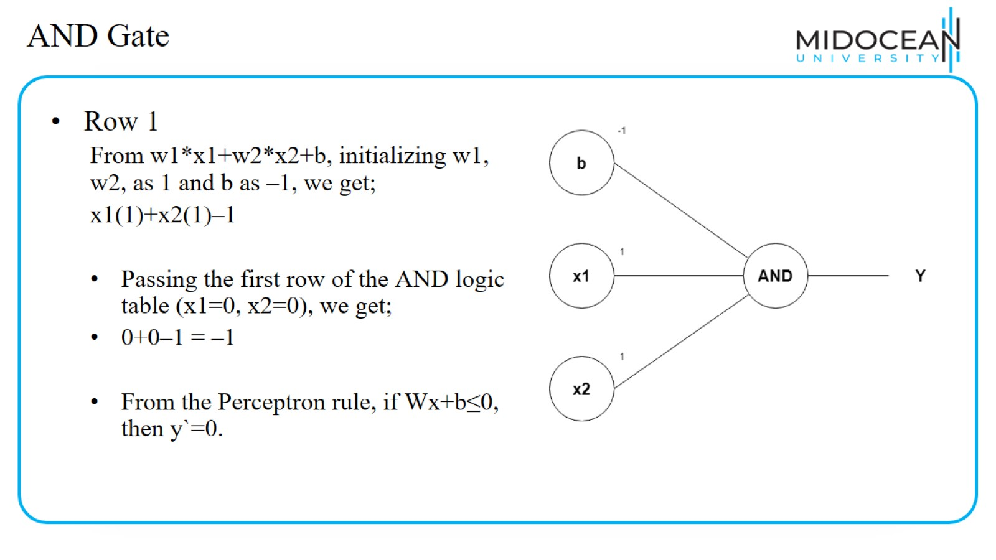
AND Gate

Slide 46
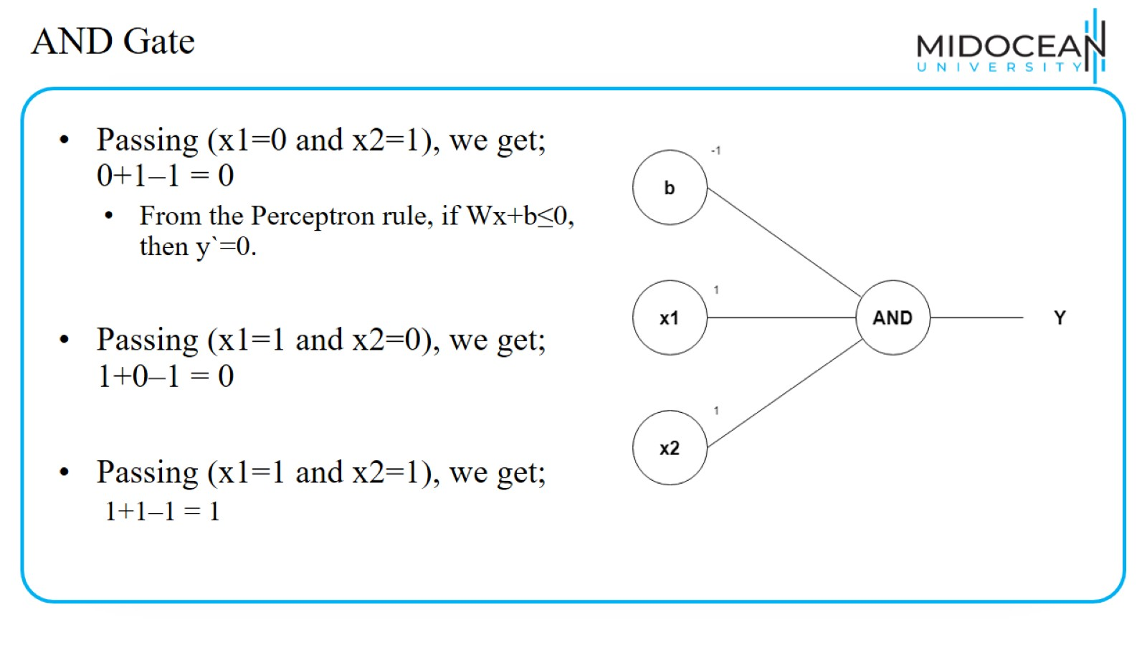
AND Gate

Slide 47
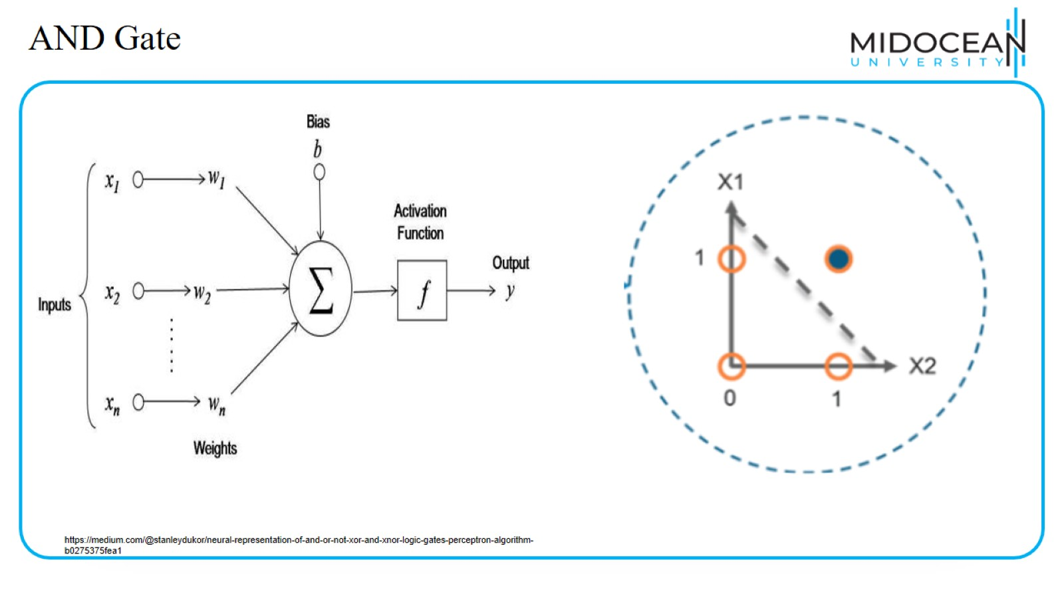
AND Gate

Slide 48
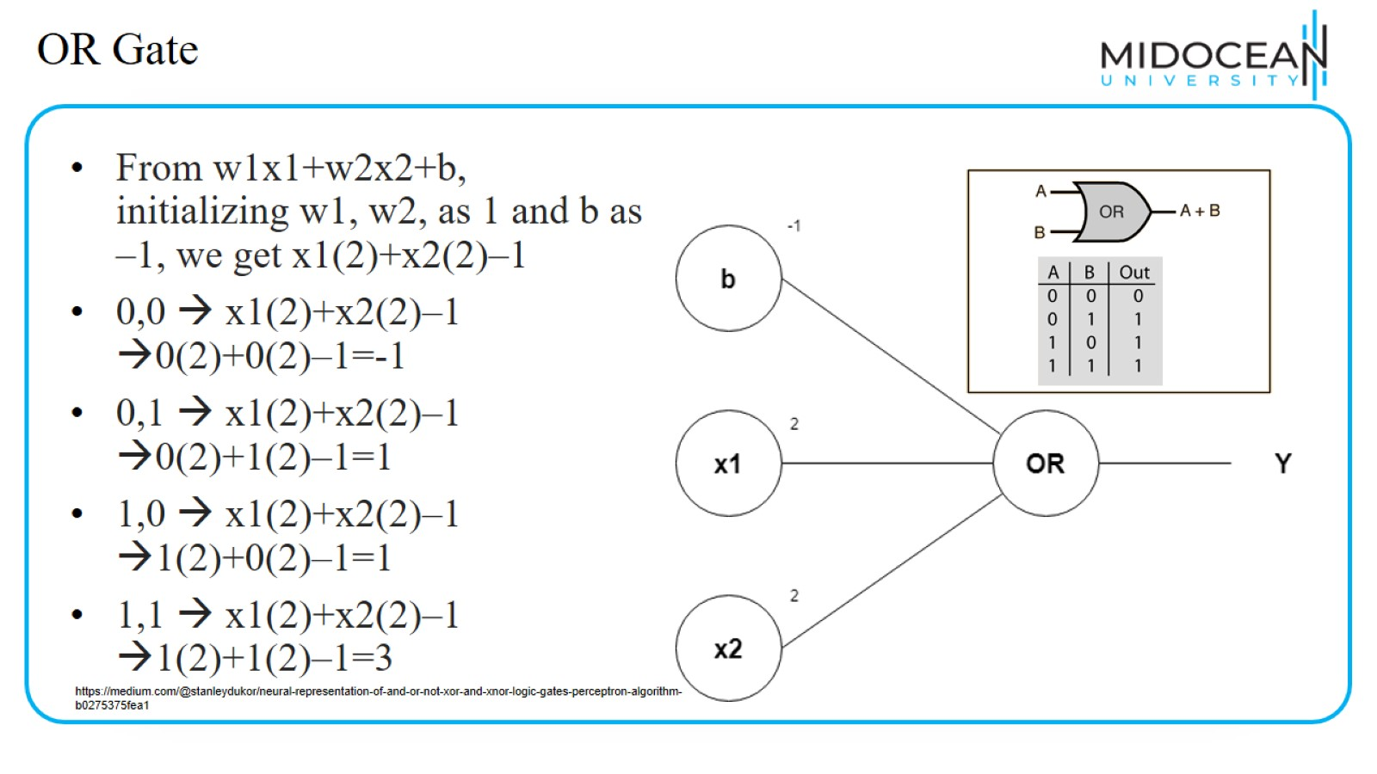
OR Gate

Slide 49
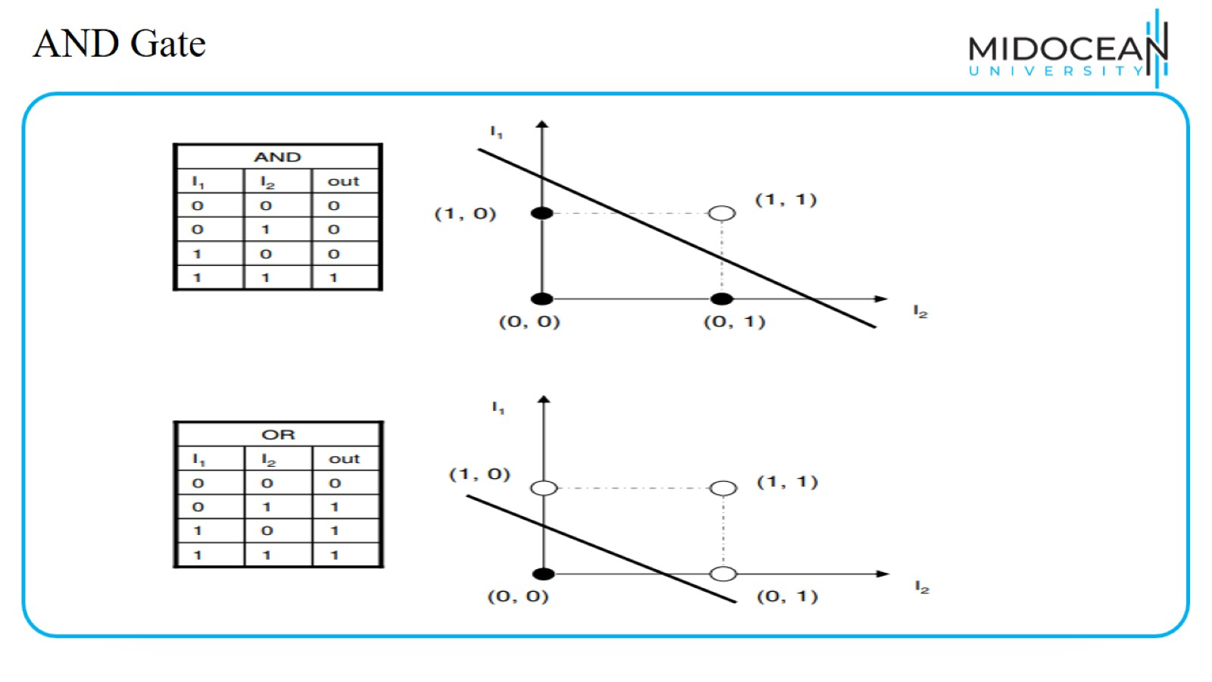
AND Gate

Slide 50
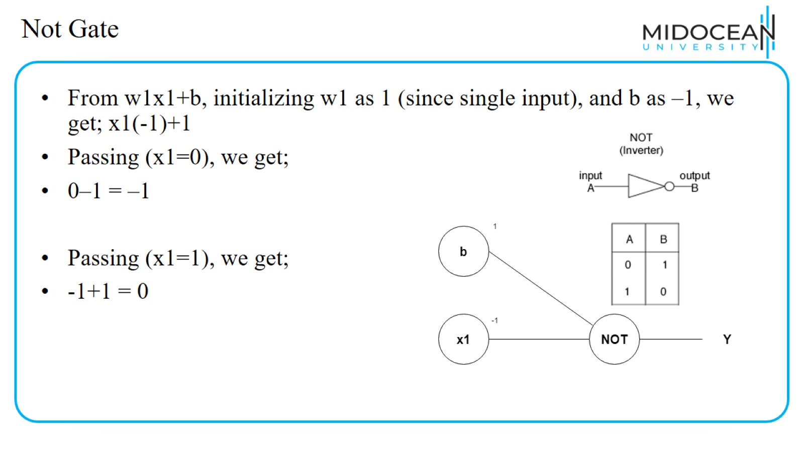
Not Gate

Slide 51
Not Gate

Slide 52
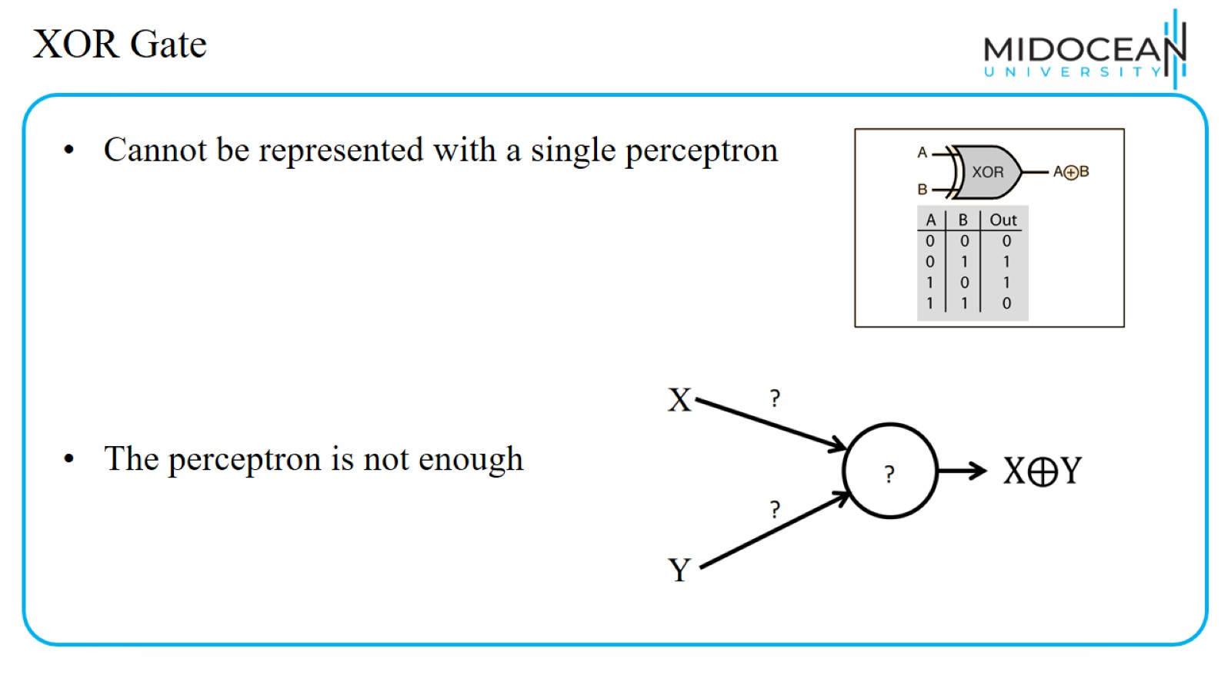
XOR Gate

Slide 53
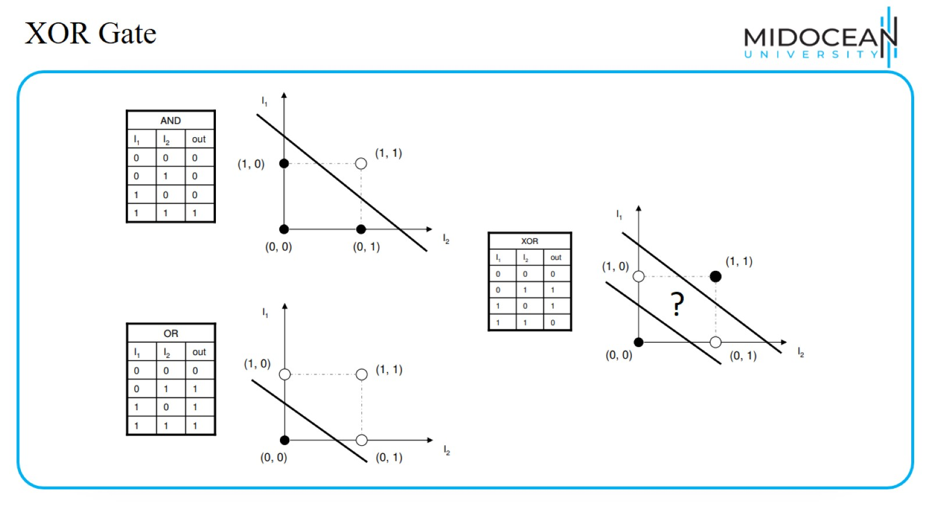
XOR Gate

Slide 54
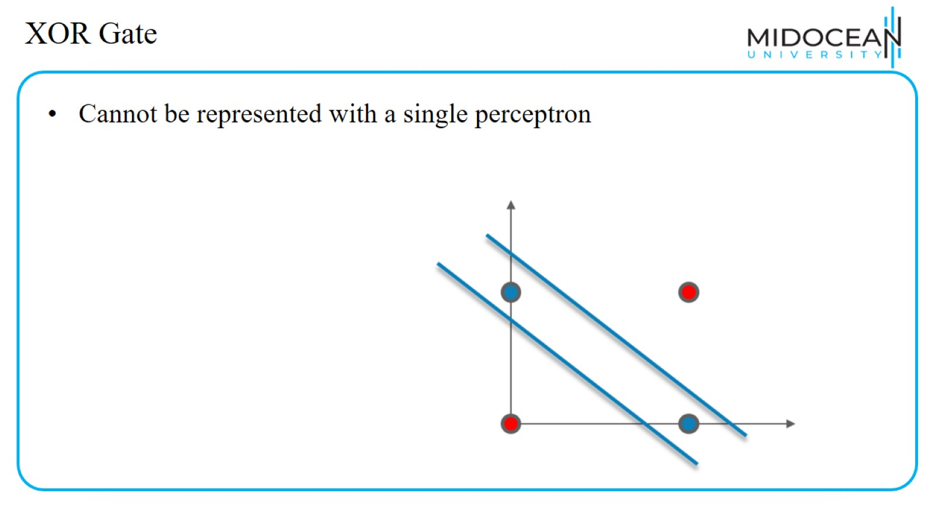
XOR Gate

Slide 55
Perceptron

Slide 56

A single Neuron is not enough

Slide 57

Multilayer Perceptron

Slide 58

Multilayer Perceptron-XOR Gate

Slide 59

Multilayer Perceptron-XOR Gate

Slide 60

Multilayer Perceptron-XOR Gate

Slide 61

Multilayer Perceptron-XOR Gate

Slide 62

Multilayer Perceptron-XOR Gate

Slide 63

Shallow learning vs Deep learning in neural network.

Slide 64

Shallow learning vs Deep learning in neural network.

Slide 65
Lecture Outline

Slide 66


