Slide 1



Project Planning
Lecture 4
PMG202
Project Planning- Risk management
Prepared by
Lec. Dina ElWakkad
www.midocean.ae

Slide 2


www.midocean.ae

Slide 3

Learning Outcomes
At the end of this chapter, students should be able to:
Discuss the definition of risk and risk management.
Discuss the terminology used by risk managers
Identify the steps of the risk management process.
Identify the types of the risk management.
www.midocean.ae

Slide 4
Project Planning
www.midocean.ae

Slide 5
Project Planning
Once a project is selected for execution, the structural project planning approach prescribes that the project get planned in detail prior to the actual start of the project.
Project planning consists of 4 main stages:
Risk Management
Quality Management
Human Resource Management
The Project Schedule, and budget
www.midocean.ae

Slide 6
Risk Management
www.midocean.ae

Slide 7
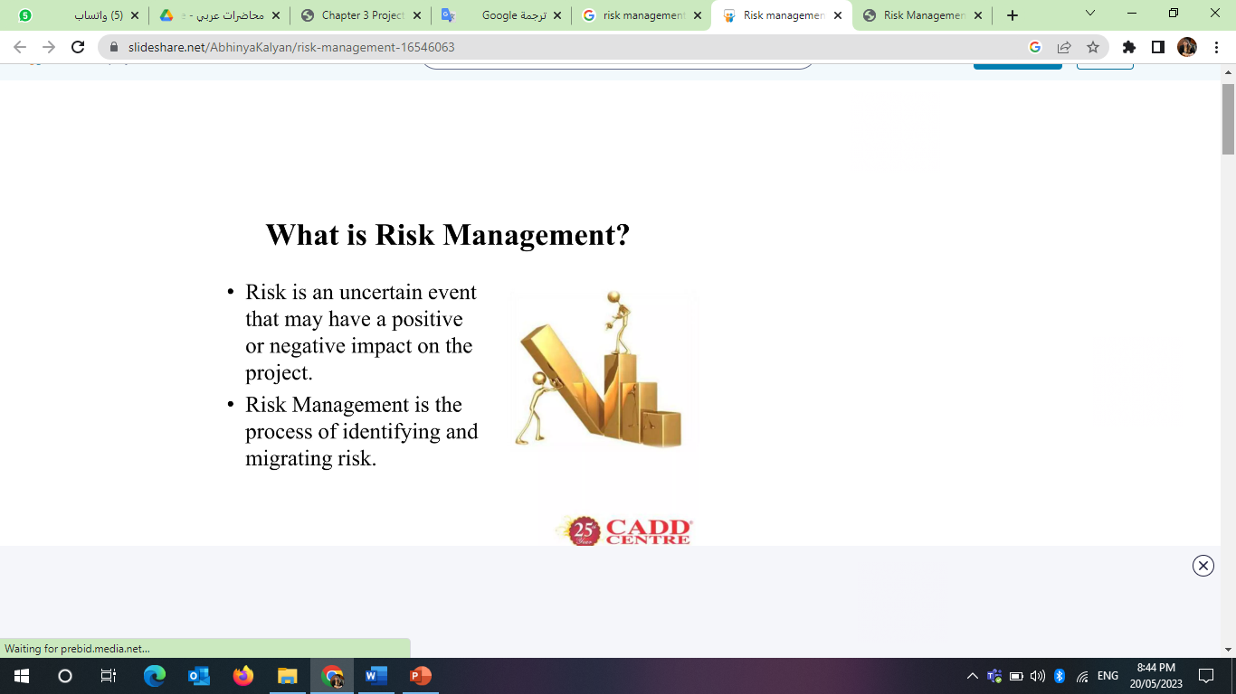
Risk Management definition
www.midocean.ae

Slide 8
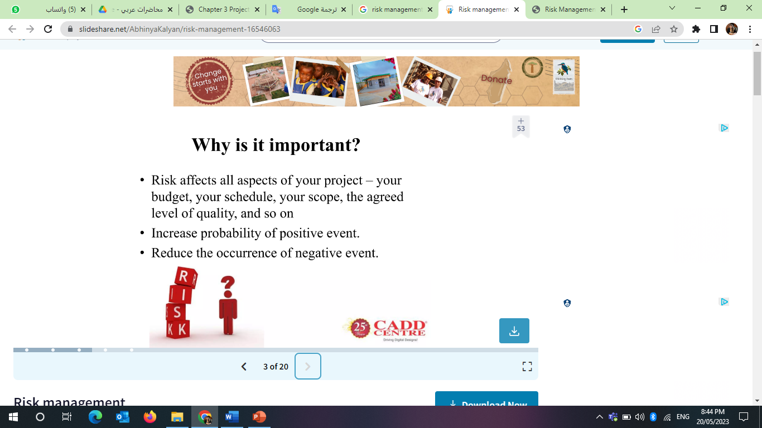
Importance of Risk Management
www.midocean.ae

Slide 9
Types of risk management
Financial risk management
Optimal risk management
Managing intangible risks
Conventional risk management
www.midocean.ae

Slide 10
Types of risk management
(1) Conventional risk management
Focuses on the risks arising from physical or legal reasons
for example: natural disasters or fires, accidents, death, and lawsuits
www.midocean.ae

Slide 11
Types of risk management
(2) Financial risk management:
Is the practice of protecting the economic value in the company by using financial tools to manage exposure to risks
for example: credit risk, market risk, foreign exchange risk, liquidity risk, inflation risk.
www.midocean.ae

Slide 12
Types of risk management
(3) Optimal risk management:
It means that priorities are given, so that risks with large losses and a high probability of occurrence are dealt with first, while risks with less losses and a lower probability of occurrence are treated later.
This process can be very difficult, and the balance between risks with high probability and low losses against risks with low probability and high losses may be misjudged.
www.midocean.ae

Slide 13
Types of risk management
(4) Managing intangible risks:
They are those that have a 100% chance of occurring but are ignored by the organization due to the lack of ability to identify them.
for example: knowledge risk, which occurs when incomplete knowledge is applied, as well as relationship risk, which occurs when there is ineffective cooperation.
www.midocean.ae

Slide 14
Risk management steps
Preparation
Risk identification
Evaluation
Response to Risks
Developing a plan
Implementation
Review and evaluation of the plan
Limitations / Obstacles
www.midocean.ae

Slide 15
Risk management steps
(1) Preparation:
It includes planning and mapping the scope of work and the basis for risk assessment.
www.midocean.ae

Slide 16
Risk management steps
(2) Risk Identification:
At this stage, risks of importance are identified. Common ways to identify risks include:
Goal-based selection:
Organizations and teams working on a project all have goals, and any event that interferes with achieving these partially or completely is considered dangerous
Scenario selection:
In the process of scenario analysis, different scenarios are created that may be alternative ways to achieve a goal, so any event that generates a scenario that is different from the one that was envisioned and undesirable, is defined as dangerous.
www.midocean.ae

Slide 17
Risk management steps
(2) Risk Identification:
At this stage, risks of importance are identified. Common ways to identify risks include:
Classification selection:
It is a breakdown of all possible sources of risk.
Check out the common risks:
In many institutions there are lists of potential hazards.
www.midocean.ae

Slide 18
Risk management steps
(3) Evaluation:
After identifying the potential risks, you must conduct an evaluation process in terms of their severity in causing losses and the possibility of their occurrence, sometimes it is easy to measure and other times it is not possible to measure.
The difficulty in evaluating risks lies in determining the rate of their occurrence, as statistical information on previous incidents is not always available, and also evaluating the severity of the results is usually difficult.
www.midocean.ae

Slide 19
Risk management steps
(4) Response to Risks:
Response to risks usually takes one of the following forms:
Avoidance: A business strives to eliminate a particular risk by getting rid of its cause.
Mitigation: Decreasing the projected financial value associated with risk by lowering the possibility of the occurrence of the risk.
Acceptance: In some cases, a business may be forced to accept risk. This option is possible if a business entity develops contingencies to mitigate the impact of the risk, should it occur.
www.midocean.ae

Slide 20
Risk management steps
(5) Developing a plan:
It involves making decisions regarding the selection of the set of methods that will be used to deal with risks, and each decision must be recorded and approved by the appropriate level of management
www.midocean.ae

Slide 21
Risk management steps
(6) Implementation:
At this stage, the methods planned to be used to mitigate the effects of risks are followed.
www.midocean.ae

Slide 22
Risk management steps
(7) Plan Review and Evaluation:
Initial plans for risk management are not complete. Through practice, experience and losses that appear in the real life, there is a need to adjust the plans and use the available knowledge to make different decisions.
www.midocean.ae

Slide 23
Risk management steps
(8) Limitations (obstacles)
If risks are improperly assessed or prioritized, this may lead to wasting time in dealing with risks that are unlikely to occur, leading to the loss of resources that could have been exploited more profitably.
www.midocean.ae

Slide 24
Summary
Risk Management definition
Importance of Risk Management
Types of Risk Management
Steps of Risk Management
www.midocean.ae

Slide 25

www.midocean.ae

Slide 26
Questions
--------Focus on the risks arising from physical or legal reasons conventional risk management Financial risk management optimal risk management All answers are correct
----------- It is the practice of protecting the economic value in a company by using financial instruments to manage risk exposure Financial risk management conventional risk management Perfect risk management All answers are correct
www.midocean.ae

Slide 27
Questions
------ means that priorities are given, so that risks with large losses and a high probability of occurrence are dealt with first, while risks with smaller losses and a lower probability of occurrence are treated later Optimal risk management Financial risk management conventional risk management All answers are correct
----- These are the risks that the probability of occurrence is 100%, but they are ignored by the institution due to the lack of the ability to identify them. Intangible risk management Optimal risk management Financial risk management conventional risk management
www.midocean.ae

Slide 28
Questions
The risk management process begins with ------ preparation Risk identification Evaluation Response to risks
Risks are determined according to--- All answers are correct Goal-based selection Scenario selection Classification based selection
www.midocean.ae

Slide 29
Questions
A company strives to eliminate a particular risk by eliminating its cause - this phrase expresses any form of response to risk: avoidance mitigation. admissions loss
Exchange rate risk from ---- financial risks Conventional risks Economic risks All answers are incorrect
www.midocean.ae

Slide 30
Questions
Natural disasters are --------risks. Conventional risks financial risks Economic risks All answers are incorrect
knowledge risk is an example of---- Managing intangible risks Conventional risk management Financial risk management Optimal risk management
www.midocean.ae

Slide 31
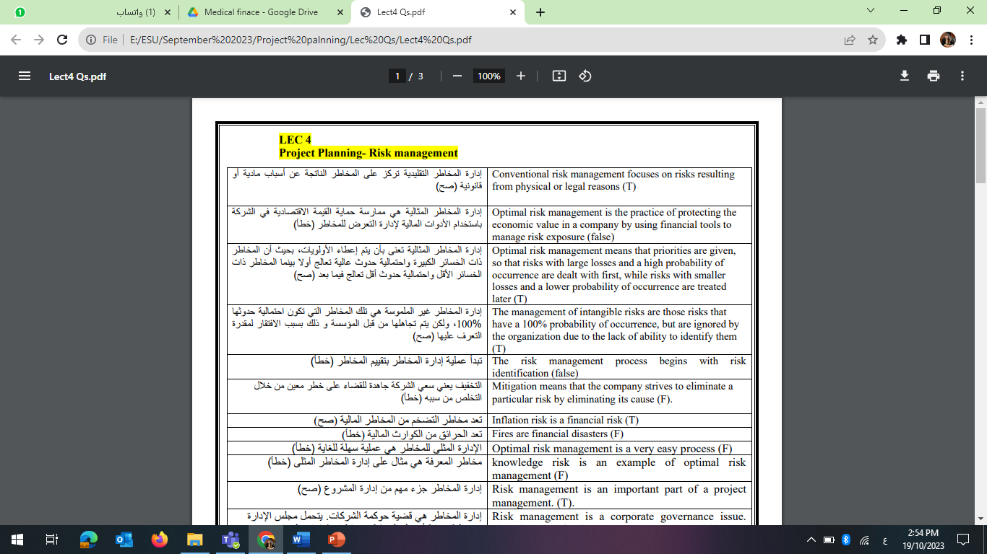
Questions
www.midocean.ae

Slide 32

Questions
www.midocean.ae

Slide 33
Questions
www.midocean.ae

Slide 34
Questions
www.midocean.ae

Slide 35
Questions
www.midocean.ae

Slide 36
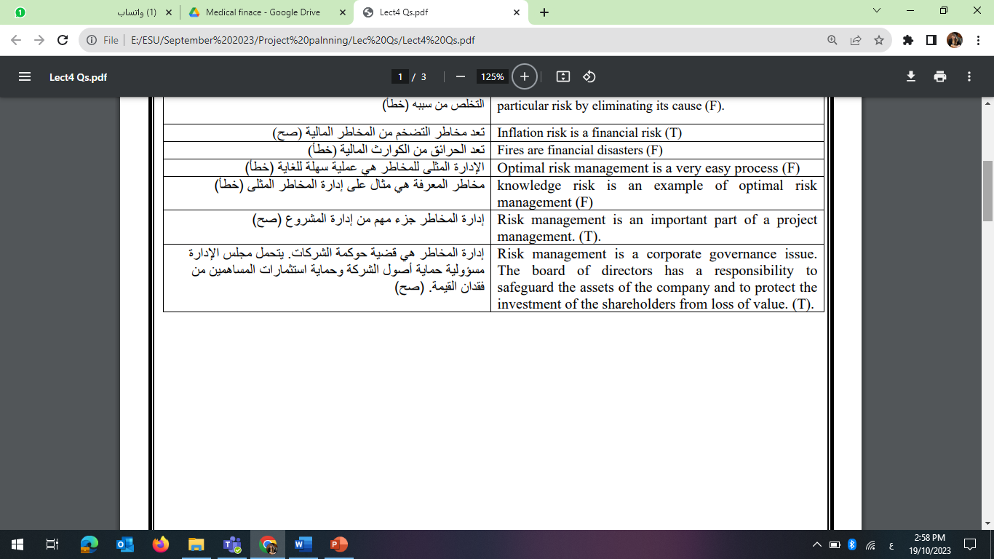
Questions
www.midocean.ae

Slide 37
Questions
www.midocean.ae

Slide 38
Questions
www.midocean.ae

Slide 39
Questions
www.midocean.ae

Slide 40


Thank You

