Slide 1


Global Project Management
Prepared by Dr. Mohamed Hamouda
Lecture 4
PMG 661
Global Communication Techniques

Slide 2
Global Project Management
Prepared by Dr. Mohamed Hamouda
Lecture 4
Global Communication Techniques

Slide 3
Global Project Management
Prepared by Dr. Mohamed Hamouda
Lecture 4
Global Communication Techniques

Slide 4
Collecting information from the global team members
The different locations and organisations participating in a global project can have diverse methods and tools to gather information about time, cost and project performance. The program or project office may need to define manual or automated processes to combine the information available in different formats, to produce consolidated reports and performance summaries. This is not an easy task, and sometimes it is not even possible to find similar information items across various time tracking and financial systems.

Slide 5

Collecting information from the global team members
Global projects will benefit from a standard method, to be used by all project team members, when recording the time spent for each work package and when reporting the cost items. This will simplify the consolidation of the project cost and time tracking information, nand the preparation of Earned Value Analysis reports, or other control and monitoring tools.

Slide 6
Collecting information from the global team members
At project onset, the program or project manager must involve the project office team, and other team members that have knowledge in the different systems and tools, in order to agree on a common method for the duration of the project. This will be a challenge for projects involving people from different organisations, but can resolve many issues when addressed early.

Slide 7

Collecting information from the global team members
The same considerations are required for other processes and tools used to collect performance information (for example, quality and customer satisfaction). The implementation of automated project management information systems may bring many benefits to global projects. During project execution, these systems can help the project manager, or project office members, to collect project information, by:

Slide 8
Collecting information from the global team members
providing a central place where project team members can store all project documentation;
allowing the use of electronic forms, where the project team members will enter information on project milestones and deliverables in a structured and standardized format;

Slide 9
Collecting information from the global team members
providing databases that will store this information and will be available for queries by different stakeholders;
integrating with other office software suites, and prompting team members to enter information on due actions, issues and risk items.

Slide 10
Collecting information from the global team members
Online meetings are another important source of project information. The meeting moderator can use databases or spreadsheets and prompt team members for the status of their activities, issues and risks, updating the project schedule or other records during the meeting. This will increase the level of commitment from key project team members, by allowing them to:

Slide 11
Collecting information from the global team members
voice their concerns on specific actions or issues;
participate in the risk assessment;
identify the impact of change on all project elements;
coordinate the activities of their local colleagues and represent them during meetings.

Slide 12
Distributing information to the global stakeholders
Project managers or project office administrators can use software packages to structure and summarise the project performance data, in formats that include spreadsheets, graphics and colour-coded presentations. The information can be presented during project status meetings, but also be available on the project website.

Slide 13
Distributing information to the global stakeholders
The web format can provide the information to a larger audience, and use hyperlinks to structure the information according to the requirements of different stakeholders. One possible approach is the preparation of a project dashboard, published on the home page of the project virtual room, with the following structure:

Slide 14
Distributing information to the global stakeholders
Level 1 – overall status: in one web page, present the actual status and the evolution of the main relevant project performance items over time. This will satisfy the requirements of stakeholders who need to have an understanding of the project progress, but who are not interested in detailed information. Figure below shows an example of a project dashboard that allows the interested parties to monitor project status by presenting a summary of the project schedule, performance of work (using Earned Value Analysis technique), scope, risks, issues and quality.

Slide 15

Distributing information to the global stakeholders

Slide 16
Distributing information to the global stakeholders
Level 2 – detailed analysis and list of additional references: depending on the audience, more explanation will be required for a complete understanding of the charts and acronyms. As illustrated in Figure below, the main dashboard page can provide hyperlinksto a second level of information, containing a detailed analysis on the project knowledge, and providing a link to other documents that contain more details on specific items. As an example, this level can expand the Earned Value Analysis charts into indexes and forecasts, with enough explanations to make all stakeholders understand the project status.

Slide 17
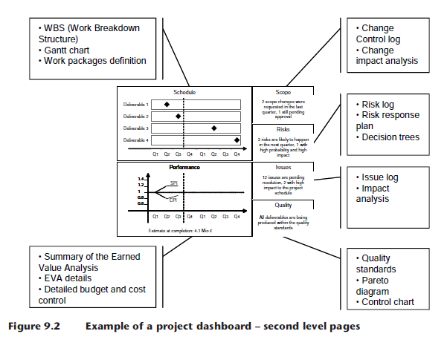
Distributing information to the global stakeholders

Slide 18
Distributing information to the global stakeholders
Level 3 – detailed information: the last level of information will be the documents that were used as a basis when producing the summaries on the previous levels. As an example, auditors can access the project cost documentation, and the spreadsheets used to calculate the Earned Value Analysis indexes, to review the data, validate the formulas and understand the reasons for deviations.

Slide 19
Exchanging project information
one project team member (usually the project office administrator) will own the project records, and have short status review meetings with individual coordinators or team members before the status review meetings.

Slide 20
Exchanging project information
The project manager will need to monitor the effectiveness of the team meetings and adapt the project organisation and the meeting agendas to obtain the optimal ratio of meeting duration and number of items discussed. The agenda of the checkpoint meetings can include discussions on:

Slide 21
Exchanging project information
Stakeholders – introduce new members to the project team, inform the team members of important changes on the stakeholder register and identify the impact of these changes on the activities from different project team members. Decide if these changes generate issues that affect the project and if separate meetings or task forces will be required to prepare a strategy for the corrective actions.

Slide 22
Exchanging project information
In the same way, identify whether these changes add new risks to the project. Discuss the impact of these changes on the project organization chart and roles and responsibilities matrix.

Slide 23
Exchanging project information
Communication – inform the team members of changes to the global communication matrix, and confirm if the project team members require inclusion in the distribution chain of new types of project information. Inform the team members of important changes to the structure of the project web site.

Slide 24
Exchanging project information
Assumptions – detect if the assumptions made in early project phases were valid or incorrect. Discuss the impact of incorrect assumptions on the project schedule, costs and risks.

Slide 25
Exchanging project information
Project schedule – review the progress of activities and the impacts of delays on the project schedule. Identify if important changes have occurred that require approval from other stakeholders. Decide if these changes generate issues or risks that must be evaluated in more detail. In this case, identify which project team members will be required for this evaluation, and who will own the corrective action.

Slide 26
Exchanging project information
Issues and corrective actions – review the latest status of the main issues and their corrective actions, and discuss the impact of critical actions that are still open after the target resolution date. Decide on the best method to obtain the appropriate resolution: a change in the action ownership, escalation to line managers, assigning more resources for its resolution or making a change to the project schedule.

Slide 27
Exchanging project information
Risks and Opportunities – review the status of the risks that have past or imminent trigger dates, reviewing the appropriateness of their response strategies and impacts on the project. Review major changes of the estimated levels of probability and impact.

Slide 28
Exchanging project information
Changes – review the changes requested or approved since the last status meeting, and discuss their impact on scope, schedule or cost. Ask the team members whether they are aware of unofficial or imminent change requests that need to be formalized.

Slide 29
Exchanging project information
Quality – review the overall results from control measurements, and discuss how the recommended corrective or preventive actions can be implemented, and if they generate a change to the project.

Slide 30
Exchanging project information
Procurement – review changes on sellers, contracts and other procurement items that have an impact on the activities of various project team members.

Slide 31
Exchanging project information
Meeting log (meeting minutes) – before closing the session, review the main decisions taken during the meeting, and other important points not captured in the previous items of the agenda.

Slide 32
Exchanging project information
In large programs and projects, separate status review meetings are required to cover points owned by different groups, organisations or organizational units. As an example, a complex program might have one status meeting for each major project, and one consolidated status meeting with all project managers to cover the items that have an impact on the different projects or on the whole program.

Slide 33
Exchanging project information
The items on the agenda refer to information in different sections of the global project binder (for example, the discussion on stakeholders may generate entries on the risk register or the issues register). Thus, the format of the Global Project Binder or project web site will need to provide a good level of flexibility, for the meeting moderator to switch from one section to another, while keeping the meeting momentum.

Slide 34
Resources:
Global Project Management
Communication, Collaboration and Management Across Borders
© Jean Binder 2007

