Slide 1

E-Commerce
Prepared by Dr. Adam Yagoub
Lecture 6
MGM 212
E-procurement

Slide 2
Lecture 6
Course Outline
Lecture 1: Introduction to e-business and e-commerce.
Lecture 2: E-commerce fundamentals.
Lecture 3: E-business infrastructure.
Lecture 4: - E-environment.
Lecture 5: E-business strategy.
Lecture 6: E-procurement.
Lecture 7: E-marketing.
Lecture 8: Customer relationship management.
Lecture 9: Analysis and design.
Lecture 10: Implementation and maintenance.

Slide 3
Lecture 6
Lecture Outline
1.Introduction.
2. What is e-procurement?
3. Estimating Focus on e-procurement costs.
4. Risks and impacts of e-procurement.
5. Implementing e-procurement.
6. Electronic B2B marketplaces.
7.The future of e-procurement?

Slide 4
Lecture 6
Learning Outcomes
After reading this chapter the student should be able to:
1. Identify the benefits and risks of e-procurement.
2. Analyze procurement methods to evaluate cost savings.
3. Assess different options for integration of organizations’ information systems with e-procurement suppliers.

Slide 5
Lecture 6
E-procurement
1. Introduction:
Procurement has not traditionally been a significant topic for management study in comparison with other areas such as marketing, operations or strategy. The concept of e-business has, however, highlighted its importance as a strategic issue since introducing electronic procurement or e-procurement can achieve significant savings and other benefits which directly impact upon the customer.

Slide 6
Lecture 6
E-procurement
2. What is e-procurement?
The terms ‘purchasing’ and ‘procurement’ are sometimes used interchangeably, but as Kalakota and Robinson point out, ‘procurement’ generally has a broader meaning. ‘Procurement’ refers to all activities involved with obtaining items from a supplier; this includes purchasing, but also inbound logistics such as transportation, goods-in and warehousing before the item is used.

Slide 7
Lecture 6
E-procurement
The key procurement activities and associated information flows within an organization are shown in Figure 7.1. In this chapter we focus on these activities which include searching and specification of product by the end-user, purchasing by the buyer, payment by an account, and receipt and distribution of goods within a warehouse. E-procurement should be directed at improving performance for each of the ‘five rights of purchasing’, which are sourcing items:

Slide 8
Lecture 6
E-procurement
1. at the right price.
2. delivered at the right time.
3. of the right quality.
4. of the right quantity.
5. from the right source.

Slide 9
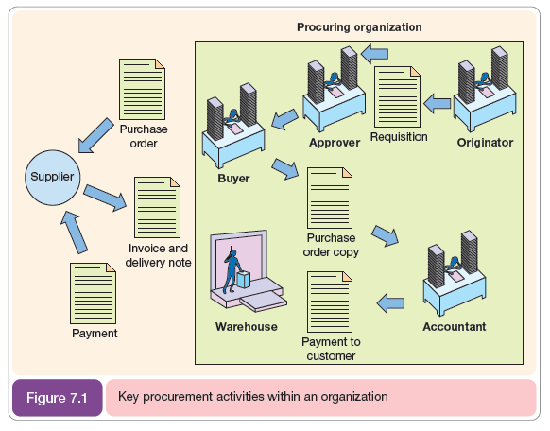
Lecture 6
E-procurement

Slide 10
Lecture 6
E-procurement
- Types of procurement
To understand the benefits of e-procurement, and also to highlight some of the practical considerations with introducing e-procurement, we need to briefly consider the different types of items that are obtained by procurement (what is bought?) and types of ordering (how is it bought?).

Slide 11
Lecture 6
E-procurement
Let us start us by reviewing what is bought by businesses. A B2B company might buy everything from steel for manufacturing products, through equipment to help machine products, to paper clips and pens for office use. There are two broad categories of procurement:

Slide 12
Lecture 6
E-procurement
those that relate to manufacturing of products (production-related procurement) and operating or nonproduction- related procurement that supports the operations of the whole business and includes office supplies, furniture, information systems, MRO goods and a range of services from catering, buying travel, and professional services such as consulting and training. Raw materials for the production of goods and MRO goods are particularly important since they are critical to the operation of a business.

Slide 13
Lecture 6
E-procurement
For the B2B company, they would include manufacturing equipment, network cables and computers to control the process. Moving to how items are bought, businesses tend to buy by one of two methods:
1. Systematic sourcing – negotiated contracts with regular suppliers, typically in long-term relationships.
2. Spot sourcing – fulfilment of an immediate need, typically of a commoditized item for which it is less important to know the credibility of the supplier.

Slide 14
Lecture 6
E-procurement
- Participants in online procurement
Riggins and Mitra identify eight types of intermediary that need to be reviewed to understand options for changes to procurement as part of developing an e-procurement strategy:
1. Traditional manufacturers which produce physical goods that are generally sold to other corporate customers.
2. Direct sales manufacturers similar to traditional manufacturers except that they bypass intermediaries and sell direct to end consumers via web or phone channels.

Slide 15
Lecture 6
E-procurement
3. Value-added procurement partners act as intermediaries to sell products and services to other businesses; examples include travel agents and office solutions companies.
4. Online hubs are industry-specific vertical portals such as Elemica (www.elemica.com) that generate revenues via B2B exchanges.
5. Knowledge experts who produce information goods.

Slide 16
Lecture 6
E-procurement
6. Online information services provide unique information to end users that is either original in its development or provides a unique editorial perspective.
7. Online retailers include start-up e-businesses and more traditional multi-channel retailers.
8. Portal communities seek to aggregate different online information services into an integrated customer experience.

Slide 17
Lecture 6
E-procurement
3. Estimating Focus on e-procurement costs:
While cost savings are commonly cited as the key benefit of e-procurement, more than half the companies in the Tranmit (1999) survey (54 per cent) did not know the procurement costs of their organization! This suggests that calculating costs is not straightforward, but it is clearly an important part of the cost justification of introducing an e-procurement system.

Slide 18
Lecture 6
E-procurement
The general approach to estimating procurement costs is straightforward. First, we calculate the average procurement cost per item, then we multiply by the average number of requisitions.

Slide 19
Lecture 6
E-procurement
4. Risks and impacts of e-procurement:
1- Organizational risks
If the cost savings referred to earlier are to be achieved it may be necessary to redeploy staff, or in the worst case make them redundant. For a medium-sized company such the purchasing team of five people was reduced to four. The threat of redundancy or redeployment is likely to lead to resistance to the introduction of the system and this needs to be managed.

Slide 20
Lecture 6
E-procurement
The purchasing manager will have to carefully explain the reasons for introducing the new system, emphasizing the benefits to the company as a whole and how it should enable more variety to be introduced to the buying role.

Slide 21
Lecture 6
E-procurement
2- Failure to achieve real cost reductions
There is a risk that the return on investment (ROI) from introducing e-procurement may be lower than that forecast and the introduction of the e-procurement system may not pay for itself.

Slide 22
Lecture 6
E-procurement
3- Technology risks
Tranmit reported the biggest barrier to automation of e-procurement as integration with existing financial systems, according to 60 per cent of respondents.

Slide 23
Lecture 6
E-procurement
5. Implementing e-procurement:
Implementing e-procurement has the challenges of change management associated with any information If the implementation can mirror existing practices, then it will be most straightforward, but many of the benefits will not be gained and the use of new technology often forces new processes to be considered.

Slide 24
Lecture 6
E-procurement
Hildebrand illustrates the challenges of implementing e-procurement when he cites a 2002 Forrester Research poll of 50 global companies. For these large, international companies, the biggest implementation ‘headache’ was rated as:
- Training/change management (32%)
- Supplier relationship management (30%)
- Catalogue management (10%)
- Project management (4%).

Slide 25
Lecture 6
E-procurement
To introduce e-procurement the IS manager and procurement team must work together to find a solution that links together the different people and tasks of procurement . Historically, it has been easier to introduce systems that only cover some parts of the procurement cycle. Figure 7.4 shows how different types of information system cover different parts of the procurement cycle. The different type of systems are as follows:

Slide 26
Lecture 6
E-procurement
1. Stock control system– this relates mainly to production-related procurement; the system highlights when reordering is required when the number in stock falls below reorder thresholds.
2. CD or web-based catalogue – paper catalogues have been replaced by electronic forms that make it quicker to find suppliers.
3. E-mail- or database-based workflow systems integrate the entry of the order by the originator, approval by manager and placement by buyer.

Slide 27
Lecture 6
E-procurement
4.Order-entry on web site – the buyer often has the opportunity to order directly on the supplier’s web site, but this will involve rekeying and there is no integration with systems for requisitioning or accounting.
5. Accounting systems – networked accounting systems enable staff in the buying department to enter an order which can then be used by accounting staff to make payment when the invoice arrives.
6. Integrated e-procurement or ERP systems – these aim to integrate all the facilities above and will also include integration with suppliers’ systems.

Slide 28
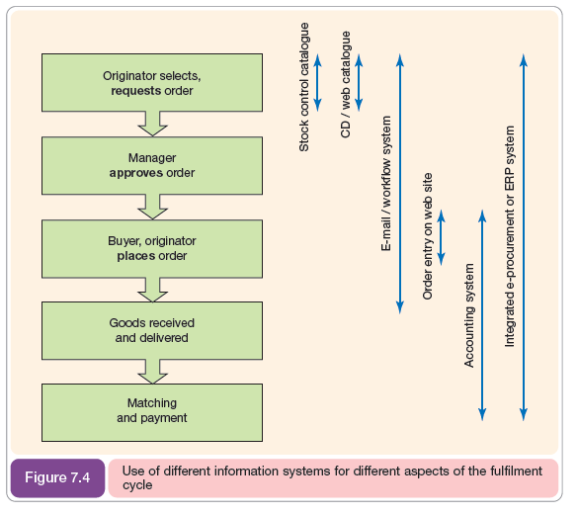
Lecture 6
E-procurement

Slide 29
Lecture 6
E-procurement
6. Electronic B2B marketplaces:
Electronic B2B marketplaces are variously known as ‘marketplaces, exchanges or hubs’. Typically they are intermediaries that are part of the reinter mediation phenomenon and are independent of buyers and suppliers.

Slide 30
Lecture 6
E-procurement
- Types of marketplace
Kaplan and Sawhney have developed a taxonomy of B2B marketplaces by applying existing classifications of corporate purchasing, namely how businesses buy (systematic purchasing or spot purchasing) and what businesses buy (manufacturing inputs or operating resource inputs).

Slide 31
Lecture 6
E-procurement
They identify the types of marketplace shown in Table 7.7. Note that manufacturing- input marketplaces tend to be vertical marketplaces set up for a particular industry such as steel, construction or chemicals while operating resources tend to be horizontal marketplaces offering a range of products to differing industries.

Slide 32
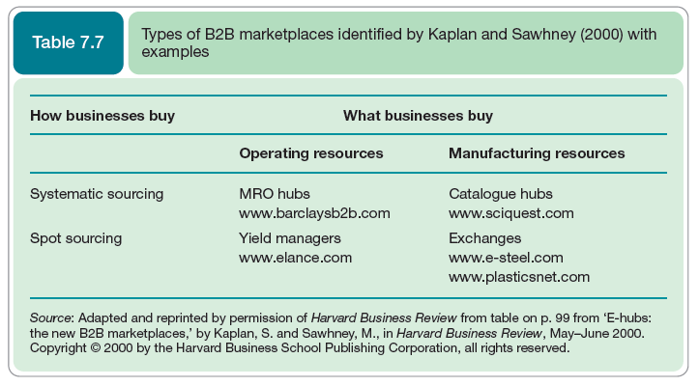
Lecture 6
E-procurement

Slide 33
Lecture 6
E-procurement
7.The future of e-procurement?
In the future, some suggest that the task of searching for suppliers and products may be taken over by software agents which have defined rules or some degree of intelligence that replicates intelligence in humans. An agent is a software program that can perform tasks to assist humans.

Slide 34
Lecture 6
E-procurement
On the Internet, agents can already be used for marketing research by performing searches using many search engines and in the future they may also be used to search for products or even purchase products. Agents work using predetermined rules or may learn rules using neural network techniques. Such rules will govern whether purchases should be made or not.

Slide 35
Lecture 6
E-procurement
Some of the implications of agent technology on marketing are explored by Gatarski and Lundkvist. They suggest that agent technology may create artificial consumers who will undertake supplier search, product evaluation and product selection functions. The authors suggest that such actors in a supplier-to-consumer dialogue will behave in a more rational way than their human equivalents and existing marketing theories may not apply.

Slide 36
Lecture 6
E-procurement
Tucker and Jones also review the use of intelligent agents for sourcing. They foresee agents undertaking evaluation of a wide range of possible alternative suppliers based on predefined quantitative selection criteria including price, availability and delivery. They believe the technology is already available – indeed, similar intelligent software is used for making investments in financial markets. What is not clear is how the software will assess trustworthiness of a supplier or their competence as a business partner or associate.

Slide 37

Lecture 6
E-procurement
References:
E-Business and E-Commerce Management : strategy, implementation and practice, fourth edition.
By: dave chaffey.
Chapter 7

