Slide 1


English Language for Digital Law
by Samara Jasim
LAW 614
Orientation Lecture

Slide 2



Who am I?
Samara Jasim
  Lecturer: specialized in Teaching English as a Foreign Language Field;
  Educational Consultant;
  Sworn Translator; and
  Paralegal
www.midocean.ae

Slide 3
Course Details
This course is designed to give students a deep understanding of the legal issues and challenges brought by the digital transformation of our economy and the regulation of the innovations it implies.
The aim of the course is to provide in-depth knowledge of legal English as well as an increased ability to communicate in international legal contexts, both academic and professional, in an effective manner.

Slide 4
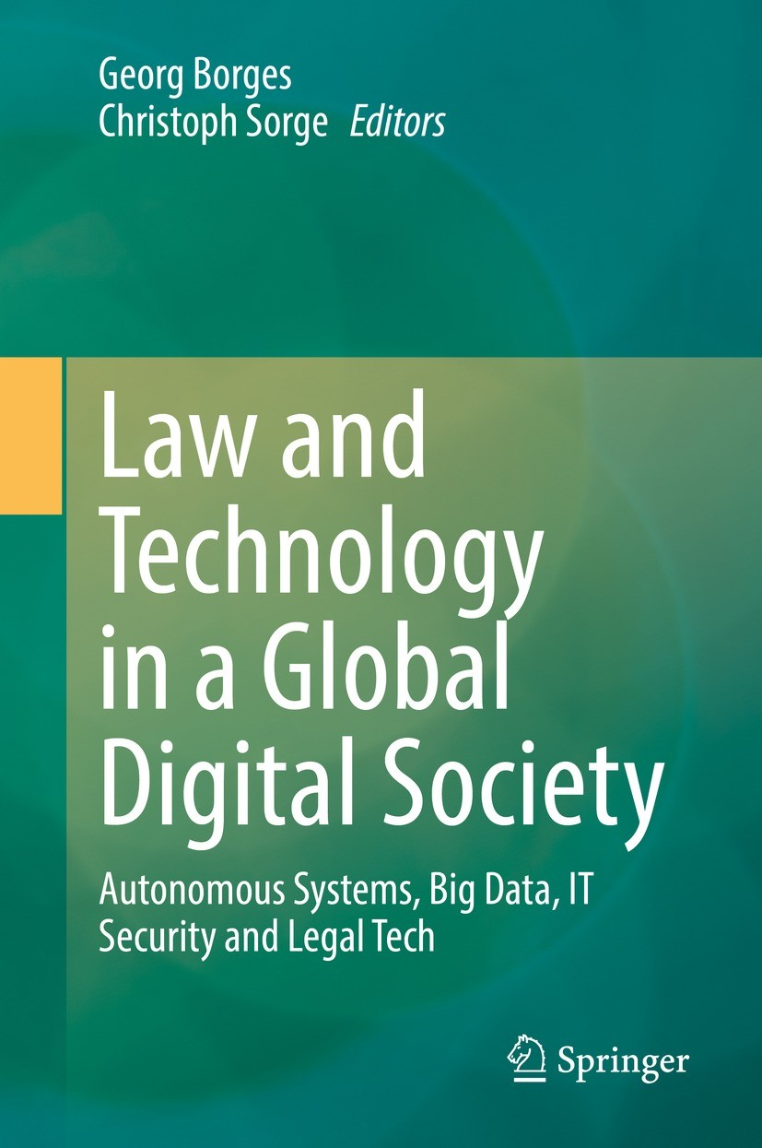

Learning Resources
Credit Hours:
3 credit hours.
  Recommended Resources:
  IT Security Risk Control Management by Raymond Pompon
  Law and Technology in a Global Digital Society
  Essential References:
1. A Dictionary

Slide 5
What is this course about?
The transformation of society into a digital society, in which essential areas of life are carried out through the exchange of data via electronic networks and machines equipped with artificial intelligence to carry out activities that were previously the preserve of humans, is taking place worldwide with great dynamics.

Slide 6
What is this course about?
This transformation process involves the law in two ways: On the one hand, law has to adapt in order to provide the changed society with appropriate rules, and on the other hand, it acts as a driving factor of the transformation by setting limits to technological development while at the same time providing a framework and basis for it.

Slide 7
Course Content
Course Unit | No.of. Weeks | Contact Hours
1. Introduction to Digital Law | 2nd | 3
2. IT Security | 3rd | 3
3. Artificial Intelligence | 4th | 3
4. Data Protection | 5th | 3
5. Smart Contracts | 6th | 3
6. Ethics of Digital Law | 7th | 3
7. Internet of Things and Consumers’ Privacy | 8th | 3
8. Phishing in Online Banking | 9th | 3
9. Digital Media | 10th | 3
10. Human Rights in the Digital Law | 11th | 3
www.midocean.ae

Slide 8
Assessment Tools
  Multiple Choice, T&F, Matching, Arranging, Audio Questions
  80% marks
    10 weekly quizzes (open on Saturdays, at 22:00 ksa and close next Saturday at 21:00 ksa)
    The duration of each quiz is (24 minutes only = 3 minutes for each question)
    8 Marks for each of short exam.
    8 questions
  20% Final Examination

Slide 9

Assessment Tools

Slide 10
Assessment Tools

Slide 11
Online Session

Slide 12
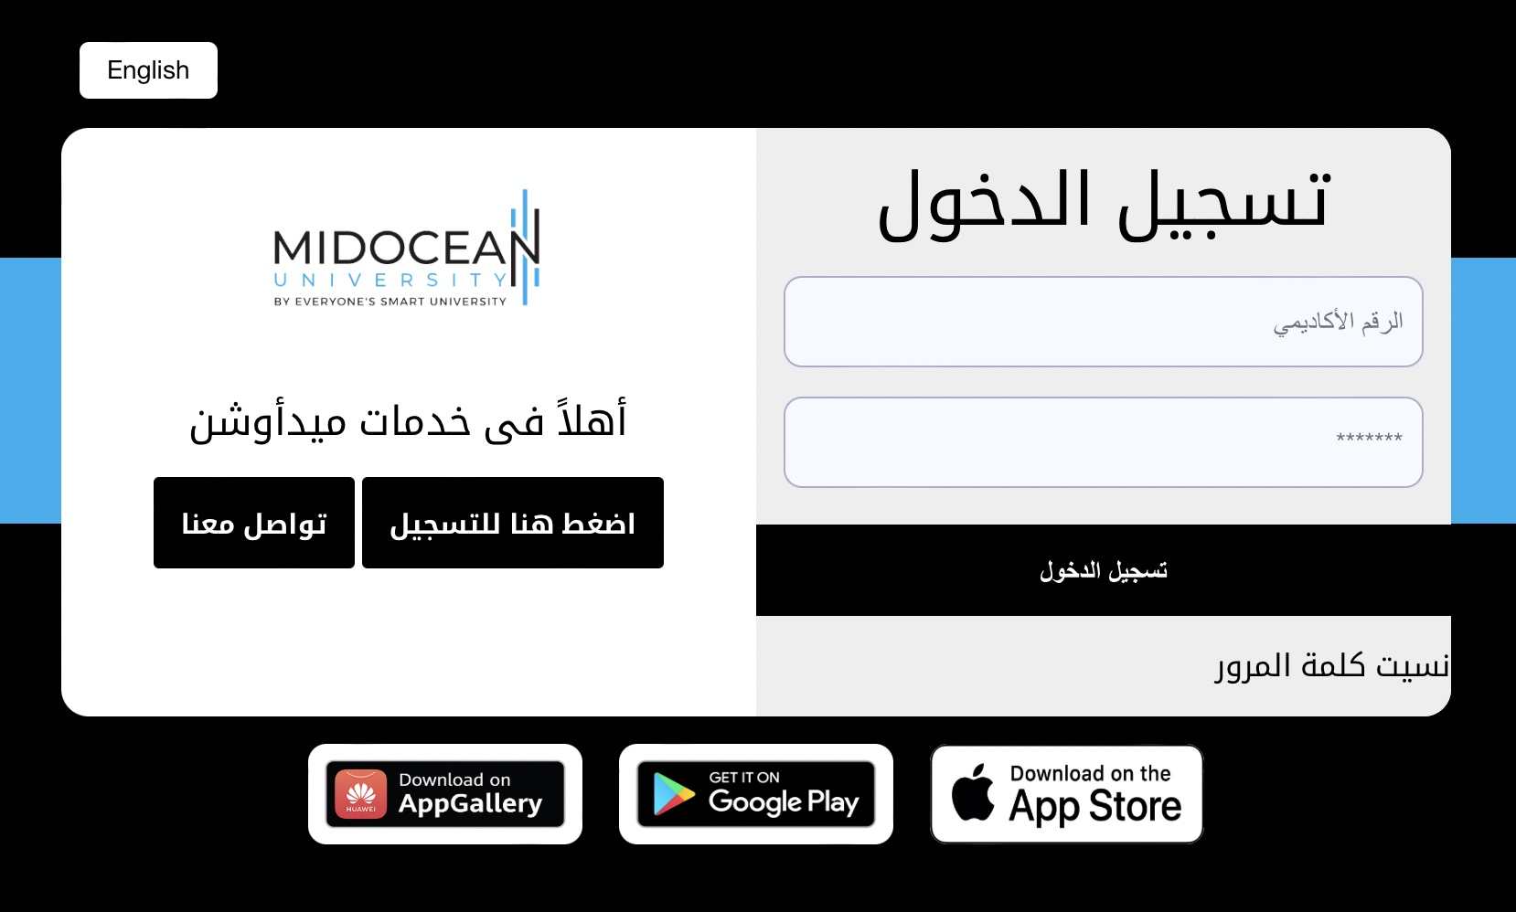
Contact Us

Slide 13


